Slide 1
IPC Working Group 34 -
Updates on IT support to the IPC
Geneva
November 6, 2015
Patrick Fiévet
Head of IT Systems Section

Slide 2
Agenda
Updates on IT support to the IPC
IPCRM Project
IPC Master files and their by-products
IPCPUB
IPCRECLASS

Slide 3
IPCRM
Project Status: On track, currently in Stage 8/8
7/8 stages delivered within agreed time and budget tolerances i.e. IPCRMS in production before the second IPC Working Group 2015
Contractor’s performance at implementing solution requested by the IB is satisfactory
Major Project risks were addressed:
RIPCIS to IPCRMS transition
WIPO Project team under-staffing and turnover
Consequence of late approval of IPCRMS functional specification
Some concessions and change requests

Slide 4
IPCRM
Some concessions:
Master files for IPC 2016.01 were finalized before the transition from RIPCIS to IPCRMS i.e. not produced by IPCRMS
Delay and scope limitation for the support of National translations
Some change requests to be implemented

Slide 5
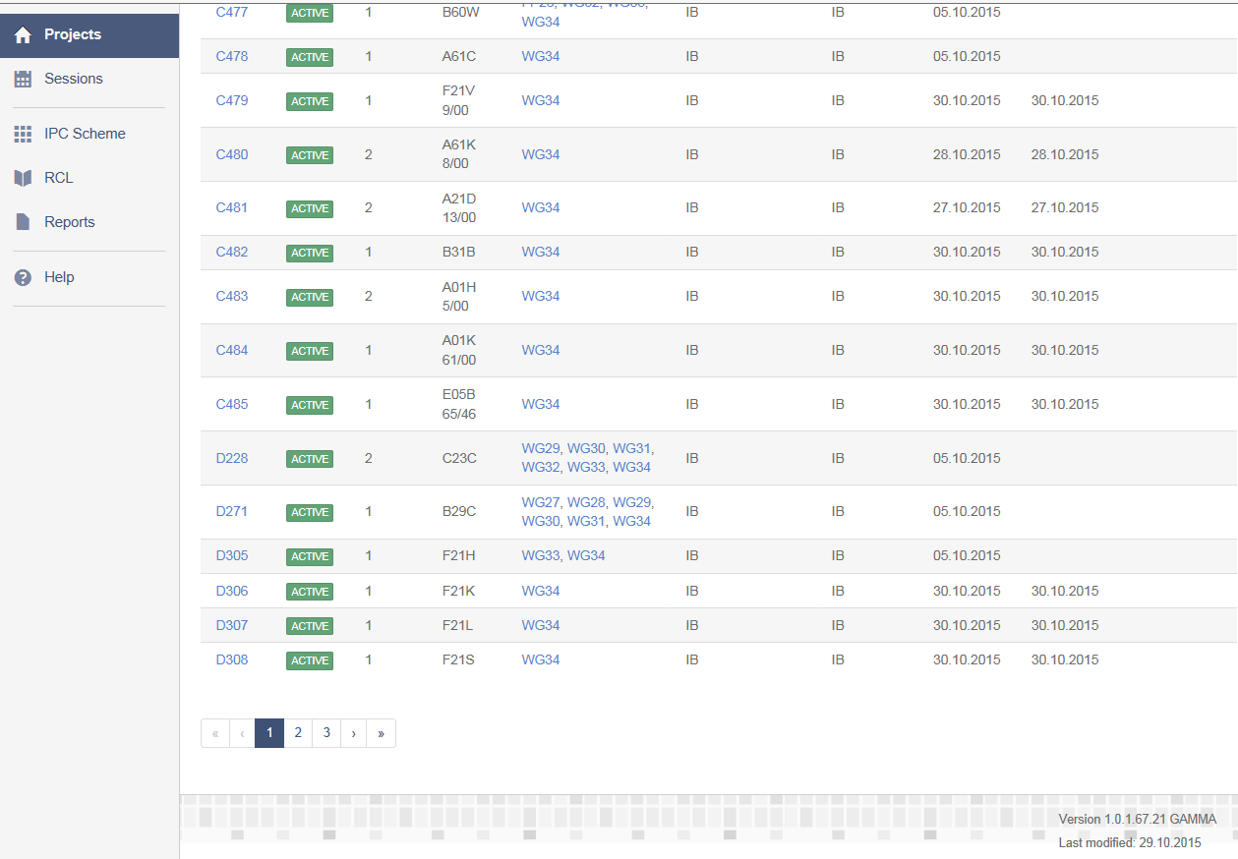
IPCRMS status: Production use

Slide 6
IPCRMS
Status: Production use since October 13th, 2015
RIPCIS to IPCRMS transition completed
Gamma version: Support for IPC WG 34 meeting
Temporarily, Read-only access for Offices, IB set as rapporteur and translator
Helpdesk and support services are ready for use
https://www3.wipo.int/classifications/ipc/ipcrms

Slide 7
IPCRM Project
Perspectives until end of 2015: IPCRMS Delta version
Remaining parts for testing at the end of November:
National translation support
IPC specific version of TAPTA for EN/FR translation assistance trained with IPC 2016.01
CPC/FI based revision proposals
RIPCIS stops on November 30.
Various change requests: December 15
Project closure after 3.5 years: December 31, 2015

Slide 8
IPCRMS
Perspective as from 2016: complete
Finalized Service Level Agreements
Offices training (organization to be discussed)
Opening of IPCRMS to Write-access for Offices
IPC 2017.01 fully managed with IPCRMS including production of associated Master files and by-products
National translation support languages to be added on ad-hoc basis

Slide 9
IPCRMS
Live Demonstration by IPCRMS users representative
https://www3.wipo.int/classifications/ipc/ipcrms

Slide 10
IPCRMS national translation support
Translation support for National Office (NO): Approach
Pre-requisite: NO Master Files must be fully aligned with EN/FR and in IPCRMS format
Upload of NO Master Files in IPCRMS (including in TAPTA, if the NO language is supported)
Maintenance of the IPC translation in this language on the basis of IPC revision projects in authentic languages
One responsible Office per NO language
Translation from scratch is out of IPCRMS scope

Slide 11
IPCRMS national translation support
IPCA6TRANS to IPCRMS Transition plan:
IPCA6TRANS data available for translation of IPC 2016.01into XX language
Adaptation of 2016.01 XX Master Files to IPCRMS format
Add XX as translation language to IPCRMS
IPCPUB software package Version 6.3 and higher

Slide 12
IPC Master files 3.x and by-products
IPC 2016.01 Master Files versus 2015.01:
Changed according to specifications approved during CE 47, except minor changes (version 3.1) and for Definitions 2016.01 (only partially converted)
Impacted By-product of IPC Master files:
Static files for the Scheme
IPC Definitions viewer 2016.01
Compilation file results of comparison of two consecutive versions of the scheme
New version of the tool to create PDF files for 2016.01, with improvement for Sections and Classes files

Slide 13
IPC publication platform IPCPUB 6.x
Changes: IPCRM impact i.e. IPC master file and by-products
Definition integrate illustrations
Compilation tab

Slide 14
IPCPUB 6.x
Other changes:
URL http://web2.wipo.int/classifications/ipc/ipcpub
Adaptation needed after CPC XML format changes of April 2015 + CPC 2000 series
2016.01 Catchwords
2016.01 Definitions

Slide 15
IPCPUB 7.x
Plan:
Alignment with WIPO guidelines for internet facing applications
Smart search for public users
Upgrade of internal components and fixes
Delivery Q1 2016

Slide 16
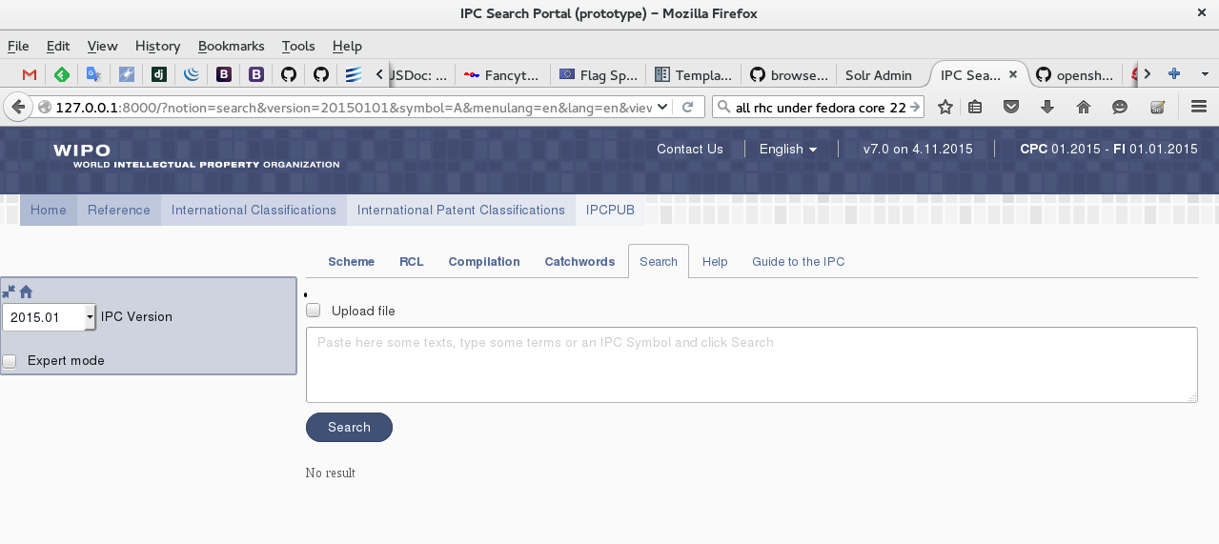
IPCPUB 7.x User interface

Slide 17
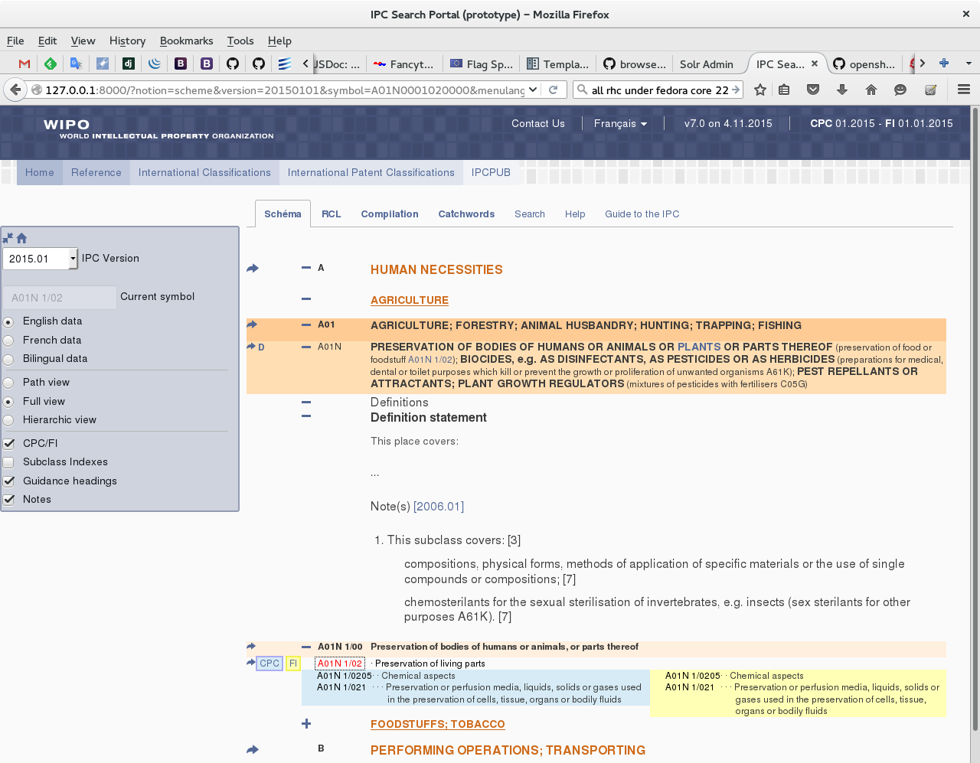
IPCPUB 7.x User interface

Slide 18
IPCRECLASS
Functional changes:
IPC symbol input similar to IPCPUB
New filter “by publication”
For Default transfer ST.8 position 40 set to “M”
IPC reclassification data:
2016.01 reclassification started
Residual Working Lists (RWL) received from MCD for 2007 and 2008 are not loaded in IPCRECLASS

Slide 19
IPCRECLASS

Slide 20
IPCRECLASS

Slide 21
IPCRECLASS
Upload of these 2007 2008 RWL would :
add 2,496 families to be reclassified in IPCRECLASS
Concern 15 offices
Represents one per thousand of the backlog of IPC reclassification (2.3 million families in IPCRECLASS)
Investigations about root causes in progress

Slide 22
Thank you for your attention!
QUESTIONS?
contact WIPO at claims@wipo.int

