Slide 1
FI/F-term
February 2020
JAPAN PATENT OFFICE

Slide 2
Index
Outline of FI/F-term
English Information on classification
  PMGS and IPC-FI-CPC scheme parallel viewer
  Revision and Reclassification
Current status of FI system

Slide 3
Index
Outline of FI/F-term
English Information on classification
  PMGS and IPC-FI-CPC scheme parallel viewer
  Revision and Reclassification
Current status of FI system

Slide 4
Patent Classification Systems in IPC and FI/F-term
System | Governance | Number of Entries | Documentation coverage
IPC | IPC/CE (Committee of Experts); supervised by WIPO | 70K | - almost all patent docs published worldwide
FI/F-term | JPO | 190K/360K | - JP docs
4

Slide 5
What is FI? Characteristics of FI
IPC
FI
(File Index)
Subdivision of IPC
(around 190,000 items)
Covers all technical fields
Covers all JP patent documents
Backlog reclassification
Biannual revise to keep pace with technology development
[Features]
70,000 entries
190,000 entries

Slide 6
FI - symbol
IPC symbol
      ex) A61B 5/00
IPC symbol + extension symbol
      ex) A61B 5/00, 101
IPC symbol + extension symbol + file discrimination symbol
ex) A61B 5/00, 101 A
IPC symbol + file discrimination symbol
      ex) A61B 5/00 A
A61B 5/00 Measuring for diagnostic purposes (radiation diagnosis A61B6/00; diagnosis by
ultrasonic, sonic or infrasonic waves A61B8/00); Identification of persons
A ・ Measurement and recording device for diagnosis
B ・・ Detection unit
Z ・ Others
101 ・ Measuring colour, pressure or vibration of human body or parts thereof
101 A ・・ Colour measurement
…
example of FI subdivisions for G06F9/00

Slide 7
What is F-term ?
The entire technical field of FI, which has section A to section H, is divided into about 2600 areas and the areas are called “theme”
About 1700 themes out of 2600 themes have “F-terms”, which are search keys and we analyze patent documents in each “theme”.
The F-term indexing system is based on multiple viewpoints differing from those in FI.
･･･
multiple
viewpoints
theme
theme
FI
F-term

Slide 8
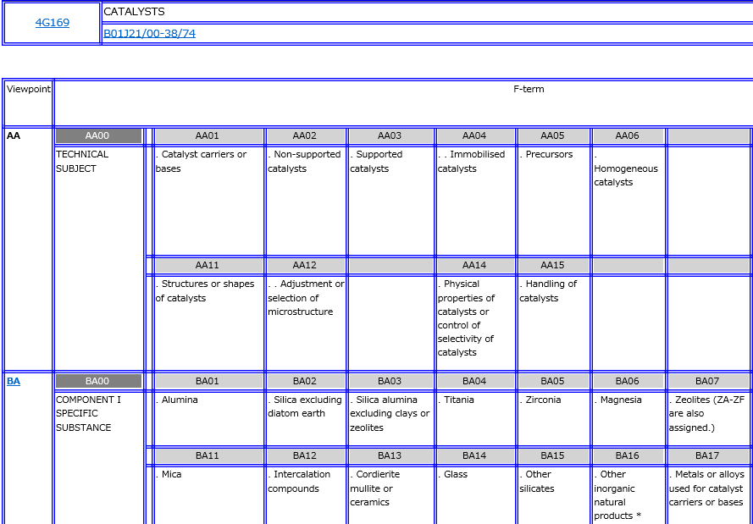
What is F-term ?
Sample of F-term List
Theme Code
Subject of theme
FI Coverage
View
point

Slide 9
What is Broad Facet?
JPO has a national classification Facet in addition to FI and F-term
  Facet covers all the fields of FI (A section to H section) or the part of the fields of FI, e.g. subclasses or groups. The coverage of Facet can be set more broadly than that of F-term.
  Facet enables prior art search of viewpoints different from viewpoints in FI and F-term
Symbol of Broad Facet
  Three Alphabet symbols
  Leftmost symbol is “Z”
  JPO has 22 Broad Facets including IoT related Facet, “ZIT”

Slide 10
File Index (FI)
“theme”
A front page of publication

Slide 11
Index
Outline of FI/F-term
English Information on classification
  PMGS and IPC-FI-CPC scheme parallel viewer
  Revision and Reclassification
Current status of FI/F-term system

Slide 12
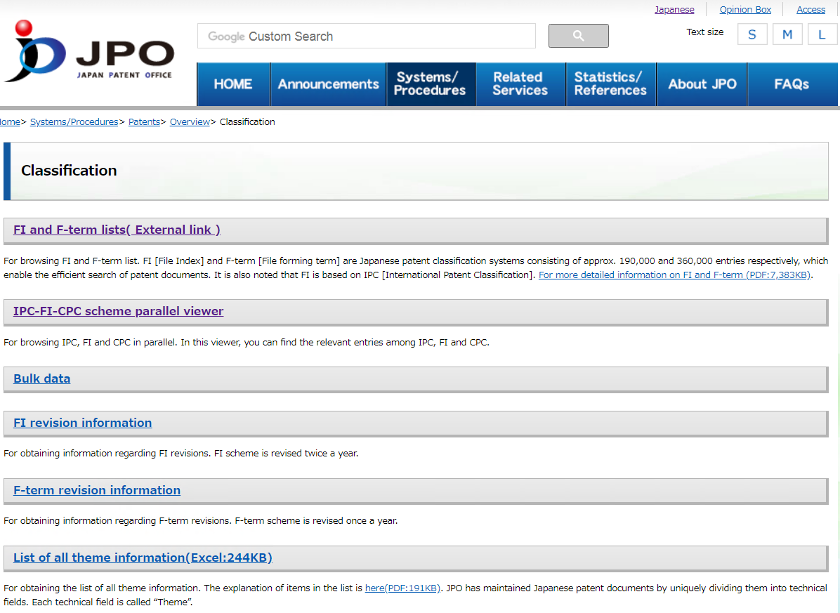
JPO website on Classification
https://www.jpo.go.jp/e/system/patent/gaiyo/seido-bunrui/index.html

Slide 13
PMGS (Patent Map Guidance)
https://www.jpo.go.jp/e/system/patent/gaiyo/seido-bunrui/index.html

Slide 14
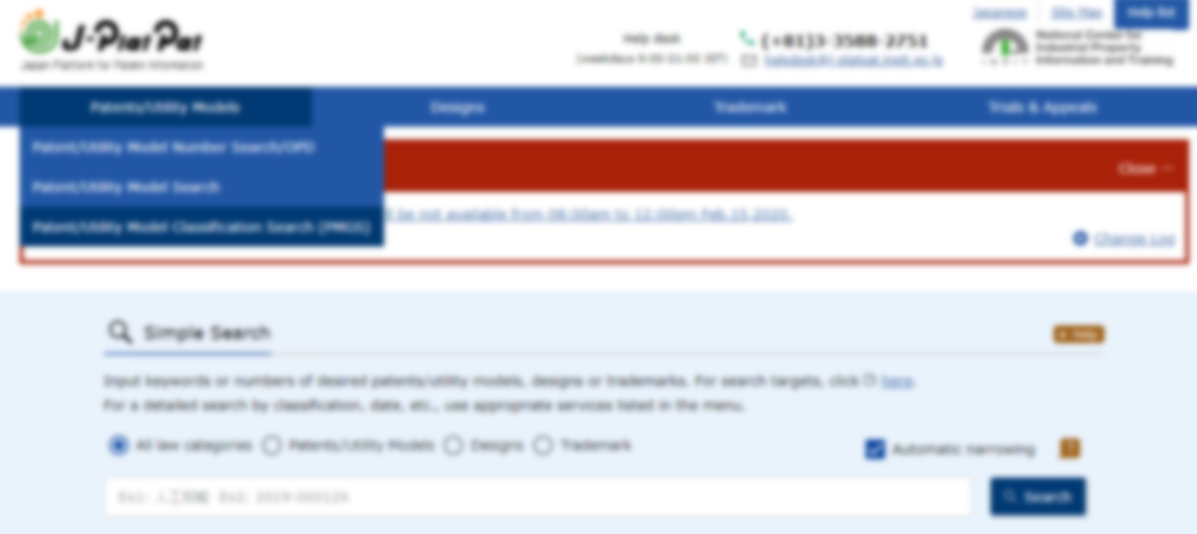

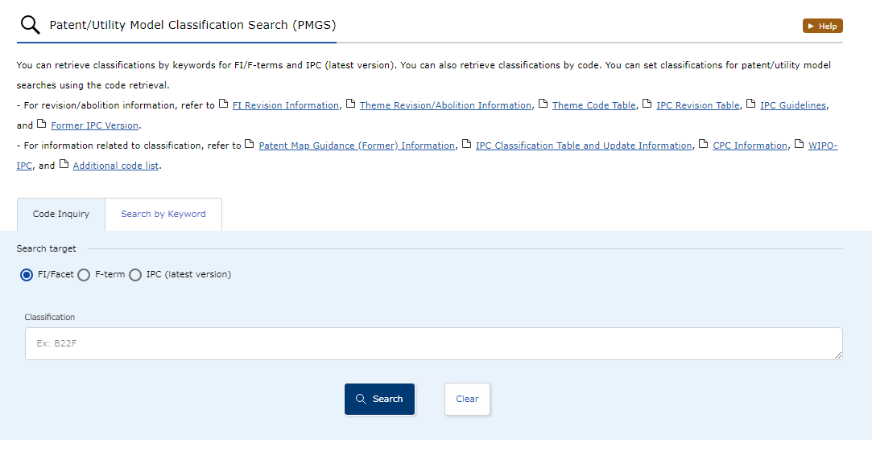
PMGS (Patent Map Guidance)
https://www.j-platpat.inpit.go.jp/p1101

Slide 15
IPC-FI-CPC scheme parallel viewer
https://www.jpo.go.jp/e/system/patent/gaiyo/seido-bunrui/index.html

Slide 16
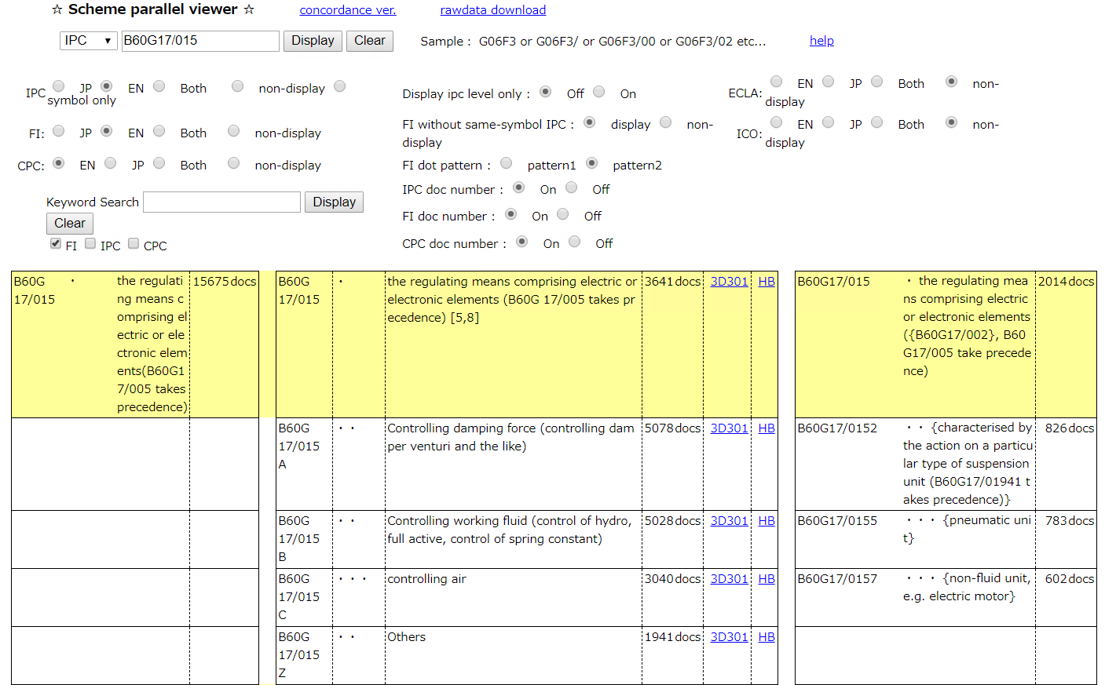
IPC-FI-CPC scheme parallel viewer
IPC
FI
CPC
http://www.jpo.go.jp/cgi/cgi-bin/search-portal/narabe_tool_e/narabe_e.cgi

Slide 17
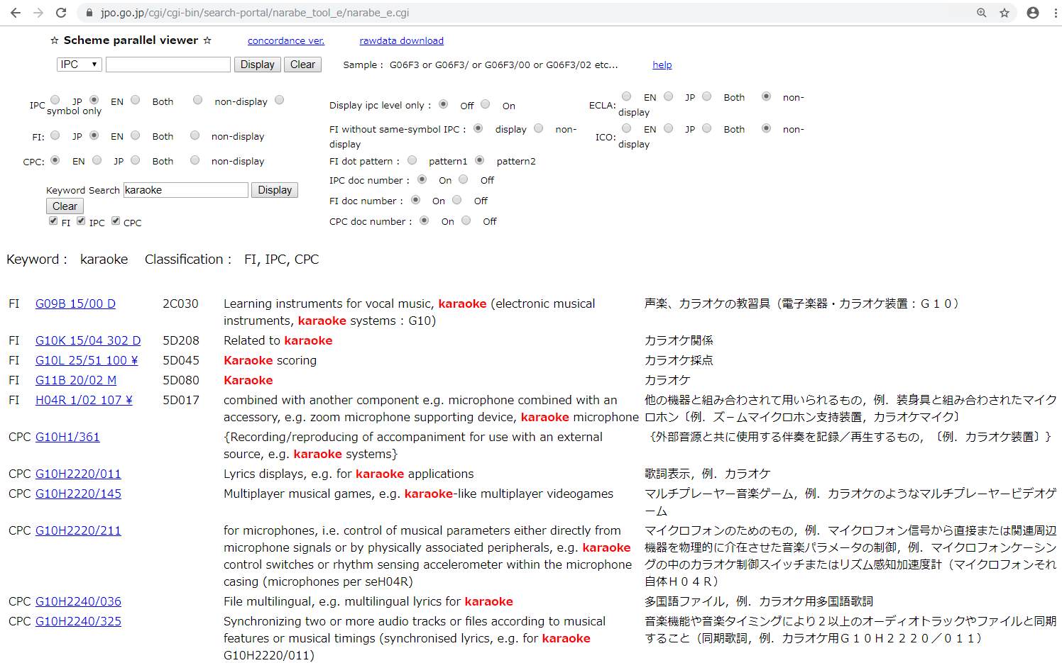
IPC-FI-CPC parallel viewer
Keyword searchable
Link to the scheme
http://www.jpo.go.jp/cgi/cgi-bin/search-portal/narabe_tool_e/narabe_e.cgi

Slide 18
Index
Outline of FI/F-term
English Information on classification
  PMGS and IPC-FI-CPC scheme parallel viewer
  Revision and Reclassification
Current status of FI/F-term revision
  FI system reform
  Updating FI scheme according to the latest version of IPC

Slide 19
JPO website on classification
https://www.jpo.go.jp/e/system/patent/gaiyo/seido-bunrui/index.html

Slide 20
Index
Outline of FI/F-term
English Information on classification
  PMGS and IPC-FI-CPC scheme parallel viewer
  Revision and Reclassification
Current status of FI system

Slide 21
FI system
FI system
  FI revision corresponding to new IPC publication twice a year
  FI revision in Nov 2019 before new IPC entering into force in Jan 2020
Advantage
  Backlog and deliver reclassification data into the MCD can be reduced quickly.
FI revision schedule
1st revision
2nd revision
1st revision
2nd revision
Jan.
Jun.
Jan.
Jun.
Jan.
2019
2020
IPC schedule
New IPC publication
(IPC2019)
New IPC publication
(IPC2020)
New IPC publication
(IPC2021)
Jan.
Jun.
Jan.
Jun.
Jan.
IPC/RWG
IPC/RWG
IPC/RWG
IPC/RWG
IPC/RWG

Slide 22
Rate for FI corresponding to the latest IPC
Upon completion of FI revision in Nov. 2019, rate of FI adopting the latest IPC reached approximately 99.6 %.

Slide 23
Thank you for your attention.

