Slide 1

CPC updates
Presented by EPO and USPTO
8 February 2018
WIPO
Geneva, Switzerland
Geneva, 20 February 2017

Slide 2
Agenda
CPC and National Offices
CPC coverage – Much more than EP and US documents and update
CPC: Latest Status and Future Development

Slide 3
CPC and National Offices

Slide 4
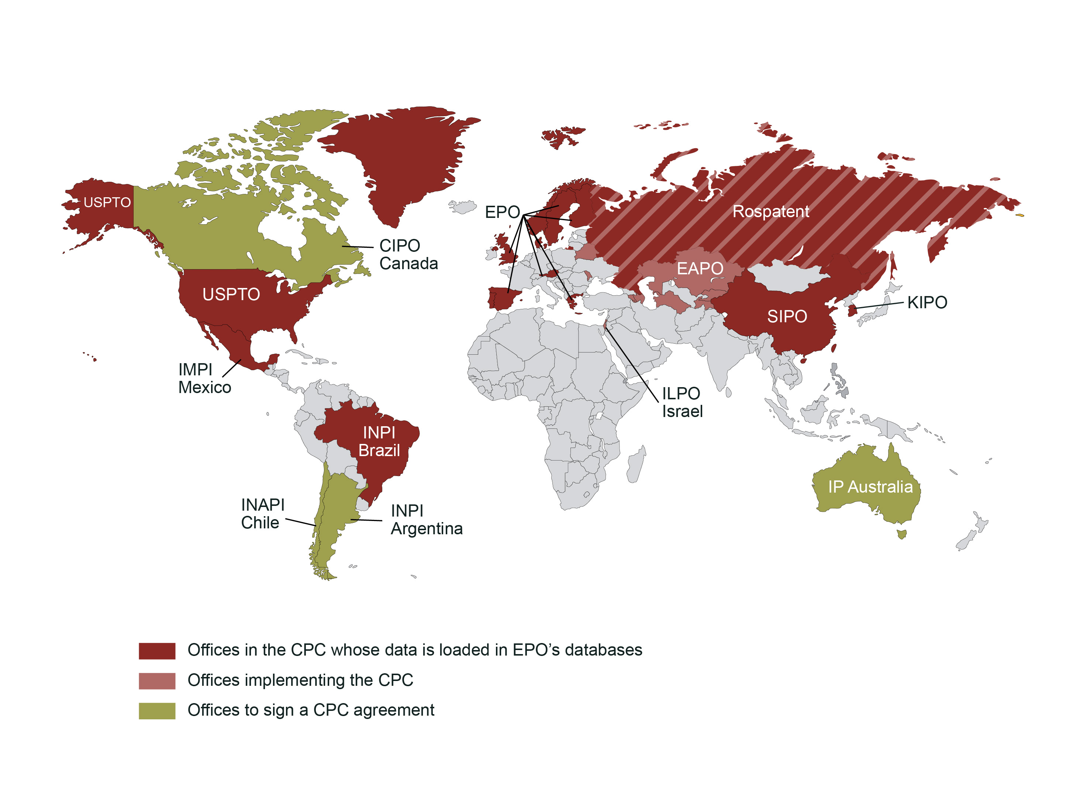
CPC Offices in the World
Notes:
Talking Points:
CPC is used for search by more than 45 Patent Offices and by more than 25000 examiners.
Light pink – EAPO – National Offices in the CPC
Dark Red – National offices in the CPC which also delivers CPC data
Green – Offices to sign a CPC agreement (MOU) or to incorporate the CPC

Slide 5
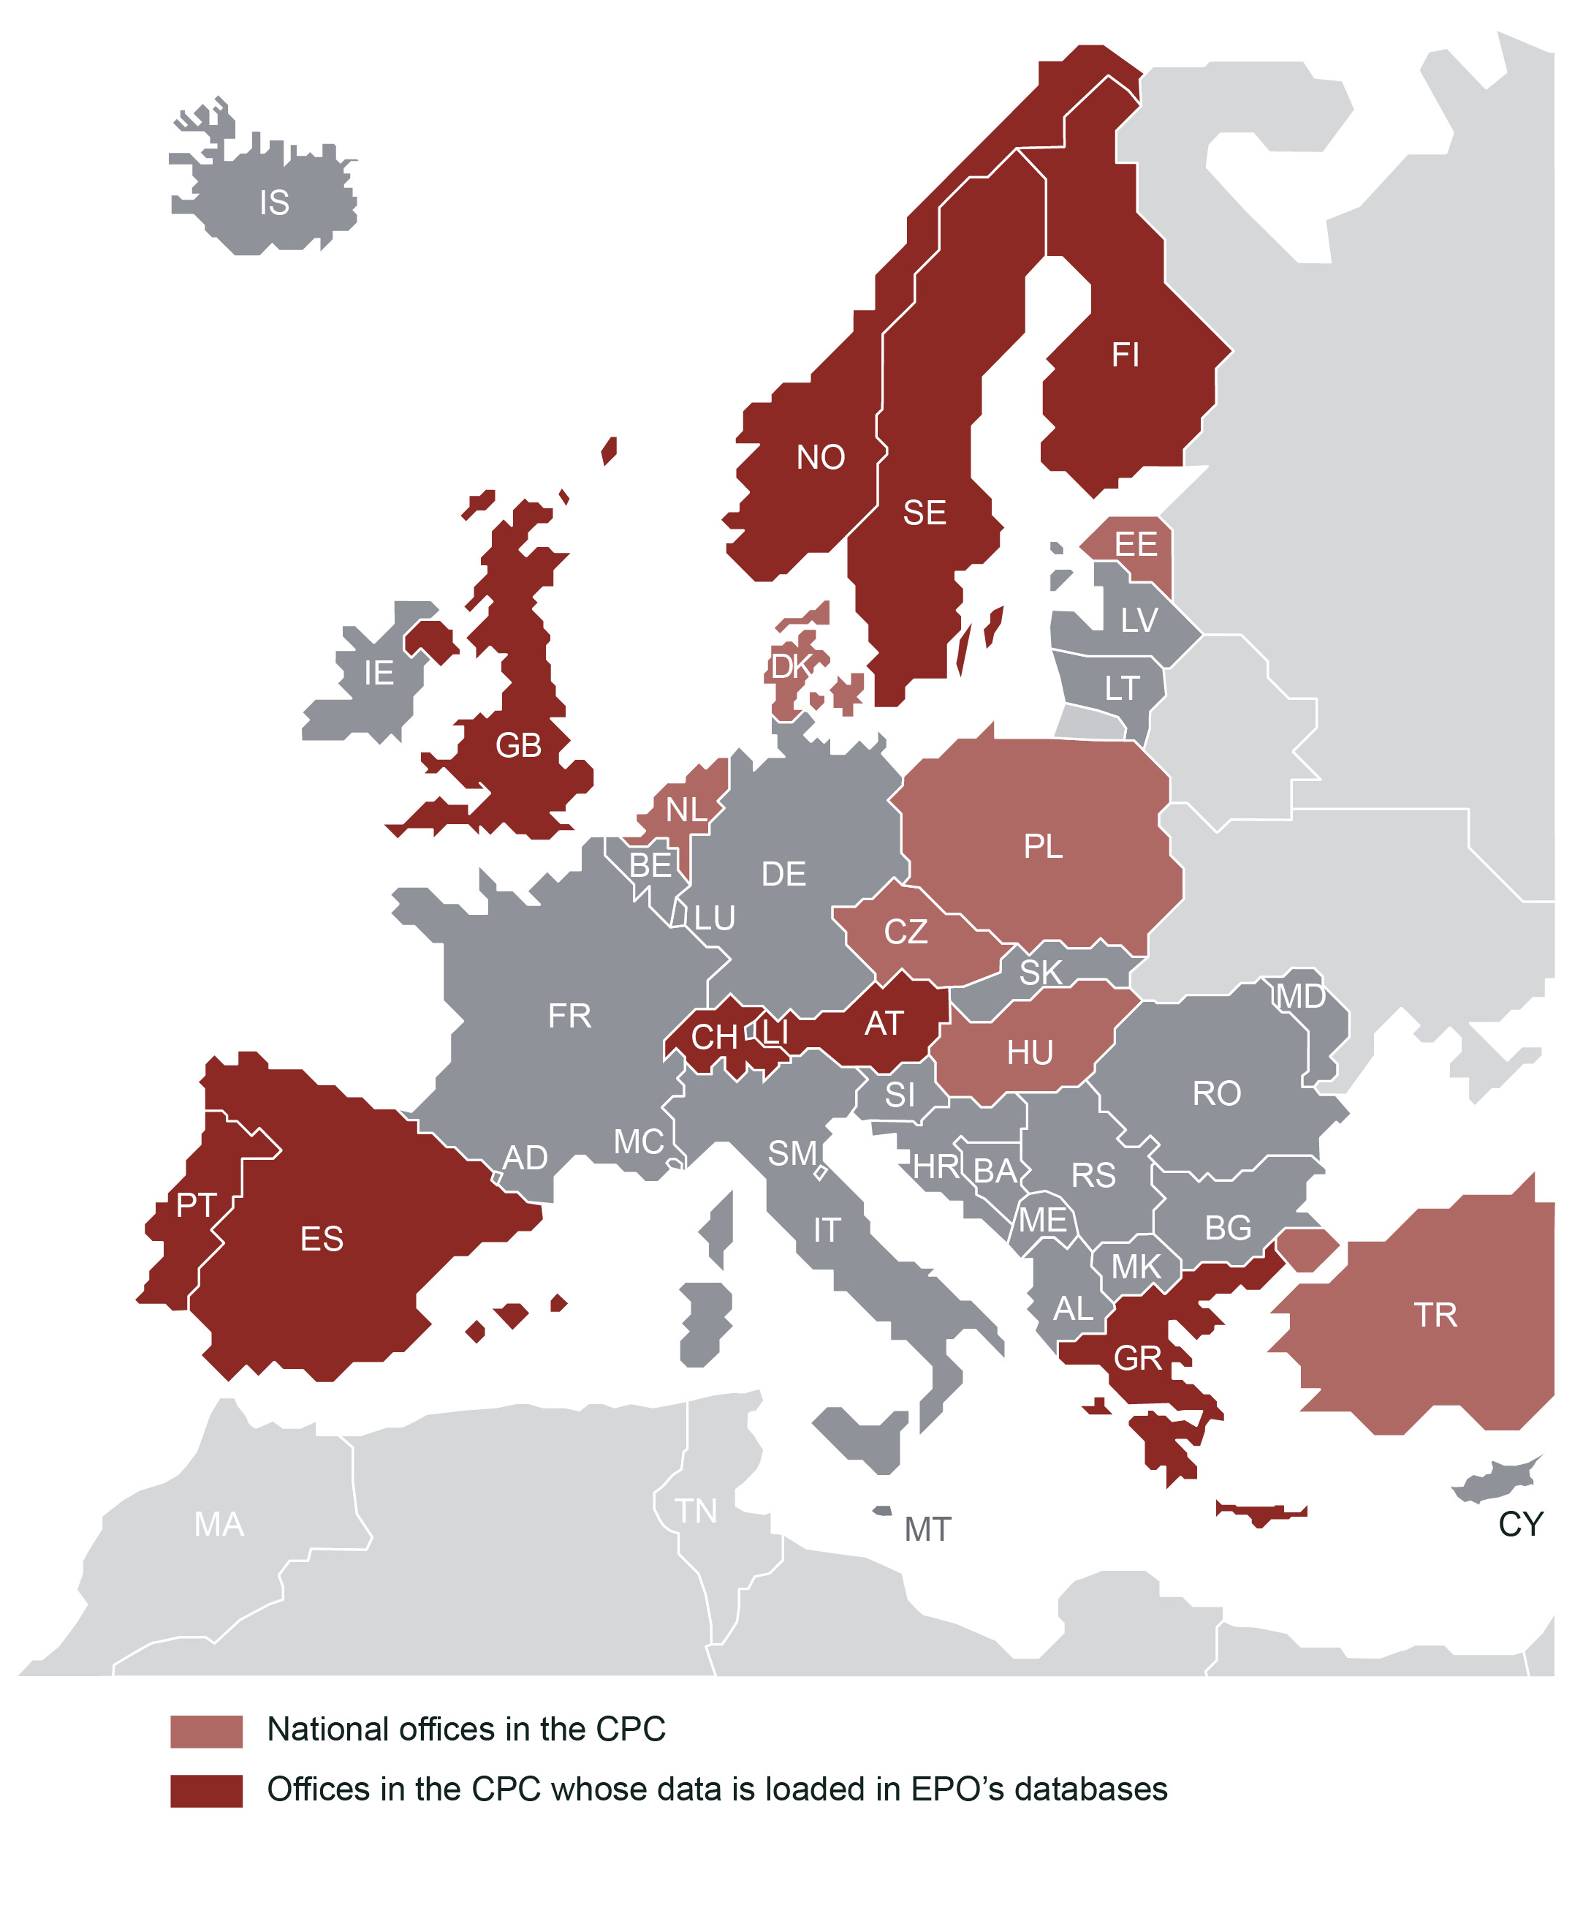
CPC Offices within the European Patent Organisation
Notes:
16 Offices within the European Patent Organization

Slide 6
CPC coverage -
Much more than EP & US documents...

Slide 7
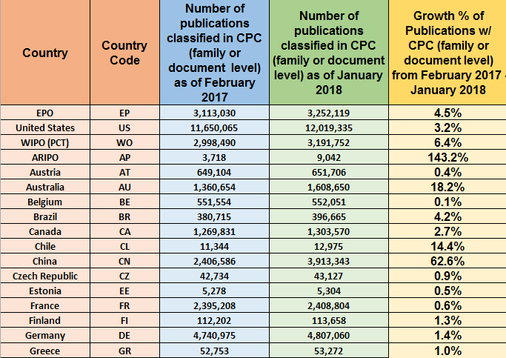
Publications with CPC from 2/2017 to 1/2018
Notes:
Data coverages statistics between 2/2017 and 1/2018

Slide 8
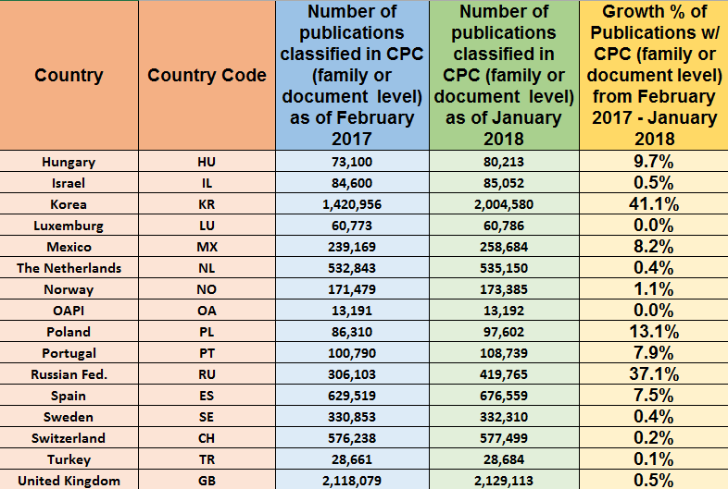
Publications with CPC from 2/2017 to 1/2018
Notes:
Data coverages statistics between 2/2017 and 1/2018

Slide 9
Intellectual Classification of WO Publications in CPC
Since January 2016, WO documents in language other than EPO official language, e.g. in Japanese, Korean, Chinese or Russian, are not intellectually classified in CPC by EPO anymore
Countries | ISA Offices | Since 2016
Australia | AU | No
Austria | AT | No
Brazil | BR | Yes
Canada | CA | No
Chile | CL | No
China | CN | No
Czech Republic | CZ | No
European Patent Offices | EP | Yes
Finland | FI | TBC
Hungary | HU | yes
Japan | JP | No
Korea | KR | Yes
Poland | PL | Yes
Israel | IL | TBC
Russian Federation | RU | Yes
Spain | ES | TBC
Sweden | SE | Yes
Turkey | TR | Yes
United Kingdom | UK | Yes
United States | US | Yes
Notes:
. Allocations inherited from family members of other offices (US,EP or others)
.

Slide 10
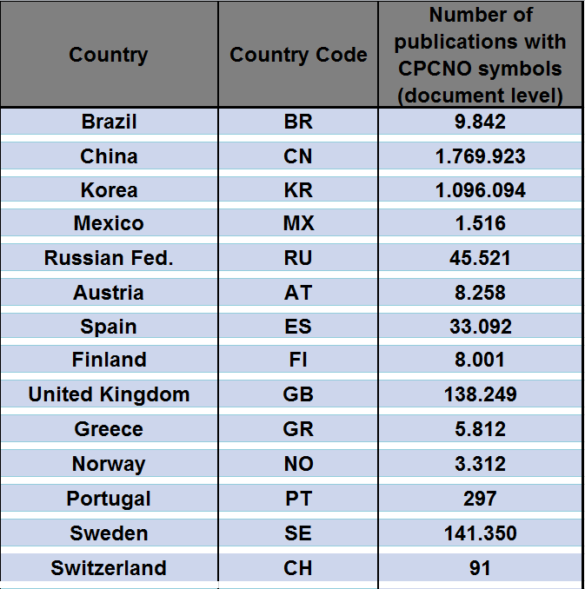
Publications with CPCNO only
Updated 2 January 2018
Notes:
Overall, 50 million documents classified in CPC (at Family or Document level), incl. 47 million patent documents
3.3 million documents bearing CPCNO allocations, AND also CPC allocations at the family level
2.6 million documents bearing only CPCNO symbols (i.e. without CPC allocations at family level)

Slide 11
CPC: Latest Status

Slide 12
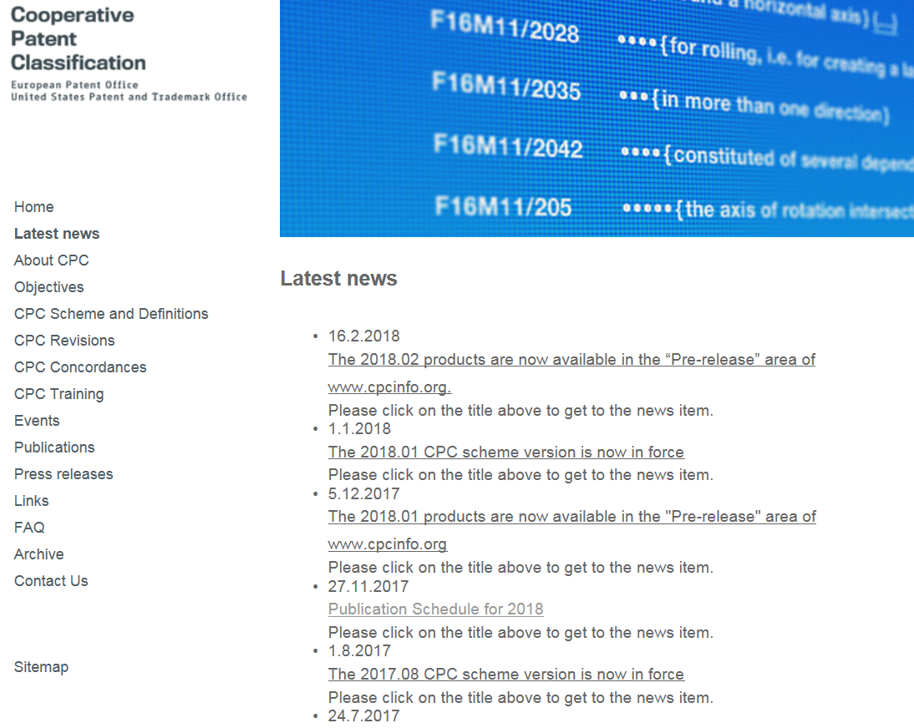
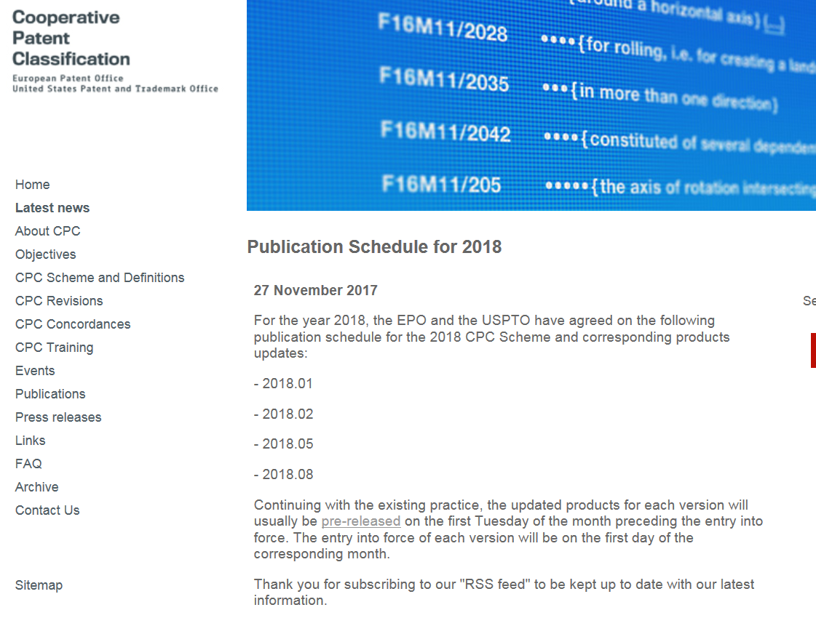
CPC Scheme Releases
Four releases in 2018:
1 January 2018 - 2018.01
1 February 2018 - 2018.02
1 May 2018 - 2018.05
1 August 2018 - 2018.08
Planning for 2018 announced on www.cpcinfo.org under Latest News
Notes:
We have decided that we will have four publication in 2018…jan and feb already released and engterd into force. Next will be in May and final one will be in August

Slide 13
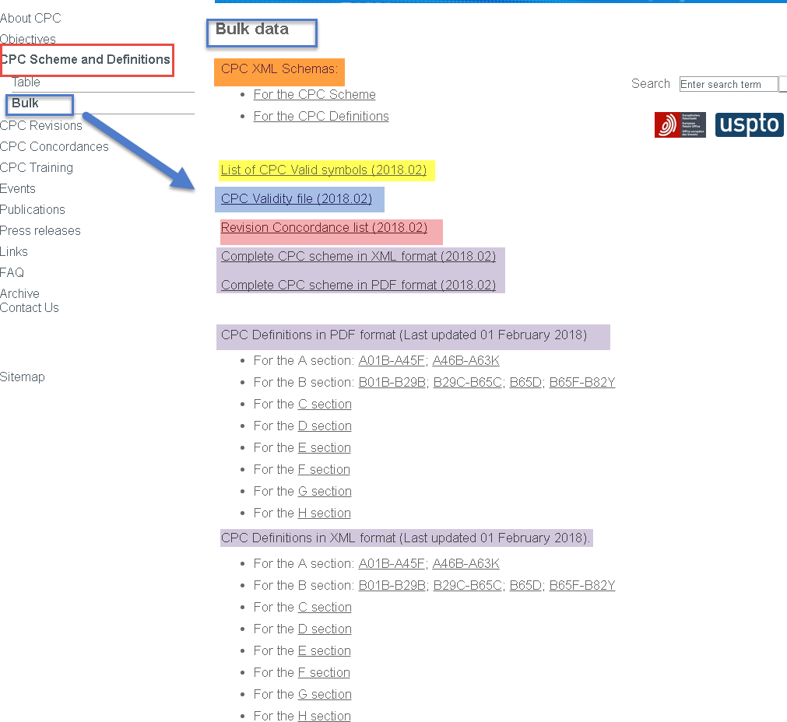
CPC products
"Bulk" section on cpcinfo:
Notes:
CPC scheme and definition

Slide 14
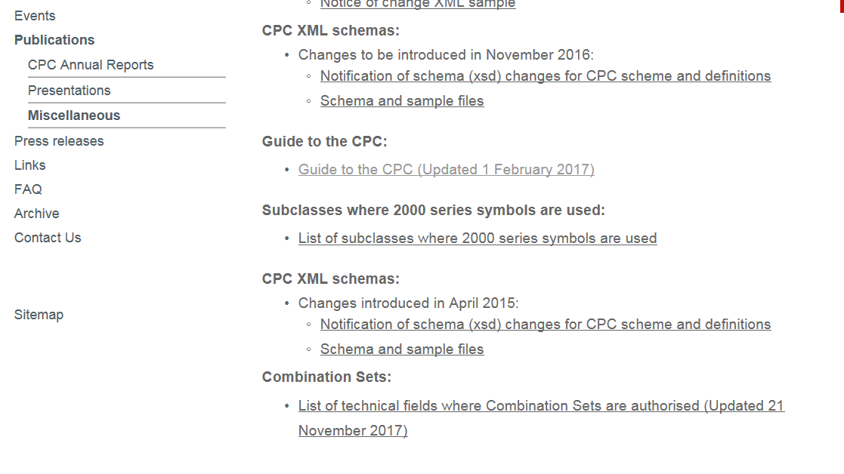
Combination Sets (C-Sets)
Updated list of subclasses where combination Sets are authorised published:
https://www.cooperativepatentclassification.org/publications/CombiSetsListofFields.pdf
Notes:
CPCinfo…we have under subsection of pubcliation a list of CPC subclasses C-sets are authorized. If some subclasses are not on this list C-sets are not used

Slide 15
Combination Sets (C-Sets)
Updated list of subclasses where combination Sets are authorised published:
CPC Sections | A | B | C | D | E | F | G | H
CPC Subclasses: | A01N | B01D | C04B | D07B | None |  | G01N | H01L
 | A23G | B01J | C05B |  |  |  | G02B
 | A23V | B05D | C05D
 | A61K | B22F | C05F
 | A61L | B29C | C05G
 | A61M | B32B | C07C
 |  | B65H | C08F
 |  |  | C08G
 |  |  | C08K
 |  |  | C08L
 |  |  | C09D
 |  |  | C09J
 |  |  | C10M
 |  |  | C12N
 |  |  | C12Q
https://www.cooperativepatentclassification.org/publications/CombiSetsListofFields.pdf
Notes:
Mostly in chemical area and some in semiconductor area. We also blocking C-sets through XML.
A – Human necessities
B- Performing Operations, Transporting
C- Chemistry, Metallurgy
D- Textile, paper
E – Fixed constructions
F – Mechanical Engineering, Lighting, Heating, weapons, blasting engines or pumps
G – Physics
H – Electricity
No Y section for C-sets

Slide 16
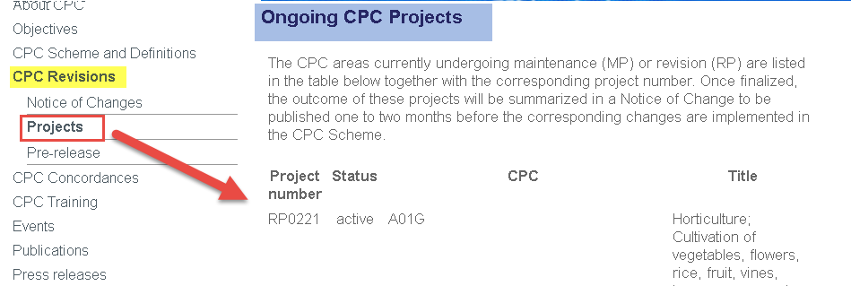
CPC Changes
CPC Revisions Projects (RP), Maintenance projects (MP) and Definition projects (DP)
Advance information?
Short summary of the ongoing CPC revision projects:
www.cpcinfo.org
Notes:
Bullet 1 –cPC changes due to RP , MP (cleaning scheme) and DP (changing definition)

Slide 17
Notices of Changes (NoCs) are published under http://www.cooperativepatentclassification.org/CPCRevisions/NoticeOfChanges.html
Section “Revisions” → Notices of Changes
NoC title linked to RP number and subclass
About 465 NoCs are published so far
Pre-published one month before entry into force in Pre-Release area
Notes:
CEF were we discussed RPs
Read access for Nos, in order to have read access f…each offices is classifying in CPC hacve access to CEF
In order to have access of CEF, your office must implement SAML authentication security. You have given the detail of how to install SAML. If you have further question contact USPTO;/EPO.
For timebeing CPC if your offices is interested in submitting feedback you can contact EPO/USPTO directly via email.
Once

Slide 18
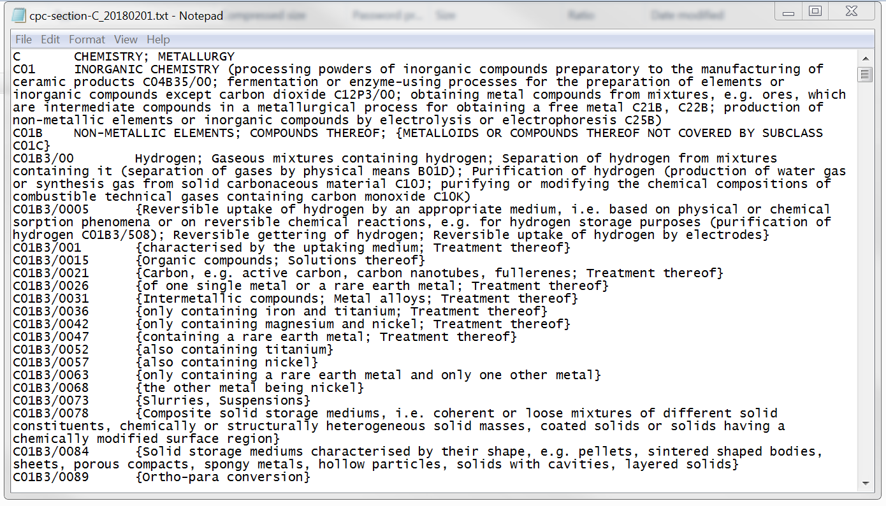
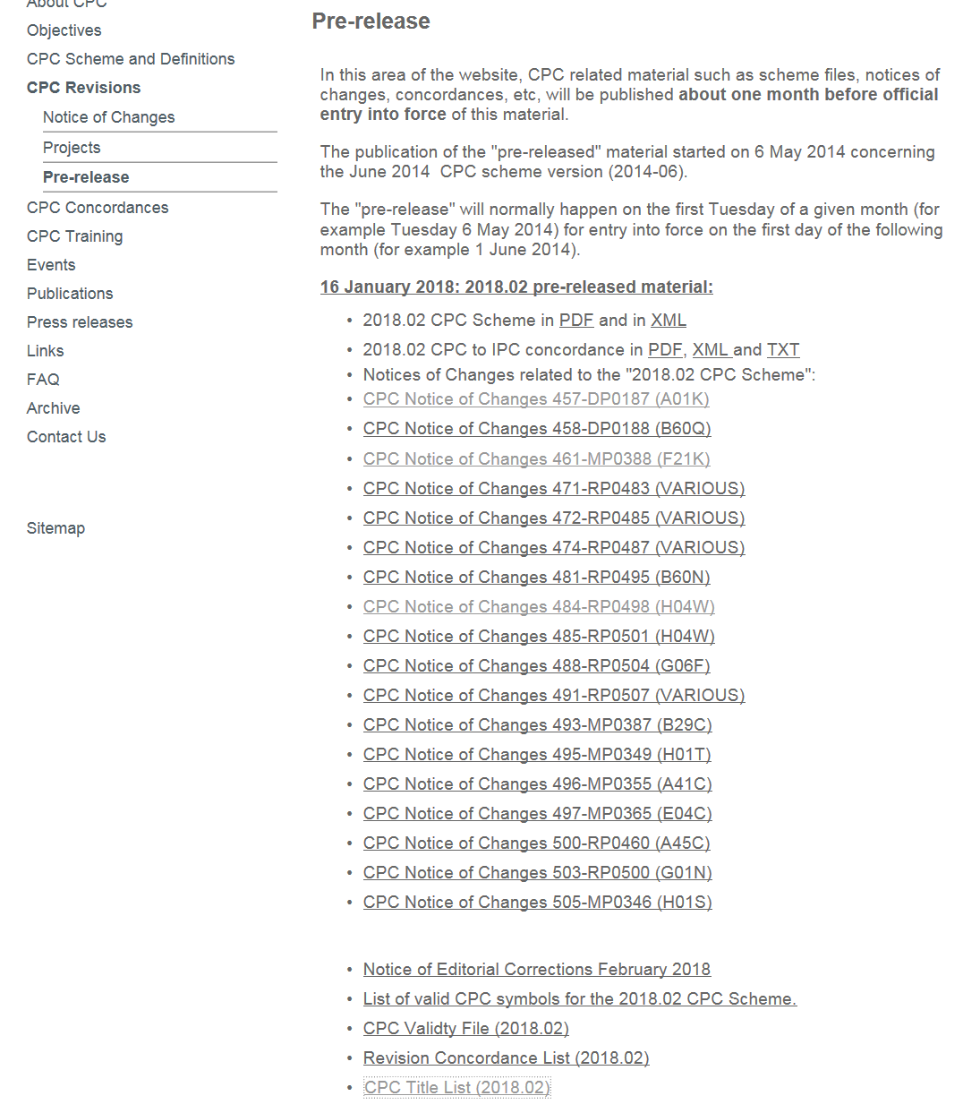
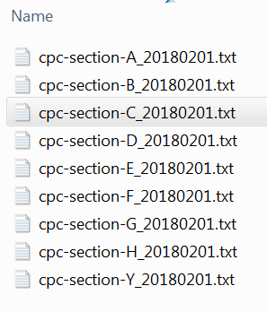
CPC Pre-Release section
New!
Notes:
Text format title list

Slide 19
Future Developments Machine readable products
Geneva, 06 February 2018

Slide 20
CPC Products after CPC revisions
Products delivered in a machine-readable format, e.g. XML (available on http://www.cooperativepatentclassification.org/cpcSchemeAndDefinitions/Bulk.html)
Scheme and Definitions (and corresponding XML schemas)
RCL (Revision Concordance List)
CICL (CPC-to-IPC Concordance List)
List of CPC Valid symbols
Validity File
In progress…
Compilation of changes (planned for CPC 2018.08 or 2019.01)
CRL (Cross-Reference List)
Geneva, 06 February 2018
Notes:
if an Office identifies areas of CPC-IPC non-alignment, please bring this to USPTO’s or EPO’s attention
ere – talking point or leave it as note?

Slide 21
Future Developments
A new approach for CPCNO data
(CPC-INTL project)

Slide 22
CPC data from National Offices
Currently, CPC data from National Offices are stored at document level, in the C(PC)NO fields.
After CPC International project (CPC-INTL):
Promotion of allocations from National Offices to simple patent family level
Visibility of name of the office endorsing allocation
New CPCDB infrastructure
Switch over to new system planned April 2019

Slide 23



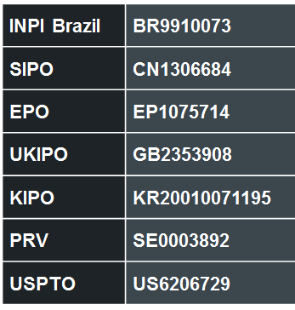
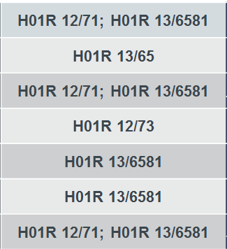
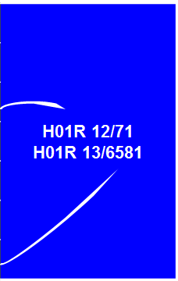

Current picture
document level
(CPCNO)
family level
(CPC)

Slide 24
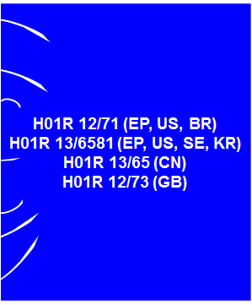
Future picture
family level
(CPC)
Expected by April 2019

Slide 25
Future Developments CPC Collaborative Environment
(CPC-CE project)

Slide 26
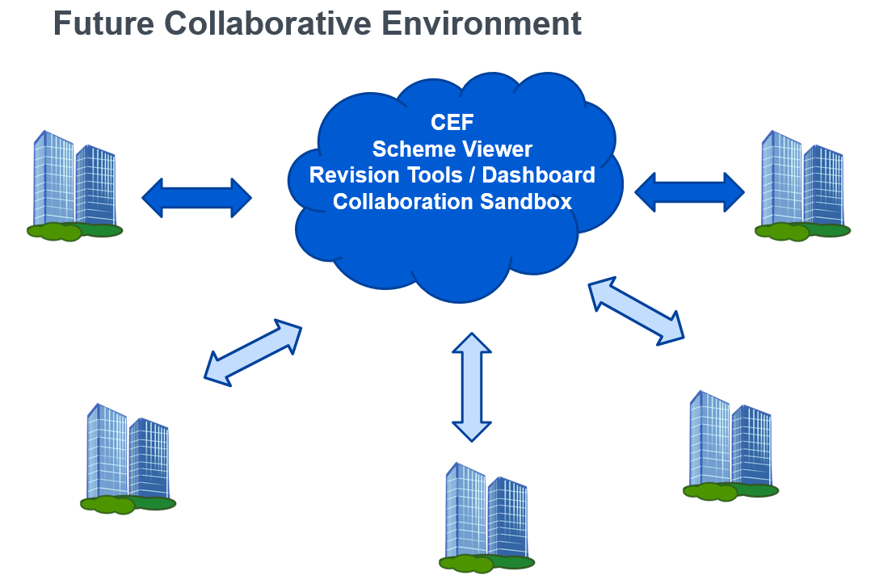
Notes:
USPTO is working on CE projecgt. We are setting up CE in cloud…for now USPTO/EPO have accesse to this product…Scheme view, revision tool and collaboration sand box
First phase - Scheme viewer
We are also working on Revision tool
In future there will be sand box
Each offices classified in CPC will have access to this CE through SAML. For the time being we do not have access for the Nos
Sometime in 2019 we expexct to have access for NOs

Slide 27
Thank you for your attention!
www.cpcinfo.org
cpc@epo.org
cpc@uspto.gov

