Slide 1


Setting the Scene: IP & Technology Scouting and Deployment
Amy Dietterich
Director, Global Challenges Division
World Intellectual Property Organization (WIPO)
Online
November 12, 2020

Slide 2
Context: Setting the Scene
Evolving risk landscape (aka «why we must act»)
Green tech growth outlook
Policies to foster low-carbon innovation
Knowledge spillover, technology diffusion, and IPRs
WIPO GREEN

Slide 3
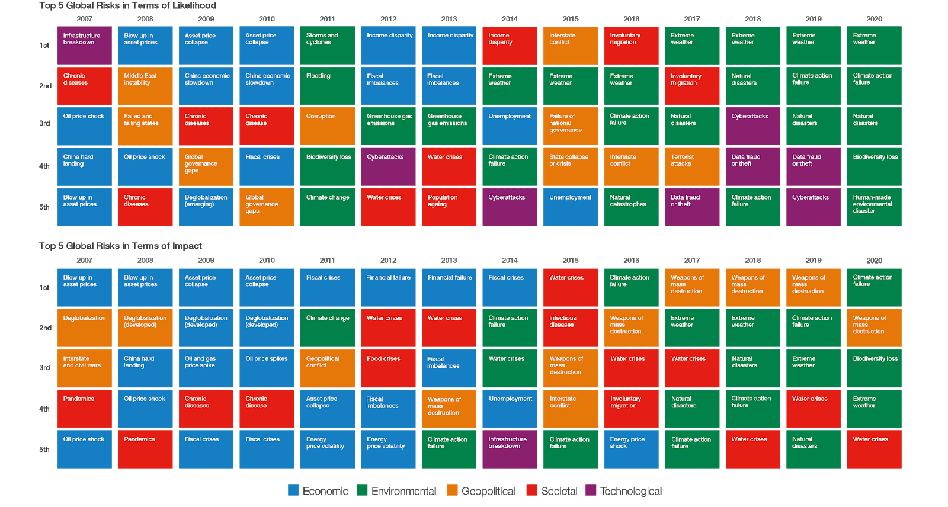

The evolving global risk landscape
Source: Global Risks Report 2019, World Economic Forum
Notes:
In terms of likelihood, it is the third consecutive year extreme weather events has remained in first place. And it is also the third consecutive year it places high in terms of impact. Failure of climate-change mitigation and adaptation has also remained at top risk since 2015. Additionally, in the top five risks in terms of impact, water crises sits in fourth place and has been in the top five since 2015 – one of its main drivers being climate change.

Slide 4
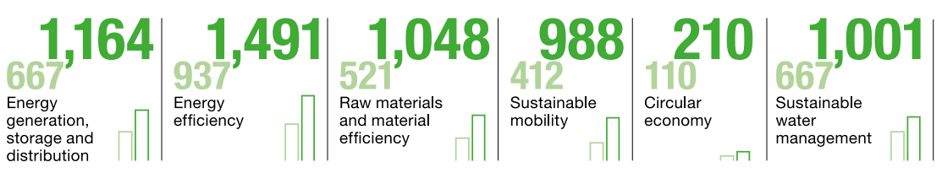

Green technology growth outlook
(in billion euros)
  Demand for green technology is expected to grow by 6.9 percent
  annually to 5,902 billion euro in 2025
Source: Federal Ministry for the Environment, Nature Conservation and Nuclear Safety (BMU) (2018): GreenTech Made in Germany 2018. www.bmu.de/fileadmin/Daten_BMU/Pools/Broschueren/greentech_2018_en_bf.pdf
Notes:
Climate change and environmental problems do not only represent risks, the demand for solutions is expected to grow.

Slide 5
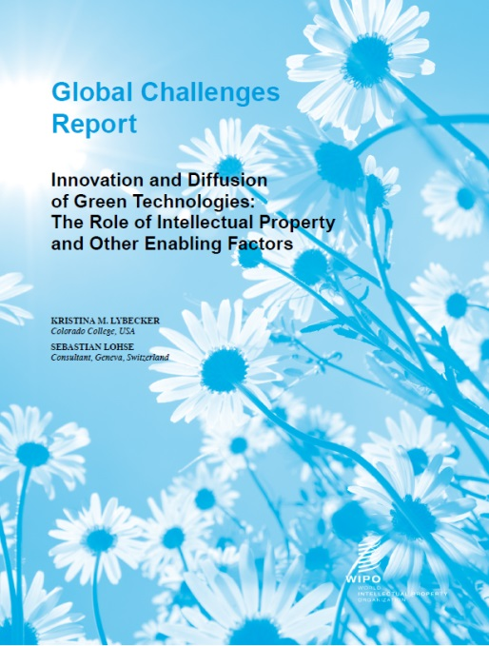
Policies that foster low-carbon innovation
More stringent environmental policies, national or international (e.g. emission standards)
Effective protection and enforcement of IP rights
Increased R&D and public support to private R&D
Better access to finance for SMEs
Notes:
A 2010 survey shows a significant increase in patent applications in wind, solar, geothermal and ocean power after the signing of the Kyoto Protocol in 1997

Slide 6

Innovation knowledge spillover
Publicly available innovation leads to derived innovation
Provides benefits to society
Often social rates of return to R&D are higher than private rates of return
Research suggests knowledge spillover 60% higher for low-carbon than high carbon technologies
Notes:
Example Apple smartphones leading to android based phones etc
Research shown typical social marginal RR of 30-50% while 7-15% for private RR
Where does the low-carbon advantage come from? One potential explanation is that clean technologies are mostly new technology fields. New technology fields offer potentially high marginal private returns to first movers and might thus generate large knowledge spillovers. intensity of spillovers from low-carbon technologies is comparable to other emerging technologies.

Slide 7
Technology Diffusion – enabling factors
Intellectual property rights
Trade and market aspects
Science, R&D and adaptation capacity
Policy considerations
Public and private sector interactions

Slide 8
Intellectual Property Rights (IPR)
IPR are a fundamental aspect of innovation and technology transfer. They stimulate the diffusion of technologies by providing secure channels to share know-how. Patents can signal the value of a technology to investors.
Increasing digitalization will lead to rising importance of intellectual property.

Slide 9
IP rights in low carbon technologies
The role of patents for low carbon technologies differs from that in other sectors:
Higher degree of substitutability and competition
Sufficient room in the market for competing technologies
It reduces the influence specific patents can have on technological progress and prices

Slide 10







What is WIPO GREEN?
An online platform for technology exchange that contributes to the accelerated adaptation, adoption and deployment of green technology solutions
WIPO GREEN connects those seeking environmentally sustainable solutions with technology and service providers
  Enable adaptation and deployment of green solutions through collaborative approaches, a transparent marketplace and reduced transaction costs
  Engage closely with the private sector, the source of ~80% of innovation in the green space
  Support innovation and innovators, particularly in the developing world
  Constructively contribute to global policy dialogue

Slide 11









WIPO GREEN and the platform business model
Create value by:
Helping the supply side (home owners, taxi drivers, technology providers)
Helping the demand side (travelers, clients, technology seekers)
None of them own any assets, they only do match-making
Value Addition
Harnessing the power of IP and innovation to address climate change
Robust partner network spanning MNCs, SMEs, governments, UN agencies, financial institutions and NGOs
Database rich in information, with green technology search and matching functions
Unique potential to go to scale
Tangible contributions towards achieving the SDGs
Global convening power
Source: Article by Dr Murat Uenlue / Platform business model, Platform business model fundamentals
Notes:
Google, Facebook, YouTube, Airbnb, Uber, eBay, Alibaba, PayPal all make use of the platform business model.
The platform business model is relevant for startups, young companies and established companies. For startups, it poses the opportunity to capture a share of established markets and grow large fast.
The success of these envied companies has made the platform business model the holy grail of business models.
Platforms help to sell products or services, to generate content and so on.
But the platform owner as such does not manufacture the products that get sold, they do not provide the services that get offered on their platform and they do not create the content that gets generated each day.
WIPO GREEN is an asset-sharing platform, such as Uber or Airbnb. The last one has been able to create value successfully by:
helping the supply side (home owners/hosts): to increase utilization of their existing assets (unit/room/house) in order to generate additional income or to get more yield out of those than through other ways.
Help the demand side (travelers): find cheaper, more individual, less “clinical” accommodation. And to find accommodation at peak times (e.g. when special events are on) when all hotels are booked out.
Airbnb captures value by charging a percentage on each booking. On the surface, they are being compared to the large hotel chains but on their balance sheet, they look much more similar to an online travel portal. They don’t need to worry about financing their lodging inventory. By comparison, hotels chains design, build and own a large amount of their real estate. Not only are they subject to the whims of the commercial real estate cycles but also does it take much longer and more capital to ramp up their supply (and write-offs/impairments in downturns). (Though in good times, commercial real estate opens a lot of financial engineering opportunities because it is excellent collateral.)
Platforms like Uber and Airbnb have created a whole new supply (sub-)category. Yes, sure, Taxis have long existed. But ride-hailing as such has not. The difference is that a taxi company is a registered business entity. The Uber driver is just an individual providing a commercial ride to a stranger. Airbnb, Uber or WIPO GREEN all have in common that neither of them own no vehicles, apartments or patents of its own, and their plan is to connect users to each other ^{[19]}.

Slide 12
https://www3.wipo.int/wipogreen-database/
WIPO GREEN Database Categories
ENERGY
POLLUTION
& WASTE
PRODUCTS,
MATERIALS
& PROCESSES
FARMING
& FORESTRY
WATER
TRANSPORTATION
BUILDING
& CONSTRUCTION
Source: The WIPO GREEN Platform, as of April 2020
Notes:
Among all categories, WIPO GREEN features a total of 3197 technologies and 256 needs (as of 16.07.2020), which is equivalent to 92% of technologies and 8% of needs on the WGDB.

Slide 13
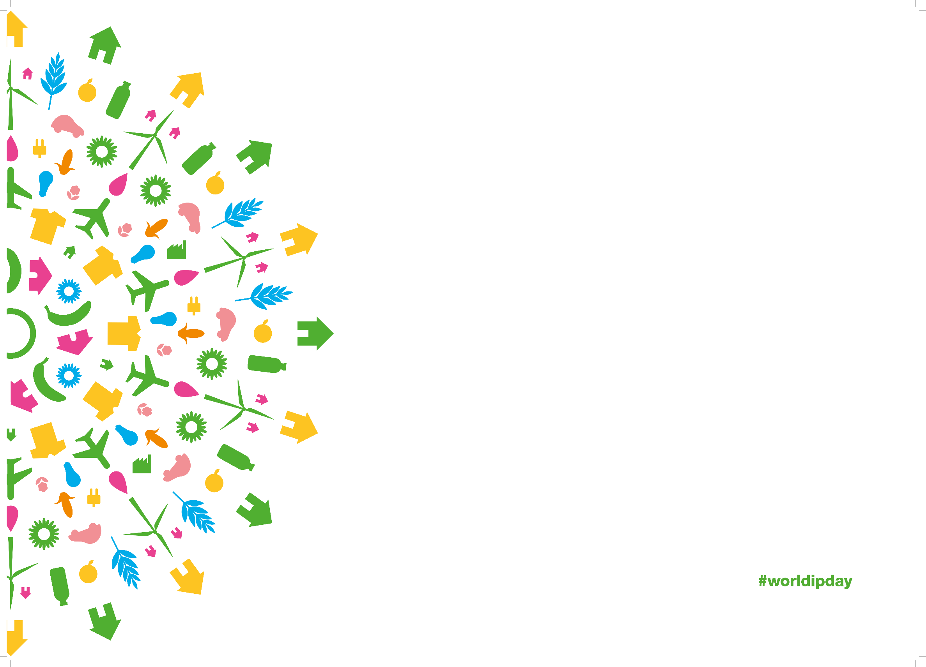

Thank you!
WIPO GREEN
Queries:
wipo.green@wipo.int
Further information: www.wipo.int/green
WIPO GREEN Newsletter
Register as a database user

