Slide 1
“Technology Deployment” objective or enabler? Master or slave?
A discussion to set the context behind deployment of technology; and steps you can take to enable rapid outcomes
Chris tan Kuala lumpur

Slide 2
... The value of technology is solely in what it enables
“technology” has no inherent value in and of itself ...
TECHNOLOGY DEPLOYMENT costs money for ...
Procurement
Configuration
Installation (hardware, software, “wetware”)
Transition and Change Management
Maintenance
Upgrades
etc
Consider and Discuss (later):
What happens when you attempt a technology deployment with less than 100% of the required resources?

Slide 3
AND here’s THE PROBLEM. How do we connect them?
“value” of technology: how much does it enable you to approach your true north?
YOU ARE FAMILIAR WITH:
BUT YOU MUST ALSO BE:
VISION
SPECIFIC
MISSION
MEASURABLE
STRATEGIC
OBJECTIVE
ACHIEVABLE
REALISTIC
KPI
TIMELY
TARGET
Before we move on
How do most people commit targets today?
Ambitious? Or Safely?

Slide 4
what is “true north” ?
True north is ...
True north isn’t ...
... the destination
... access to clean water
... access & journey time
... health & well being
... services & satisfaction
... education & results
... the objective
... the journey
... plants & pipelines (infra)
... roads & vehicles
... hospitals
... systems
... internet & computers
... the KPIs
Understanding “true north” helps you distinguish between urgent and important

Slide 5
The path to true north varies depending on stakeholders’ unique, specific (& valid) perspectives
Each party’s priority is unique to him/herself
You cannot please everyone
(at the same time)
Decisive leadership is required
to optimise resources vs impact
OVER TIME

Slide 6
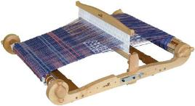
We must confront the following realities to safely descend from the clouds. Stop dreaming!
NOTHING IS FREE
“Gifts” often have strings attached ...
GOVERNMENTS (everywhere & always) Fuzzy focus. Fluid priorities. Diverse stakeholders across social / economic / geographic spectra. Multiple institutions, pursuing different targets, drawing from common pool of resources.
… but do they match the pattern our friends are trying to weave ?
Unpopular things
For long term deployment, our “local” stakeholders must be enabled as TRANSFORMATIONAL LEADERS.
Popular things
We must help our friends to “dance on the edge”.
How to do “just enough” with what they have?
And make it to the next round? And the next ….
The Scope of expectations from the People
“Transformational Leadership is about disappointing people;
at the rate they will permit.”
– Prof Marty Linsky

Slide 7
The journey of a thousand miles begins with the first step. Avoid “analysis paralysis” !!!
Doing “Action”
Being “Character”
It operates
its business
differently
It becomes
a different organisation
The desired transformation is achieved via rapid disciplined execution of difficult decisions towards a long term vision.
Short term results are essential learnings
Towards a sustainable deployment ecosystem

Slide 8
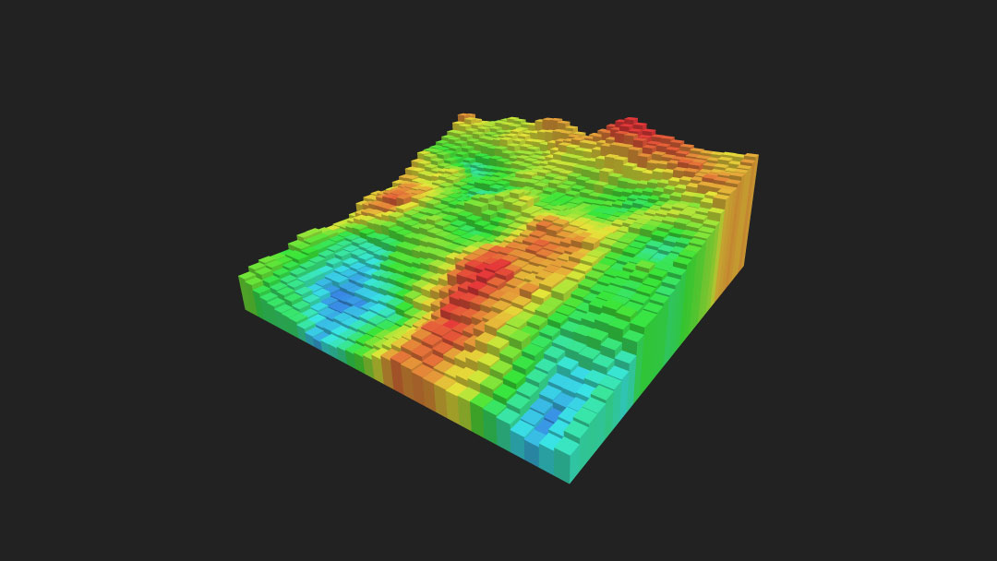
Smart factory strategies should also be refined by dissecting the value chain
Value Add @ Delivery Chain
Value Add
No nation is homogenous.
Understanding your heatmap ...
“Fabrication”
“Sales”
Entry Point Choices
Who’s hurting the most?
Who can wait (until we get resources)?
.. will help you plot alternatives and priorities.
“Assembly”
LOW
Proximity to User
HIGH
An observable flow of short term results will be gleaned from granular analysis & action

Slide 9
leaders need to paint a long term vision to obtain the support of the people
Results
OBSERVED BY PEOPLE Positive trajectory of a long term program
due to constant delivery of short term results
“Reality” on the ground dictates deployment tactics in specific places & times
“Vision” drives the decision to deploy a certain technology
#3. More results from
new platforms created
by innovations (e.g. new products)
#2. Additional results
through innovations
on existing platforms (e.g. expansion)
BIG Fast
Results
#1. Results from
diligent execution
on existing platforms (e.g. maintenance)
Time
We must enable Leaders to deliver short term results to maintain the people’s support

Slide 10
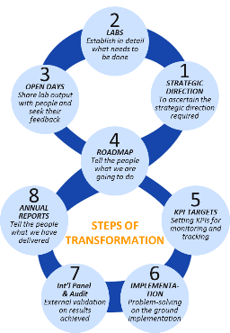
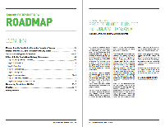
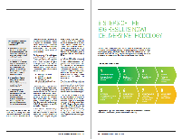
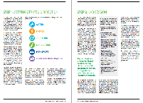
The big fast results methodology integrates yin & Yang, Doing & Being, body & Soul
We incept the SIX SECRETS OF TRANSFORMATIONAL LEADERSHIP …
… to produce detailed programs with 3-FEET DETAIL for monitoring & real time PROBLEM SOLVING (by the Chief Executive* via his Delivery Unit).
The Game of Impossible
KPI Anchorage
… and execute the 8 STEP BFR METHODOLOGY …
Discipline of Action
Situational Leadership
Winning Coalitions
Divine Interventions
10
The Malaysian Experience:
“Big Fast Results”program management technology; later transferred to many countries worldwide.

Slide 11
EXAMPLE Malaysia National Transformation Program: Performance Management and Delivery Unit (PEMANDU) set up to facilitate transformation of the program governance structure
Before …
After …
Prime Minister
Prime Minister
PEMANDU CEO reports to PM
Level 1:
Leadership, governance and prioritisation
Problem-Solving Meeting/Delivery Task Force
Cabinet Meeting
*MKRA
PEMANDU
Level 2:
Performance management and problem-solving
VS
PEMANDU monitors and upskill DMO
DMO sends updates on lab implementation
Ministers
Ministers
Ministers
PEMANDU
runs labs
Lead Ministries
Level 3:
Implementation and delivery
MDU
Ministers
Lead Ministries
Lead Ministries
MDU
Ministers
Lead Ministries
Lead Ministries
Ministers
Ministries
DMO
Delivery labs
DMO reports to PS / Minister
*Ministerial
Key Results Area
NKEA/NKRA Steering Committee
Role of PEMANDU:
monitors and evaluates the implementation process by working closely with the DMO and EPP/project owners
build institutional capacity and skills to carry out the work better.
to leave the system once respective govt’ institutions have become competent – sustainable approach.

Slide 12
Technology deployment should not be treated as “one size fits all”
“Horses for courses”
Because your stakeholders are diverse

Slide 14
Thank you terima kasih salamat khab Khun Ka kyay zuu cam on ban khob chai
Chris Tan chris@equus.com.my +60-19-2827400

