Slide 1
TECHNOLOGY DEPLOYMENT FOR SUSTAINABLE DEVELOPMENT
Alfred Watkins
Global Solutions Summit
WIPO Virtual Conference
Technology Scouting and Deployment
for Sustainable Development
12 November 2020

Slide 2
Critical Development Issues for the Asia Pacific Region
Developing smarter, more productive factories, farms, and service companies
Promoting inclusive, affordable access to potable water, off grid, renewable energy, internet connectivity, and food security
Boosting income and creating jobs
Climate change

Slide 3
R&D vs.
Technology Scouting and Deployment
Research is the transformation of money into knowledge, know how, and inventions
Scouting and Deployment are the transformation of knowledge into results on the ground

Slide 4
Selected Questions from Tech Scouting Panel
Who owns the IP?
Tech scouting and transfer – from whom to whom
How do you adapt existing technology for local use? Who does this? How?
Who performs, organizes and/or finances technology scouting activities?
How would technology scouting help drive domestic innovation development initiatives?
What is curated matchmaking?
What specific capacities are needed for tech scouting?
What is the link between tech scouting and deployment?

Slide 5

Identifying innovative solutions is not the same as deploying them at scale in thousands of urban and rural communities and businesses
PASSING THE BATON
Notes:
https://www.hippocraticpost.com/wp-content/uploads/2019/08/shutterstock_106091447-1-1280x720.jpg

Slide 6
Step 1 Scouting
Step 2
Deployment

Slide 7
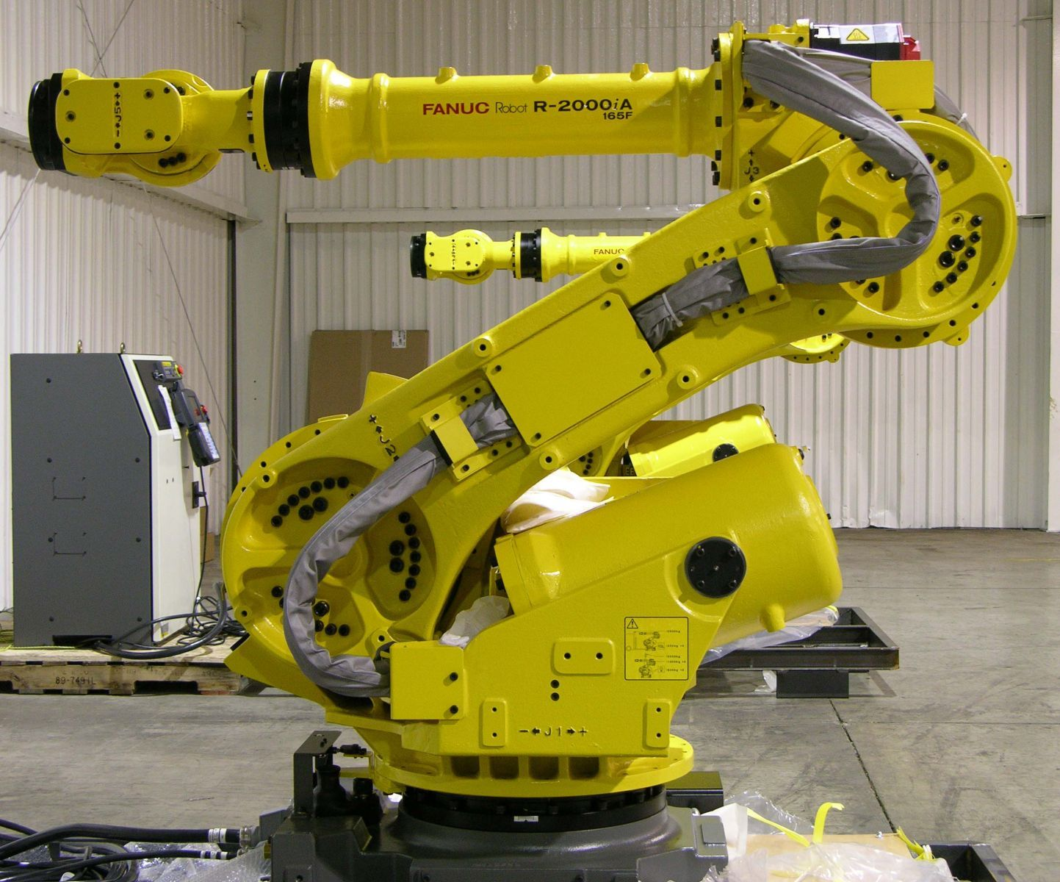
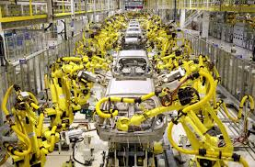
Scouting
Deployment

Slide 8
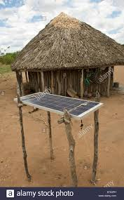

Scouting
Deployment

Slide 9


The Deployment Challenge
After you identify a useful solution, how do you use it to solve problems?

Slide 10

Simply matching technology supply
with national needs won’t work

Slide 11

Perplexed
Technology
Provider
Who is the customer
Vendor or service provider
Local partners
O&M
Supply chain
Financing
Business model
Combine with other technologies
Embed it in a financially and operationally viable business
Community interest and support
Government support
Permits
Workforce training and skills
Scale-up strategy

Slide 12

Confused Buyers
  Will the solution be cost effective and affordable?
  What are the technical merits of different solutions?
  Will it deliver the expected benefits?
  Is it tailored to the needs of my specific company, country, or region?
  What are the requirements for successfully deploying this technology at scale on a financially and operationally sustainable basis?

Slide 13
Business Tasks
Market Studies
Supply Chain Development
Install, O&M, Repair
Business Model
Community Outreach
Finance
Local Partners
Who?

Slide 14
How?
Entrepreneurs
Community
Leaders
Technology
Vendors
Local
Suppliers
Local Universities, Scientists, and Engineers
Social Enterprises
Local and National Governments
Foundations
NGO's
Financiers
Multinational
Corporations
Multilateral and Bilateral Agencies

Slide 15
Government? Tasks
Specify Problem
Regulations and Support
Business Case
RFP
Implementation
Arrangements

Slide 16


Tip of the Iceberg

Slide 17
THANK YOU!!
Alfred Watkins
Global Solutions Summit
alfred.watkins07@gmail.com

