Slide 1
Technology Scouting
Cung Vu, PhD November 10, 2020 WIPO Panel on Technology Scouting

Slide 2
Table of Content
. Technology scouting at ONR/ONRG
. Technology scouting in Asia
. Conclusions

Slide 7
India: India Institute of Technology Madras (Chennai), Indian Institute of Science (Bengaluru), TERI university (New Delhi)
Thailand: Chulalongkorn U, Mahidol U, King Mongkut IT, National Science and Technology Development Agency, Chiang Mai U, CMRU, U Phayao, CCRU, Naresuan U
Myanmar: U of Yangon
Vietnam: MOST, VISTI, VAST, UT/USc/VNU HCMC, Hanoi UT, Can Tho U
Singapore: NTU, NUS, SUTD
Malaysia: Universiti Teknologi MARA (UiTM)
Indonesia: ASEAN Center of Energy

Slide 9
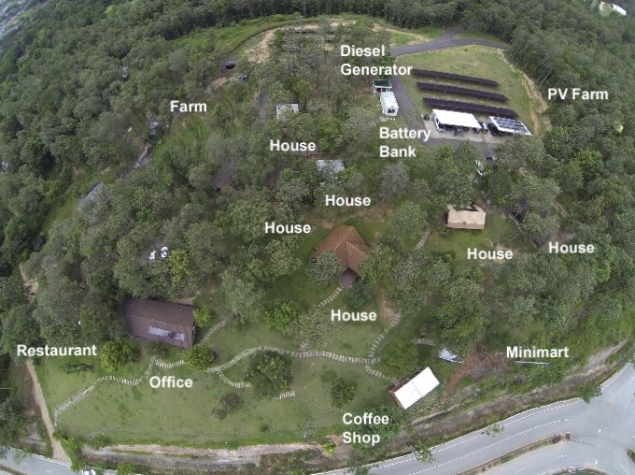

Slide 10
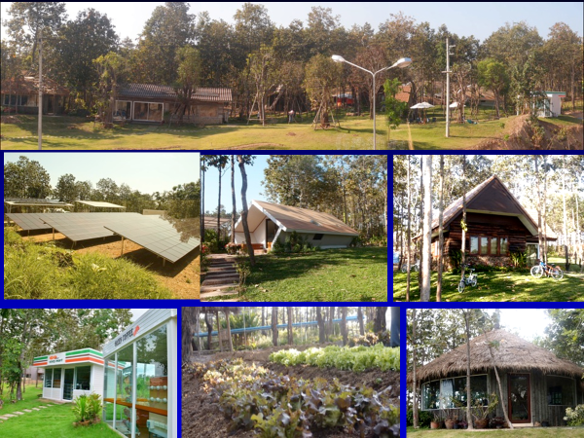

Slide 11
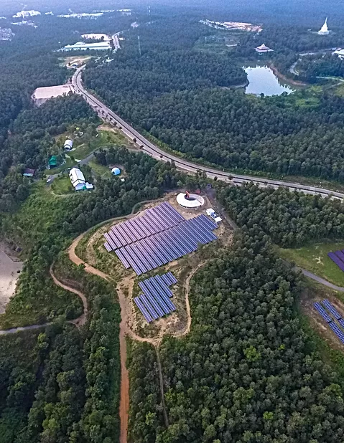

Slide 13
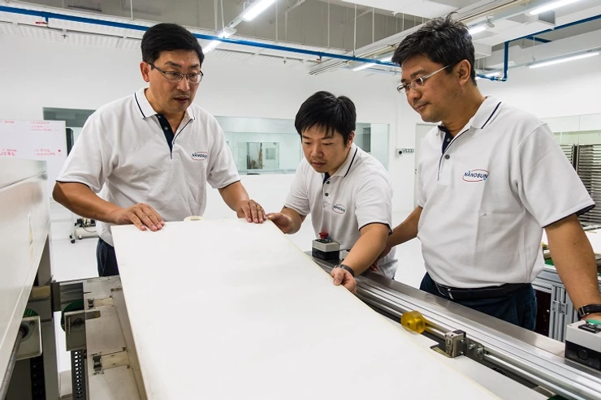

Slide 14
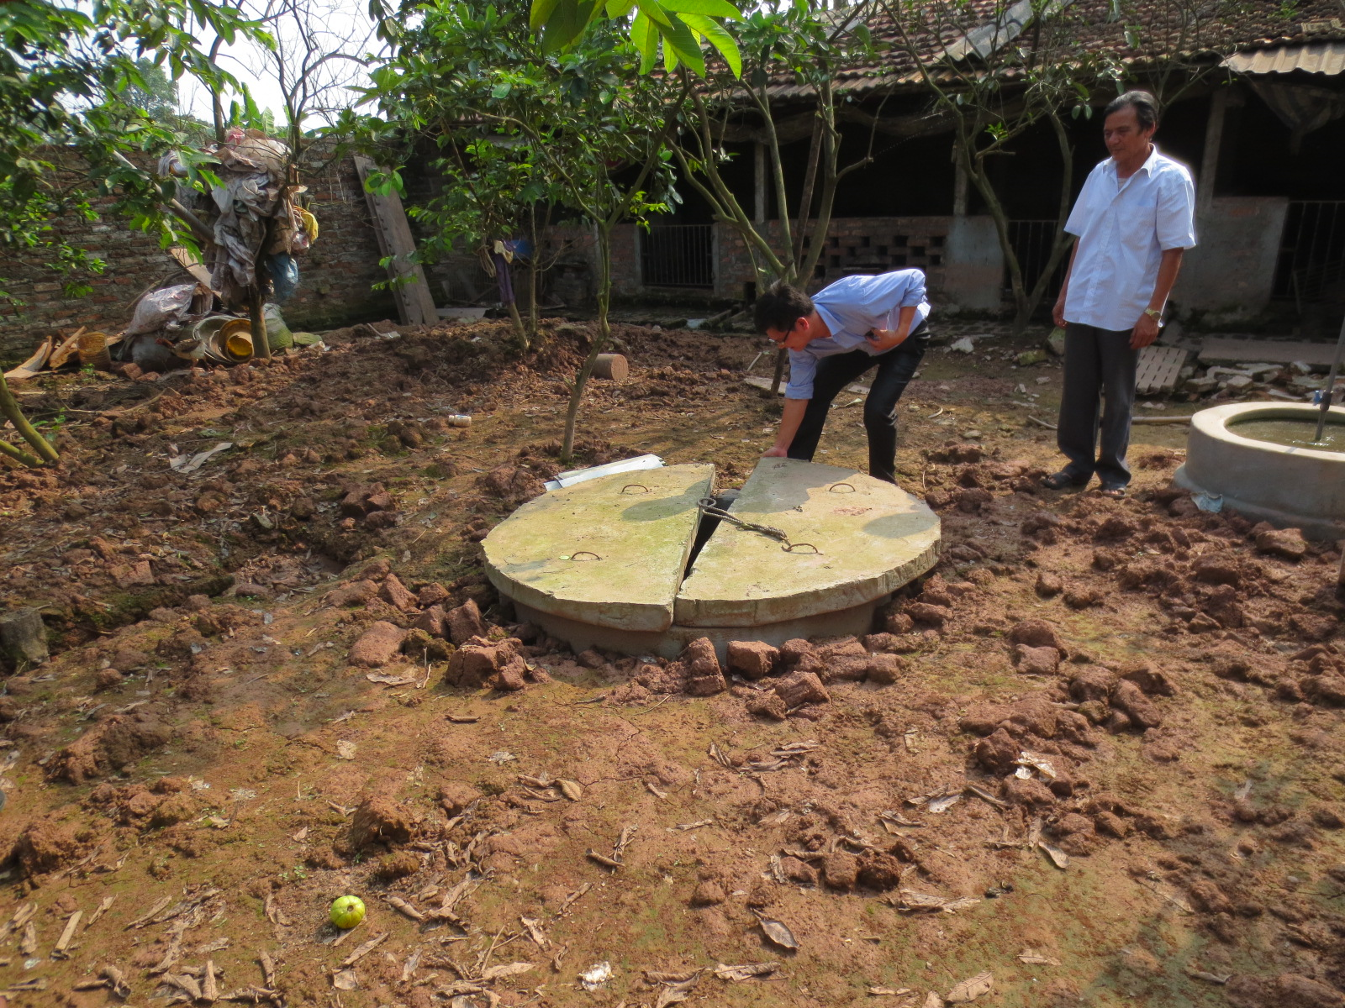

Slide 15
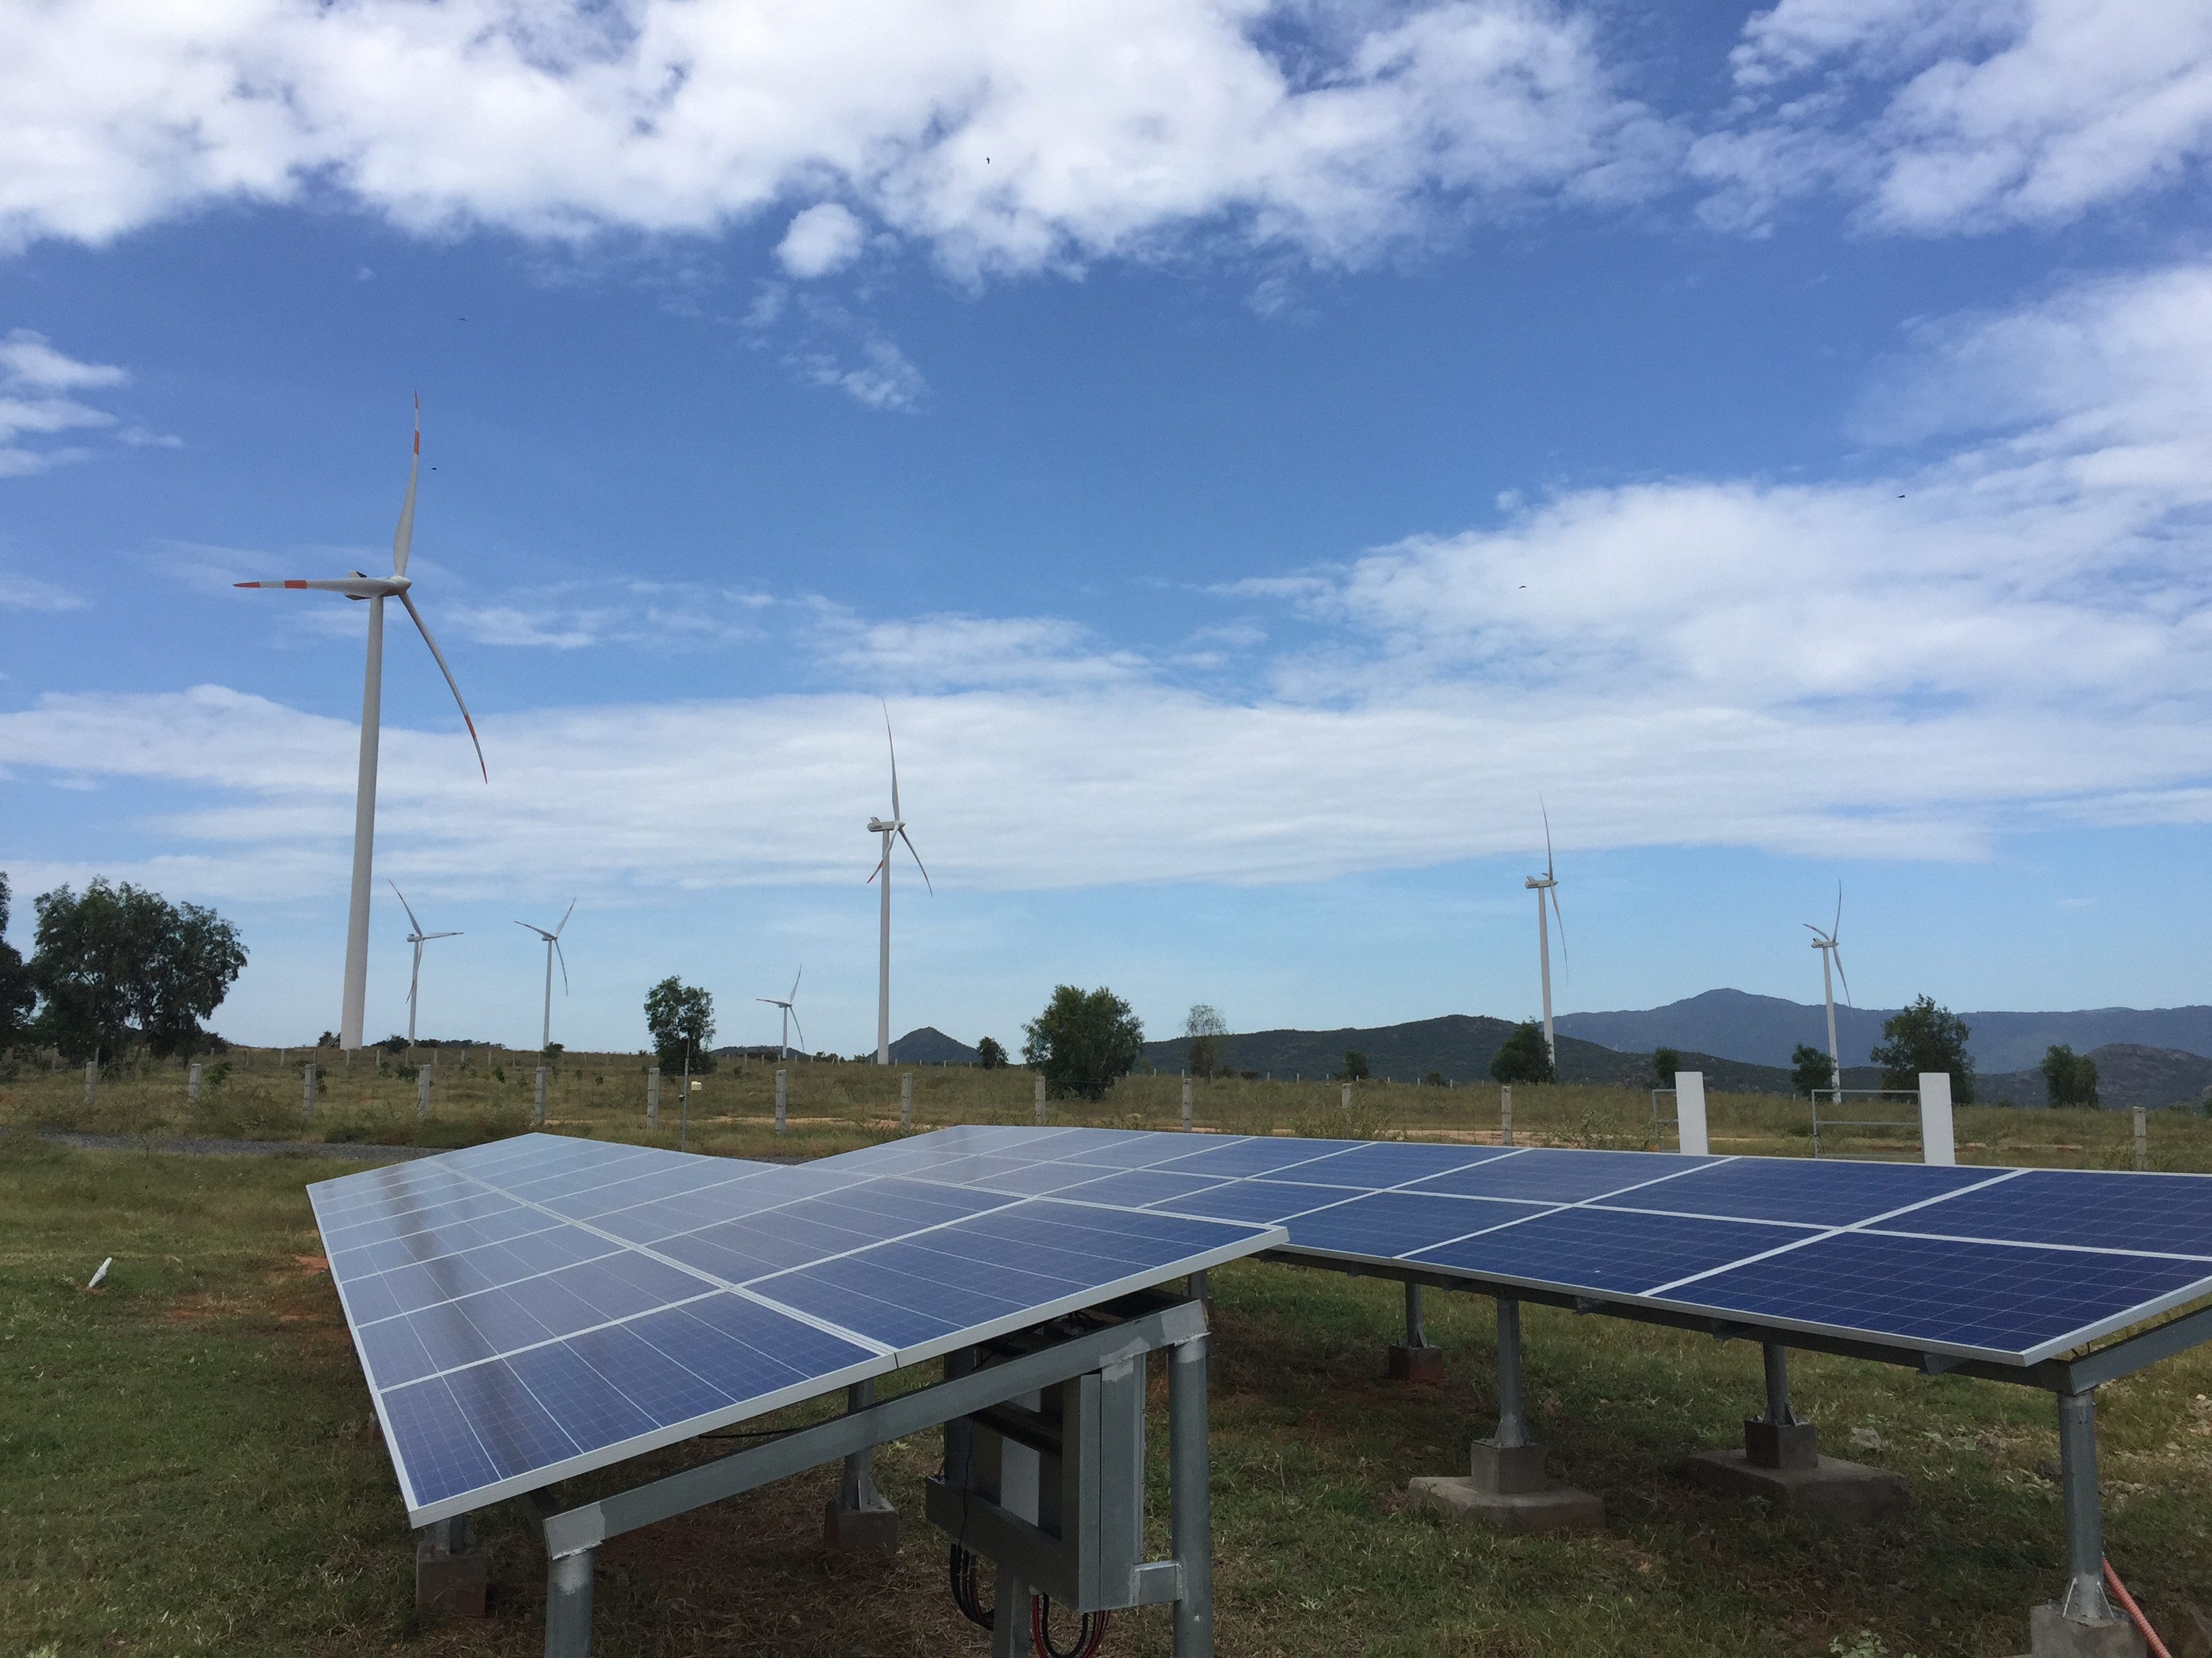

Slide 16
Conclusions
Policy and decision makers must be aware of technology scouting to set policy, funding, education, training, infrastructure. Business leaders to develop products/services and to know their competitors
Technology scouting is the first step but critical to identify both technology available and requirements

Slide 17
Thank you
Vu Consulting LLC
Cung.vu@gmail.com

