Slide 1
London, United Kingdom November 10, 2014
XML4IP Task Force Meeting
UPOV Electronic Application Form Project
Ben Rivoire
(Technical/ Regional Officer , Africa, Arab countries, UPOV)

Slide 2
Overview
Introduction to UPOV
Overview on the EAF project
Link with ST.96
Communication with stakeholders
Workplan and next steps

Slide 3
UPOV: INDEPENDENT INTERGOVERNMENTAL ORGANIZATION
The International Convention for the Protection of New Varieties of Plants
established in 1961
The International Union for the Protection of New Varieties of Plants
Union internationale pour la protection des obtentions végétales

Slide 4
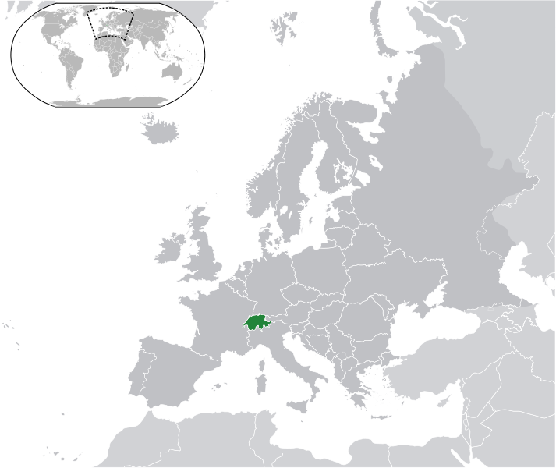
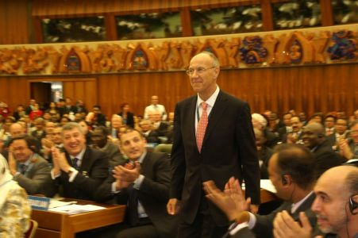

.

Slide 5

UPOV MISSION STATEMENT
“To provide and promote an effective system of plant variety protection, with the aim of encouraging the development of new varieties of plants, for the benefit of society”

Slide 6

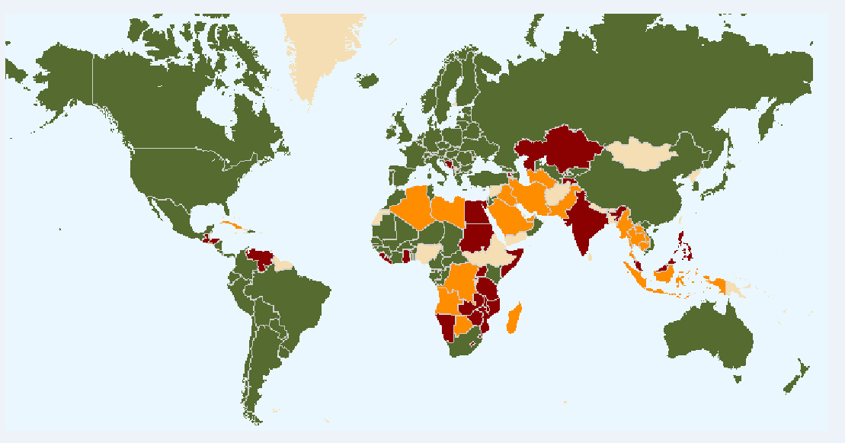
72 members of UPOV (green) 16 initiating States & 1 organizations (brown) 24 States and 1 IGO have requested assistance for the development of laws (orange)
The boundaries shown on this map do not imply the expression of any opinion whatsoever on the part of UPOV concerning the legal status of any country or territory

Slide 7
UPOV MISSION STATEMENT
“To provide and promote an effective system of plant variety protection (PVP), […]”
Plant Breeder’s Right (PBR)

Slide 8
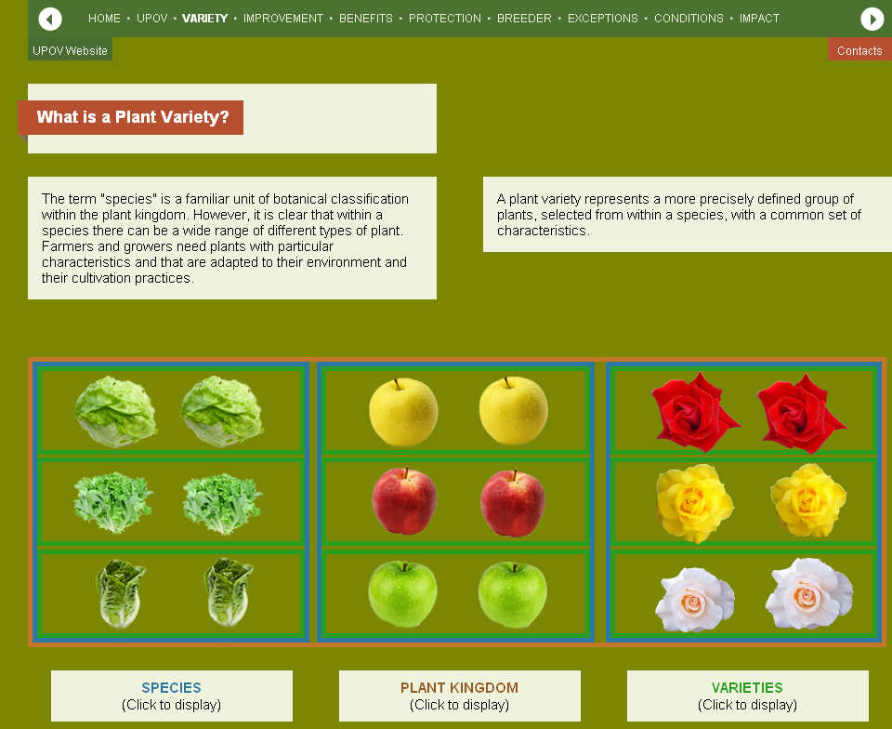

Slide 9
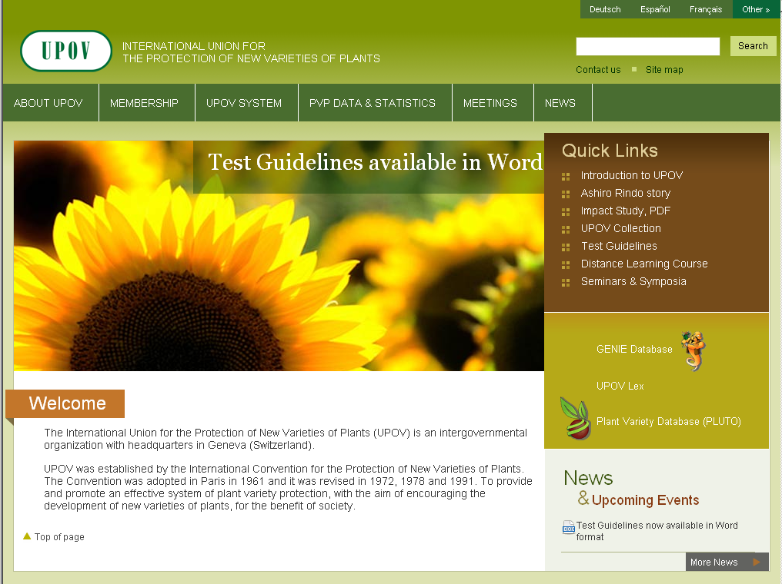
http://www.upov.int

Slide 10
Overview
Introduction to UPOV
Overview on the EAF project
Link with ST.96
Communication with stakeholders
Workplan and next steps

Slide 11
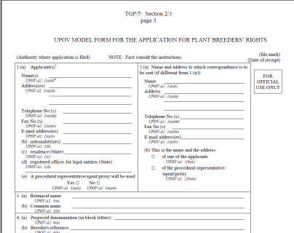

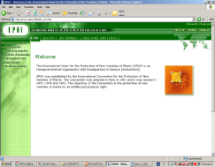
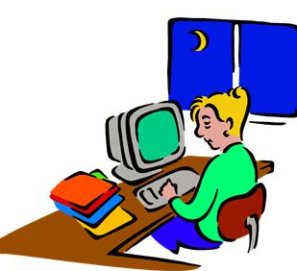
PBR Application- how it works today ?
MANUAL Form
?
Authority A
ELECTRONIC Form
?
Authority B
11
Notes:
11

Slide 12



UPOV Electronic Application Form Project
Applicants (Breeders)
On-line form
DATABASE
Output language
Authority B
Output language
Authority A
Authorities (PVP Offices)
12
Notes:
12

Slide 13
Prototype Electronic Application Form
Participating UPOV members
Partners
UPOV Office
WIPO
CPVO
ISF
CIOPORA
Argentina
Australia
Brazil
Canada
Colombia
Dominican Republic
Ecuador
European Union
France
Germany
Japan
Mexico
Netherlands
New Zealand
Paraguay
Republic of Korea
Switzerland
United States of America
Viet Nam
(China)
≥ 60% of the total applications within UPOV members
13
Notes:
13

Slide 14
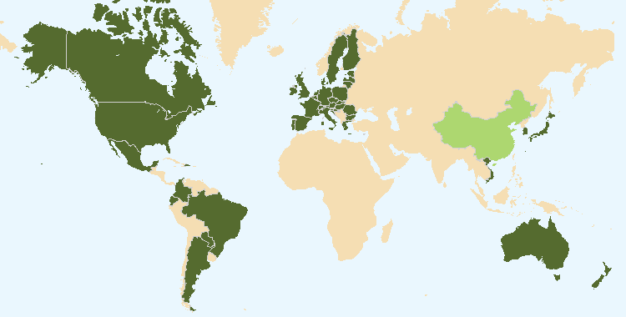
Prototype Electronic Application Form
Participating UPOV members
The boundaries shown on this map do not imply the expression of any opinion whatsoever on the part of UPOV concerning the legal status of any country or territory

Slide 15
Overview
Introduction to UPOV
Overview on the EAF project
Link with ST.96
Communication with stakeholders
Workplan and next steps

Slide 16







UPOV Electronic Application System (EAS)
Implement Electronic Data Interchange system
Establish basic common format (XML Schema) for data exchange based on WIPO Standard ST 96
Create Admin Interface
To monitor/ validate input
Implement Electronic Application Form
In English
For Lettuce
Establish UPOV Design Rules and Conventions
Establish communication protocol (WSDL) for the transfer of PVP applications btw breeders and UPOV, and btw UPOV and PVP Offices
Dashboard
Prepare PVP Data Dictionary and generate Schema Technical Specs
Application form
Create/Edit
Prepare TEST campaigns (templates and guidelines)
Create Import facility
Create
Export facility
Technical Questionnaire
Create/Edit
Design Database
PVP-XML Data Model
Data Exchange
On-line Electronic Form

Slide 17
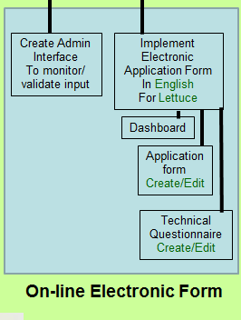
Electronic Form

Slide 18
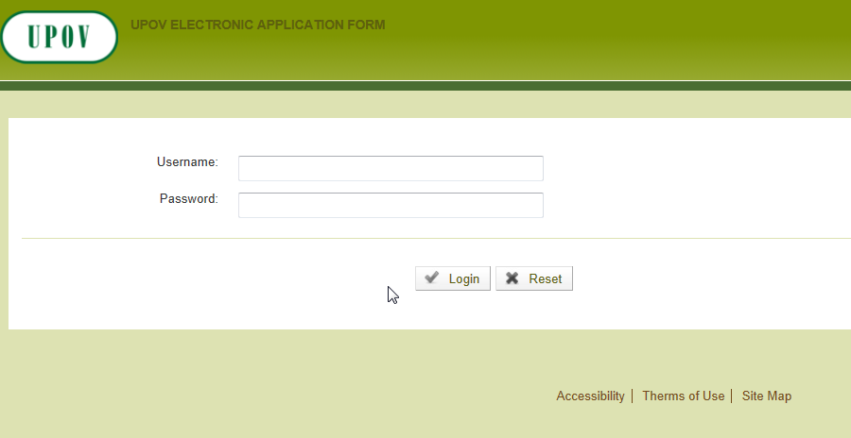
Presentation of the mock-up

Slide 19
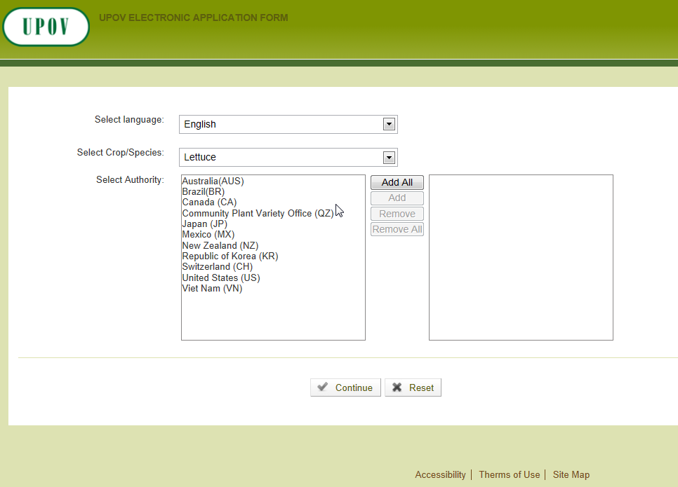

Slide 20
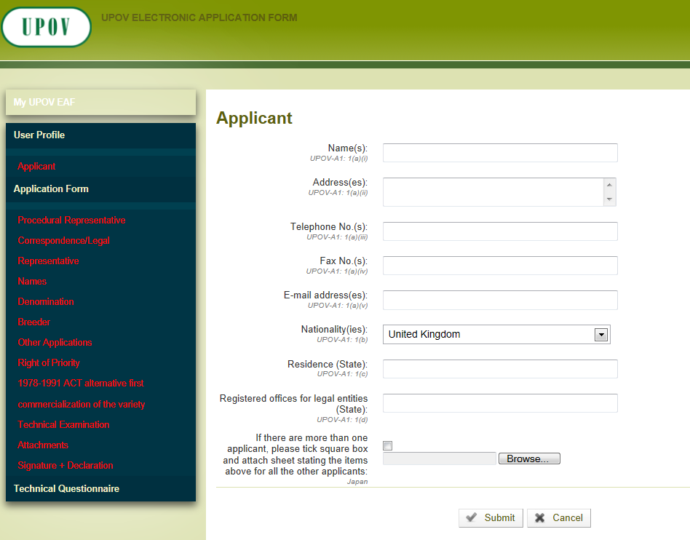
COMMON QUESTIONS

Slide 21
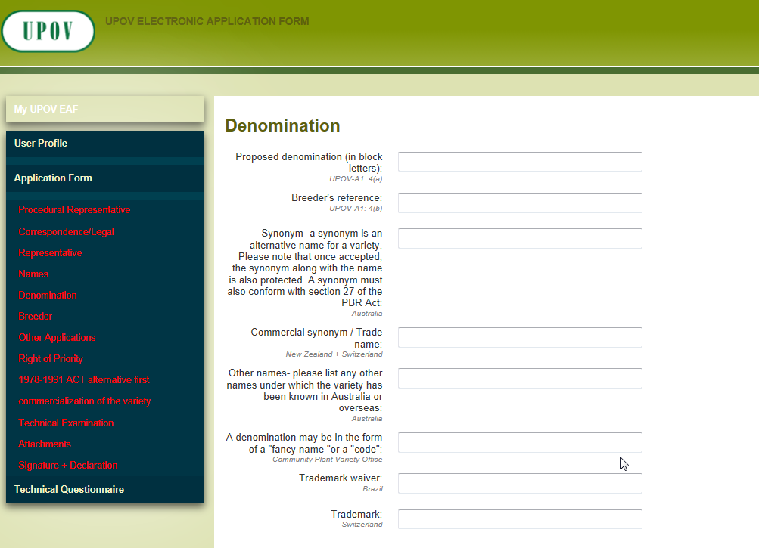
PVP CORE QUESTIONS
PVP OFFICE SPECIFIC QUESTIONS

Slide 22
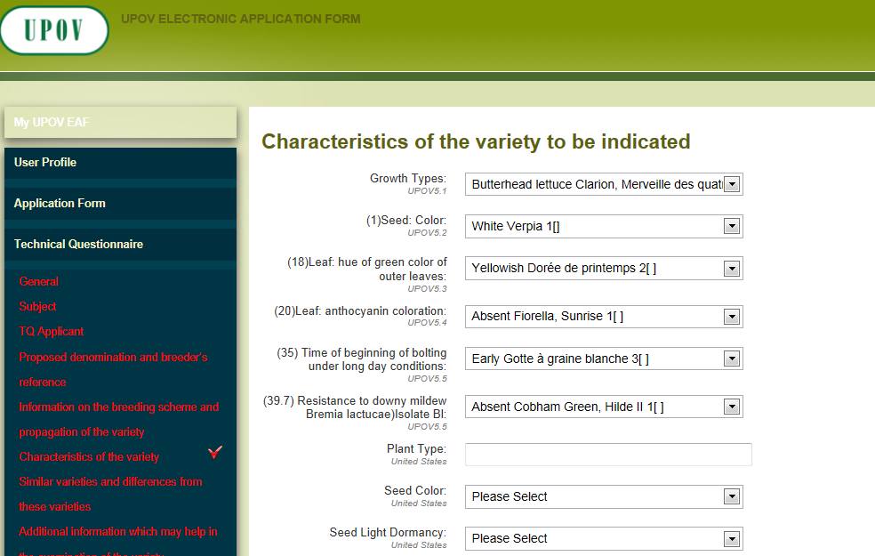
PVP CROP SPECIFIC QUESTIONS

Slide 23
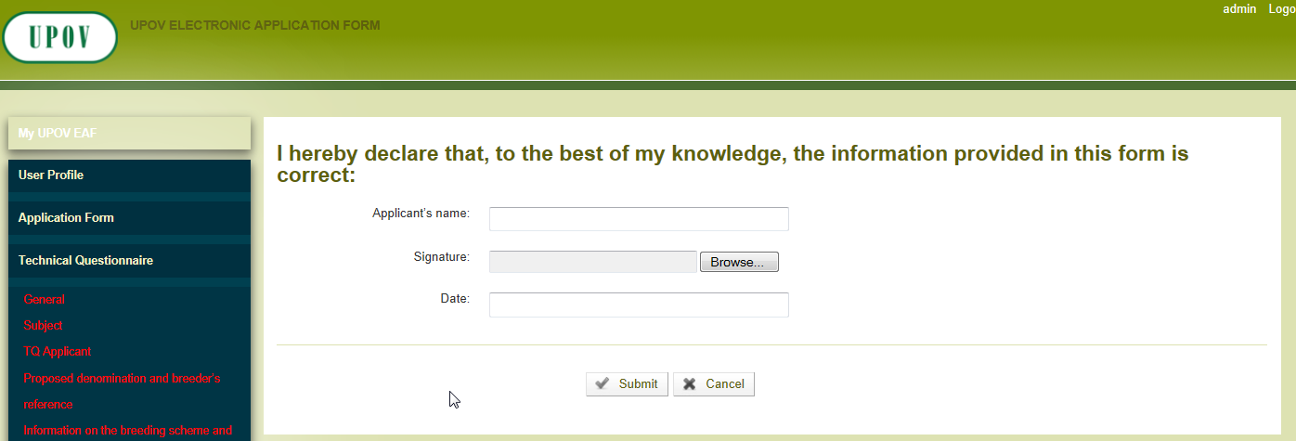
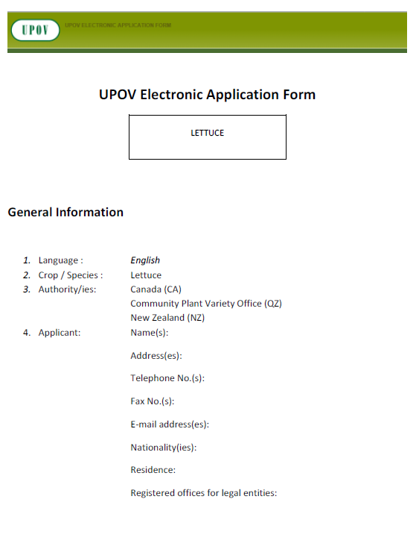

Slide 24
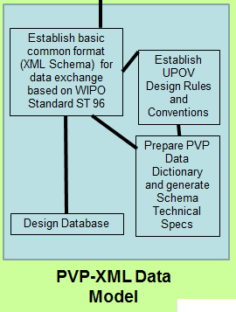
Data Model

Slide 25
Background
The Administrative and Legal Committee (CAJ) at its sixty-sixth session in Geneva on October 29, 2012, endorsed the development of a prototype electronic form for interested members of the Union and agreed that the key aspects of the prototype from the perspective of members of the Union would
be as follows (see document CAJ/66/8 “Report on the Conclusions”, paragraphs 22 and 23):
Form Content: […]
Status: […]
Languages: […]
Crops/species: […]
Partners:[…]
Data format: The UPOV electronic form would enable data to be transferred to participating members of the Union in Word, Excel, PDF or XML format. The participating members of the Union would decide in which format(s) to accept data. In the case of XML format, a standard format would be developed, based on WIPO standard ST.96.

Slide 26
Developments in 2014
At the 4th meeting on the development of a prototype electronic form, held in Geneva on October 14, 2014, it was noted that the PVP-XML Schema would, as far as possible, reuse and refer to relevant components of the WIPO Standard ST.96 (“common components”).
It was agreed that components which were not covered by the ST.96 standard would be described and developed on the basis of the ST.96 Annex I (Design Rules and conventions) and UPOV XML Design Rules and Conventions (DRCs).
It was agreed that the PVP-XML would be updated in line with ST.96, as appropriate; however, it was not planned for the PVP-XML to be prepared for adoption as a WIPO standard.

Slide 27



Data Model
PVP-XML and ST.96
PVP-XML

Slide 28
DRCs
Design rules
Schemas and XML instances
Naming conventions
Tag and file names
UPOV DRCs:
New Namespace for PVP components

Slide 29
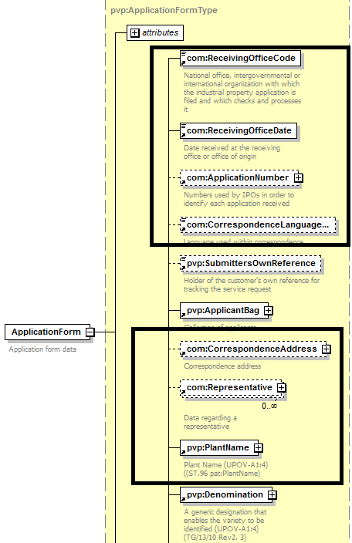
Use of ST.96 Components without modification

Slide 30
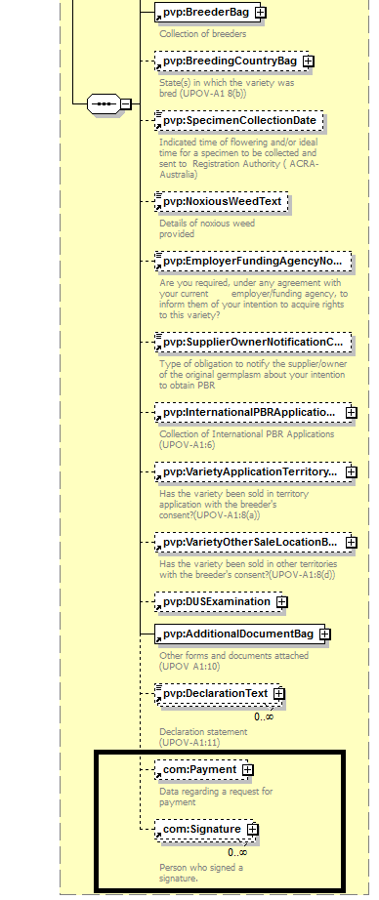
Use of ST.96 Components without modification

Slide 31
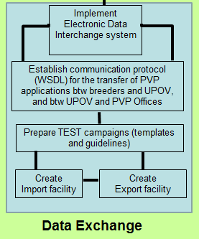
Data Exchange

Slide 32







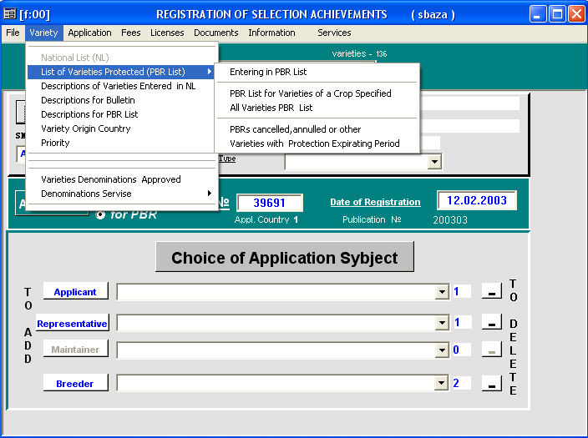
Application e-filing tools
IMPORT
Web Service
EXPORT
Web Service
PVP Offices internal
tools
Breeders
Online form
Bulk upload
PVP-XML
PVP-XML
FTP
Job scheduler
+
PVP-XML
DATABASE
PVP
Offices
e.g. DE
e.g US.
PVP-XML
PVP-XML
PVP-XML
PVP-XML
DATA SUBMISSION
APPLICATION

Slide 33
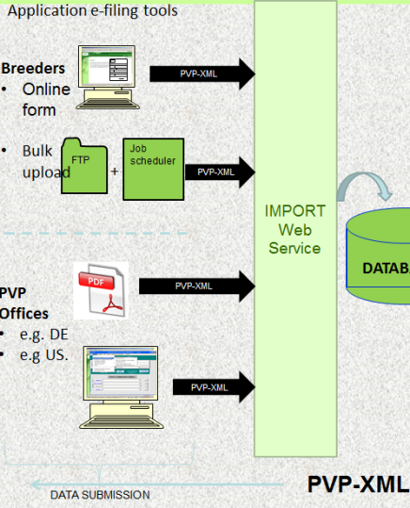
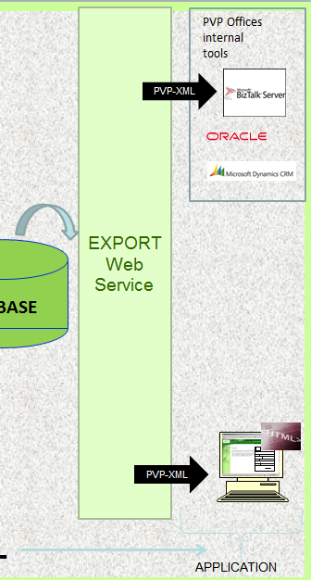
Data Exchange- Use Cases
Transfer of PVP applications between:
Breeders/Applicants and UPOV
Online submission using online form
Bulk upload
Dashboard: View and/or Edit applications
UPOV and PVP Offices
PVP Office system with import facility
PVP Office without import facility

Slide 34
Overview
Introduction to UPOV
Overview on the EAF project
Link with ST.96
Communication with stakeholders
Workplan and next steps

Slide 35


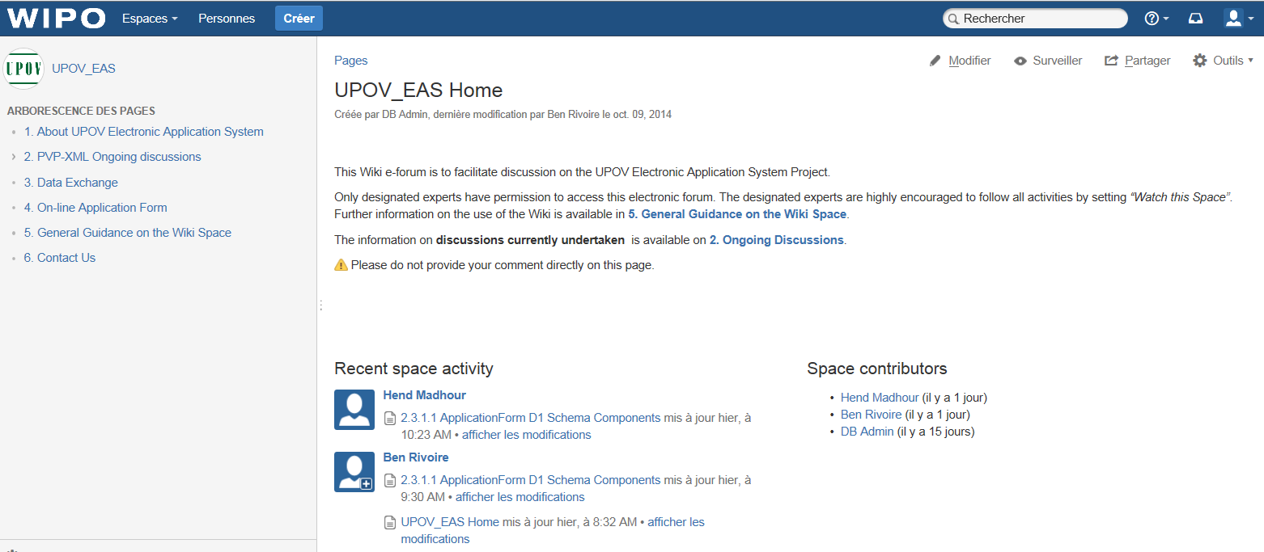
Wiki space UPOV_EAS

Slide 36
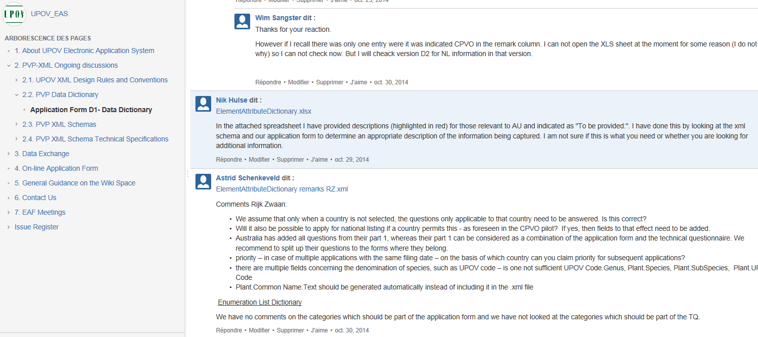

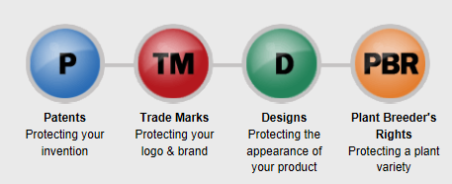
Wiki space UPOV_EAS

Slide 37
Overview
Introduction to UPOV
Overview on the EAF project
Link with ST.96
Communication with stakeholders
Work plan and next steps

Slide 38
Work plan and next steps
Agreement on the XML Schema
Test campaign/ Implementation
Data exchange
Development of the e-form and Validation by Users
Presentation of the prototype to the CAJ and Council
December 2014
February 2015
October 2015

