Slide 1
Women and IP
Fostering Women’s Innovativeness and Entrepreneurship - Good Practice from
the Polish Patent Office
Dr Alicja Adamczak
President of the Patent Office of the Republic of Poland
13 October 2015

Slide 2
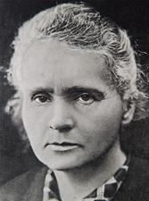
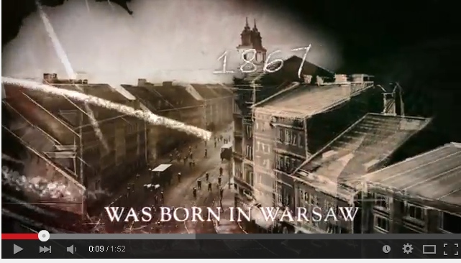
Maria Skłodowska-Curie – inspiration for innumerable women scientists
best-known female scientist of all time;
two-time Nobel Prize winner;
first female student at the Paris-Sorbonne University;
first woman in Europe to receive her PhD in science;
first woman to win a Nobel Prize in Physics.
https://www.youtube.com/watch?v=oj8Py1UXs8Y

Slide 3
How can we accelerate the positive changes we witness?
6% increase in female employment in technological industry over last 5 years
11% increase in female employment in management boards over last 5 years
26% Management Board members are women
Panel Discussion on Women and Intellectual Property, Oct. 13, 2015

Slide 4


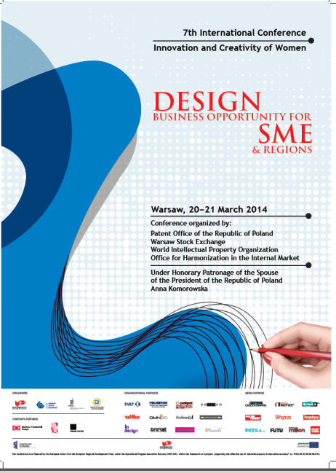


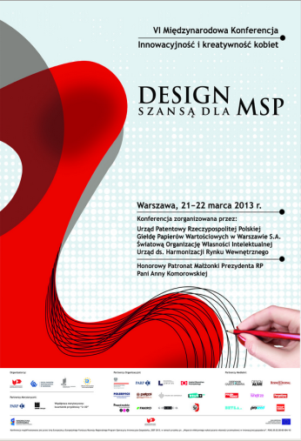
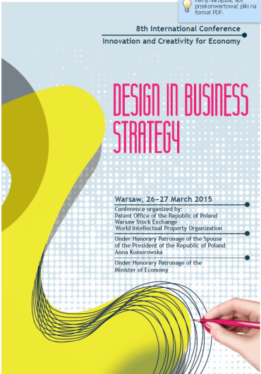

Examples of Good Practices from the PPO
Innovation and Creativity of Women in Science and Business for Economic Development
Annual international conference organized by the Polish Patent Office on women’s entrepreneurship and innovativeness. This well-established and developing initiative has been traditionally organized in cooperation with the World Intellectual Property Organization and has been each year declared by the participants and speakers to be a great success.
Panel Discussion on Women and Intellectual Property, Oct. 13, 2015

Slide 5



Examples of Initiatives Supported by the PPO
Organized since 2006 by the Perspektywy Education Foundation and the Conference of Rectors of Polish Technical Universities.
Over 70 000 girls have participated in the campaigns.
Each year in April Polish public technical universities and STEM (Science, Technology, Engineering, Mathematic) faculties invited to take part in an „National Open Day - For Girls Only”.
Girls as Engineers!
Girls go Science!
The main aim of “Girls as Engineers!” and “Girls go Science!” is to introduce technical and engineering studies to female high school students and to promote this educational path as interesting, satisfying and very beneficial in the long run.
“Girls as Engineers! ”and “Girls go Science ” have been very successful; the share of girls involved in the STEM education in Poland increased from 29% to 37%.
Polish Patent Office –
Partner of the Campaigns

Slide 6



Examples of Initiatives Supported by the PPO
The discussion panels during the 7th Congress of Women took place in the: Parenting, Education, Social, Spiritual, Public Speech, Health, Culture, Green and
Congress of Women
The largest civic movement in Poland;
Innovation and Entrepreneurship Centre
A movement that brings together women from all over Poland, irrespective of their views, origin, class, profession, and membership in parties, organisations, and background;
Area of cooperation
Dr. Alicja Adamczak,
President of the Polish Patent Office is a member of the Programme Board of the Congress of Women
The aim of all the Congress meetings is raising the consciousness, exchange of information about activities and problems of women in Poland, mutual support, community building, solidarity, formulation of proposals, lobbying, and the creation of mechanisms to achieve all of the above.

Slide 7


Examples of Initiatives Supported by the PPO
The aim of the contest is to find talented women scientists and to reward them for their incredible creativity and ideas.
The authors of innovative inventions are invited to present their solutions at the international trade fair iENA in Nuremberg.
The competition “Innovation is a Woman” has been organized for the fifth time by the Foundation Women of Science.
The conference aims at considering how to strengthen the empowerment of women in professional and social life, including how to support their self-esteem in order for them to carry out their tasks better and more effectively.
The aim is to provide a place where women can share their experience and thoughts.
„Innovation
is a Woman”
“Woman – Knowledge – Power”
Polish Patent Office –
Partner of the Initiatives

Slide 8
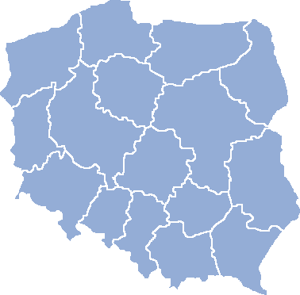
Variety of Bottom-up Initiatives in Poland
Woman’s Potential Survey
Objective of survey is an analysis of conditions relating to the choice of educational path by women as well as a diagnosis how facilitate activation and dynamisation of women’s potential for the technological industry.
Women’s Entrepreneurship Foundation/ Black Swan Fund
is a non profit organization dedicated to promote female entrepreneurship in Poland and support women who want to set up and grow their own businesses.
Women Leadership in Business Foundation
"For Women in Science" organised by L'Oréal Polska in collaboration with Polish Committee for UNESCO and the Ministry of Science and Higher Education
Best Woman Inventor
competition organized by the Association of Polish Inventors and Rationalizers and the periodical „Technical Review. Engineering Magazine”.
Lean in STEM! Project
The project offers several solutions supporting creation of a female networking culture in the technological industry and the STEM area. The objective of the project is promotion of technical and scientific education and career in the technological industry and other STEM-related areas among young women.
Competition "Girls of the Future - in the footsteps of Maria Skłodowska-Curie”
organized by the Ministry of Science and Higher Education and Elle magazine to award outstanding students in science, engineering, natural and medical sciences, who conduct their own research or work in research teams.

Slide 9
Are we there yet? - Recommendations
Being aware of stereotypes (unconscious bias)
Media and awareness raising
Knowledge aggregation
Women – leave your comfort zone!
Promoting diversity and social support for women especially in technology field
Role models in Public Policy
Promoting equal recruitment , equality in the workplace and fighting gender pay gap

Slide 10
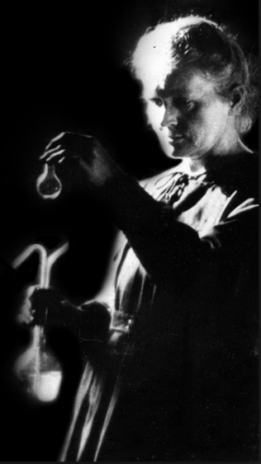
 We must have perseverance and above all confidence in ourselves. We must believe that we are gifted for something, and that this thing, at whatever cost, must be attained. .
Maria Skłodowska-Curie

Slide 11
Thank you for
your attention!

