Slide 1
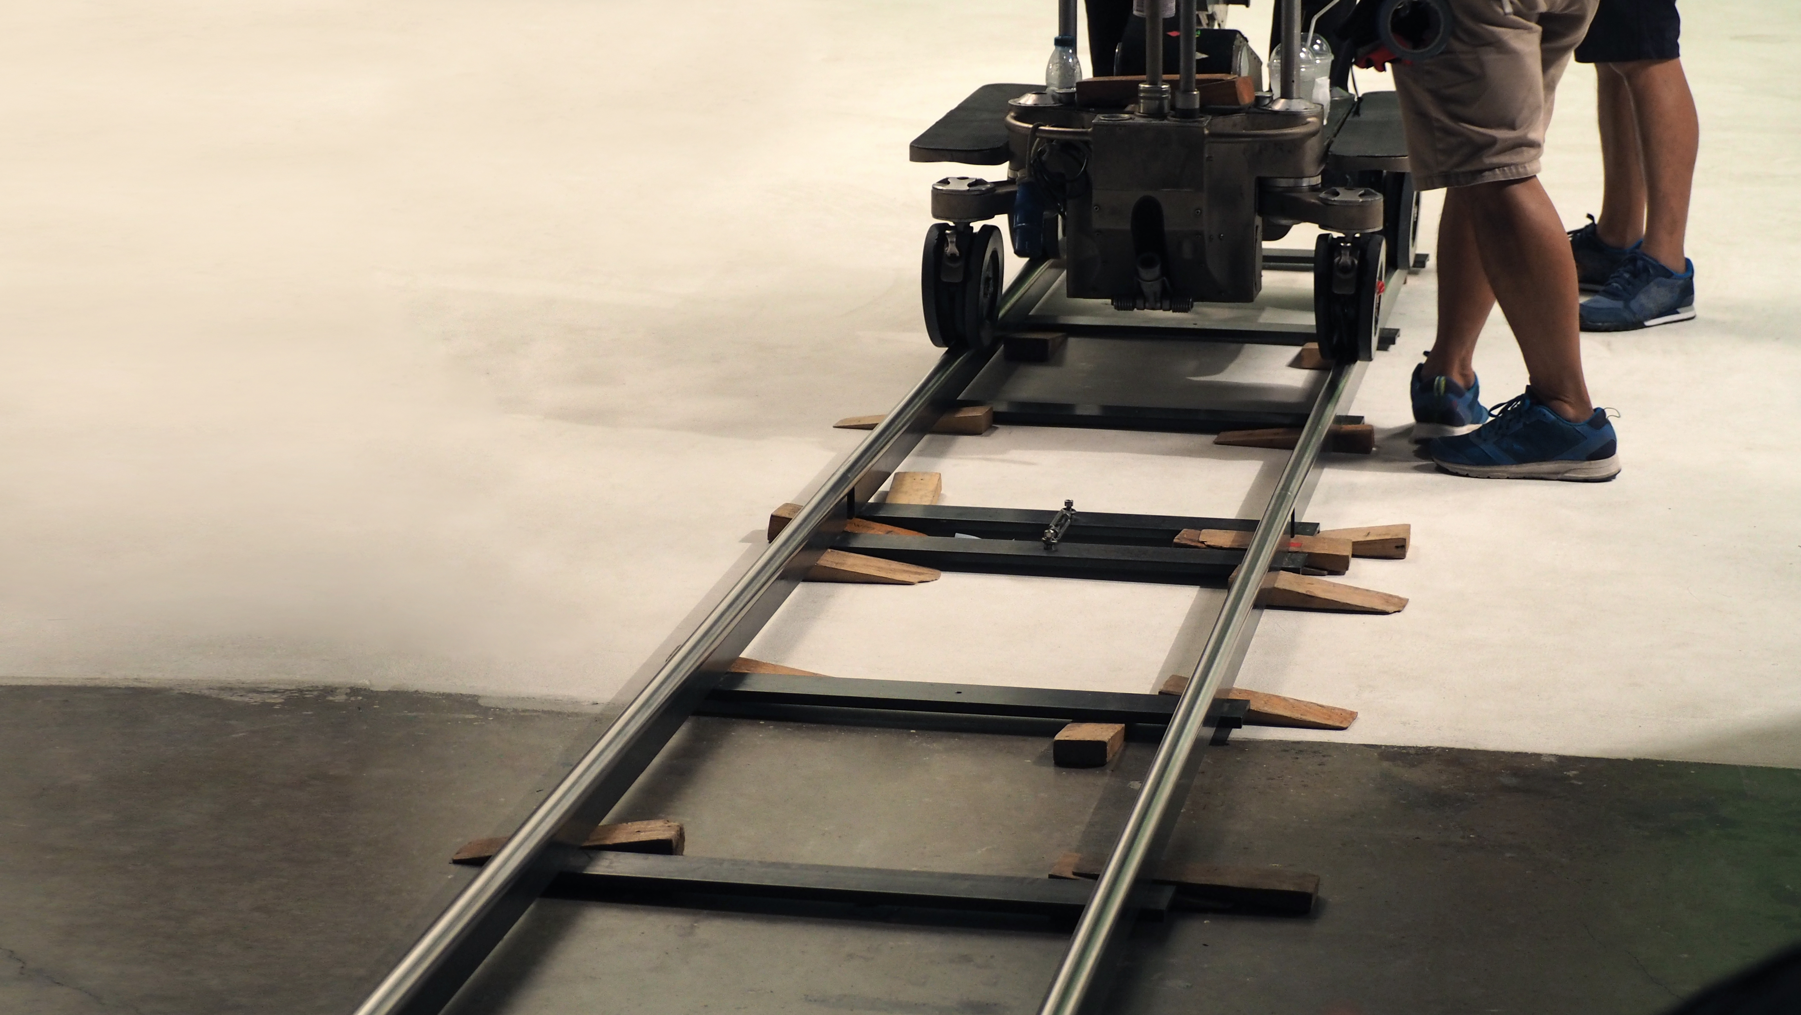
Rights, Camera, Action IP Rights and the film-making
process
Module 1
DEVELOPMENT

Slide 2
Development
Production
(inc. post-production)
Commercialisation
(Sales & Distribution)
The three basic stages in the life cycle of a film

Slide 3
Development
is the immersed part
of the time iceberg
Development time generally a multiple of
production time – can go from 6 months to
10 years +
Often complex an onerous – development involves acquiring
or licensing different sets of IP rights

Slide 4
The Stages of Development
1. Sourcing: Original idea – book, play, life story
News article, existing film or TV series, etc
2. Optioning and acquisition of rights in underlying works
3. Treatments, story outlines‘bibles’
draft screenplays, pitch decks
4. Attaching key cast and/or director
5. Budgeting, location scouting, pre-production

Slide 5
The OPTION AGREEMENT – a useful bridge to acquiring underlying right
In existing works (novels, plays, existing screenplays, etc)
You effectively pre-purchase at unit of time – e.g. typically 18 months with possibility to renew for a shorter period (e.g. 6 to 12 months)
And: you agree in advance future
rights acquisition price
In effect, it is an option and purchasing agreement
(and is often called this)

Slide 6
The Option Agreement – a real life case
An autobiography to be adapted into a film
US$6,500 for first 18 months option – sum is on account
Of final purchase price for rights to the book
Agreement that the company may extend for a further 12 months
For an additional US$10,000
Should company EXERCISE the option (buying the rights to the book)
The pre-agreed price will be 3% of the film’s final budget and no less
Than US$100,000
3% of 100% of the film’s net profits pledged to the authors, on a
most favoured nation basis with all the other profit participants
(companies and individuals)
Against these terms, the company would acquire all audiovisual rights
and ancillary rights. Radio adaptations and publishing rights were
Reserved by the authors
Company requested for its lawyers to check the author had full chain
of title (legal documentation evidencing ownership of rights transacted
In the option)

Slide 7
The Core of Development
Commissioning treatments, scripts, re-writes, polishes, etc

Slide 8
Droit d’auteur’ regime: Script writer and director (+ composer, etc)
are authors
e.g. French regime: Script writer is the co-author of the finished film - not just author/co-author of the screenplay
Economic rights vested in their person
Dispositions for the transfer of economic rights to the
Producer and his/her successor in chain of title
Moral right remains: unwaivable not transferable. Impact on contractual practice

Slide 9
Common law approaches: US ‘Work For Hire’ Doctrine
UK has writer as author but Copyright may vest in the
Producer when script is commissioned or written by
a person employed by her/him
Script writer assigns all rights to the screenplay against staged payments: 1st and second draft, re-writes, polishes, etc
Also: commencement of principal photography payments
Through sheer bargaining power writer’s agent may obtain additional terms
(e.g. share of net profits)
Writer may waive all moral rights in the screenplay by contract

Slide 10
End of Module 1 - Development

