Slide 1
Promoting gender equality in STEM:
UNESCO and the SAGA Project
WIPO General Assembly
4 October 2016
Ernesto Fernández Polcuch
Chief of Section, Science Policy and Partnerships
Natural Science Sector, UNESCO
e.Fernandez-Polcuch@unesco.org
@efpolcuch

Slide 2



Slide 3


Gender Equality: UNESCO Global Priority
Gender Equality is one of UNESCO's two global priorities, with a commitment to promote equality between women and men across the Organization's mandate. Gender Equality is not only a fundamental human right, but a necessary foundation for the creation of sustainable and peaceful societies.
The UNESCO Priority Gender Equality Action Plan 2014-2021 (GEAP II), provides an operational framework for the implementation of Priority Gender Equality. It explains what gender equality means for UNESCO, and provides guidance on how the Organization will ensure that a gender equality perspective is reflected in all its policies.

Slide 4

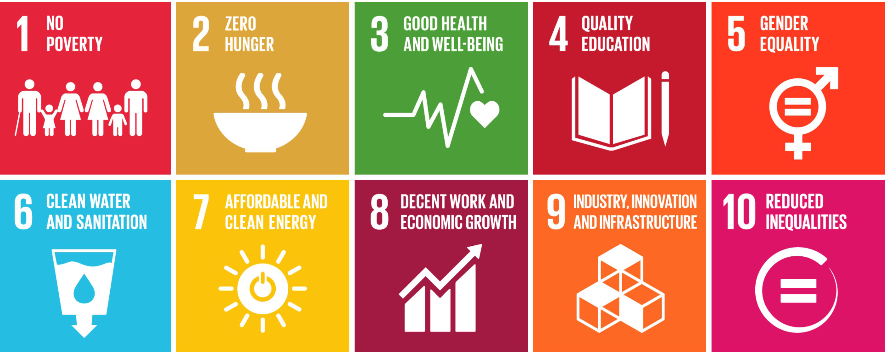

Women and girls in STEM
for achieving Sustainable Development
STEM plays a crucial role in meeting all the Sustainable Development Goals. So does gender equality.
Reducing inequality by attracting more women into STEM fields specifically will support, among others, the achievement of SDG targets 4.3, 5.5, 5.c, 9.5 and 17.18.
The lack of relevant data, standard methodology and guidelines to assess women’s participation and contribution in STEM obstructs the design, monitoring and evaluation of policies aimed at promoting gender equality in these fields.

Slide 5
Examples of UNESCO action towards Gender Equality in STEM
Promoting Role Models and raising awareness:
  UNESCO-L’Oreal For Women in Science Programme
Global monitoring of the status of women and girls in STEM:
  Collection and publication of statistics and analysis (UIS and UNESCO Science Report)
Supporting evidence-based policy making:
  Development of new indicators
  Collection and dissemination of policies and policy mechanisms

Slide 6

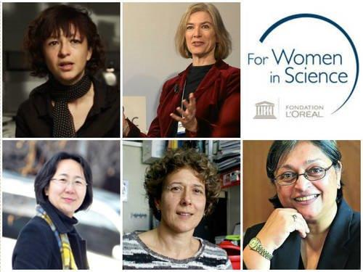
L’Oréal-UNESCO
For Women in Science Programme
Established in 1998, to
  Recognize women’s contribution to science and the scientific agenda
  Encourage more young women to take up science careers and promote careers of promising young women researchers

Slide 7

L’Oréal-UNESCO
For Women in Science Programme
Every year:
  5 Laureates – one per region
  15 International Rising Talents (until 2015 Intl. Fellowships)
  4 regional programmes - 19 Fellowships
  43 national programmes - 217 Fellowships
Up to now:
  92 laureates
  250 Fellowships given worldwide
  2530 promising young women scientists supported
  From 115 countries

Slide 8



Sign and promote the For Women in Science Manifesto!
http://www.fwis.fr/en/manifesto
We are committed to:
Inspiring interest in the sciences among the next generation of girls and young women.
Addressing the current barriers to the full participation of women in science so as to facilitate their engagement in long-term careers in research.
Promoting the advancement of women, as well as supporting women through the ranks to encourage their presence at the highest levels of research and decision making in science.
Raising awareness on the work of women scientists’ around the world, and celebrating their contributions to the advancement of science and society.
Ensuring equal opportunities for women’s participation and leadership in scientific symposia, panels, boards, networks, prizes and awards.
Acknowledging the importance of highlighting women scientists as role models for young girls and women.
Promoting mentoring opportunities for young women scientists, to help them with career planning and development so that they are better able to reach any level they aspire to.

Slide 9

UNESCO Science Report
Towards 2030
Chapter 3: Is the gender gap narrowing in science and engineering?
Sophia Huyer

Slide 10

UIS data visualisation

Slide 11
UNESCO eAtlas series and UIS database
Database: www.uis.unesco.org/datacentre/
UNESCO eAtlas of Gender Inequality in Education http://tellmaps.com/uis/gender/
UNESCO eAtlas of Research and Experimental Development http://www.tellmaps.com/uis/rd/

Slide 12
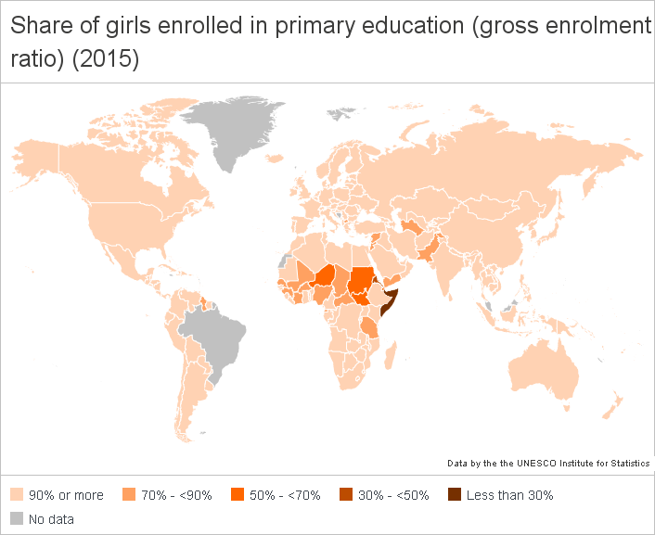
Share of girls in primary education
(gross enrolment ratio)
(2015)

Slide 13
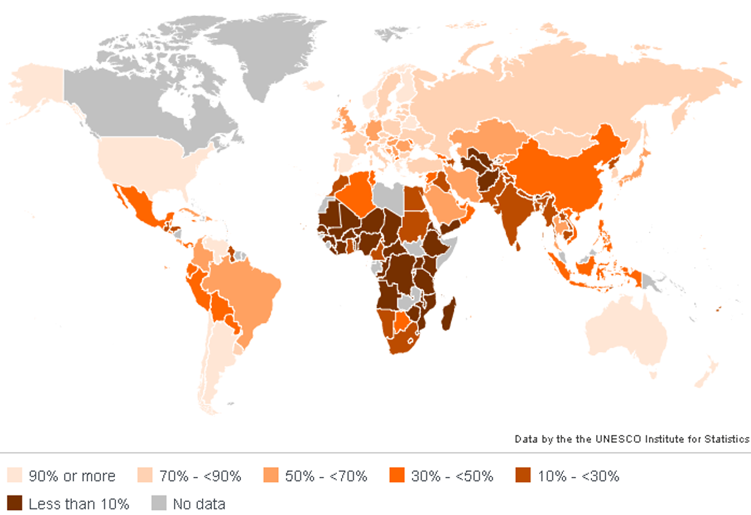
Share of women enrolled in tertiary education
(gross enrolment ratio)
(2015)

Slide 14
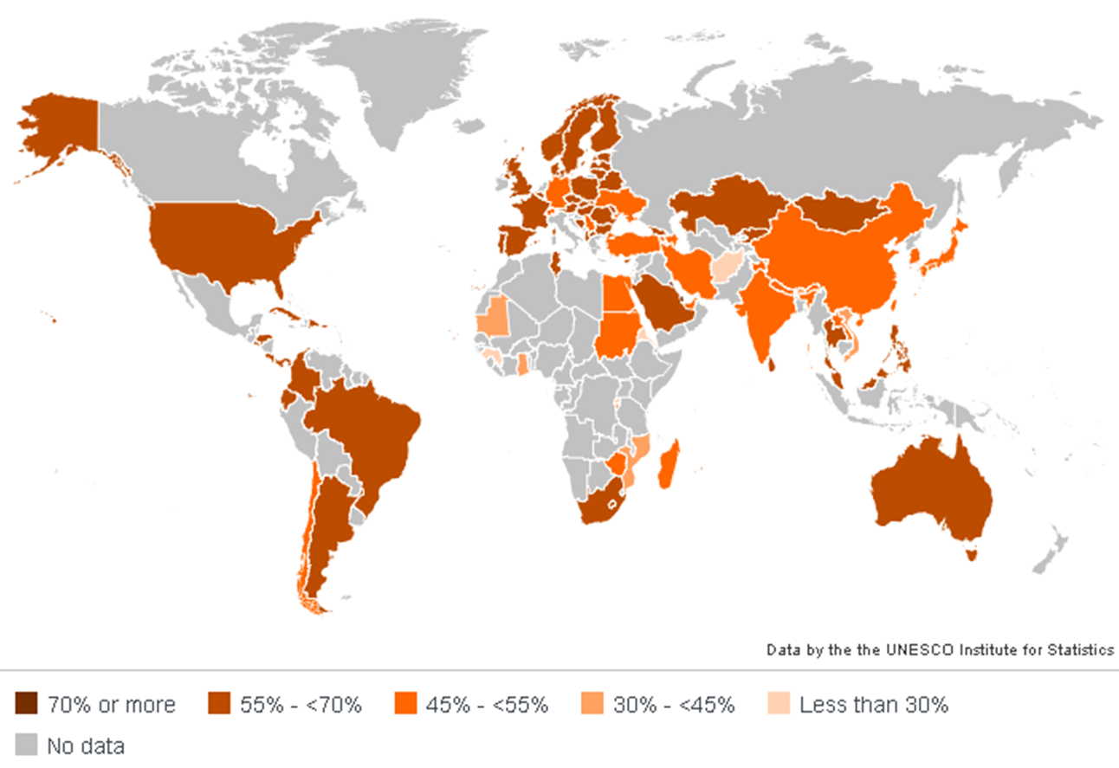
Share of female graduates from
Bachelor’s programmes
(2015)

Slide 15
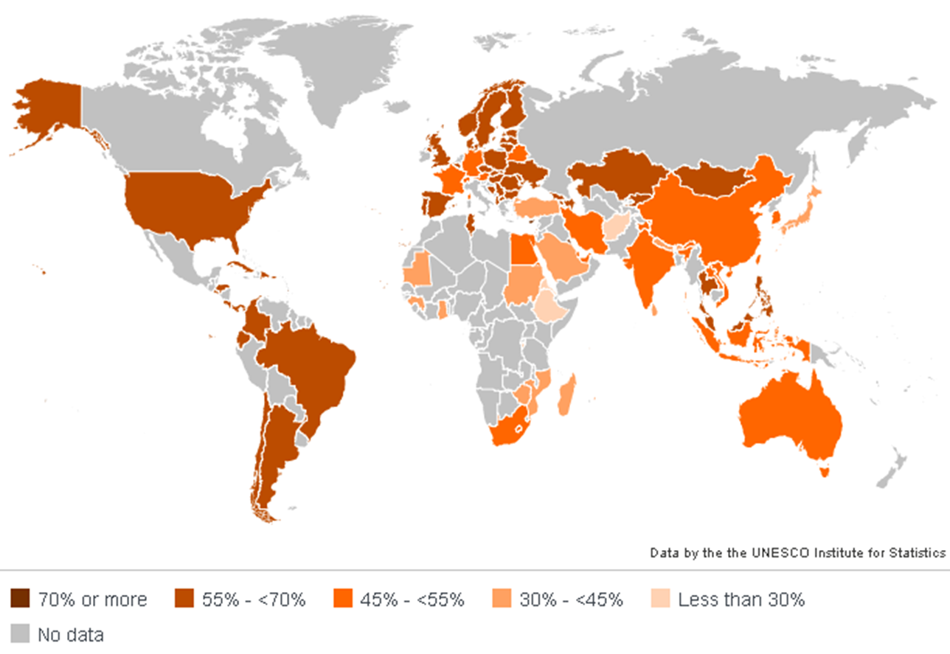
Share of female graduates from
Master’s programmes
(2015)

Slide 16
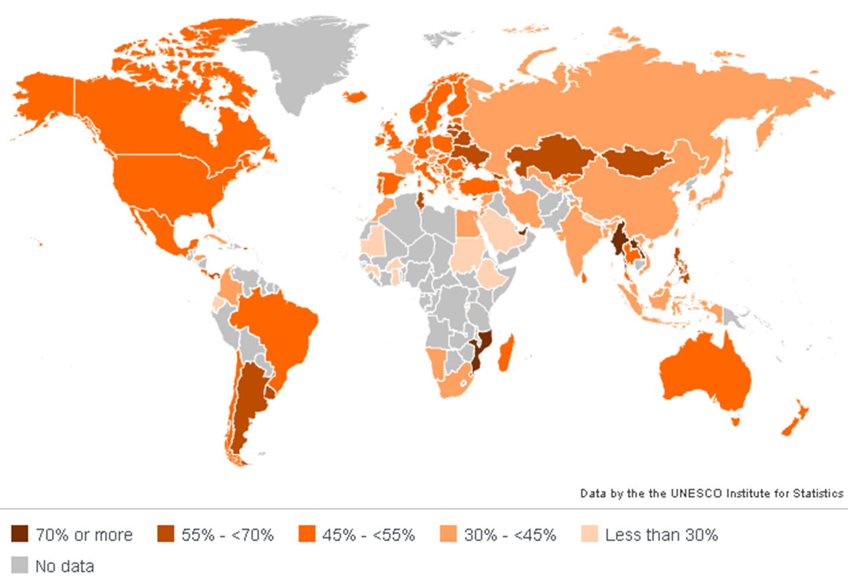
Share of graduates from PhD programmes
(2015)

Slide 17
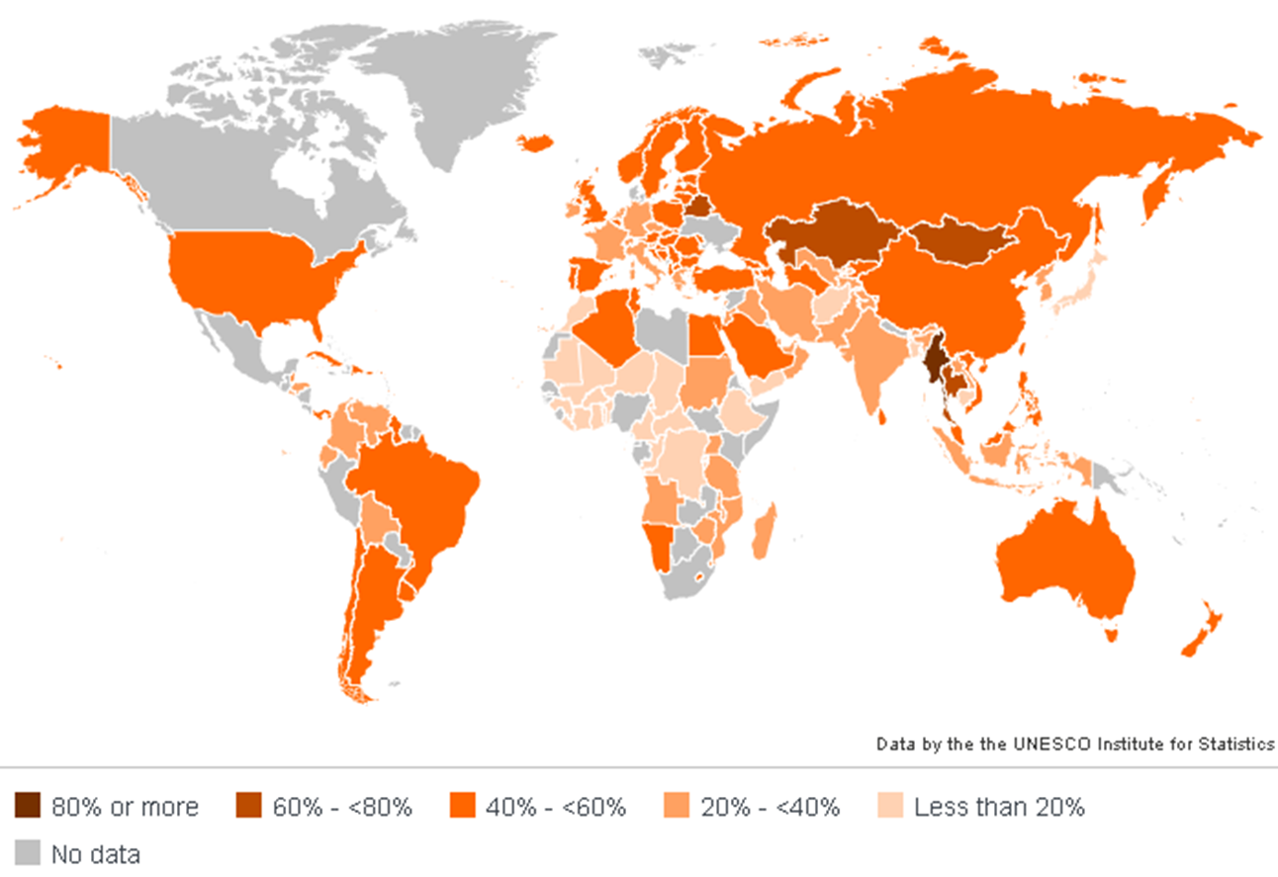
Share of female teachers in tertiary education
(2015)

Slide 18
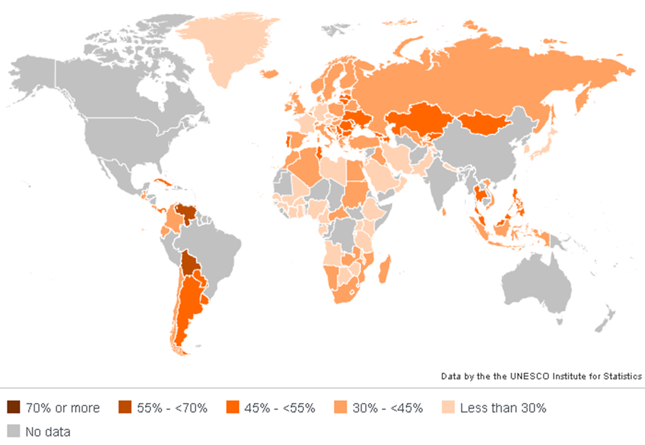
Share of women in total researchers
(2015)

Slide 19
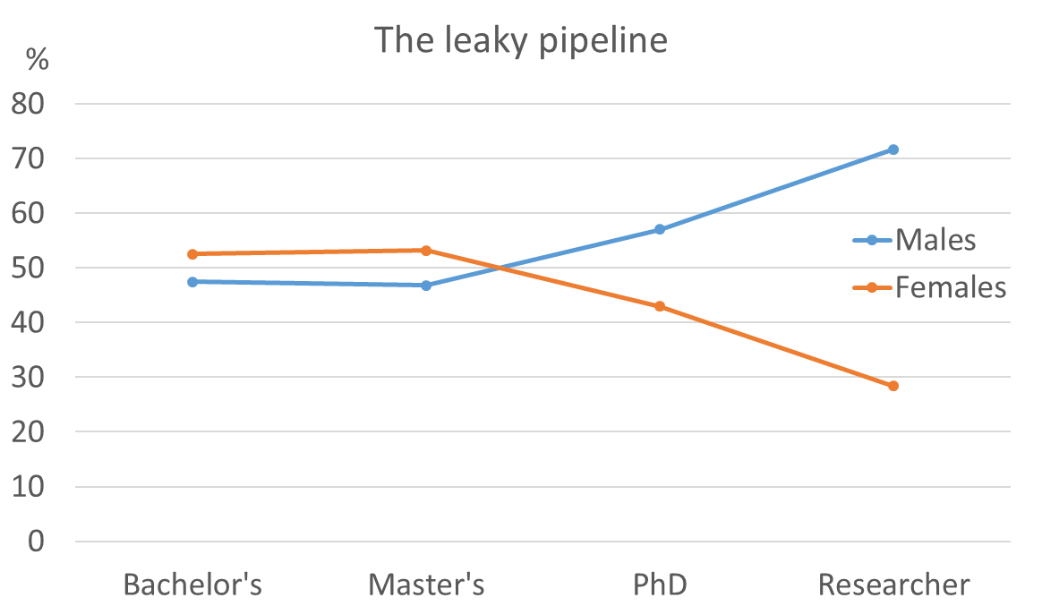
Women in Science
Notes: Higher education graduate data are for School Year 2013 or the latest year available since 2007. Researcher data are for the tear 2013 or the latest year available since 1997. Data reported by 116 countries (or territories) representing 79% of total population worldwide. Indian higher education data come from the All India Survey on Higher Education (2011-2012)
Source: UNESCO Institute for Statistics, June 2015

Slide 20
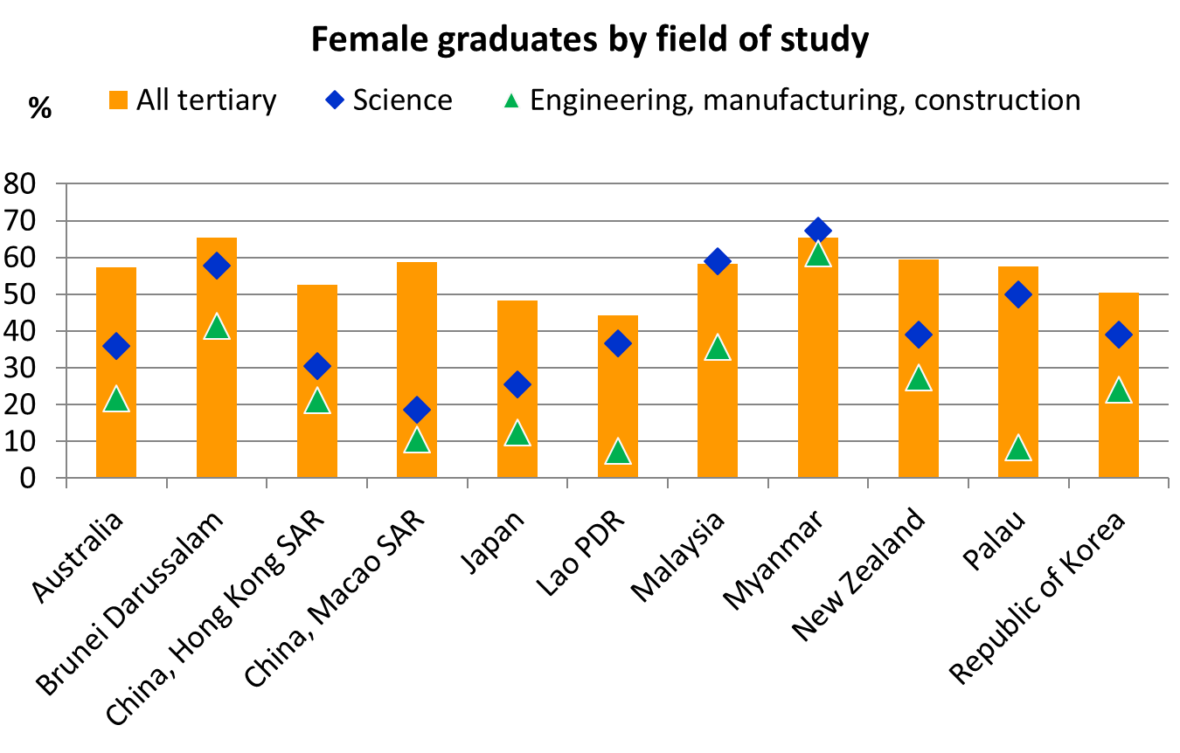
Field of study – example for EAP
Source: UNESCO Institute for Statistics, June 2015

Slide 21
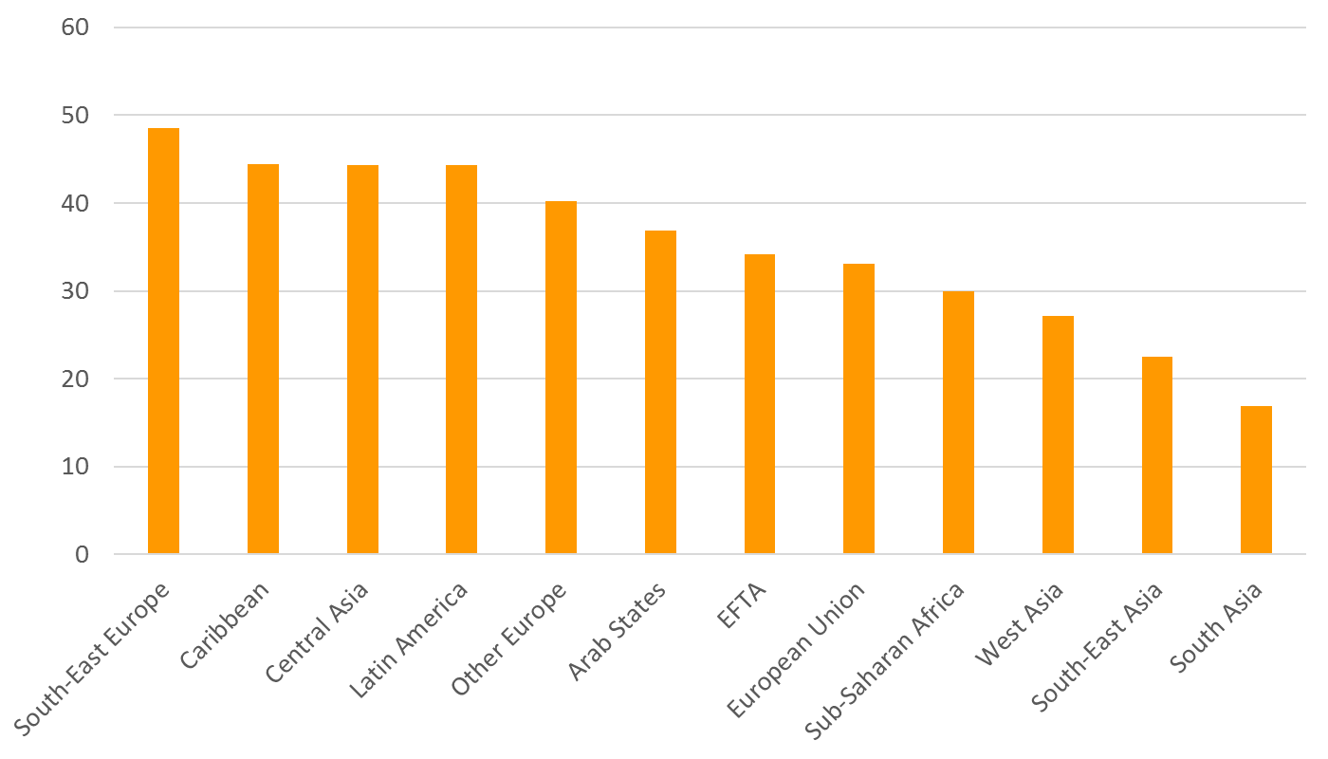
Female researchers by region (%)
Source: UNESCO Institute for Statistics, June 2015

Slide 22
Source: UNESCO Science Report, 2015

Slide 23

Key SDG targets 4.3, 5.5, 5.c, 9.5 & 17.18
4.3 By 2030, ensure equal access for all women and men to affordable and quality technical, vocational and tertiary education, including university
5.5 Ensure women’s full and effective participation and equal opportunities for leadership at all levels of decision-making in political, economic and public life
5.c Adopt and strengthen sound policies and enforceable legislation for the promotion of gender equality and the empowerment of all women and girls at all levels
9.5 Enhance scientific research, upgrade the technological capabilities of industrial sectors in all countries, in particular developing countries, including, by 2030, encouraging innovation and substantially increasing the number of research and development workers per 1 million people and public and private research and development spending
17.18 By 2020, enhance capacity-building support to developing countries, including for least developed countries and small island developing States, to increase significantly the availability of high-quality, timely and reliable data disaggregated by income, gender, age, race, ethnicity, migratory status, disability, geographic location and other characteristics relevant in national contexts

Slide 24
STEM and Gender Advancement (SAGA)
A global UNESCO project with the support of Sweden (Sida)
Objectives:
  Reduce the gender gap in scientific and engineering fields in all countries at all levels of education and research
  Analyse gender related policies and indicators and how they affect the gender balance in STEM
  Strengthen gender equality perspectives in science, technology and innovation (STI) policy design

Slide 25
Expected Results
Member States, UNESCO and others enabled to measure the status of women and girls in science using sound methodologies and tested indicators on gender equality in STEM and data included in the UIS database.
An updated inventory of policy instruments affecting gender equality in STEM incorporated into the Global Observatory on Science Technology and Innovation Policy Instruments (GO→SPIN).
A critical mass of officials in pilot countries trained to collect data.
Technical Papers, including a final one of proposed standard practices for surveys on gender policy instruments and indicators on STEM published.

Slide 26
SAGA Project implementation
Phase 1
2015-2016
Phase 2
2016-2017
Phase 3
2018
Research and development of critical tools and methodology
Manual and publications
Pilot Country activities

Slide 27
Means of implementation
Strengthen gender equality perspectives in science policy design
  Providing knowledge on how to achieve gender equality in STI, including the critical steps necessary to design better STI policies focused on gender equality from different angles
  Undertaking an inventory and gap analysis of policy instruments that affect gender equality in STI
Improve measurement of gender related indicators and how they affect the gender balance in STEM
  Developing new and better indicators to provide tools for evidence-based policy-making
Build capacity in Member States

Slide 28
Gender Equality in STI
POLICIES
SAGA STI GENDER OBJECTIVES LIST
(STI GOL)
Gender Equality in STEM
INDICATORS
SAGA TOOLKIT
SAGA CAPACITY BUILDING IN PILOT COUNTRIES

Slide 29
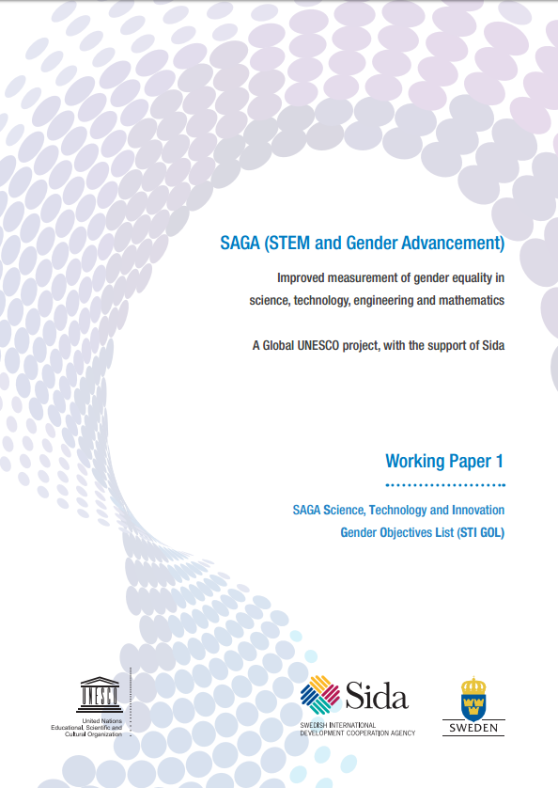
SAGA Science, Technology and Innovation
Gender Objectives List (STI GOL)
Enables the categorization of STI policies and policy instruments, and indicators.
Assists in identifying gaps in the STI policy mix and aims at encompassing all aspects of gender equality in STI policy making.
Aims at encompassing all aspects of gender equality in policy making, as identified through research conducted in the framework of SAGA.
Allows the mapping of existing indicators to gender objectives and facilitate identifying gaps.
http://unesdoc.unesco.org/images/0024/002450/245006E.pdf

Slide 30
7 Gender Objectives
Social norms and stereotypes
Primary and secondary education
Higher education
Career progression
Research content, practice
Policy-making
Entrepreneurship and
innovation

Slide 31
SAGA Gender Objectives
Change perceptions, attitudes, behaviour, social norms and stereotypes towards women in STEM in Society
Engage girls and young women in STEM primary and secondary education, as well as in TVET
Attraction, access to and retention of women in STEM higher education at all levels
Gender equality in career progression for scientists and engineers (S&E)
Promote the gender dimension in research content, practice and agenda
Promote gender equality in STEM-related policy-making
Promote gender equality in science and technology-based entrepreneurship and innovation activities

Slide 32
1 – Change perceptions, attitudes, behaviours, social norms and stereotypes towards women in STEM in society
1.1 – Promote awareness of and overcome non conscious and cultural gender biases widely expressed as gender stereotypes, among scientists, educators, policy-makers, research organizations, the media, and the public at large.
1.2 – Promote visibility of women with STEM qualifications, and in STEM careers, especially in leadership positions in governments, business enterprises, universities, and research organizations.
1.3 – Mainstream gender perspectives in science communication and informal and non-formal STEM education activities, including in science centres and museums.

Slide 33
2 – Engage girls and young women in STEM primary and secondary education, as well as in technical and vocational education and training
2.1 – Promote S&E vocations to girls and young women, including by stimulating interest, fostering in-depth knowledge about S&E career issues, and presenting role models.
2.2 – Mainstream the gender perspective in educational content (teacher training, curricula, pedagogical methods, and teaching material).
2.3 – Promote gender-sensitive pedagogical approaches to STEM teaching, including encouraging hands-on training and experiments.
2.4 – Promote gender balance among STEM teachers.
2.5 – Promote gender equality in STEM school-to-work transitions.

Slide 34
3 – Attraction, access to and retention of women in STEM higher education at all levels
3.1 – Promote access of and attract women to STEM higher education (including Masters and PhD), including through specific scholarships and awards.
3.2 – Prevent gender bias in the student admission process.
3.3 – Promote retention of women in STEM higher education at all levels, including through gender-sensitive mentoring, workshops and networks.
3.4 – Prevent gender-based discrimination and sexual harassment particularly at graduate level, including Masters and PhD.
3.5 – Promote gender equality in international mobility of students.
3.6 – Promote day care/child care facilities for students, particularly at STEM higher education institutions.

Slide 35
4 – Gender equality in career progression for scientists and engineers (S&E)
4.1 – Ensure gender equality in access to job opportunities, recruitment criteria and processes.
4.2 – Promote equal work conditions through, among others:
  Gender equality in remuneration
  Preventing gender bias in performance evaluation criteria (including productivity measurement)
  Adequate safety and security fieldwork
  Sexual harassment prevention policies and procedures.
4.3 – Ensure gender equality in access to opportunities in the workplace:
  Training and conferences
  Research teams, networks (national and international), expert panels and advisory groups
  Publications and patent applications
  Financial and non-financial incentives
  Recognition, rewards and awards.

Slide 36
4 – Gender equality in career progression for scientists and engineers (S&E) (2)
4.4 – Promote work-life balance through among others:
  infrastructure for child care
  flexible working hours
  reduction and redistribution of unpaid care and domestic care
  family leave for both parents
  appropriate re-entry mechanisms to the S&E workforce after career break or family leave.
4.5 – Promote gender equality in international mobility of post-docs and researchers, and facilitate women’s return.
4.6 – Promote gender balance in leadership positions in S&E occupations (including decision making and research).

Slide 37
4 – Gender equality in career progression for scientists and engineers (S&E) (3)
4.7 – Promote transformations of STI institutions and organizations (structure, governance, policies, norms and values) aimed at achieving gender equality.
4.8 – Ensure gender equality in S&E professional certifications, in particular engineering accreditation.

Slide 38
5 – Promote the gender dimension in research content, practice and agendas
5.1 – Establish specific gender-oriented R&D programmes, including research on gender in STEM and on the gender dimension of the country’s research agenda and portfolio.
5.2 – Incorporate gender dimensions into the evaluation of R&D projects.
5.3 – Promote gender-sensitive analysis in research hypotheses and consideration of sex of research subjects.
5.4 – Promote gender responsive and gender sensitive research dissemination and science communication, including through science centres and museums, science journalism, specific conferences, workshops, and publications.

Slide 39
6 – Promote gender equality in STEM-related policy-making
6.1 – Ensure gender balance in STEM-related policy design (decision makers, consultative committees, expert groups, etc.):
  Education policy
  Higher education policy
  STI policy
  Economic policy
  Workforce policy
  SDGs / international policies

Slide 40
6 – Promote gender equality in STEM-related policy-making
6.2 – Ensure gender mainstreaming and prioritization on gender equality in STEM-related policy design, monitoring and evaluation:
  Education policy
  Higher education policy
  STI policy
  Economic policy
  Workforce policy
  SDGs / international policies

Slide 41
7 – Promote gender equality in science and technology-based entrepreneurship and innovation activities
7.1 – Promote gender equality in access to seed capital, angel investors, venture capital, and similar start-up financing.
7.2 – Ensure equal access to public support for innovation for women-owned firms.
7.3 – Ensure visibility of women entrepreneurs as role models.
7.4 – Ensure women’s access to mentorship and participation in the design and implementation of gender-sensitive training in entrepreneurship, innovation management, and intellectual Property Rights.
7.5 – Promote networks of women entrepreneurs and women’s participation in entrepreneurship networks.

Slide 42
7 – Promote gender equality in science and technology-based entrepreneurship and innovation activities
7.6 – Promote gendered innovation approaches.
7.7 – Promote external incentives and recognition for women-led innovation and acceptance of women innovators in society.
7.8 – Promote gender equality in the access and use of enabling technology, in particular information and communication technology.
7.9 – Promote a gender balanced workforce and equal opportunities in start-up companies.

Slide 43
Instrument
STI GOL Level 2
STI GOL Level 1
Extension during pre- and postnatal period and parental permission
Medium term
4.4 Promote work-life balance through
Long term
4. Gender equality in career progression for scientists and engineers (S&E)

Slide 44
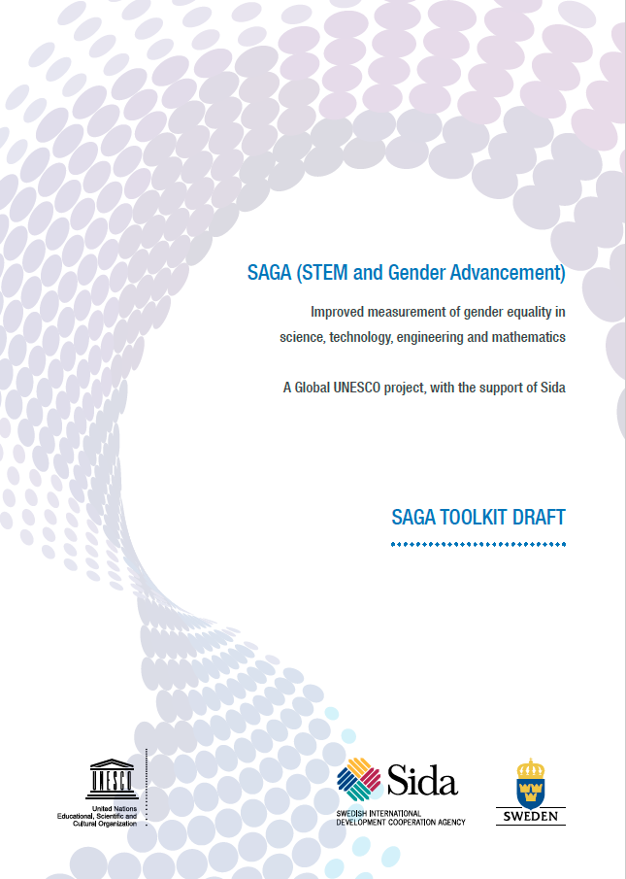
SAGA Toolkit
Provides countries with a set of instruments for improved measurement of gender in STEM and to support the design of better STI policies.
Provides practical tools to monitor and evaluate gender equality and to integrate gender aspects in STI policies in a field where solid information is still lacking and analysis is frequently based primarily on anecdotal evidence.
Establishes a new basis for evidence-based policy making, including impact assessment and policy design.

Slide 45
The SAGA Toolkit
Science, Technology and Innovation
Gender Objectives List (STI GOL)
SAGA Matrix
Policies
Survey of STI
Policies and Instruments
Indicators
Survey of Drivers and Barriers to Careers in Science and Engineering
Existing data

Slide 46
For whom is the Toolkit
All concerned with gender equality in STEM in education and S&E workforce, including:
  National governments
  Statistics offices
  National science foundations
  Policy-makers and decision-makers
  Research institutions
  Development agencies…

Slide 47
STEM population:
Definitions and classifications
STEM education
S&E workforce
Individuals with a formal education, training or professional experience in STEM, but not in an S&E job
Individuals with S&E job but without a formal education in STEM
Individuals with S&E job and formal education in STEM
International Standard Classification of Education (ISCED)
International Standard Classification of Occupation (ISCO)

Slide 48
SAGA Matrix
Tool to help linkages between STI gender objectives and indicators, using the STI GOL as an interface.
Each gender objective is matched with indicators to highlight the information needed for evidence in assessing gender-related STI policies.
  The information may already be existing but not used as evidence for policies
  It may be missing and ways of accessing the missing information are suggested.

Slide 49
SAGA Matrix
1. Change perceptions, attitudes, behaviours, social norms and stereotypes towards women in STEM in society
Objectives |  | Policies and instruments | Indicators | Data Sources
1.1 | Promote awareness of and overcome non conscious and cultural gender biases widely expressed as gender stereotypes, among scientists, educators, policy-makers, research organizations, the media, and the public at large. | National Award for Innovation in Guatemala (unofficial translation) | Demographic distribution of scientists, educators, policy-makers, research organizations, media, public at large in all communication strategies related to STEM | Databases of scientists Administrative data from Ministry of Education Polls and surveys of public opinion Survey of Drivers and Barriers to Careers in S&E Module Attitudes and social norms

Slide 50
SAGA Instruments
Survey of Science, Technology and Innovation Policies and Instruments
The Survey of Drivers and Barriers to Careers in Science and Engineering
Guidelines and methodologies for existing sources of data:
  research and experimental development (R&D) surveys
  surveys of formal education
  researchers database…

Slide 51
Survey of Science, Technology and
Innovation Policies and Instruments
The survey collects information on different facets of STI policies, such as the legal and institutional framework, the policies in place, and the decisions and actions taken to promote, regulate and use STI.
Follows the conceptual approach and methodology of the UNESCO Global Observatory of Science, Technology and Innovation Policy Instruments (GO-SPIN).
Helps policy-makers, policy analysts and scholars to cluster policies, detect flaws in the policy mix, and establish an agenda for filling the gaps.

Slide 52
Survey of Drivers and Barriers to
Careers in Science and Engineering
Addresses the lack of knowledge by providing the tools to better understand the drivers and barriers to S&E careers and address gender equality in STEM.
Developed closely in conjunction with the STI GOL to assist in the collection of information on drivers and barriers to careers in science and engineering (S&E).
Notes:
The information currently available on progress from tertiary education in STEM to the S&E workforce shows an important loss of women in the transition. Various reasons have been put forward to explain why women are not as present as men in the S&E workforce; these includes work-life balance, harassment and explicit and implicit discrimination. The STI GOL makes reference to many barriers, but also identifies drivers that encourage people, men and women, to enter an S&E career. However, there is not enough reliable evidence to assess the effects of these drivers and barriers on the access to, retention and the progress of men and women in S&E careers. This is largely explained by the important lack of appropriate tools to gather adequate information on this issue. As a matter of fact, to derive this kind of information, surveys need to be administered to people, which is more complicated and costly than conducting institutional surveys, or compiling the information from administrative systems.

Slide 53
Survey of Drivers and Barriers to Careers in Science and Engineering
Includes modules on the following themes:
Education experience
Postdoctoral experience
Transition to workforce
Workforce experience
Recognition and awards
Work-life balance
Time use
Career breaks
Work policies
Discrimination and harassment
Attitudes and social norms
Role models
Funding
Respondent’s characteristics
Notes:
The survey consists of short modules on individual’s experiences from higher education to their transition and participation to the S&E workforce. In addition, the survey also covers all drivers and barriers highlighted in the STI GOL and ranging from the work environment, access to funding opportunities, professional recognition and awards, work-life balance experience, discrimination and harassment, role models, and attitudes and social norms on gender and science and engineering. These themes are divided in several modules to facilitate the customizing of the survey and to better address national priorities in STI policies. This underlines the versatility and ease of use of this survey to address specific gaps in knowledge to better understand gender imbalance in STEM.

Slide 54
Data Sources
Research and experimental development surveys
Surveys of formal education
CV and researchers databases
Academies and professional associations
Research funding agencies
Information on outputs such as bibliometrics and patents
Mobility surveys
Time use surveys
Surveys on holders of advanced qualifications
Notes:
For the majority of these sources, the simple addition of a variable or a greater precision on the classification would allows for better information.

Slide 55












SAGA Advisory Committee and Partners
SAGA

Slide 56
Sign and promote the For Women in Science Manifesto!
http://www.fwis.fr/en/manifesto
We are committed to:
Inspiring interest in the sciences among the next generation of girls and young women.
Addressing the current barriers to the full participation of women in science so as to facilitate their engagement in long-term careers in research.
Promoting the advancement of women, as well as supporting women through the ranks to encourage their presence at the highest levels of research and decision making in science.
Raising awareness on the work of women scientists’ around the world, and celebrating their contributions to the advancement of science and society.
Ensuring equal opportunities for women’s participation and leadership in scientific symposia, panels, boards, networks, prizes and awards.
Acknowledging the importance of highlighting women scientists as role models for young girls and women.
Promoting mentoring opportunities for young women scientists, to help them with career planning and development so that they are better able to reach any level they aspire to.

Slide 57
Be part of the change, be part of SAGA!

Slide 58
For more information:
SAGA@unesco.org
http://www.unesco.org/new/en/saga
Ernesto Fernández Polcuch
e.fernandez-polcuch@unesco.org
@efpolcuch

