Slide 1
Complex queries
Cyberworld
November
2014
Sandrine Ammann
Marketing & Communications Officer

Slide 2
Agenda
Latest developments
Complex queries
Search syntax
Field code
Examples
CLIR
“Wrap-up” example
Q&A session

Slide 4
New collection: Germany

Slide 5
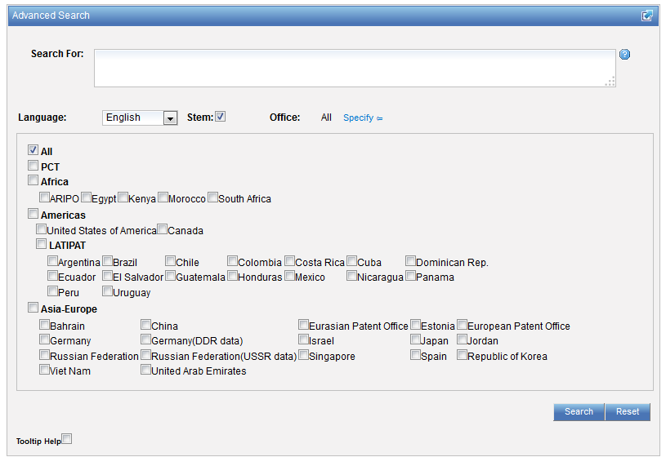

Slide 6
PATENTSCOPE account

Slide 7
COMPLEX QUERIES

Slide 8
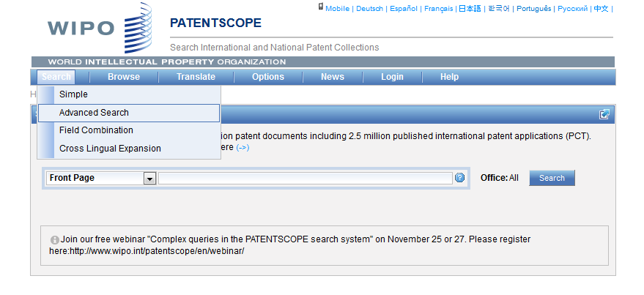
Advanced search interface

Slide 9
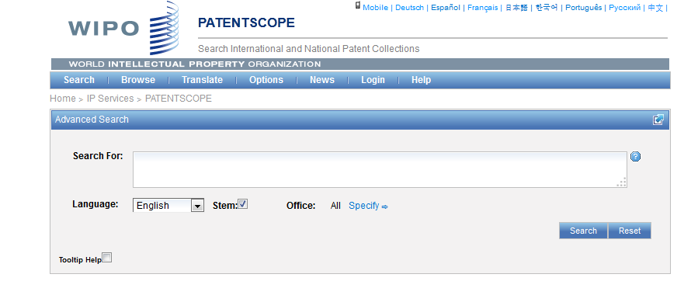
Help

Slide 10
Tooltip help

Slide 11
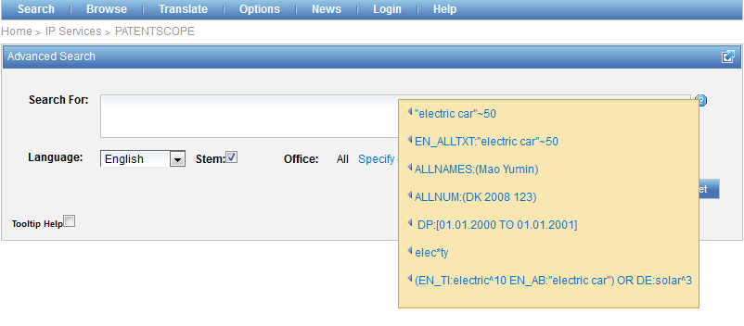
Question mark help

Slide 12
Advanced search interface

Slide 13
Stem
Stem = stemming
Process that removes common endings from words.
critical critically criticism each word is reduced to ‘critic’
criticisms critics

Slide 14
Stemming
no dictionary includes the necessary technical terms to express patent concepts
Porter Stemming Algorithm finds words that contain common roots
Save time and effort

Slide 15
Stemming - example
Results: 308,082

Slide 16
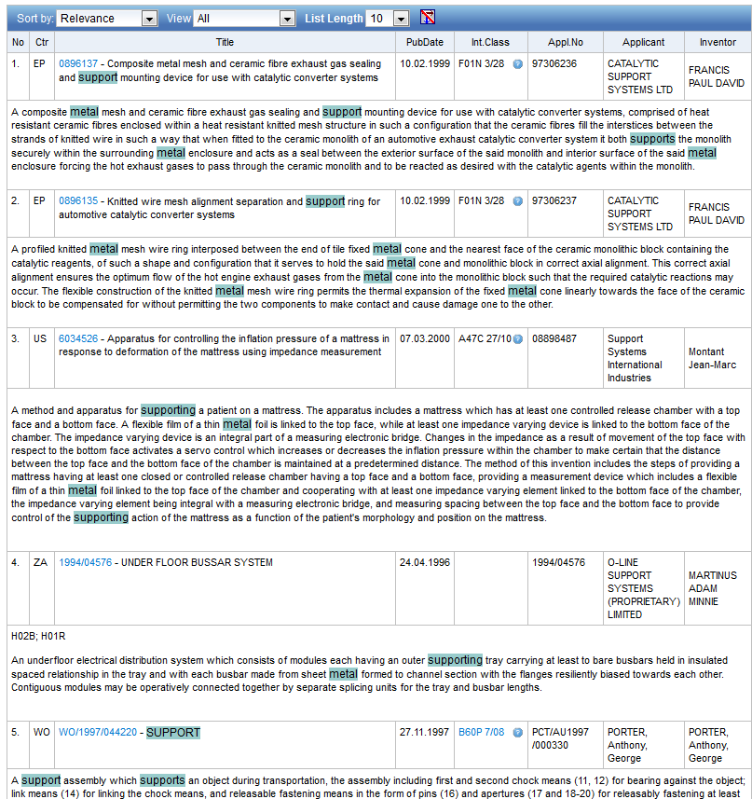

Slide 17
Stemming - example
Results: 172,233

Slide 18
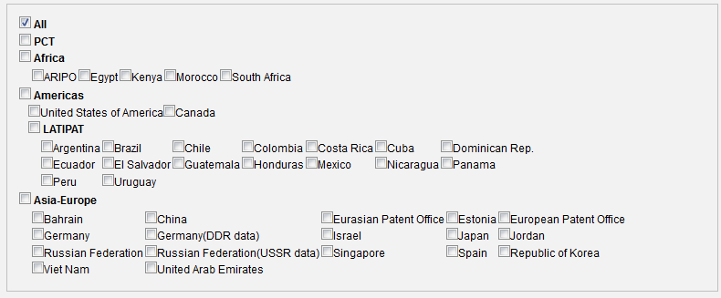
Advanced search interface

Slide 19
Advanced search interface
Search syntax
Search fields

Slide 20
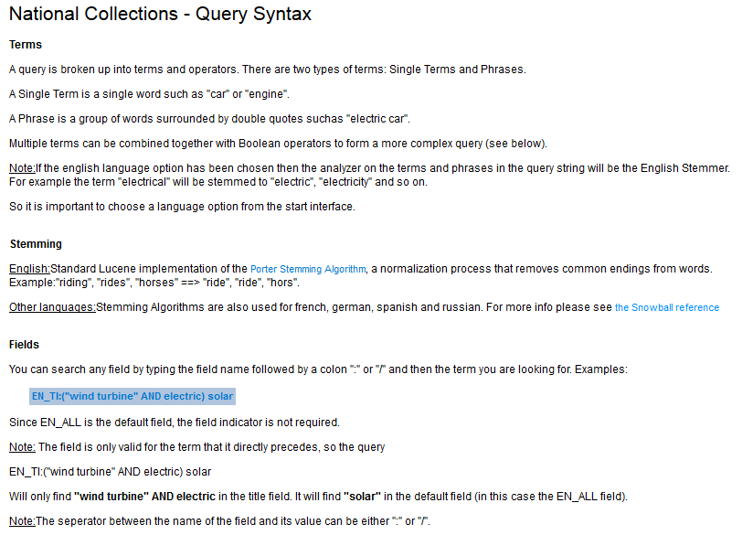
Search syntax

Slide 21
Wildcards – truncation: ? *
plural form of a word, or alternative spellings
* stands for 0 or more characters
? stands single character
te?t = test or text
electric* = electrical; electricity
behavi*r = behaviour or behavior
micro?p* = microspeaker, microsporidial

Slide 22
Boolean operators
Boolean operators define the relationships between words or groups of words.
AND
OR
ANDNOT - NOT

Slide 23
Proximity: NEAR = ~5
cell NEAR10 pack = «cell pack»~10

Slide 24
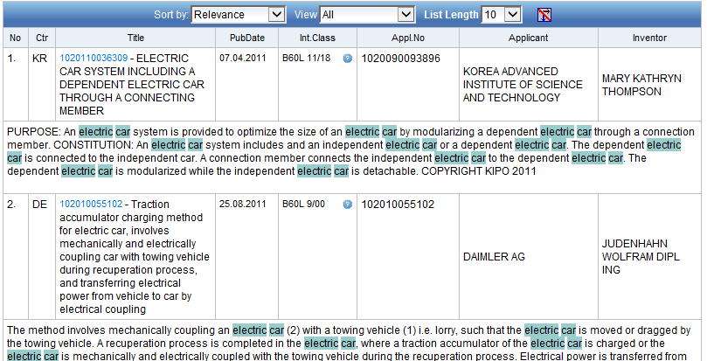
Proximity: before
EN_AB:(electric BEFORE car)

Slide 25
Fuzzy searches
Use of the tilde: ~
Examples:
roam~ foam / roams
Roam~0.8
Notes:
Smilar in spelling

Slide 26
Grouping/nesting
Solar OR (wind AND turbine)
(solar OR wind) AND turbine
EN_TI: electric car
electric will be searched in English title but car in all fields
EN_TI: (electric car)
Both electric and car will be searched in the English title

Slide 27
Grouping/nesting
Not all combinations work:
(electric AND car) NEAR power X
power NEAR (electric AND car) X
power NEAR (vehicle OR car)
EN_AB: hearing NEAR aid X
EN_AB: (hearing NEAR aid)
Notes:
Composition rules of operators
Avoid ambiguity

Slide 28
Date search
Range:
DP:[01.01.2000 TO 01.01.2001]
Can also be used to search non-date fields
IN: {Smith to Terence}

Slide 29
^ caret = weighting factor
Same result but ranking will be different
touch^3 AND polarize

Slide 30
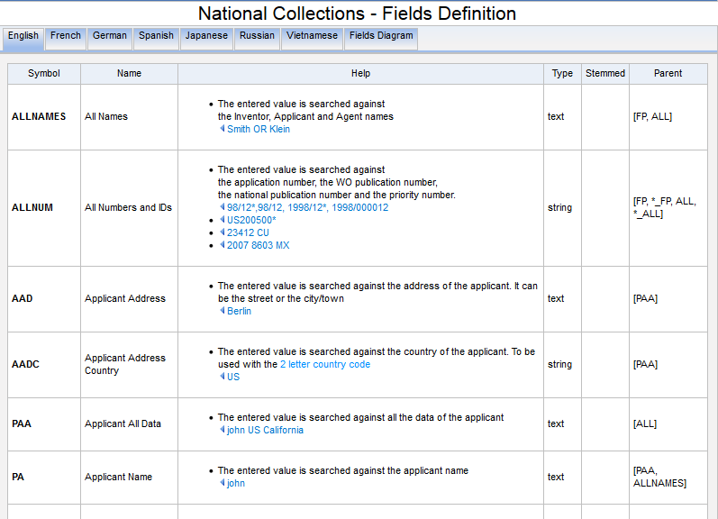
Search fields

Slide 31
Examples
FP = front page
ALL = all fields
ALL_NAMES = all names
IC = IPC
DP = publication date
CTR = country either WO or country from nat collection
NPCC= national phase entry
AN = origin of PCT
http://patentscope.wipo.int/search/en/help/fieldsHelp.jsf

Slide 32
Fields rules
Basic fields: elements of a patent document
Derived fields
2 letter code = individual field
EN_TI FR_AB ES_DE_S
Convention: language specified by 2 letters
if not specified all languages
S = stemmed
: to separate term without any space

Slide 33
Fields: golden rules
EN_ALL = default field field indicator not required
Field name followed by : ":" or "/"
The field is only valid for the term that it directly precedes, so the query:
EN_TI:("wind turbine" AND electric) solar
Results: "wind turbine" AND electric in the title field. "solar" in the default field (EN_ALL ).

Slide 34
Date search
Simple:
DP:01.02.2000
DP:20000201
DP:02.2000
DP:200002
DP:2000

Slide 35
Example: IPC
IC :A
IC :A47
IC :A47L
IC :A47L1
IC:A47L11
IC:A47L11/03

Slide 36
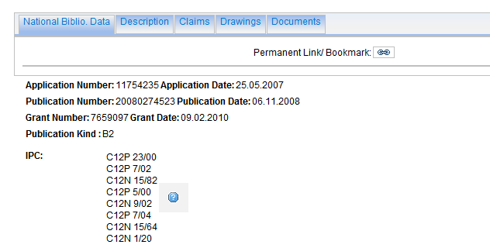
Example: grant

Slide 37
Example: grant

Slide 38
Example: licensing + 3rd party observation

Slide 39
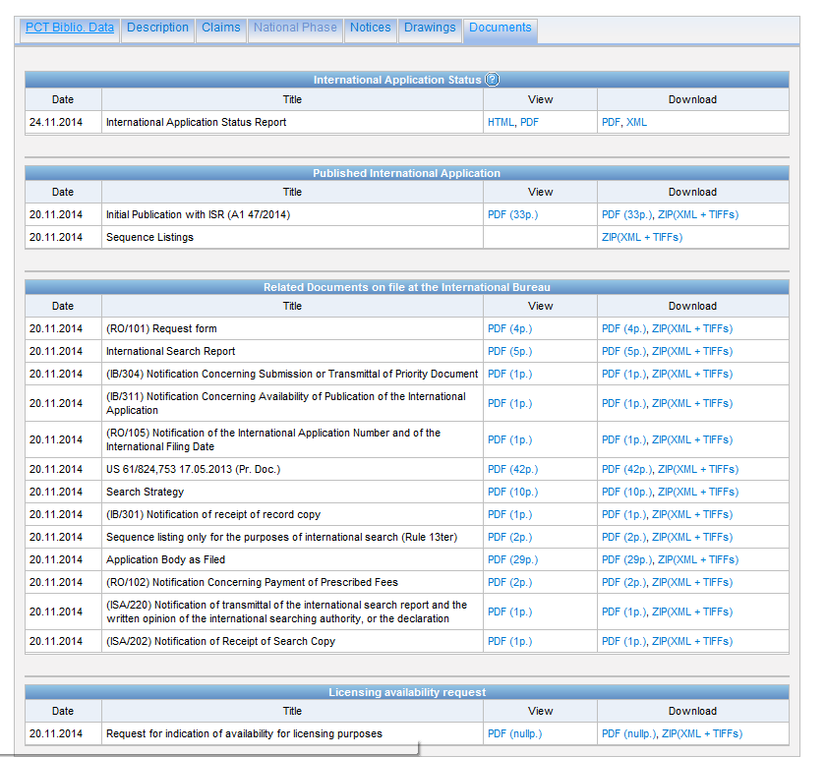

Slide 40
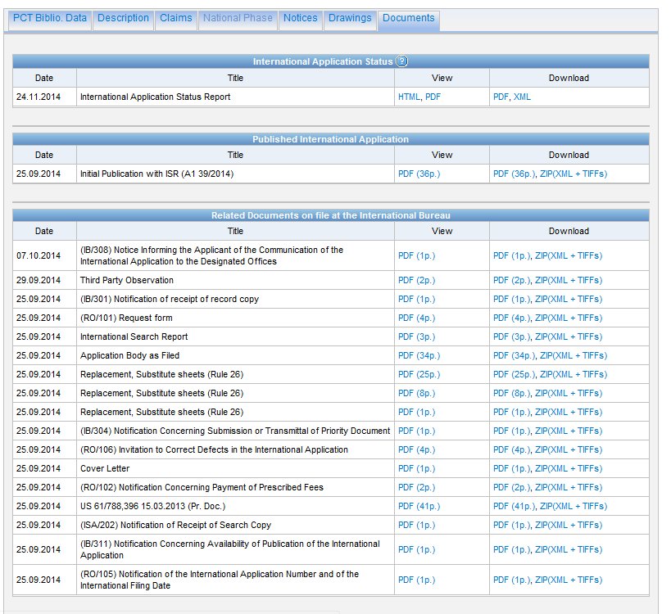

Slide 41
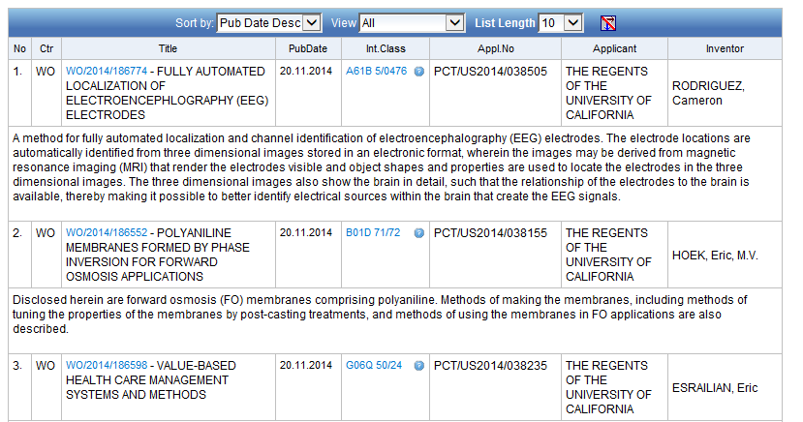
Example: last pub + applicant

Slide 42
Example: national phase entry
All applications that entered national phase in China in 2012

Slide 43
Searching with CLIR
Synonyms
Translation into 12 languages

Slide 44
How to search using CLIR - example

Slide 45
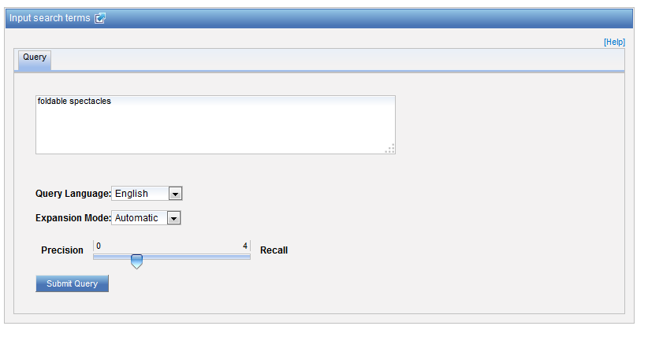
Example – automatic mode

Slide 47
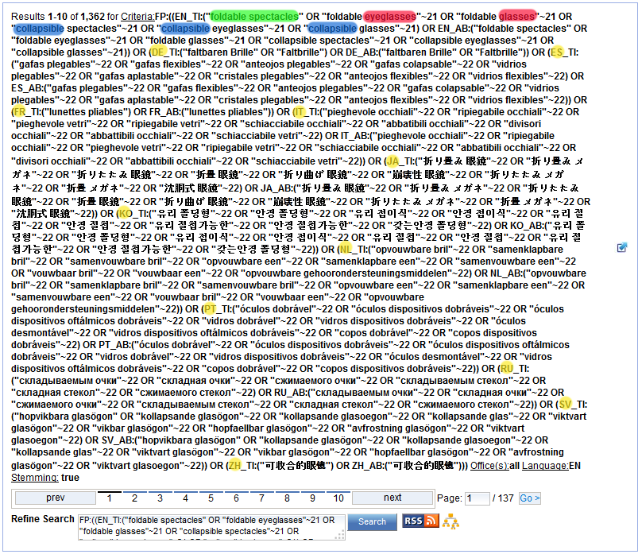
Result

Slide 48
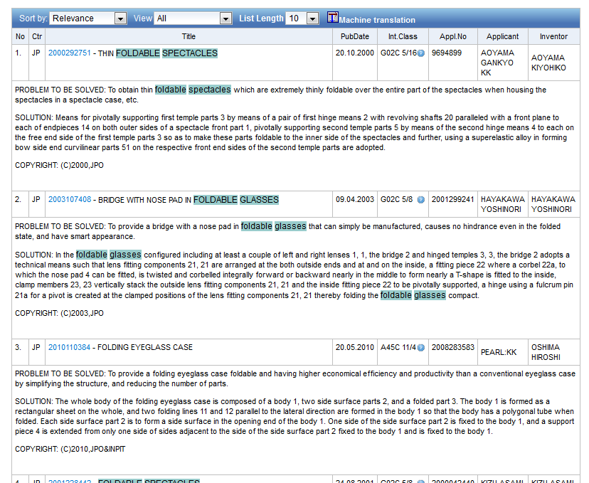

Slide 49
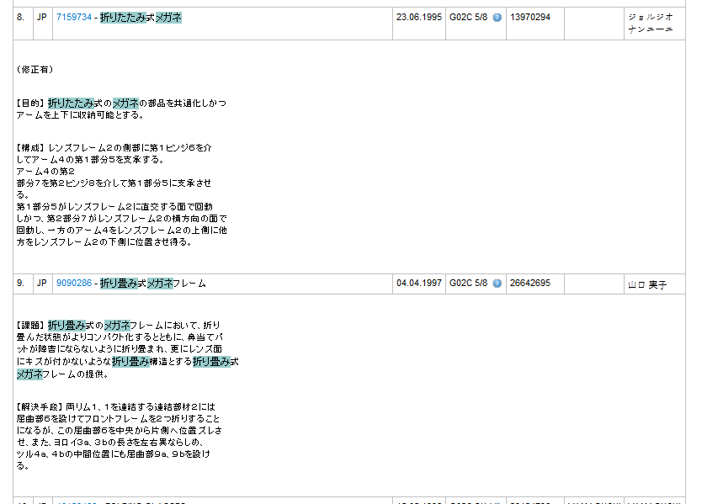

Slide 51
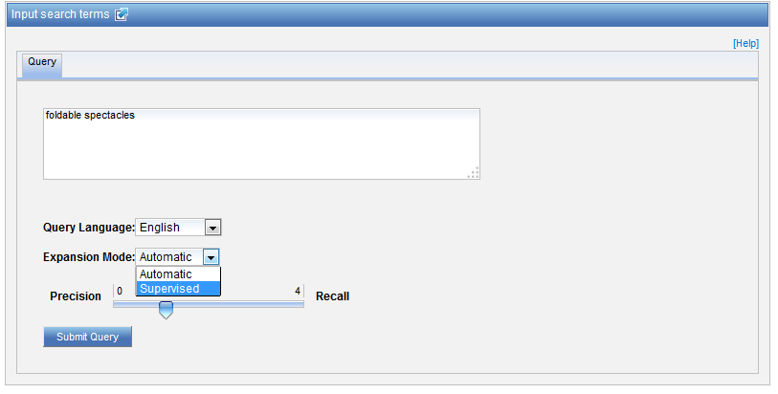
Example - supervised

Slide 52
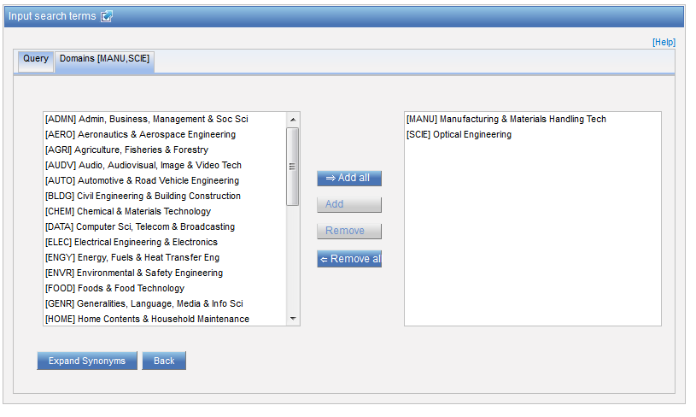
Technical fields

Slide 53
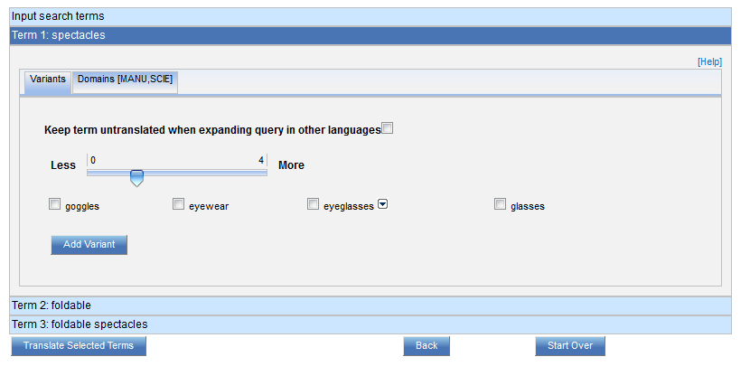
Variants

Slide 54
Translations

Slide 55
Check and edit in Google Translate
EDIT

Slide 56
Checking: IPC

Slide 57
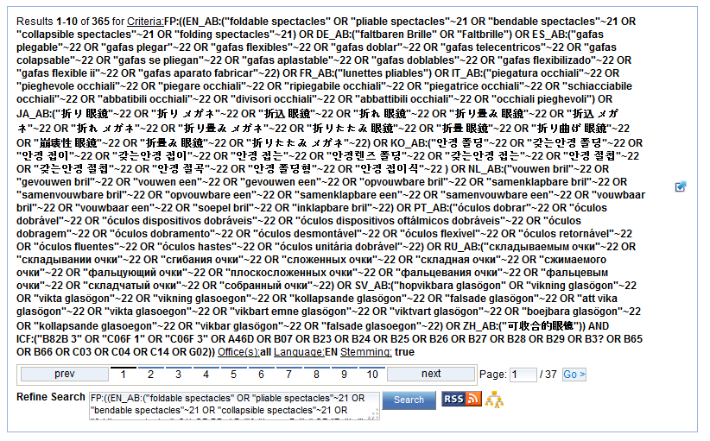

Slide 58
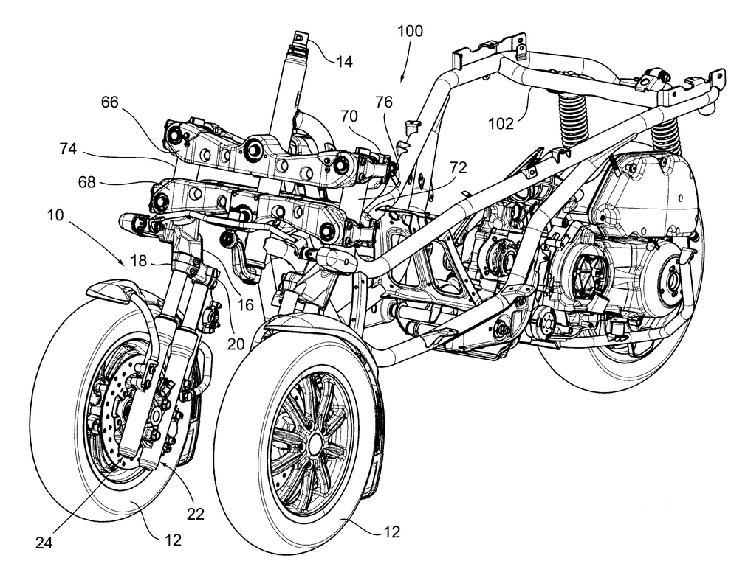
How to search Chinese full text data?

Slide 59
Step 1: Define the search strategy
CTR:CN Chinese collection
IC:B62 high level IPC for road vehicles
ZH_DE: (+twoFrontWheels AND +motorcycle)
for the two concepts to be translated using CLIR

Slide 60
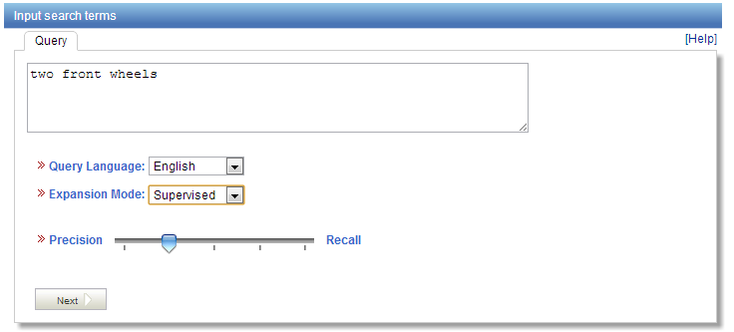
Step 2: use PATENTSCOPE CLIR

Slide 61
Step 3: Assembling the query
(b) Replace the concepts +twoFrontWheels and +motorcycle by the Chinese CLIR subqueries:
ZH_DE: ((( "具有双前轮" ) OR (( "两个" OR "联体" OR "式二" OR "双重" ) NEAR1 "前轮" ) OR ((( "两个" OR "联体" OR "式二" OR "双重" ) NEAR1 "前部") NEAR1 "车轮" ))
AND
("摩托车" OR "滑板车" OR "踏板车" OR "助力车" OR "滑行车" OR "机动车" OR "电动自行车" OR "助动车" OR "自行摩托车动力机" OR "两轮摩托车" OR "机动二轮车" OR "助动自行车" OR "辅助自行车" OR "跨乘式车辆"))

Slide 62
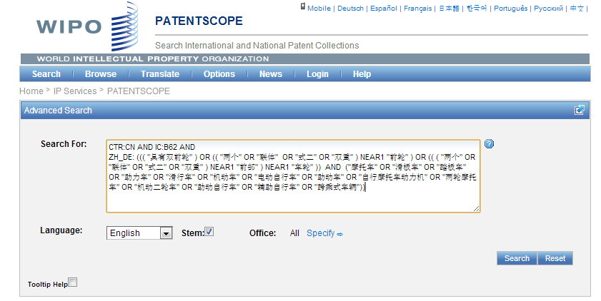
Step 4: Copy/paste your query in PATENTSCOPE to execute it

Slide 63
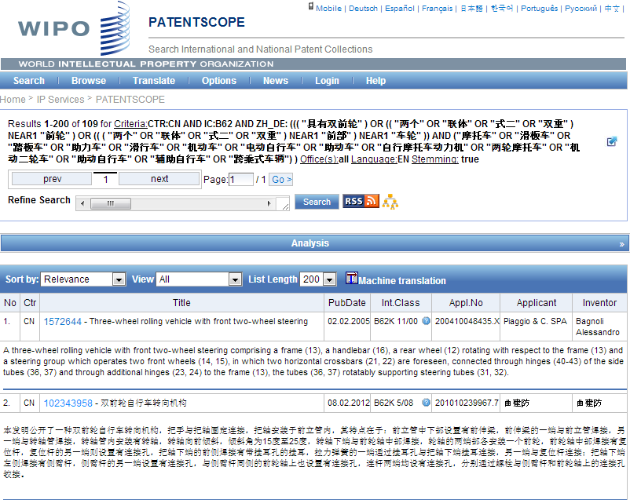

Slide 64
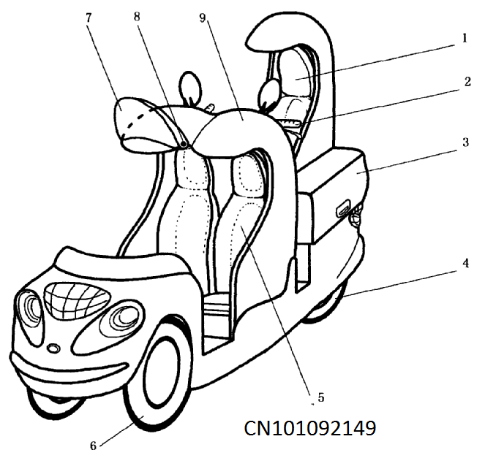

Slide 65
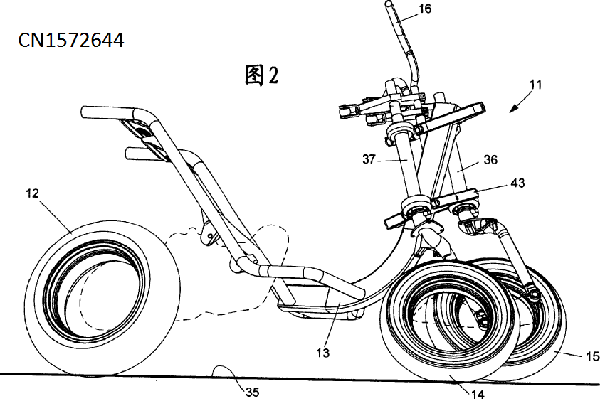

Slide 66
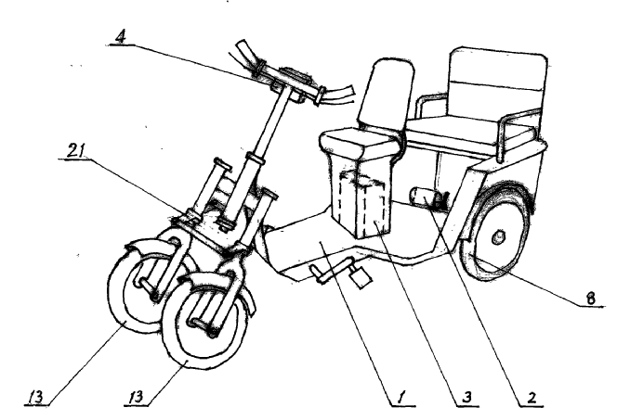

Slide 67
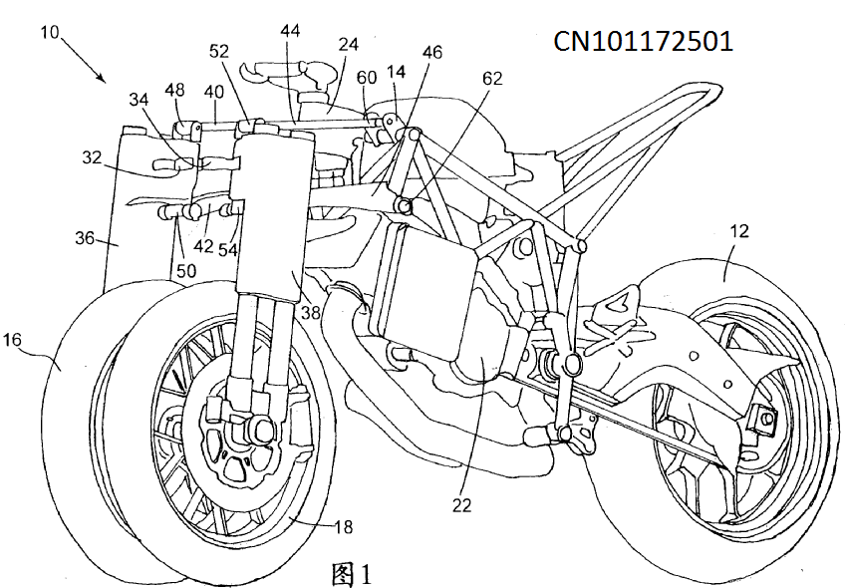

Slide 68
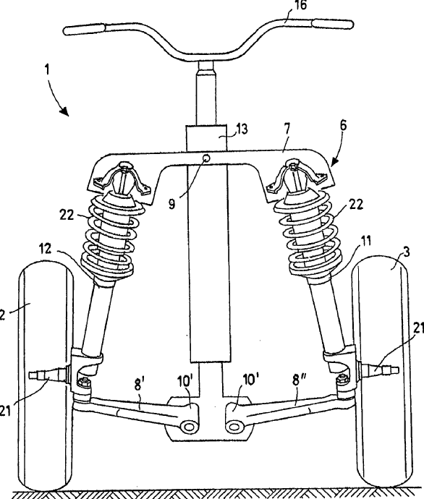

Slide 70
Slides
www.wipo.int/patentscope/en/webinar/index.html

Slide 71
patentscope@wipo.int

Slide 72
Next webinar
Retrospective of 2014: December 9 and 11
http://www.wipo.int/patentscope/en/webinar/

Slide 73
mulțumesc
mulțumesc

