Slide 1
Complex queries in the PATENTSCOPE search system
Online
November
2016
Sandrine Ammann
Marketing & Communications Officer

Slide 2
To the PATENTSCOPE search system webinar
Complex queries

Slide 3
Agenda
Complex queries:
Interfaces
Search syntax
Field definition
Interface combination
Next webinar
Q&A

Slide 4
Complex queries
The “complexity” of queries will depend on:
Skills
Experience level

Slide 5
Q:Would consider yourself as a
A
Beginner seacher
B
Expert searcher

Slide 6
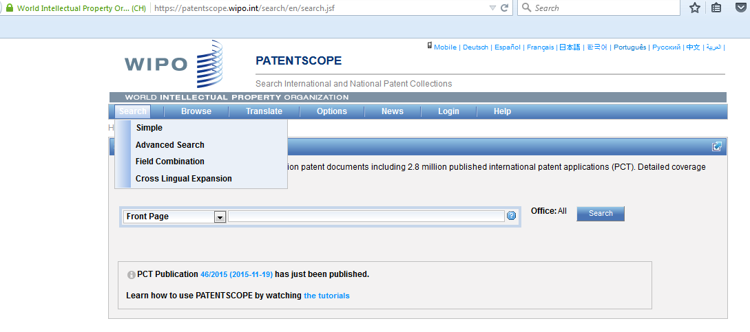
2 interfaces

Slide 7
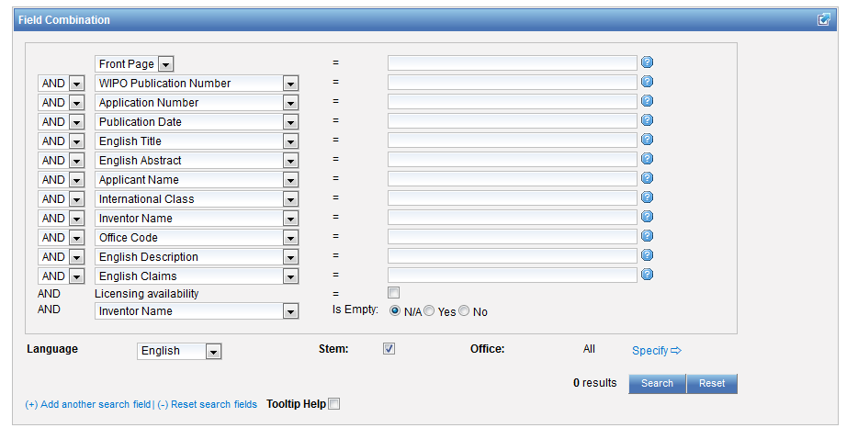
Advanced or Field Combination

Slide 8
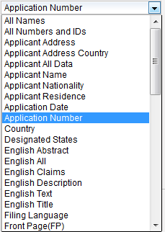
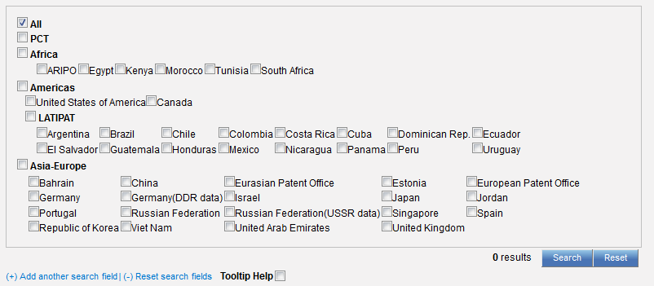
Field Combination

Slide 9
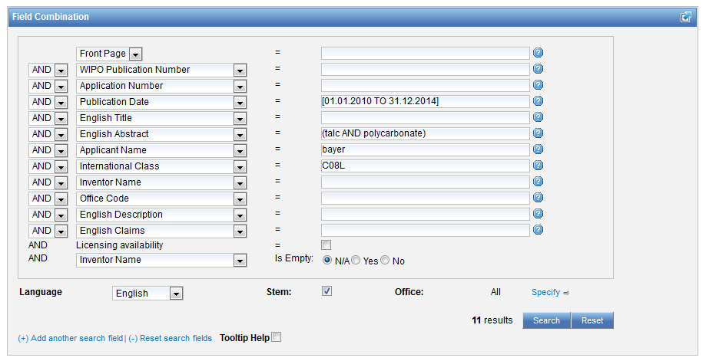
Interface Field Combination

Slide 10
Field Combination - pros
Predefined fields
Immediate results on the same page

Slide 11
Field combination - cons

Slide 12
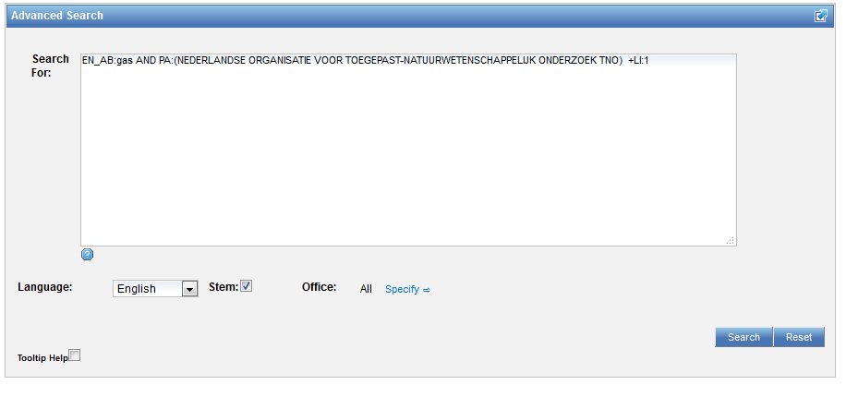
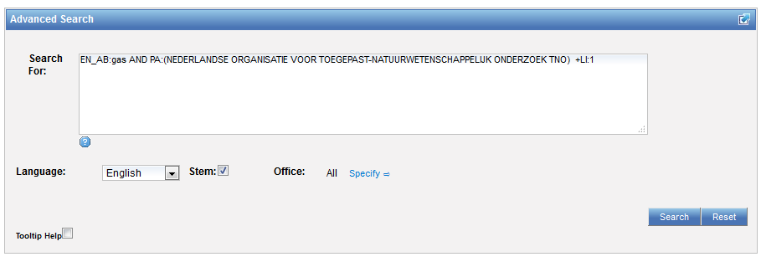
Interface: Advanced search

Slide 13
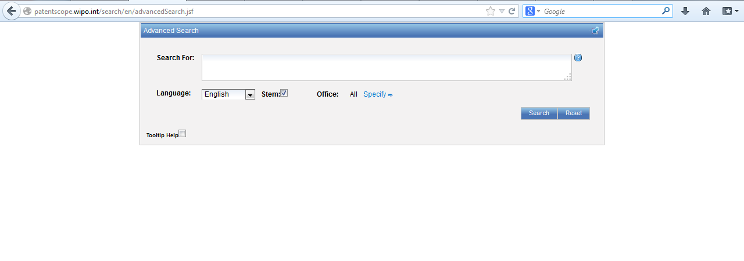
Advanced search interface

Slide 14
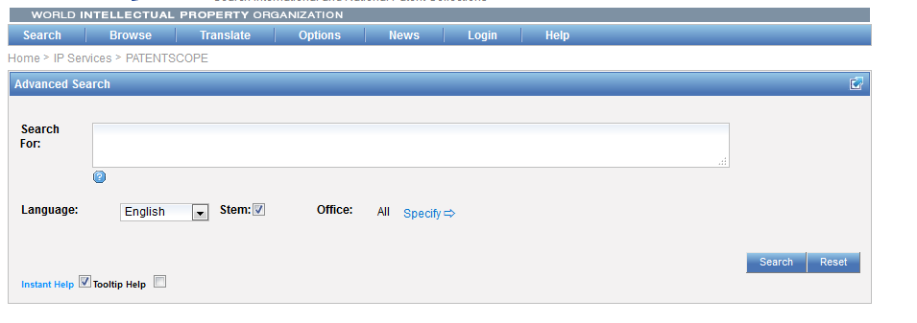
Help

Slide 15
Tooltip help

Slide 16
Instant help
Validates search query
Suggests terms
Provides:
List of IPC codes
List of countries

Slide 18
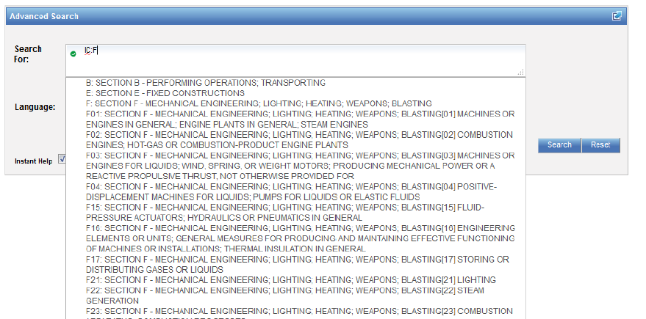

Slide 19
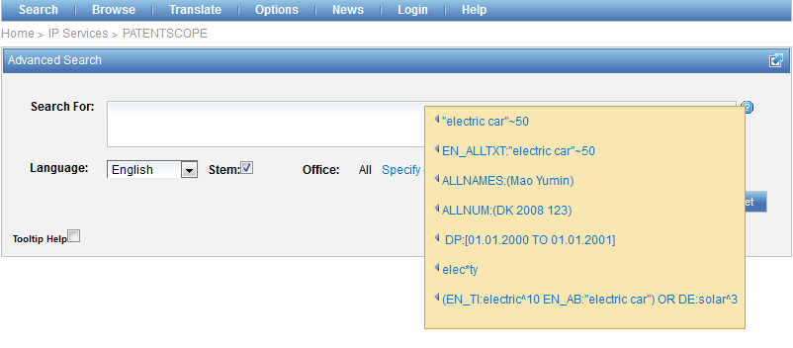
Question mark help

Slide 20
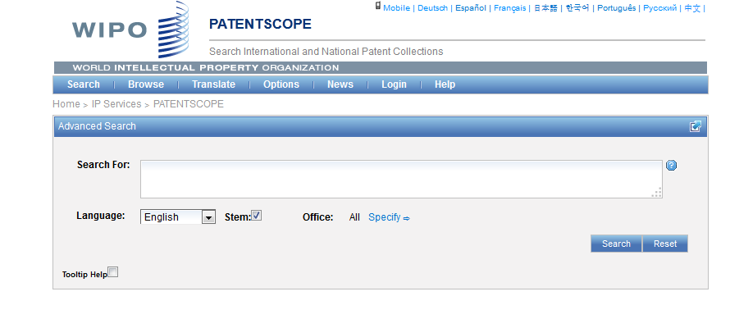
Advanced search interface

Slide 21
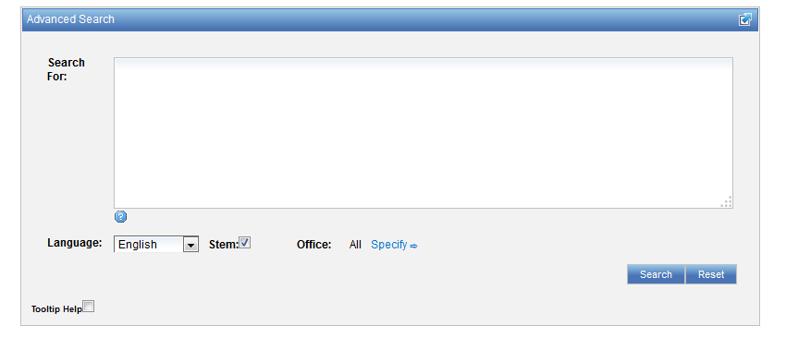
Advanced search interface

Slide 22
Advanced search interface
Search syntax
Search fields

Slide 23
Advanced search interface
To expand and/or limit search result:
Syntax
Words
Combination of words
Fields
Where to search in a patent document

Slide 24
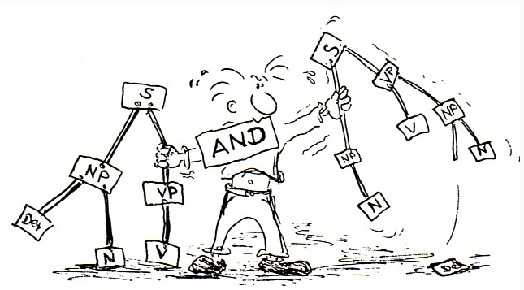
Search syntax

Slide 25
Keywords
Stemming
Wildcard
Truncation
Fuzzy

Slide 26
Stemming

Slide 27
Stemming
Stem = stemming
Process that removes common endings from words.
critical critically criticism each word is reduced to ‘critic’
criticisms critics

Slide 28
Stemming
no dictionary includes the necessary technical terms to express patent concepts
Porter Stemming Algorithm finds words that contain common roots
Save time and effort

Slide 29
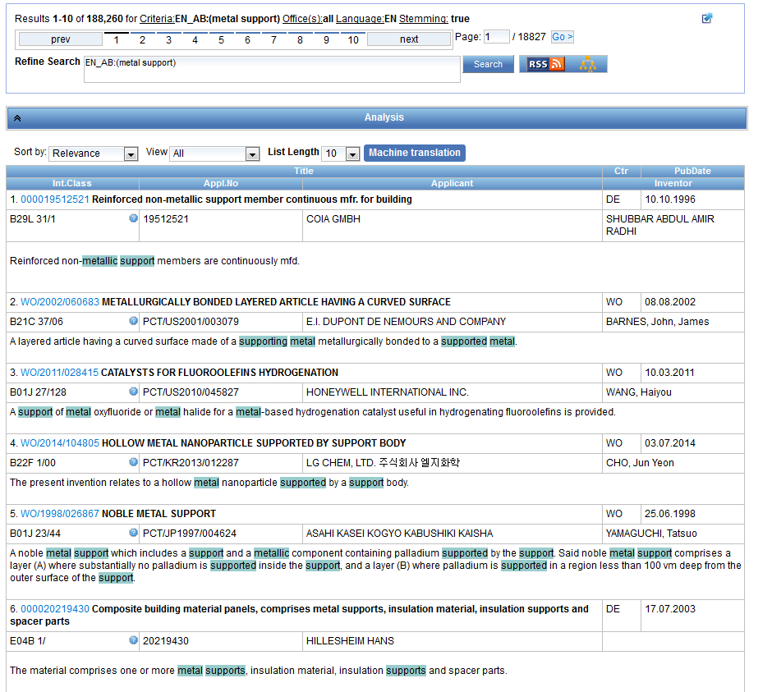
Stemming - example

Slide 30
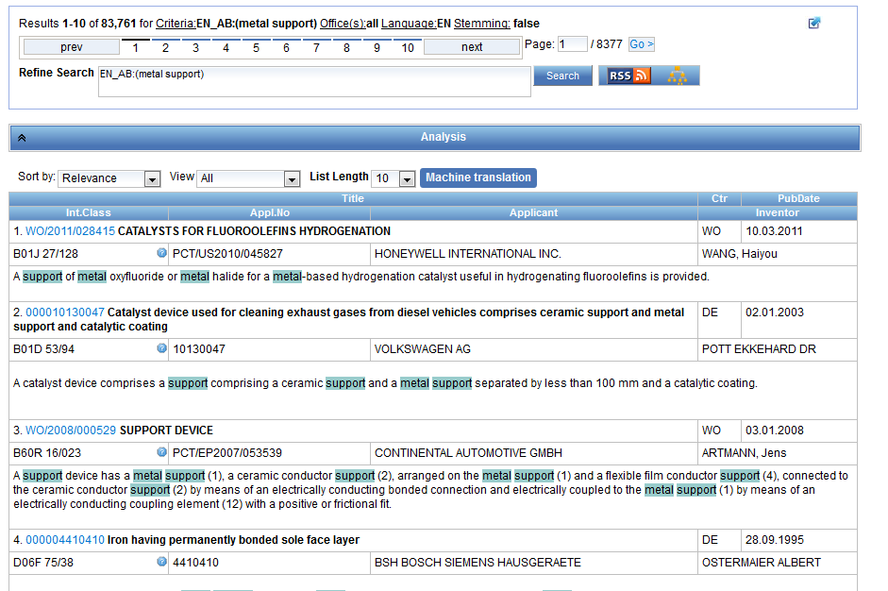
Same search without stemming

Slide 31
Wildcards/truncation : ? *
* stands for 0 or more characters
? stands single character
te?t = test or text
electric* = electrical; electricity
behavi*r = behaviour or behavior
micro?p* = microspeaker, microsporidial

Slide 32
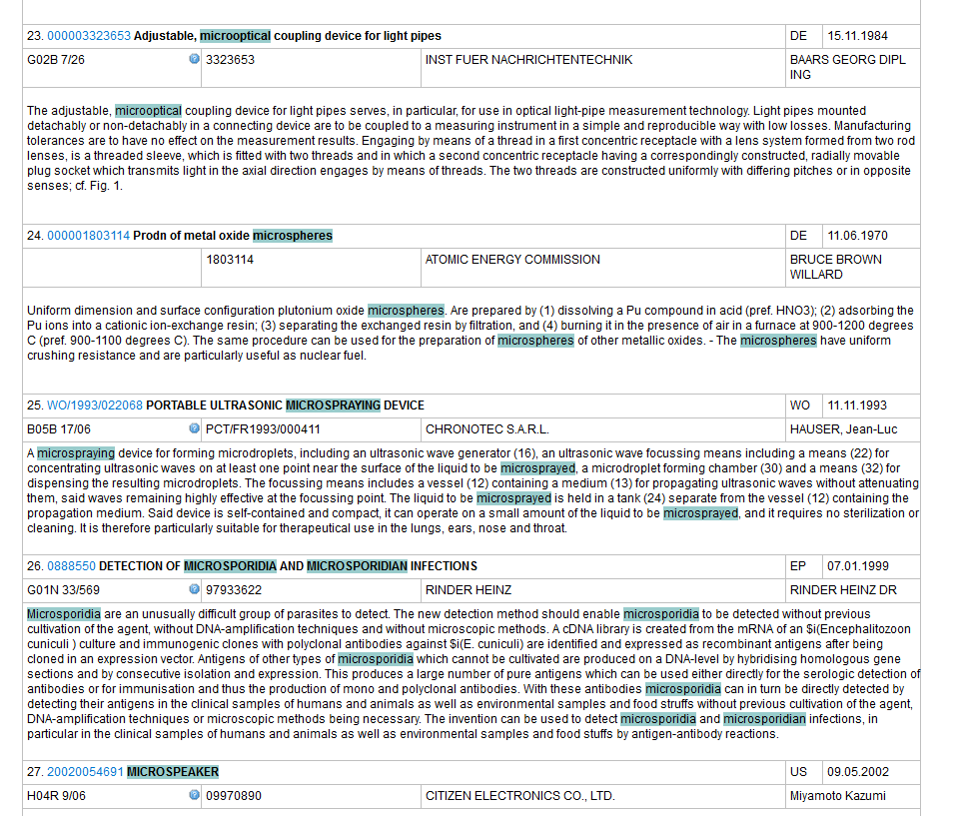
An example

Slide 33
When should you use wildcards?
Spelling uncertainty, plural, tenses: tyre vs. tire
t*re
Multiple spelling variants are known: color vs. colour
col*;
Uncertainty of foreign words: University vs Universität Universit* Stuttgart).
Preferred option over stemming: electric vs. electricity electri*;

Slide 34
Wildcard vs stemming
Be sure to think through the logic results before doing this as you may get unwanted words - for example:
You might want navy, navies or naval so you decide to try NAV* as the root but you will also get navigating, navigation, etc.
You are looking for electricity or electric so you decide to try ELECT* as the root/stem but you will also get electoral, etc.

Slide 35
Fuzzy searches
Use of the tilde: ~
Examples:
roam~ foam / roams
Roam~0.8
Useful to find misstpyed, misspelt or mis-OCRed words
Notes:
Smilar in spelling

Slide 36
Q: when you use wildcard, …
A
The results retrieved are all relevant
B
Stemming is turned off

Slide 37
Q: when you use wildcards, …
A
The results retrieved are all relevant
B
Stemming is turned off

Slide 38
How to combine those keywords
Boolean logic
AND
OR
ANDNOT
NOT
Proximity operators
NEAR
BEFORE
Weighting factor
Grouping/nesting

Slide 39
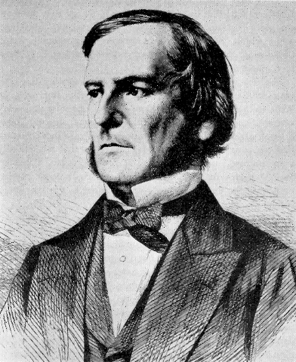
Boolean operators
AND
OR
NOT
ANDNOT

Slide 40
ANDNOT - NOT
Use ANDNOT when searching A excluding B
bicycle ANDNOT boat
Use NOT when searching all documents except A
NOT(car AND bicycle AND boat)

Slide 41
Boolean operators
Narrow, broad and related terms grouped together in proximity and related to other groups of terms expressing functionality or application
Are some words required to be in your results?
Are any words to be excluded?
Should words be near? How near?

Slide 42
Proximity operator NEAR
Proximity searching
Find words that are next to each other
NEAR2 = 2 defines the maximum number of word gaps between 2 search terms

Slide 43
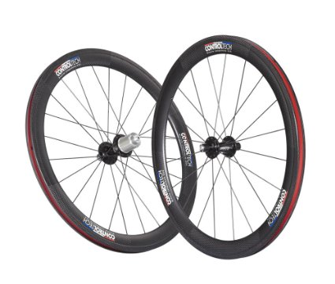
NEAR: an example
carbon AND wheel 118,828 results
"wheels made of carbon",
"carbon may be used to make said wheel“
carbon NEAR10 wheel 3.020 results

Slide 44
Proximity search: BEFORE
the order of terms is significant.
trunk BEFORE cutting

Slide 45
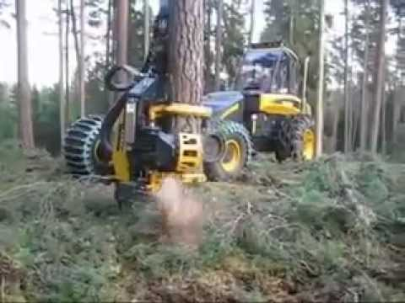
An example

Slide 46
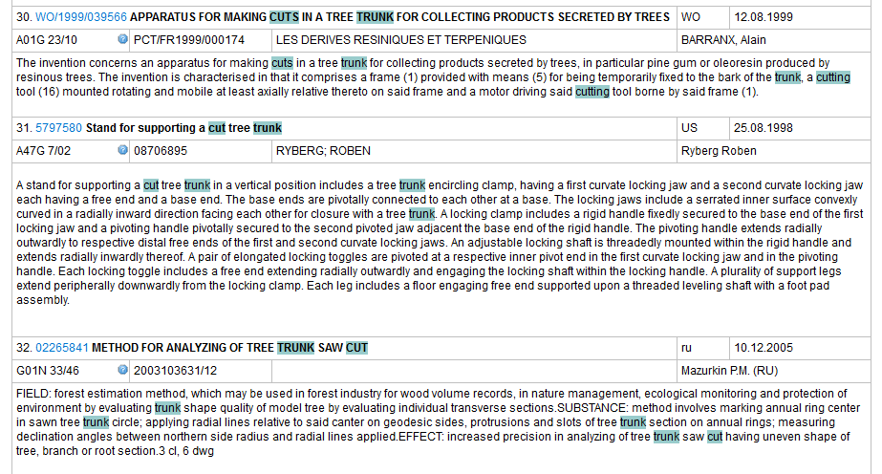

Slide 47
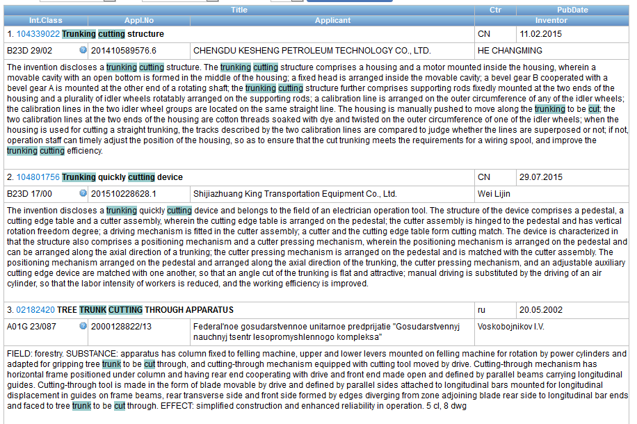

Slide 48
^ caret = weighting factor
Same result but ranking will be different
touch^3 AND polarize

Slide 49
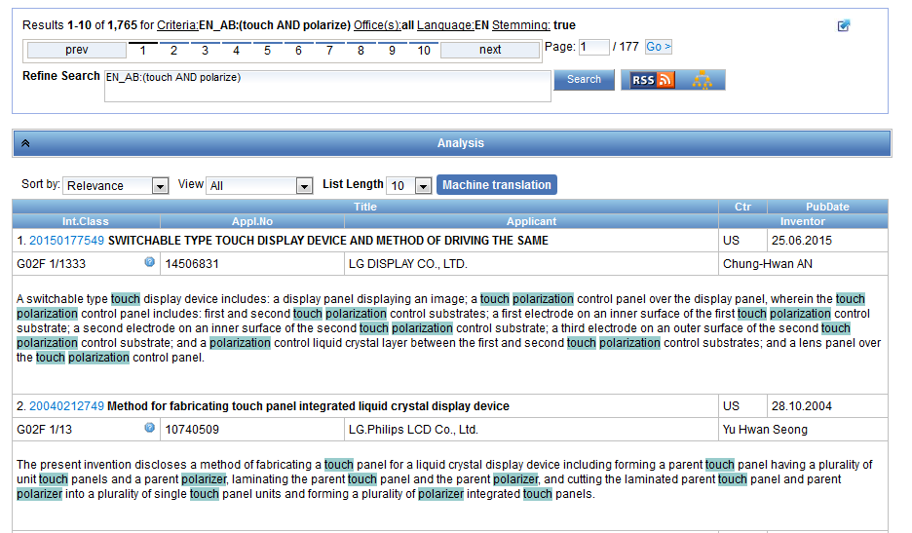

Slide 50
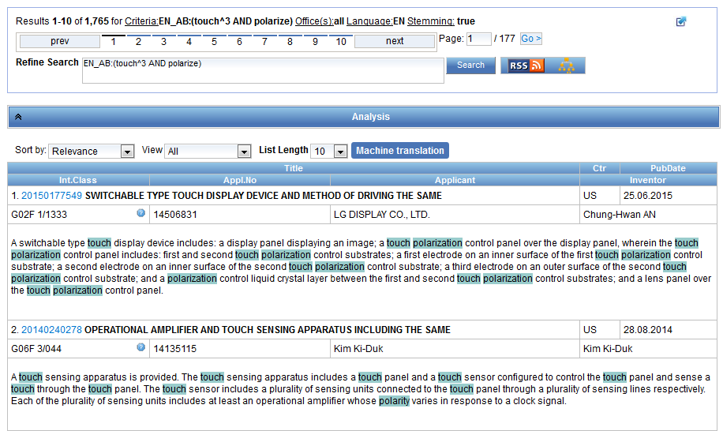

Slide 51
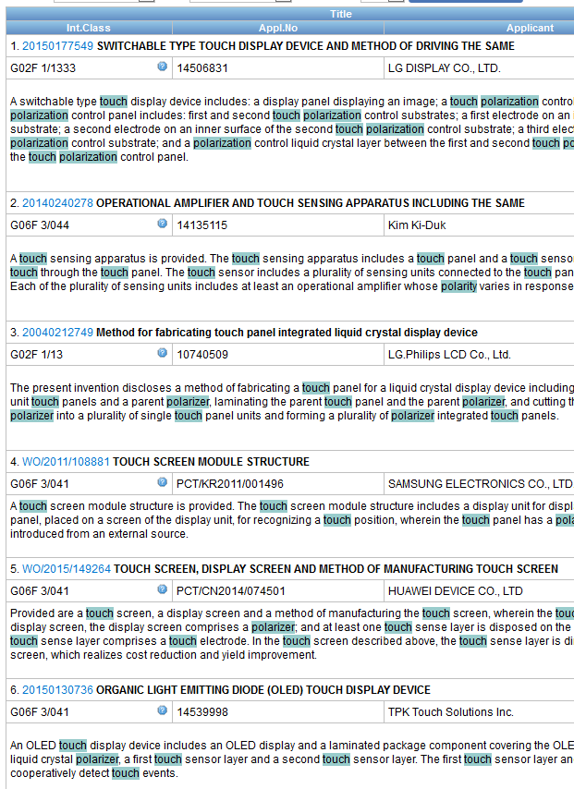

Slide 52
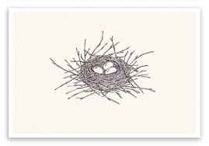
Grouping

Slide 53
Grouping/nesting
Solar OR (wind AND turbine)
(solar OR wind) AND turbine
EN_TI: electric car
electric will be searched in English title but car in all fields
EN_TI: (electric car)
Both electric and car will be searched in the English title

Slide 54
Where to search: Fields Source: http://spicewallpaper.blogspot.ch/2012/08/green-fields-with-blue-sky.html

Slide 55
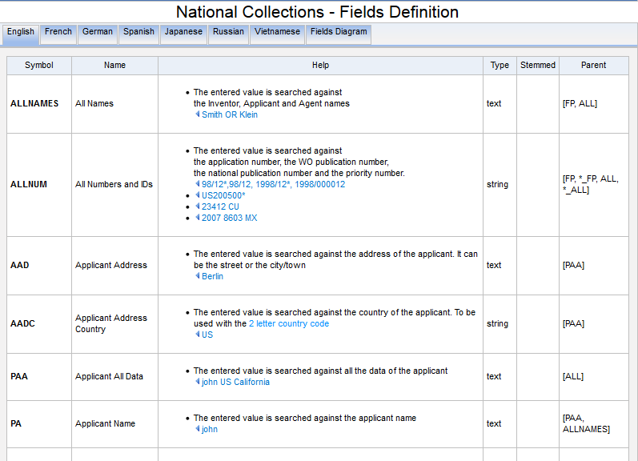
Search fields

Slide 56
Examples
FP = front page
ALL = all fields
ALL_NAMES = all names
IC = IPC
DP = publication date
CTR = country either WO or country from nat collection
NPCC= national phase entry
AN = origin of PCT

Slide 57
New Fields
ISA
ST.3 Office code of the patent authority that performed the preliminary search report
ISA:US and OF:WO
ISR
For an ISR document in status filed (ISR): Report ; if there is an Article 17(2)(a) declaration in status filed (A172A): Declaration
ISR:declaration and OF:WO
SIS
If any Supplementary International Search Report has been received, show status “report”;If no SIS Reports or Declarations are on file, show status “None” SIS:report and OF:WO
IPE
If there is an IPER in status filed (IPER or IPRP2) and the time limit for making the report visible to Patentscope has passed: Report
IPE:report and OF:WO

Slide 58
Fields rules
Basic fields: elements of a patent document
Derived fields
2 letter code = individual field
EN_TI FR_AB ES_DE_S
Convention: language specified by 2 letters
if not specified all languages
S = stemmed
: to separate term without any space

Slide 59
Intuitive queries
PCTHavingThirdPartyObservations
PCTPublishedLastWeek
PCTHavingApplicantFromUS
DP:Last1Year
DP:[Today-1Week TO Today]

Slide 60
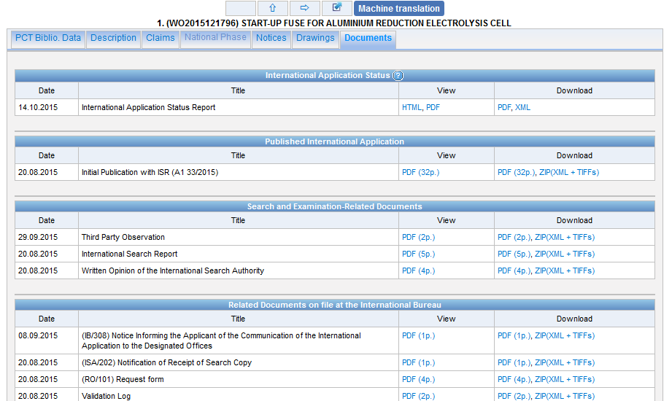
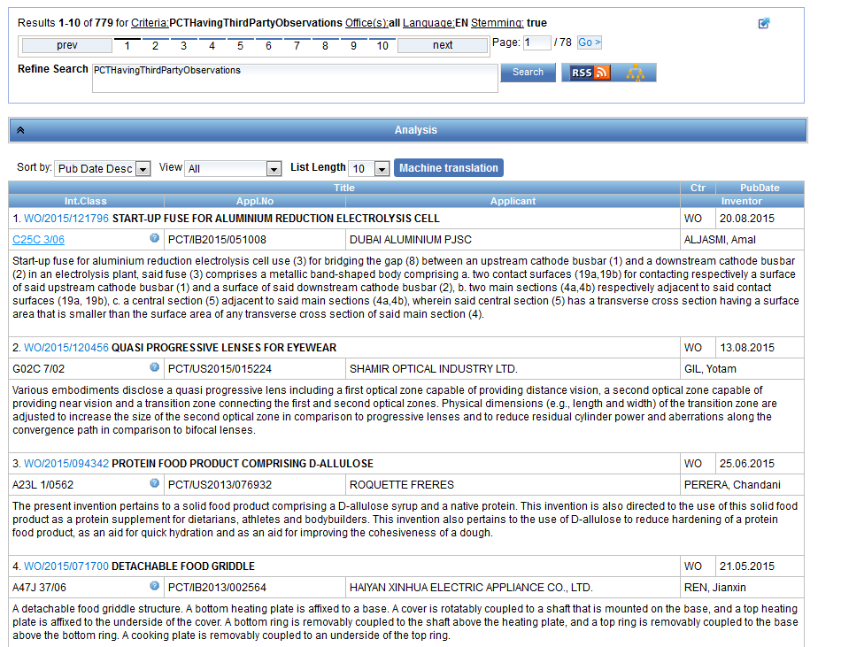

Slide 61
Fields: golden rules
EN_ALL = default field field indicator not required
Field name followed by : ":" or "/"
The field is only valid for the term that it directly precedes, so the query:
EN_TI:("wind turbine" AND electric) solar
Results: "wind turbine" AND electric in the title field. "solar" in the default field (EN_ALL ).

Slide 62
Date search
Simple:
DP:01.02.2000
DP:20000201
DP:02.2000
DP:200002
DP:2000

Slide 63
Range search
Range:
DP:[01.01.2000 TO 01.01.2001]
Can also be used to search non-date fields
IN: {Smith to Terence}

Slide 64
In the Publication Date field:
Examples
DP:today DP:today-3days DP:today-1Week DP:today-2Years
Time ranges:
DP:[today-1Year TO today] DP:[today-3Years TO today-1year]
Simplified time period ranges :
DP:Last3Days DP:Last2Weeks DP:Last1Year
Last Publications published :
DP:pct_lastpubdate DP:pct_lastpubdate and PA:"University of Paris"
Notes:
DP:Last3Days --> returns all the record that were published by the national/international authority in the last 3 days
Last Publications published Also, the following query returns all the PCT applications published the last time, very useful for implementing RSS queries:

Slide 65
Example: IPC
IC :A
IC :A47
IC :A47L
IC :A47L1
IC:A47L11
IC:A47L11/03

Slide 66
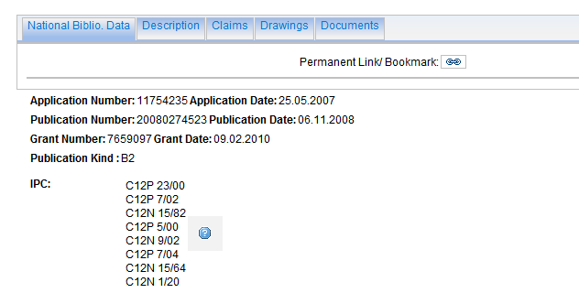
Example: grant

Slide 67
Example: grant

Slide 68
Example: licensing + 3rd party observation

Slide 69
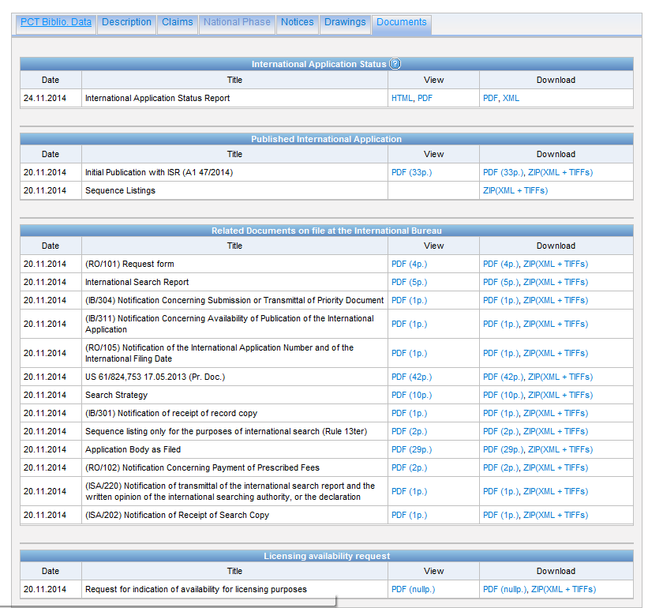

Slide 70
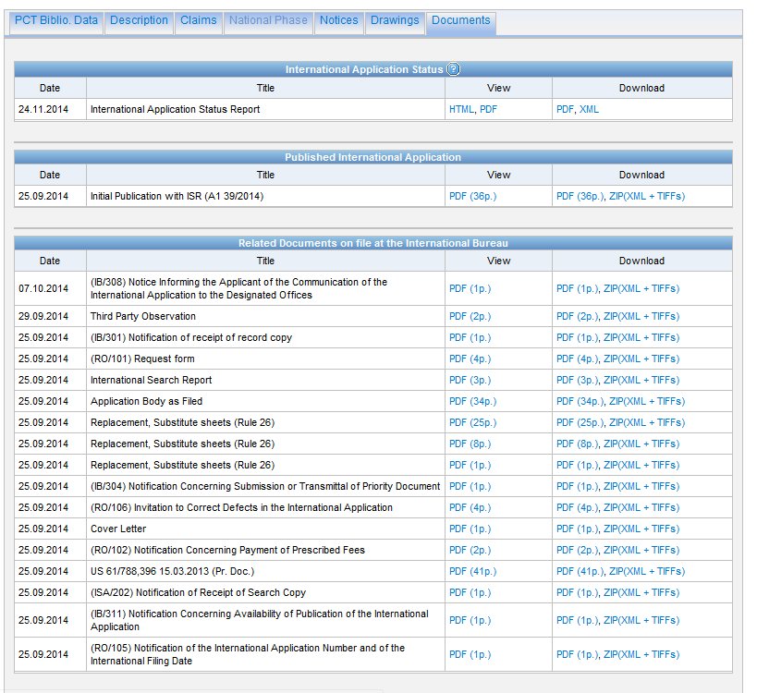

Slide 71
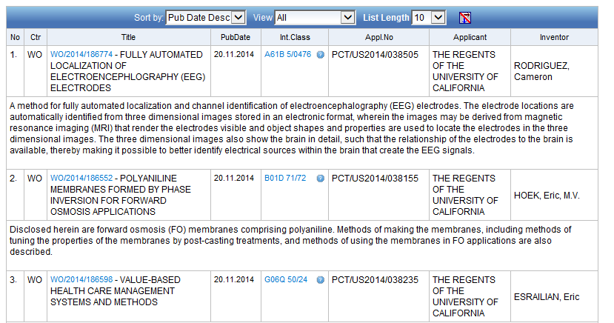
Example: last pub + applicant

Slide 72
Example: national phase entry
All applications that entered national phase in China in 2012

Slide 73
Example: nb of patent applications from France seeking protection in USA

Slide 74
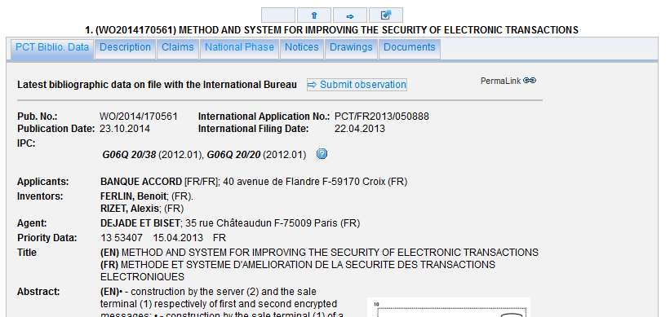

Slide 75
Interfaces combination
Combine search with chemical structure search
Combine search with CLIR

Slide 76
For queries with compounds

Slide 79
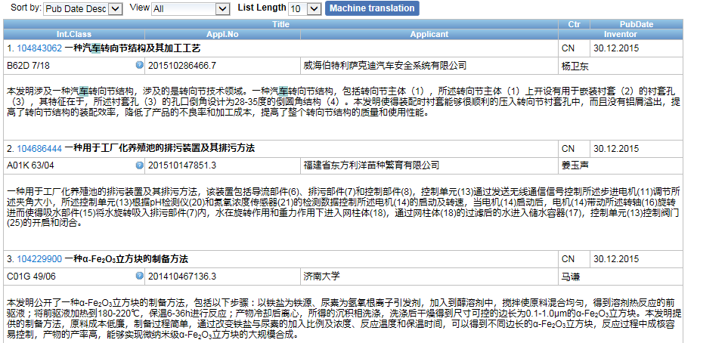
Combining with CLIR

Slide 81
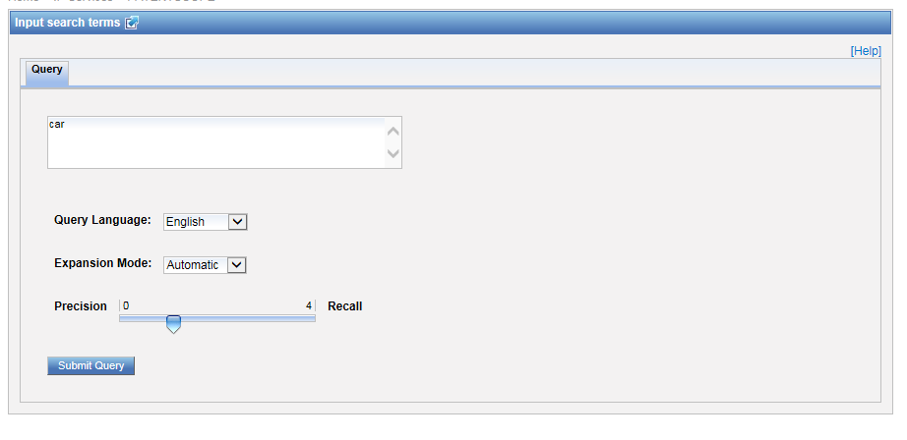

Slide 82
Most common errors
(….) "…"
" not “
Field name
No space
No wildcard at the beginning of a word

Slide 83
Q: how to build a query in order to obtain patents by the company Huawei with at least one innovator from Germany?
A
Huawei AND Germany
B
IN:Huawei AND INA: Germany
C
IADC:DE AND PA:Huawei
D
CTR: Germany AND IN: Huawei

Slide 84
Q: how to build a query in order to obtain patents by the company Huawei with at least one innovator from Germany?
A
Huawei AND Germany
B
IN:Huawei AND INA: Germany
C
IADC:DE AND PA:Huawei
D
CTR: Germany AND IN: Huawei

Slide 85
Next webinar
Retrospective of 2016 and plans for 2017
December 6 or 8
To register:
http://www.wipo.int/patentscope/en/webinar/
https://attendee.gotowebinar.com/rt/5339380573171764740 December 6
https://attendee.gotowebinar.com/rt/5339380573171764740 December 8

Slide 86
patentscope@wipo.int

Slide 88
mulțumesc
mulțumesc

