Slide 1
PATENTSCOPE
Browse menu
June
2017
Sandrine Ammann
Marketing & Communications Officer

Slide 3
Agenda
Browse menu
Quiz
Next webinar
Q&A session

Slide 4
Browse menu

Slide 5
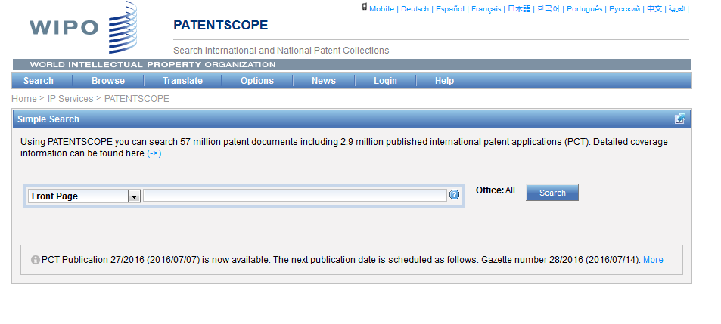
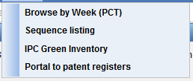

Slide 6
Browse by week (PCT)
Access PCT published applications by week
View IPC statistics

Slide 7
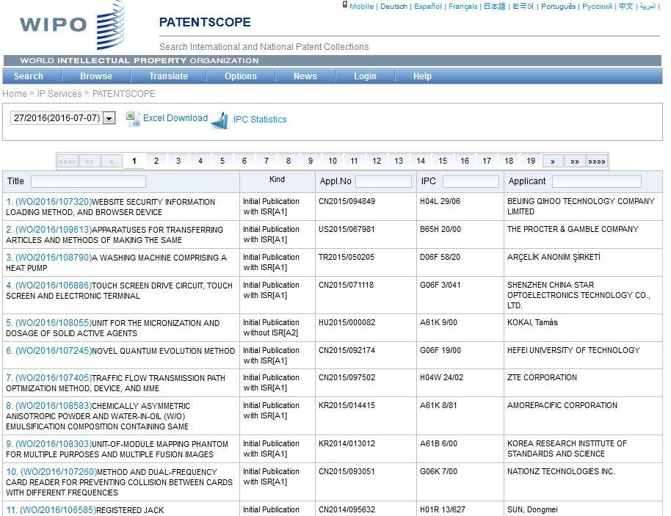

Slide 8
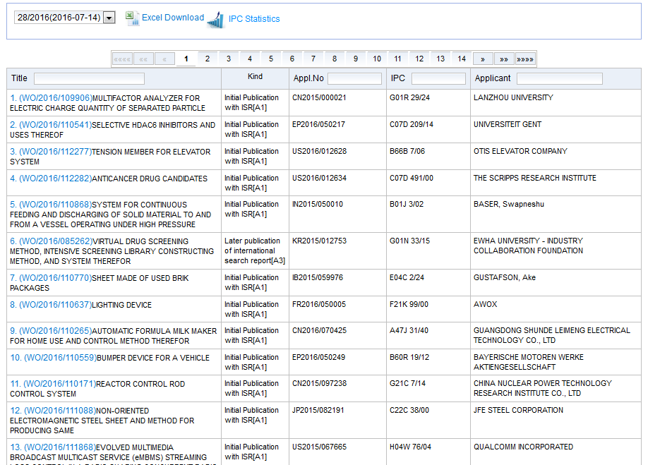
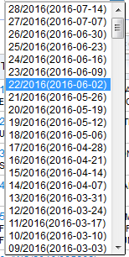
Access weekly publication

Slide 9
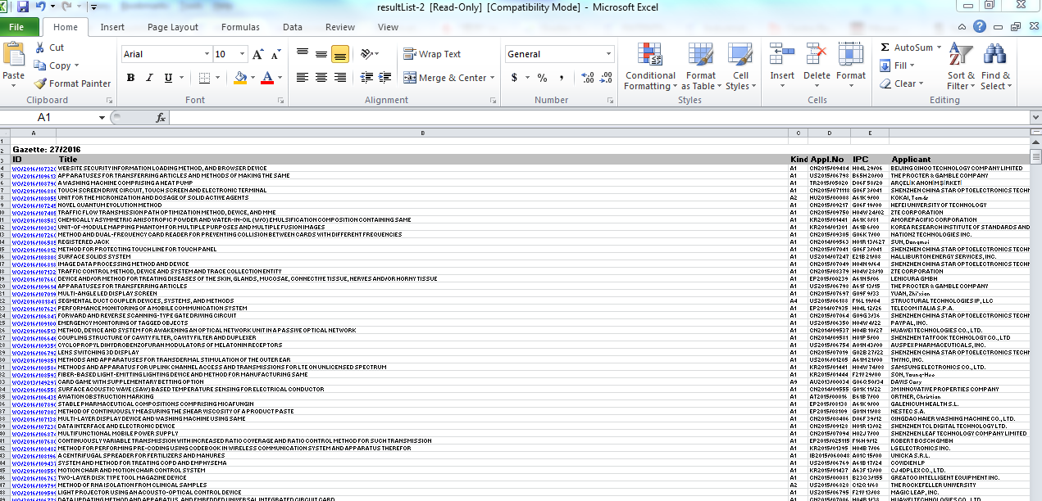
Downloaded list

Slide 10
IPC statistics

Slide 11
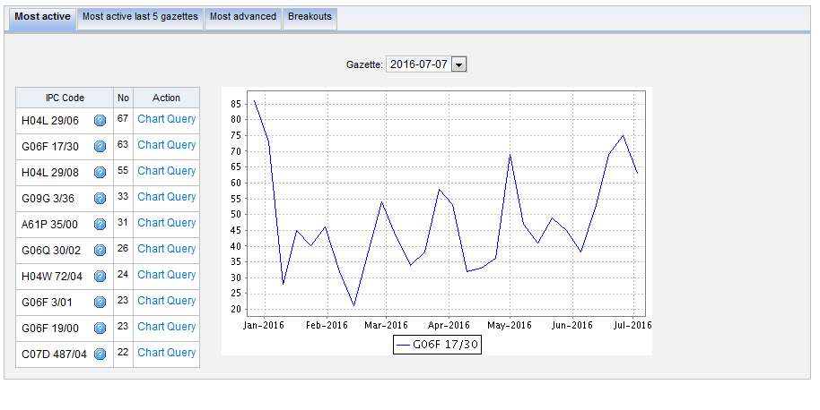
Most active

Slide 12
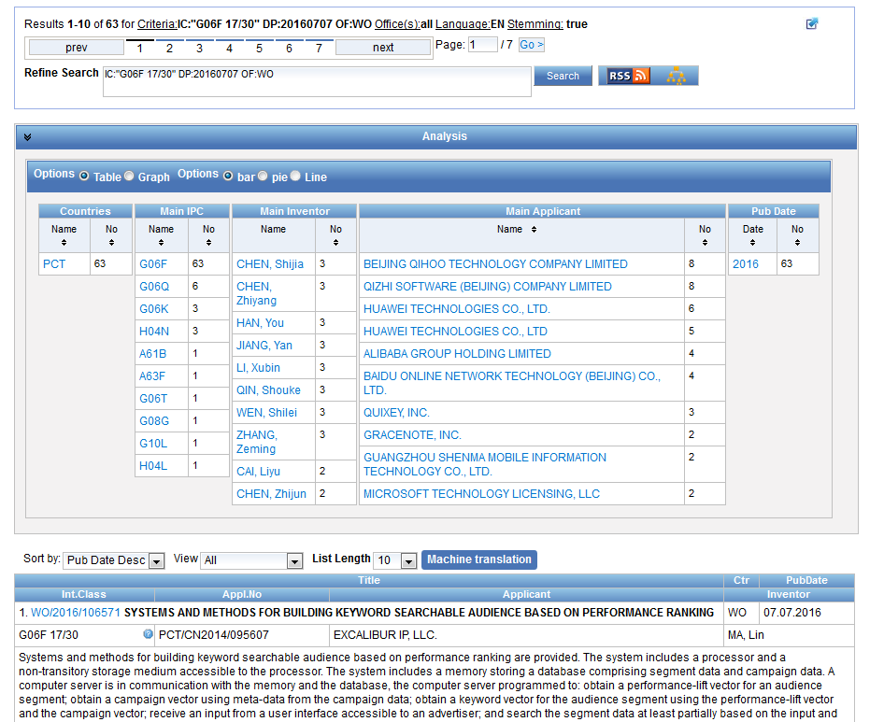

Slide 13
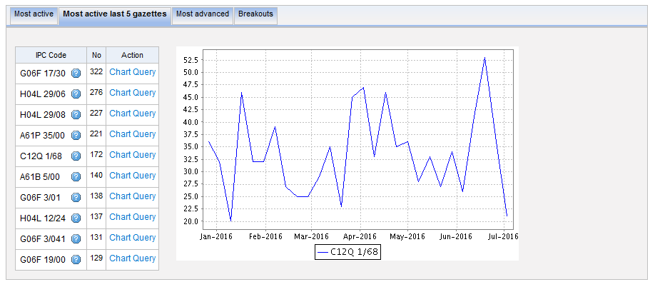
Most active last 5 gazettes

Slide 14
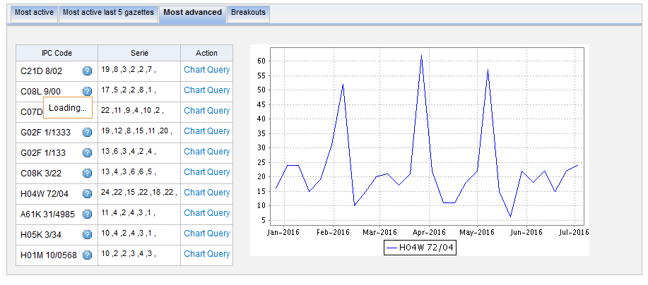
Most advanced

Slide 15
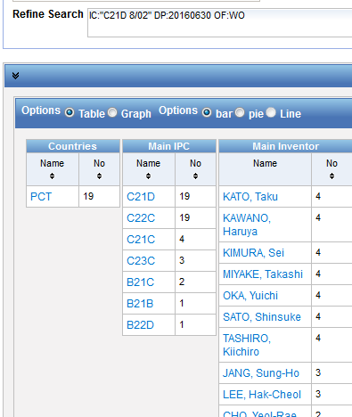
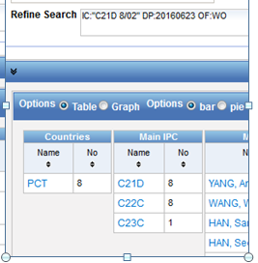
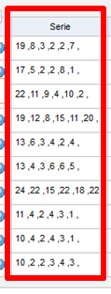
Serie column
6 last publications, nb of IPC per publication

Slide 16
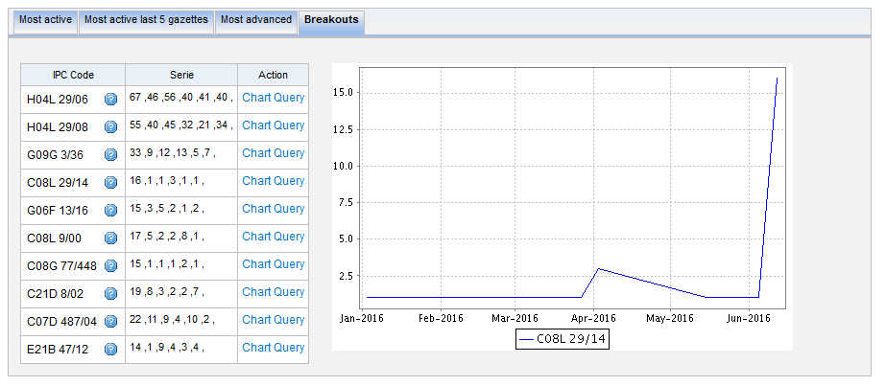
Breakouts

Slide 17
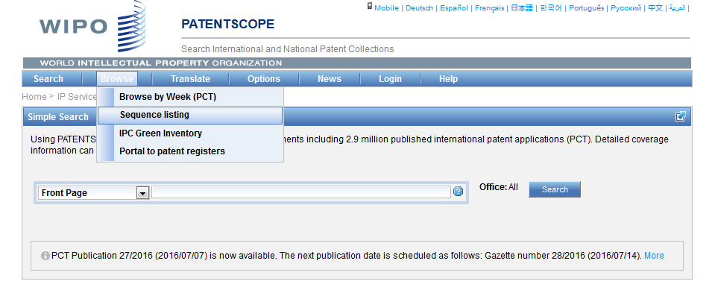
Sequence Listing (SL)

Slide 18
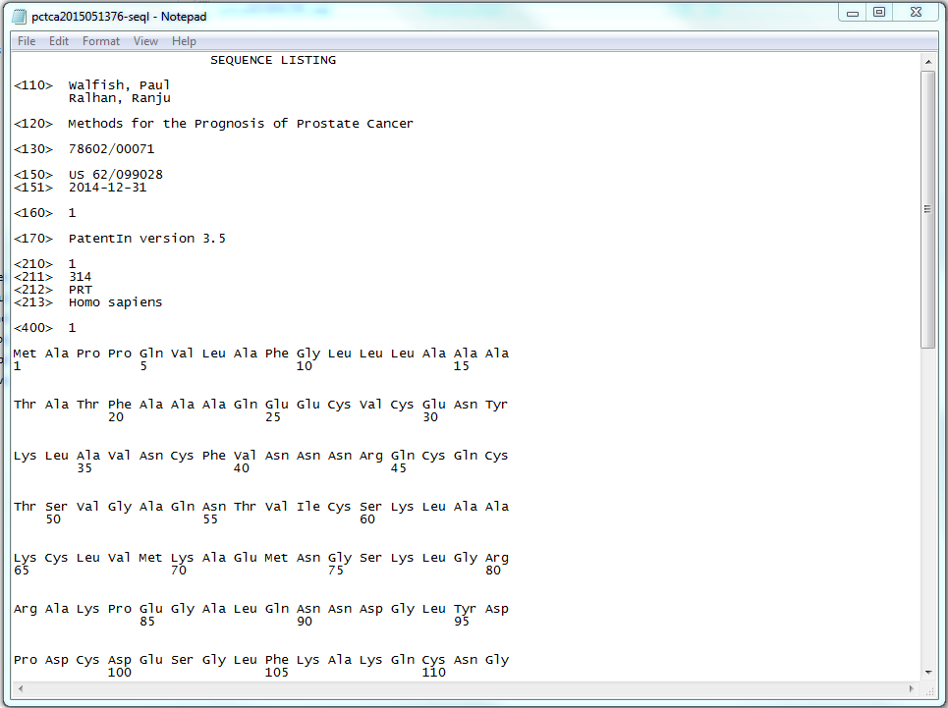
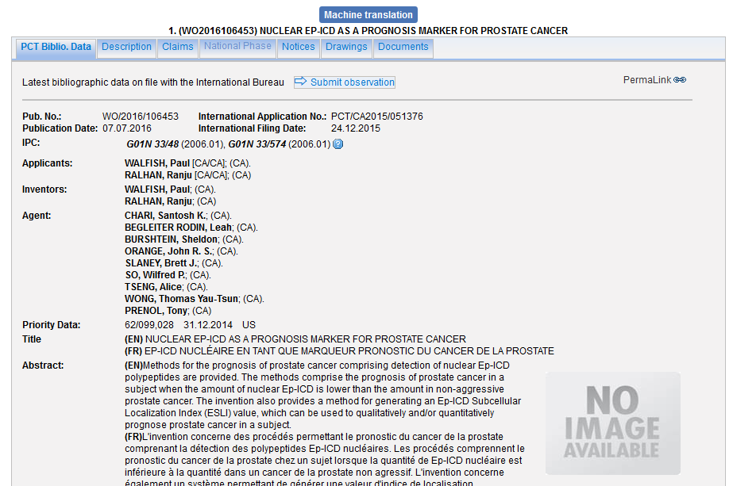
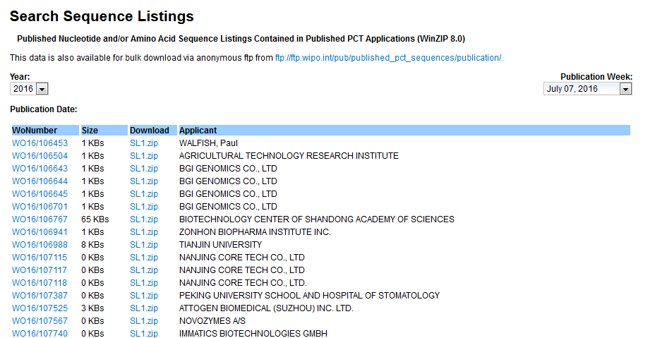
Sequence listing

Slide 19
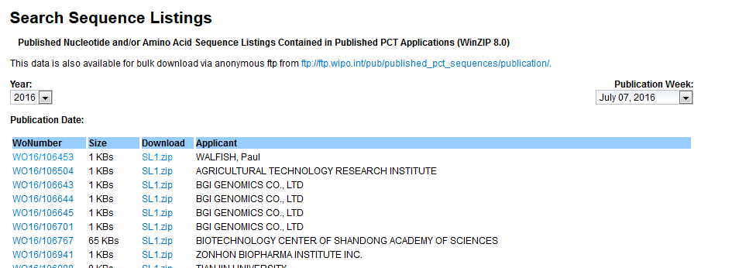
SL bulk downloading

Slide 20
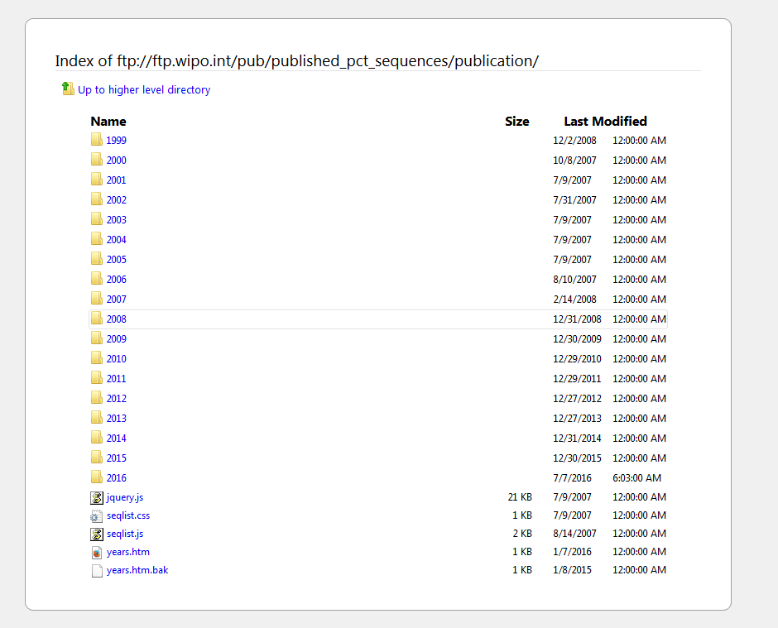

Slide 21
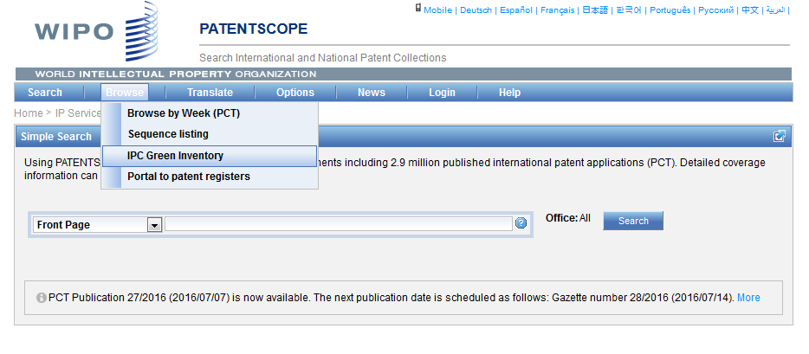
IPC Green Inventory

Slide 22
IPC Green Inventory
facilitates searches for patent information relating to so-called Environmentally Sound Technologies (ESTs)
collects ESTs in one place: ESTs are currently scattered widely across the IPC in numerous technical fields

Slide 23
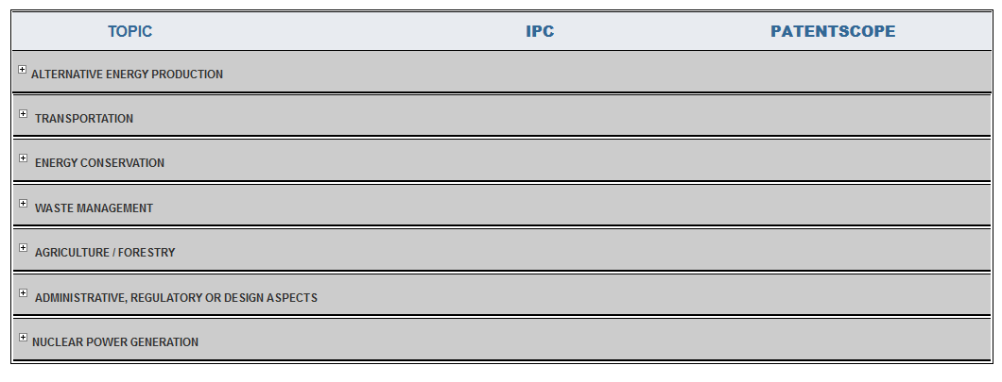
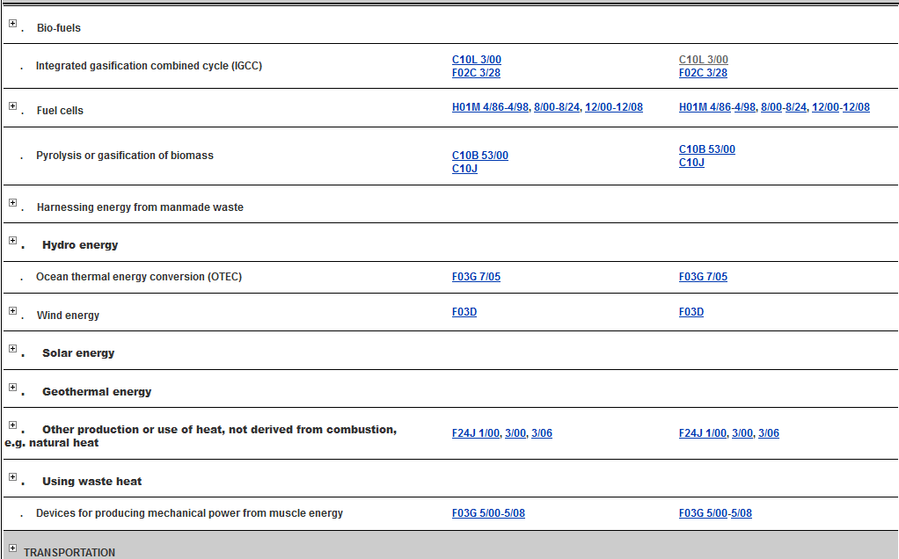

Slide 24
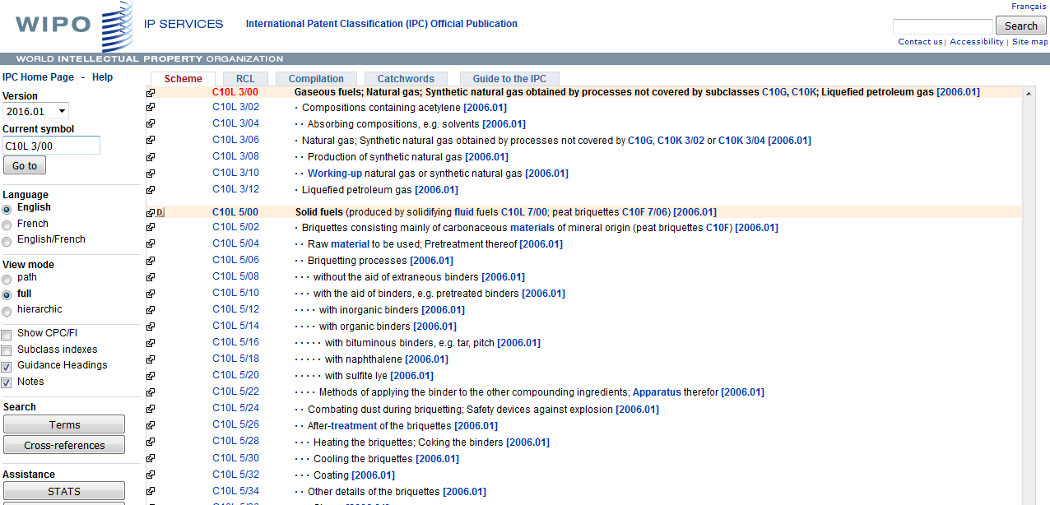

Slide 26
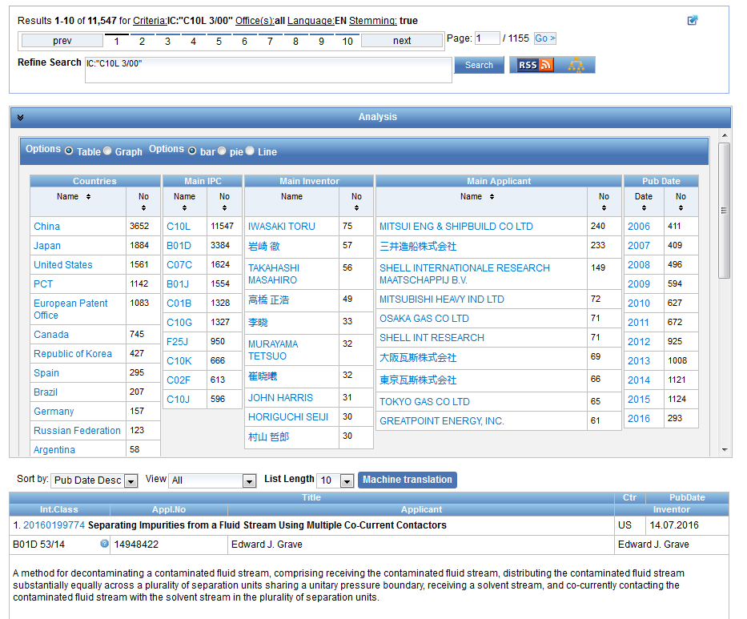

Slide 27
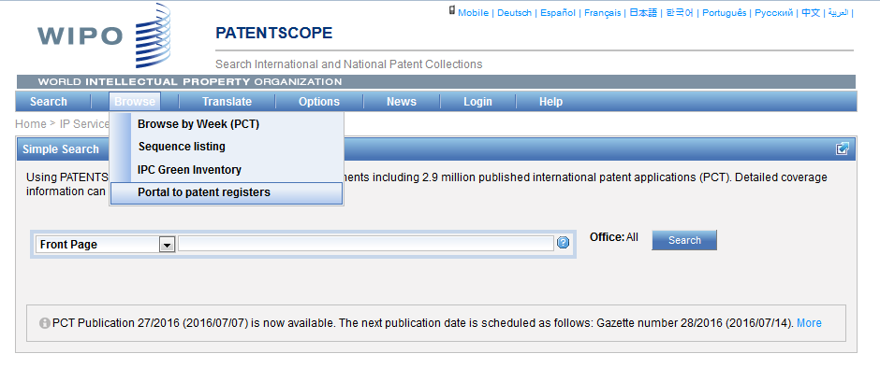
Portal to patent registers

Slide 28
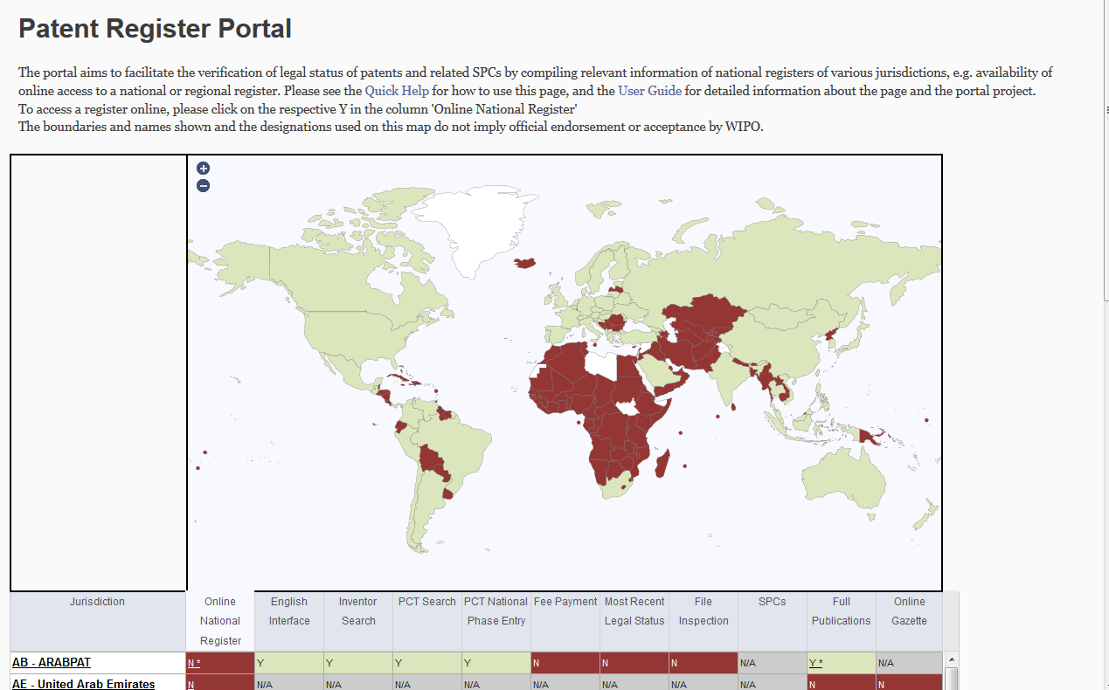

Slide 29
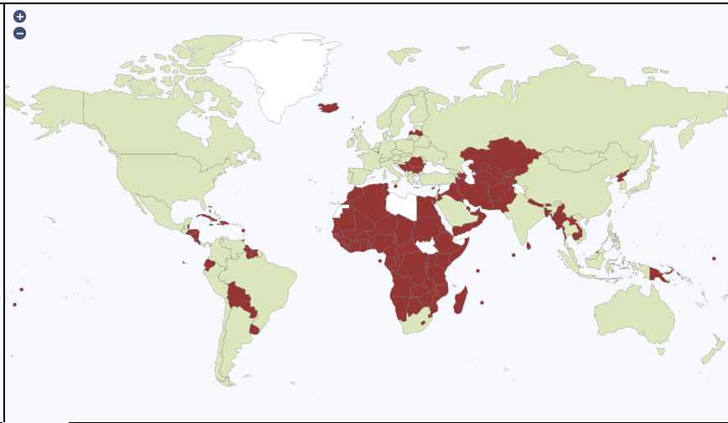
The map

Slide 30
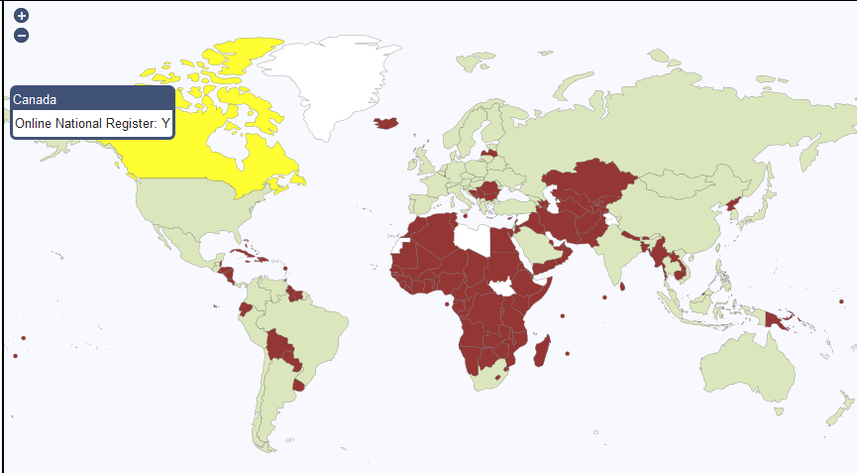
Specific country

Slide 31
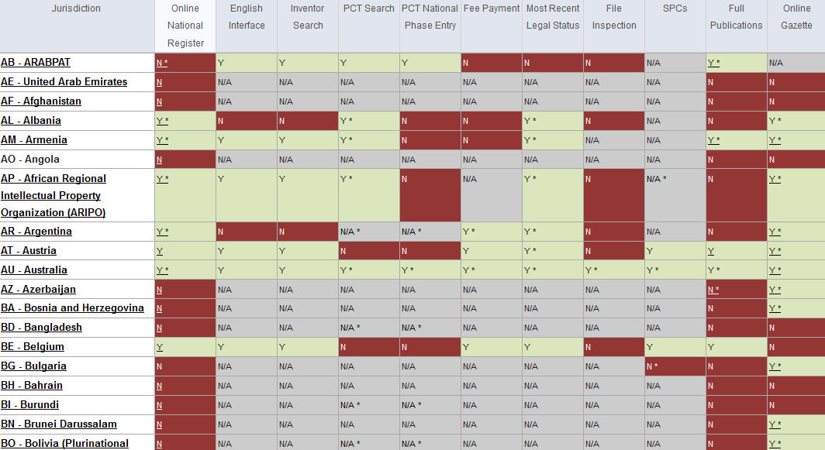

Slide 32
The table

Slide 34
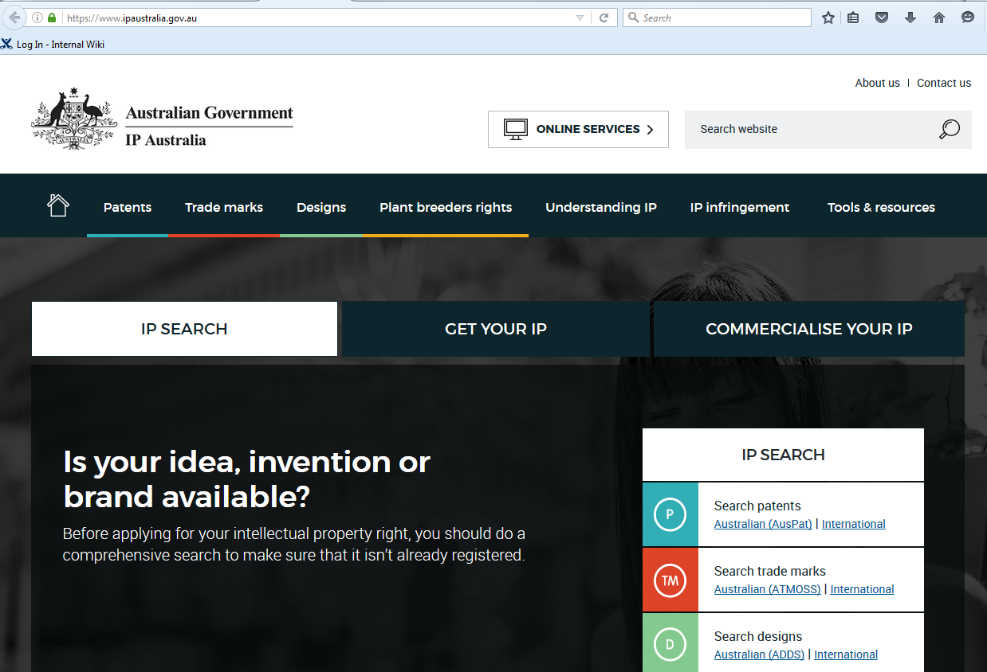

Slide 36
Q:1. In the Browse menu, you cannot access:
A
Sequence Listing
B
IPC Green Inventory
C
Chemical structure search
D
IPC Statistics

Slide 37
Q:1. In the Browse menu, you cannot access:
A
Sequence Listing
B
IPC Green Inventory
C
Chemical structure search
D
IPC Statistics
Spain

Slide 38
Q:2. Where can IPC statistics be accessed from?
A
Search result list
B
Options menu
C
Browse menu
D
IPC website

Slide 39
Q:2. Where can IPC statistics be accessed from?
A
Search result list
B
Options menu
C
Browse menu
D
IPC website

Slide 40
Q:3. The IPC Green Inventory is:
A
Repository of plants
B
Platform to facilitate green technologies searches

Slide 41
Q:3. The IPC Green Inventory is:
A
Repository of plants
B
Platform to facilitate green technologies searches

Slide 43
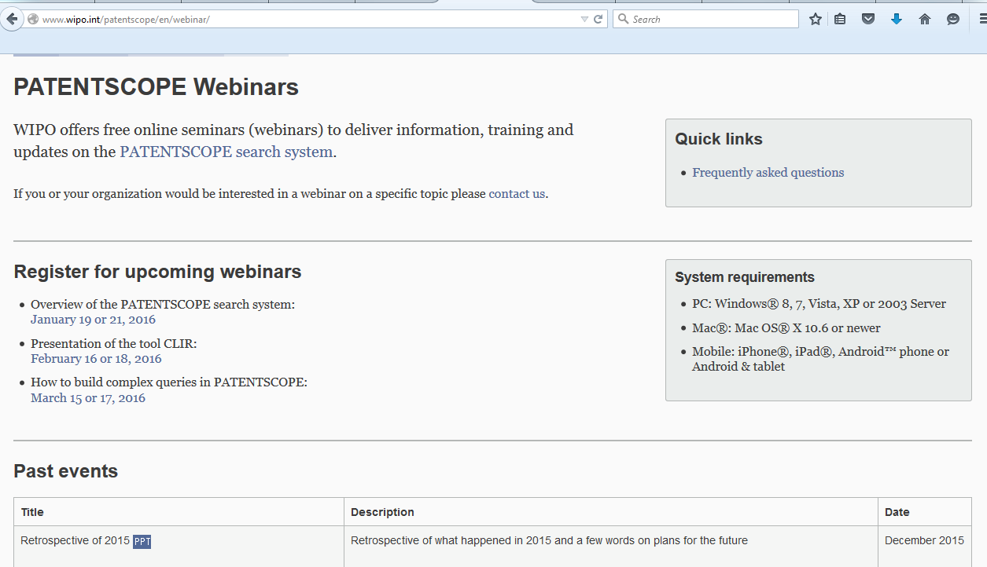
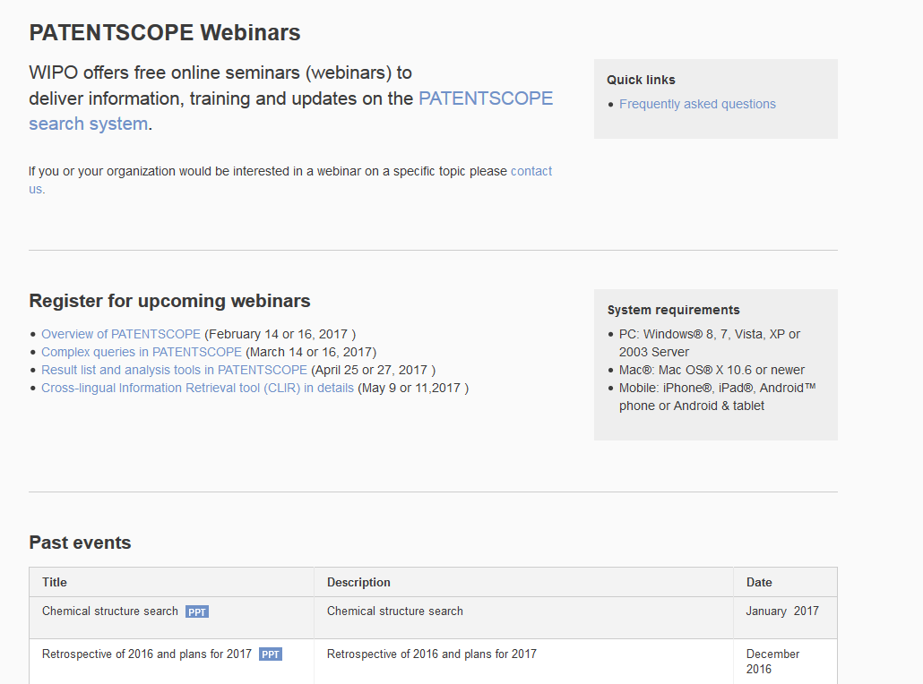
Future/past webinars:
wipo.int/patentscope/en/webinar

Slide 44
July webinar: Translation tools
Tue, July 18
5:30 PM - 6:30 PM CEST
Thu, July 20
8:30 AM - 9:30 AM CEST
To sign up: http://www.wipo.int/patentscope/en/webinar/

Slide 45
Global Design Database: webinar
The Global Design Database: an introduction
July 25 at 5:30pm CET
https://attendee.gotowebinar.com/rt/1717422151261026817
July 27 at 8:30 am CET
https://attendee.gotowebinar.com/rt/1717422151261026817

Slide 46
Global Brand Database: webinar
Performing effective searches in the Global Brand Database
August 29 at 5:30pm CET
https://attendee.gotowebinar.com/rt/1767524697735436802
August 31 at 8:30 am CET
https://attendee.gotowebinar.com/rt/1767524697735436802

Slide 47
Forum

Slide 48
patentscope@wipo.int

