Slide 1
PATENTSCOPE
Translation tools
July
2017
Sandrine Ammann
Marketing & Communications Officer

Slide 2
Agenda
Translation tools
Quiz
Next webinar
Q&A session

Slide 3
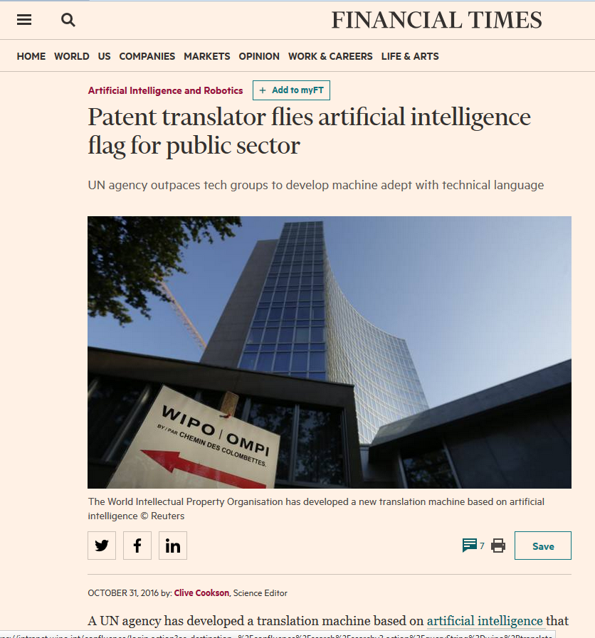

Slide 4
WIPO Translate before/after
发明公布了一种通过在不同位置摆放现实物体来演奏音乐的娱乐装置
invention discloses
one kind by this
of mean
different location
placing real object
by/for
play music
of
entertainment
device

Slide 5
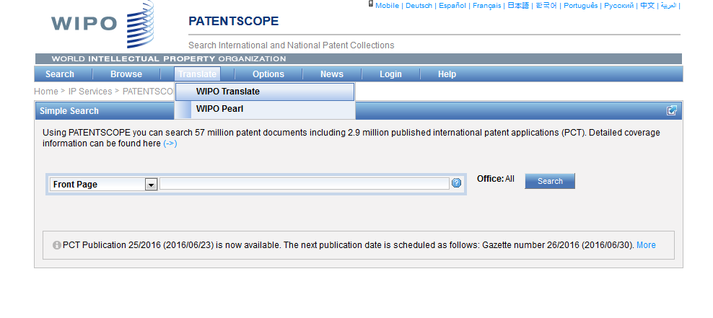
WIPO Translate

Slide 6
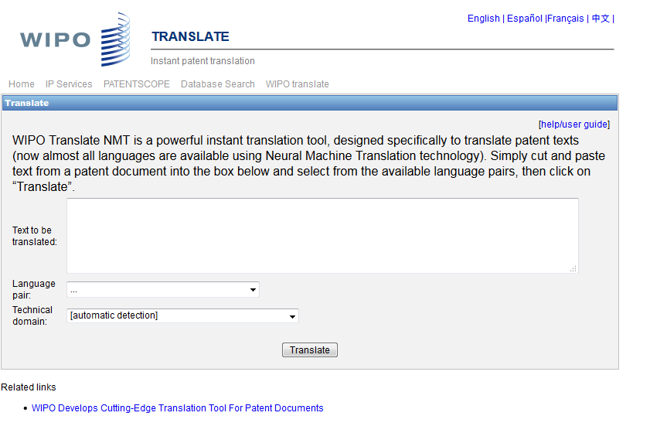
WIPO Translate: interface

Slide 7


18 Language pairs
Arabic – English English-Arabic
Chinese – English English - Chinese
French – English English - French
German – English English - German
Japanese – English English - Japanese
Korean – English English - Korean
Portuguese – English English - Portuguese
Russian – English English - Russian
Spanish – English English - Spanish

Slide 8
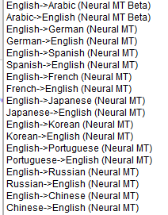

Slide 9

32 Technical domains from the IPC
[ADMN] Admin, Business, Management & Soc Sci
[AERO] Aeronautics & Aerospace Engineering
[AGRI] Agriculture, Fisheries & Forestry
[AUDV] Audio, Audiovisual, Image & Video Tech
[AUTO] Automotive & Road Vehicle Engineering
[BLDG] Civil Engineering & Building Construction
[CHEM] Chemical & Materials Technology
[DATA] Computer Sci, Telecom & Broadcasting
[ELEC] Electrical Engineering & Electronics
[ENGY] Energy, Fuels & Heat Transfer Eng
[ENVR] Environmental & Safety Engineering
[FOOD] Foods & Food Technology
[GENR] Generalities, Language, Media & Info Sci
[HOME] Home Contents & Household Maintenance
[HORO] Precision Mechanics, Jewelry & Horology
[MANU] Manufacturing & Materials Handling Tech
[MARI] Marine Engineering
[MEAS] Standards, Units, Metrology & Testing
[MECH] Mechanical Engineering
[MEDI] Medical Technology
[METL] Metallurgy
[MILI] Military Technology
[MINE] Mining, Oil & Gas Extraction & Minerals
[NANO] Nano Technology
[PACK] Packaging & Distribution of Goods
[PRNT] Printing & Paper
[RAIL] Railway Engineering
[SCIE] Optical Engineering
[SPRT] Sports, Leisure, Tourism & Hospitality
[TEXT] Textile & Clothing Industries
[TRAN] Transportation

Slide 10
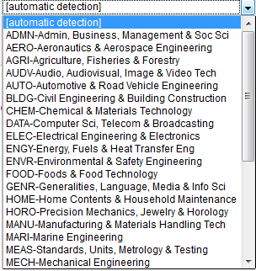

Slide 11
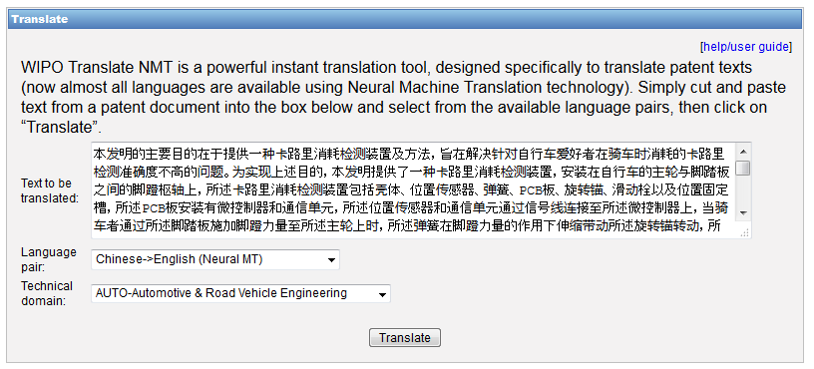
WIPO Translate: an example

Slide 12
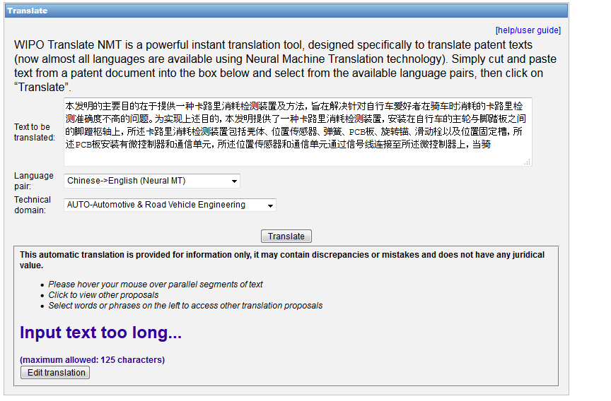

Slide 13
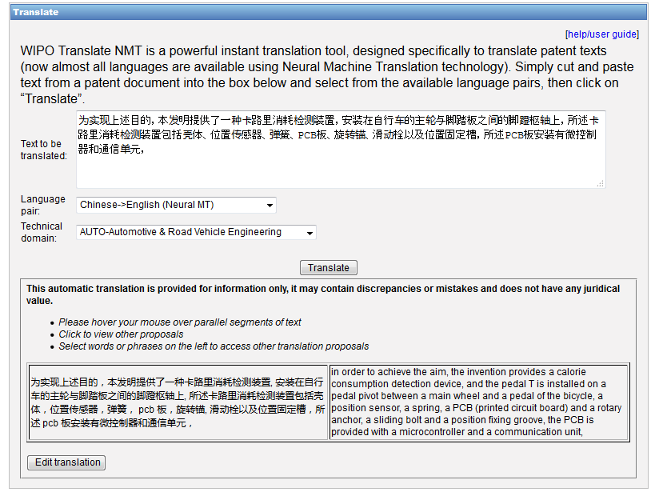

Slide 14
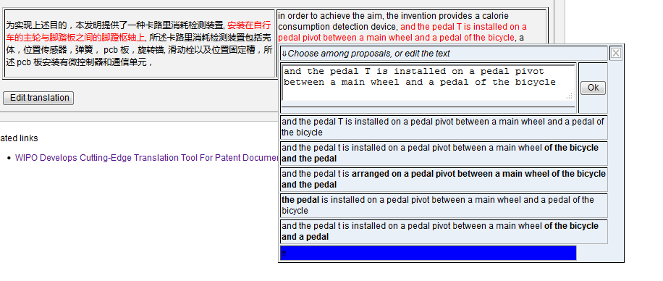

Slide 15
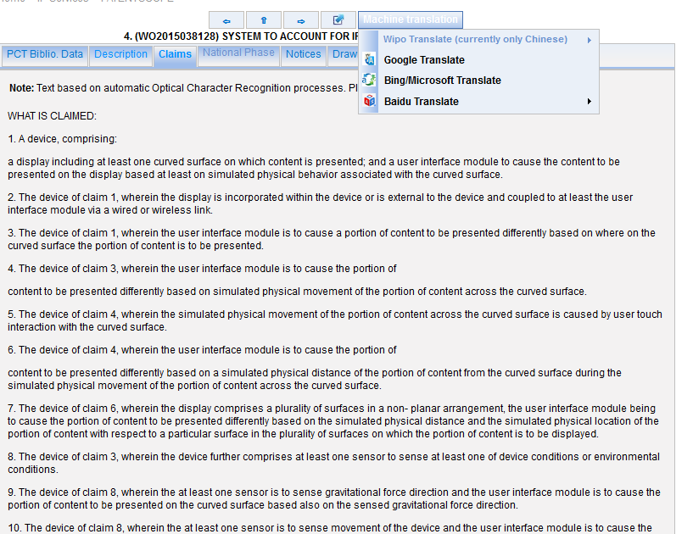
WIPO Translate: description/claims

Slide 16
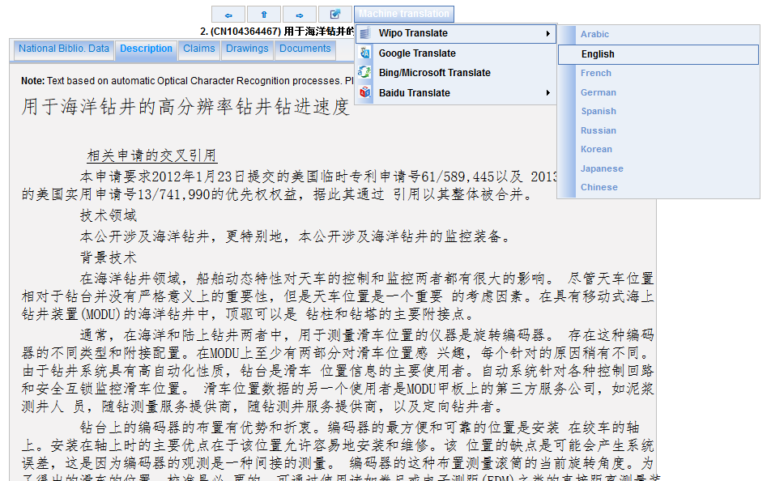

Slide 17
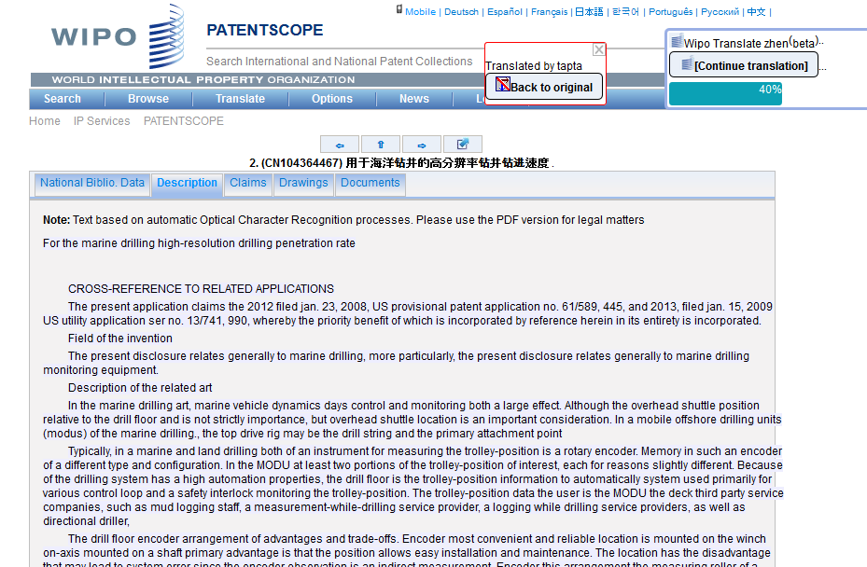

Slide 18
Description/claims: 8 language pairs
Chinese – English English - Chinese
French – English English - French
Japanese – English English - Japanese
Russian – English English - Russian

Slide 19
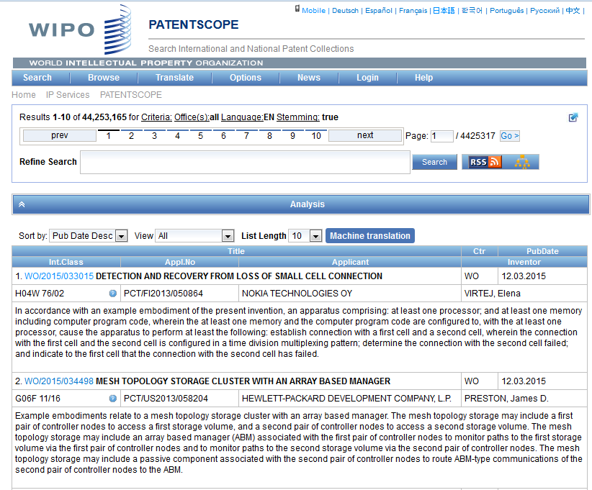
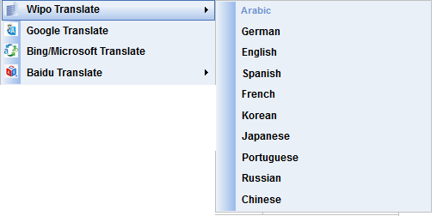
Result list

Slide 20
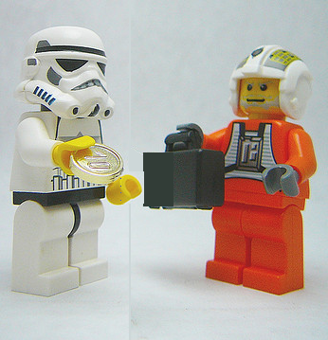
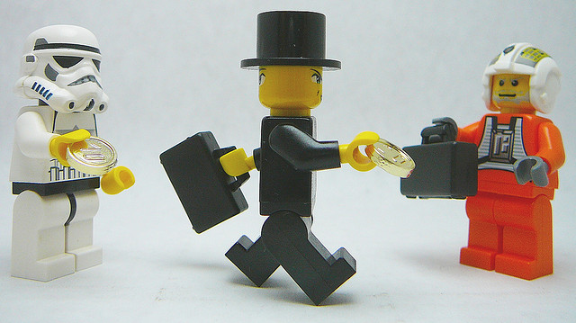
Neural vs. Standard in result list
Direction translation neural
Non- direct translation standard
English - French
Spanish– via English- French

Slide 21
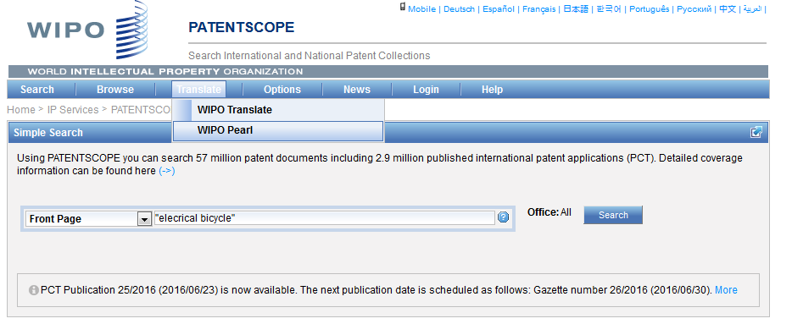
WIPO Pearl

Slide 22
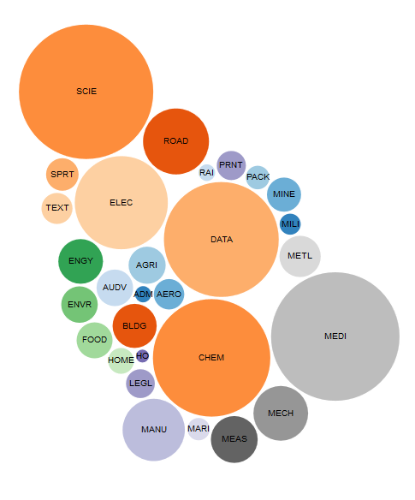
WIPO Pearl http://www.wipo.int/wipopearl/search/home.html

Slide 23

WIPO Pearl
WIPO’s online terminology database
17’000 concepts, 115’000 terms
10 languages
Contents validated by WIPO language experts and terminologists

Slide 24
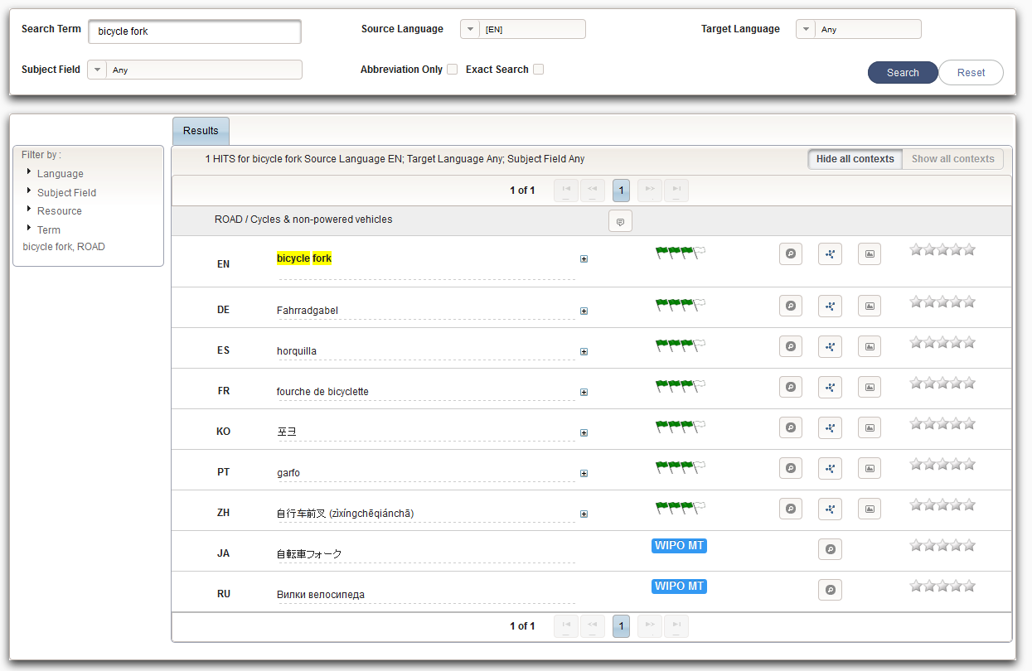
Example: bicycle fork

Slide 25
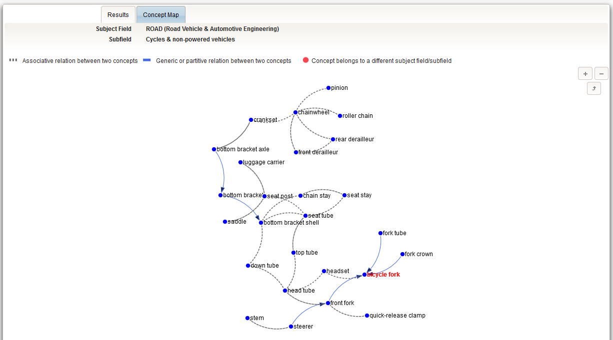

Slide 26
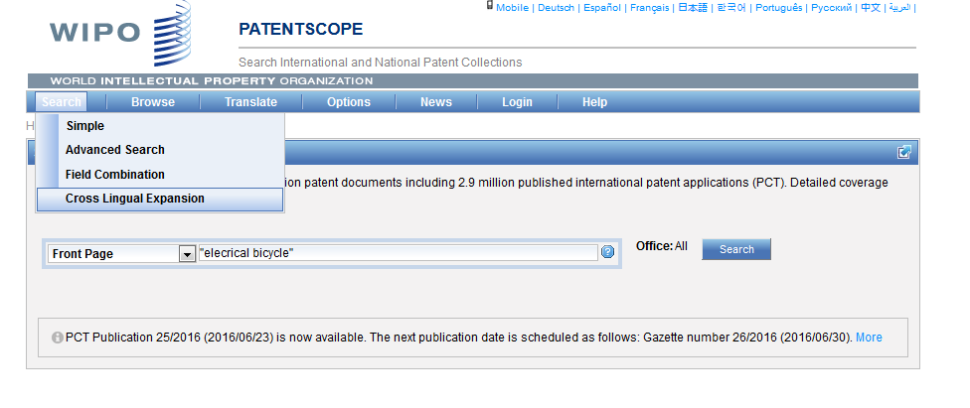
CLIR

Slide 27
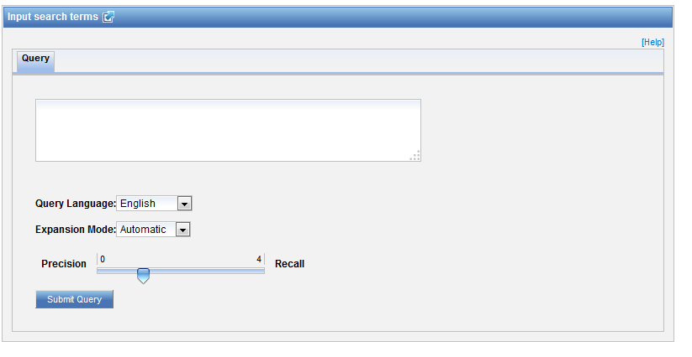
CLIR: interface

Slide 28
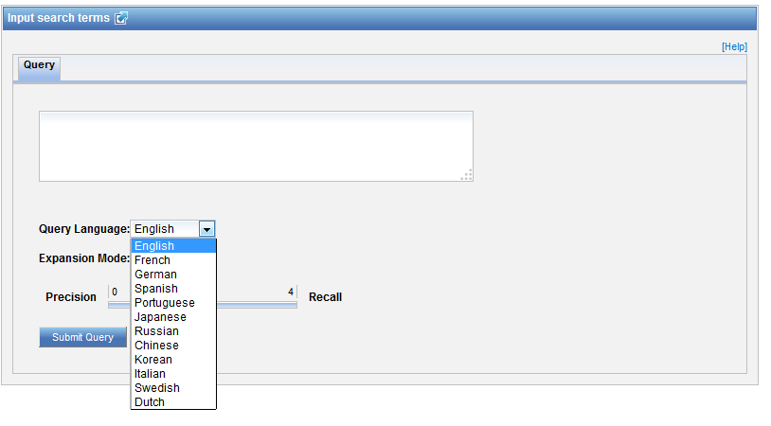
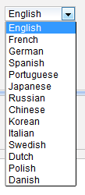
CLIR: query language

Slide 30
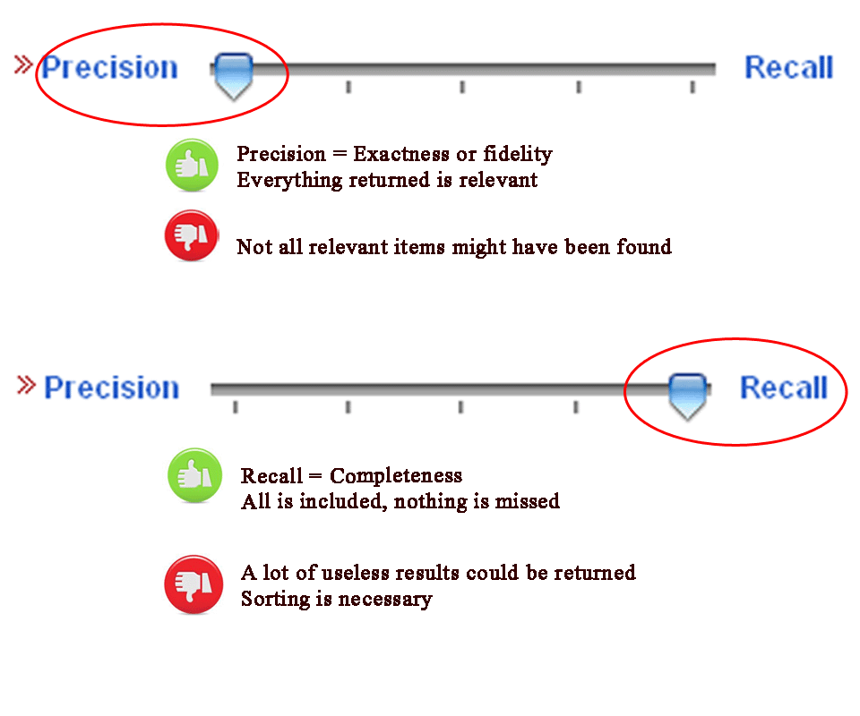
CLIR: precision vs recall

Slide 31
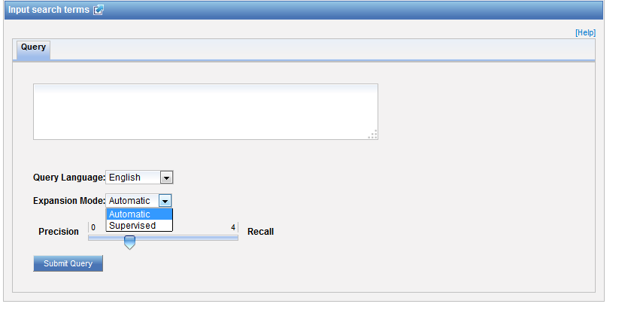
CLIR: expansion mode

Slide 32
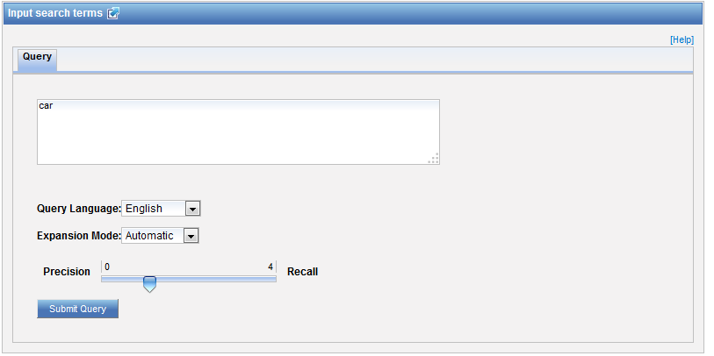
CLIR: an example

Slide 33
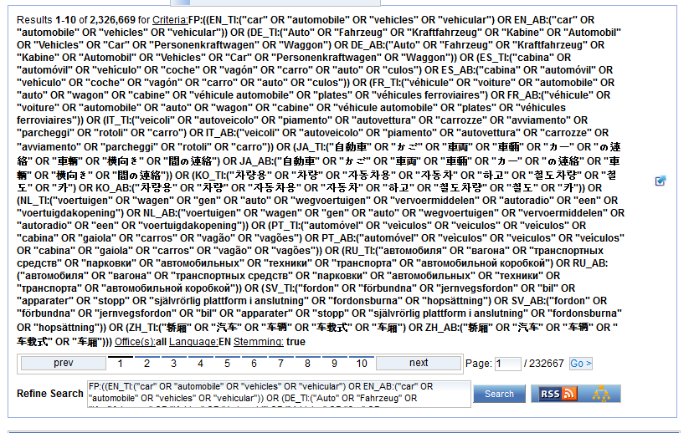
CLIR: an example

Slide 34
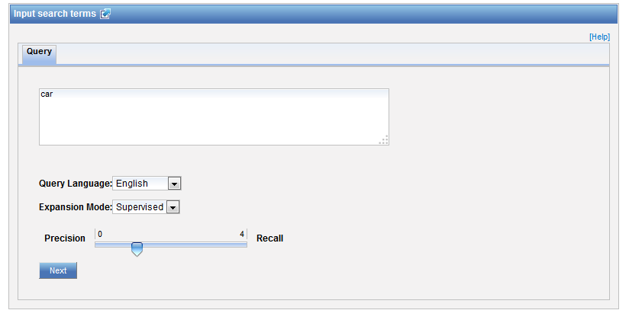
CLIR: supervised

Slide 35
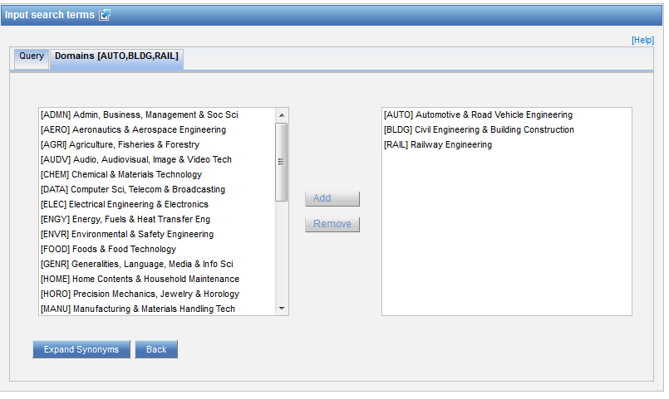
Domain selection

Slide 36
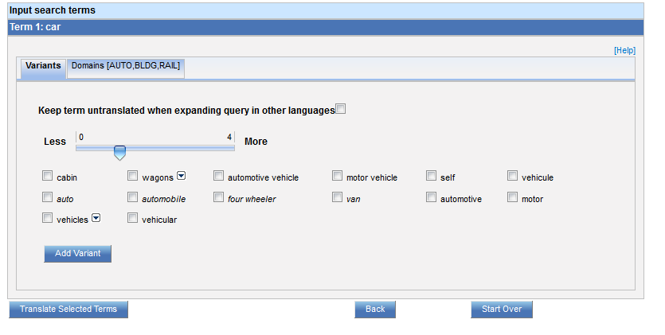
Variants selection

Slide 37
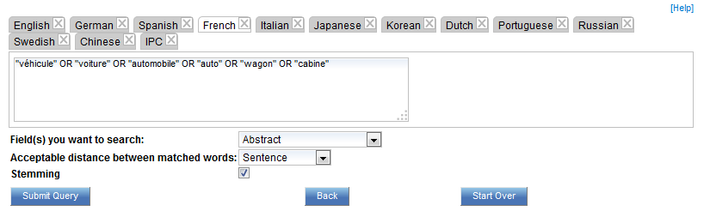
Summary of variants

Slide 38
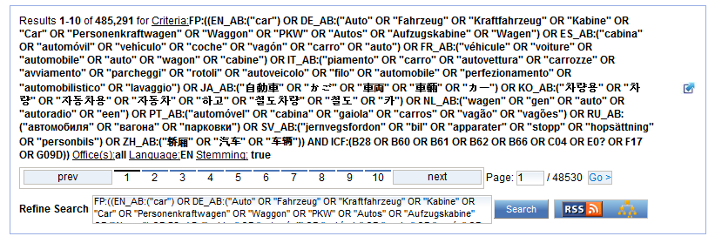
Results

Slide 39


Slide 40
Q.1: The new language available in WIPO Translate is?
A
Swedish
B
Estonian
C
Portuguese
D
Croatian

Slide 41

R.1: The new language available in WIPO Translate is?
A
Swedish
B
Estonian
C
Portuguese
D
Croatian

Slide 42
Q.2: Which translation tools are available in the result list?
A
Bing
B
WIPO translate
C
Baidu
D
Google

Slide 43
R.2: which translation tools are available in the result list?
A
Bing
B
WIPO translate
C
Baidu
D
Google
Spain

Slide 44
Q.3: Is WIPO Translate all neural at the moment?
A
Yes
B
No

Slide 45
R.3: Is WIPO Translate all neural at the moment?
A
Yes
B
No

Slide 46


Slide 47
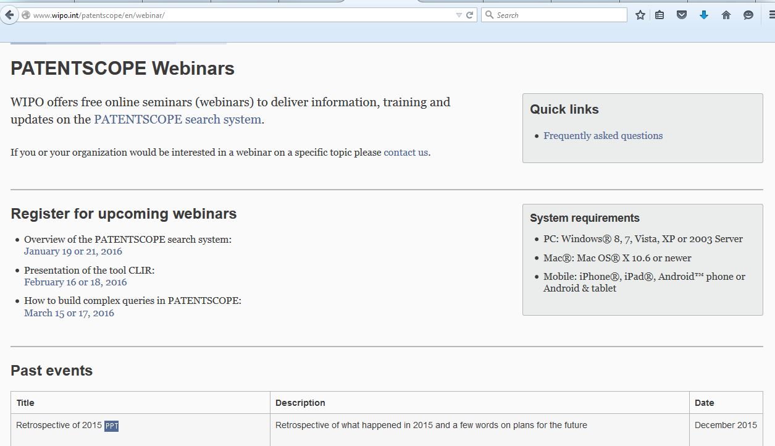
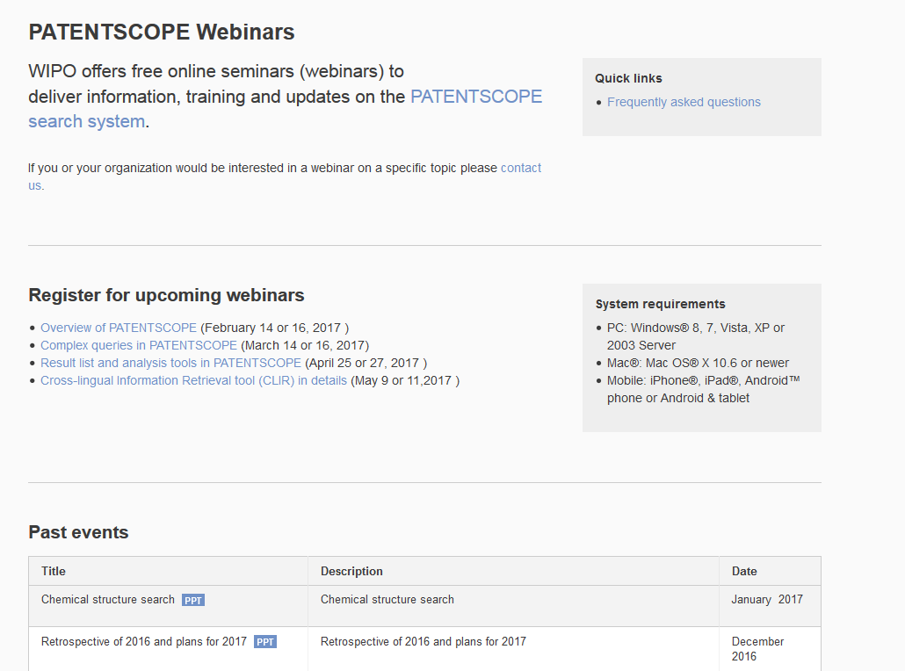
Future/past webinars:
wipo.int/patentscope/en/webinar

Slide 48
August webinar: IPC & PATENTSCOPE
Tue, August 15
5:30 PM - 6:30 PM CEST
Thu, August 17
8:30 AM - 9:30 AM CEST
To sign up: http://www.wipo.int/patentscope/en/webinar/

Slide 49
Global Design Database: webinar
The Global Design Database: an introduction
  July 25 at 5:30pm CET
  https://attendee.gotowebinar.com/rt/1717422151261026817
  July 27 at 8:30 am CET
  https://attendee.gotowebinar.com/rt/1717422151261026817

Slide 50
Global Brand Database: webinar
Performing effective searches in the Global Brand Database
  August 29 at 5:30pm CET
  https://attendee.gotowebinar.com/rt/1767524697735436802
  August 31 at 8:30 am CET
  https://attendee.gotowebinar.com/rt/1767524697735436802

Slide 51
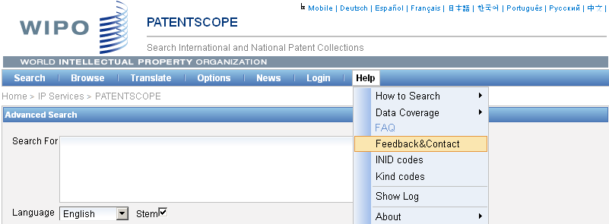
Forum

Slide 52

patentscope@wipo.int

