Slide 1
Advanced search
PATENTSCOPE search system
Cyberworld
February
2015
Sandrine Ammann
Marketing & Communications Officer

Slide 2
To the PATENTSCOPE search system webinar
Advanced search

Slide 3
Agenda
Future developments & news
Advanced search interface
Why use it?
“Cosmectic” features
Search features
Quiz
Q & A

Slide 5
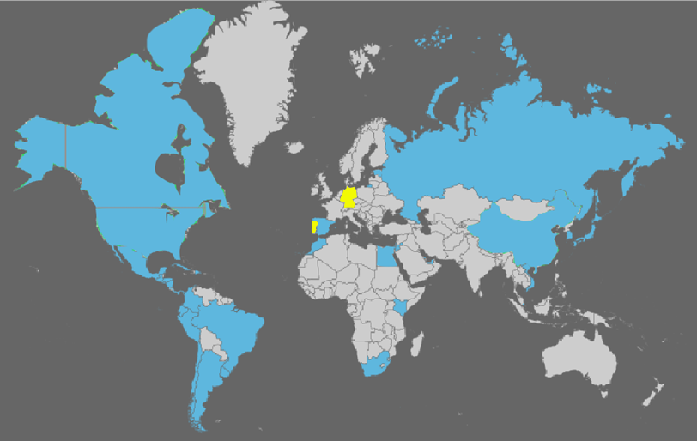
Coverage : Collections
PCT applications, ARIPO, EP, EAPO and LATIPAT collections
Notes:
ARIPO: African Regional IP Org
PCT: 1st publication worldwide

Slide 6
Coverage : Details of collections

Slide 7
To be added in the future
UK
DK
AU
NZ

Slide 8
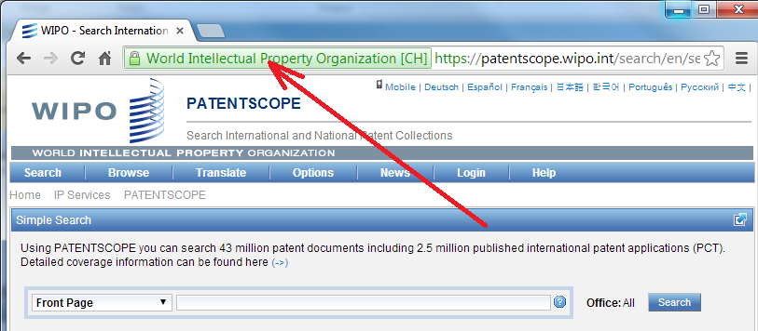
New: https

Slide 9
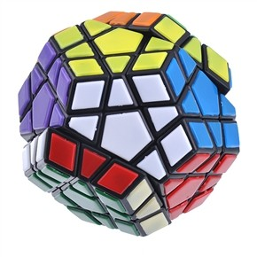
COMPLEX QUERIES

Slide 10
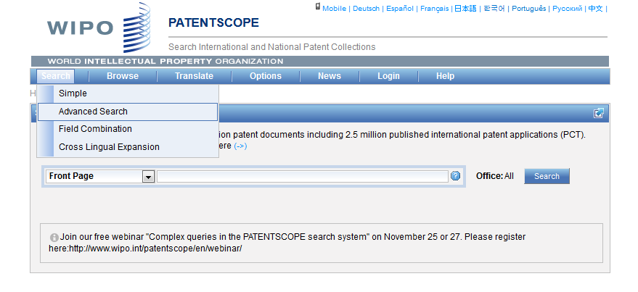
Advanced search interface

Slide 11
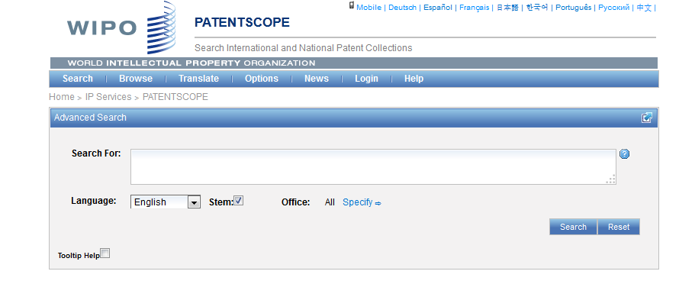
Help

Slide 12
Tooltip help

Slide 13
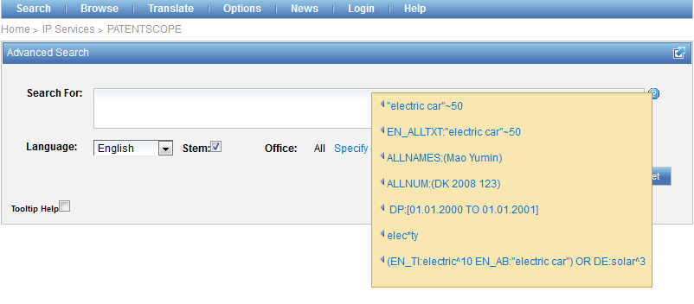
Question mark help

Slide 14
Advanced search interface

Slide 15
Stem
Stem = stemming
Process that removes common endings from words.
critical critically criticism each word is reduced to ‘critic’
criticisms critics

Slide 16
Stemming
no dictionary includes the necessary technical terms to express patent concepts
Porter Stemming Algorithm finds words that contain common roots
Save time and effort

Slide 17
Stemming - example
Results: 308,082

Slide 18
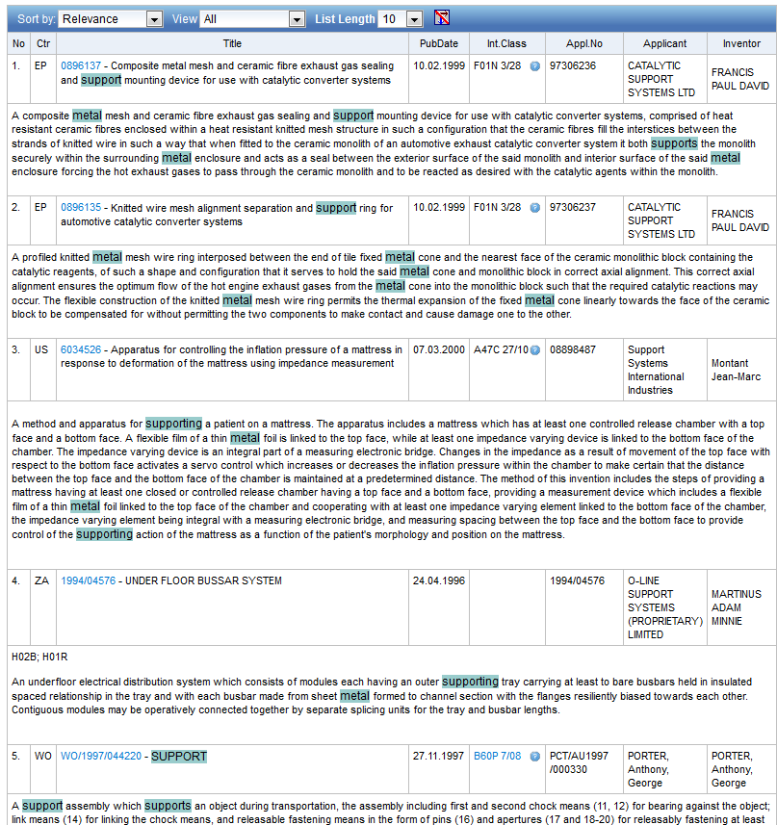

Slide 19
Stemming - example
Results: 172,233

Slide 20
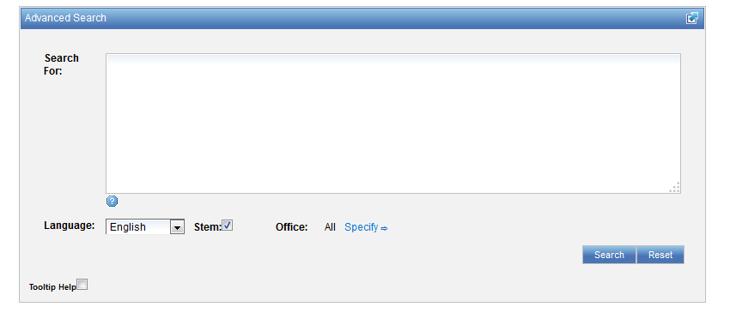
Advanced search interface

Slide 21
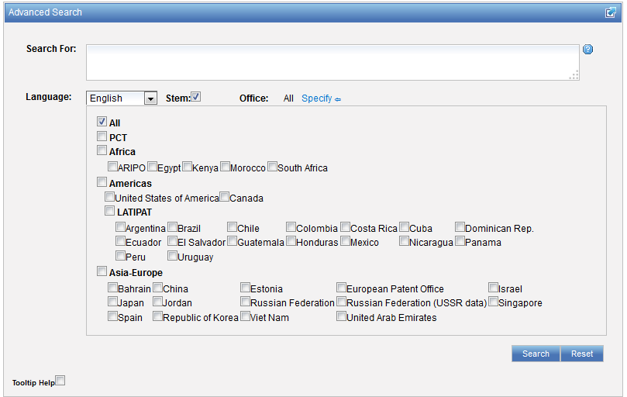
Advanced search interface

Slide 22
Advanced search interface
Search syntax
Search fields

Slide 23
Query : terms and phrases
Query: single word or multiple words or phrases
Multiple terms can be combined together with Boolean operators to form a more complex query
Notes:
A Single Term is a single word such as "car" or "engine".
A Phrase is a group of words surrounded by double quotes suchas "electric car".

Slide 24
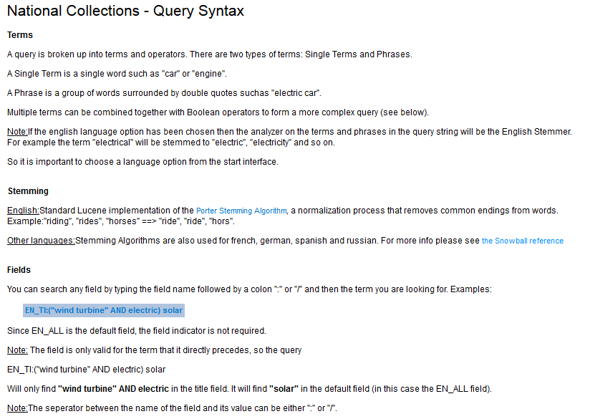
Search syntax

Slide 25
Wildcards – truncation: ? *
plural form of a word, or alternative spellings
* stands for 0 or more characters
? stands single character
te?t = test or text
electric* = electrical; electricity
behavi*r = behaviour or behavior
micro?p* = microspeaker, microsporidial

Slide 26
Boolean operators
Boolean operators define the relationships between words or groups of words.
AND
OR
ANDNOT - NOT

Slide 27
Proximity: NEAR = ~5
cell NEAR10 pack = «cell pack»~10

Slide 28
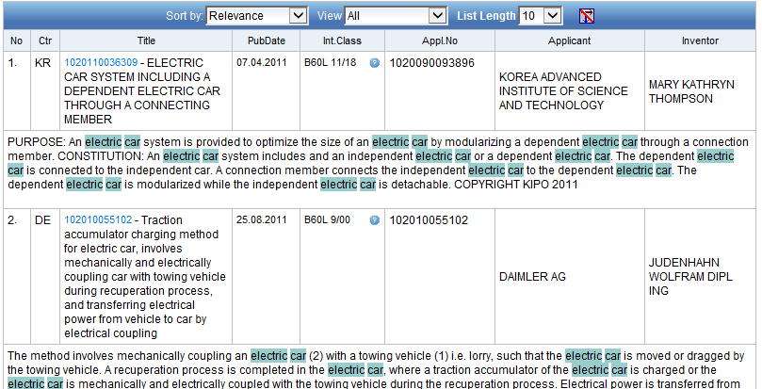
Proximity: before
EN_AB:(electric BEFORE car)

Slide 29
Fuzzy searches
Use of the tilde: ~
Examples:
roam~ foam / roams
Roam~0.8
Notes:
Smilar in spelling

Slide 30
^ caret = weighting factor
Same result but ranking will be different
touch^3 AND polarize

Slide 31
Source: http://spicewallpaper.blogspot.ch/2012/08/green-fields-with-blue-sky.html

Slide 32
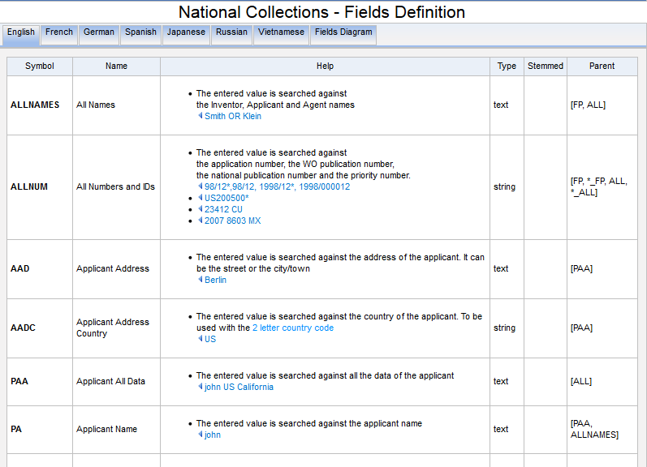
Search fields

Slide 33
Examples
FP = front page
ALL = all fields
ALL_NAMES = all names
IC = IPC
DP = publication date
CTR = country either WO or country from nat collection
NPCC= national phase entry
AN = origin of PCT
http://patentscope.wipo.int/search/en/help/fieldsHelp.jsf

Slide 34
Fields rules
Basic fields: elements of a patent document
Derived fields
2 letter code = individual field
EN_TI FR_AB ES_DE_S
Convention: language specified by 2 letters
if not specified all languages
S = stemmed
: to separate term without any space

Slide 35
Fields: golden rules
EN_ALL = default field field indicator not required
Field name followed by : ":" or "/"
The field is only valid for the term that it directly precedes, so the query:
EN_TI:("wind turbine" AND electric) solar
Results: "wind turbine" AND electric in the title field. "solar" in the default field (EN_ALL ).

Slide 36
Grouping/nesting
Solar OR (wind AND turbine)
(solar OR wind) AND turbine
EN_TI: electric car
electric will be searched in English title but car in all fields
EN_TI: (electric car)
Both electric and car will be searched in the English title

Slide 37
Grouping/nesting
Not all combinations work:
(electric AND car) NEAR power X
power NEAR (electric AND car) X
power NEAR (vehicle OR car)
EN_AB: hearing NEAR aid X
EN_AB: (hearing NEAR aid)
Notes:
Composition rules of operators
Avoid ambiguity

Slide 38
Range search
Range:
DP:[01.01.2000 TO 01.01.2001]
Can also be used to search non-date fields
IN: {Smith to Terence}

Slide 39
Date search
Simple:
DP:01.02.2000
DP:20000201
DP:02.2000
DP:200002
DP:2000

Slide 40
In the Publication Date field:
Examples
DP:today DP:today-3days DP:today-1Week DP:today-2Years
Time ranges:
DP:[today-1Year TO today] DP:[today-3Years TO today-1year]
Simplified time period ranges :
DP:Last3Days DP:Last2Weeks DP:Last1Year
Last Publications published :
DP:pct_lastpubdate DP:pct_lastpubdate and PA:"University of Paris"
Notes:
DP:Last3Days --> returns all the record that were published by the national/international authority in the last 3 days
Last Publications published Also, the following query returns all the PCT applications published the last time, very useful for implementing RSS queries:

Slide 41
Example: IPC
IC :A
IC :A47
IC :A47L
IC :A47L1
IC:A47L11
IC:A47L11/03

Slide 42
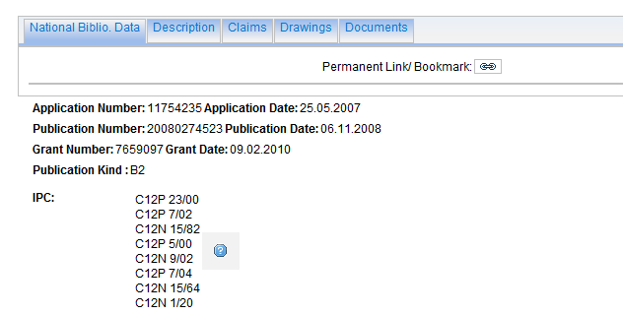
Example: grant

Slide 43
Example: grant

Slide 44
Example: licensing + 3rd party observation

Slide 45
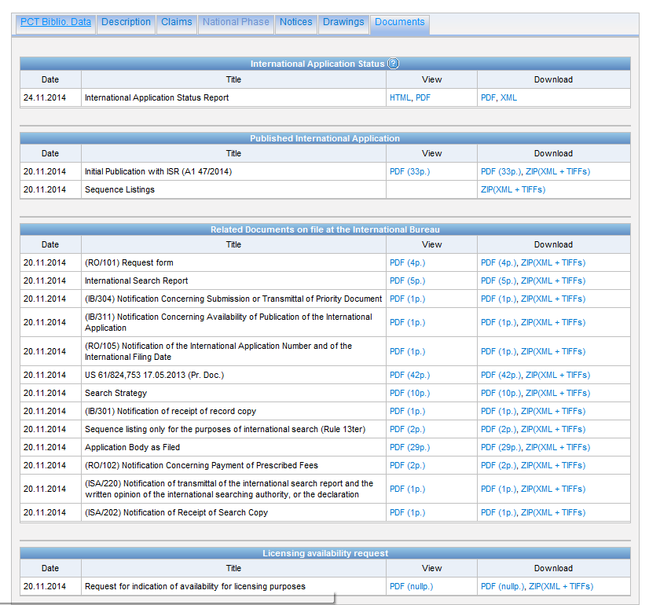

Slide 46
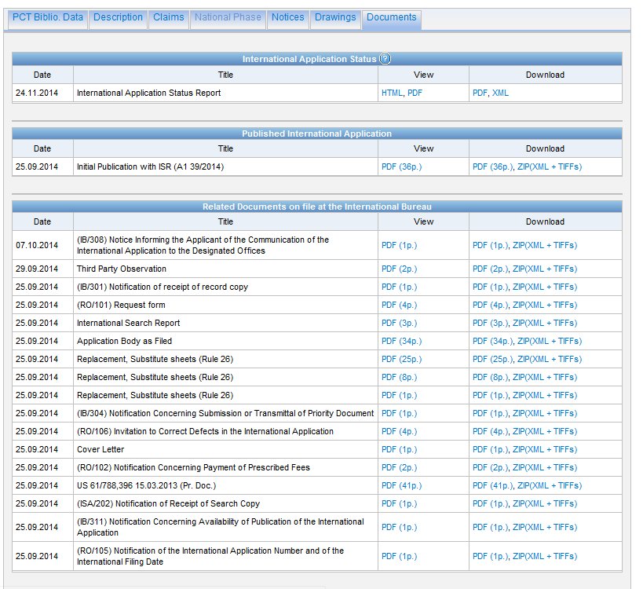

Slide 47
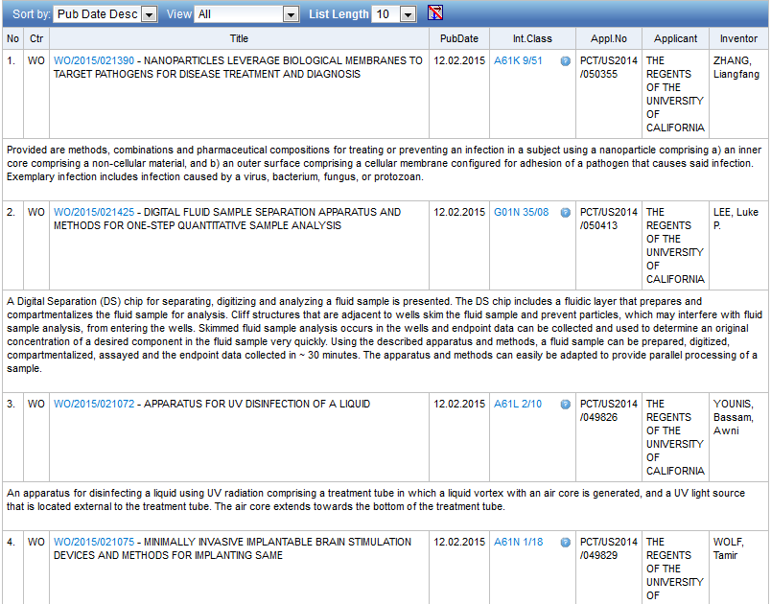
Example: last pub + applicant

Slide 48
Example: national phase entry
All applications that entered national phase in China in 2012

Slide 49
Example: nb of patent applications from France seeking protection in USA in 2012.

Slide 50
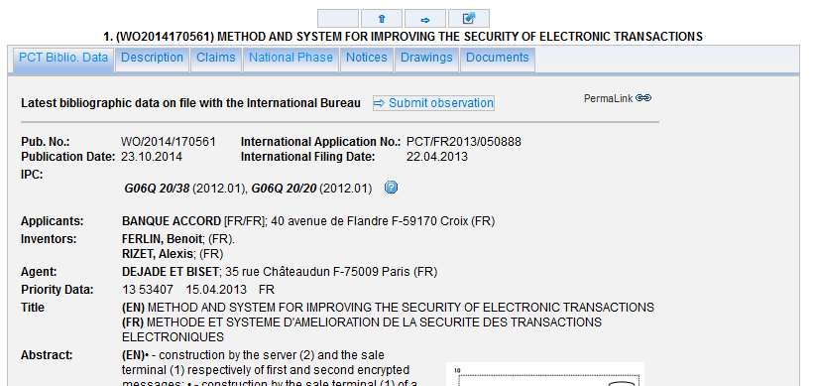

Slide 52
Most common errors
(….) "…"
Field name
No space
No wildcard at the beginning of a word

Slide 53
Challenges
Differences in languages: vent = wind in FR and outlet in EN
Number formatting: 75 percent -75%- ¾- 0.75
Measurement units: : cm/yard/km
Synonyms – homonyms: mobile/cell phone mouse
Human error
Name variation

Slide 55
Q:1: which national collections were added last in the system?
A
Norway
B
Butan
C
Germany
D
Portugal

Slide 56
Q:1: which national collection was/were added last in the system?
A
Norway
B
Butan
C
Germany
D
Portugal
Spain

Slide 57
Q:2: when you use wildcard, …
A
The results retrieved are all relevant
B
Stemming is turned off

Slide 58
Q: 2: when you use wildcards, …
A
The results retrieved are all relevant
B
Stemming is turned off

Slide 59
Q:3 how to build a query in order to obtain patent documents by the company Huawei with at least one innovator from Germany ?
A
Huawei AND Germany
B
IN:Huawei AND INA: Germany
C
IADC:DE AND PA:Huawei
D
CTR: Germany AND IN: Huawei

Slide 60
Q:3 how to build a query in order to obtain patents by the company Huawei with at least one innovator from Germany (DE)?
A
Huawei AND Germany
B
IN:Huawei AND INA: Germany
C
IADC:DE AND PA:Huawei
D
CTR: Germany AND IN: Huawei

Slide 62
patentscope@wipo.int

Slide 63
mulțumesc
mulțumesc

