Slide 1


Slide 2
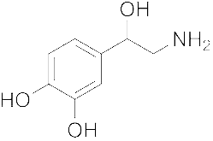
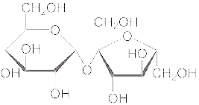
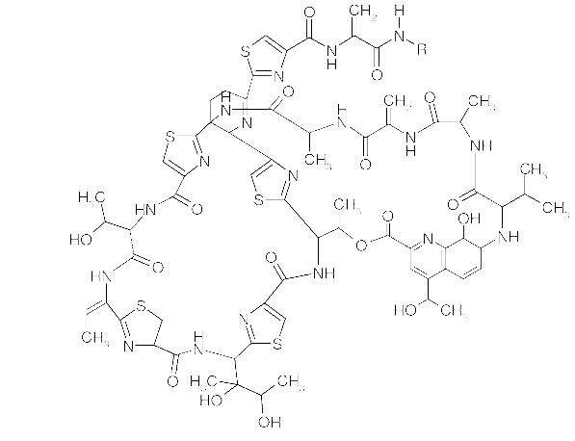
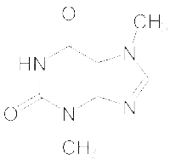
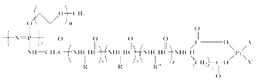
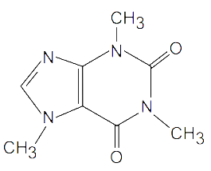
Agenda
Chemical structure search
Access
How does it work?
Future plans
Q&A

Slide 3
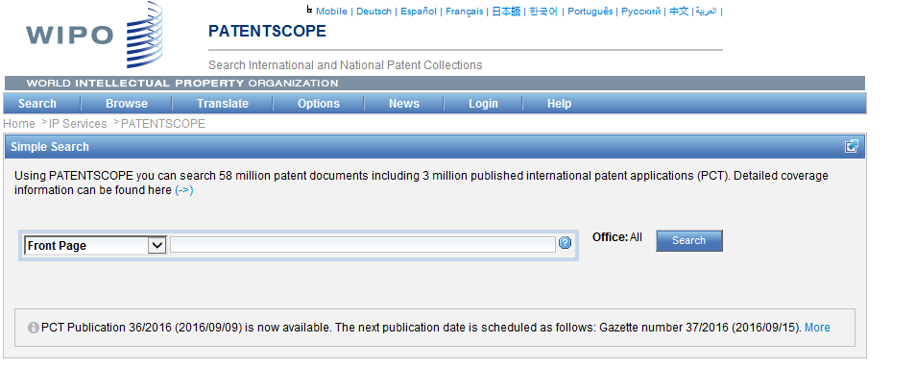
Access
Available at https://patentscope.wipo.int
Access only with a PATENTSCOPE account

Slide 4
The concept
Recognize the names of chemical compounds in patent texts and their structures from embedded drawings included in patent texts
Standardize all the different representations of chemical structures into InchIkeys
Implement search functions using InchIkeys that can be used by non chemists

Slide 5
InchIkeys
Definition: a short, fixed-length character signature based on a hash code of the InChI string.
  InChIkeys provide a precise, robust, IUPAC* approved structure-derived tag for a chemical substance.
*International Union of Pure and Applied Chemistry

Slide 6
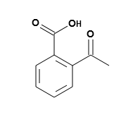
Example: InchI – InchIKey for aspirin
InChIKey = a fixed-length (27-character) condensed digital representation of an InChI
InChI = is a textual identifier developed to make it easy to perform web searches for chemical structures

Slide 7
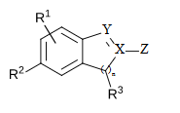
Scope
Works on developed exact formulas ≠ Markush structures (-R) that are chemical symbols used to indicate a collection of chemicals with similar structures.

Slide 8
Limitations
Long automated procedures, no supervision
Will not recognize 100%! Same drawbacks as the OCR
Depends on OCR quality for PCT applications
Does not work with simple formulas such H2O
Not all collections and related languages
Notes:
Simple formulae like H2O are not captured to avoid information overload (and they can be searched by keywords).

Slide 9
Why is it useful?
Common names such as “aspirin”, “paracetamol” might not be used in patent documents
There are many ways of representing formulas

Slide 10
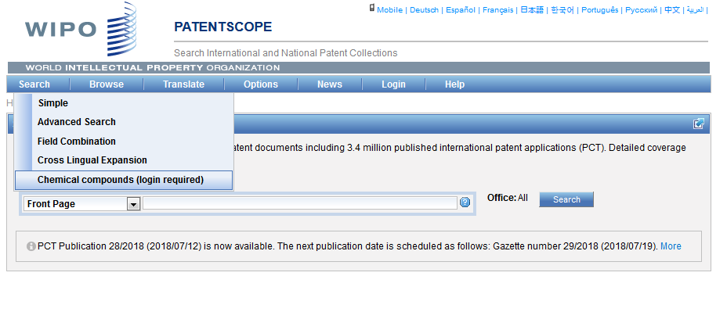

How does it work?

Slide 11
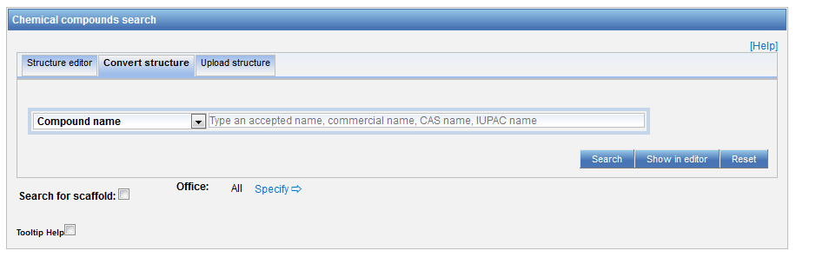
3 options

Slide 12
Scaffold
Basic skeleton of a molecule to which further groups and moieties are attached

Slide 13
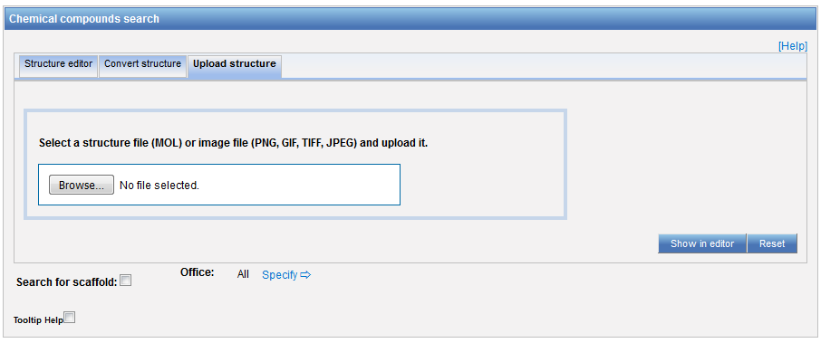
Upload a structure

Slide 14
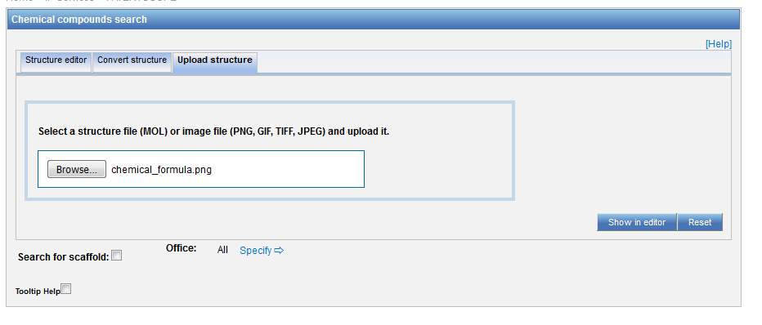
Example

Slide 15
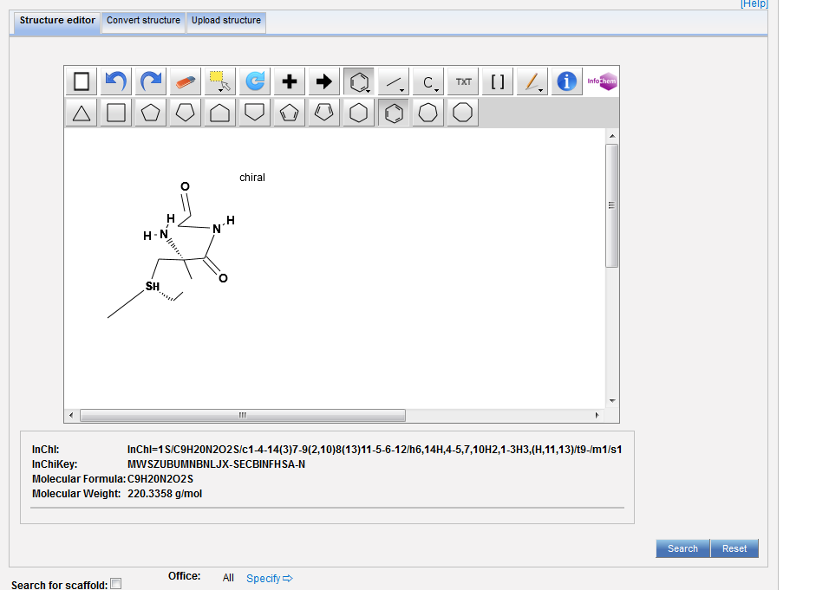

Slide 16
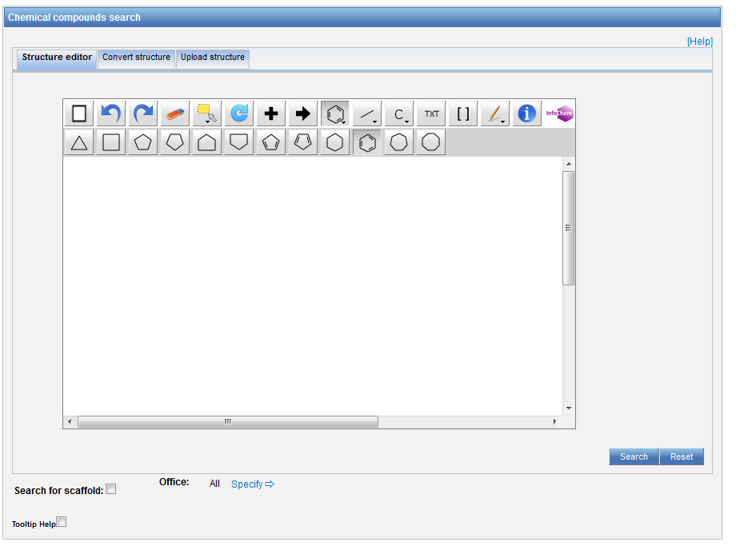
Structure editor

Slide 17
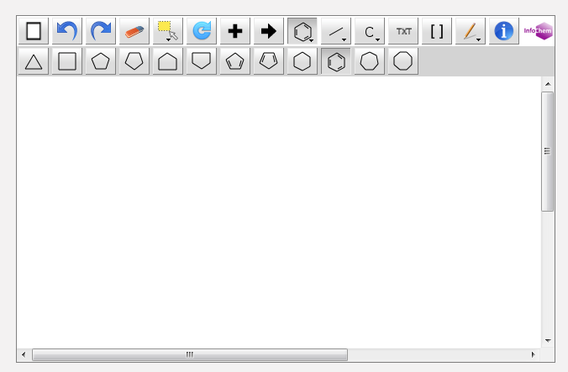

Example

Slide 18
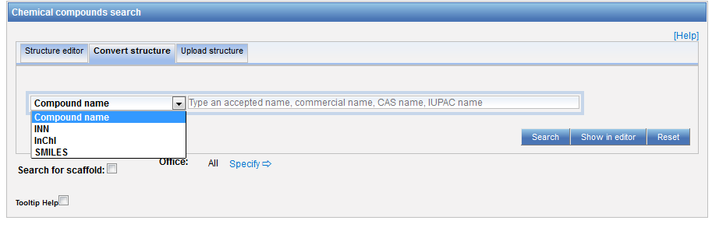
Convert a structure

Slide 19
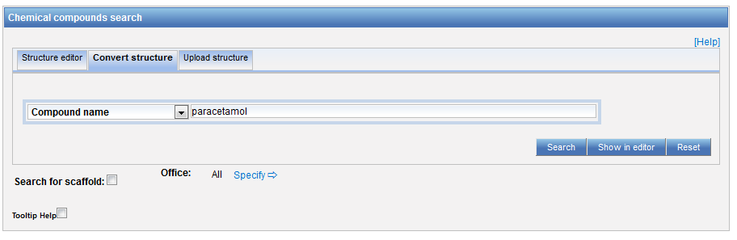
Convert structure: ex.: paracetamol

Slide 20
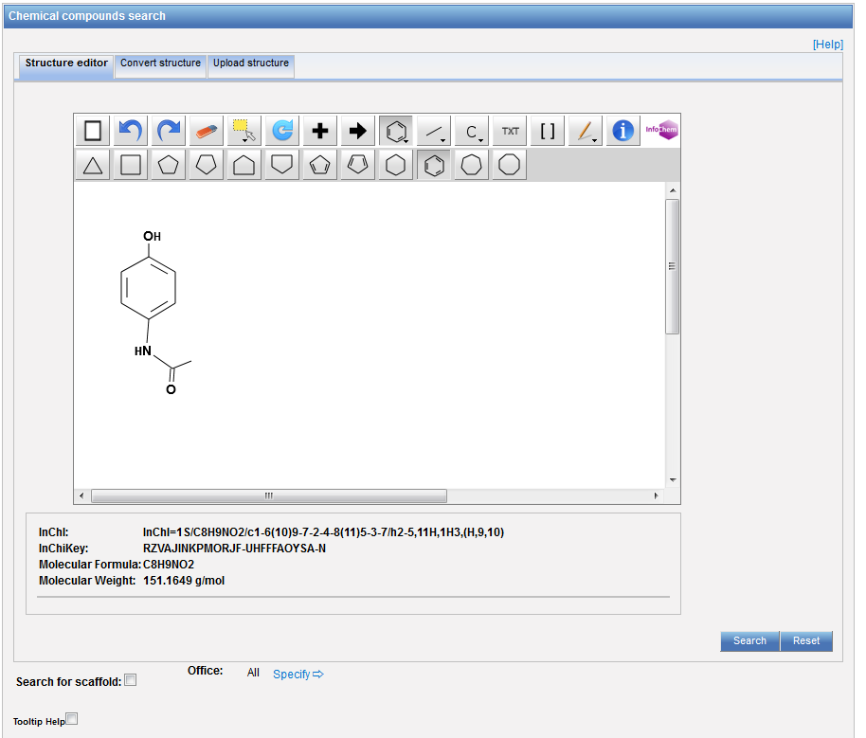

Slide 21
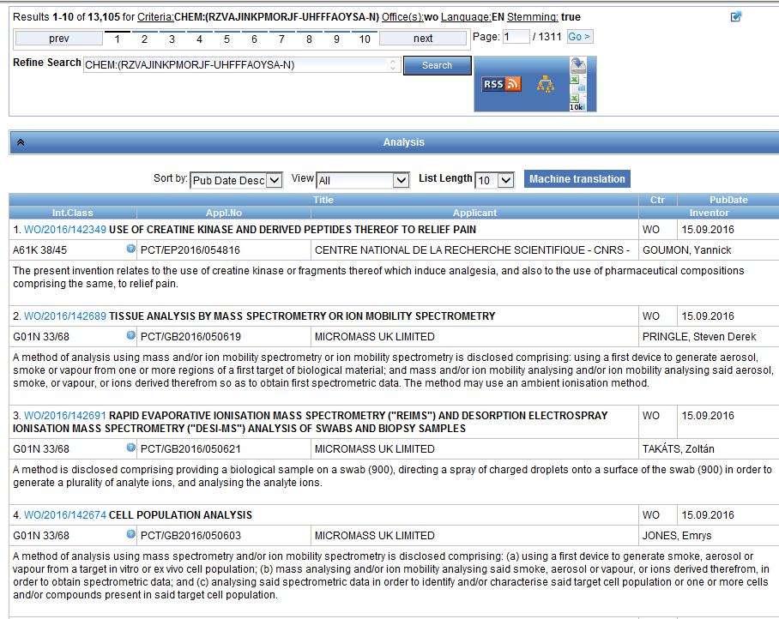
Results

Slide 22
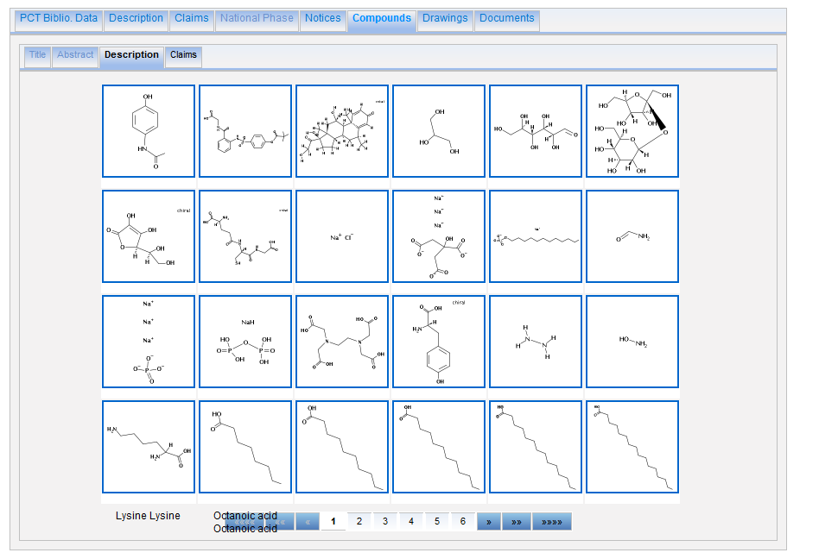

Slide 23
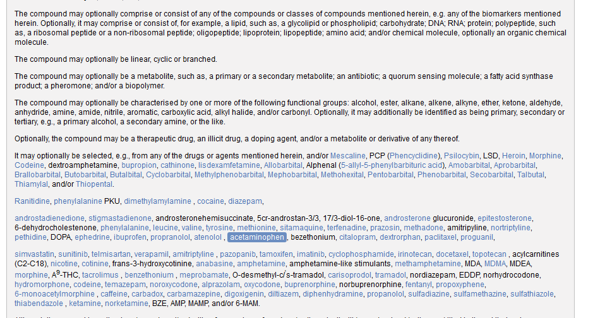

Slide 24
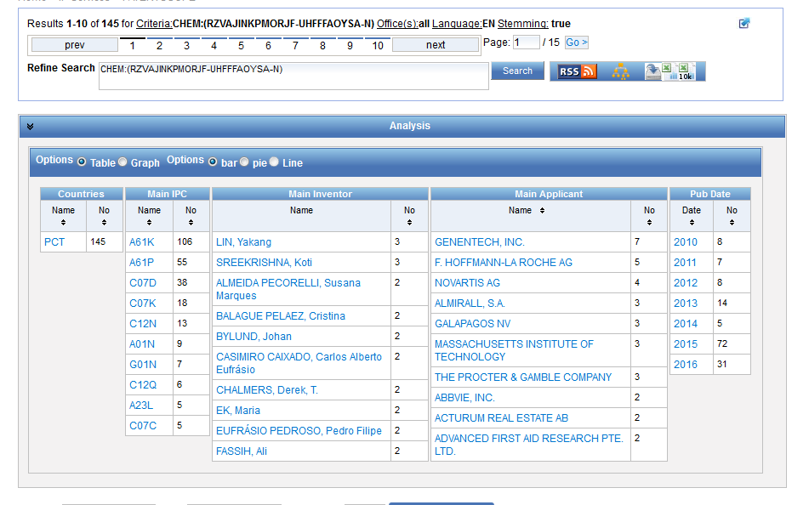
Analysis

Slide 25
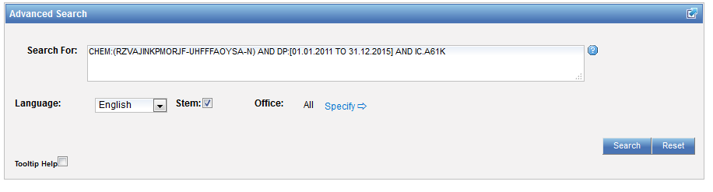
Combine results with searches

Slide 26
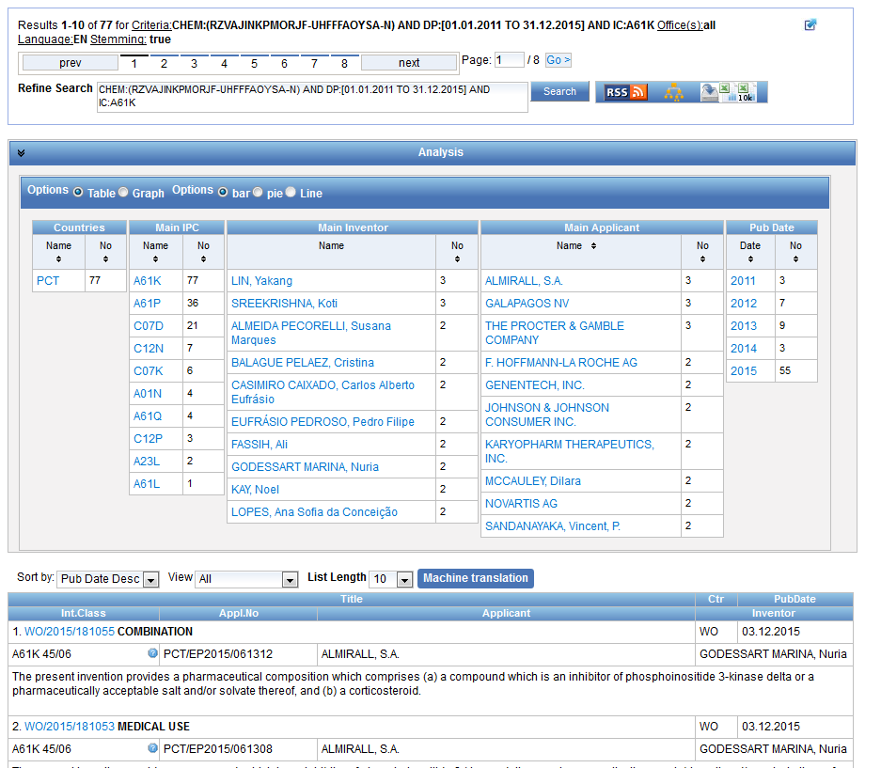

Slide 27

Search example: Theobromine
Its chemical formula is C₇H₈N₄O₂ and IUPAC name:
3,7-dimethyl-1H-purine-2,6-dione
Theobromine is found in the seeds of the plant Theobroma Cacao, which is the well-known source of chocolate and cocoa. It has a bitter flavor, which gives dark chocolate its typical bitter taste.
Notes:
I will now show you how to use the system with the example of theobromine.
The IUPAC name of theobromine is 3,7 dimethyl 1H purine 2,6 dione. It can be found in dark chocolate and is responsible for it’s bitter taste.
27

Slide 28
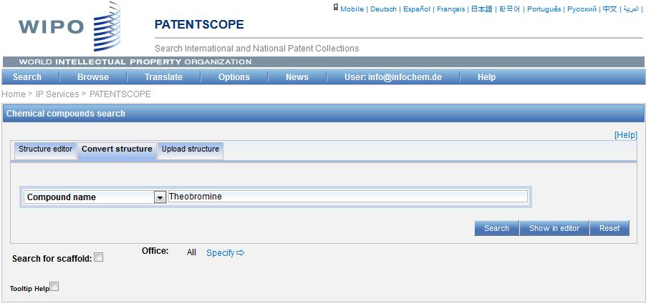
Notes:
I enter theobromine in the search by component name text field but instead of clicking the search button directly, I click the «show in editor» button to show you the information the system can find about this name.

Slide 29
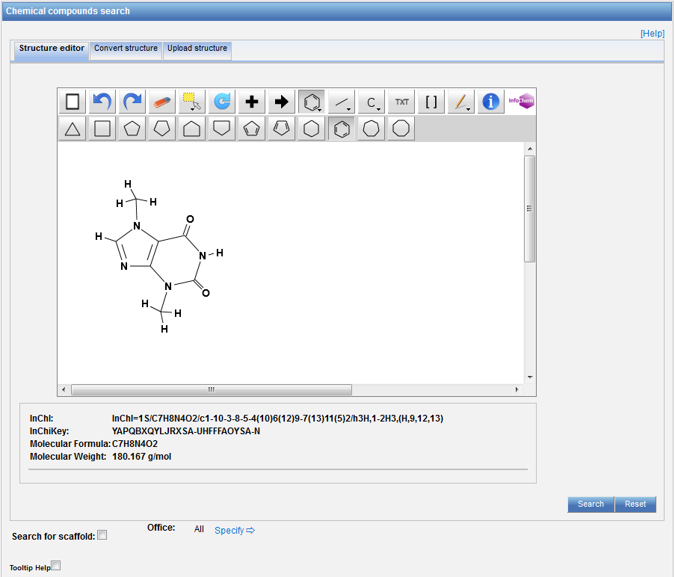
Notes:
We see indeed that theobromine is a recognized compound, we have even a drawing of its formula but more importantly we have the corresponding Inchi key which is displayed here. Now, we click on the Search button.

Slide 30
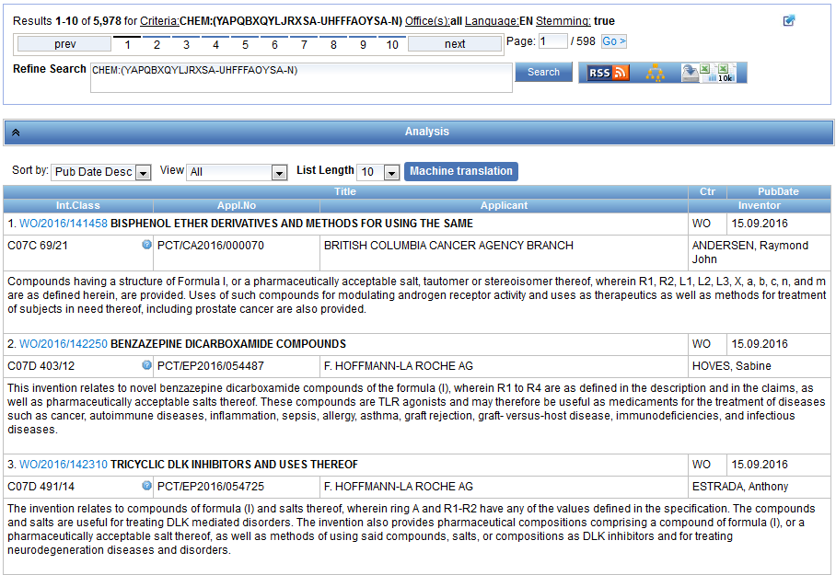
Notes:
And the system displays the results list of the PATENTSCOPE documents citing theobromine or any of its other representations in the title or abstract or description or claims. We see here that there are almost 6000 results and we see here the new PATENTSCOPE indexed field called CHEM that has been used to perform the search.
As with most PATENTSCOPE queries, the result list can be sorted by relevancy, which will show first the documents citing the compound the most frequently.
Now, let us click on the first result to see the details of the retrieved patent application.

Slide 31
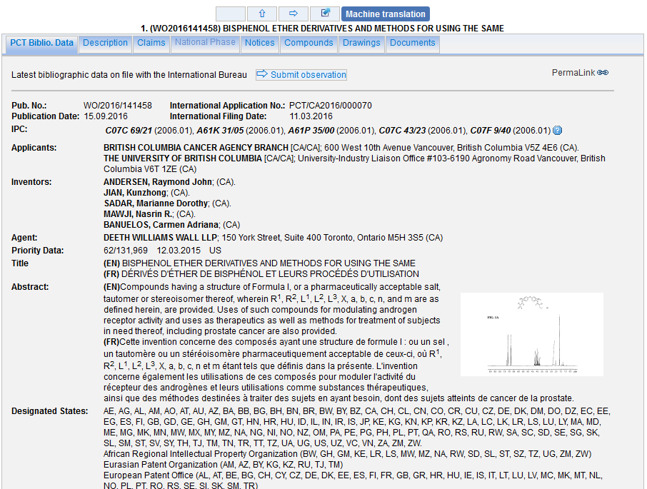
Notes:
It is a PCT application filed in Canada. We see here a new tab called compounds.

Slide 32
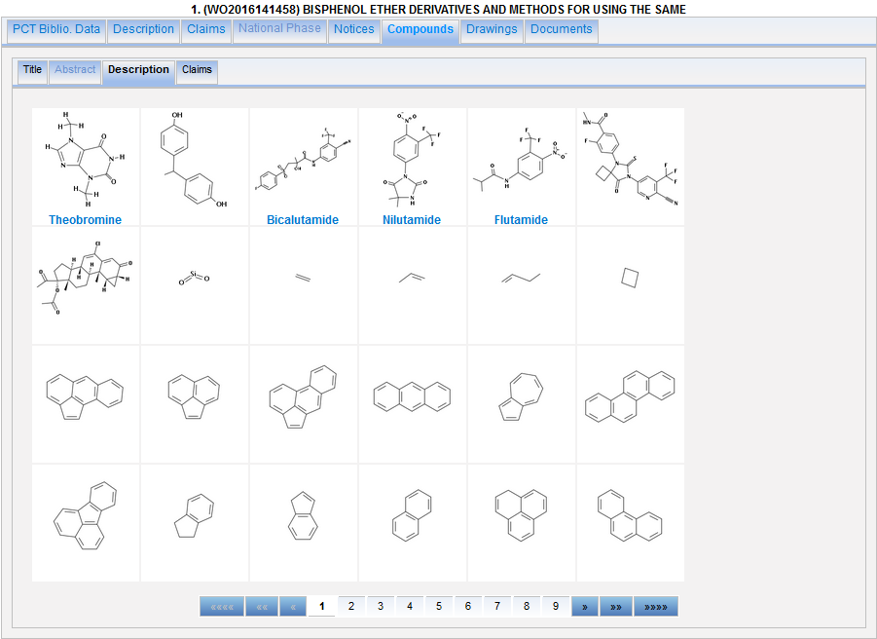
Notes:
Well, as expected, it shows the compounds detected in the document respectîvely in the title, abstract, description and claims of the application.
If we click on theobromine,

Slide 33
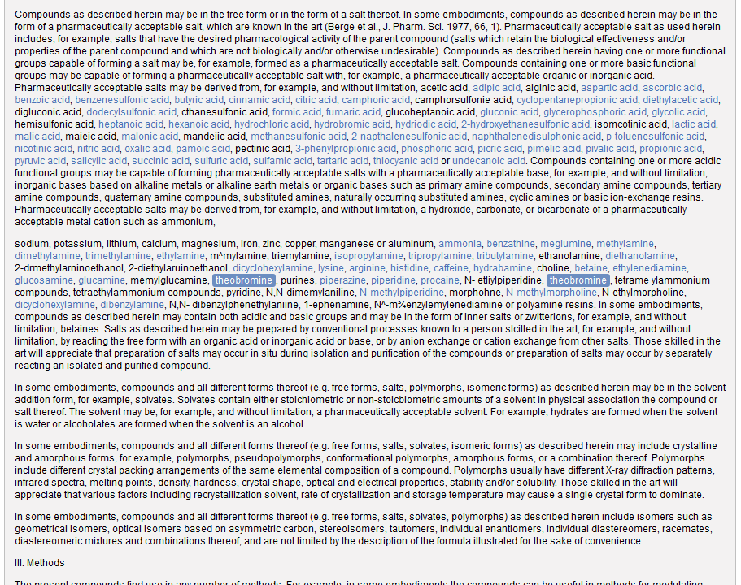
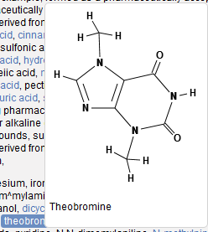
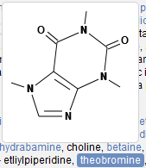
Notes:
Then the system opens the corresponding part of the document containing the compound, here the description.
If you move your mouse over the compound representation in the text, then the system displays the drawing of the formula. All recognized formulae are displayed also in blue and can be examined the same way, for example this is caffeine.

Slide 34
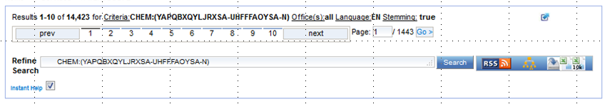
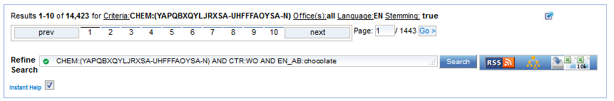
Add search criteria
PCT applications
Chocolate in English abstract
Notes:
Now let us imagine we want to restrict our search to PCT applications citing chocolate in their abstract.
This is done by combining the chemical compound search with other criteria using boolean logic as displayed here and now we only have 9 results to look at.

Slide 35
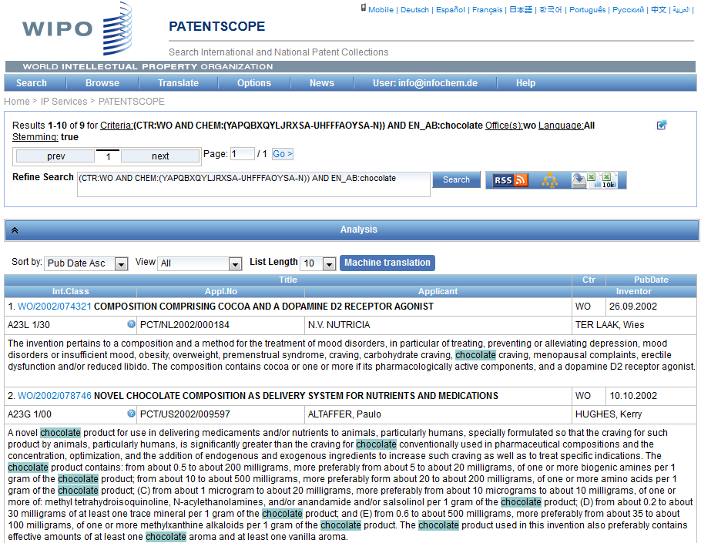

Slide 36
Example: fluoxetine hydrochloride
Its chemical formula is C₁₇H₁₉ClF₃NO
the first highly specific serotonin uptake inhibitor. It is used as an antidepressant and often has a more acceptable side-effects profile than traditional antidepressants.
Synonyms: Prozac, Sarafem

Slide 37
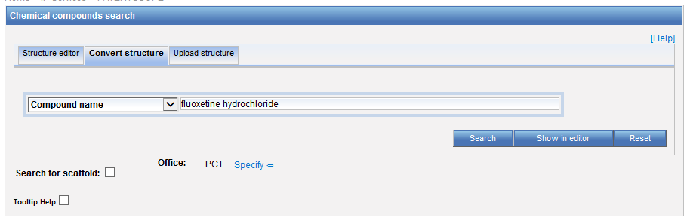
Chemical compound search

Slide 38
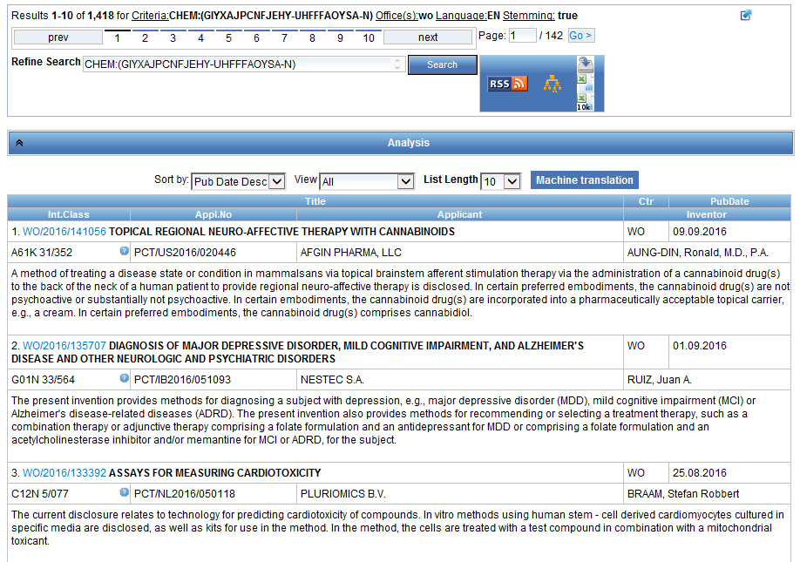

Slide 39
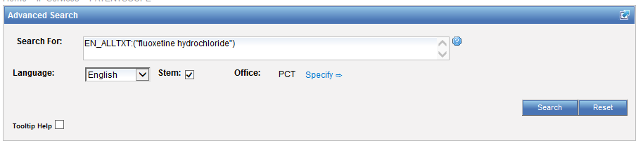
Advanced search

Slide 40
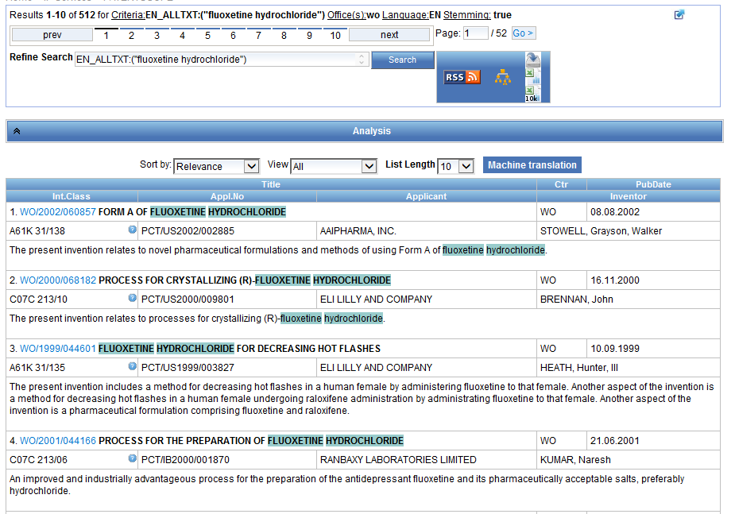

Slide 41
Example: Viagra
Chemical names: Sildenafil; 139755-83-2; Revatio; VIAGRA; Sildenafil [INN:BAN]; CHEMBL192
Molecular formula: C₂₂H₃₀N₆O₄S

Slide 42
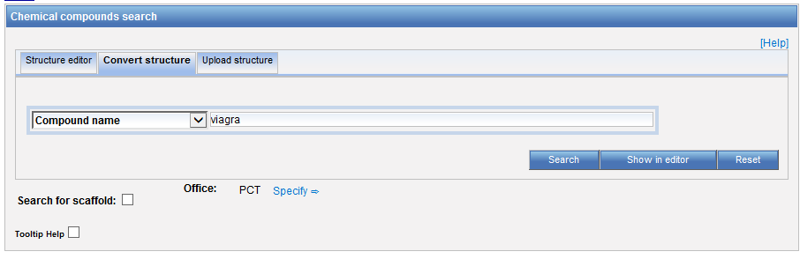
Chemical compound search

Slide 43
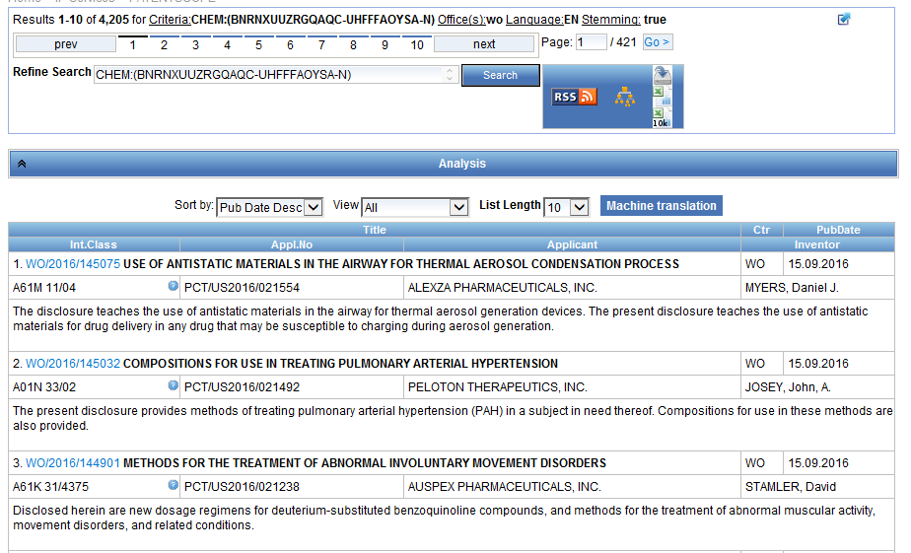

Slide 44
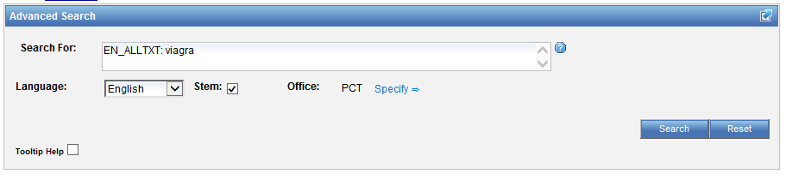
Advanced search

Slide 45
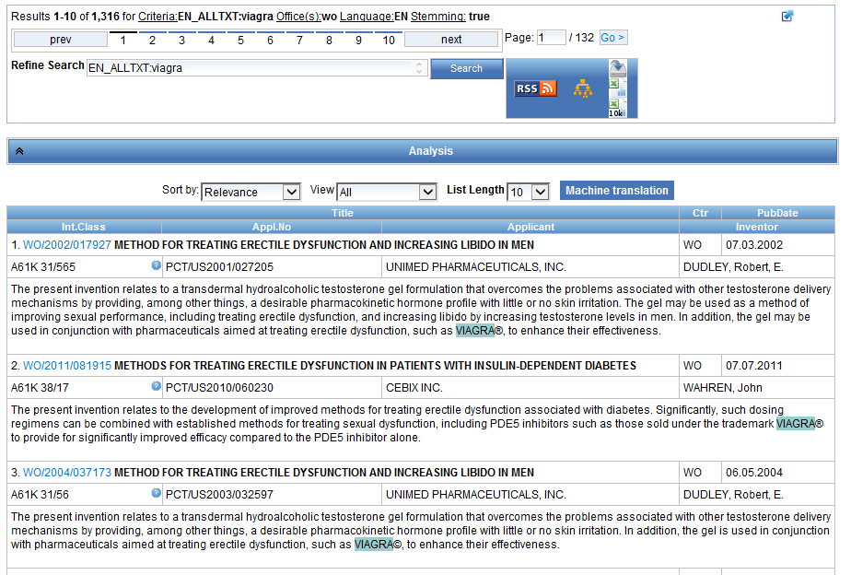

Slide 46
Example formula searching
4-(3-chloro-2-fluoroanilino)-7-methoxy-6-((1-(N-methylcarbamoylmethyl)piperidin-4-yl)oxy)quinazoline

Slide 47
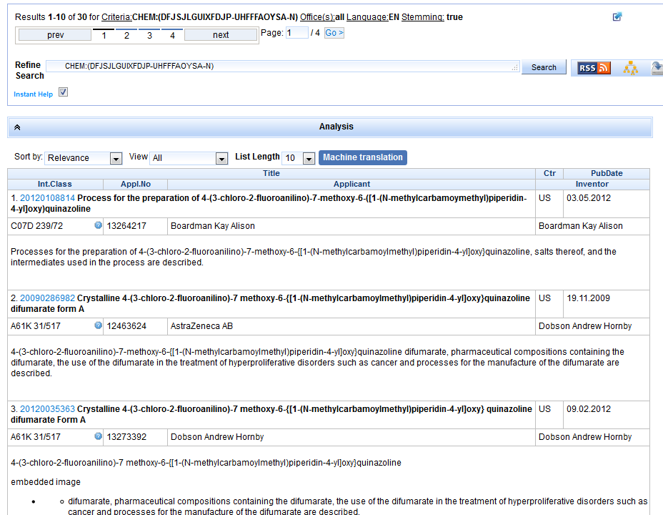

Slide 48
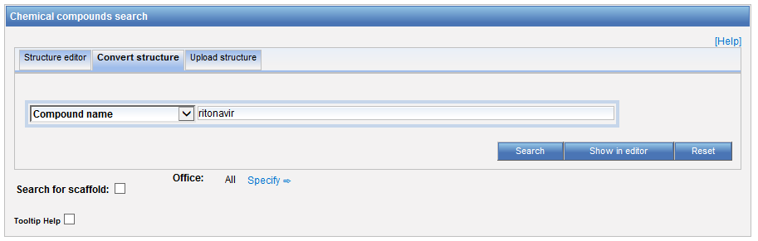
Example: Ritonavir

Slide 49
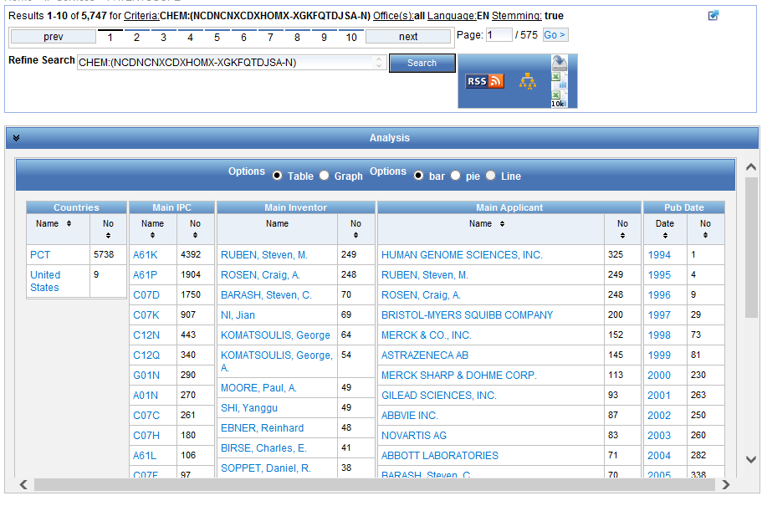

Slide 50
Patent landscape Report on Ritonavir- October 2011 http://www.wipo.int/edocs/pubdocs/en/patents/946/wipo_pub_946.pdf
Ritonavir is an antiretroviral drug from the protease inhibitor class used to treat HIV infection and AIDS. Ritonavir is included in the WHO Model List of Essential Medicines (EML)1.
The originator company is Abbott Laboratories, which markets Ritonavir under the brand name Norvir, or in combination with the protease inhibitor Lopinavir, as Kaletra or Aluvia. The U.S. Food and Drug Administration (FDA) approved the drug in March 1996 for oral solution and in June 1999 for capsules.

Slide 51
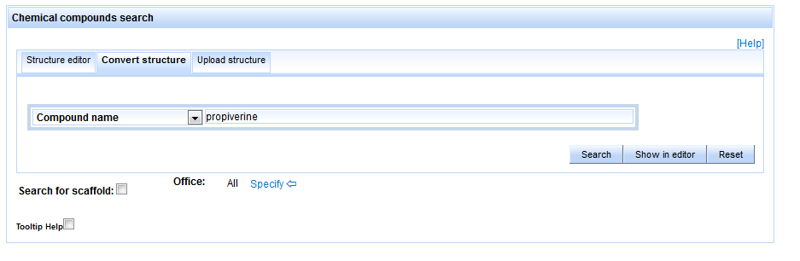
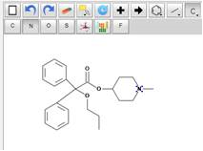
A specific case: Propiverine
Draw/convert Structure

Slide 52
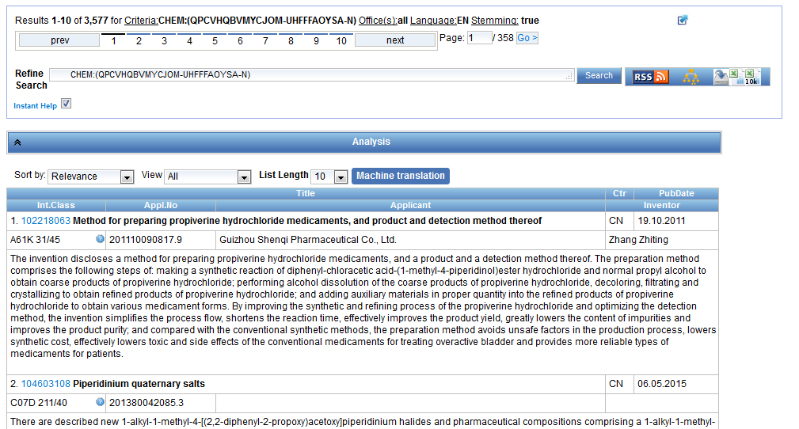
Results

Slide 53

Propiverin* in Advanced Search

Slide 54

Results

Slide 55
Difference in nb of results
Chemical structure search only works:
  with at least 1 IPC code related to chemistry
  for titles, abstracts, descriptions and claims for drawings included in description and claims (all languages)
  Not all collections (and related languages yet)

Slide 56
Can I search?
Stereoisomer
Monomer
Enantiomer
CAS name
Polymer, Poly(vinyl alcohol)
Inorganic cluster
Metal-organic framework
Transformable into InchI reactions
CAS number
DNA sequence listing

Slide 57
Restrict to the claims field
CHEM:( Inchikey BEFORE10000 description)

Slide 58


Slide 59
Future plans
Additional collections and languages
Implement sub-structures searches
Notes:
languages for the detection of chemical compounds in text
Process backfile and index chemical compounds for the

Slide 60


Sub-structure search
Notes:
Back in October 2016, we added the chemical search tool
It’s was developed on by InfoChem
You can draw the molecule or can search by compound name, INN, Inchi, SMILES or upload a MOL of images file
Chemical annotation of PATENTSCOPE full-text documents using InfoChem’s ICANNOTATOR

Slide 61

Sub-structure search

Slide 62

Sub-structure search
Notes:
Resultats

Slide 63

Sub-structure search
Notes:
Detail

Slide 64

Future/past webinars:
wipo.int/patentscope/en/webinar

Slide 65
Next webinar
IPC & PATENTSCOPE
  August 14 at 5:30 pm
  https://attendee.gotowebinar.com/rt/3459673102547796739
  August 16 at 8:30 am
  https://attendee.gotowebinar.com/rt/3459673102547796739

Slide 66
Global Design Database: webinar
How to read, save and share your results in the Global Design Database
  September 19 at 4:30 pm CET
  https://attendee.gotowebinar.com/register/3976121410613718786

Slide 67
Global Brand Database: webinar
Image search in the Global Brand Database
  September 26 at 4:30 pm CET
  https://attendee.gotowebinar.com/register/1256669614973868035

Slide 68

Forum

Slide 69


Slide 70

patentscope@wipo.int

