Slide 1
IPC & PATENTSCOPE
Internet
August
2017
Sandrine Ammann
Marketing & Communications Officer

Slide 2


Slide 3
Agenda
  IPC introduction
  IPC in PATENTSCOPE:
    search
    in the result list
    in CLIR
    statistics in the Browse menu
  Quiz
  Q & A session

Slide 4

What is IPC? International Patent Classification

Slide 5
What is classified?
► 2 types of information
► 1. Invention information:
Technical information worth granting a patent
► 2. Additional information:
Supplementary non-invention information
the classifier/examiner considers interesting
> obligatory classification
> discretionary classification
Notes:
Patent documents contain a lot of technical information and not all of it is directly linked to the invention but merely explains the state of the art. The rules of the IPC require all new and non-obvious technical information, i.e. the disclosed information that is eventually worth granting a patent must be classified.
Any additional information, that need not be new but may be useful for search purposes, can also be classified, at the discretion of the classifier.

Slide 6
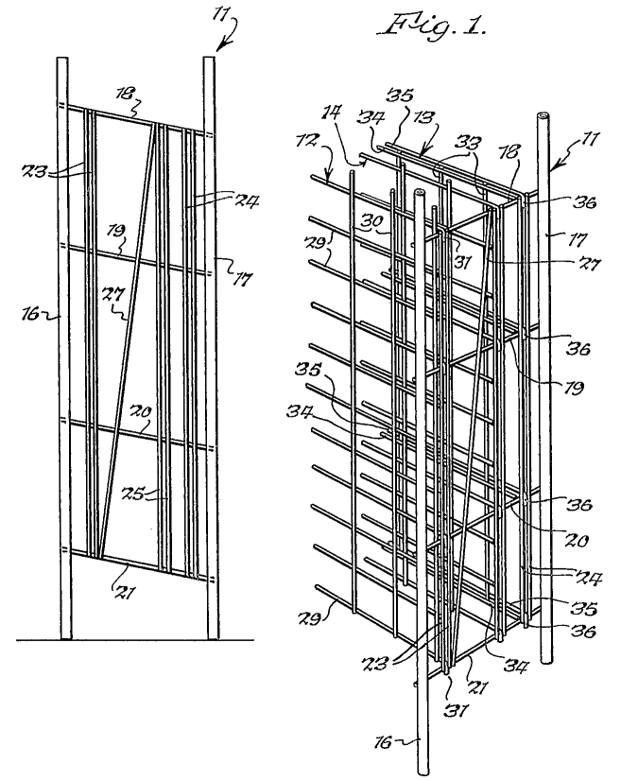
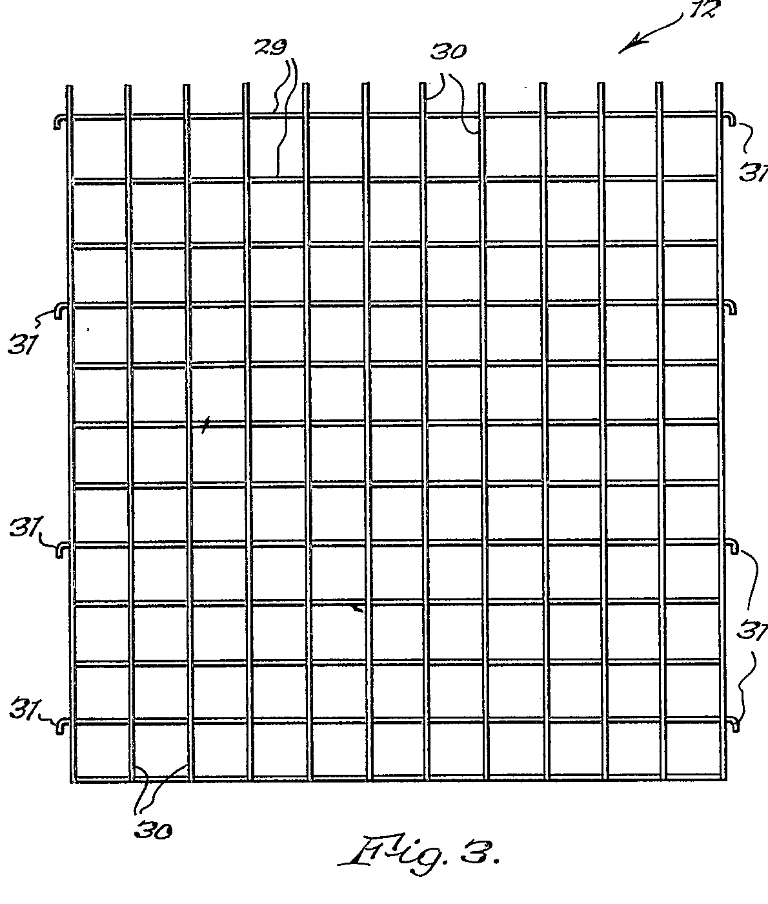
Example: A metal rod wine rack
1.Invention Information
A wine rack which is easily dismantled (claim)
2.Additional Information
A rigid wine rack made of “wire”
Int. Cl.
A47B 73/00 (2006.01)
A47B 47/02 (2006.01)
A47B 55/02 (2006.01)
6
Notes:
6

Slide 7
The IPC serves as a:
Tool for:
  classifying patent documents
Basis for:
  disseminating information
  investigating the state of the art
  preparing industrial property statistics

Slide 8

How does it work? Tree type structure

Slide 9
Symbols and Titles
70,000 entries
Each place/entry (Section, Class, Subclass, Group) is characterized by a symbol and a title
  Symbol = succession of upper case letters and numbers
  Title = phrase describing the technical content (scope) of the place
  Example:
Notes:
Symbol is a succession of upper case letters and numbers.
Title is a phrase or succession of phrases

Slide 10
Tree type hierarchical structure
Sections
8
Classes
Classes
Classes
129
Subclasses
Subclasses
Subclasses
Subclasses
Subclasses
640
Groups
Groups
Groups
Groups
Groups
Groups
Groups
Groups
Groups
70,000

Slide 11
IPC group symbols
A23G 9/02
► complete group symbol; consists of different components
A ....................... Section (A, B, ... H)
A23 ....................... Class (any 2 digits)
A23G ....................... Subclass (any letter)
A23G 9/02 ............ Group
Main group part
Subgroup part
Notes:
A23G 9/02 is a symbol representing an IPC group. Any group symbol consists of different components:
The first letter indicates the section of the IPC to which it belongs; there are 8 sections represented by the letters A, B,..H.
The section letter and the following two digits represent a class symbol.
Adding another letter to the class symbol generates the symbol of a subclass being part of the class.
After this subclass part of the symbol follows the group part which consist of two different elements separated by a stroke: the main group part and the subgroup part.
The formatting shown above with a space between the subclass part and the group parts and a slash between the two group parts is the offical format of IPC symbols that should be used for presenting IPC symbols. However, sometimes different presentations can be found or used for searching databases, e.g. no space after the subclass part, or a dash instead of a stroke.

Slide 12
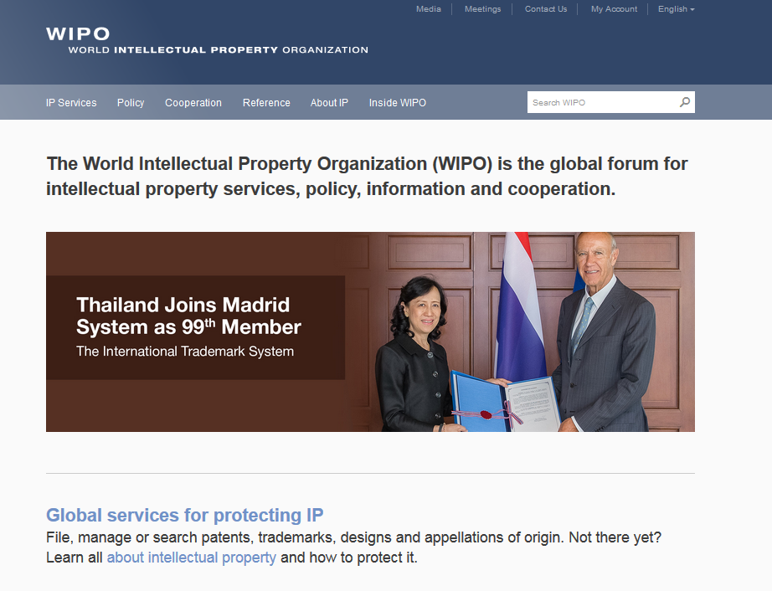

Slide 13
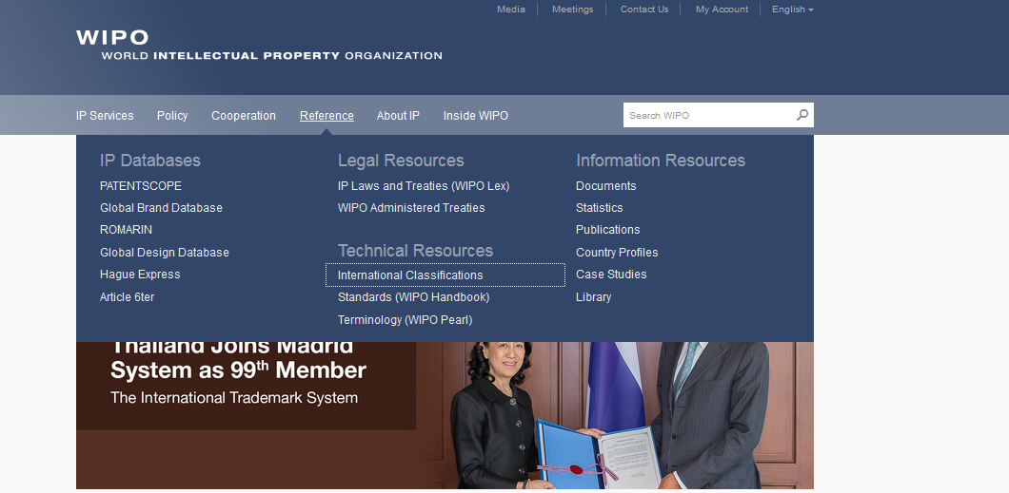
WIPO Homepage > Reference

Slide 14
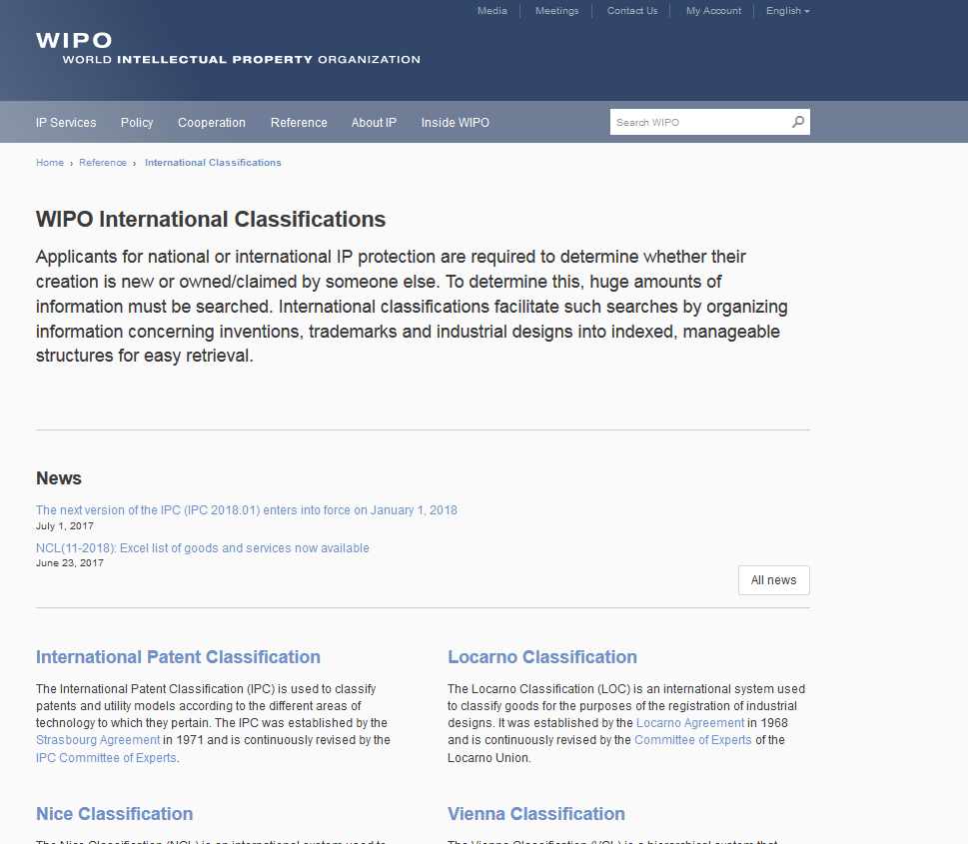
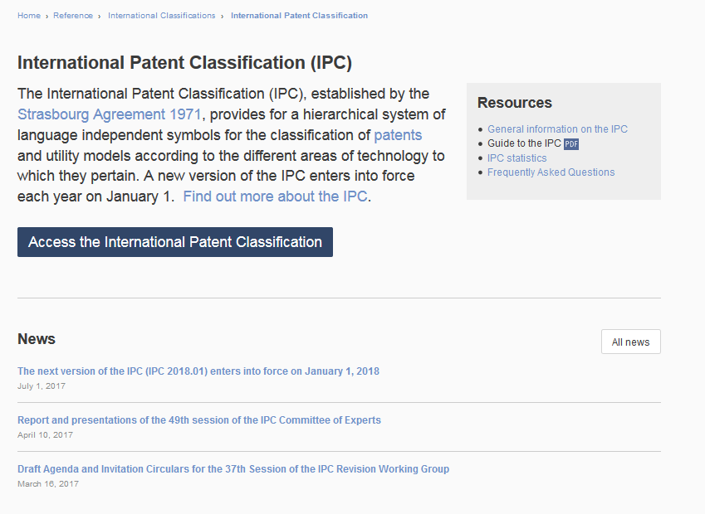

Slide 15
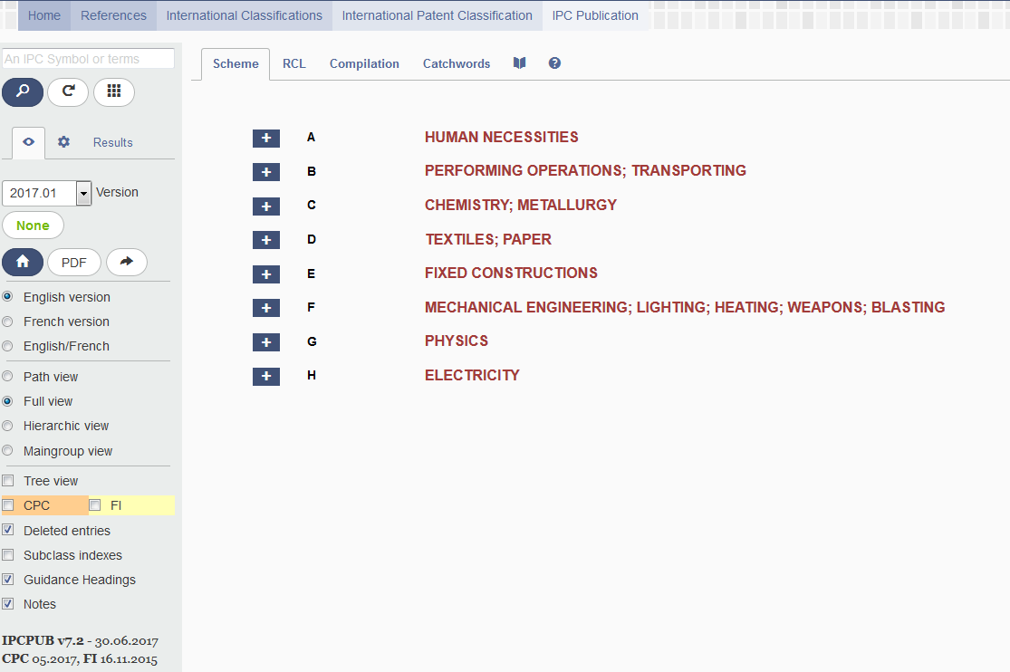
Help
IPC version and IPC symbol
View mode (path/full/hierarchic)
Display option (Subclass indexes, Guidance Headings, Notes, etc.)

Slide 16
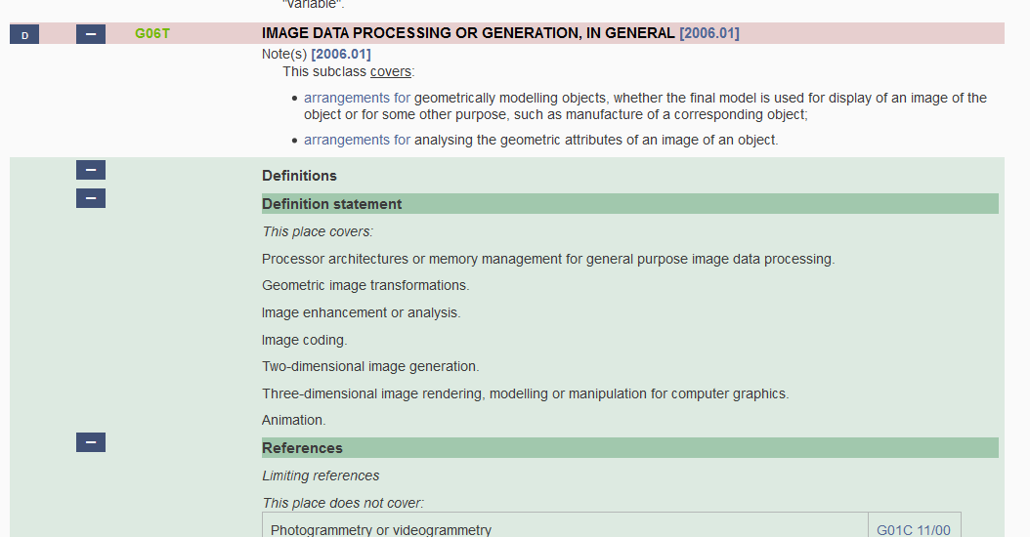
Definitions

Slide 17

Index – pdf – bridge

Slide 18
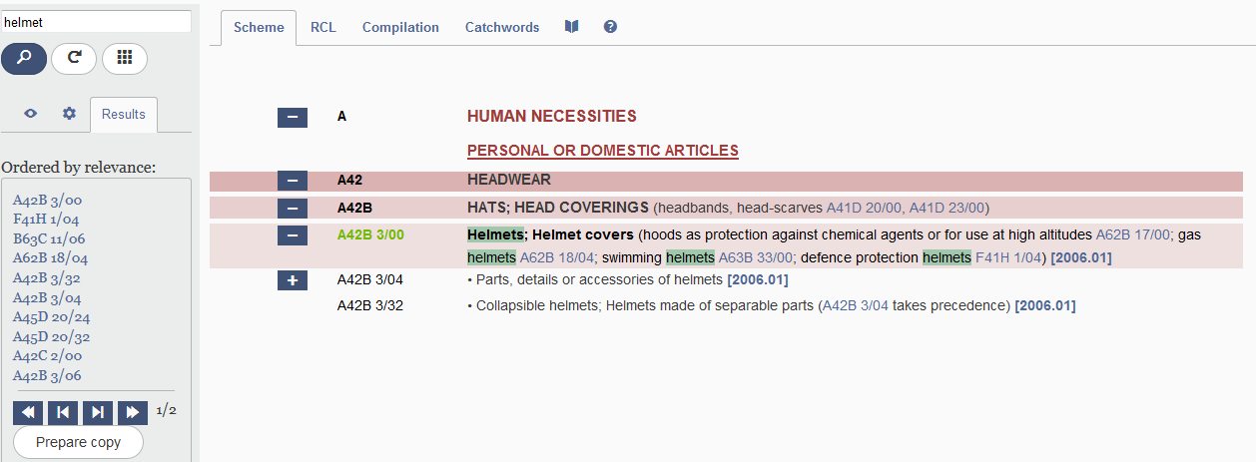
Catchwords

Slide 19
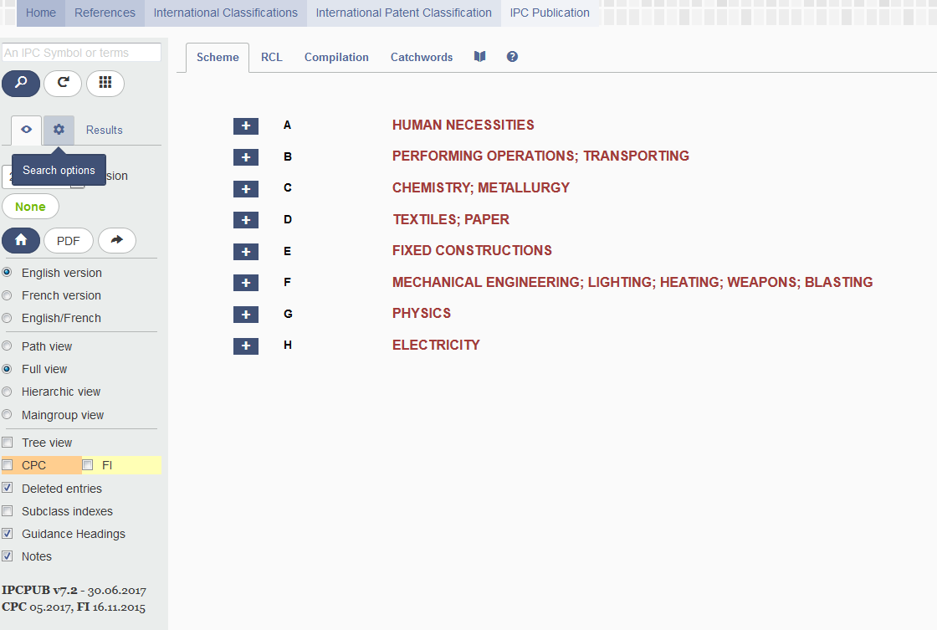
Search options

Slide 20
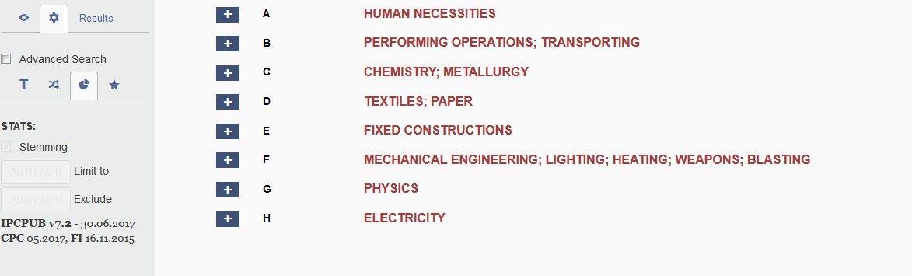
Terms/crossreference/stats/ipccat

Slide 21
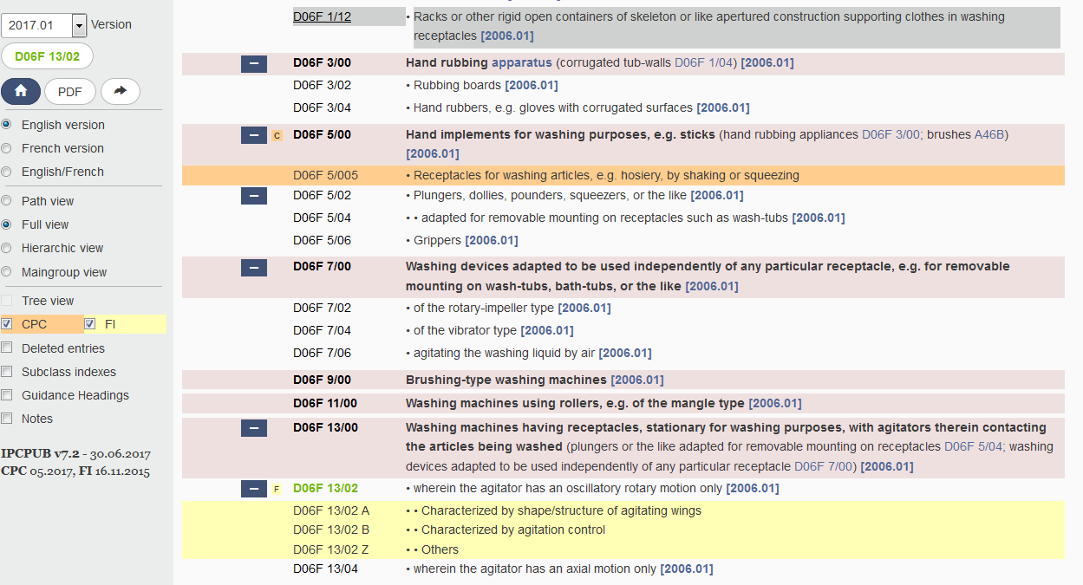
CPC/FI

Slide 22
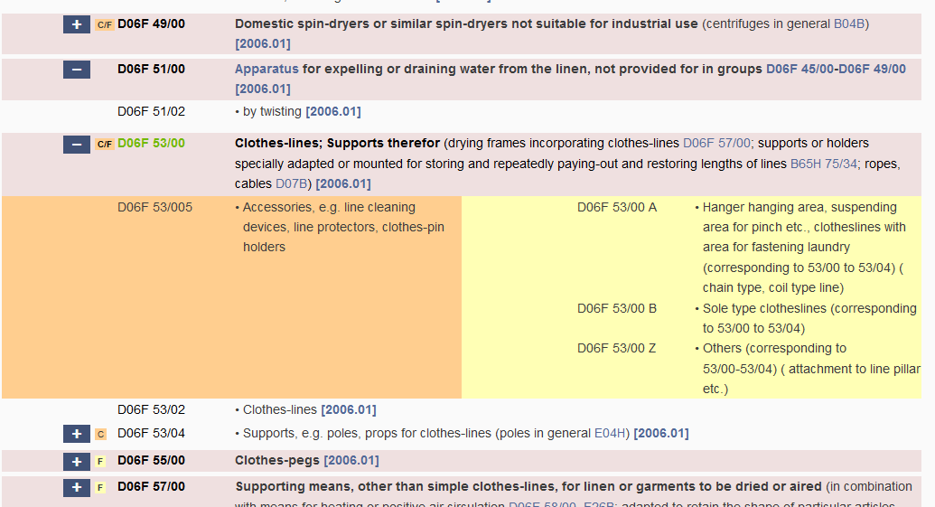
An example

Slide 23
Guide to the IPC
The official Guide to the IPC (version 2017) provides comprehensive information on the IPC. It is available for download on the WIPO website of the IPC at:
http://www.wipo.int/classifications/ipc/en/general/
Notes:
see the slide

Slide 24
Why is it useful?
Primary purpose:
  effective search tool
  classification of patent documents
Other purposes:
  dissemination of information
  investigation of the state of the art
  industrial property statistics

Slide 25
Summary of the advantages of using IPC
  Language independent
  Terminology / ”jargon” independent
  Standardized application to documents
  Available for (old) patent documents
  Concept search

Slide 26
Any questions related to IPC/CPC
ipc.mail@wipo.int

Slide 27
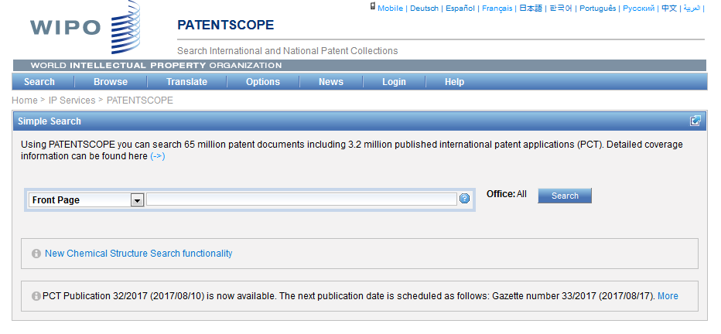
IPC in PATENTSCOPE
Statistics in the Browse by week option
Search IPC with Simple, Advanced, Field Combination
IPC in the result list
IPC in CLIR

Slide 28
Statistics in the Browse by week
  Show global trends
    Main/new actors

Slide 29
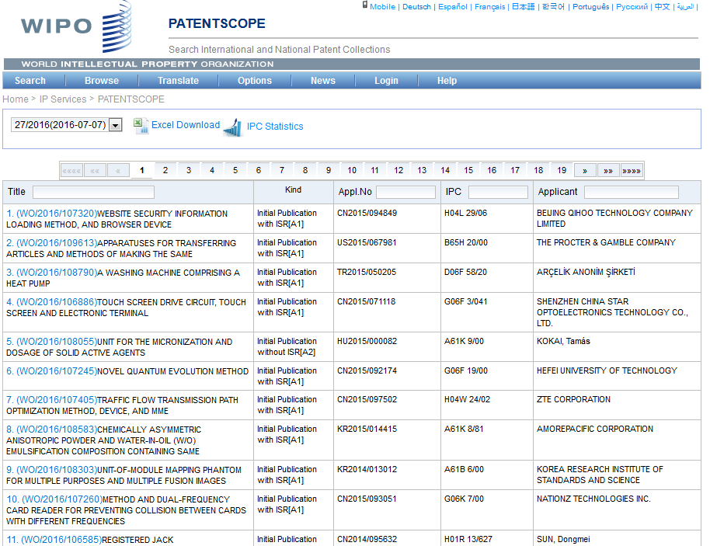
IPC statistics

Slide 30
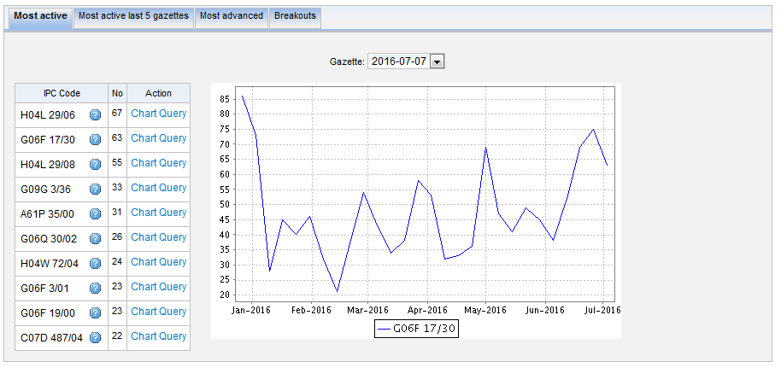
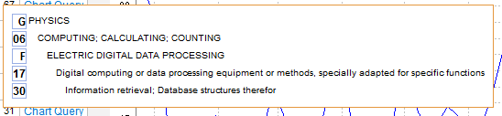
Most active

Slide 31
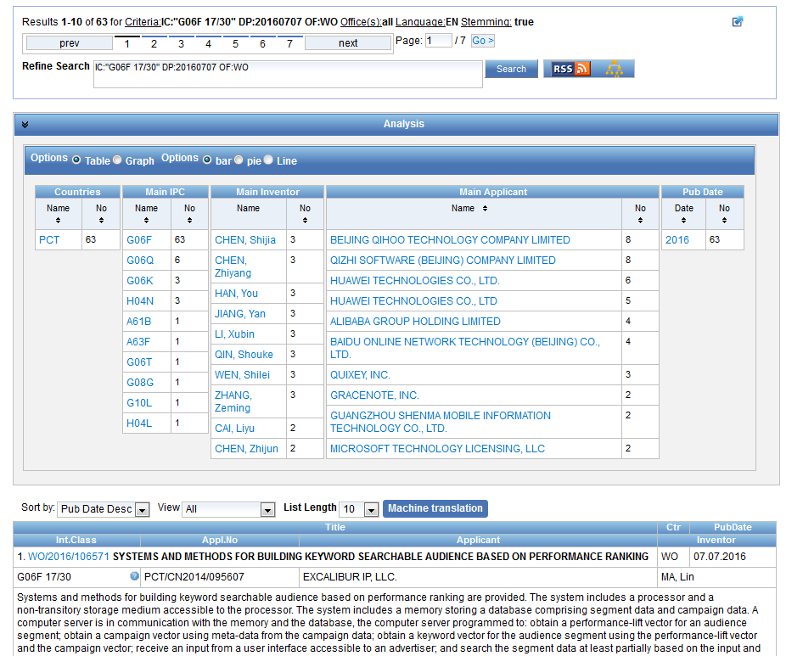

Slide 32
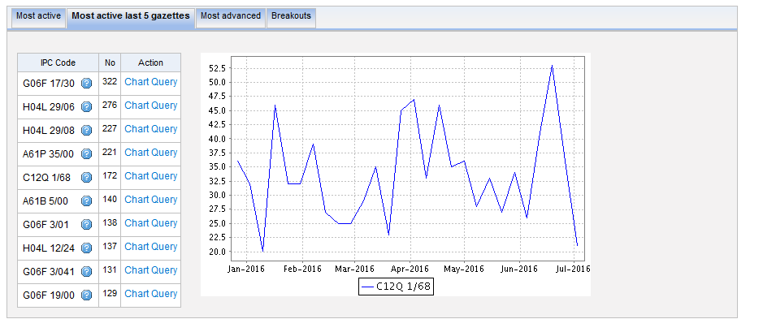
Most active last 5 gazettes

Slide 33
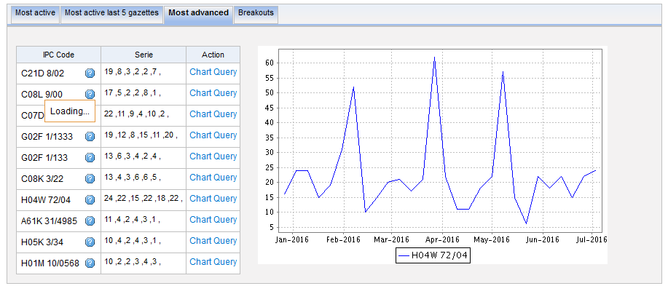
Most advanced

Slide 34
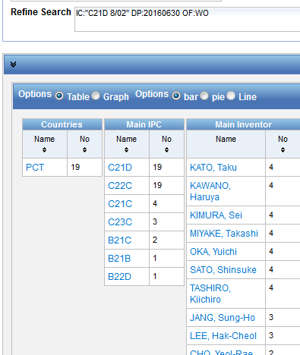
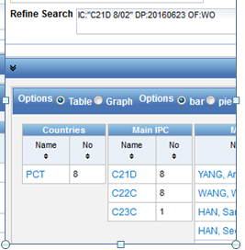
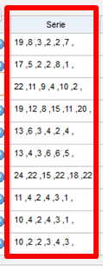
Serie column
6 last publications, nb of IPC per publication

Slide 35
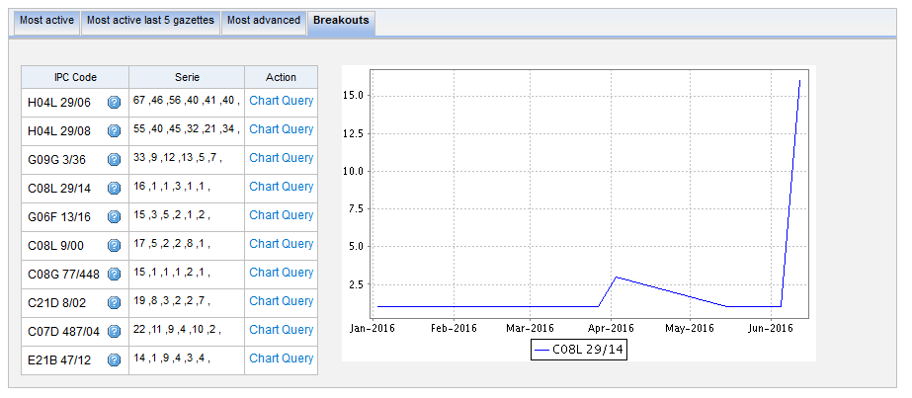
Breakouts

Slide 36

IPC searching in PATENTSCOPE

Slide 37
IPC search in PATENTSCOPE
Searching and Grouping now by complete IPC codes:
D06F 1/06 will include by default
D06F 1/08
1/10
1/16

Slide 38
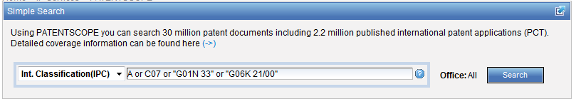
IPC search: Simple search

Slide 39
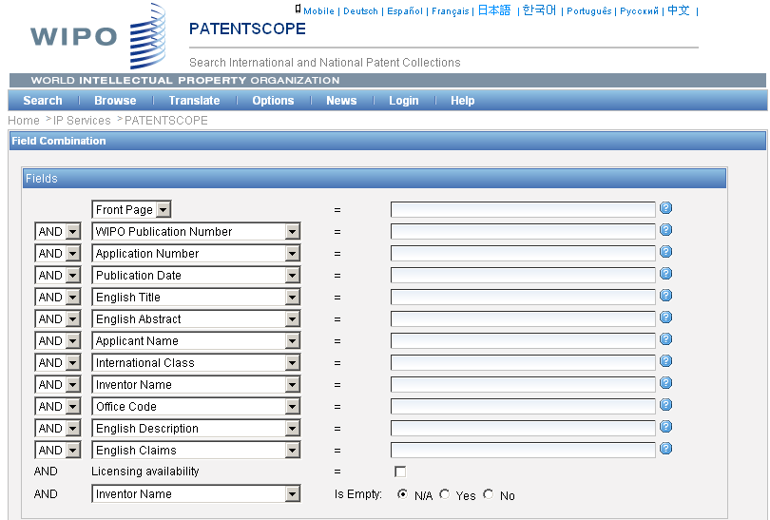
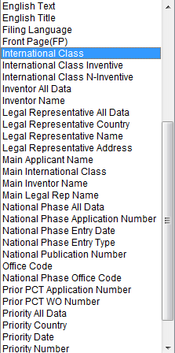
IPC search: Field combination

Slide 40
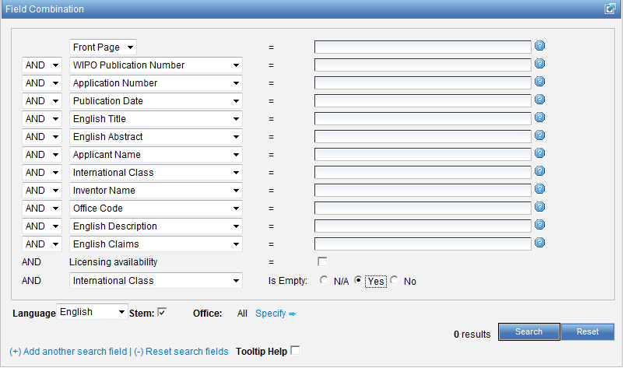

Slide 41
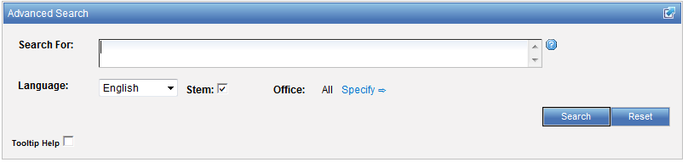
IPC search: Advanced search
http://patentscope.wipo.int/search/en/help/fieldsHelp.jsf

Slide 42
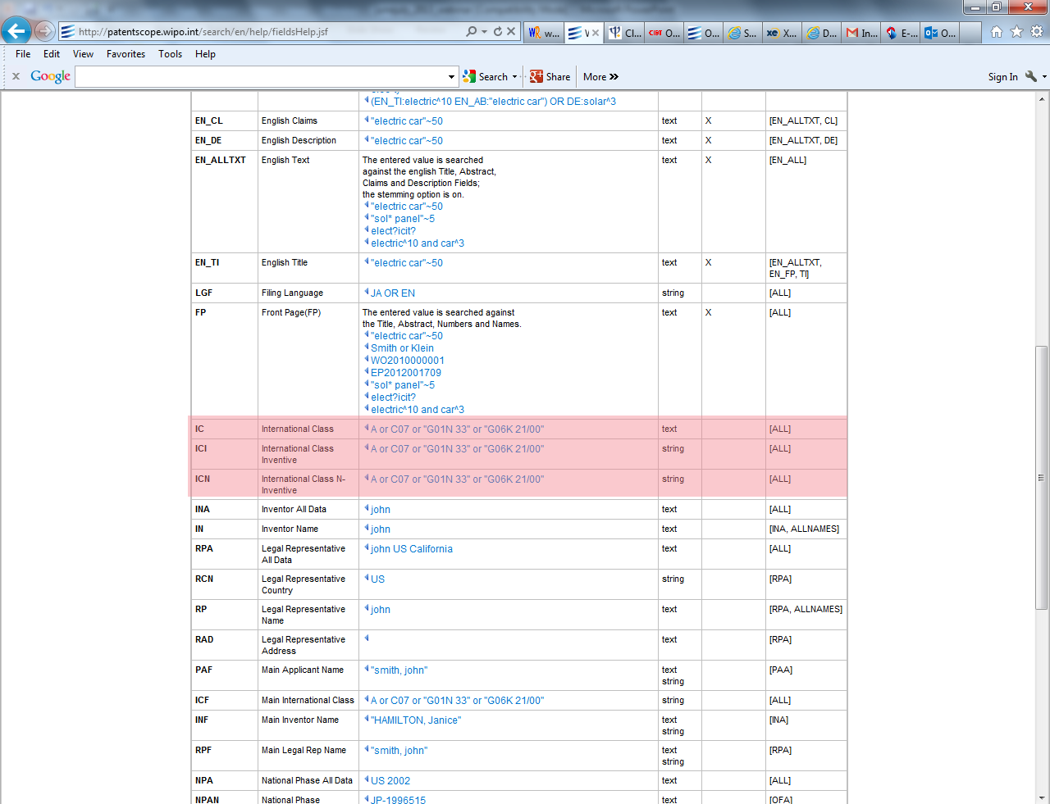

Slide 43
IC / ICI / ICN
IC = International Classification
ICI = International Classification Inventive
ICN = International Classification Non-inventive
IC_EX ICI_EX ICN_EX = no subgroup

Slide 44
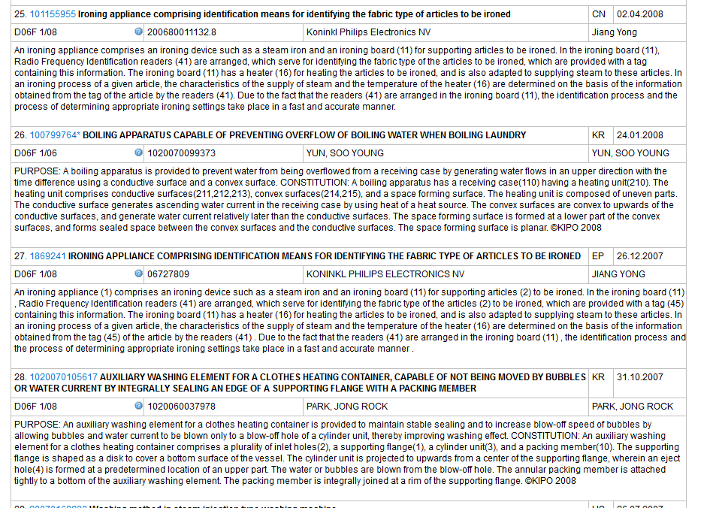
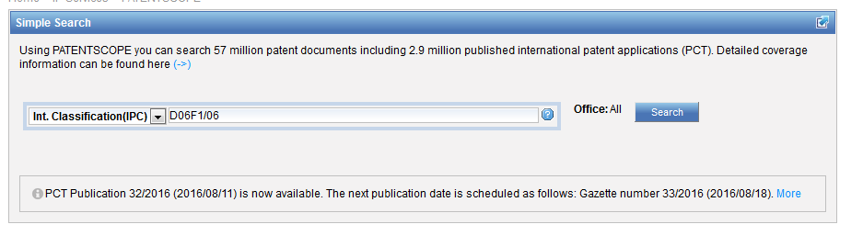
Example

Slide 45
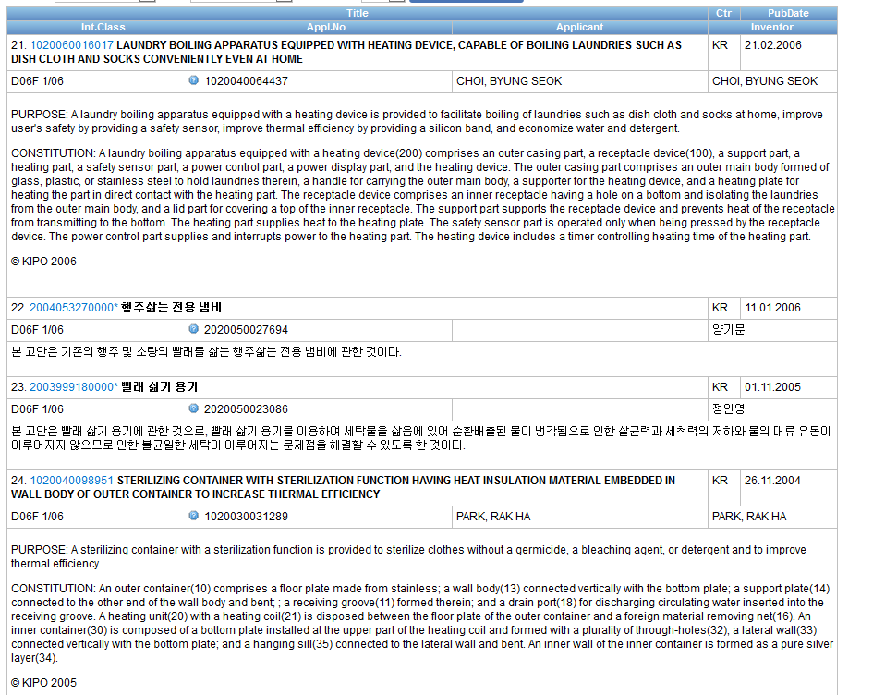

Slide 46
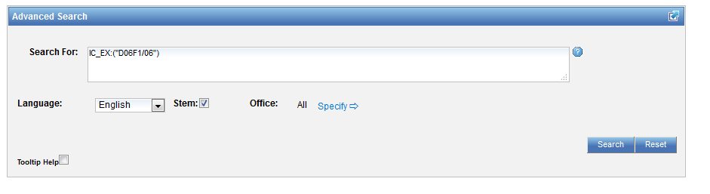

Slide 47
Combined search
Retrieve results that are specific "A23B 4/00“ and date range:
AD:[01.06.2012 TO 24.06.2016] AND IC_EX:("A23B 4/00")

Slide 48
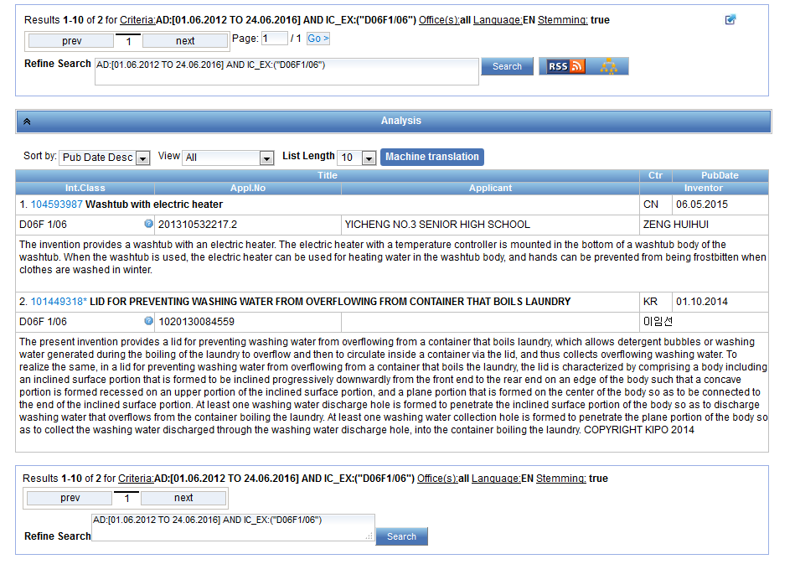
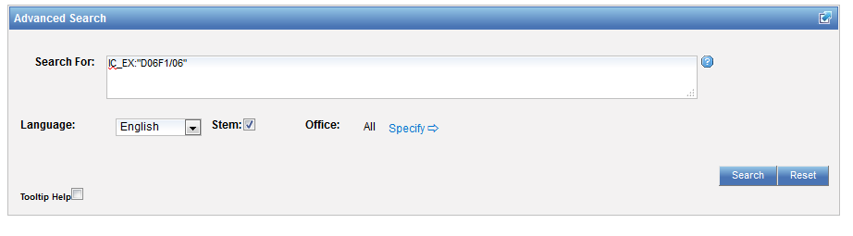
Search for D06F1/06

Slide 49
Caution
Use of (…) and […]
Use of " … "
(IC: A or B or C)
AD:([01.06.2012 TO 24.06.2016]) AND IC:("A23B 4/00")

Slide 50
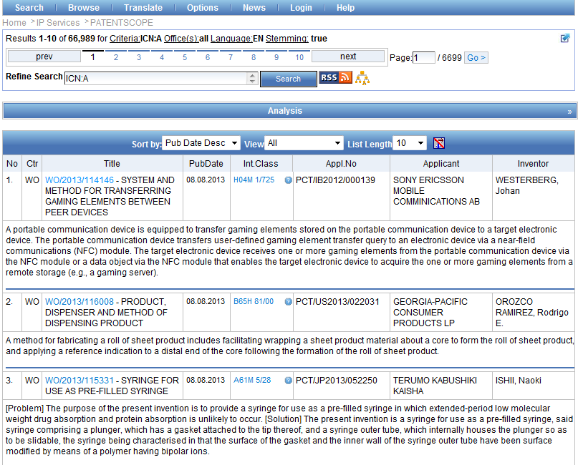

Slide 51
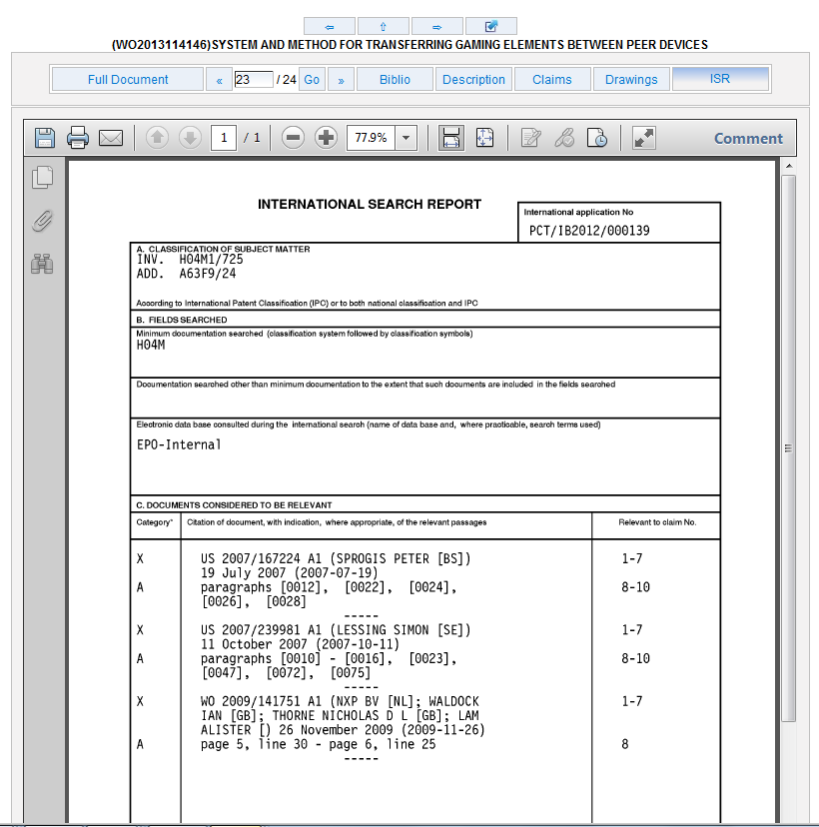

Slide 52
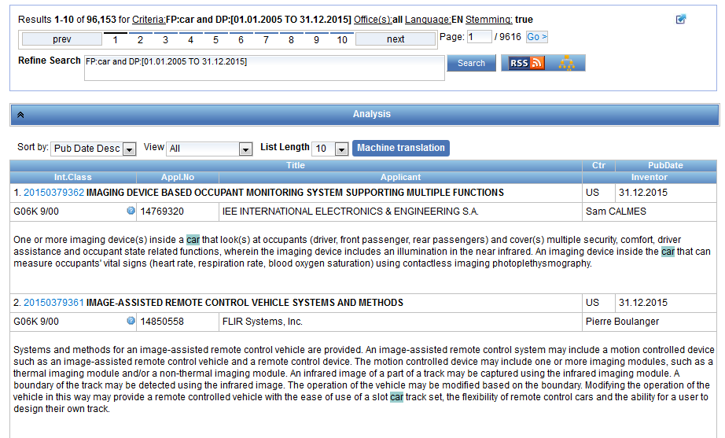
IPC in the result list

Slide 53
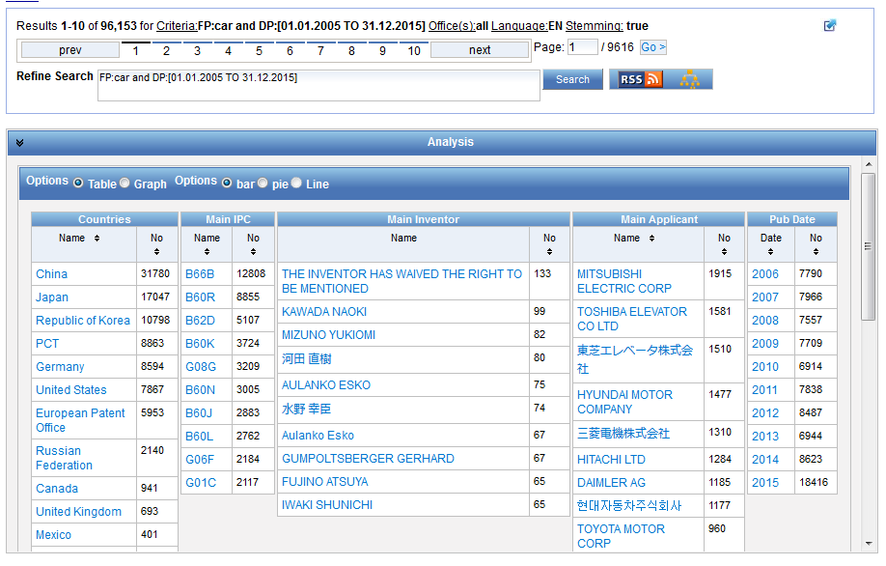

Slide 54
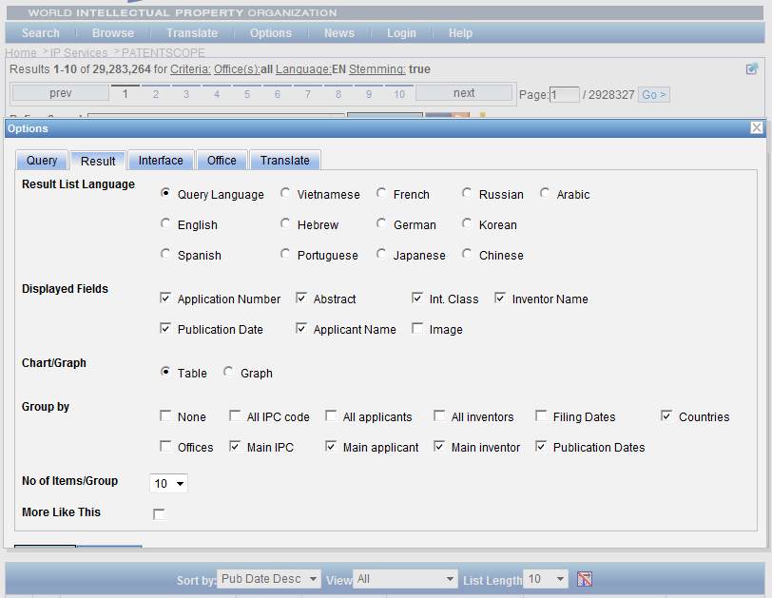

Slide 55
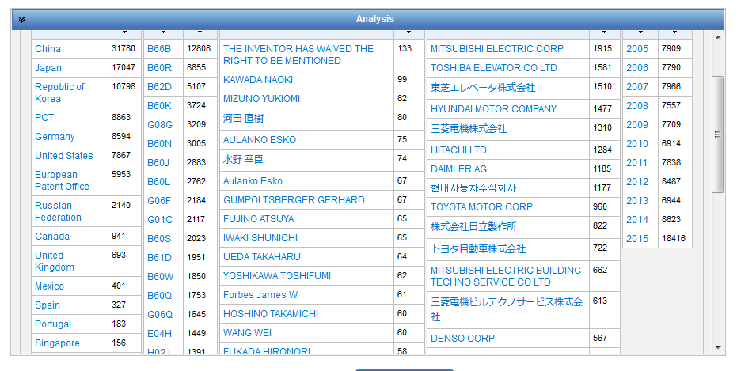

Slide 56
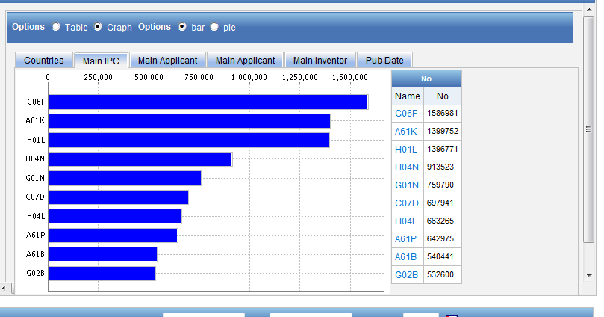
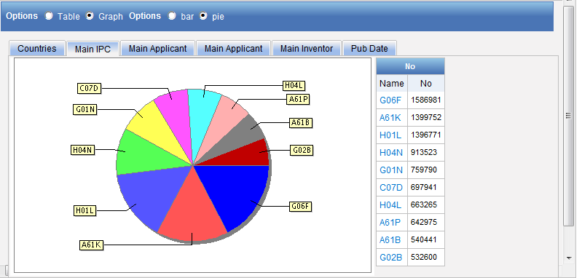
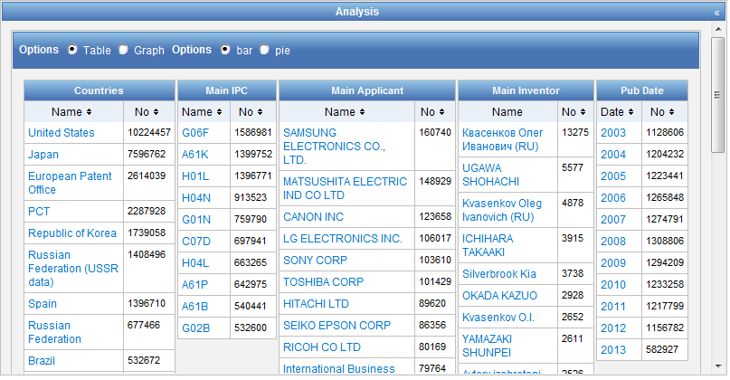

Slide 57
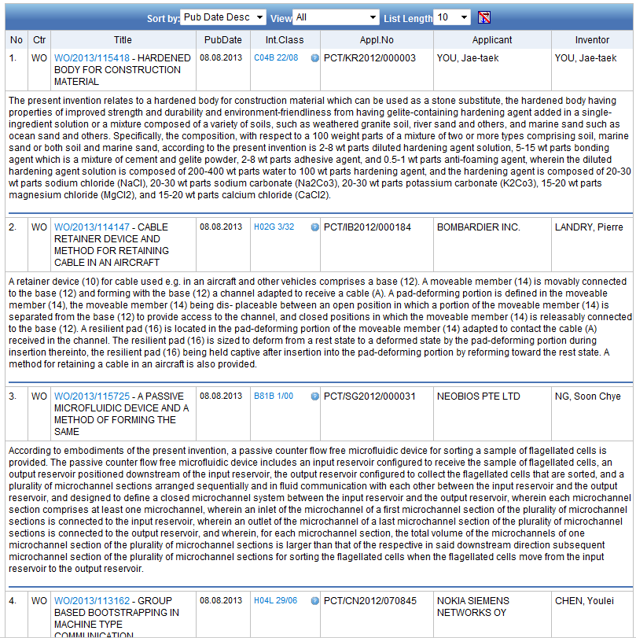
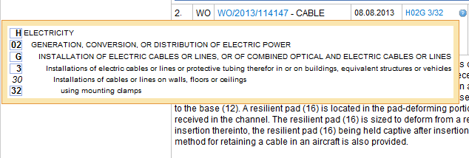

Slide 58
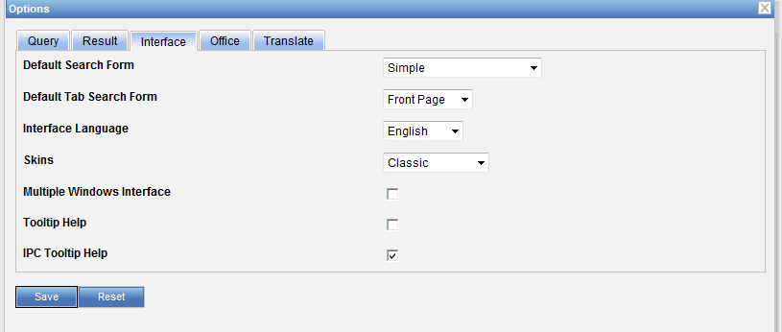

Slide 59
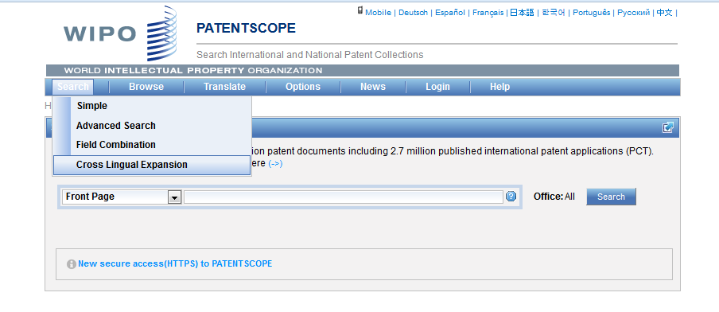
IPC CLIR

Slide 60
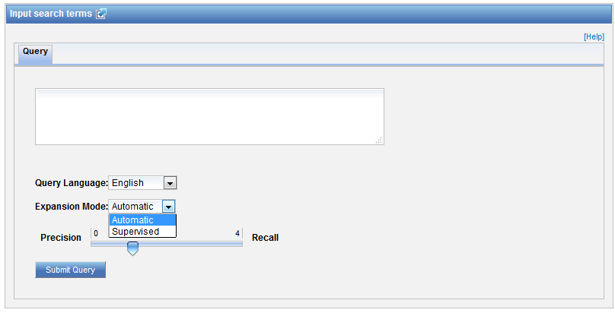

Supervised mode

Slide 61


Technical domains

Slide 62

IPC

Slide 63


Slide 64
Q:1: IPC statistics are available in the
A
Search menu
B
Browse menu

Slide 65

Q: 1: IPC statistics are available in the
A
Search menu
B
Browse menu

Slide 66
Q:2: To find an IPC code, you can use
A
The IPC website
B
PATENTSCOPE CLIR
C
PATENTSCOPE Simple and Advanced
D
PATENTSCOPE Field Combination

Slide 67
Q:2: To find an IPC code, you can use
A
The IPC website
B
PATENTSCOPE CLIR
C
PATENTSCOPE Simple and Advanced
D
PATENTSCOPE Field Combination
Spain

Slide 68
Q:3 Why is the IPC so useful in patent searches?
A
Not standarized
B
Language-independent

Slide 69
Q:3: Why is the IPC so useful in patent searches?
A
Not standarized
C
Language-independent

Slide 70


Slide 71

Future/past webinars:
wipo.int/patentscope/en/webinar

Slide 72
Next webinar
Chemical structure search
  September 27 at 5:30 pm
  https://attendee.gotowebinar.com/rt/6570654375885586692
  September 29 at 8:30 am
  https://attendee.gotowebinar.com/rt/6570654375885586692

Slide 73
Global Brand Database: webinar
Performing effective searches in the Global Brand Database
  August 29 at 5:30pm CET
  https://attendee.gotowebinar.com/rt/1767524697735436802
  August 31 at 8:30 am CET
  https://attendee.gotowebinar.com/rt/1767524697735436802

Slide 74

Forum

Slide 75

patentscope@wipo.int

