Slide 1
Presentation Title
Presentation Subtitle and/or Conference Name
Place
Day Month
Year
First Name Last Name
Job Title

Slide 2
CLIR
PATENTSCOPE search system
Cyberworld
April
2015
Sandrine Ammann
Marketing & Communications Officer

Slide 3


To the PATENTSCOPE search system webinar
CLIR

Slide 4
Agenda
Latest developments
CLIR
  What is CLIR?
  How to use it?
  Why is it useful?
  How was it developed?
  What is next?
  Quiz
  Q & A session

Slide 5

Latest developements

Slide 6
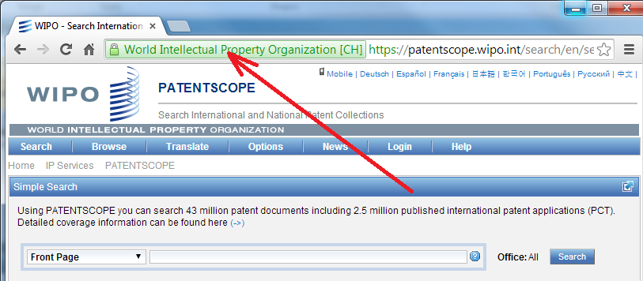
New: https

Slide 7
National patent collections be added in the future
UK
DK
AU
NZ

Slide 8
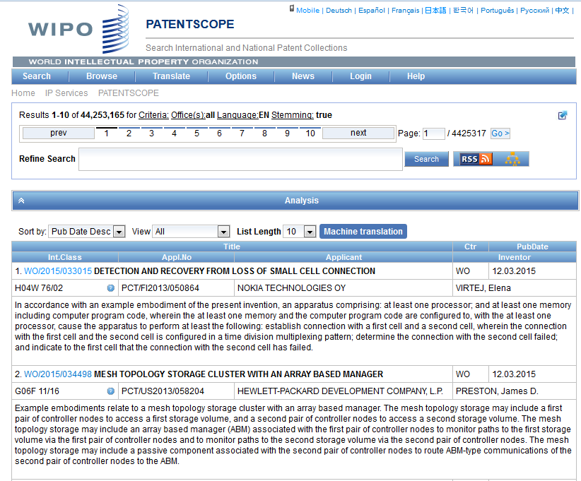

Slide 9
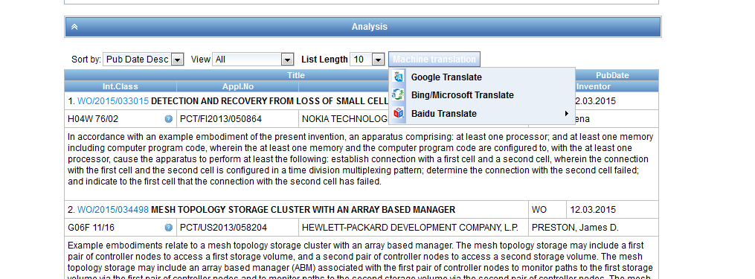

Slide 10
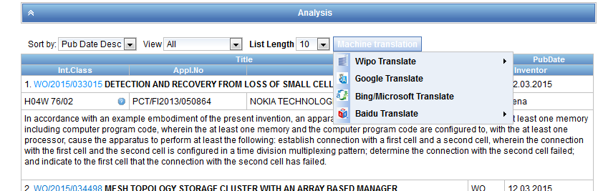

Slide 11
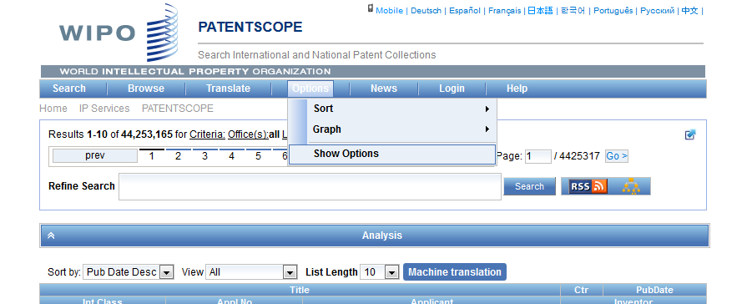
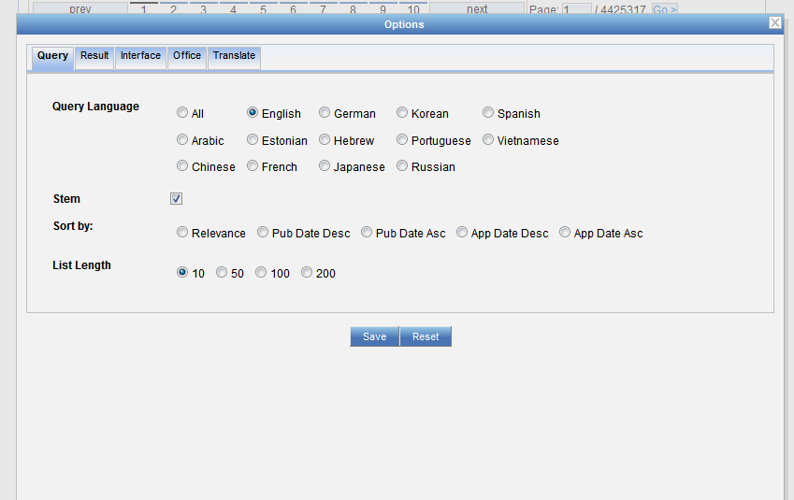
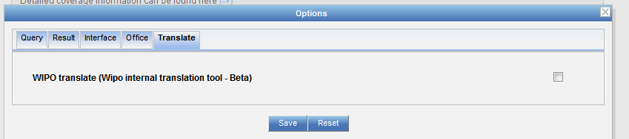

Slide 12
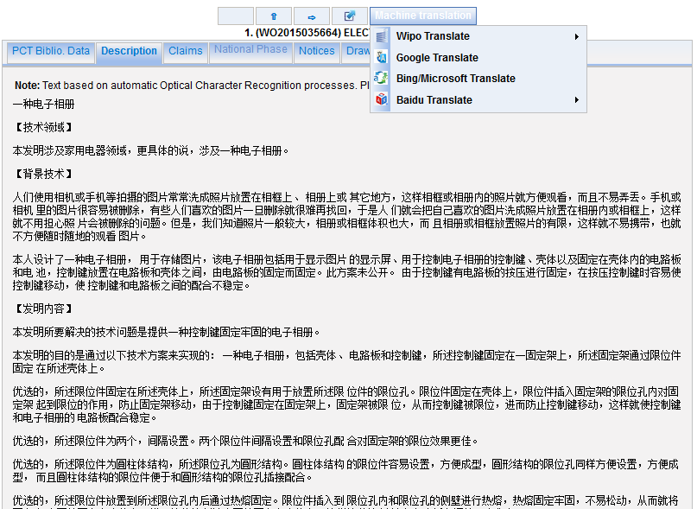

Slide 13
CLIR
Cross-Lingual Information Retrieval

Slide 14
What is it?
1. Finds synonyms:
container receptacles/ reservoir/tank
2. Translates into 11 languages
container
emballage
conteneurs
contenants
Verpackung
Transportbehälter
Behältnisses
behaallare
viravattenbehållare
pappersmaskins
集装箱
容器
盒
コンテナ
タンク
貯槽
envase
contenedor
tanque
contentor
receptáculo
embalagem
용기
기
탱크
recipienti
serbatoio
riserva
Контейнера
Емкости
резервуара
toevoertank
watervat
opslagtank

Slide 15
CLIR – 12 languages available
NON-ASIAN
Dutch
English
French
German
Italian
Portuguese
Russian
Spanish
Swedish
ASIAN
Chinese
Japanese
Korean

Slide 16
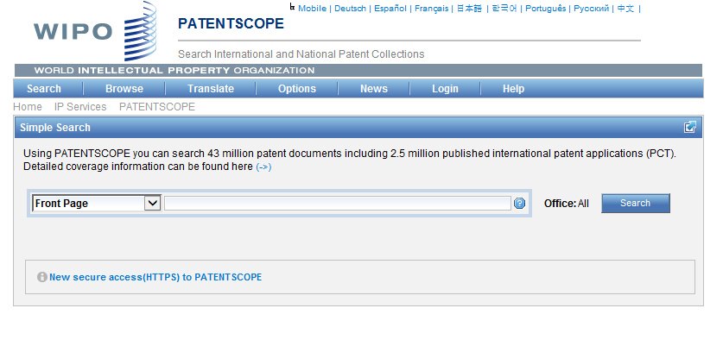
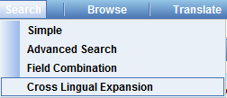
How to use it?

Slide 17
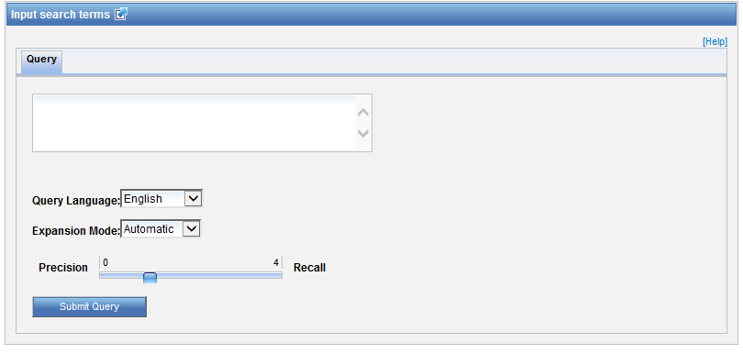
Interface

Slide 18

Query language
Define the language of the query:

Slide 19
Expansion mode
2 modes:
  Automatic = 1 step
  Supervised = 4 steps

Slide 20
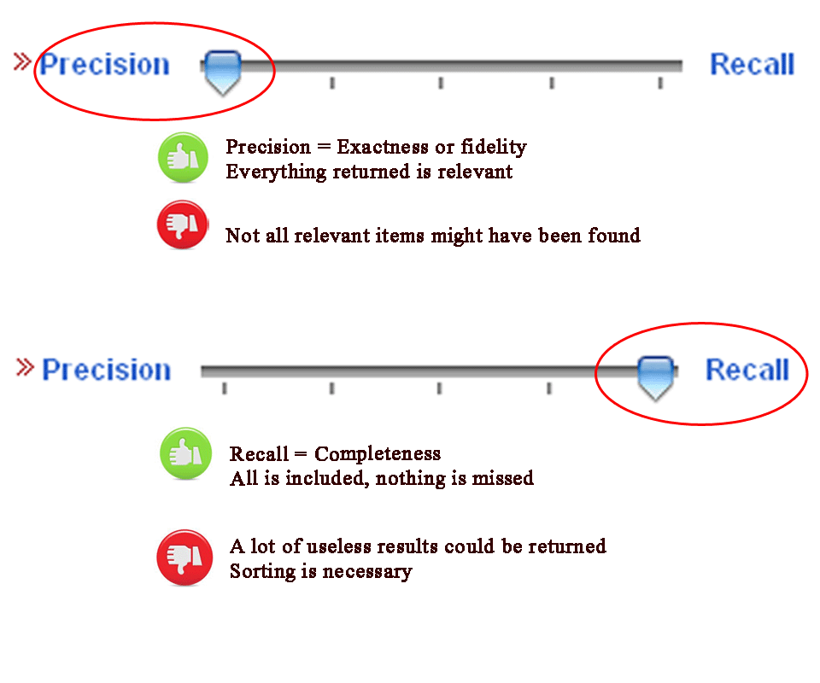
CLIR: precision vs recall

Slide 21
CLIR: precision vs recall
Precision = the ability to retrieve the most precise results.
Trying to find only precisely relevant items (high precision) = miss important items because they don't use quite the same vocabulary.
Recall = the ability to retrieve as many documents as possible that match or are related to a query.
Trying to find all the relevant items (high recall) = often get a lot of junk.

Slide 22
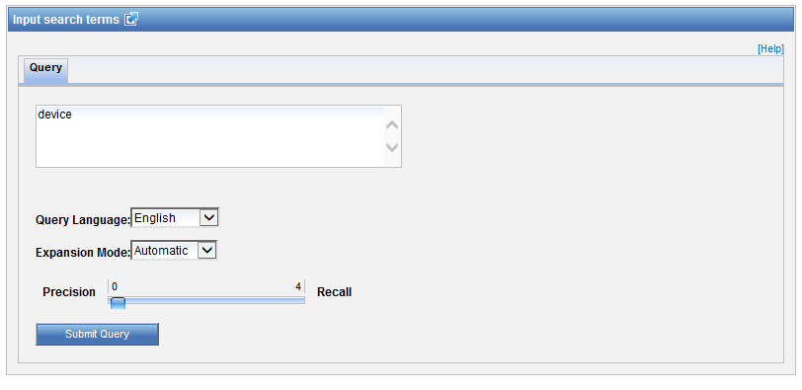
Example: precision

Slide 23
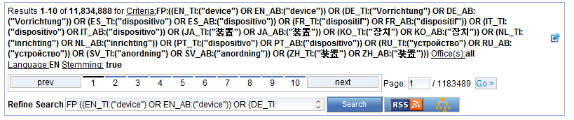
Results for «precision»

Slide 24

Example: recall

Slide 25
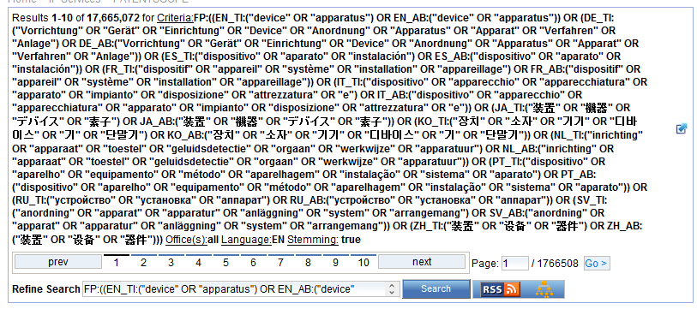
Results for «recall»

Slide 26

Examples
Source:https://www.kickstarter.com/projects/igreenpod/biodegradable-coffee-pod-from-portland-oregon

Slide 27
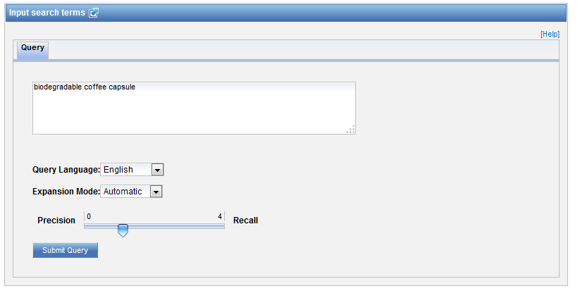

Automatic mode

Slide 28
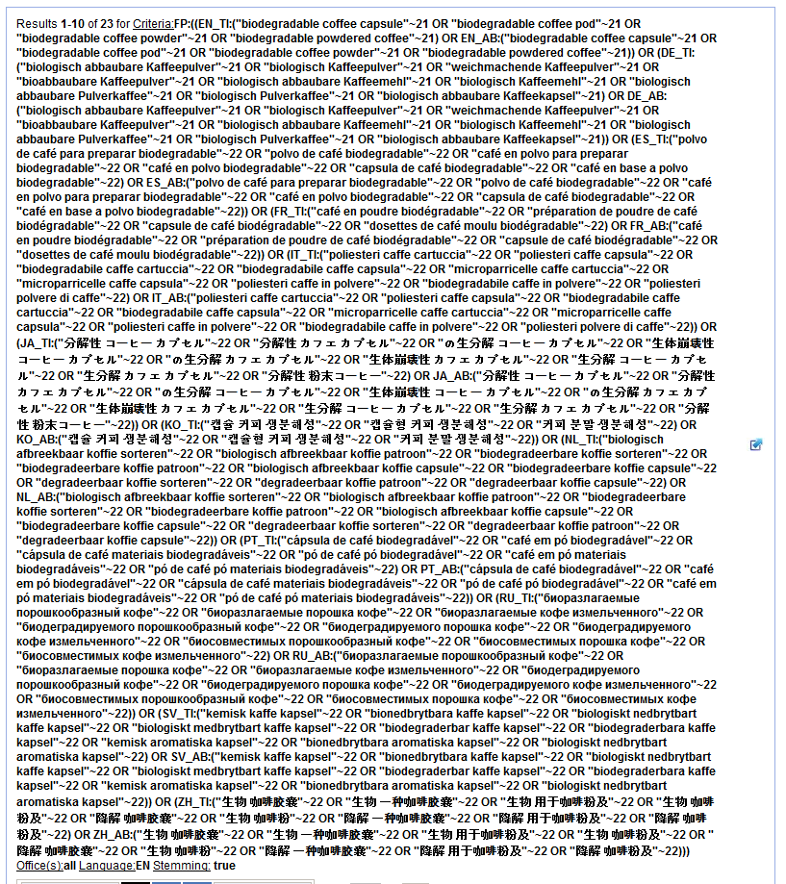

Slide 29
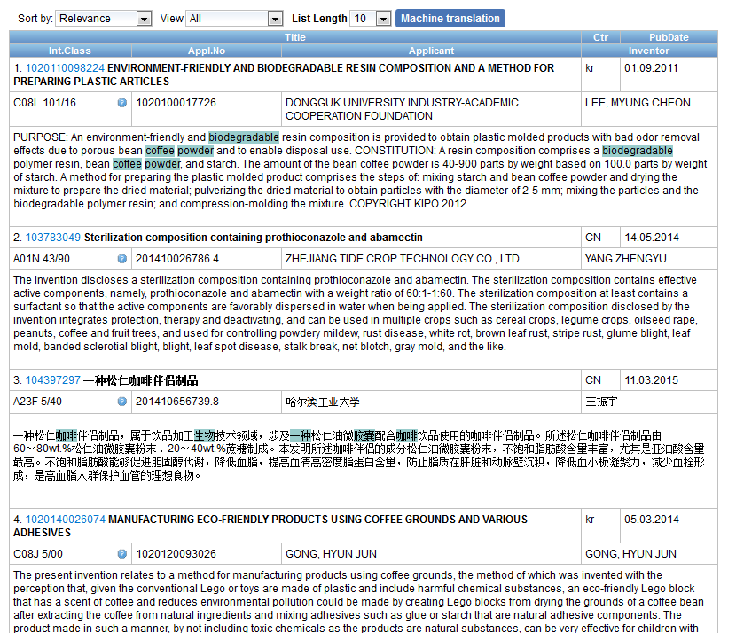
Result list

Slide 30
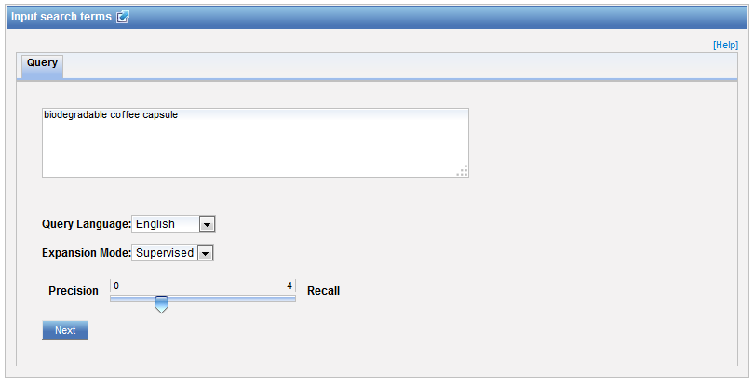

Supervised mode

Slide 31
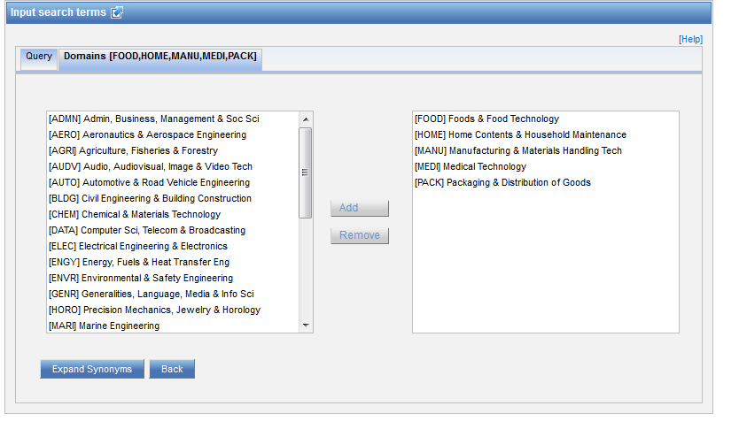
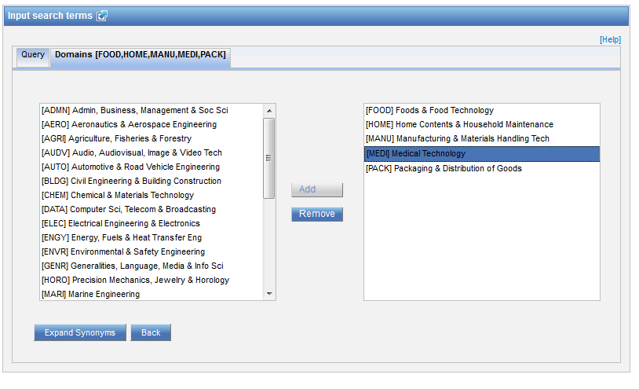
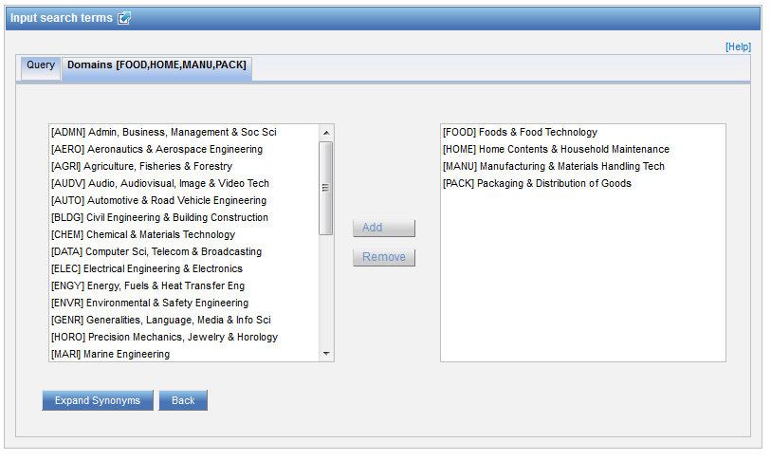
Step 1: technical field selection

Slide 32
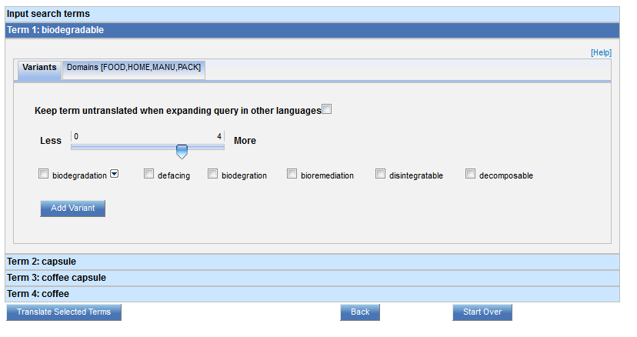
Step 2: synonym selection

Slide 33
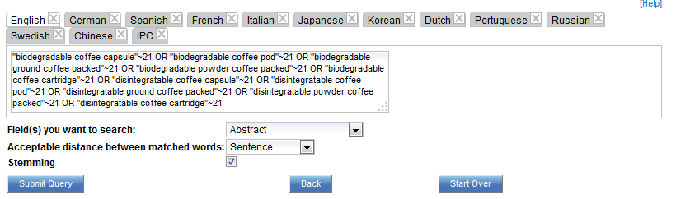
Step 3: translated term selection

Slide 34
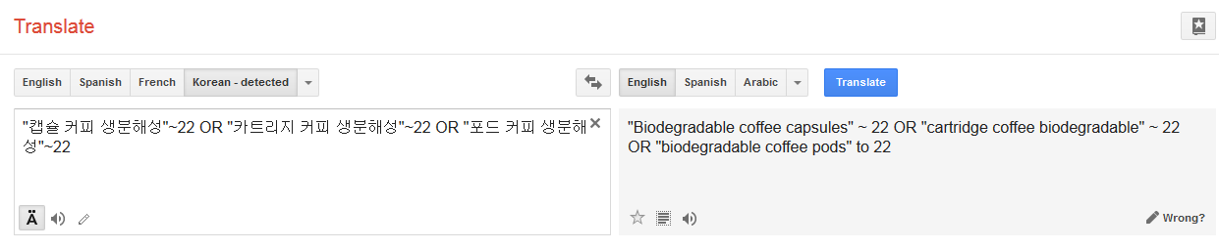
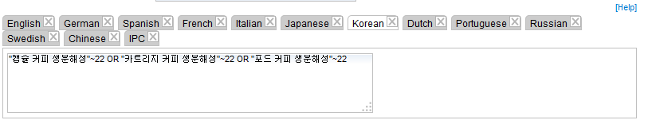
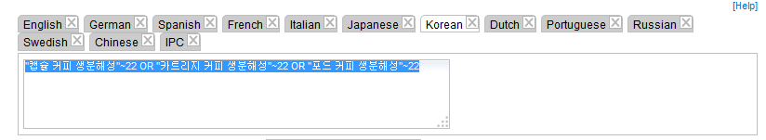
Relevance checking

Slide 35
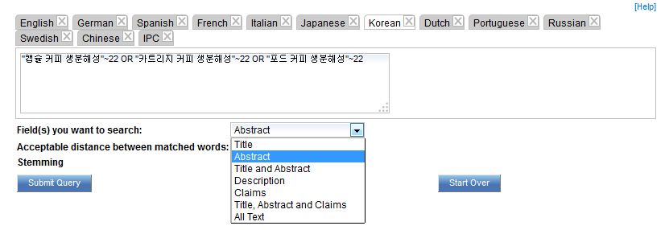
Fields

Slide 36
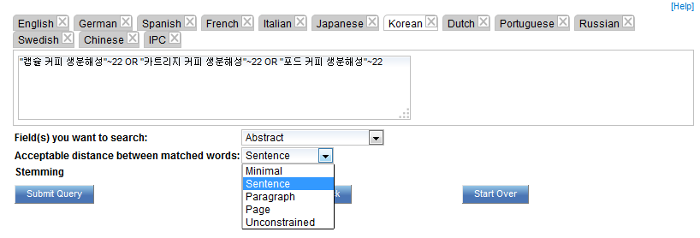
Acceptable distance

Slide 37
Stemming

Slide 38
Stemming
Use of the root form of a word
        displayed
        Display displaying
        displays

Slide 39
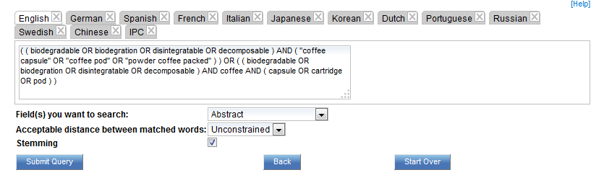
IPC checking

Slide 40
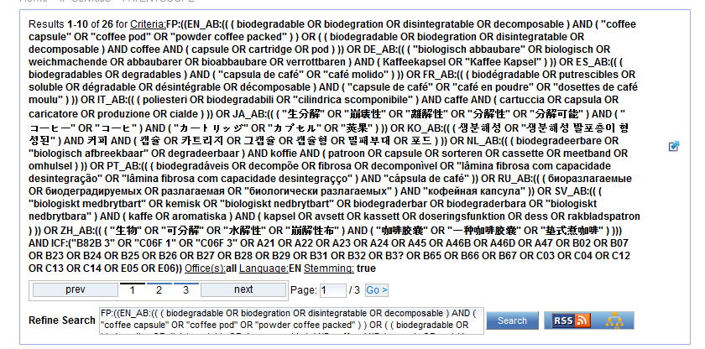

Slide 41
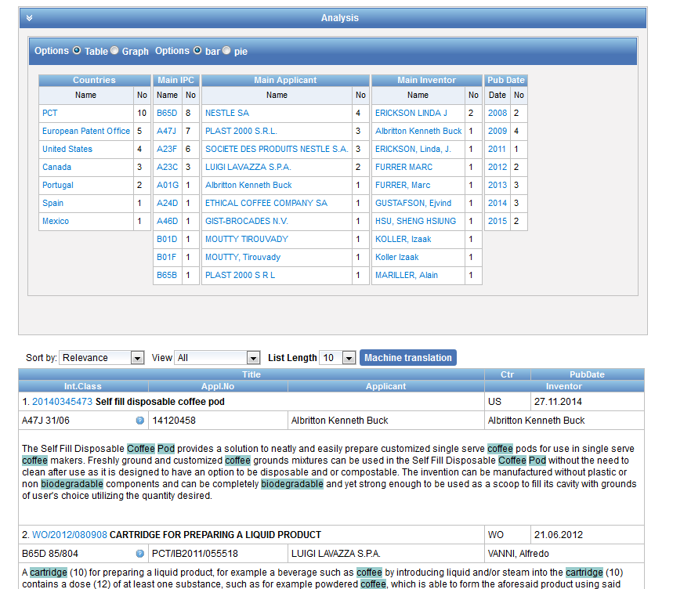

Slide 42
Why is CLIR useful?
Search full text collections simultaneously in many foreign languages
B) Improve significantly the number of relevant results without increasing significantly the number of irrelevant results
C) Have confidence in your searches:
No black box: users have access to the CLIR generated Boolean queries (albeit complex) and have the full control on them
D) Have a responsive system even for complex queries

Slide 43
How to make the most of out CLIR?
Expansion modes
Keyword very specific with only 1 meaning AUTOMATIC
For any other queries, SUPERVISED is recommended
Variants/synonyms
Select words that you would like to appear in your search results
If you have too much noise in the result list, remove generic variant

Slide 44
How to make the most of out CLIR?
Parameters
1. Title and abstract: unconstrained distance
2. Claims: sentence/paragraph distance
3. Description: sentence/paragraph distance
Stemming recommended

Slide 45
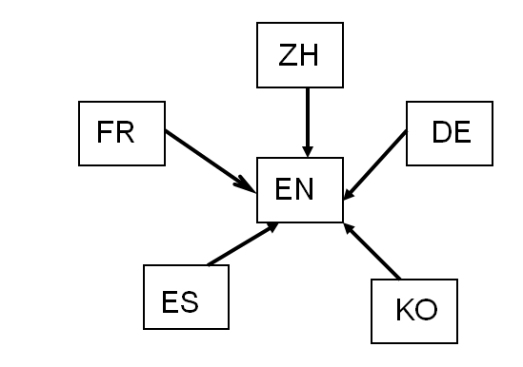
How was it developed?
Compilation of a long list of titles in language pairs
Creation of in-house extraction methodology
Tool learns statistical bilingual dictionaries of titles

Slide 46



Quality of dictionaries
Quality of dictionaries: no human intervention
  The more title available, the better the coverage
  Chinese Korean Dutch
  English Portuguese Italian
  French Russian Swedish
  German Spanish
  Japanese

Slide 47
Disambiguation
Disambiguation: process of identifying the sense of a word in a sentence. http://en.wikipedia.org/wiki/Disambiguation_%28disambiguation%29
Disambiguation is applied to keywords:
Technical domains based on the IPC
Synonyms selection

Slide 48
What is next?
Improve terminology coverage of Korean, Chinese and Japanese
Add Polish and Danish
Notes:
(Arabic)?
(ideally 500’000)

Slide 49


Slide 50
Q:1: About latest developments …
A
Some fee-based search features
B
Secure https protocol

Slide 51

Q: 1: About latest developments …
A
Some fee-based search features
B
The secure https protocol

Slide 52
Q:2: which languages are supported by CLIR?
A
Chinese
B
Swedish
C
Korean
D
French

Slide 53
Q:2: which languages are supported by CLIR?
A
Chinese
B
Swedish
C
Korean
D
French
Spain

Slide 54
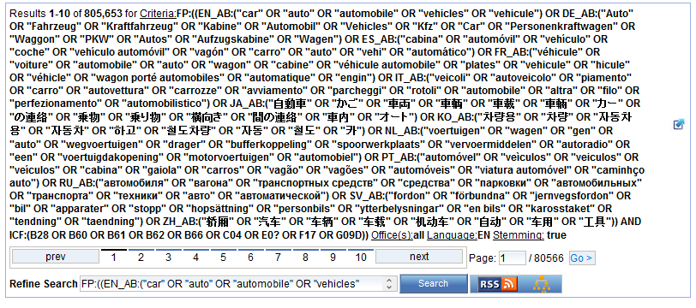

Slide 55
Q:3 which expansion mode was used to obtain this result list?
A
Automatic
B
Supervised

Slide 56
Q:3: which expansion mode was used to obtain this result list?
A
Automatic
C
Supervised

Slide 57


Slide 58
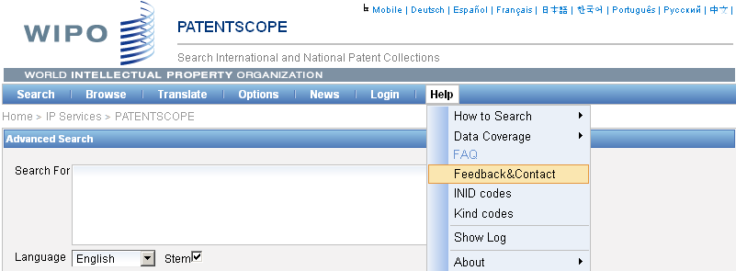

patentscope@wipo.int

Slide 59

mulțumesc
mulțumesc

