Slide 1
KACST
http://xellectip.com

Slide 2

Inventing the Future
KACST
WORLD INTELLECTUAL PROPERTY ORGANIZATION
WIPO TRAINING OF TRAINERS PROGRAM
ON EFFECTIVE INTELLECTUAL PROPERTY ASSET MANAGEMENT BY SMALL AND MEDIUM-SIZED ENTERPRISES IN DUBAI
Riyadh, Jan 29 to Feb 2, 2011
The Role of Utility Models and Patents in Leveraging Technical Innovation in the Marketplace
Rachna Singh Puri
Xellect IP Solutions, India
www.xellectip.com

Slide 3
Marketplace &Competitiveness
KACST
Defined as the ability of a firm to increase in size, market share and profitability. May be achieved by:
Producing more cheaply, for example by finding ways to reduce labour costs
Applying other non-price factors such as:
  Human resource endowments, such as skills and worker motivation
  Technical factors such as R&D capabilities, and the ability to adapt and use technologies
  Managerial and organisational factors

Slide 4
Innovation
KACST
Ideas applied successfully in practice
Typically is expected to lead to a drastic change
  In the system
  By introduction of new products or services
Expected to clear out the old and in with the new
No limit to where innovations may be applied

Slide 5
Characteristics of Technical Innovation
KACST
Coupling (of changing technology, production and markets)
Creating (new products, processes, systems and industries)
Clustering (of groups of related innovations)
Comprehending (new skills, new technologies, new markets)
Coping (with the technical and market uncertainty of innovation)
TECHNOLOGICAL INFRASTRUCTURE AND INTERNATIONAL COMPETITIVENESS Draft paper submitted to the OECD ad hoc group on science, technology and competitiveness. August 1982 C. Freeman

Slide 6
Drivers of Innovation
KACST
Market Forces (Competition)
Consumers (Value-Add to Existing Products)
Regulatory Requirements (Pollution Control by EHS, ISO Certification etc.)
Quality (Process Improvements, Waste & Defect Reduction, Increasing Productivity)

Slide 7
Inventions
KACST
Solves a problem
Stems from a novel & non-obvious idea
  Subsequently, the working idea is applied to a specific or several applications
Comes out of a business choice
  Determined by market needs
  Core competency taken into account
  High monetary returns expected
  Also typically one problem or application area

Slide 8
KACST
Innovation vs. Invention
Invention solves an existing problem by providing solutions
Innovation utilizes the invention and brings it to practice
Innovation does not require a problem
  Creates its own problem and provides solutions

Slide 9
Invention Methodology
KACST
Problem Identification
Problem Definition
Appraisal of State-of-the-Art
Identify Plausible Solutions
Identify Best Mode of Operation

Slide 10
Invention Methods
KACST
Systematic or Incremental Approach
Out-of-the-box Approach
Breakthrough
Serendipity

Slide 11
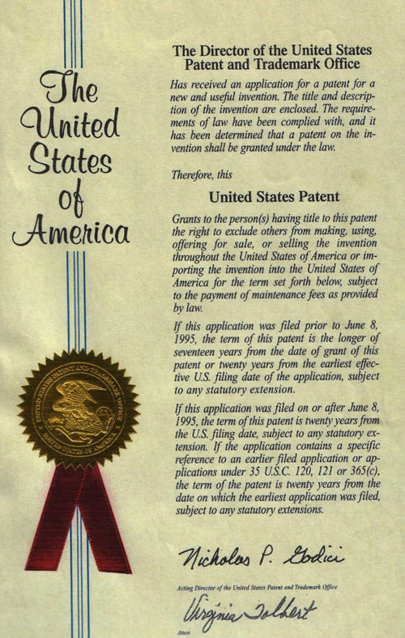
Patents
KACST
The term "patent" originates from the Latin word patere which means "to lay open" (i.e., make available for public inspection)
Patent provides a set of exclusive rights granted by a state to a patentee for a fixed period of time in exchange for a full disclosure of an invention
Encompasses any new and useful process, machine, article of manufacture, or composition of matter
Also included are any new and useful improvements thereof

Slide 12
KACST
Three Tenets of Patentability™
Novelty
Non-Obviousness
≈
Inventiveness
Utility/ Usefulness
≠
Industrial Applicability

Slide 13
Utility Models
KACST
Similar to Patents but only for “Minor improvements” to existing products
The requirements for acquiring a utility model are less stringent than for patents
  “Novelty” requirement is always to be met, that of "inventive step" or "non-obviousness" may be much lower or absent altogether
The term of protection for utility models is shorter than for patents and varies from country to country (usually between 7 and 10 years)
In most countries where utility model protection is available, patent offices do not examine applications as to substance prior to registration
Utility models are much cheaper to obtain and to maintain
In some countries, utility model protection can only be obtained for certain fields of technology and only for products but not for processes.

Slide 14
The Central Theme
KACST
“How a Lone Inventor and an Unknown Company Created the Biggest Communication Breakthrough Since Gutenberg†”
† Part of the title of the biography of Chester Carlson by David Owen

Slide 15
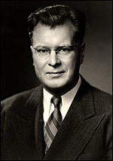
The Inventor
KACST
B.S. in Physics from California Institute of Technology in 1930
Research Engineer in Bell Laboratories
  Found work “Dull and Routine”
Transferred to the Patent Department
Laid off during the Great Depression
Found work in an electronics firm
  Promoted to head of Patent Department in a few years
Got his L.L.B degree in 1939
Chester Carlson

Slide 16
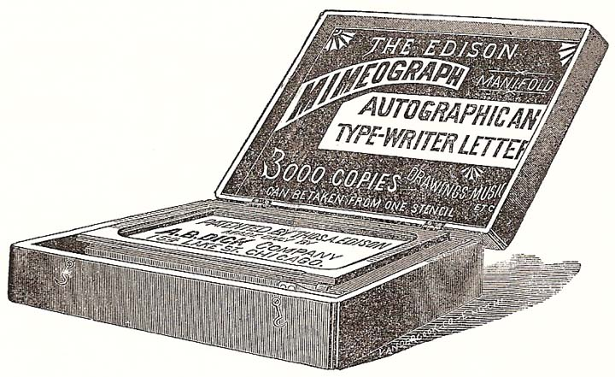
Problem
KACST
  Mimeograph process made wet copies which then required a long drying time
  Photostats were adequate but too expensive
  Desirable to make “Xerographs” or “Dry Copies”

Slide 17

The Principle
KACST
Electrophotography
Simple basic principle that led to a revolutionary technology:
  when light and shadow strike a charged plate, the dark parts attract a special powder while the light parts repel

Slide 18
The Patenting Strategy
KACST
First patent filed in 1937
Developed the technology over 15 years
Filed several patents along the way
  His training in patent law stood him in good stead

Slide 19
Commercialization
KACST
Tried to convince organizations to invest in the invention, unsuccessfully
  Included giants like General Electric, IBM, RCA and the U.S. Army Signal Corps
Finally struck a deal with Battelle Memorial Institute in 1944 to prove feasibility of technology
Subsequently licensed to Haloid Corporation for commercialization

Slide 20
Naming
KACST
  Haloid Corporation sold its first photocopier in 1950
    Used Carlson’s concept of ‘Xerography’
  Plain paper push button Photocopier first introduced in 1959
  The parent company coined the term XeroX
    Short for Xerography
  Reinvented itself as Haloid Xerox in 1958
  Renamed itself as Xerox Corporation in 1961

Slide 21
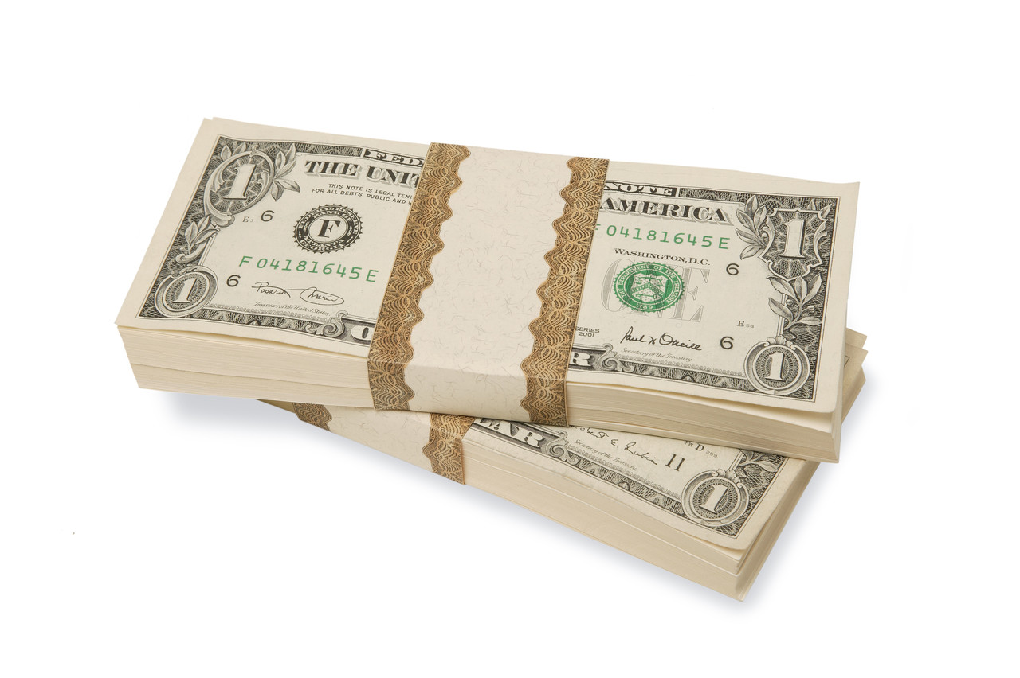
Revenues
KACST
The initial model Xerox 914 made $60 million in revenue in the year 1961 alone
  Met their long term sales target within 6 months
Revenues leaped to more than $500 million within 5 years*
Chester Carlson grossed about $150,000,000 from his invention eventually
*: By this time, most of the original patents had expired

Slide 22


Currently
KACST
Xerox Corporation has adapted to modern day demands
  Reinvented itself as ‘The Document Company’
  No more stand-alone copiers, but printers, scanners etc. associated with it
Aware of environmental concerns of paper usage
  According to a study conducted by Xerox, around 40 percent of the pages printed are only viewed once before being thrown away
  In the process of developing “Erasable” Paper
Xerox logo 1971–2008
Redesigned the logo to reflect the changes in corporate strategy
Logos used herein are a registered trademark and/or copyrighted logo belonging to Xerox Corporation.

Slide 23

IP and the Big Picture
KACST
Introduction
Incident
Tylenol®- a popular over-the-counter drug
  Comes in various grades
Sold by McNeil Laboratories
  Now a subsidiary of J&J
In Fall 1982, 7 people died after ingesting Extra Strength Tylenol®
    Capsules deliberately contaminated with cyanide
    Killer never caught
Brand sales collapsed immediately
Damage Control
Within a week, parent company recalled all products
  Estimated retail value of US$100 million
Issued warning on all national media
Offered to exchange all capsules purchased
Reintroduced product with triple-seal package very quickly
Helped develop tamper-resistant packaging
Introduced heavy price promotions
Result
Within a few years, regained market dominance

Slide 24
Shrewd Businessman
Using Patents to Get Initial Monopoly
Making Room to Enjoy Business Success

Slide 25
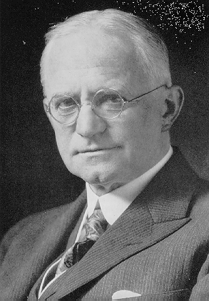
“You press the button, we do the rest†”
KACST
Developed and patented a dry photographic plate in 1880
In 1884, patented a photographic medium
  Both in England and U.S.A
Patented roll film camera in 1888
Filed key patents in all important facets
Then, focused the company to making film when competition heated in the camera industry
  By providing quality and affortable film to every camera manufacturer, Kodak managed to turn all competition into more business
George Eastman
† Marketing phrase coined for the film roll camera created by Geaorge Eastman

Slide 26
Shifting Paradigms
“Next killer product is the patent itself†”
† Title of the article written by Rick Merritt in EETimes

Slide 27
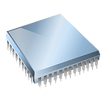
The Organization
KACST
Patriot Scientific Corp.
Based out of Carlsbad, CA, USA
Six-person company
Focused on establishing a new microprocessor architecture
In the process filed several patents related to its core technology

Slide 28
Shift in Focus
KACST
The six-person company netted more than $24 million in 2005 by licensing seven U.S. patents fundamental to CPUs
  Advanced Micro Devices, Casio, Fujitsu, Intel, Hewlett-Packard
Will be collecting more from royalties on sales of all microprocessor-based systems
  Virtually every electronic product is touched by this portfolio
  sales estimated at $200 billion a year
Further, hundreds of companies have been put on notice as potential infringers

Slide 29
Repositioning the Organization
KACST
Then, clarified company’s strategy & acquired a strong IP portfolio
Subsequently, outsourced enforcement of its patents in a joint venture
Commissioned a study to look at how it might dispose of its CPU business
Decided that "This company doesn't need to be manufacturing anything or marketing a product"
Essentially relied on the licensing team to create revenue
Are one of a rising number of Patent Licensing and Enforcement Companies (PLECs)
Multiple venture funds are forming to bankroll the efforts of these PLECs
Effort to carve out business models in the midst of a gold rush in intellectual property

Slide 30
Intellectual Property
KACST
“If you Think it, Protect it…”
“Because if it is worth copying, it is worth protecting”

Slide 31
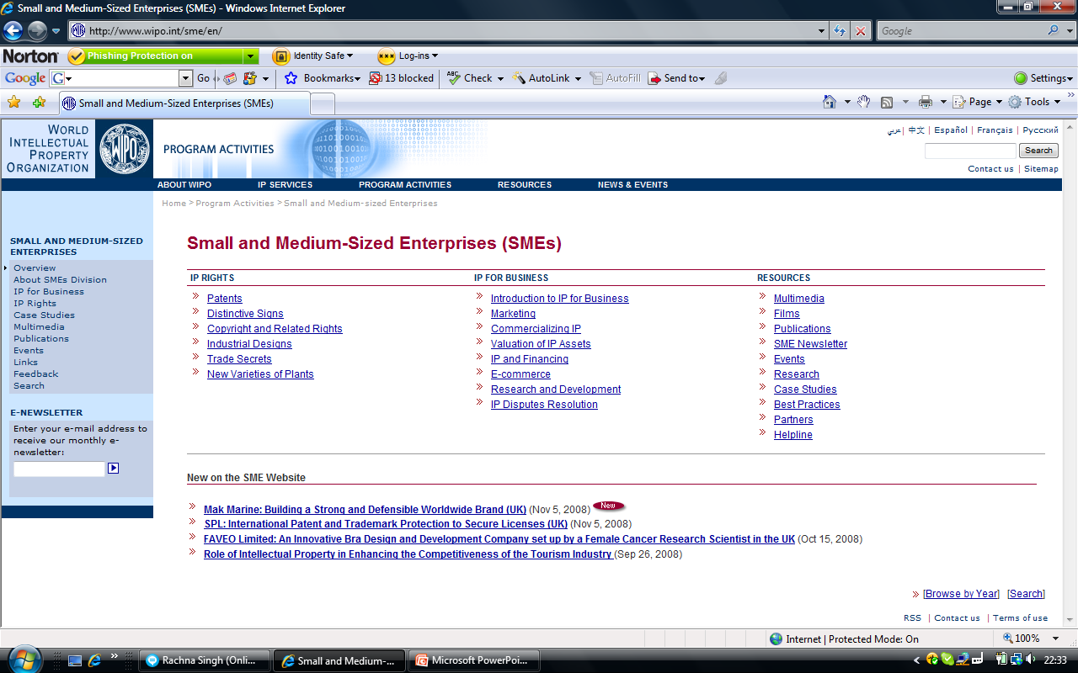
KACST
WIPO RESOURCES FOR SMEs

