Slide 1
Intensive Presentation of IP PANORAMA
June 2010, Lagos
Eusloo Seo
Counsellor
Small and Medium-Sized Enterprises Division
World Intellectual Property Organization
Eulsoo.seo@wipo.int

Slide 2
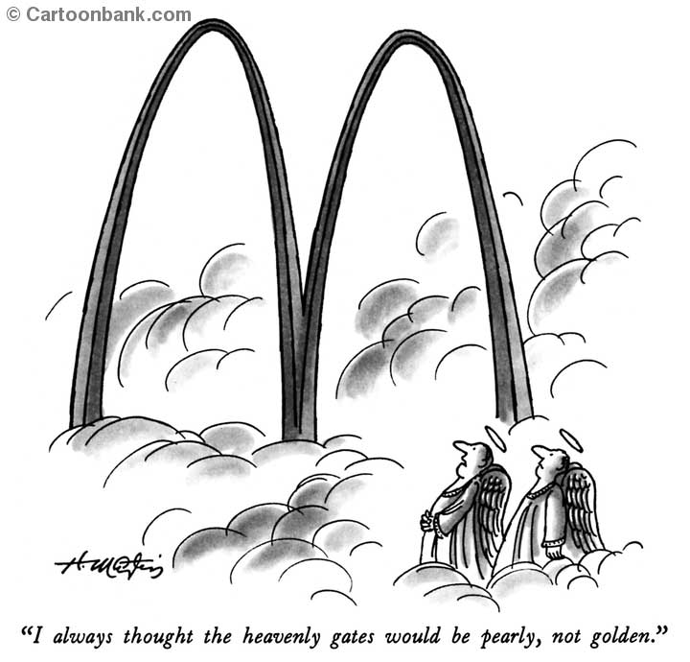
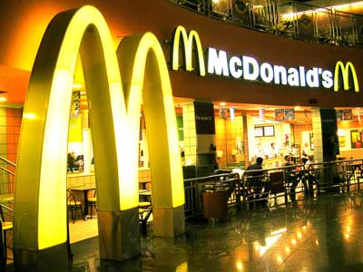


Slide 3
What is a trademark?
Trademark = Trade + Mark
A distinctive sign or indicator used by an individual, business organization, or other legal entity to identify that the products or services to consumers with which the trademark appears originate from a unique source, and to distinguish its products or services from those of other entities.

Slide 4


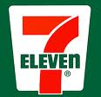


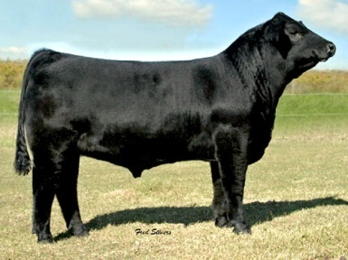
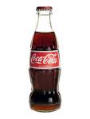

Trademark
Distinctive
Word
Letter
Numeral
Drawing
Picture
Shape
Color
Logotype
Label
A combination of one of more of the above

Slide 5

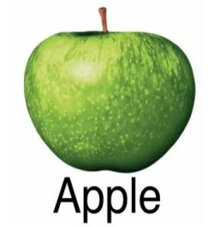


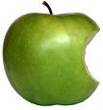
Trademarks
Common words or phrases under certain circumstances can be trademarked
An increasing number of countries consider a single color, a three-dimensional sign (shape of a product or packaging), an audible signs (sound), an olfactory sign (scent or smell), a moving image, a hologram, a taste or a texture of a product to be a mark

Slide 6
Trademark Protection
Protected by its registration as a mark under the relevant trademark law
In some countries, protected by its use as a mark in the marketplace.
Even where a mark is protected through use, it is advisable to register it as mark as such registration provides stronger protection

Slide 7
To Register a Mark
Must be distinctive: capable of distinguishing the products of the trademark owner or holder from the products of others
To be considered distinctive, it should either be inherently distinctive, or should have acquired distinctiveness through its use as a mark in the marketplace, which helps it to acquire a secondary meaning as a mark

Slide 8

Period of Protection
Initial registration valid for 10 years
Can be renewed indefinitely, as long as the mark is neither abandoned by the trademark owner, or loses its significance in the marketplace as a trademark by becoming a generic mark

Slide 9
Trademarks are Territorial
Protection is afforded under the national or regional trademark law.

Slide 10
Basic Steps for Registration
File a trademark application to the national trademark office as early as possible!
Application
Formal examination
Substantive examination
Publication and Opposition
Registration
Renewal

Slide 11
Cases of Rejection - Trademarks
Generic terms – e.g. CHAIR for office furniture
Descriptive terms – e.g. SWEET for sugar
Deceptive terms – e.g. SUPERSILK for Syn. Clothing
Geographical terms
Marks that are contrary to public order or morality
Flags, armorial bearings, official hallmarks and emblems of States and international organizations
Prior pending or registered trademarks

Slide 12
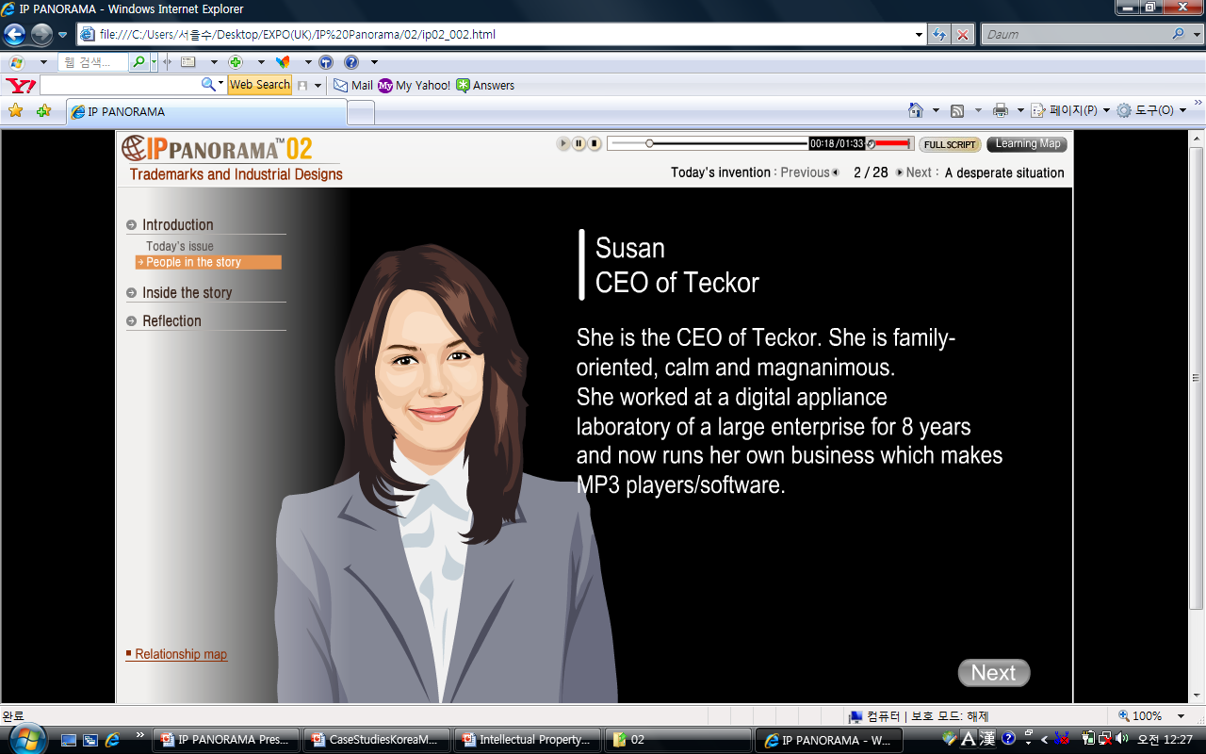
Module 2: Trademarks and Industrial Designs

Slide 13
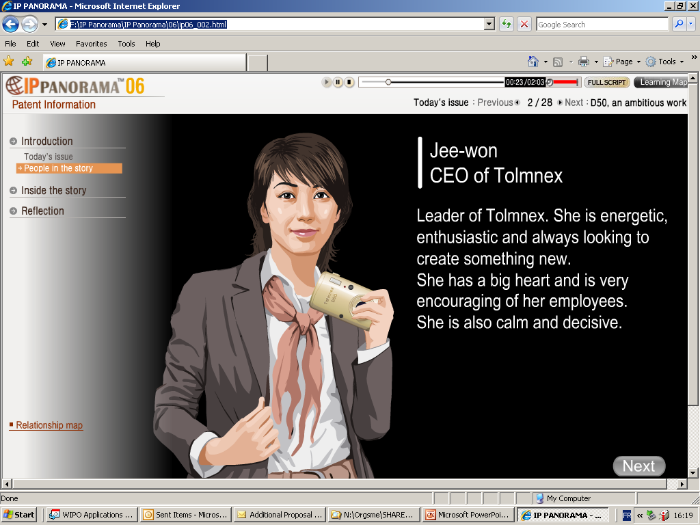
Module 06: Patent Information

Slide 14
"A good name is better than riches."
by Miguel de Cervantes

Slide 15

Eulsoo Seo
eulsoo.seo@wipo.int
Tel)+41-22-338-8159
Fax)+41-22-338-8760

