Slide 1








WIPO Expert Group on Internationally Agreed Scope and Methodology for Undertaking National Surveys and/Studies on IP and SMEs
South Africa
Dr Alex Antonites
Chair for Entrepreneurship
Department of Business Management
Email: alex1@up.ac.za

Slide 2

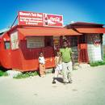

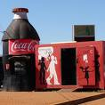
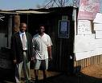
SMME Environment in S.A.
High unemployment level: 25%
Strong push economy
Large informal sector / subsistence micro
enterprises
Strong focus on start-up finance and not
growth incentives
Inefficient entrepreneurship enabling
environment
High failure rate

Slide 3
SMME Environment in S.A.

Slide 4

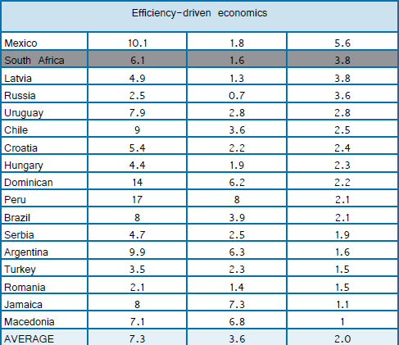
SMME Environment in S.A.

Slide 5
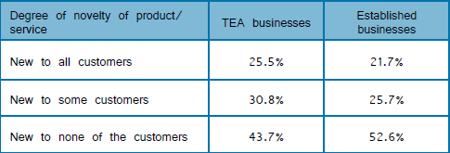
SMME Environment in S.A.

Slide 6
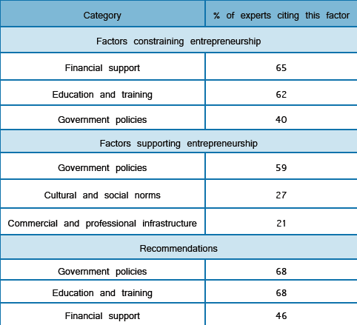
SMME Environment in S.A.

Slide 7
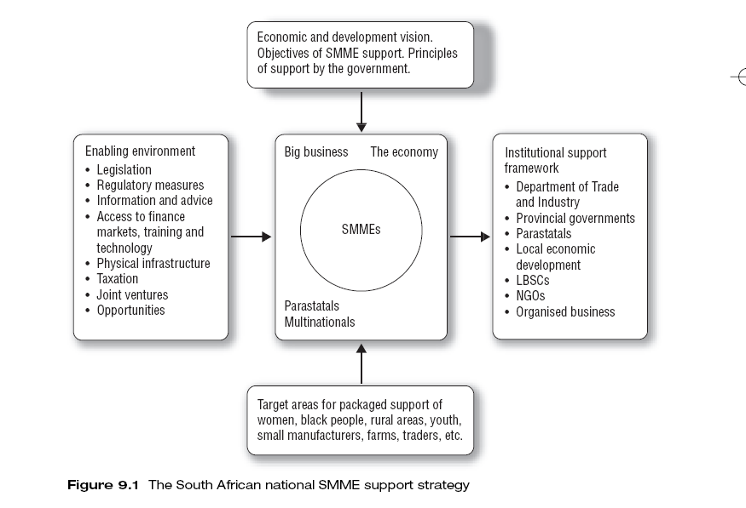
Intellectual Property Rights from Publicly Financed Research Bill
No. 26 of 2008: Technology Innovation Agency Act, 2008
South African Institute for IP Law
Southern African Research & Innovation Management Association
(SARIMA)
National Advisory Council on Innovation
South African Universities Technology (TEKTIQUE)

Slide 8

NATIONAL GOVERNMENT
DEPT. OF TRADE & INDUSTRY
DEPT. OF SCIENCE & TECHNOLOGY
TECHNOLOGY INNOVATION AGENCY
SEDA
INNOVATION FUND
Tech Transfer Offices
KHULA FINANCE
Innovation Hub

Slide 9

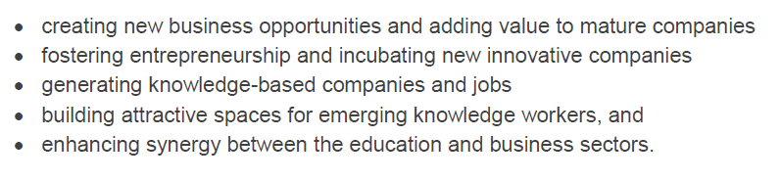
Innovation Hub

Slide 10
Conducting SMME survey
Engage in Incubation sector
Tertiary and secondary EDT (focus on Entrepreneurship, Engineering & Bio Science interventions)
  Content assessment
  Create awareness
  Adapt interventions
Technology Transfer Offices (role?)
Government policy (finance/incentive)
  Commercialisation strategy
Patent lawyers???

Slide 11
Obstacles in conducting survey method
Low literacy rate (11 languages); most effective = interview technique (cost)
ETD environment – focus on experimental design
Awareness of IP process low on all levels
Cost of IP process perceived as high (link to response rate)
Decrease in patent registrations (tracking, ex post facto)
High emphasis on commercialisation (6%)
Engage creative style & nature of population in in process of protection

