Slide 1
Ted Shapiro
SVP, General Counsel - Europe
Motion Picture Association-Europe
WIPO SEMINAR 27 May

Slide 2
“THE TIME WHEN THE LAW OF COPYRIGHT AND ITS INTERNATIONAL REGIME WAS A RELATIVELY SIMPLE AND WELL-DEFINED SUBJECT HAS PASSED. THE PRODUCTION OF COPYRIGHTED WORKS AND THEIR USES HAVE BEEN ENORMOUSLY ENLARGED IN THE LAST QUARTER CENTURY. THE CONFLICTS OF INTERESTS BETWEEN PRODUCERS OF LITERARY, MUSICAL AND ARTISTIC WORKS, AND THEIR CONSUMERS AND INTERMEDIARIES AFFECT LARGE GROUPS AND INVOLVE GREAT SOCIAL INTERESTS.
STEPHEN P. LADAS: PREFACE, THE INTERNATIONAL PROTECTION OF LITERARY AND ARTISTIC PROPERTY (MACMILLAN COMPANY, 1938)

Slide 3
Malheureusement, trop souvent, le droit d'auteur est présenté comme un obstacle à la création d'un marché numérique unique. Je crois que ce n'est pas juste. Le droit d'auteur permet au créateur de vendre ce qu'il a créé, lui garantit un retour sur investissement…C'est aussi vrai dans le domaine de l'industrie, de la création, de l'innovation industrielle; un retour sur investissement grâce auquel le créateur pourra ensuite continuer à créer d'autres œuvres et de nouveaux contenus. Ce modèle économique qui sous-tend le droit d'auteur existe depuis plusieurs centaines d'années, …. Chaque fois, les nouvelles technologies ont permis de passer à de nouveaux modèles économiques qui ont entraîné un changement dans l'exploitation et la commercialisation du droit d'auteur.
11 May at the European Parliament, Michel Barnier, Commissioner for the Internal Market – European Commission

Slide 4
“We should not see the observance and enforcement of IP rights as merely protecting the interests of the developed world, but rather as a powerful tool to galvanize our domestic industry while retaining national culture, national inventiveness, and national creativity”.
Betty Mould-Iddrisu, Chief State Attorney, International Law Division, Ministry of Justice, Ghana
Moladee (Senegal, 2004)

Slide 5
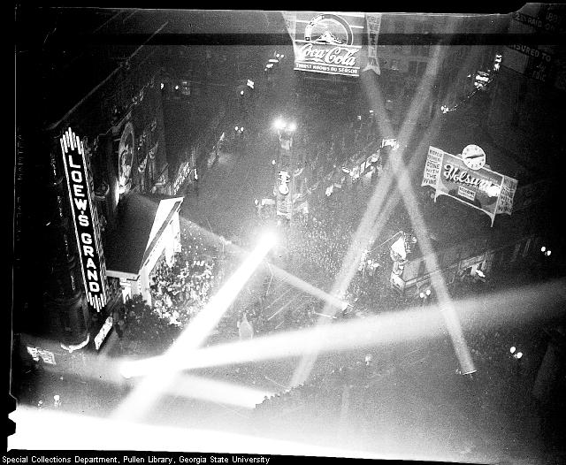

Slide 6
COPYRIGHT IS MORE THAN
A MERE RIGHT TO GET PAID

Slide 7
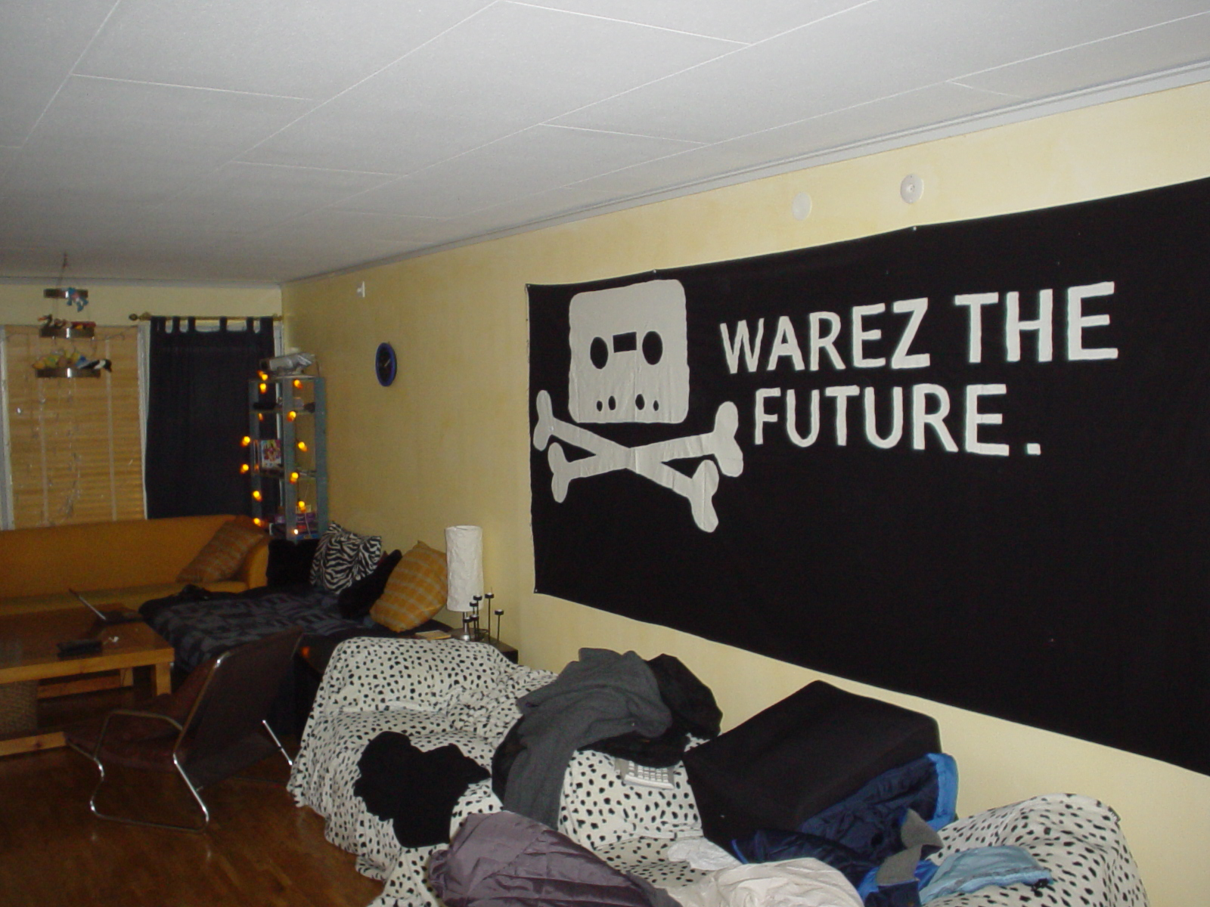

Slide 8
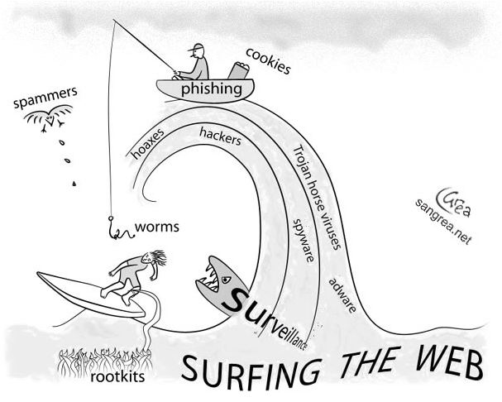
EU Digital Agenda – © points
“framework Directive on collective rights management“
Orphan Works Directive
Green paper “opportunities and challenges of online distribution of AV works and other creative content”.
Review 2004 Enforcement Directive

Slide 9
Looking at EU Copyright Law from on high
Unprecedented number of cases currently pending before ECJ which concern copyright/content protection
References for preliminary rulings from national courts
Potential for ECJ to have a profound impact on EU ©…
Copyright Directive
Conditional Access Directive
Cable & Satellite Directive
Software Directive
Enforcement Directive
E-Commerce Directive
ePrivacy Directive
Data Protection Directive
TFEU - Free Movement of Goods/Services
TFEU - Competition Law
European Convention on Human Rights and Fundamental Freedoms
ECJ decisions are binding on all Member States

Slide 10
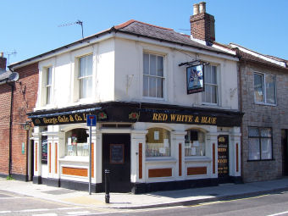
Cases C-403/08 and 429/08: Premier League
Condacc, Copyright, CabSat Directives
Free movement principles
Competition law
Territorial exclusive rights under © acquis
Freedom to license.
Financing /Production/Distribution/
Impact of differing Nat’l Regulations
Concept of an illicit device (services include © works)
© Issues
Scope of reproduction right/exception for temp copies
Communication to the pub (Spanish Hotels case)
CABSAT DIR NOT RELEVANT
Competition law - Coditel cases are good law
Market has not changed to extent it’s time to overrule it
Specific subject matter and essential function of ©
Ex Article 81 does not apply/ECJ set economic points

Slide 11
Thuiskopie (C-462/09), SGAE (C-467/08) & EGEDA (C-387/09)
Copyright Directive 2001/29/EC
Article 5.2b: Private Copy Exception
Article 5.5: 3 Step Test
Main issues
“Fair Compensation”
EU concept – uniform interpretation
Who is liable to pay? Scope?
Relation to national equitable remuneration schemes
Leeway for Member States? Can they discriminate? How to balance interests?
Role of collecting societies
Distance selling of equipment or blank media
Taking into account use, harm, direct payments
Professionals purchase equipment for non-private uses
SGAE AG opinion: a levy on private copies only where it may be presumed devices are used for private copying

Slide 12
Case C-393/08: BSA v. Czech Ministry of Culture
Software, Copyright and Cabsat Directives
Does © protection extend to graphic interface: “look and feel”?
Com to Pub/Making available/retransmission of video games?
Cases C-431 & 432/08: Airfield/Canaal Digitaal v. Sabam/Agicoa
Cable & Satellite Directive 93/83
Guidance on "communication to the public by satellite”
Satellite platforms --channel bundling/uplink/downlink
Separate act of communication to the public?
Article 11bis Berne Convention
Case C-136/09 Greek Hotel Case
© Directive 2001/29 - Beyond Spanish Hotels (C-306/05)
TV sets in hotel rooms connected to central antenna

Slide 14
ECJ C-236/08 – 23 Mar 2010
TMs/Keyword ads/displays and links
ECJ punted issue of whether the Art 14
liability privilege applies back to nat’l courts
Whether Google is “neutral, in the sense that its conduct is merely technical, automatic and passive, pointing to a lack of knowledge or control of the data which it stores.”
Remuneration by itself not enough
Fact that there is “concordance between the keyword selected and the search term entered by an internet user is not sufficient of itself”, but
“the role played by Google in the drafting of the commercial message which accompanies the advertising link or in the establishment or selection of keywords is relevant.”

Slide 15
Sabam v. Scarlet
Article 8.3 before the ECJ

Slide 16
Copyright, E-Commerce, Enforcement, Data Protection, and ePrivacy Directive as well as the ECHRFF
Brussels Ct of Appeal: Promusicae - insufficient guidance
(Sabam a worse case?)
Impact on other Art 8.3 cases and draft legislation?
Trick questions (against RHs)? Back to Member States?
1. Can nat’l judges issue injunctions ordering ISPs to filter?
relationship to Art 15 E-Com Dir – no general monitoring
2. If yes, do they have to apply principle of proportionality
Promusicae? -- Principle is well-established
National courts have to strike a fair balance between fundamental rights (privacy v. copyright).
Yes!?
Or an invitation to the ECJ to erect more hurdles?
subsidiarity (action 1st agst direct infringers), ISP liability, costs for ISPs, effectiveness of technology, others....

Slide 17
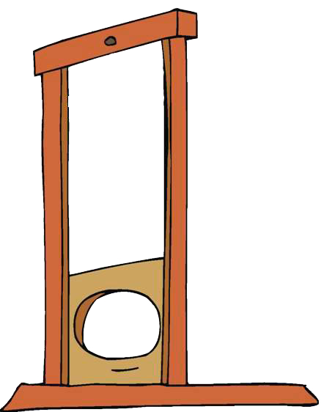
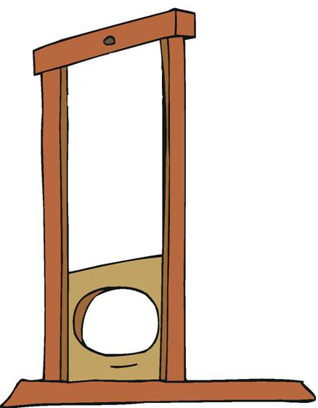
Meanwhile at WIPO…
CDIP
Dev. Agenda
SCCR
VIP
E&L
AVP
B’casters
TK/Folklore
©

Slide 18
© Sector in the Developing World
Shortage of local investors and chronic undercapitalisation of the production and distribution sectors.
Inadequate support services, including technical training and facilities, crews for film and music production, etc.
Weak marketing and distribution infrastructure.
Endemic illegal copying and illegal distribution of content.
Deficiencies in existing systems for the collection of royalties for producers, publishers, authors and artists.
Deficiencies in local IPR enforcement, which are often due to economic reasons or allocation of limited resources.
Chronic lack of funding creates a vicious circle: Poorly funded and marketed works earn low returns. The distribution infrastructure remains inefficient and in many cases insecure, which multiplies opportunities for a black market to develop.
All of these factors in turn make lenders and investors more reluctant to provide the funds to support publishing, production and distribution of new creative content.

Slide 19
Liam Neeson .... Qui-Gon Jinn Ewan McGregor .... Obi-Wan Kenobi Natalie Portman .... Queen Padmé Amidala Jake Lloyd .... Anakin Skywalker Pernilla August .... Shmi Skywalker Frank Oz .... Yoda (voice) Ian McDiarmid .... Senator Palpatine Oliver Ford Davies .... Gov. Sio Bibble Ray Park .... Darth Maul Hugh Quarshie .... Capt. Panaka Ahmed Best .... Jar Jar Binks (voice) Anthony Daniels .... C-3PO Kenny Baker .... R2-D2 Terence Stamp .... Supreme Chancellor Valorum Brian Blessed .... Boss Nass (voice) Andrew Secombe .... Watto Lewis Macleod .... Sebulba (voice) Steven Spiers .... Capt. Tarpals Silas Carson .... Viceroy Nute Gunray/Ki-Adi-Mundi Ralph Brown .... Ric Olié Celia Imrie .... Fighter Pilot Bravo 5 Benedict Taylor .... Fighter Pilot Bravo 2 Karol Cristina da Silva .... Rabé Clarence Smith .... Fighter Pilot Bravo 3 Samuel L. Jackson .... Mace Windu Dominic West .... Palace guard Liz Wilson .... Eirtaé (as Friday 'Liz' Wilson) Candice Orwell .... Yané Sofia Coppola .... Saché Keira Knightley .... Sabé Bronagh Gallagher .... Radiant VII captain John Fensom .... TC-14 Greg Proops .... Beed (voice) Scott Capurro .... Fode (voice) Margaret Towner .... Jira Dhruv Chanchani .... Kitster Oliver Walpole .... Seek Katie Lucas .... Amee (as Jenna Green) Megan Udall .... Melee Hassani Shapi .... Eeth Koth Gin Clarke .... Adi Gallia (as Gin) Khan Bonfils .... Saesee Tiin Michelle Taylor .... Yarael Poof Michaela Cottrell .... Even Piell Dipika O'Neill Joti .... Depa Billaba Phil Eason .... Yaddle Mark Coulier .... Aks Moe Lindsay Duncan .... TC-14 (voice) Peter Serafinowicz .... Darth Maul (voice) James Taylor .... Rune Haako (voice) Chris Sanders .... Daultay Dofine (voice) Toby Longworth .... Sen. Lott Dodd/Gragra (voice) Marc Silk .... Aks Moe (voice) Amanda Lucas .... Tey How/Diva Funquita (voice) (as Tyger) Produced by George Lucas .... executive producer Rick McCallum .... producer Original Music by John Williams Cinematography by David Tattersall Film Editing by Ben Burtt Paul Martin Smith Casting by Robin Gurland Production Design by Gavin Bocquet Art Direction by Phil Harvey Fred Hole John King Rod McLean Set Decoration by Peter Walpole Costume Design by Trisha Biggar

