Slide 1
http://xellectip.com

Slide 2


Inventing the Future
WORLD INTELLECTUAL PROPERTY ORGANIZATION
WIPO TRAINING OF TRAINERS PROGRAM
ON EFFECTIVE INTELLECTUAL PROPERTY ASSET MANAGEMENT BY SMALL AND MEDIUM-SIZED ENTERPRISES IN DUBAI
Dubai, December 19 to 23, 2010
The Importance of Inventive and Innovative Activity in Maintaining Competitiveness
Rachna Singh Puri
Xellect IP Solutions, India
www.xellectip.com

Slide 3
Competitiveness
Defined as the ability of a firm to increase in size, market share and profitability. May be achieved by:
Producing more cheaply, for example by finding ways to reduce labour costs
Applying other non-price factors such as:
  Human resource endowments, such as skills and worker motivation
  Technical factors such as R&D capabilities, and the ability to adapt and use technologies
  Managerial and organisational factors

Slide 4
Innovation
Ideas applied successfully in practice
Typically is expected to lead to a drastic change
  In the system
  By introduction of new products or services
Expected to clear out the old and in with the new
No limit to where innovations may be applied

Slide 5
Characteristics of Technical Innovation
Coupling (of changing technology, production and markets)
Creating (new products, processes, systems and industries)
Clustering (of groups of related innovations)
Comprehending (new skills, new technologies, new markets)
Coping (with the technical and market uncertainty of innovation)
TECHNOLOGICAL INFRASTRUCTURE AND INTERNATIONAL COMPETITIVENESS Draft paper submitted to the OECD ad hoc group on science, technology and competitiveness. August 1982 C. Freeman

Slide 6
Drivers of Innovation
Market Forces (Competition)
Consumers (Value-Add to Existing Products)
Regulatory Requirements (Pollution Control by EHS, ISO Certification etc.)
Quality (Process Improvements, Waste & Defect Reduction, Increasing Productivity)

Slide 7
Inventions
Solves a problem
Stems from a novel & non-obvious idea
  Subsequently, the working idea is applied to a specific or several applications
Comes out of a business choice
  Determined by market needs
  Core competency taken into account
  High monetary returns expected
  Also typically one problem or application area

Slide 8
Innovation vs. Invention
Invention solves an existing problem by providing solutions
Innovation utilizes the invention and brings it to practice
Innovation does not require a problem
  Creates its own problem and provides solutions

Slide 9
Invention Methodology
Problem Identification
Problem Definition
Appraisal of State-of-the-Art
Identify Plausible Solutions
Identify Best Mode of Operation

Slide 10
Invention Methods
Systematic or Incremental Approach
Out-of-the-box Approach
Breakthrough
Serendipity

Slide 11
The Central Theme
“How a Lone Inventor and an Unknown Company Created the Biggest Communication Breakthrough Since Gutenberg†”
† Part of the title of the biography of Chester Carlson by David Owen

Slide 12
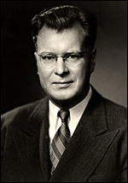
The Inventor
B.S. in Physics from California Institute of Technology in 1930
Research Engineer in Bell Laboratories
  Found work “Dull and Routine”
Transferred to the Patent Department
Laid off during the Great Depression
Found work in an electronics firm
  Promoted to head of Patent Department in a few years
Got his L.L.B degree in 1939
Chester Carlson

Slide 13
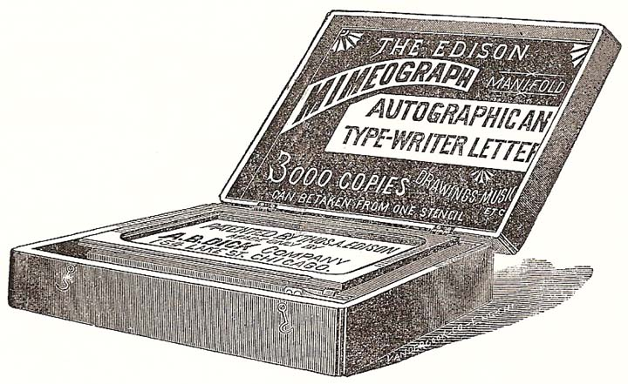
Problem
  Mimeograph process made wet copies which then required a long drying time
  Photostats were adequate but too expensive
  Desirable to make “Xerographs” or “Dry Copies”

Slide 14

The Principle
Electrophotography
Simple basic principle that led to a revolutionary technology:
  when light and shadow strike a charged plate, the dark parts attract a special powder while the light parts repel

Slide 15
The Patenting Strategy
First patent filed in 1937
Developed the technology over 15 years
Filed several patents along the way
  His training in patent law stood him in good stead

Slide 16
Commercialization
Tried to convince organizations to invest in the invention, unsuccessfully
  Included giants like General Electric, IBM, RCA and the U.S. Army Signal Corps
Finally struck a deal with Battelle Memorial Institute in 1944 to prove feasibility of technology
Subsequently licensed to Haloid Corporation for commercialization

Slide 17
Naming
  Haloid Corporation sold its first photocopier in 1950
    Used Carlson’s concept of ‘Xerography’
  Plain paper push button Photocopier first introduced in 1959
  The parent company coined the term XeroX
    Short for Xerography
  Reinvented itself as Haloid Xerox in 1958
  Renamed itself as Xerox Corporation in 1961

Slide 18

Revenues
The initial model Xerox 914 made $60 million in revenue in the year 1961 alone
  Met their long term sales target within 6 months
Revenues leaped to more than $500 million within 5 years*
Chester Carlson grossed about $150,000,000 from his invention eventually
*: By this time, most of the original patents had expired

Slide 19


Currently
Xerox Corporation has adapted to modern day demands
  Reinvented itself as ‘The Document Company’
  No more stand-alone copiers, but printers, scanners etc. associated with it
Aware of environmental concerns of paper usage
  According to a study conducted by Xerox, around 40 percent of the pages printed are only viewed once before being thrown away
  In the process of developing “Erasable” Paper
Xerox logo 1971–2008
Redesigned the logo to reflect the changes in corporate strategy
Logos used herein are a registered trademark and/or copyrighted logo belonging to Xerox Corporation.

Slide 20

IP and the Big Picture
Introduction
Incident
Tylenol®- a popular over-the-counter drug
  Comes in various grades
Sold by McNeil Laboratories
  Now a subsidiary of J&J
In Fall 1982, 7 people died after ingesting Extra Strength Tylenol®
    Capsules deliberately contaminated with cyanide
    Killer never caught
Brand sales collapsed immediately
Damage Control
Within a week, parent company recalled all products
  Estimated retail value of US$100 million
Issued warning on all national media
Offered to exchange all capsules purchased
Reintroduced product with triple-seal package very quickly
Helped develop tamper-resistant packaging
Introduced heavy price promotions
Result
Within a few years, regained market dominance

Slide 21
Shrewd Businessman
Using Patents to Get Initial Monopoly
Making Room to Enjoy Business Success

Slide 22
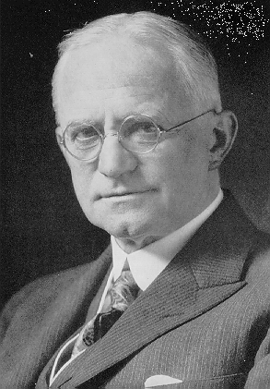
“You press the button, we do the rest†”
Developed and patented a dry photographic plate in 1880
In 1884, patented a photographic medium
  Both in England and U.S.A
Patented roll film camera in 1888
Filed key patents in all important facets
Then, focused the company to making film when competition heated in the camera industry
  By providing quality and affortable film to every camera manufacturer, Kodak managed to turn all competition into more business
George Eastman
† Marketing phrase coined for the film roll camera created by Geaorge Eastman

Slide 23
Shifting Paradigms
“Next killer product is the patent itself†”
† Title of the article written by Rick Merritt in EETimes

Slide 24
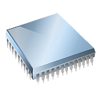
The Organization
Patriot Scientific Corp.
Based out of Carlsbad, CA, USA
Six-person company
Focused on establishing a new microprocessor architecture
In the process filed several patents related to its core technology

Slide 25
Shift in Focus
The six-person company netted more than $24 million in 2005 by licensing seven U.S. patents fundamental to CPUs
  Advanced Micro Devices, Casio, Fujitsu, Intel, Hewlett-Packard
Will be collecting more from royalties on sales of all microprocessor-based systems
  Virtually every electronic product is touched by this portfolio
  sales estimated at $200 billion a year
Further, hundreds of companies have been put on notice as potential infringers

Slide 26
Repositioning the Organization
Then, clarified company’s strategy & acquired a strong IP portfolio
Subsequently, outsourced enforcement of its patents in a joint venture
Commissioned a study to look at how it might dispose of its CPU business
Decided that "This company doesn't need to be manufacturing anything or marketing a product"
Essentially relied on the licensing team to create revenue
Are one of a rising number of Patent Licensing and Enforcement Companies (PLECs)
Multiple venture funds are forming to bankroll the efforts of these PLECs
Effort to carve out business models in the midst of a gold rush in intellectual property

Slide 27
IP Strategy for Competitiveness
Decisions regarding
  Research Direction
  Product Launches and Sales
  Licensing
  Litigations
  Mergers & Acquisitions
  Other Partnerships
Protection Strategy
  Filings
    Blocking filings around competitors’ patents
    Fencing filings around core technology
    Filings on Critical Design Elements
  Invalidation & Infringement
  Enforcement
Trademark Strategy
  Branding
  Marketing

Slide 28
Intellectual Property
“If you Think it, Protect it…”
“Because if it is worth copying, it is worth protecting”

Slide 29
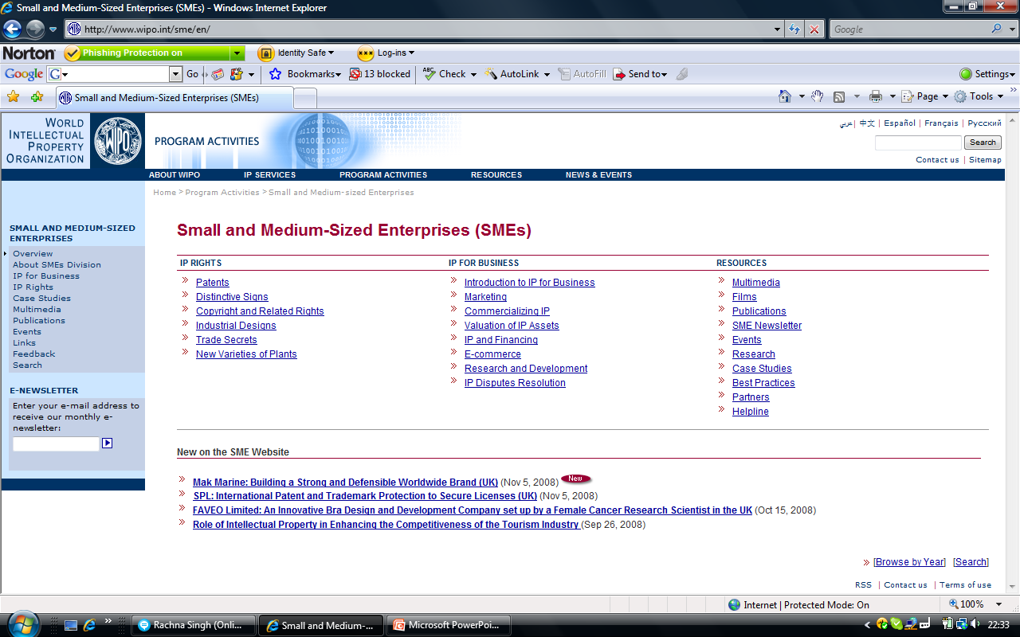
WIPO RESOURCES FOR SMEs

