Slide 1
Chemical searches
In PATENTSCOPE
Virtual
September
2020
Sandrine Ammann
Marketing & Communications Officer

Slide 2
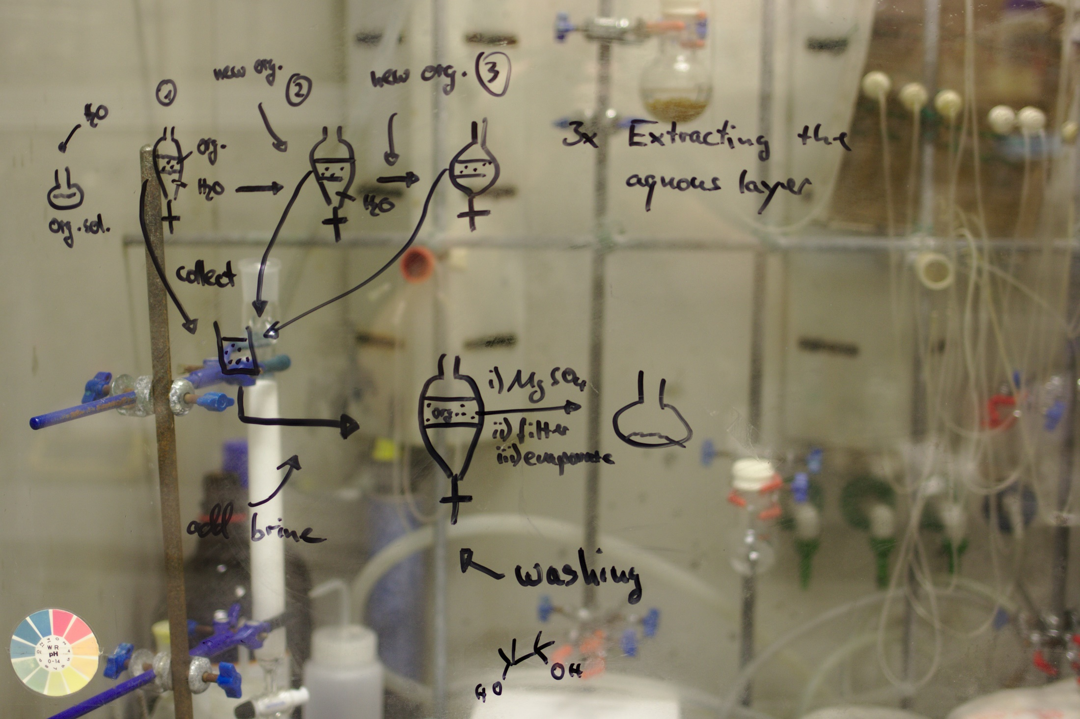

Slide 3
Click this button if you can hear my voice and see my screen

Slide 6
Questions/concerns
patentscope@wipo.int

Slide 7
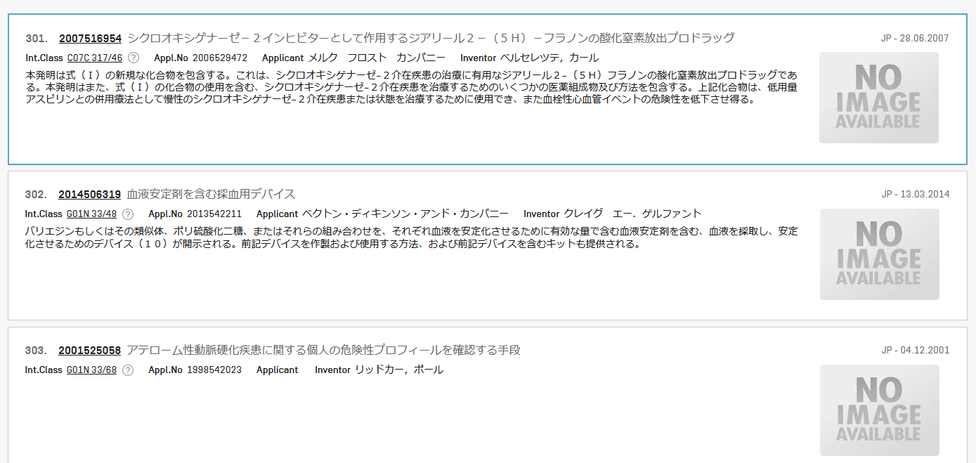
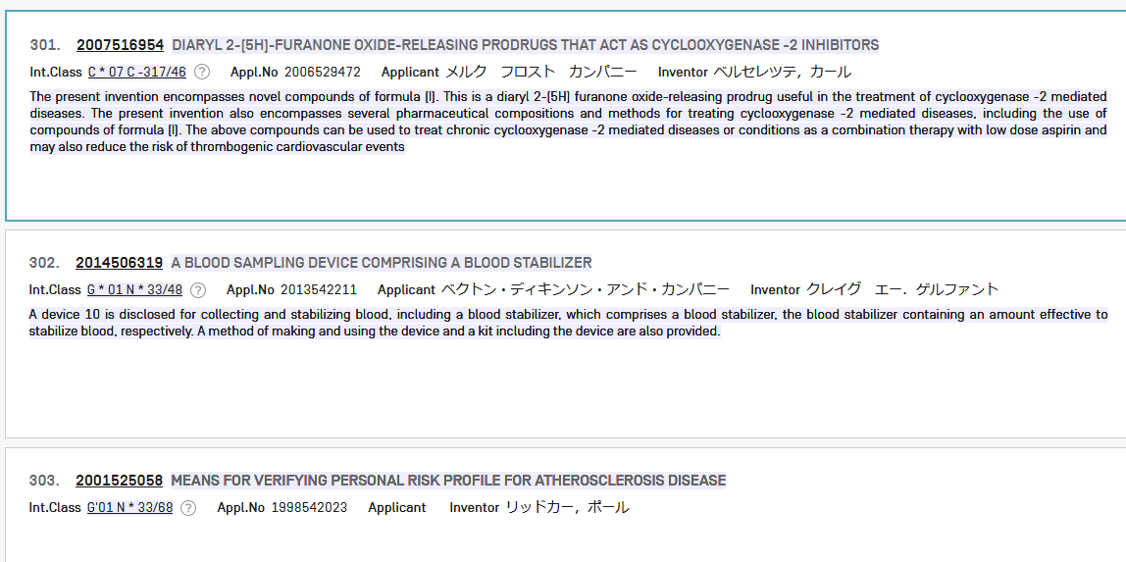
Search: aspirin in Japanese patents

Slide 8
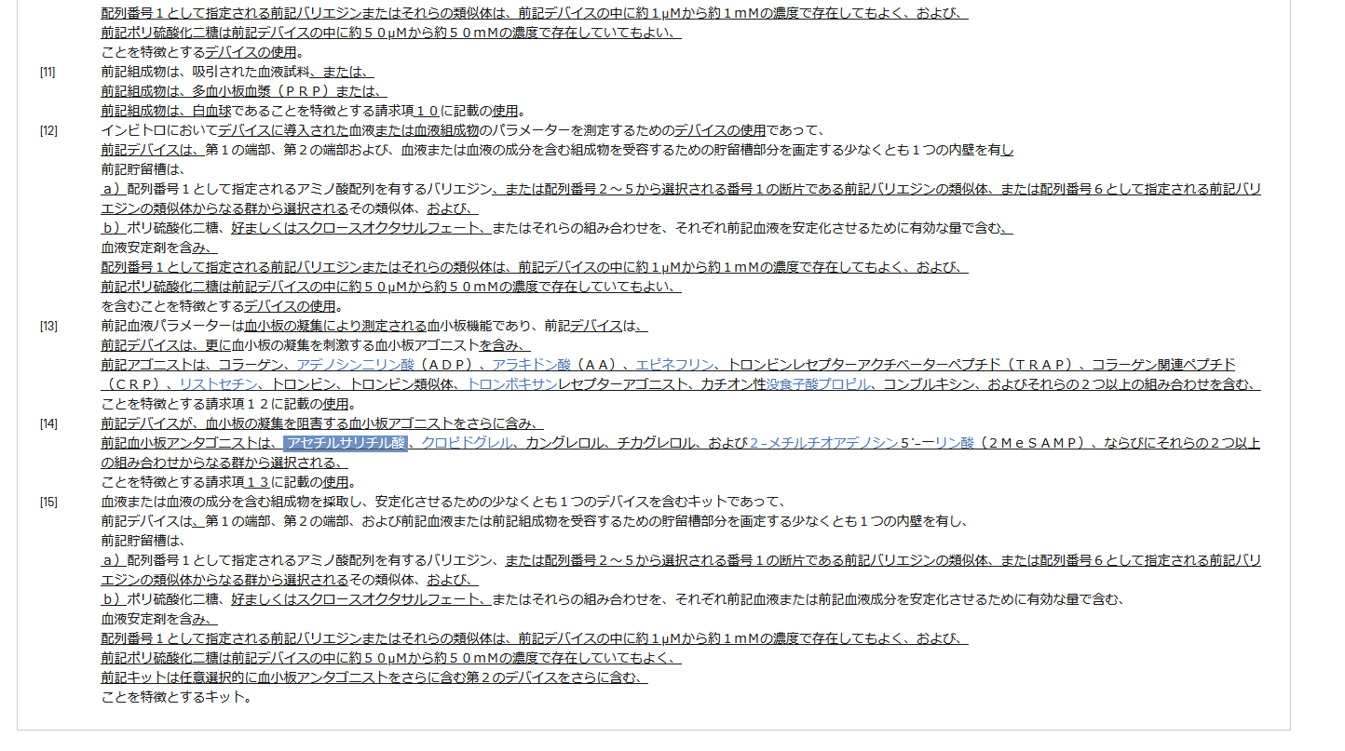
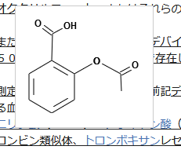

Slide 9
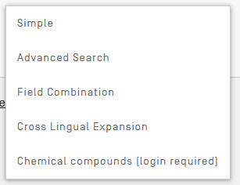
Access
Available freely at https://patentscope.wipo.int
Access only with a WIPO account

Slide 10
Structure search - the concept
Recognize names and structures of chemical compounds in patent texts and embedded drawings
Standardize all the different representations of chemical structures into InchIkeys
InchIkeys can be used by non chemists

Slide 11
Inchikeys
Definition: a short, fixed-length character signature based on a hash code of the InChI string.
Provide a precise & robust IUPAC* approved structure-derived tag for a chemical substance.
*International Union of Pure and Applied Chemistry

Slide 12
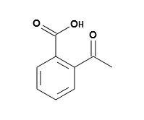
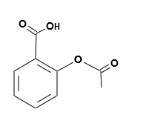
Example: InchI – InchIKey for aspirin
InChIKey = a fixed-length (27-character) condensed digital representation of an InChI
InChI = is a textual identifier developed to make it easy to perform web searches for chemical structures

Slide 13
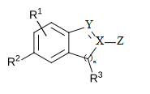
Scope
Works on developed exact formulas ≠ Markush structures (-R) that are chemical symbols used to indicate a collection of chemicals with similar structures.

Slide 14
Collections
- China [1996 -2020]
- European Patent Office [1978 -2020]
- Eurasian Patent Office [1998 -2020]
- Japan [1993 -2020]
- Republic of Korea [1980 -2020]
- PCT [1979 -2020]
- Russia [1995 -2020]
- United States [1979 -2020]

Slide 15
IPC codes
C08L C09B C09C C09D C09J C09K C10H C10L C10M C10N C11D C12C C12H C12M C12N C12P C12Q C13B C13K C14C C23C C25B C40B H05B G01N G03C
A01N A01P A23J A61K A61L A61P A61Q B01J B01S C01B C01C C01D C01F C01G C06B C07B C07C C07D C07F C07H C07J C07K C08F C08G C08J C08K

Slide 16
Fields
Title
Abstract
Description
Claim

Slide 17
Limitations
Long automated procedures, no supervision
Will not recognize 100%! Same drawbacks as the OCR
Depends on OCR quality for PCT applications
Does not work with simple formulas such H2O
Not all collections and related languages

Slide 18
Why is it useful?
Terms such as “aspirin”, “paracetamol” not always used in patent documents
Many ways of representing formulas
Expansion of searches

Slide 19
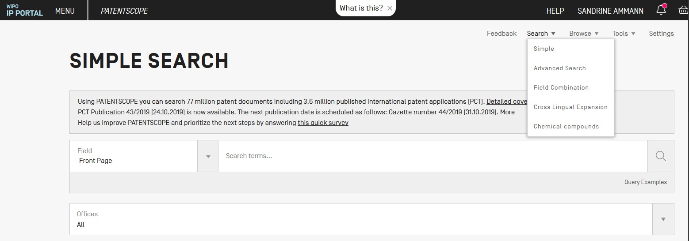
How does it work?

Slide 20
4 options

Slide 21
Scaffold
Basic skeleton of a molecule to which further groups and moieties are attached
Secondary information is ignored
≠Markush
Markush =searches for a formula implicitly cited in a patent using a Markush formula
Scaffold = searches for formulas explicitly cited in patents

Slide 22
Upload a structure

Slide 23
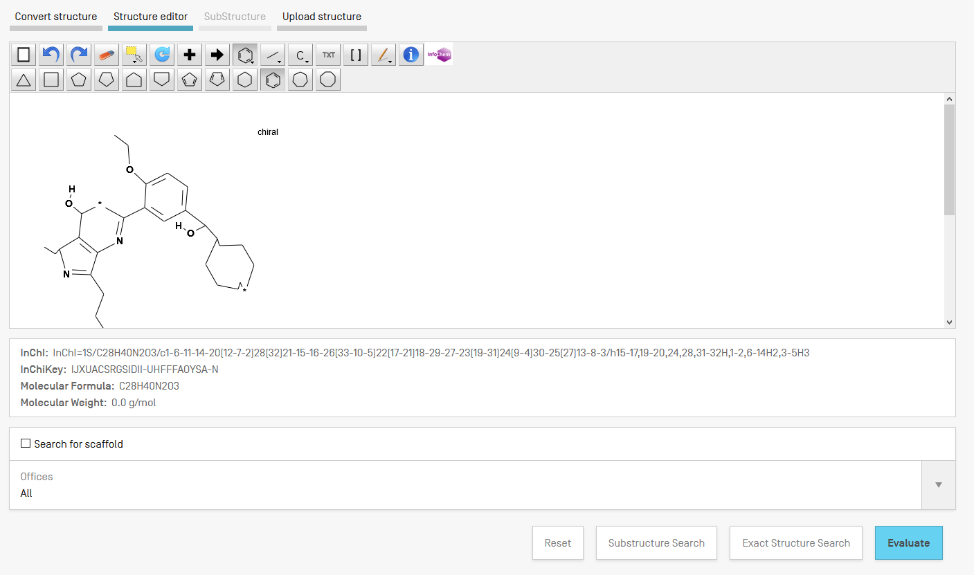
Example

Slide 24
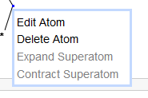
Structure editor

Slide 25
Convert a structure

Slide 26
Convert structure: aspirin

Slide 27
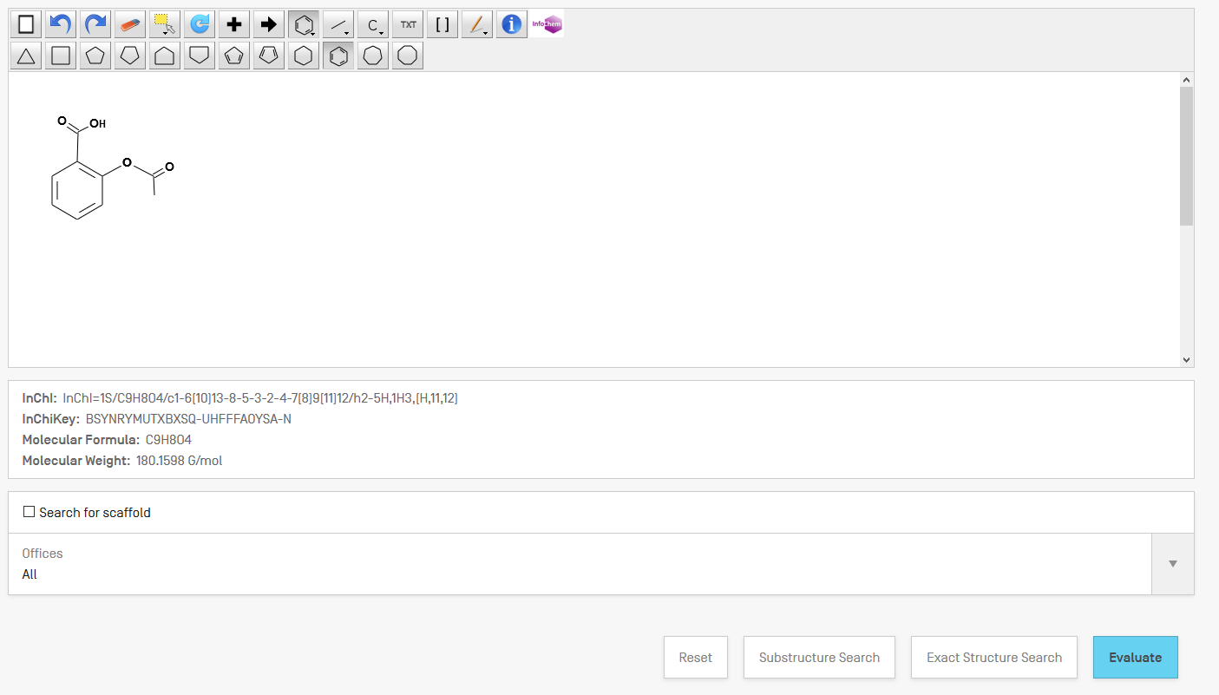

Slide 28
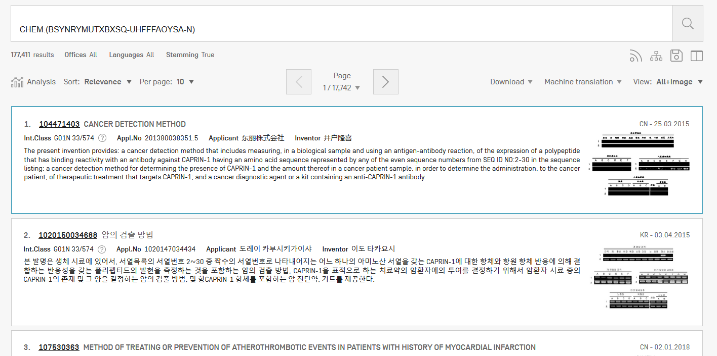
Results

Slide 29
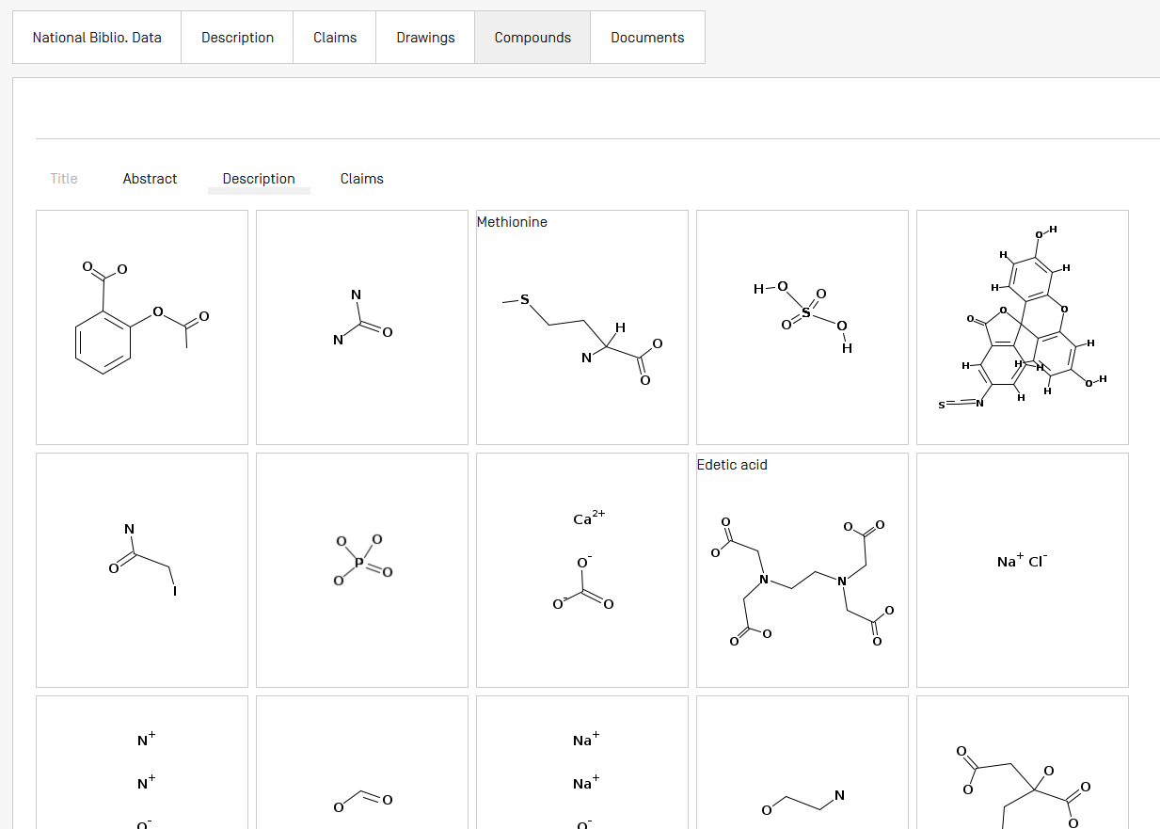

Slide 30
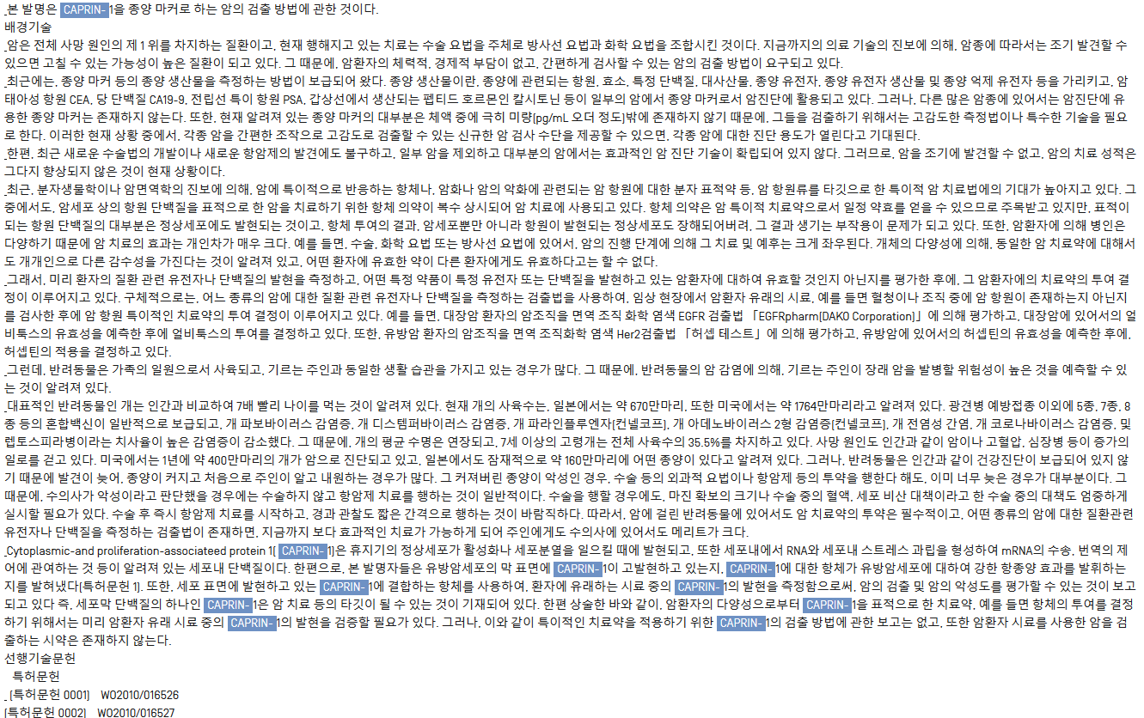

Slide 31
Example formula searching
4-(3-chloro-2-fluoroanilino)-7-methoxy-6-((1-(N-methylcarbamoylmethyl)piperidin-4-yl)oxy)quinazoline

Slide 32
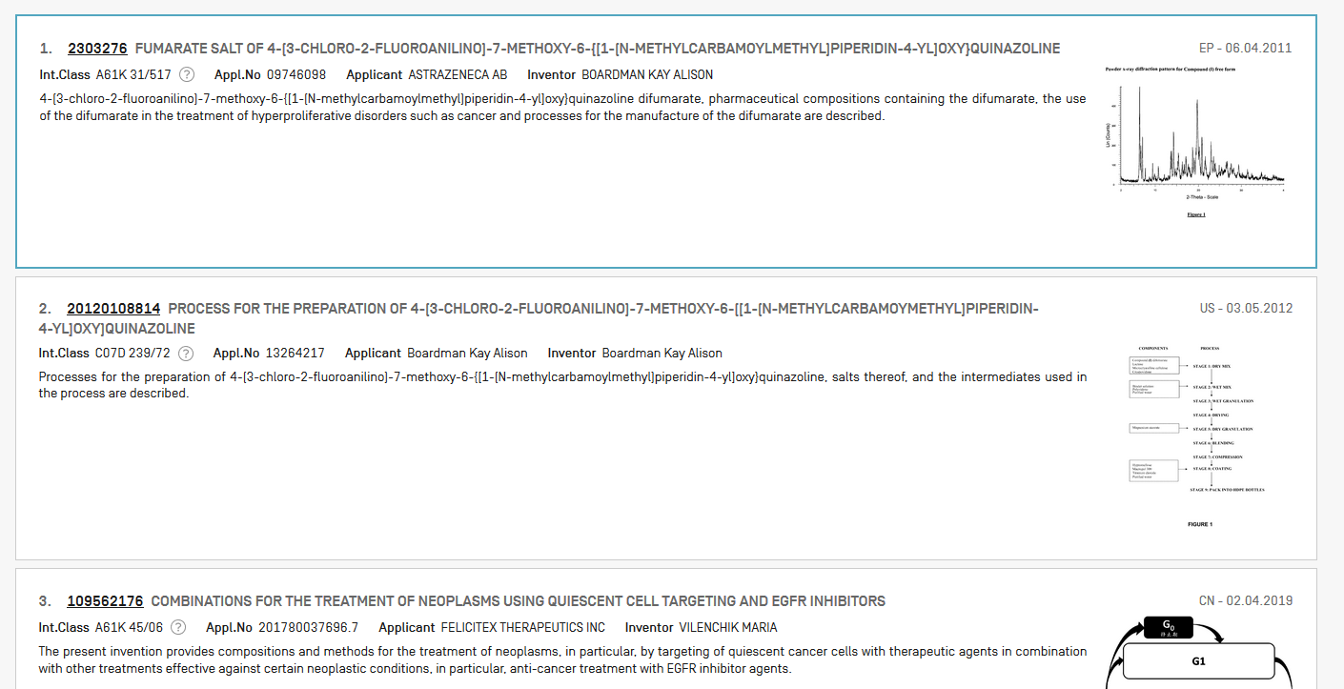

Slide 33
Example: Ritonavir

Slide 34
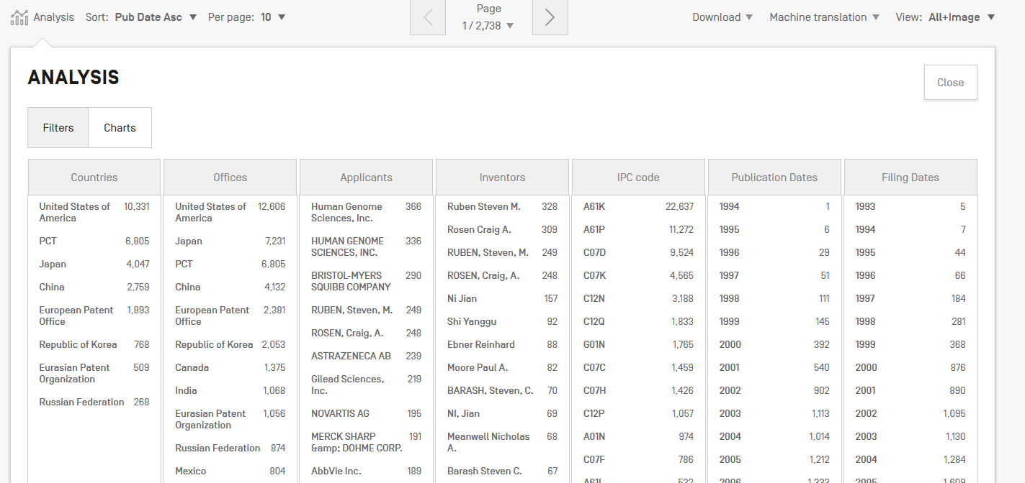

Slide 35
Patent landscape Report on Ritonavir-
Ritonavir is an antiretroviral drug from the protease inhibitor class used to treat HIV infection and AIDS. Ritonavir is included in the WHO Model List of Essential Medicines (EML)1.
The originator company is Abbott Laboratories, which markets Ritonavir under the brand name Norvir, or in combination with the protease inhibitor Lopinavir, as Kaletra or Aluvia. The U.S. Food and Drug Administration (FDA) approved the drug in March 1996 for oral solution and in June 1999 for capsules.
http://www.wipo.int/edocs/pubdocs/en/patents/946/wipo_pub_946.pdf

Slide 36
Sub-structure search – the concept
Identification of elements in larger structures

Slide 37
Substructure search

Slide 38
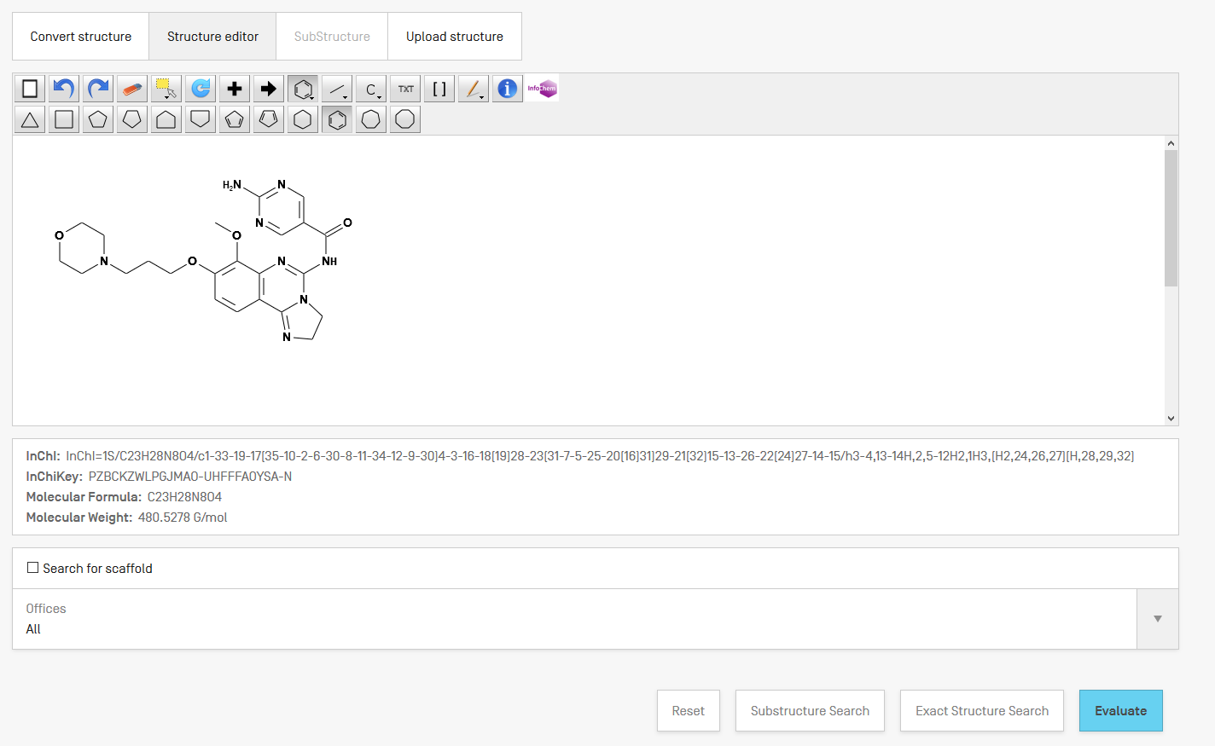

Slide 39
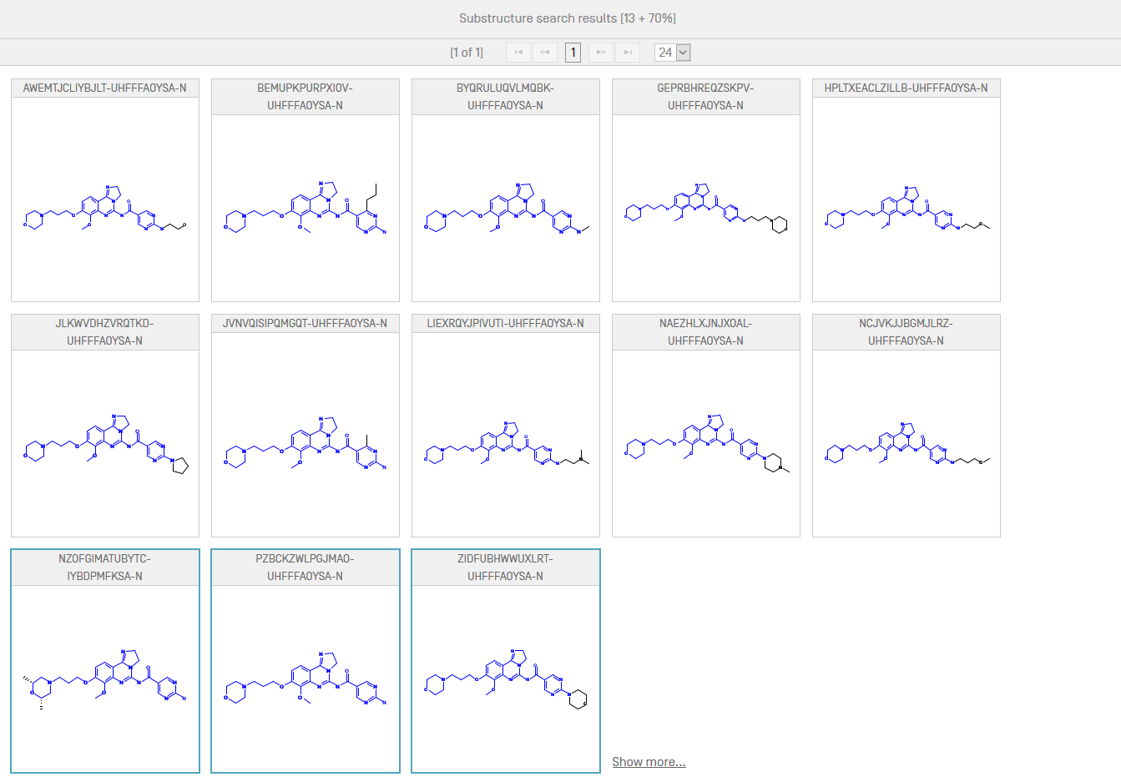

Slide 40
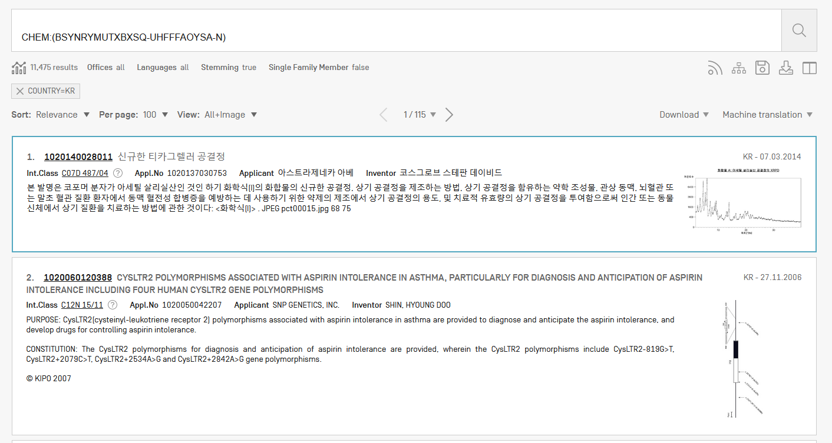
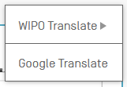
Results

Slide 43
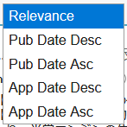
Result sorting

Slide 44
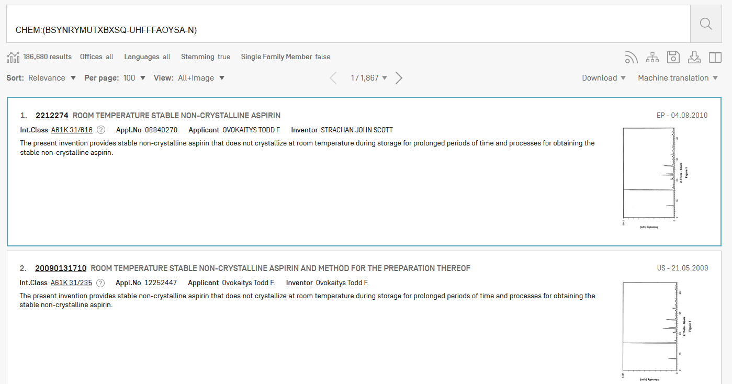
Analysis

Slide 45
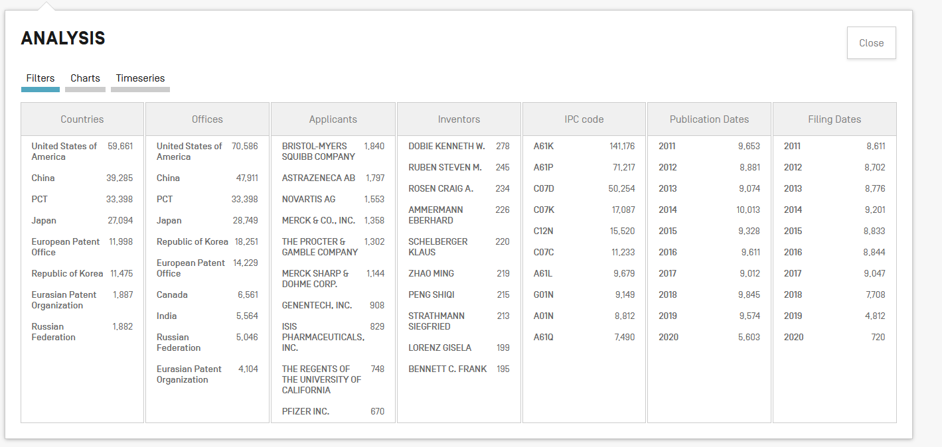
Analysis

Slide 46
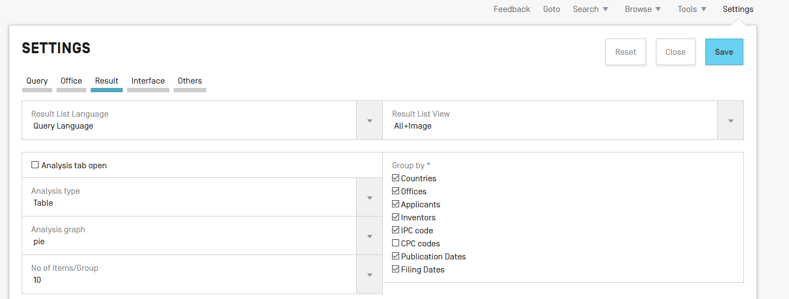
Customize

Slide 48
Search by CAS number
CAS83-88-5

Slide 49
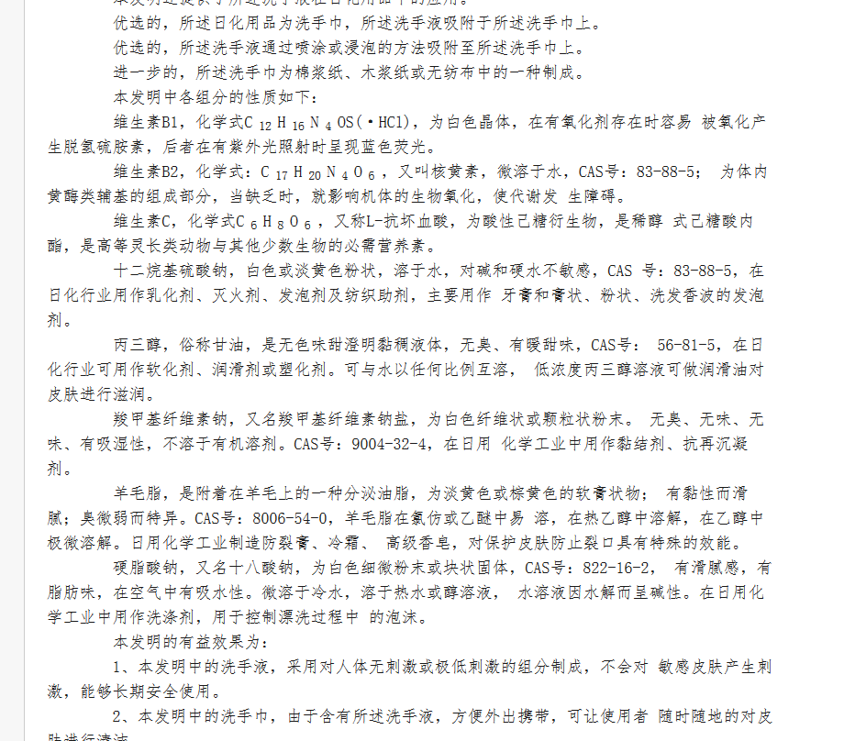

Slide 51
Compound + keywords + wildcard

Slide 52
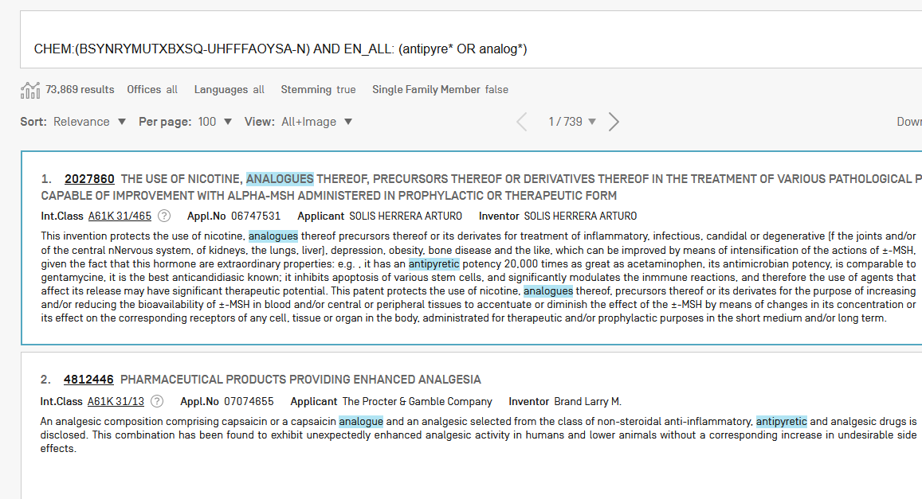

Slide 53
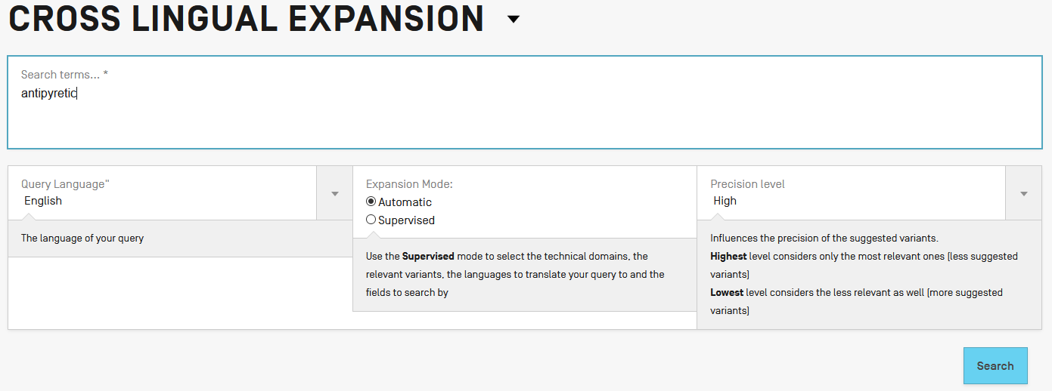
Antipyretic in Japanese?

Slide 55
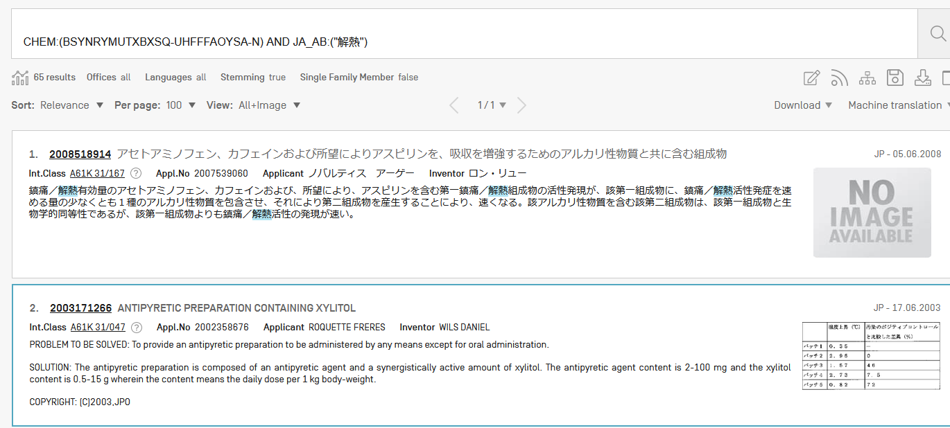

Slide 56
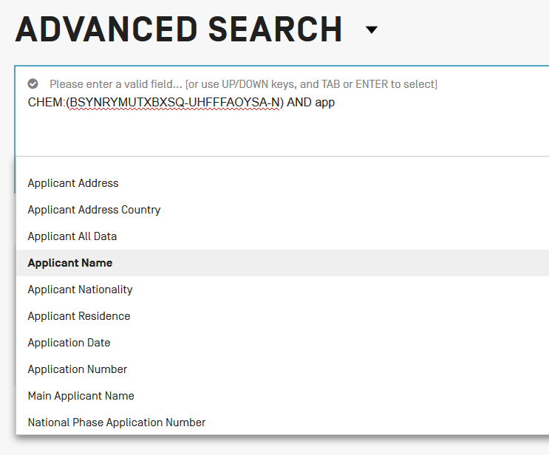
Combine with applicant

Slide 58
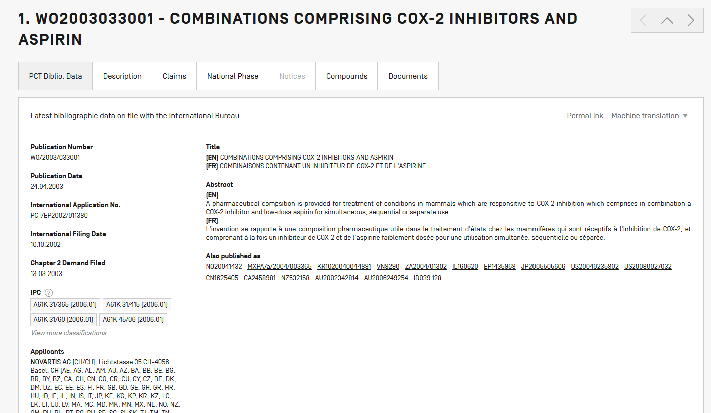

Slide 59
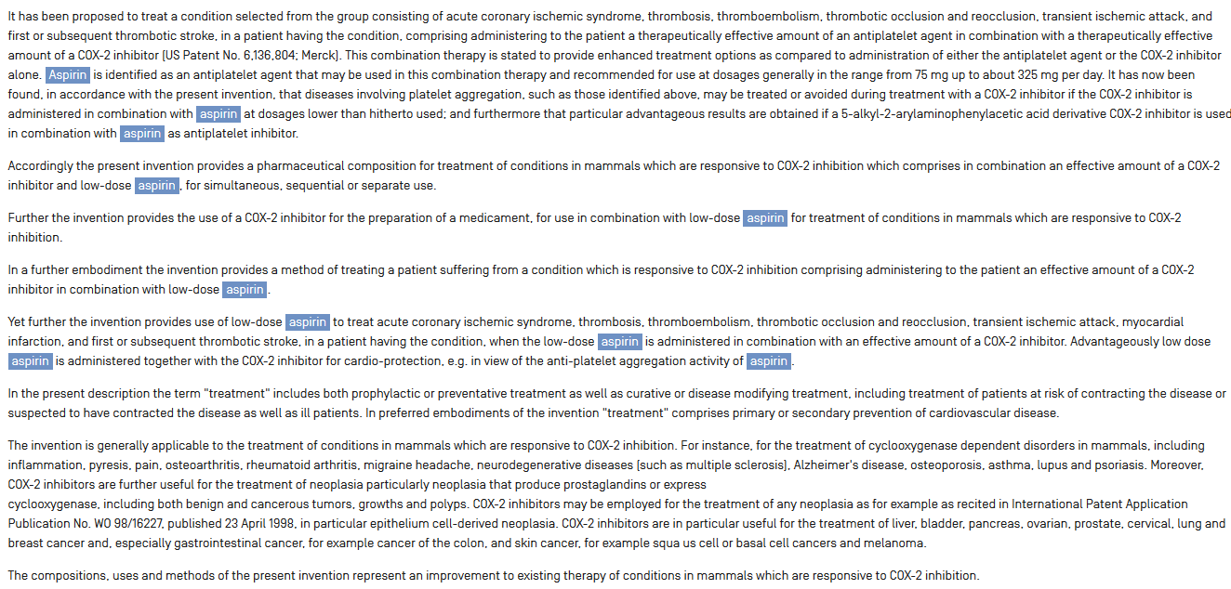

Slide 60
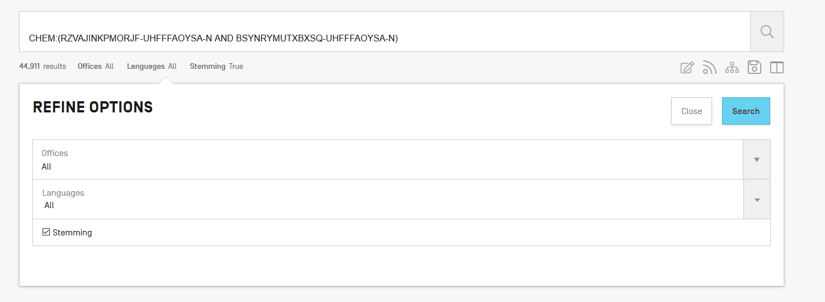
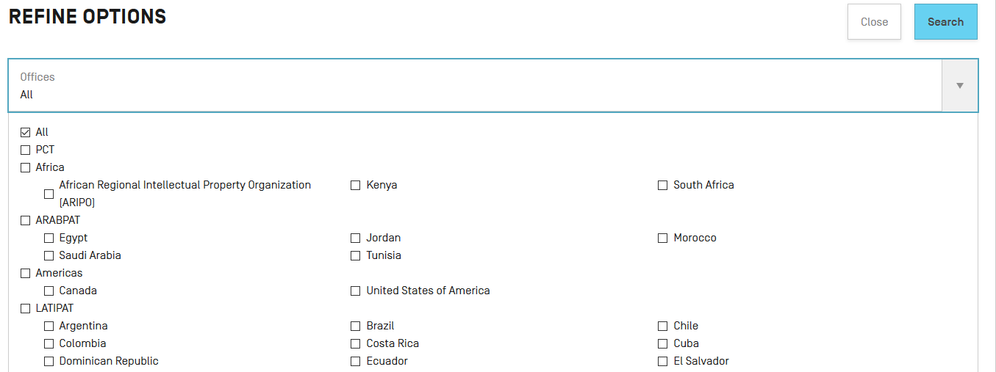
Combine with a country

Slide 61
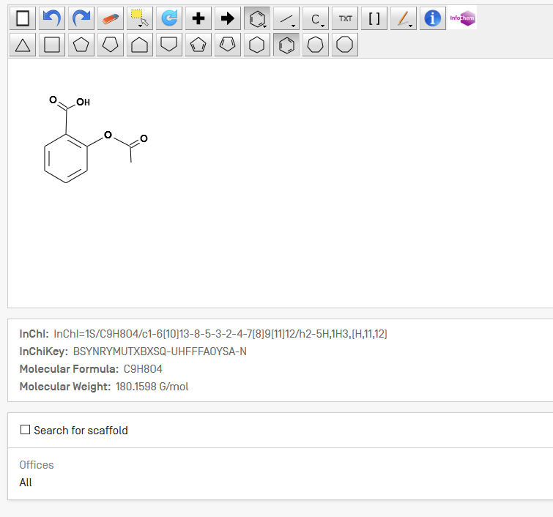
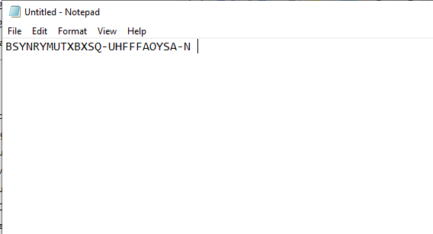
Combine 2 compounds
Notes:
61

Slide 62
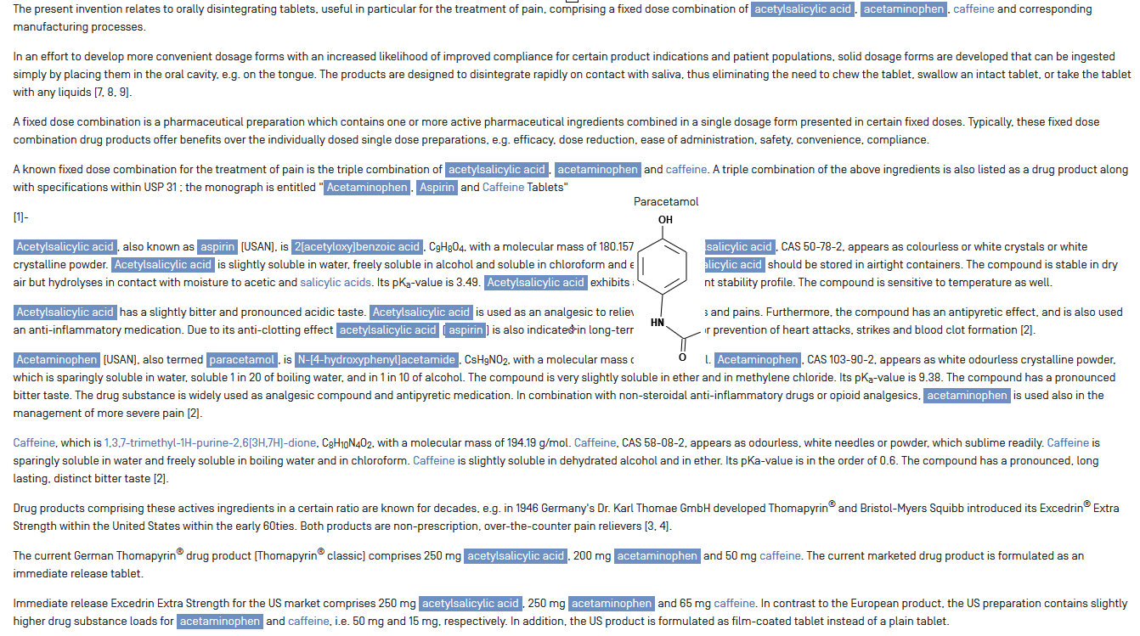

Slide 63
Combine with dates/IPC

Slide 64
Restrict to the claims field
CHEM:((BSYNRYMUTXBXSQ-UHFFFAOYSA-N BEFORE1000 description) AND (claims BEFORE1000 BSYNRYMUTXBXSQ-UHFFFAOYSA-N))

Slide 65
Can I search?
CAS name
Enantiomer
Monomer
Stereoisomer
Transition metal complex like cisplatin
Antibody sequence
Compound within genus
Inorganic cluster
Intermediate and impurity search
Metal-organic framework
Peptide
Polymer
Polymorphs
Poly(vinyl alcohol)
Protein sequences
Reaction search
Table that contains structures

Slide 66
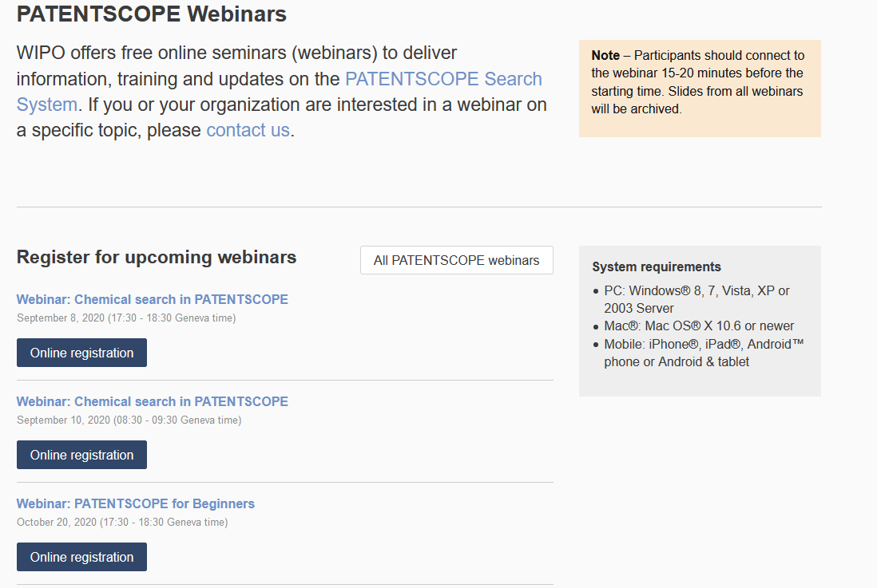
Future/past webinars:
wipo.int/patentscope/en/webinar

Slide 67
Chemical searches for and by experts
Paying webinar on September 24, 2020 @ 5:30pm CEST
https://attendee.gotowebinar.com/register/2024318963945118220

Slide 68
Next webinar
PATENTSCOPE for beginners
October 20 @ 5:30 pm CEST or 22 @ 8:30 am CEST
https://www.wipo.int/patentscope/en/webinar/

Slide 69
Global Brand Database: webinar
An overview
September 22 @ 5.30 PM CEST
https://www.wipo.int/reference/en/branddb/webinar/index.html

Slide 70
Global Design Database: webinar
An introduction
September 30 at 5:30 pm CEST
https://www.wipo.int/reference/en/designdb/webinar/index.html

Slide 71
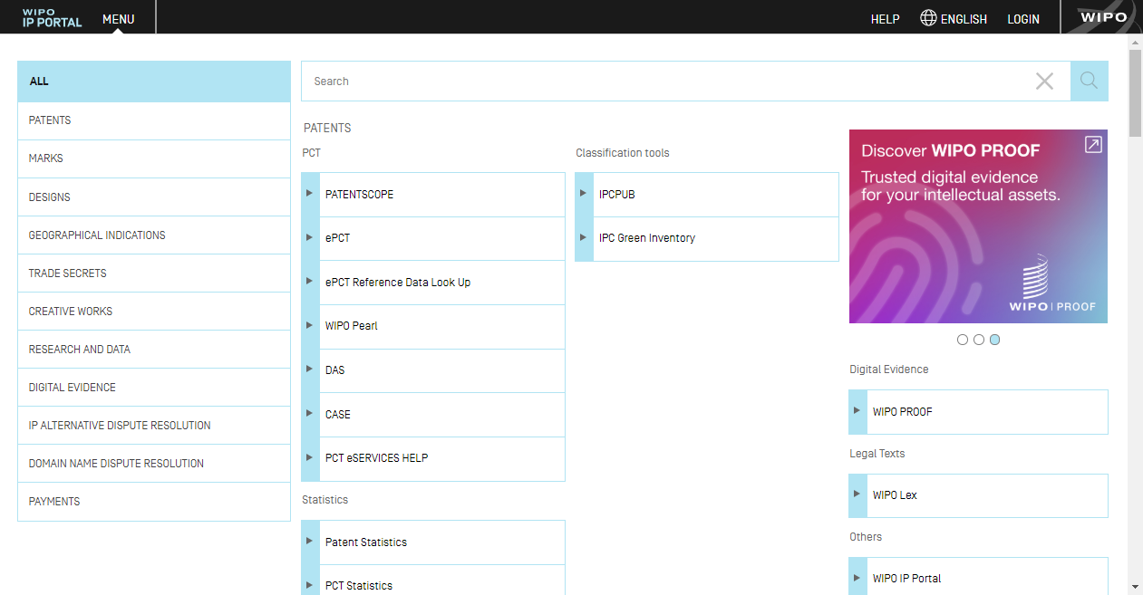
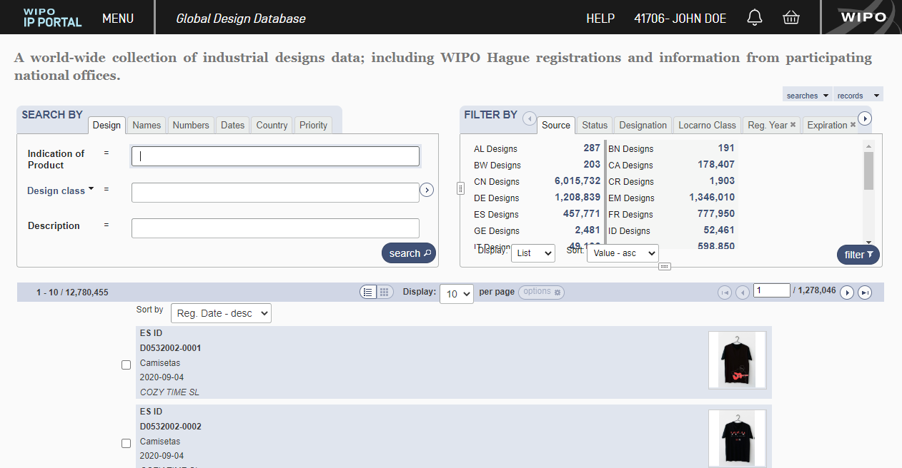
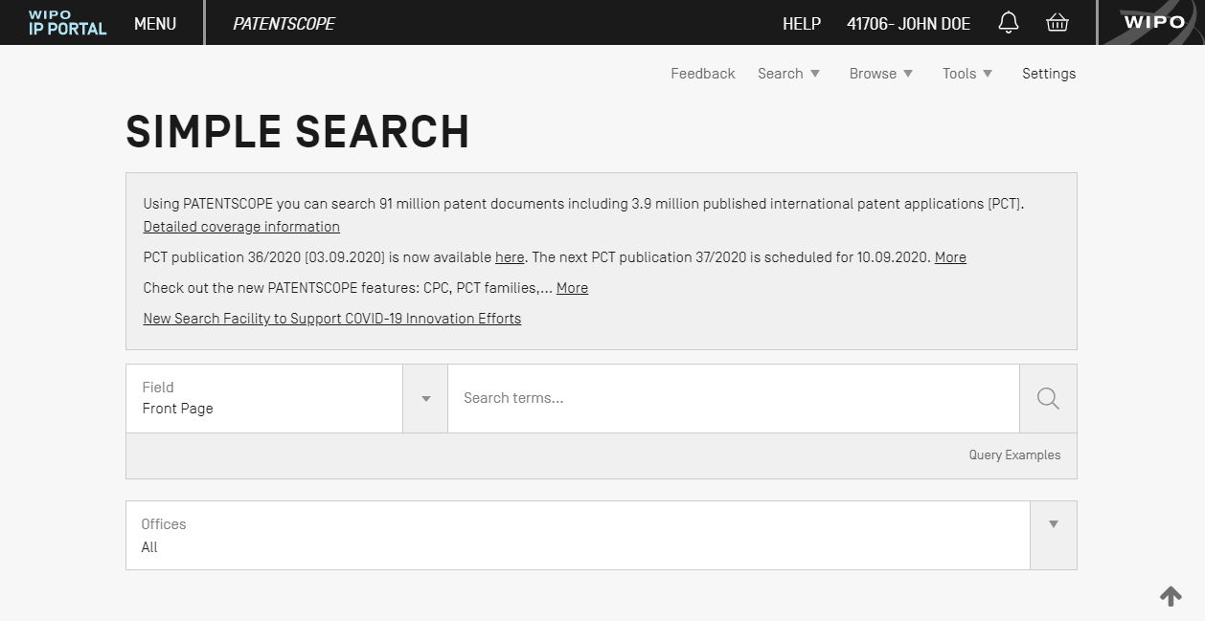
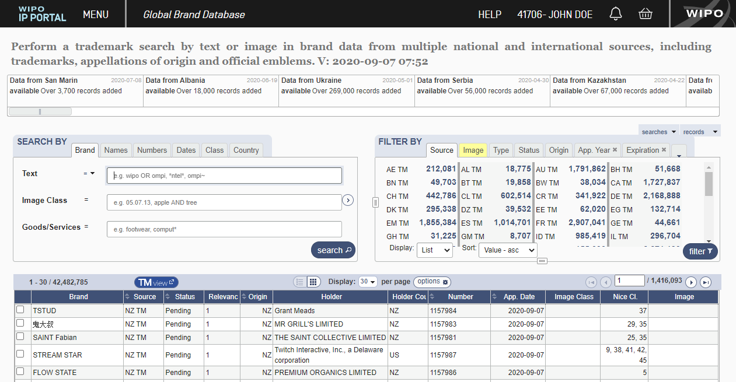
IP Portal

Slide 72
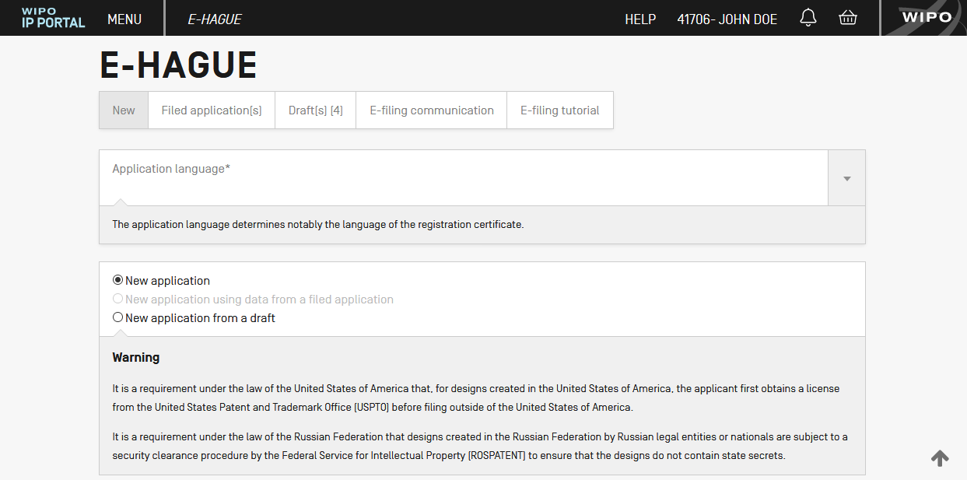
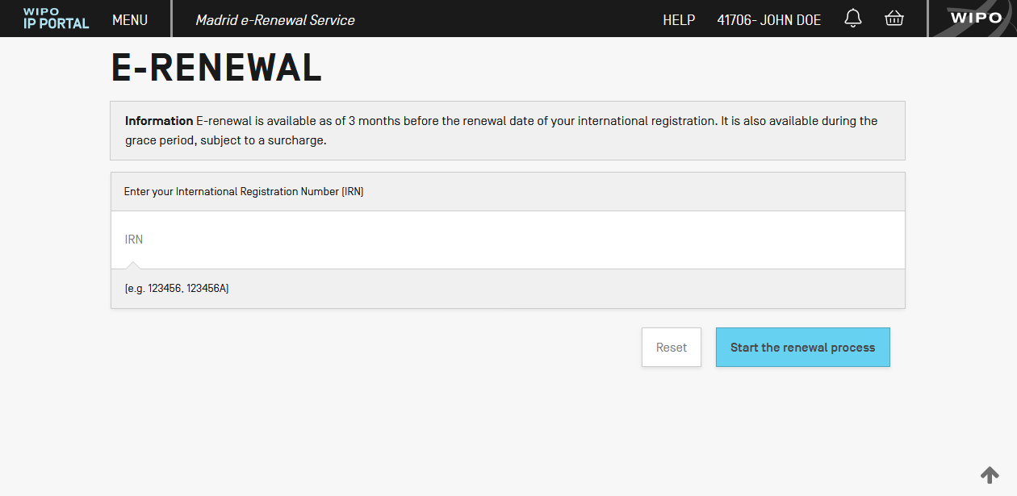
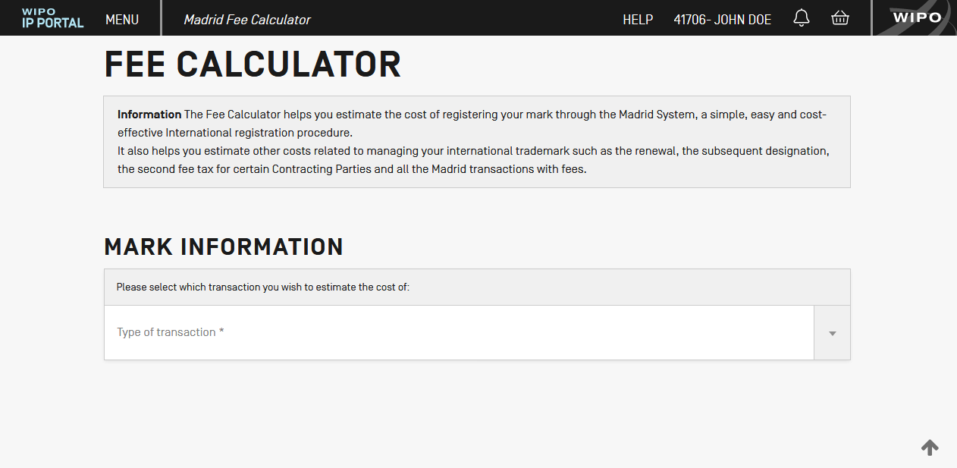
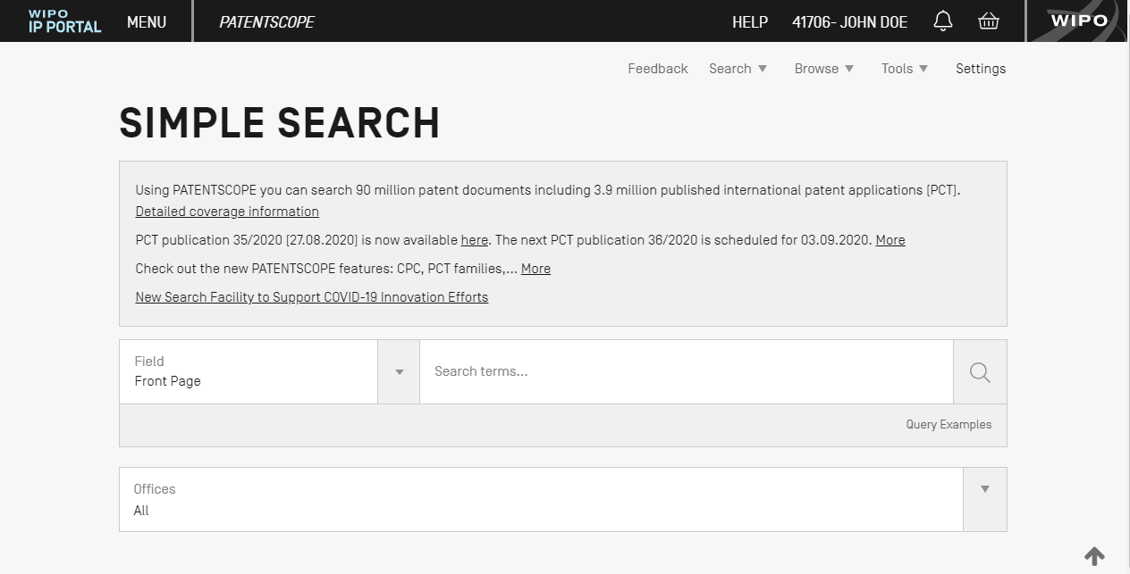
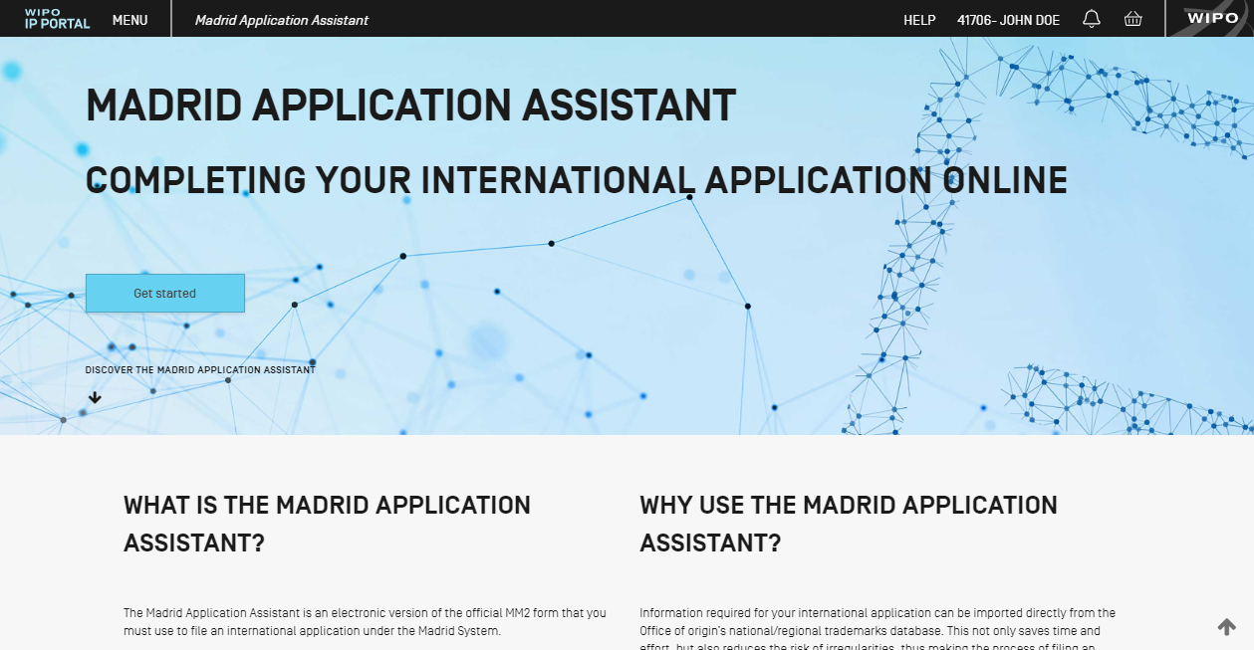
Login & Help

Slide 73
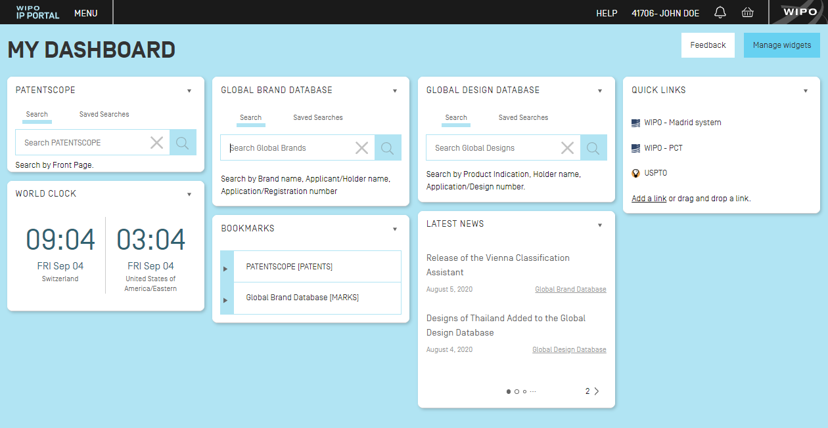
Customizable dashboard of widgets

Slide 75
patentscope@wipo.int

