Slide 1
Patenting from the Perspective of a Universities in a Developing Country - South Africa -
McLean Sibanda, PhD
Chief Executive Officer: The Innovation Hub (South Africa)
President of the International Association of Science Parks (IASP) Advisory Council
WIPO Workshop on PCT Fee Reduction for Universities
organized by the World Intellectual Property Organization (WIPO)
Geneva, June 18 2018

Slide 2
Presentation Outline
Introduction
South Africa PCT Applications
Perceptions of PCT System from South African Publicly Financed Institutions
Concluding Remarks

Slide 3
Introduction
________________
South Africa’s Patenting Trends in Context of Rest of Africa and the World

Slide 4
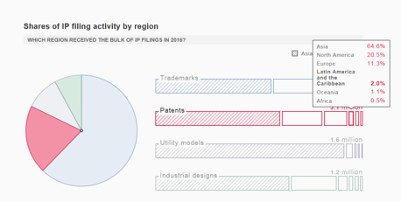
Introduction
Global IP Filings and Africa’s Contribution

Slide 5
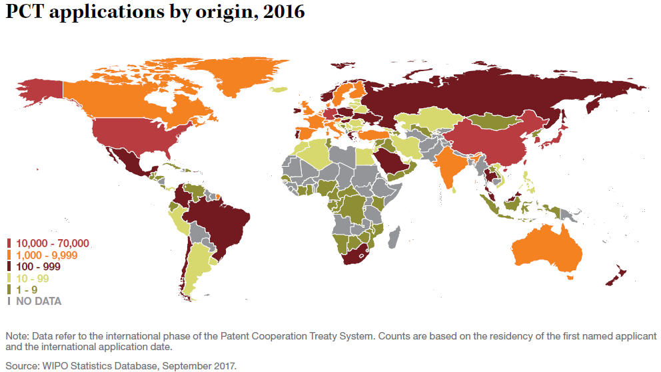
Introduction
Geographical Distribution of Global PCT Applications

Slide 6
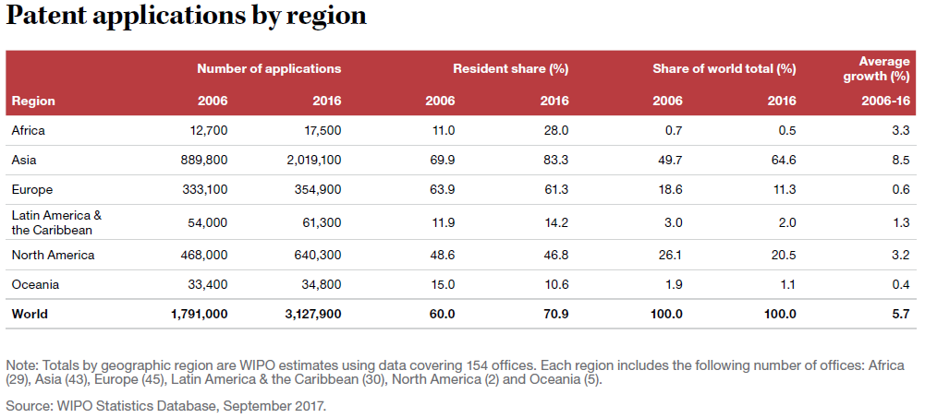
Introduction
Africa’s Contribution to Global PCT Applications

Slide 7
South Africa - PCT Applications

Slide 8
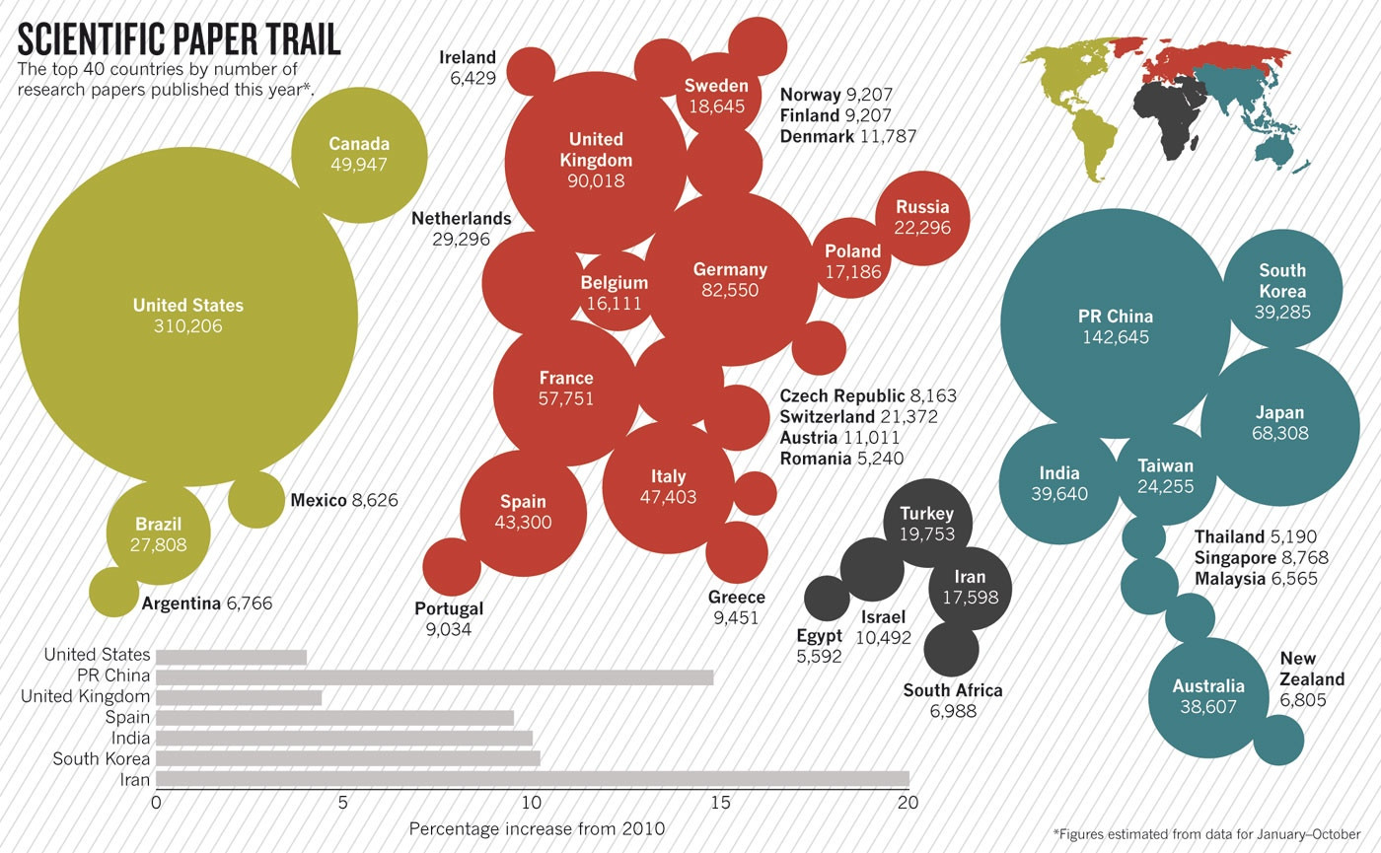
Global Scientific Knowledge Production
South Africa
Source: http://i.imgur.com/g5sdKFr.jpg

Slide 9
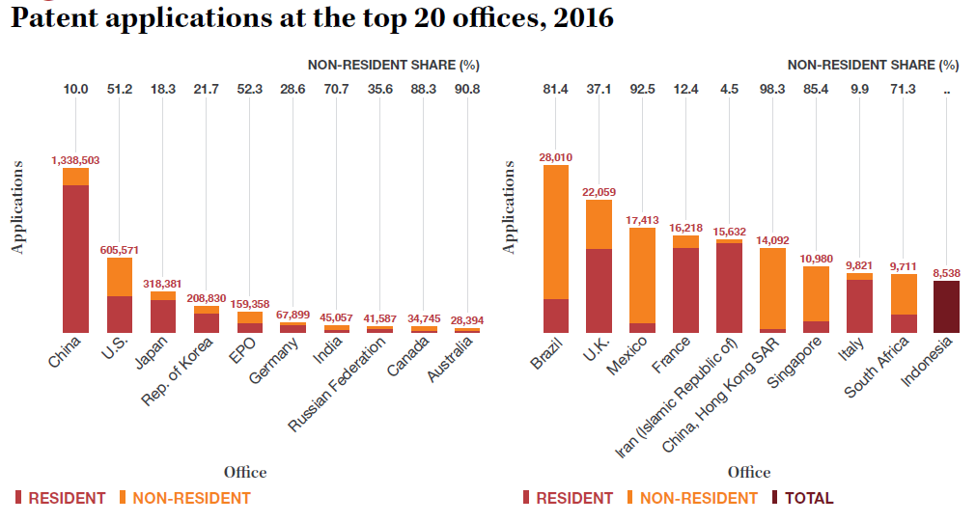
PCT Applications for Top 20 Offices
South Africa
Source: PCT Yearly Reviews 2017 - www.wipo.int/ipstats

Slide 10
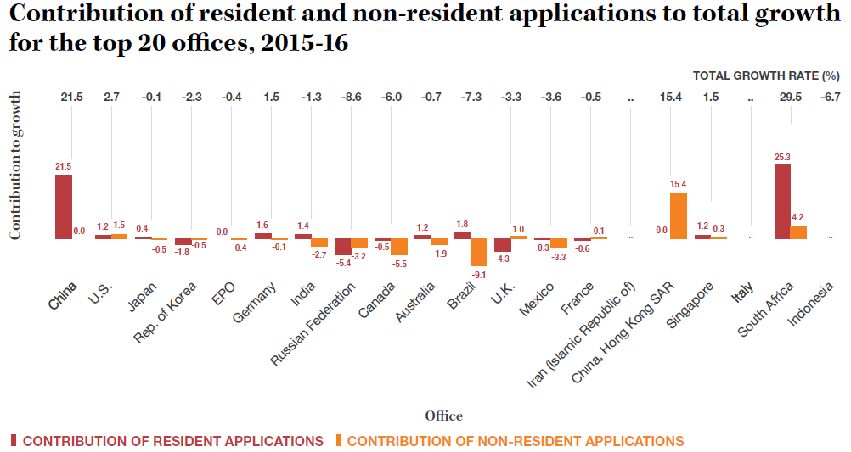
PCT Applications for Top 20 Offices
South Africa – Growth in Filings by Residents
Source: PCT Yearly Reviews 2017 - www.wipo.int/ipstats

Slide 11
PCT Applications by South Africans
Applications filed in period 1996-2005 (ZA Inventor Address)
* Publicly financed Institution
*
*
Source: Sibanda, Ph.D thesis, 2018 (UNISA)

Slide 12
PCT Applications by South Africans
Applications filed in period 2006-2015 (ZA Inventor Address)
* Publicly financed Institution
Significant growth in PCT applications in recent years by universities in particular
Up to 50% subsidies by National Intellectual Property Office (NIPMO)
*
*
*
*
*
*
Source: Sibanda, Ph.D thesis, 2018 (UNISA)

Slide 13
PCT Applications by South Africa Public Institutions
Applications filed in period 2006-2015 (ZA Inventor Address)
Significant growth applications my research intensive universities
Law governing publicly financed R&D significant factor
Subsidies on costs by NIPMO
Source: Sibanda, Ph.D thesis, 2018 (UNISA)

Slide 14
PCT Applications by South Africa Public Institutions
Top Technology Fields of PCT Applications
53% biotechnology related
11.76% environmental
6.24% ICT related
Source: https://stats.oecd.org/

Slide 15
Perceptions of PCT System by South Africa Publicly Financed Institutions

Slide 16
PCT Applications in South African Public Institutions
Survey to Publicly Financed Institutions (June 2018)
Reasons for your institution filing PCT Applications | Invention has international application and there are prospects to file at least 3 international patent applications
 | We are interested in the patent search / opinion to determine if it is valuable
 | Other (Please state)
2. Is cost relevant in the decision to file a PCT Application | Yes
 | No
3. The decision regarding the International Search Authority is determined by | Cost
 | Quality of the search report
 | Language of the prior art
 | Other (Please state)
4. If you were to influence the costs of the PCT application, which aspects would you ask for discount | Filing costs
 | Search and examination costs
 | Combination of (a) and (b)
5. Is the PCT system useful for universities and Science Councils? | Yes
 | No
6. Any other information
THANK YOU SO MUCH

Slide 17
PCT Applications by South African Public Institutions
Reasons South African Institutions File a PCT Application

Slide 18
PCT Applications by South Africa Public Institutions
Usefulness of PCT and Selection of ISA

Slide 19
PCT Applications by South Africa Public Institutions
Aspects of Costs Institutions Wish to be Discounted

Slide 20
PCT Applications by South Africa Public Institutions
Role of Costs in Determining Filing of PCT Application

Slide 21
Concluding Remarks
South Africa a significant contributor to global knowledge production
Potential for increased PCT Applications
Demonstrated perception of value offered by PCT System
Significant increases in PCT applications by publicly financed institutions (esp. universities)
Cost a factor – Subsidies by South African Government (NIPMO)
Reduction in subsidies will impact filings
Differentiated Fee Reduction - potential areas of economic competitiveness / research intensity / sectors to be stimulated

Slide 22
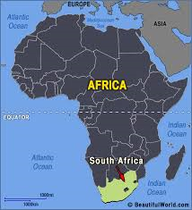
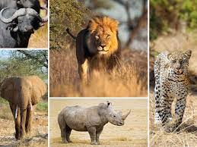
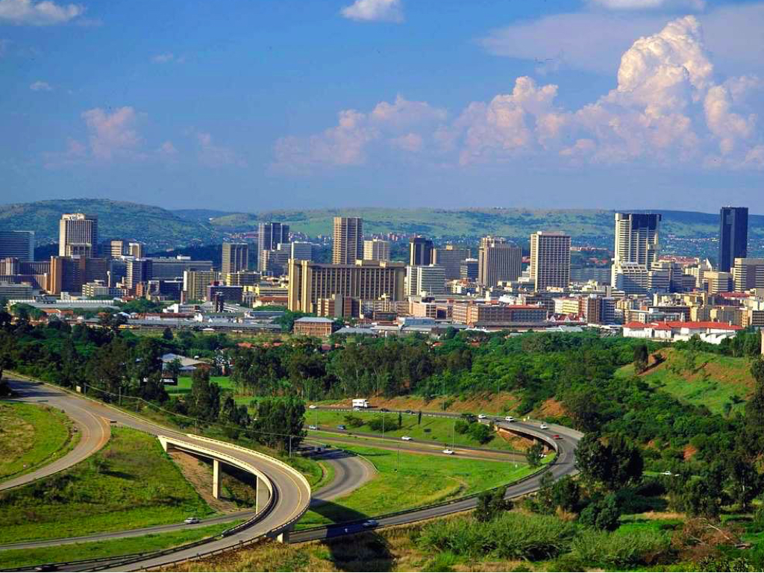
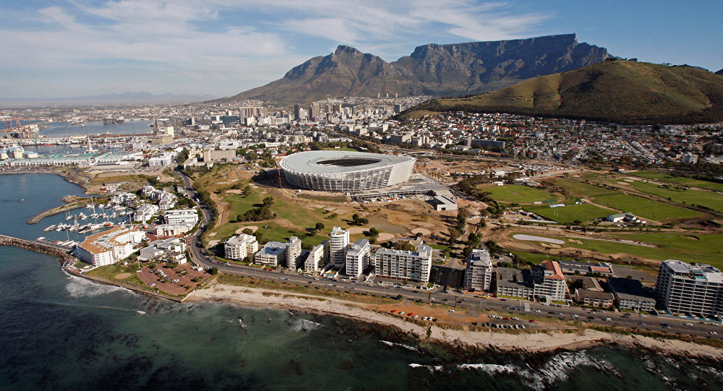
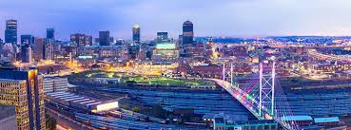
Thank You

