Slide 1
From academic inventing to university patenting
Catalina Martinez
Institute of Public Goods and Policies (IPP)
Spanish National Research Council (CSIC)
Madrid, Spain
WIPO Workshop on PCT Fee Reductions for Universities, Geneva, 18 June 2018

Slide 2
Focus:
Economist perspective of patenting by universities and possible measures to increase patenting activity.
Questions from an economic perspective:
How many inventions originate at universities?
What are the best channels to transfer academic inventions to society?
How many patents are filed and owned by universities?
Are patent fees a barrier to university patenting?

Slide 3
How many inventions originate at universities?
This question relates to the definition of ‘invention’ and the propensity to invent at universities.
We do not have direct measures of the ‘inventiveness capacity’ of the universities in a given country. Some universities have statistics of number of inventions disclosed, but not all, and that kind of information is generally not publicly available.
We could proxy it by the number of scientific articles published by researchers from its universities in technology-related fields, that is, excluding social sciences and humanities.
But a better proxy would be the number of scientific articles cited in patents, ideally distinguishing by the country of residence of the citing patent owner (domestic and foreign). This would be closer to a measure of the ‘technology-relevant knowledge’ produced in a given country. We would still need to distinguish between that produced by universities and other institutions.
None of these two measures is readily available for all countries and over time. But we can see orders of magnitude in the next two slides.

Slide 4
Scientific publications
by region
Source: Data from Scopus, analysis by SCImago Research, https://www.scimagojr.com/worldreport.php

Slide 5
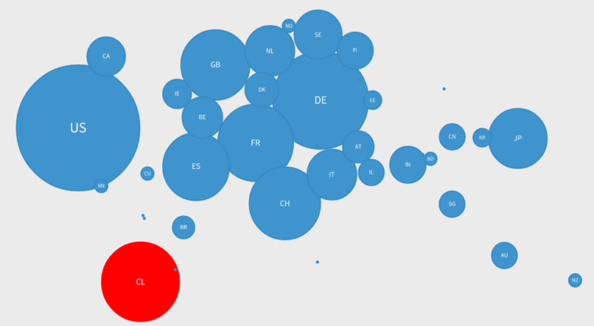
Map of patent appropriation of knowledge generated in Chile between 2003 and 2013
Source: Analysis by SCImago Research, data from SCOPUS and PATSTAT. Graph published in CONICYT (2015). Principales indicadores cienciométricos de la actividad científica chilena 2013, available at http://www.informacioncientifica.cl/Informe_2015/chile2015/

Slide 6
What are the best channels to transfer academic inventions to society?
Public domain
Contracts with industry
University spin-offs
Patents
Other IPRs
In all cases the know-how of the inventor would often be needed to implement the invention. Engaging the inventor increases commercialisation success (Agrawal 2006).
Advantages of patents:
Set the boundaries of the invention in the claims
Help creating markets for technology.
Make the priority more visible to patent examiners in national and foreign jurisdictions, to prevent others from patenting academic prior art.

Slide 7
How many patents are filed by universities?
Thus, if patents are used to protect academic inventions, how many are filed by
The universities that employ the inventors as professors?
The funding institutions (business companies, governments, foundations, etc) that sponsor the research leading to the inventions?
The inventors themselves?
Starting in the 1980s with the Bayh-Dole Act in the United States, many countries have favoured patenting by universities over patenting by funders or inventors.
This has resulted in a generalised increase of university filings and a proliferation of technology transfer offices to manage and license them to indutry, but also tensions between universities, firms and inventors.

Slide 8
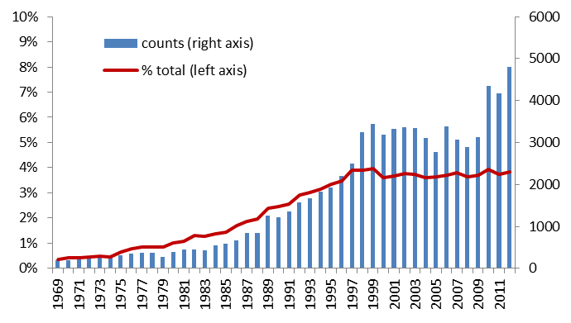
USPTO patents owned by universities
Bayh-Dole Act
Notes: Patents were identified as university owned based on the name of the first assignee.
Data: USPTO official data from https://www.uspto.gov/web/offices/ac/ido/oeip/taf/univ/asgn/table_1_2012.htm
Source: Martínez, Catalina and Valerio Sterzi, 2018. University patenting and the quest for technology transfer policy models in Europe, chapter in Varga A. and Erdos K. (Eds.), Handbook of Universities and Regional Development, Edward Elgar (forthcoming)

Slide 9
European paradox?
The so-called European paradox was framed in this context as the conjecture that EU countries play a leading global role in terms of top-level scientific output, but lag behind in the ability of converting this strength into wealth-generating innovations.
“Contrary to the ‘paradox’ conjecture, European weaknesses reside both in its system of scientific research and in a relatively weak industry” (Dosi et al 2009)
Moreover, observations to support the European paradox were often drawn from statistics on university patenting, without taking into account that not all academic inventions are patented on the university name.

Slide 10
More than 50% of academic-invented patents are owned by firms in many European countries
Lissoni (2012), “Academic patenting in Europe: An overview of recent research and new perspectives”, World Patent Information, 34, 3, 197–205, DOI: 10.1016/j.wpi.2012.03.002.
More studies at http://www.esf-ape-inv.eu/

Slide 11
Can institutional incentives to inventors increase university patenting?
University and researcher’s interests may not be alligned. Researchers may not be interested in patenting and commercialisation and find the whole process onerous. Scientists’ effort mainly driven by Mertonian norms of science, valuing more academic freedom than shares from uncertain royalties…some may prefer not to patent, a change of culture would be needed to change their mind.
Once the culture is changed, ability to get monetary rewards matter:
Royalties and bonuses can make a real difference in earnings for those generating the blockbusters (Stephan 2012, Lach and Schankerman 2008)
But would not be effective when inventions have low potential for commercialisation (low value) or TTOs are inexperienced (lack of skills to manage value) (Arqué Castells et al 2016)
Complementarity between commercialisation efforts of the inventor and those of the university’s support depends on the ability of the university TTO to raise the value of the IP (Macho-Stadler et al 2007)

Slide 12
European heterogeneity in IP ownership regimes
Policy and legal changes | Country | Change
Abolishment of the Professor’s privilege, to increase scientists’ incentives to disclose inventions to universities | Denmark | 2000
 | Germany | 2002
 | Austria | 2002
 | Norway | 2003
 | Finland | 2007
Stronger enforcement of institutional ownership system already in place | United Kingdom | 1977
 | Spain | 1986
 | France | 1999
 | Switzerland | 1991
 | Belgium | 1997
 | Portugal | 1998
Introduction of Professor’s privilege | Italy | 2001
Continuation of the Professor’s privilege | Sweden | 1949
The rationale behind the abolishment
of Professor’s privilege in some countries in the early 2000s was to increase incentives of professors to disclose inventions to universities. Universities filings increased overall but:
Has growth mainly been driven by a shift of property from industry to universities?
Has the technological importance of the underlying inventions increased?
Has patent management improved when transferred from professors to TTOs?
Source: Martínez, Catalina and Valerio Sterzi, 2018. University patenting and the quest for technology transfer policy models in Europe, chapter in Varga A. and Erdos K. (Eds.), Handbook of Universities and Regional Development, Edward Elgar (forthcoming)

Slide 13
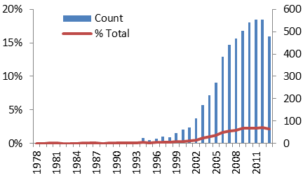
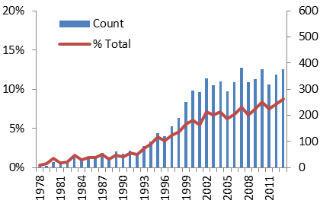
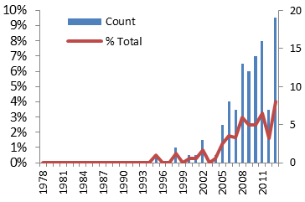
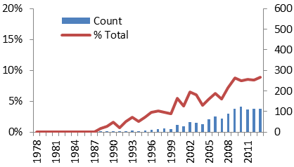
EPO filings by universities
Germany
United Kingdom
Professor’s privilege abolished 2002
Professor’s privilege abolished
Norway
Spain
Professor’s privilege abolished 2003
Source: Martínez, Catalina and Valerio Sterzi, 2018. University patenting and the quest for technology transfer policy models in Europe, chapter in Varga A. and Erdos K. (Eds.), Handbook of Universities and Regional Development, Edward Elgar (forthcoming)

Slide 14
Are patent fees a barrier for university patenting?
Between 2001 and 2017, Spanish public universities have been fully exempt from paying filing and maintenance fees at the Spanish Patent and Trademark Office (OEPM), as well as the international searching fee when OEPM acted as PCT international search authority.

Slide 15
Link between entering the PCT national phase and commercialisation
Patents filed by Andalusian public universities
Fee exemption
Source: Martínez, Catalina and Lydia Bares, 2018. The link between technology transfer and international extension of university patents: evidence from Spain. Science and Public Policy, online first, doi: 10.1093/scipol/scy008

Slide 16
Conclusion I:
University patenting is not the only way to transfer academic inventions to industry and society in general
Patents have been traditionally justified as a means to provide incentives to firms to invest in R&D, to solve the market failure derived for the nature of knowledge as a public good (e.g. Arrow 1962)
For universities, however, the rationale for patent protection lies on the ‘commercialisation theory’ (Lemley 2008), as universities are essentially non-practicing entities.
Measures to increase patenting by universities, such as reducing fees, aim to increase the patenting propensity of universities based on the idea that:
there is a pool of academic inventions for which universities would seek patent protection if the right incentives were in place.
the lack of patent filings by universities for those academic inventions prevents their commercialisation.
We have nevertheless seen that ‘university patenting’ is not the only channel to protect and transfer academic inventions to society, and even when patents are chosen, the university does not always retains the ownership.

Slide 17
Conclusion II:
University patenting makes academic inventions more visible ‘for and within’ the patent system
One clear advantage of university patenting is that it makes academic inventions more visible ‘for and within the patent system’:
to potential commercial partners worldwide (window of 30 months)
to signal academic prior art (forever, 18 months from filing).
Even when there is no commercialisation of the university patented invention, the patent system can be used as a (costly) open access publication outlet for technology relevant knowledge generated at universities.
Innovation is increasingly science-based and draws from academic scientific results without always acknowledging or rewarding them.
The question of whether the overall cost of using the patent system to increase the visibility of university inventions (in terms of university resources, patent offices workload, etc) outweighs the benefits for society is a matter of research.

