Slide 1
(Simulated) Impact of the Proposal to Introduce Fee Reductions for Universities on PCT Fee Income
Geneva
June 18, 2018

Slide 2
Introduction
Study “Estimating a PCT Fee Elasticity” presented at the 7th session of the Working Group, which provided a first ever estimate of the overall fee elasticity of PCT applications
Two Supplements to this Study explore the effects of possible fee reductions for universities originating in different country groups

Slide 3
The approach
Dependent variable:
0: Paris route
1: PCT route
$${pct}_{ijt}=\left\{\begin{matrix}0 if {pct}_{ijt}^{∗}≤0 \\ 1 if {pct}_{ijt}^{∗}>0\end{matrix}\right.$$
Local currency PCT fee divided by Consumer Price Index (CPI)
Origin is PCT member
Origin & time fixed effects
Error term
$${pct}_{ijt}^{∗}=α{ lnf}_{jt}+{β lnunemp}_{jt}+{γ mem}_{jt}+δ Ω_{i}+μ_{j}+θ_{t}+{φ mkt}_{j(t−12)}+ε_{ijt}$$
Unemployment rate
Family characteristics:
size
applicant type
technology field
Moving average of PCT market share, 12-month lag

Slide 4
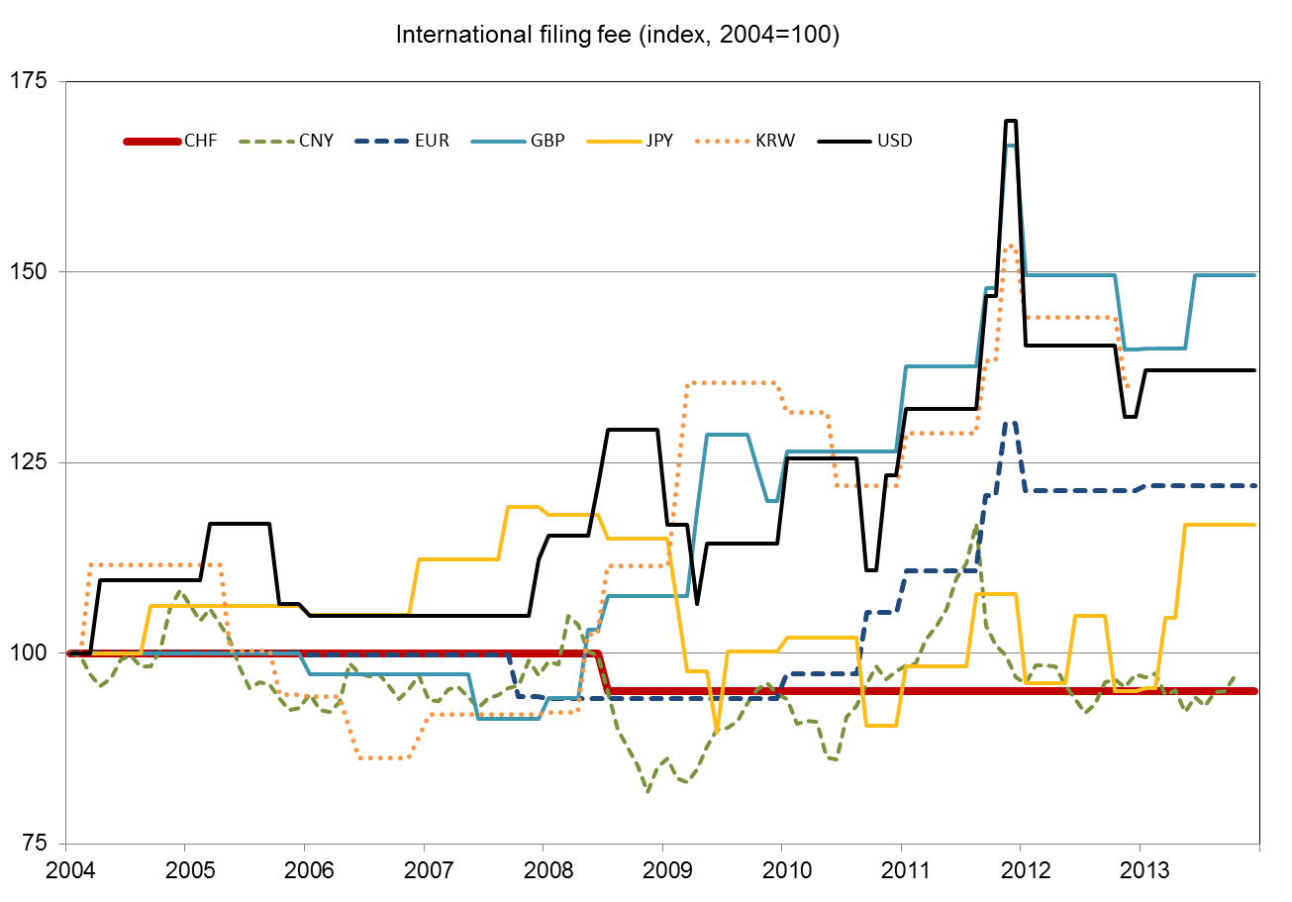
Historical fee variation

Slide 5
Market shares and elasticity estimates
 | Full sample |  | Estimation sample |  | Implied elasticity
 | #obs | PCT share | #obs | PCT share
University (developed country) | 24,754 | 0.865 | 20,730 | 0.861 | -0.040
University (developing country) | 3,609 | 0.675 | 453 | 0.620 | -0.164
Other applicants | 1,342,593 | 0.492 | 1,092,352 | 0.489 | -0.021

Slide 6
Filing response – developed countries

Slide 7
Filing response – developing countries

Slide 8
Income effect – developed countries

Slide 9
Income effect – developing countries

Slide 10
The conclusion
Developing country universities are more price sensitive than developed country universities
Eligibility ceilings work to soften the filing response and the implied income loss
Caveats:
Only model PCT-Paris choice
Simulations of large fee discount exceeds historical fee variation
Assume uniform elasticities for universities of all sizes in developed/developing economies

