Slide 1
2018 PCT WG Workshop on Erroneously-Filed Elements and Parts
Views of Paul Rosenich June 19th 2018
Representing:
UNION-IP UNION of European Practitioners in Intellectual Property

Slide 2
2018 PCT WG Workshop on Erroneously-Filed Elements and Parts
Introduction of the Speaker Paul Rosenich (AT)
Resident of LI, 40 years in IP:
Engineer for Electro-Technics, Optics, Optoelectronics,
Former Industrial Inhouse Patent Engineer in various Austrians Industries
Since 1998 Patent Attorney and President at Patentbüro Paul Rosenich AG (representing at WIPO,EPO,CH-,LI-,AT-PTO)
After Diploma Studies in Intellectual Property Management and Law
Mediator at WIPO Mediation and Arbitration Center
Board Member at I3PM,
President of Admissions Commission UNION-IP
EXCO-Member for LI and Member of Patents Commission UNION-IP
Chairman of epi Disciplinary Committee

Slide 3
2018 PCT WG Workshop on Erroneously-Filed Elements and Parts
Introduction of
Founded 2007
More than 100 Members working in the environment of IP-Managing
Focussed on improving Benefits of IP Systems by proper IP Managing
Details: http://www.i3pm.org/index-1.html

Slide 4
2018 PCT WG Workshop on Erroneously-Filed Elements and Parts
Introduction of
UNION-IP UNION of European Practitioners in Intellectual Property
Founded 1961
About 450 Members (restricted to Europe in geogr. sense) including Patent Attorneys and Attorneys at law
Focussing on all aspects of IP including Patents, Trademarks, Copyrights etc.
Details: https://www.union-ip.org/

Slide 5
2018 PCT WG Workshop on Erroneously-Filed Elements and Parts
Basic Principles of PCT and Regulation under the PCT
from a Practitioners View
> Support Applicants (fair, simple and equal worldwide)
> Allow filing Patent Applications very Easy for very Many Countries Worldwide
> Help to Avoid Making Mistakes when Filing Patent Applications Worldwide

Slide 6
2018 PCT WG Workshop on Erroneously-Filed Elements and Parts
Basic Principles of IP Law from a Practitioners View
> Give in a fair Manner Patent Protection to Inventors who teach something useful and new to the Society
> On the one hand Applicants (Inventors) should have Benefits from the Patent System;
> On the other hand The Public should be safeguarded > Legal Security

Slide 7
2018 PCT WG Workshop on Erroneously-Filed Elements and Parts
Basic Principles of IP Practice from a Practitioners View
Workload is rising, Systems do not become easier to deal with
Number of Provisions and Number of Options rise constantly.
On the economical side and on the legal side, to assist Applicants to an optimum level might be quit tricky.
> Errors may happen.
> Such errors should not be to the Disadvantage of Applicants (Inventors), as long as the Public (third parties) is/are Not Negatively Effected by the Correction of such Errors;
> The Correction of Errors should not give the Applicant or his/her Representatives Possibilities to Expand Advantages of the Patent Systems to them.
> Legal Security

Slide 8
2018 PCT WG Workshop on Erroneously-Filed Elements and Parts
IP Practice as noted with regard to the “missing parts” provision
Luckily these provisions are not used/needed often > not much of practical experience.
However:
Errare Humanum Est

Slide 9
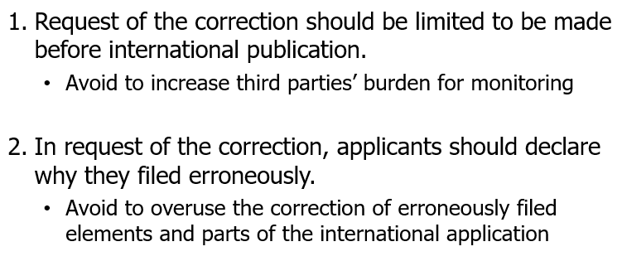
Proposals as noted and supported with regard to the “missing parts” provision
from JIPA:
2018 PCT WG Workshop on Erroneously-Filed Elements and Parts

Slide 10
2018 PCT WG Workshop on Erroneously-Filed Elements and Parts
Proposals as noted and supported with regard to the “missing parts” provision
from JIPA with some amendment:
The scope for the corrections should be strictly limited within the subjects contained in the priority document or within what could be proven beyond any doubts (up to the hilts) was meant to be filed on the filing day.
Assessments by Offices (Receiving Offices or International Search Authority) or International Bureau would be useful.

Slide 11
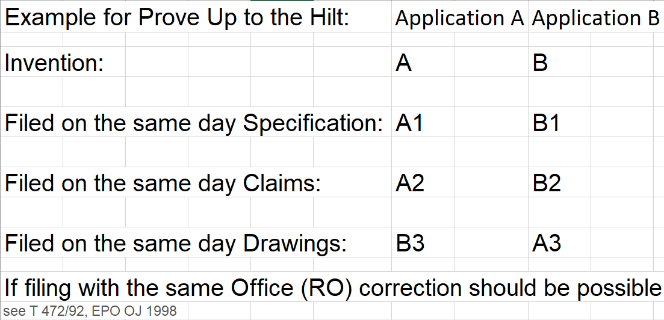
Example for a Case not having a Priority Document but need for Correction:
2018 PCT WG Workshop on Erroneously-Filed Elements and Parts

Slide 12
2018 PCT WG Workshop on Erroneously-Filed Elements and Parts
Proposal as to noted conflicts regarding the handling of “missing parts” provision
At different offices:
HARMONIZATION would be the best in order to provide fair treatments for Applicants worldwide and at all stages of the procedure.
From Applicants view a divergence in views is neither practical nor justified. The IB should set a standard which should be fair and balanced and this standard should be adopted.
If the problem lies with the interpretation of the PLT, then also here the IB could provide an interpretation which should then be adopted by all offices. Whether the interpretation was then proper could be left to national Courts > hence all rights are safeguarded.

Slide 13
2018 PCT WG Workshop on Erroneously-Filed Elements and Parts
Proposal as to noted conflicts regarding the handling of “missing parts” provision
At different offices:
The Applicant should have the Granted Opportunity to File Replacement Parts of an Application, rather than having to Rely on the RO’s Findings that Something Might be Wrong.
The Applicant should therefore, Within a Strict TimeLimit (say 2 months from the filing date), be able to Initiate the Missing Parts Provisions by requesting that Part of the application as filed is replaced, or added to, by something that is Present in, or Directly and Unambiguously Derivable from, a Priority Document relevant for that PCT-Application. Or when Not Covered by a Priority Document, Applicant should Provide a Proof going Beyond any Doubts (up to the hilts) that What He/She files/replaces/adds was Ready and Planned to be Filed on the Filing Day of the PCT-Patent-Application.

Slide 14
2018 PCT WG Workshop on Erroneously-Filed Elements and Parts
THANK YOU

