Slide 1
PCT Statistics PCT Working Group Seventeenth Session
February 19 to 21, 2024

Slide 2
Sources:
2023 PCT Yearly Review
The International Patent System
WIPO Publication No. 901EN/23
WIPO IP Statistics Data Center
http://www.wipo.int/ipstats/en/

Slide 3
Outline
PCT Application Filings
Receiving Offices
International Authorities
PCT National Phase Entries

Slide 4
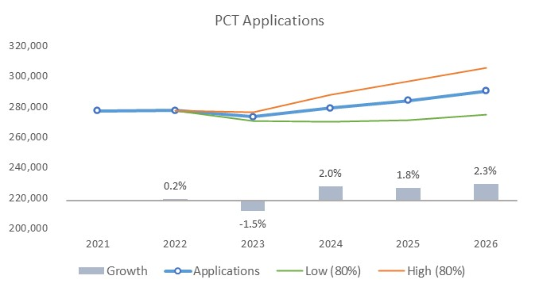
PCT Application Filings
284,000
290,400
277,179
277,624
273,500*
279,000
*Provisional data

Slide 5
Filing Trends for the Top 5 Origins

Slide 6
PCT Applications for the Top 20 Origins in 2022

Slide 7
Distribution of PCT Applicants in 2022
Top Applicants:
Businesses: Huawei Technologies – 7,689 published applications
Universities: University of California – 552 published applications
Government and Research Institutions: Shenzhen Institute of Advanced Technology of China – 486 published applications

Slide 8
PCT Applications by Gender
In 2022, the share of women listed as inventors grew to 17.1% (provisionally 17.7% in 2023).
About 96% of all PCT applications listed at least one man as inventor, and around 35% listed at least one woman as inventor in 2022.

Slide 9
Main Fields of Technology in 2022
Main Fields of Technology by Percentage of Total
Computer Technology 28,224 applications (10.4%)
Digital Communication 25,664 applications (9.4%)
Electrical Machinery 19,353 applications (7.1%)
Medical Technology 19,013 applications (7%)
Largest increases:
Furniture, games: +9.8%
Digital communication: +8.7%
Other consumer goods: +8.4%
Computer technology: +8.1%
Largest decreases:
Textile and paper machines:
-7.5%
Optics: -6.6%
Audio-visual technology:
-6.3%
Civil engineering: - 6.0%

Slide 10
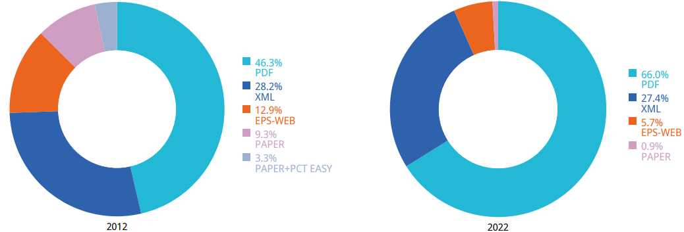
PCT Applications by Medium of Filing
10 years
Filing medium distribution for 2022 (2021): 66.0% (65.0%) PDF, 27.4% (27.3%) XML, 0.9% (1.3%) Paper.
Provisionally for 2023: 65.8% PDF, 28.3% XML, 0.8% Paper.

Slide 11
Percentage of PCT Filings in XML
XML filings were increasing and rose to 29% in 2019, then slightly declined, 28.3% provisionally for 2023.

Slide 12
Percentage of PCT Filings in Paper
Paper filings have been steadily declining.

Slide 13
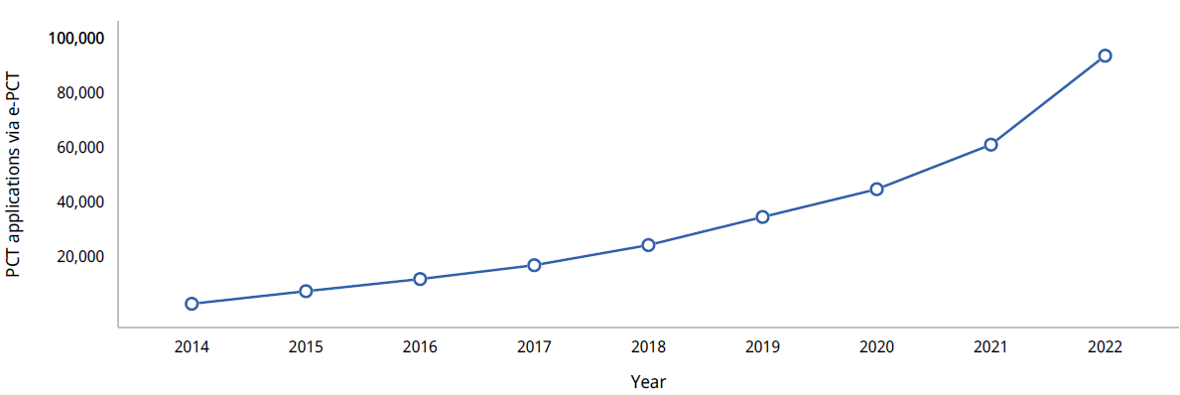
Number of Applications filed using ePCT
Nearly 93.5K PCT applications were filed by applicants using ePCT in 2022, 53.5% more than in 2021.
About a third of all PCT applications filed globally in 2022 were filed using ePCT.

Slide 14
PCT Applications by Publication Language
Share of PCT publications in English declined (42.5% in 2023 provisionally).
Other percentages (2023 provisionally): 24.3% Chinese, 17.8% Japanese, 7.2% Korean, 5.3% German, 2.0% French, 0.5% Spanish, 0.3% Russian, 0.2% Portuguese, 0.01% Arabic.

Slide 15
PCT Applications for Top 20 Receiving Offices in 2022
China and United States of America received the most PCT applications in 2022.

Slide 16
Receiving Offices: Timeliness of Transmitting PCT Applications to the IB
Average transmission time between international filing date and date the IB received the application increased slightly to 2.9 weeks in 2022 (from 2.5 weeks in 2021).

Slide 17
Search Reports established by International Searching Authority in 2022
China and EPO combined, established the majority of international search reports issued in 2022.

Slide 18
Distribution of International Search Reports by International Searching Authority
IP5 Offices established 94.5% of reports in 2022 (93.7% in 2012).

Slide 19
Average Timeliness in transmitting ISRs to the IB from Date of Receipt of Search Copy
Excludes cases where the time limit of 9 months from the priority date applies.
Since 2008, the average timeliness in transmitting international search reports to IB has improved significantly.

Slide 20
Supplementary International Search Requests
The EPO accounted for 90.6% of requests for supplementary international search in 2022.
Provisionally for 2023: EPO – 28 requests, Austria - 3 requests and Sweden – 1 request).

Slide 21
IPRPs (Chapter II) by International Preliminary Examination Authority
Reports established by IPEA fell by 7.5% in 2022 to 8,791.
82% of IPRPs (Chapter II) were produced by the EPO, the JPO or the USPTO.

Slide 22
Average Timeliness in Transmitting IPRPs
Average time in transmitting IPRPs decreased to 27.1 months from priority date in 2022.
80% of all IPRPs from 18 offices were transmitted to the IB within 28 months of the priority date.

Slide 23
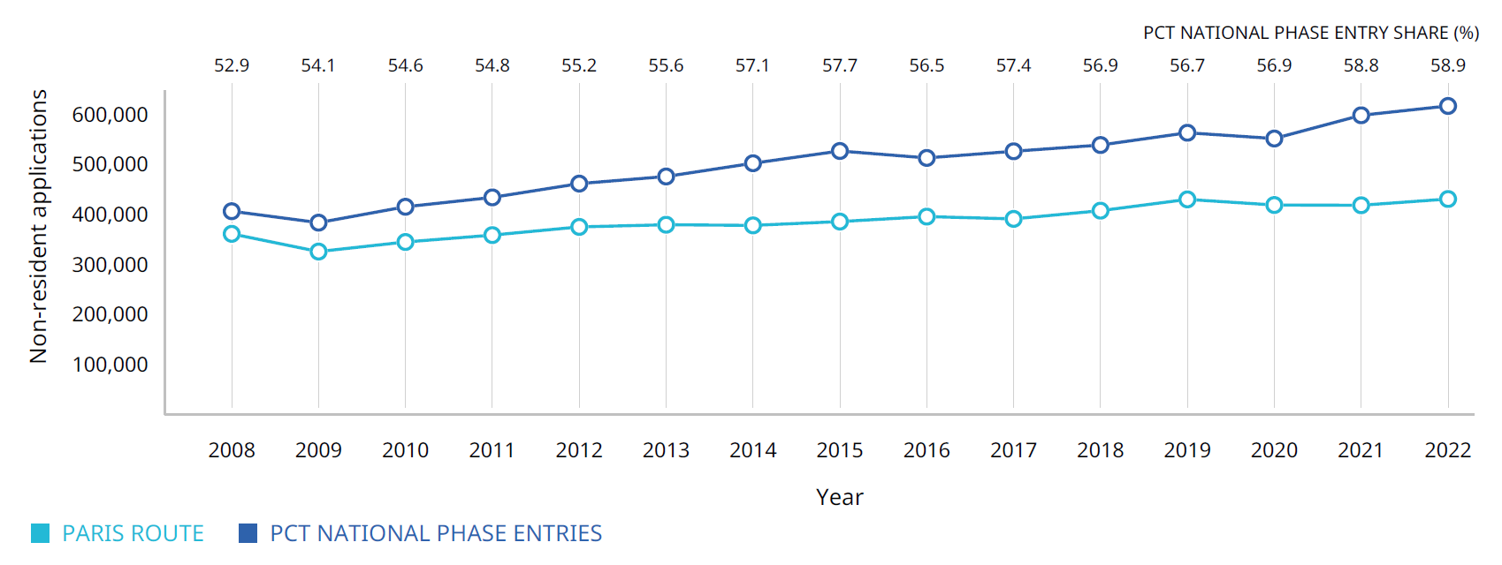
Non-Resident Applications by Filing Route
PCT national phase entries accounted for nearly 59% of all non-resident patent applications filed worldwide in 2022 (provisional).

Slide 24
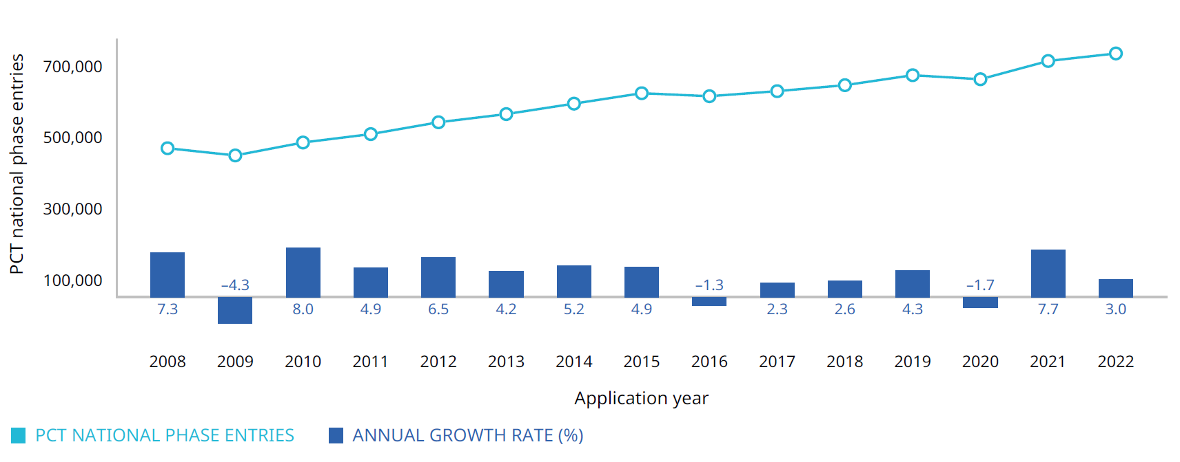
Trend in PCT national phase entries, 2008–2022
Note: This table shows data for the 20 offices to receive the most PCT national phase entries. NPE data may not be available at some offices.
In 2021, PCT national phase entries grew by 7.7%, the most since 2010. In 2022, national phase entries growth rate provisionally estimated at 3%.

Slide 25
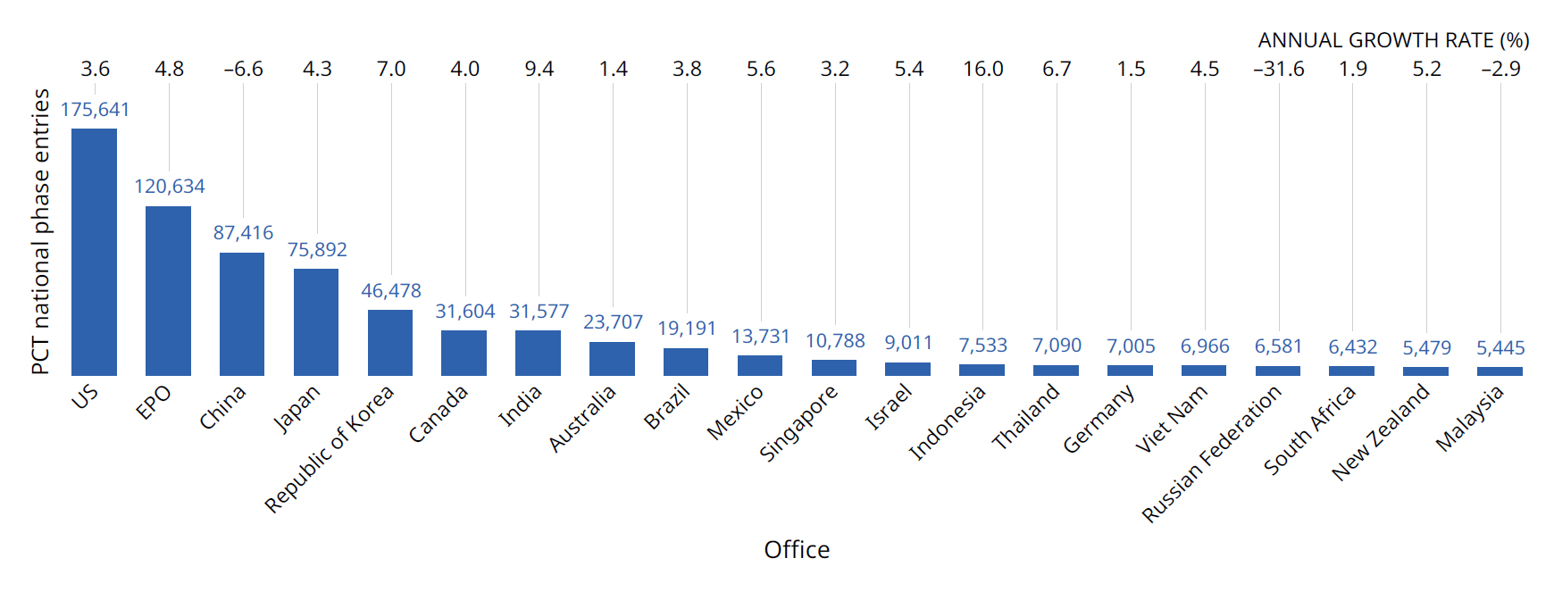
PCT- National Phase Entries for the top 20 offices
Note: This table shows data for the 20 offices to receive the most PCT national phase entries. NPE data may not be available at some offices.
Most of the top 20 Offices saw provisional growth in the PCT national phase entries in 2022.

