Slide 1

PCT Statistics
PCT Working Group
Eleventh Session
Geneva
June 18 to 22, 2018

Slide 2
PCT Statistics Outline
PCT Application Filings
Receiving Offices
International Authorities
PCT National Phase Entries

Slide 3
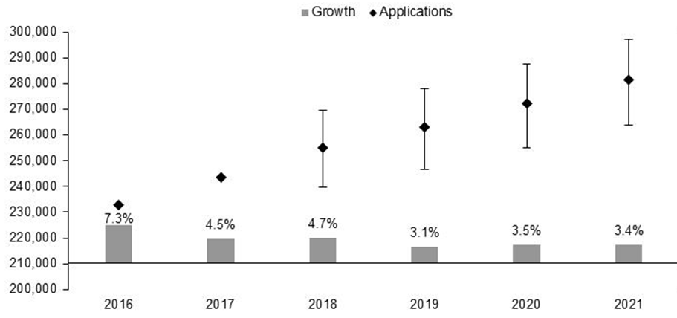
PCT Application Filings
281,500
272,200
262,900
255,500
243,500
232,912
Source: Economics and Statistics Division, WIPO

Slide 4
Filing Trends for the Top 5 Origins
Source: WIPO Statistics Database, March 2018

Slide 5
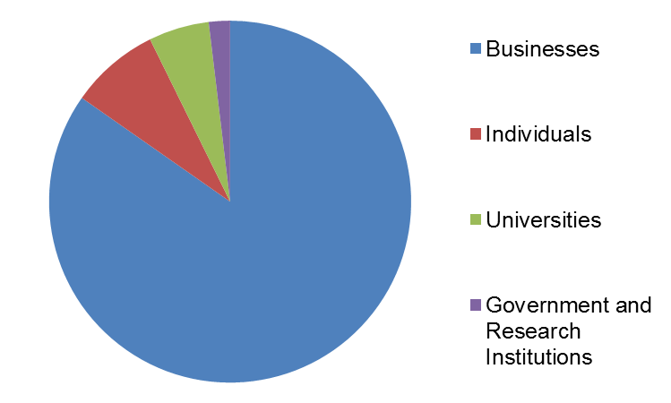
Distribution of PCT Applicants in 2017
Top Applicants
Businesses: Huawei Technologies – 4,024 published applications
Universities: University of California – 482 published applications
Government and Research Institutions: Commissariat à l’Energie Atomique et aux Energies Alternatives – 300 published applications

Slide 6
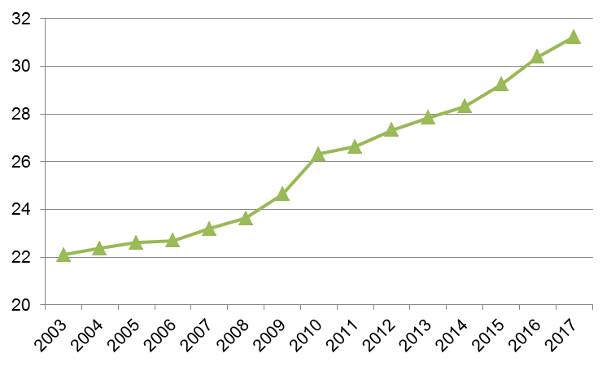
PCT Applications by Gender
Share of applications
with women inventors (%)
30.5% of all PCT applications in 2017 included women inventors (+0.7 percentage points)
Source: WIPO Statistics Database, March 2018

Slide 7
Main Fields of Technology in 2017
Main Fields of Technology by Percentage of Total
  Computer Technology 19,122 applications (8.6%)
  Digital Communication 18,400 applications (8.2%)
  Electrical Machinery 15,223 applications (6.8%)
  Medical Technology 15,024 applications (6.7%)
Largest increases:
  Control: +16.5%
  Thermal Processes: +14.9%
  Transport: +11.8%
  Computer Technology: +11.4%
Largest decreases:
  Basic Communication Processes: -4.7%
  Civil Engineering: -2.5%
  Machine Tools: -1.3%
  Organic Fine Chemistry: -0.6%
Source: WIPO Statistics Database, March 2018

Slide 8
PCT Applications by Medium of Filing
Distribution in 2017: 3.8% paper, 96.2% fully electronic (PDF 57.9%, EFS-Web 9.1%, XML 29.2%)
XML filings rose by 6 percentage points from 2008 to 2011, and then by slightly over 3 percentage points from 2011 to 2017
Source: WIPO Statistics Database, March 2018

Slide 9
PCT Applications by Publication Language
For the first time in 2017, less than half of PCT applications were published in English
Publication share in Chinese rose from 12.4% in 2016 to 15.7% in 2017
Source: WIPO Statistics Database, March 2018

Slide 10
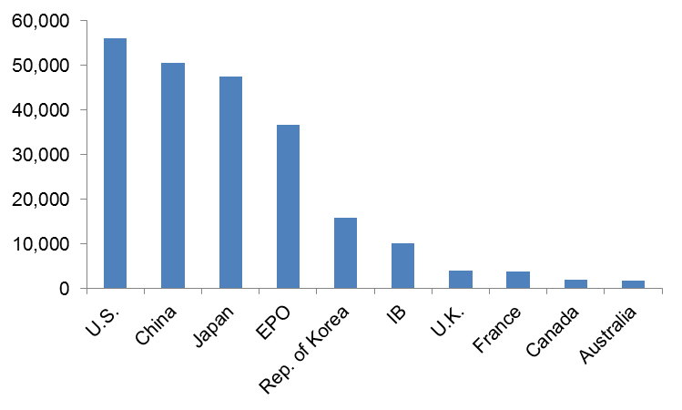
PCT Applications for Top 10 Receiving Offices
56,158
-0.9%
50,674
+14.0%
47,425
+6.6%
36,714
+4.0%
15,830
+1.5%
10,212
+1.9%
3,941
-1.7%
3,827
+6.1%
1,871
+0.6%
1,756
+3.1%
Source: WIPO Statistics Database, March 2018
China replaced Japan as second most-used receiving
Office in 2017

Slide 11
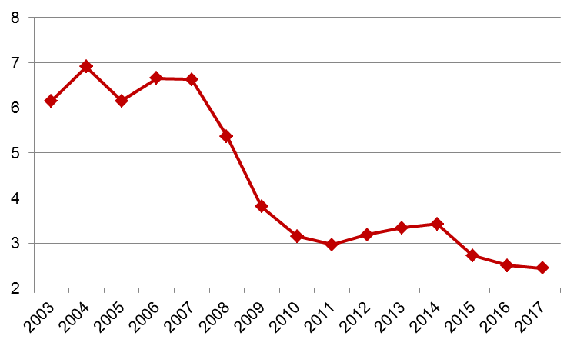
Receiving Offices: Timeliness of Transmitting PCT Applications to the IB
Weeks
Source: WIPO Statistics Database, March 2018
Average transmission time between international filing date and date the IB received the application decreased to under 2.5 weeks in 2017
95.1% of PCT applications transmitted to IB within
4 weeks in 2017 (94.8% in 2016)

Slide 12
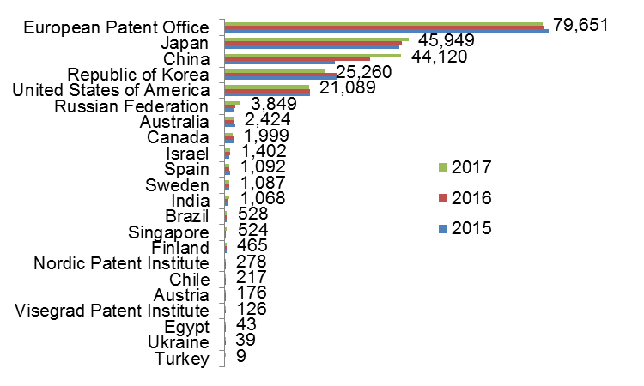
Search Reports established by International Searching Authority
Data based on international filing year of application
Source: WIPO statistics database, June 2018

Slide 13
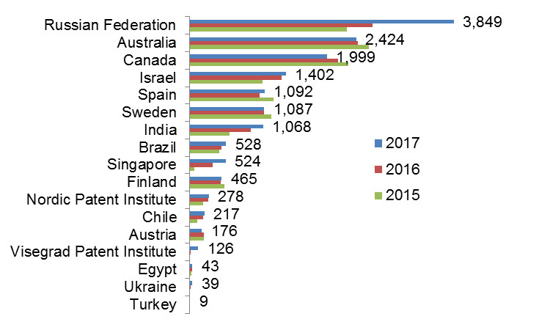
Search Reports established by ISA (excluding IP5 Offices)
Data based on international filing year of application
Source: WIPO statistics database, June 2018

Slide 14
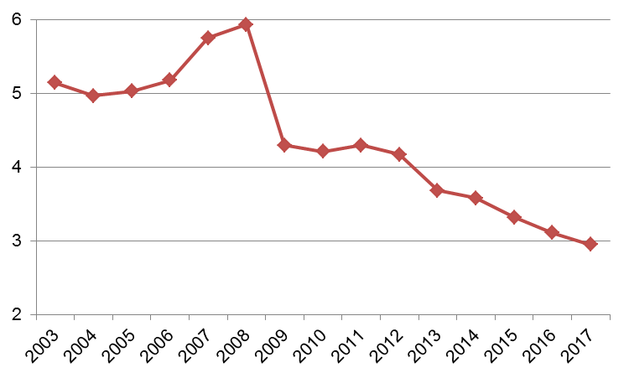
Average Timeliness in transmitting ISRs to the IB from Date of Receipt of Search Copy
Months
Source: WIPO statistics database, March 2018. Excludes cases where the time limit of 9 months from the priority date applies.
Average timeliness in transmitting ISRs to the IB was 2.96 months in 2017
84.1% of PCT applications transmitted to IB within 3 months from date of receipt of search copy (80.4% in 2016)
97.4% of international publications published
with ISR (96.2% in 2016)

Slide 15
Supplementary International Search Requests
The EPO accounted for 81.6% of requests for supplementary international search in 2017
Source: WIPO Statistics Database, March 2018

Slide 16
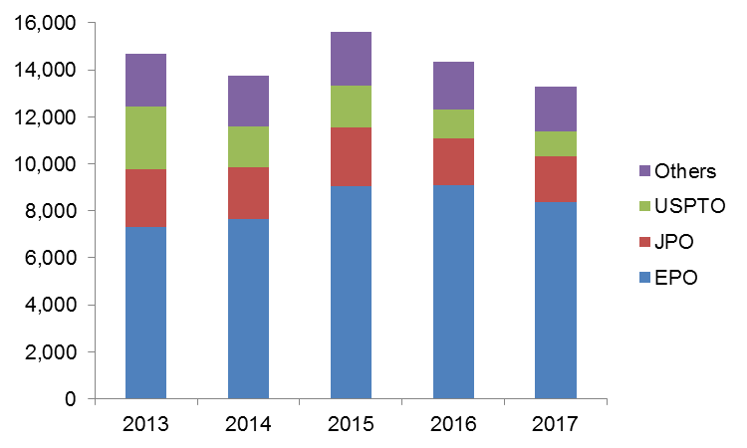
IPRPs (Chapter II) by International Preliminary Examination Authority
Source: WIPO Statistics Database, June 2018
Reports established by IPEA fell by 7.6% in 2017 to 13,270
85.7% of IPRPs (Chapter II) were produced by the EPO,
the JPO or the USPTO

Slide 17
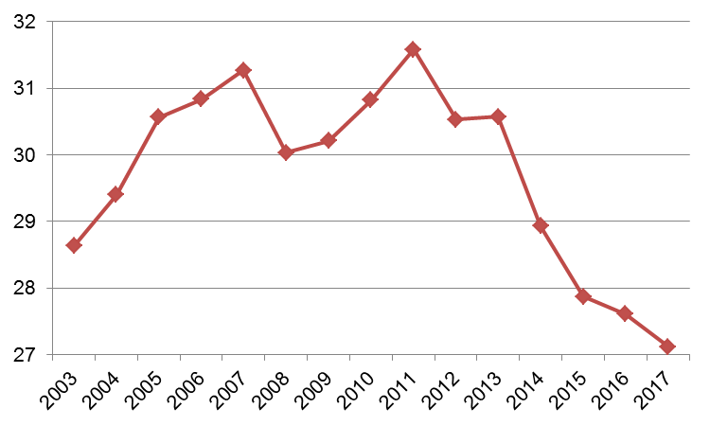
Average Timeliness in Transmitting IPRPs
Months
Source: WIPO Statistics Database, March 2018
Average time in transmitting IPRPs fell to 27.1 months from priority date in 2017
89.3% of all IPRPs were transmitted to the IB within 28 months of priority date (85.8% in 2016)

Slide 18
PCT- National Phase Entries
Source: WIPO Statistics Database, March 2018
615,400 national phase entries estimated for 2016
(-1.4%) (first decline since 2009)
About 83% are non-resident national phase entries

Slide 19
Non-Resident Applications by Filing Route
Source: WIPO Statistics Database, March 2018
512,200 non-resident national phase entries (-1.7%), 398,900 non-resident Paris-route filings (+1.3%) in 2016
56.2% of all non-resident applications filed through PCT in 2016 (57.6% in 2017)

Slide 20
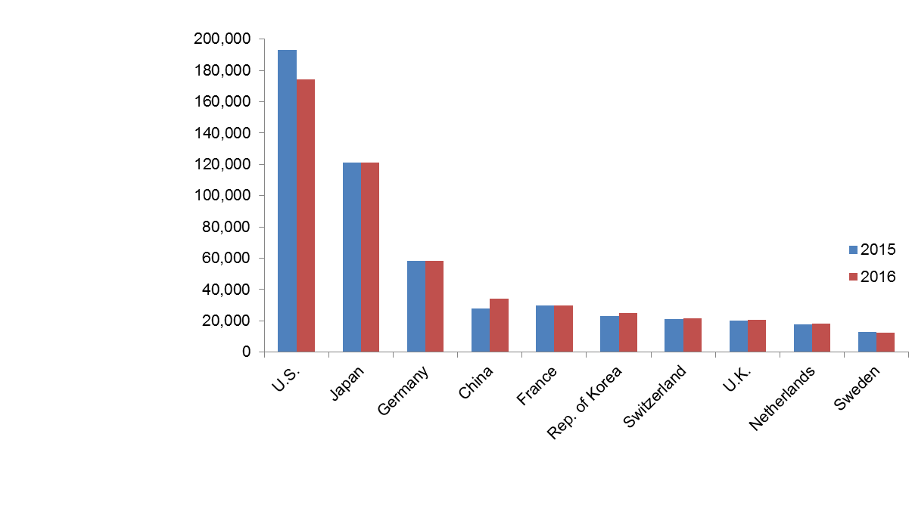
National Phase Entry for Top 10 Origins
-9.60%
+0.6%
-0.04%
+24.4%
+0.9%
+8.7%
+1.7%
+2.1%
+3.8%
-5.3%
Source: WIPO Statistics Database, March 2018
U.S. origin national phase entries dropped by 9.6% from 192,933 to 174,417 in 2016 (after rise of 12.3% in previous year)
24.4% growth for China is third successive >20% growth

Slide 21
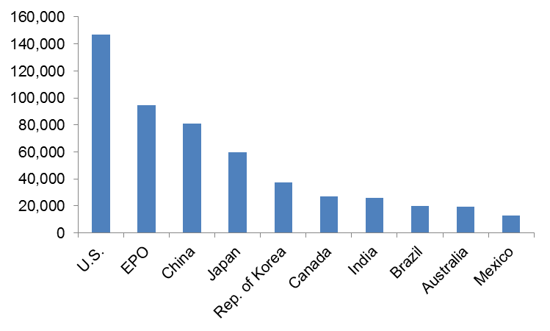
National Phase Entry for Top 10 Offices
146,867
+6.9%
94,625
-3.7%
81,055
-1.0%
59,893
-0.9%
37,093
-0.2%
27,021
-8.1%
25,896
-7.1%
19,857
-11.6%
19,375
-7.9%
12,884
-6.5%
Source: WIPO Statistics Database, March 2018
Among top 20 Offices, only U.S. (+6.9%), South Africa (+5.7%) and Viet Nam (+3.5%) showed growth in
national phase entries in 2016

Slide 22
Further information:
2018 PCT Yearly Review
The International Patent System
WIPO Publication No. 901E/2018
World Intellectual Property Indicators 2017
WIPO Publication No. 941E/2017
WIPO IP Statistics Data Center
http://www.wipo.int/ipstats/en/

