Slide 1

PCT Statistics
Meeting of International Authorities
Thirtieth Session
Geneva
November 1, 2023

Slide 2
Outline
International Filings
  Data for 2022
  Medium of Filing
National Phase Entries
International Authorities
  International Search
  Supplementary International Search
  International Preliminary Examination
PCT-Patent Prosecution Highway (PPH) pilots

Slide 3
PCT Filings in 2022
278,100 international applications filed in 2022 (+0.3%)
Top 5 countries: China (70,015 +0.6%), United States of America (59,056, -0.6%), Japan (50,345 +0.2%), Republic of Korea (22,012 +6.2%) and Germany (17,530 +1.5%)
Top applicant: Huawei Technologies (7,689 published PCT applications in 2022, +10%)
Top educational institution filer: University of California (552 published PCT applications in 2022, +0.2%)
More information in PCT Yearly Review 2023
Source: PCT Yearly Review 2023

Slide 4
PCT Filings from 2021, month-to-month
Source: WIPO Statistics Database, October 2023

Slide 5
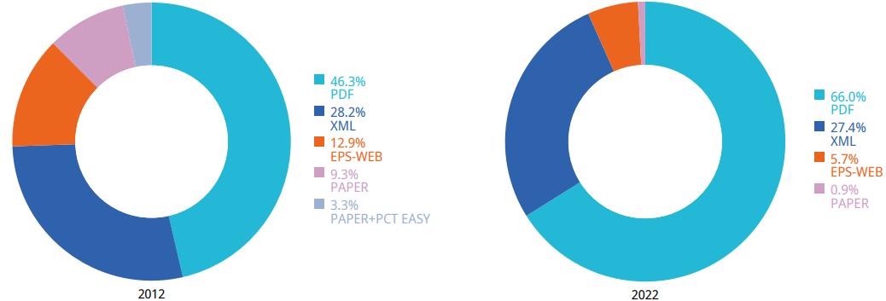
Medium of Filing
10 years
Filing medium distribution for 2022 (2021):
66.0% (65.0%) PDF, 27.4% (27.3%) XML, 0.9% (1.3%) Paper
Source: WIPO statistics database. October 2023, PCT Yearly Review 2023

Slide 6
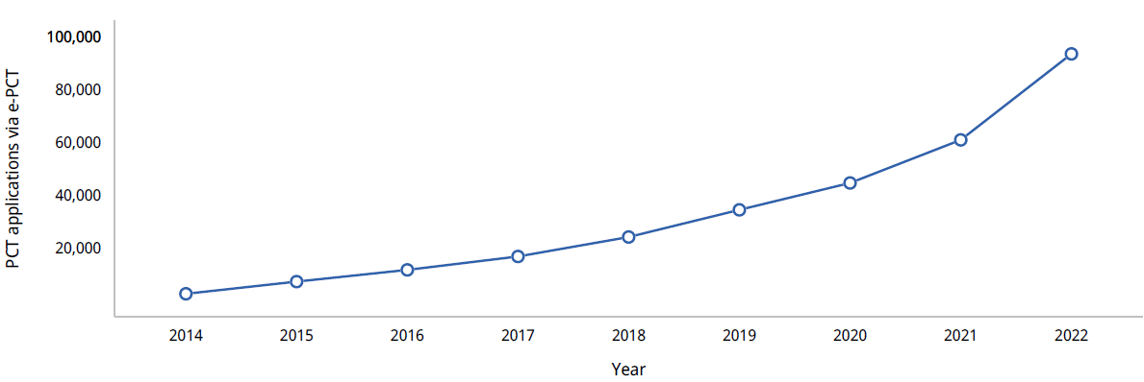
Medium of Filing : focus on ePCT
Nearly 100k PCT applications were filed by applicants using ePCT in 2022, 53.5% more than in 2021
About a third of all PCT applications filed globally in 2022 were filed using ePCT
Source: WIPO statistics database, March 2023, PCT Yearly Review 2023

Slide 7
PCT National Phase Entries
715,200 total national phase entries in 2021 (+7.6%)
598,600 non-resident national phase entries in 2021
PCT system accounted for 58.9% of all non-resident filings in 2021 (+2%)
Source: WIPO statistics database. June 2023

Slide 8
International Authorities
International Search Reports
  Distribution by International Authority
  Timeliness of Transmission to International Bureau
  A1 Publication Percentage
Supplementary International Search Reports
International Preliminary Examination Reports
  Number of IPRPs per IPEA
  Timeliness of Transmission to International Bureau

Slide 9
Distribution of ISRs established by ISA
84,051
75,312
49,154
29,937
22,974
IP5 Offices produce 94.4% of International Search Reports
Data based on international filing year of application
Source: WIPO statistics database. October 2023

Slide 10
Distribution of ISRs established by ISA (excluding IP5 Offices)
2,393
2,292
1,982
1,853
1,463
1,407
886
812
564
491
316
249
212
146
116
51
48
16
5
Data based on international filing year of application
Source: WIPO statistics database. October 2023

Slide 11
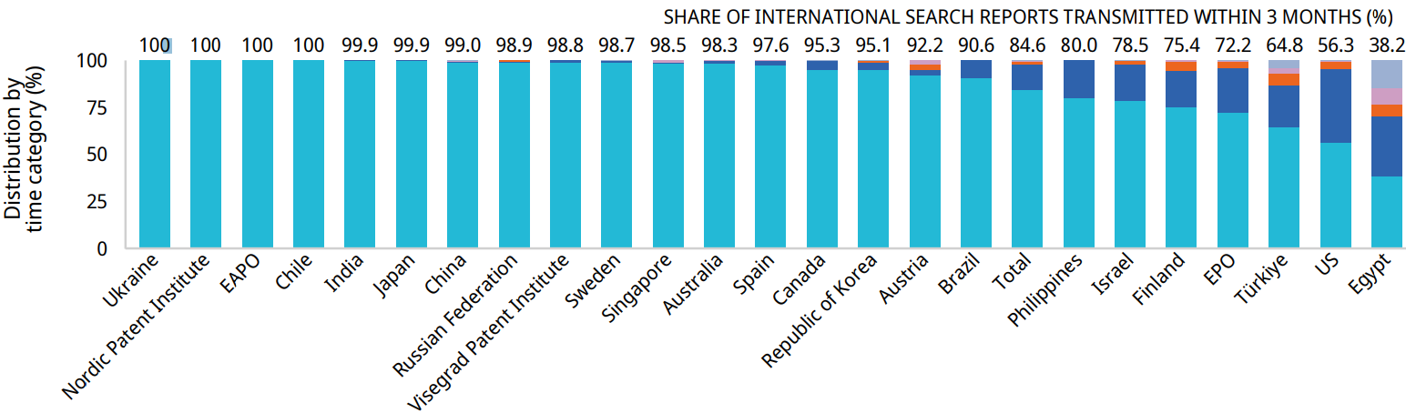
Timeliness in Transmitting ISRs to the IB measured from Date of Receipt of Search Copy by ISA for 2022
All ISRs that ought to be transmitted to the International Bureau within 3 months of the date of receipt of the search copy met this deadline at the Office of Chile, Ukraine, the Nordic Patent Institute and Eurasian Patent Office.
In 2021, 85.6 % of all ISRs were transmitted within 3 months
Source: WIPO statistics database. March 2023. Excludes cases where Rule 42 time limit of 9 months from priority date applies.

Slide 12
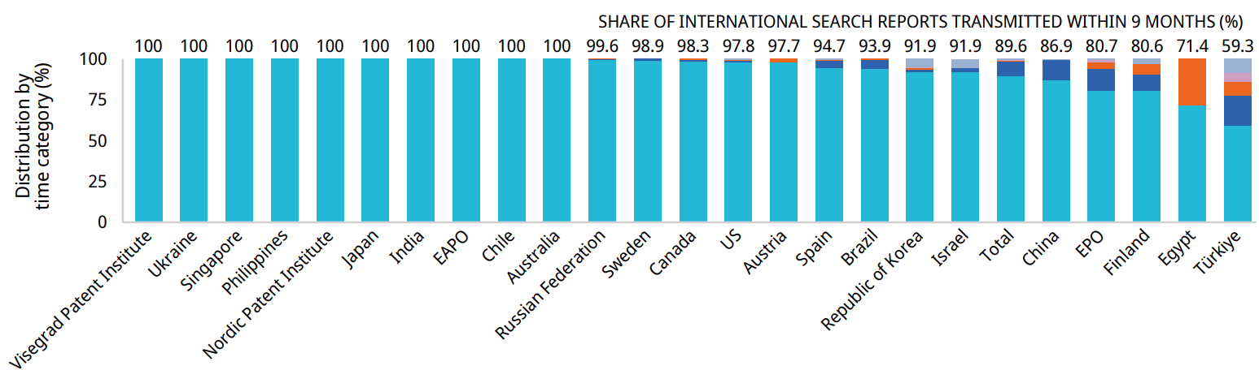
Timeliness in Transmitting ISRs to the IB measured from Priority Date by ISA for 2022
At 19 ISAs, more than 90% of international search reports required to be transmitted to the International Bureau within 9 months of the priority date met the deadline
In 2021, 81.6 % of all ISRs were transmitted within 9 months of the priority date
Source: WIPO statistics database, March 2023. Excludes cases where Rule 42 time limit of 3 months from date of receipt of search copy applies.

Slide 13
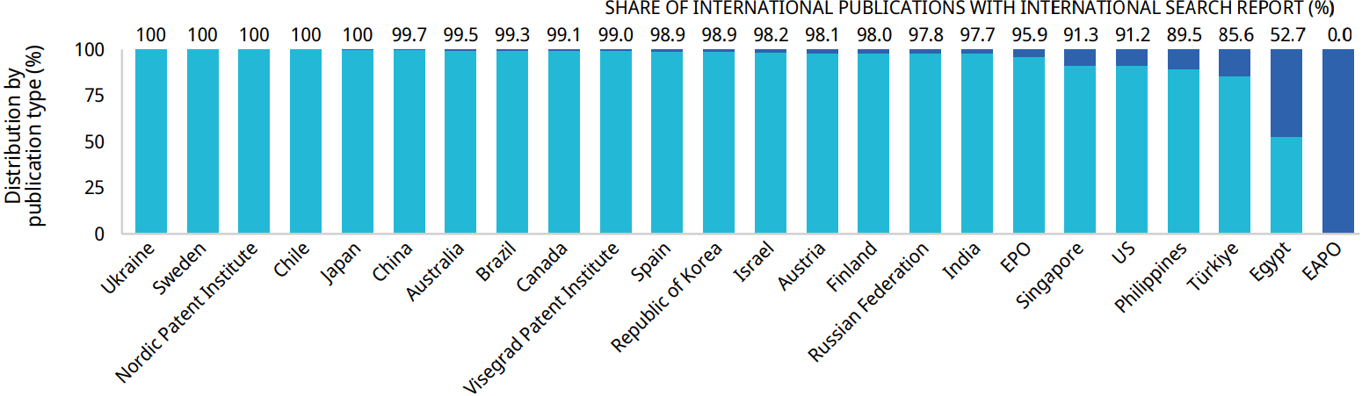
PCT A1 Publication Percentage by ISA in 2022
The International Bureau published more than 90% of PCT applications together with an ISR for 20 of the 24 ISAs
Overall, in 2022, 97.6 % of published IAs were A1 publications (slightly down from 97.9 % in 2021)
Source: WIPO statistics database. March 2023

Slide 14
Supplementary International Search Requests
 | 2015 | 2016 | 2017 | 2018 | 2019 | 2020 | 2021 | 2022 | 2023 (until 09-23)
Austria | 2 |  | 1 | 1 | 2 | 2 | 1 |  | (3)
European Patent Office | 40 | 44 | 40 | 54 | 94 | 50 | 48 | 48 | (22)
Nordic Patent Institute |  |  |  |  | 2 | 1 | 1
Russian Federation | 22 | 3 | 6 |  | 3 | 1 | 3
Singapore |  | 1 |  | 3 | 4 | 2 |  | 3
Sweden |  |  |  | 3 | 1 | 1 | 1 | 1 | (1)
Turkey |  |  |  | 1 | 2 | 1
Ukraine |  |  | 2 | 1 | 4 | 1 |  | 1
Visegrad Patent Institute |  |  |  |  | 2 | 1
Total | 64 | 48 | 49 | 63 | 114 | 60 | 54 | 53 | (26)
Source: WIPO statistics database. October 2023

Slide 15
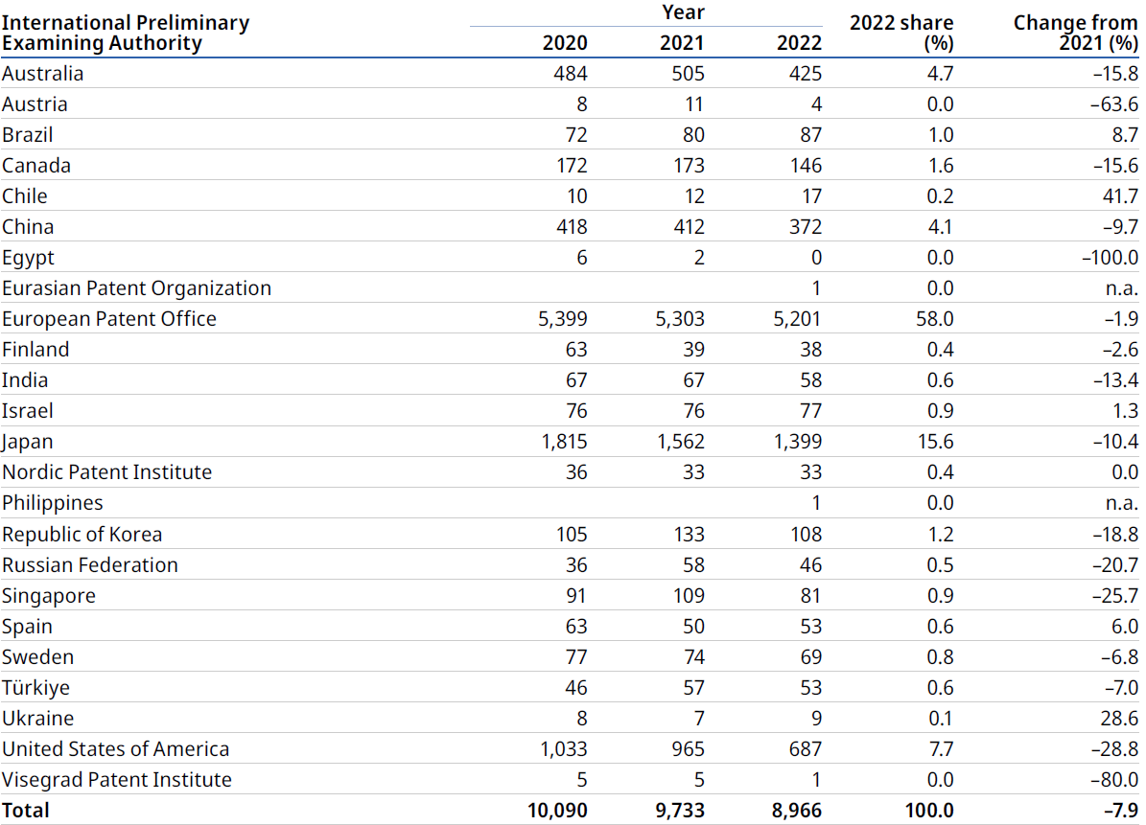
Number of IPRPs issued by IPEA
Steady decline over the last few years
EPO and Japan issue 74% of all Chapter II IPRPs
Source : PCT Yearly Review 2023 (Data for 2022 may be incomplete)
Source: WIPO statistics database. October 2023

Slide 16
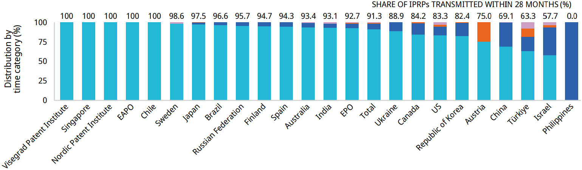
Timeliness in transmitting IPRPs by IPEA in 2022
19 Offices transmitted at least 80% of IPRPs to the International Bureau within 28 months of the priority date
On average, 87.3 % of all IPRPs were transmitted within 28 months in 2021
Timeliness calculated as time elapsed between priority date and date on which
International Bureau received IPRP from IPEA
Source: WIPO statistics database. March 2023

Slide 17
Distribution of PCT-PPH requests by Office of earlier and later examination
Office of later examination (OLE) | Office of earlier examination (OEE) | EPO | Japan | US | China | Republic of Korea | Canada | Israel | Australia | Singapore | Spain | Sweden | Russian Federation | Finland | Brazil | Others | Total
US |  | 1243 | 306 | 912 | 700 | 207 | 103 | 57 | 40 | 42 | 2 | 20 | 17 | 7 | 1 | 17 | 3674
Japan |  | 473 | 1177 | 83 | 149 | 45 | 13 | 5 | 7 | 16 | 5 | 3 | 0 | 1 | 0 | 3 | 1980
China |  | 592 | 323 | 171 | 0 | 84 | 14 | 7 | 0 | 16 | 0 | 13 | 8 | 5 | 0 | 0 | 1233
EPO |  | 0 | 151 | 162 | 123 | 48 | 28 | 12 | 14 | 1 | 0 | 0 | 5 | 0 | 0 | 0 | 544
Republic of Korea |  | 138 | 100 | 92 | 65 | 59 | 5 | 7 | 0 | 18 | 0 | 0 | 0 | 1 | 0 | 10 | 495
Canada |  | 158 | 17 | 101 | 22 | 19 | 76 | 9 | 9 | 1 | 1 | 3 | 0 | 1 | 0 | 0 | 417
Australia |  | 140 | 25 | 171 | 0 | 25 | 8 | 3 | 0 | 1 | 0 | 0 | 2 | 0 | 0 | 7 | 382
Mexico |  | 48 | 24 | 28 | 20 | 0 | 2 | 0 | 0 | 0 | 35 | 0 | 0 | 0 | 0 | 0 | 157
Philippines |  | 0 | 83 | 39 | 0 | 7 | 0 | 0 | 0 | 0 | 0 | 0 | 0 | 0 | 0 | 0 | 129
Israel |  | 53 | 4 | 24 | 6 | 2 | 0 | 20 | 0 | 1 | 0 | 0 | 0 | 0 | 0 | 1 | 111
Brazil |  | 51 | 10 | 25 | 2 | 2 | 0 | 0 | 0 | 1 | 0 | 0 | 0 | 0 | 8 | 0 | 99
Colombia |  | 24 | 3 | 58 | 0 | 2 | 3 | 1 | 1 | 0 | 2 | 0 | 0 | 0 | 0 | 2 | 96
Singapore |  | 36 | 19 | 7 | 9 | 3 | 0 | 2 | 5 | 0 | 0 | 1 | 0 | 0 | 0 | 1 | 83
New Zealand |  | 0 | 6 | 23 | 0 | 0 | 2 | 1 | 20 | 0 | 0 | 0 | 1 | 0 | 0 | 2 | 55
Russian Federation |  | 12 | 11 | 6 | 17 | 1 | 0 | 0 | 2 | 0 | 1 | 0 | 1 | 0 | 0 | 0 | 51
UK |  | 0 | 7 | 11 | 6 | 0 | 2 | 0 | 2 | 0 | 0 | 0 | 0 | 0 | 0 | 2 | 30
Eurasian Patent Organization |  | 14 | 0 | 0 | 0 | 1 | 0 | 0 | 0 | 0 | 0 | 0 | 0 | 0 | 0 | 0 | 15
Others |  | 0 | 3 | 6 | 1 | 0 | 0 | 1 | 3 | 0 | 0 | 1 | 0 | 0 | 0 | 0 | 15
Total |  | 2982 | 2269 | 1919 | 1120 | 505 | 256 | 125 | 103 | 97 | 46 | 41 | 34 | 15 | 9 | 45 | 9566
US and Japan are the main
Offices of Later Examination
(> 50 % of the global volume
of PPH requests)
Source: WIPO statistics database. March 2023, data for certain Offices of later examination such as Germany, Indonesia, are unavailable

Slide 18
Further information:
2023 PCT Yearly Review
The International Patent System
WIPO Publication No. 901EN/2023
WIPO IP Statistics Data Center
http://www.wipo.int/ipstats/en/

