Slide 1
EPO′s QMS
Piotr Wierzejewski
Quality Management
February 2018

Slide 2
Employing highly qualified specialists as examiners
Minimum requirements
Master's degree in physics, chemistry, engineering or natural sciences
Excellent knowledge of one official language (DE, EN, FR) and the ability to understand the other two
Only the best candidates are recruited
20 000 job applications were received in 2016
185 examiners were recruited

Slide 3
Building and retaining examiners’ expertise
Building expertise
Retaining expertise
First two years
45.5 days instructor-led, interactive, classroom training
On the job coaching by experienced examiners supervising all activities
Career-long training
regular training on technical and legal matters
In 2016, 89.5% of staff received at least one training exercise
Examiners are fully trained in about four years
No outsourcing of core activities such as search, examination, classification
Low staff turnover (around 3.5%)

Slide 4
Fostering collaborative work between our experts
Proposals for grant are checked and signed by three examiners - Article 18 EPC
Examining Division
Coaches
Directors / Team managers
Experienced examiners help newcomers during first two years
They manage examiners and review decisions of the examining divisions
Examiner
Asian prior art experts
Formalities officers
Examiners specialised in Asian patent data transfer their expertise
They handle administrative matters throughout
Classi- fication experts
Examiners specialised in classification use peers’ input to further optimise the tools
Notes:
4

Slide 5
World’s most comprehensive prior art collection
Largest prior art collection: millions of centralised records
over 100 databases
1 billion technical records
> 100 million full-text patent documents
> 30 million non-patent literature documents
> 3 million standards documents
A
Patent Translate: patent–specific machine translation
谢
developed in collaboration with Google
covering 32 languages worldwide
Source: EPO data, October 2017

Slide 6
“Get it right first time”
Search Phase
Examination Phase
Search Examiner
1st Examiner
EPO searches are delivered within 6 months. They are as complete and thorough as possible.
In the examination phase, the same examiner who carried out the search will perform the substantive examination:
The EPO approach offers early legal certainty.

Slide 7
“Get it right first time” and PCT
If the EPO performed a search during the PCT Phase (International Search Report or Supplementary International Search Report):
The EPO recognises its own PCT searches in the European Phase
no European search will be performed, no European search fee
on entering the European phase, the application will proceed immediately to the EPO’s examination phase (saving time)
the same examiner who performed the PCT search will be responsible for the examination at the EPO

Slide 8
Providing Early Certainty throughout the process
Search reports
Delivering search reports within 6 months of receipt
Examination time
Reducing examination times to just 12 months on average by 2020
Opposition time
Completing oppositions in just 15 months on average, while ensuring the parties are heard
Actual¹ Search timeliness: 4.9 months
Actual¹ Examination timeliness: 22.6 months
Actual¹ duration of oppositions: 23.8 months
6.0
12.0
15.0
4.8
22.1
22.4
¹ Data from Q4 2017

Slide 9
PCT search timeliness
The “in time” indicator increased from 76% in 2010 to 97% in 2017 (Q1 and Q2)
Resulting from two initiatives:
Early Certainty from Search, 6 months from receipt
Fast track for PCT applications delivered late from other Receiving Offices

Slide 10
PCT examination timeliness
“Within 28 months” indicator increased from 76% in 2014 to 92% in 2017 (Q1 and Q2)
Resulting from:
Prioritising PCT Ch. II applications
International searches (PCT Ch. I) delivered on time

Slide 11
Retaining highest quality standards
2017: re-certification audit under revised ISO 9001:2015 standard
First of the world’s largest offices to achieve ISO 9001 certification for its Quality Management System (QMS) covering the entire patent process
Includes supporting processes (e.g. HR-related, Automation support, QMS maintenance and review)
Patent process
Search
Examination
Limitation/ Revocation
Opposition
Classification
EP Publication
EP Register and Bulletin
Post-grant fee handling
Supporting processes
ISO 9001 re-certified in 2017
Preparatory work for UPP to integrate into the Patent process
Ratification pending. Integration in the QMS after a period of operative implementation.

Slide 12
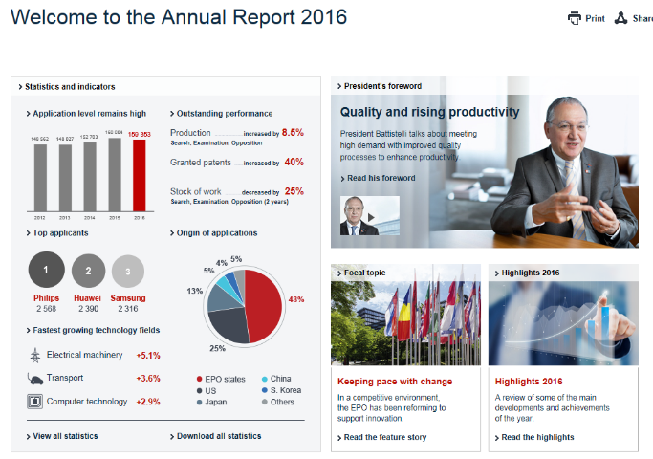
Annual reporting of quality deliverables
Reporting transparency
Quality indicators integrated in the Annual Report since 2014
First Quality Report published in 2017

Slide 13
Expanding EPO Services
Fee levels have remained stable
The level of EPO services has expanded
More validation states: Morocco, Tunisia and Moldova
Patent Prosecution Highway agreements with 15 other offices, giving easy access to accelerated examination abroad free of charge
Innovative new services such as PCT-Direct
Timeliness has dramatically improved
Patent Translate in co-operation with Google
Free access to world’s largest patent databases (Espacenet: now over 100 million documents)

Slide 14
Need more information?
Visit epo.org/quality
Follow us on
facebook.com/europeanpatentoffice
twitter.com/EPOorg
youtube.com/EPOfilms
linkedin.com/company/european-patent-office
Contact us via epo.org/contact

