Slide 1


Antibiotic usage and resistance unavoidable link?
Antimicrobial Resistance: How to Foster Innovation, Access
and Appropriate Use of Antibiotics?
Geneva 25.10.2016
Evelina Tacconelli
Comprehensive Center for Infectious Diseases
DZIF Partner Center
Tübingen University
Germany

Slide 2

Road map
Antibiotic usage
as ethic issue
1
Limitations of
prescribing antibiotics
2
3
Antibiotic and resistance
4
Antibiotic stewardship
5
Keys actions

Slide 3
Road map
Antibiotic usage
as ethic issue
1
Prescribing and outcome
2
3
Antibiotic and resistance
4
Antibiotic stewardship
5
Keys actions

Slide 4

AMR is a distinct ethical issue
Successful responses to the problem of AMR will not only be a scientific or medical undertaking, it must also be an ethical undertaking
Every level of an AMR response (improving surveillance and reporting, reducing ATB usage, ..) strategy will inevitably involve making decisions with ethical implications
Promoting research and innovation into different preventative, diagnostic and therapeutic interventions will require us to make funding and allocation decisions that prioritise AMR over other important projects and policies
Littmann, Public Health Ethics 2015

Slide 5
Attributable mortality of infections due to resistant bacteria
Cases
Controls
Tacconelli, Task1B2-1 (EU-Commission, Annual Report 2016)

Slide 6
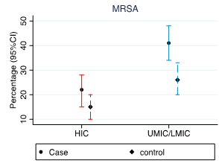
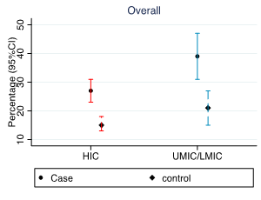
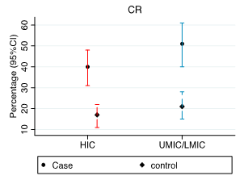
Mortality due to resistant bacteria
World bank regions classification
Cases
Controls
Cases
Controls
Cases
Controls
Tacconelli, Task1B2-1 (EU-Commission, Annual Report 2016)

Slide 7
Lenght of hospital stay (days) after infections due to resistant bacteria
 | Overall | CR-GN | ESBL-GN | MRSA | VRE | VRSA
Hospital wide WMD (95% CI) | 7.5 (6-9) | 10 (7-14) | 5 (1.5-11) | 5.5 (4- 7) | 9.9 (6-14) | 4.9 (0.21-9.58)
ICU WMD (95% CI) | 6 (4-8) | 4 (0.09-8) | 6 (3-9) | 5 (0.7-9) | - | 3 (5-12)
weighted mean difference, WMD 95% Confidence Interval
Tacconelli, Task1B2-1 (EU-Commission, Annual Report 2016)

Slide 8
Road map
1
Antibiotic as ethic issue
Limitations of
prescribing antibiotics
2
3
Antibiotic and resistance
4
Antibiotic stewardship
5
Keys actions

Slide 9
Inappropriate therapy in hospitalised patients
TREAT project
The percentage of inappropriate empiric antibiotic use ranged from 14% to 79%; 13 of 27 studies (48%) described an incidence of 50% or more
%
N: 350 patients; DSS: decision support system; MD: medical doctors
Paul and Tacconelli, JAC 2013
Marquet, Crit Care 2015

Slide 10
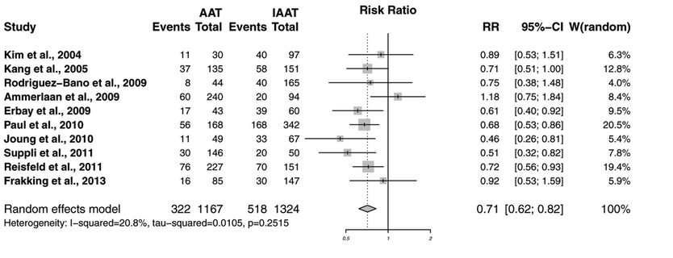
Effect of inappropriate antibiotic therapy against severe infections
29% increase in mortality in patients
receiving inappropriate therapy
Marquet, Crit Care 2015
Notes:
Introduction: The aims of this study were to explore the incidence of in-hospital inappropriate empiric antibiotic
use in patients with severe infection and to identify its relationship with patient outcomes.
Methods: Medline (from 2004 to 2014) was systematically searched by using predefined inclusion criteria.
Reference lists of retrieved articles were screened for additional relevant studies. The systematic review included
original articles reporting a quantitative measure of the association between the use of (in)appropriate empiric
antibiotics in patients with severe in-hospital infections and their outcomes. A meta-analysis, using a random-effects
model, was conducted to quantify the effect on mortality by using risk ratios.
Results: In total, 27 individual articles fulfilled the inclusion criteria. The percentage of inappropriate empiric
antibiotic use ranged from 14.1% to 78.9% (Q1-Q3: 28.1% to 57.8%); 13 of 27 studies (48.1%) described an incidence of
50% or more. A meta-analysis for 30-day mortality and in-hospital mortality showed risk ratios of 0.71 (95% confidence
interval 0.62 to 0.82) and 0.67 (95% confidence interval 0.56 to 0.80), respectively. Studies with outcome parameter
28-day and 60-day mortality reported significantly (P ≤0.02) higher mortality rates in patients receiving inappropriate
antibiotics. Two studies assessed the total costs, which were significantly higher in both studies (P ≤0.01).
Conclusions: This systematic review with meta-analysis provides evidence that inappropriate use of empiric antibiotics
increases 30-day and in-hospital mortality in patients with a severe infection.

Slide 11
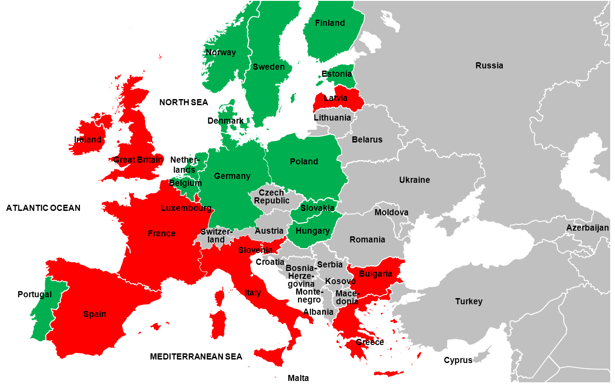
Trends in glycopeptide consumption and MRSA rate
Correlation between resistance rate and consumption
In the “red” country there is an increasing usage of antibiotics although rate of resistance are significantly decreasing
Tacconelli (under submission)

Slide 12
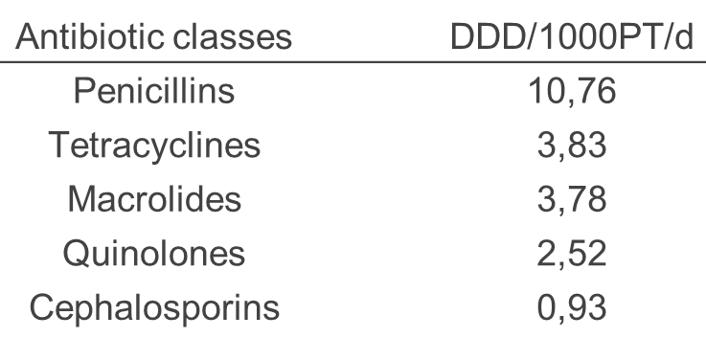
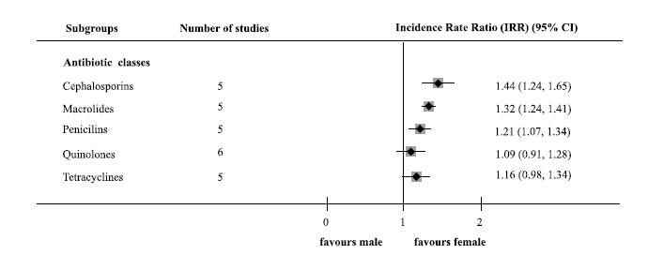
Antibiotics prescription by general practitioners (40M individuals)
The amount of antibiotics prescribed to women is 36% higher than that prescribed for men in the 16 to 34 years age group and 40% greater in the 35 to 54 years age group
Tacconelli, JAC 2016

Slide 13
Road map
1
Antibiotic as ethic issue
Prescribing and outcome
2
3
Antibiotic and resistance
4
Antibiotic stewardship
5
Keys actions

Slide 14
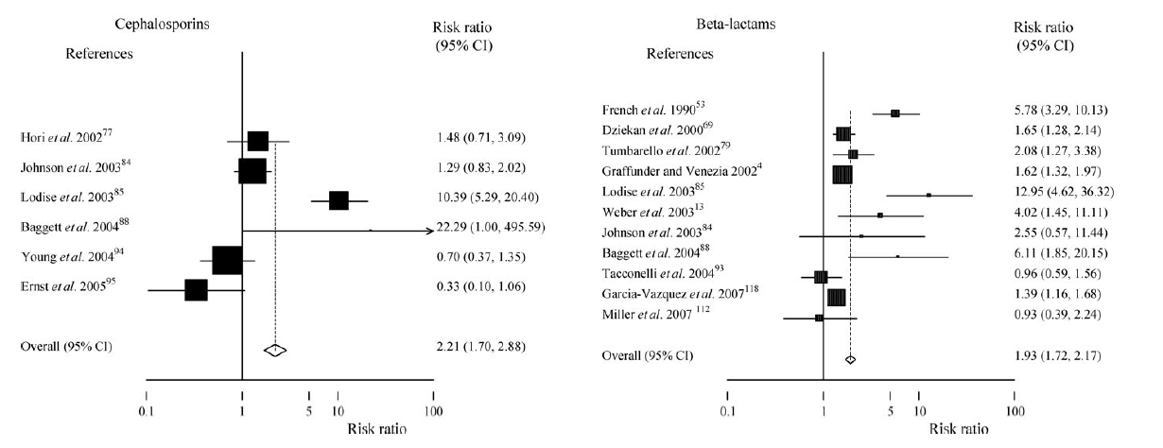
Previous antibiotics usage and MRSA
26 studies, 24 230 patients
Tacconelli, JAC 2008
Notes:
Background: Current evidence does not provide a clear definition of the association between methicillinresistant
Staphylococcus aureus (MRSA) isolation and previous antibiotic use. A systematic review was
performed to determine whether antibiotic exposure is a risk factor for the isolation of MRSA.
Methods: MEDLINE and EMBASE databases were searched to identify studies published between 1976
and 2007 on the role of antibiotics as a risk factor for MRSA isolation in adult patients. The outcome of
interest was MRSA isolation. Summary statistics were risk ratios (RR) comparing MRSA-positive patients
to those without S. aureus isolation or with methicillin-susceptible S. aureus isolation.
Results: Seventy-six studies, including a total of 24 230 patients, met the inclusion criteria. Antibiotic
exposure was determined in the 126 + 184 (mean + SD) days preceding MRSA isolation. The risk of
acquiring MRSA was increased by 1.8-fold [95% confidence interval (CI), 1.7–1.9; P < 0.001] in patients
who had taken antibiotics. The RR for single classes of antibiotics was 3 (95% CI, 2.5–3.5) for quinolones,
2.9 (95% CI, 2.4–3.5) for glycopeptides, 2.2 (95% CI, 1.7–2.9) for cephalosporins and 1.9 (95% CI,
1.7–2.2) for other b-lactams. Significant heterogeneity was detected among studies. A regression analysis
revealed that the heterogeneity was linked to the length of time in which antibiotic exposure was
detected before MRSA isolation (more or less than 180 days).
Conclusions: This meta-analysis shows a clear association between exposure to antibiotics and MRSA
isolation. This information may be useful for researchers in designing future studies and for policy
decision-making on the appropriate management of antibiotic therapies.

Slide 15


 | ESBL+ % | MRSA %
At hospital admission | 11 | 3
At discharge without taking antibiotics | 11 | 2
At discharge after taking antibiotics | 28 | 4
Rates of colonization
Multicenter Prospective
EU study
24-month study period
10,197 patients
Screening at hospital admission
Screening at hospital discharge
Screening samples: 58,804
www.saturn-project.eu
Tacconelli, AAC 2009
mRR: 3.2
mRR: 2.1

Slide 16
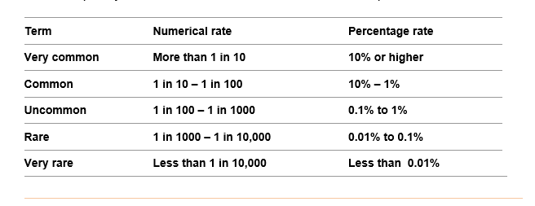
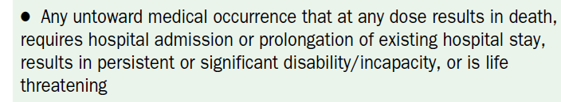
ESBL colonisation develops in 18% of patients taking cephalosporins
(very common AE)
Hospital stay (days) in antibiotic resistant infections
vs sensitive infections
16.3 (12) vs 7.1 (11) days
Tacconelli, ECCMID 2016
Notes:
16
16
Accurate assessment of risk factors for nosocomial acquisition of colonization by antibiotic-resistant bacteria
(ARB) is often confounded by scarce data on antibiotic use. A 12-month, nested, multicenter cohort study
was conducted. Target ARB were methicillin (meticillin)-resistant Staphylococcus aureus (MRSA), vancomycinresistant
enterococci (VRE), and ciprofloxacin-resistant Pseudomonas aeruginosa (CR-PA). Nares and rectal
swabs were obtained before and after starting antibiotics. Pulsed-field gel electrophoresis was done to define
genetic relatedness of the strains. Primary outcomes were (i) the mean time, in days, for acquisition of target
ARB colonization in patients previously not colonized; (ii) the rate of acquisition per 1,000 antibiotic-days
according to different classes of antibiotics; (iii) the rate of infection caused by the same bacteria as those
previously isolated in screening samples; and (iv) the risk factors for ARB acquisition. In total, 6,245 swabs
from 864 inpatients were processed. The rate of acquisition was 3%, 2%, and 1% for MRSA, VRE, and CR-PA,
respectively. The rate of acquisition of ARB per 1,000 antibiotic-days was 14 for carbapenems, 9 for glycopeptides,
and 6 for broad-spectrum cephalosporins and quinolones. The highest rates of acquisition were observed
for carbapenems in dialyzed and diabetic patients. Four risk factors were independently associated with
acquisition of target ARB: use of carbapenems, age of >70 years, hospitalization for >16 days, and human
immunodeficiency virus infection. During the 30-day follow-up, 4 among 42 patients newly colonized by ARB
(9%) suffered from an infection due to the same bacteria as those isolated in a previous screening sample.
Colonizing and infecting strains from single patients were genotypically identical. Identifying ARB colonization
early during antibiotic therapy could target a high-risk hospitalized population that may benefit from intervention
to decrease the risk of subsequent nosocomial infections.

Slide 17
Road map
1
Antibiotic as ethic issue
Prescribing and outcome
2
3
Antibiotic and resistance
4
Antibiotic stewardship
5
Keys actions

Slide 18
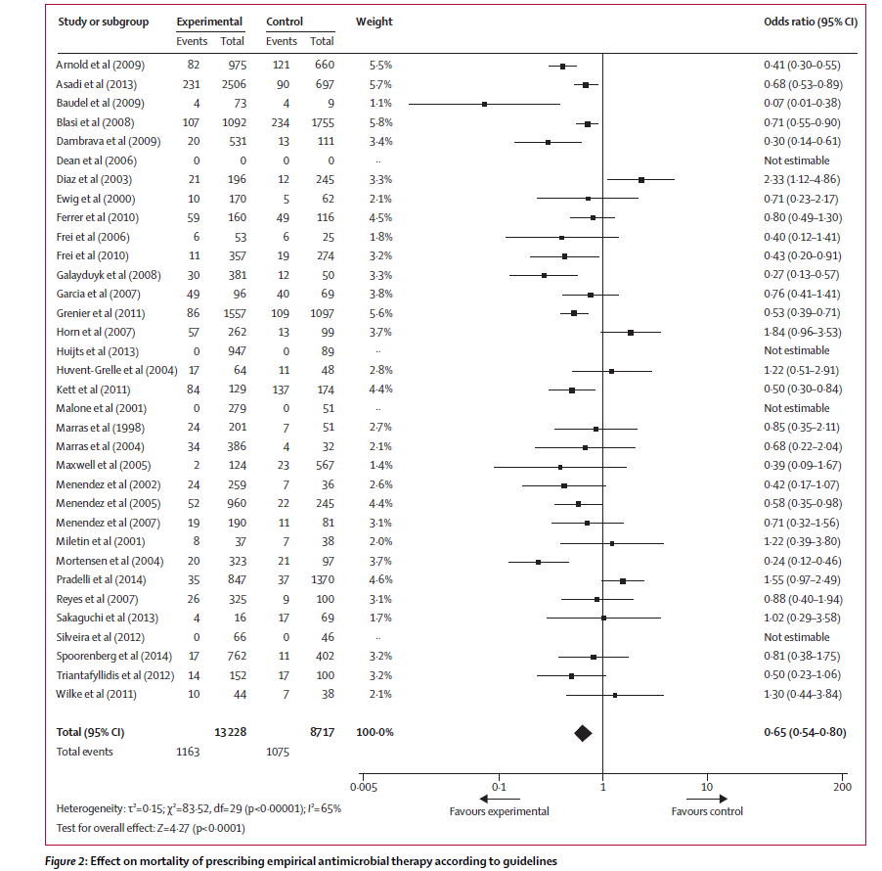
Effect of antimicrobial stewardship on hospitalized patients
145 studies / 14 objectives
Guideline-adherent empirical therapy was
associated with a RR for mortality of 35%
Schuts, LID 2016
Notes:
In reality no information on reisstance
no focus on the resistance-rate
review and meta-analysis to assess whether antimicrobial stewardship objectives had any eff ects in hospitals and longterm
care facilities on four predefi ned patients’ outcomes: clinical outcomes, adverse events, costs, and bacterial
resistance rates.
Methods We identifi ed 14 stewardship objectives and did a separate systematic search for articles relating to each one
in Embase, Ovid MEDLINE, and PubMed. Studies were included if they reported data on any of the four predefi ned
outcomes in patients in whom the specifi c antimicrobial stewardship objective was assessed and compared the
fi ndings in patients in whom the objective was or was not met. We used a random-eff ects model to calculate relative
risk reductions with relative risks and 95% CIs.
Findings We identifi ed 145 unique studies with data on nine stewardship objectives. Overall, the quality of
evidence was generally low and heterogeneity between studies was mostly moderate to high. For the objectives
empirical therapy according to guidelines, de-escalation of therapy, switch from intravenous to oral treatment,
therapeutic drug monitoring, use of a list of restricted antibiotics, and bedside consultation the overall evidence
showed signifi cant benefi ts for one or more of the four outcomes. Guideline-adherent empirical therapy was
associated with a relative risk reduction for mortality of 35% (relative risk 0·65, 95% CI 0·54–0·80, p<0⋅0001)
and for de-escalation of 66% (0·44, 0·30–0·66, p<0⋅0001). Evidence of eff ects was less clear for adjusting therapy
according to renal function, discontinuing therapy based on lack of clinical or microbiological evidence of
infection, and having a local antibiotic guide. We found no reports for the remaining fi ve stewardship objectives
or for long-term care facilities.
Interpretation Our fi ndings of benefi cial eff ects on outcomes with nine antimicrobial stewardship objectives
suggest they can guide stewardship teams in their eff orts to improve the quality of antibiotic use in hospitals.

Slide 19
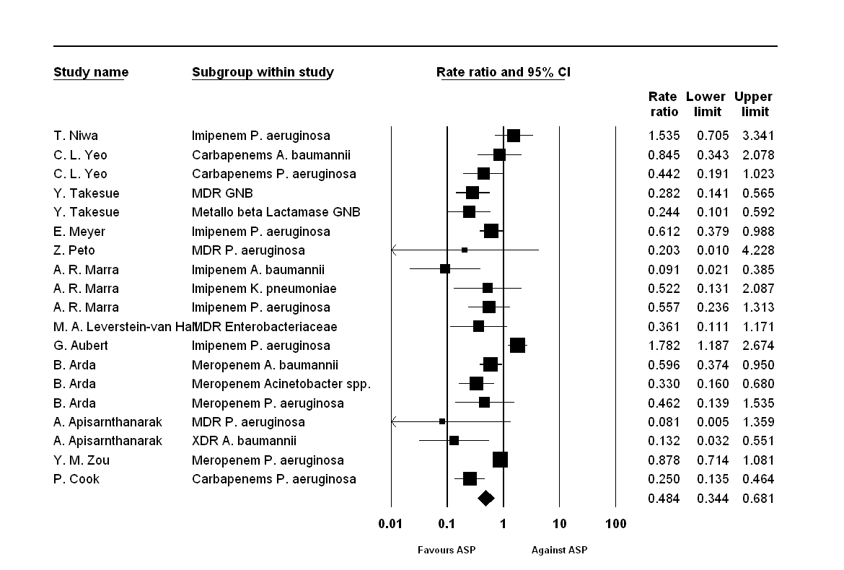
Effectiveness of AMS on resistance rate
Carbapenems resistant bacteria
Major impact
when implemented with hand hygiene programme
in haematological / immunocompromised patients
Overall reduction of the CR rate in gram negative by
52% (32% to 66%)
Tacconelli, ECCMID 2016

Slide 20
Road map
1
Antibiotic as ethic issue
Prescribing and outcome
2
3
Antibiotic and resistance
4
Antibiotic stewardship
5
Keys actions

Slide 21
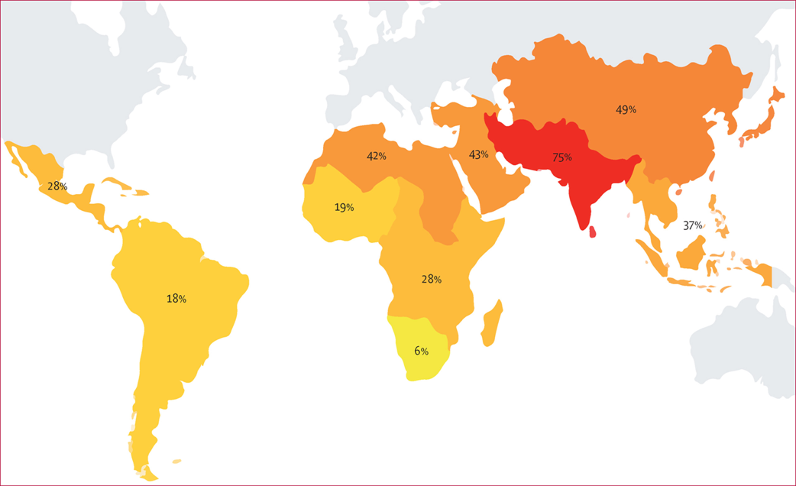
Import and spread of extended-spectrum β-lactamaseproducing Enterobacteriaceae by international travellers (COMBAT study): a prospective, multicentre cohort study
Global action
Percentages of travellers that acquired β-lactamase-producing Enterobacteriaceae per subregion
Arcilla, LID 2016
Notes:
Summary
Background International travel contributes to the dissemination of antimicrobial resistance. We investigated the
acquisition of extended-spectrum β-lactamase-producing Enterobacteriaceae (ESBL-E) during international travel,
with a focus on predictive factors for acquisition, duration of colonisation, and probability of onward transmission.
Methods Within the prospective, multicentre COMBAT study, 2001 Dutch travellers and 215 non-travelling
household members were enrolled. Faecal samples and questionnaires on demographics, illnesses, and behaviour
were collected before travel and immediately and 1, 3, 6, and 12 months after return. Samples were screened for the
presence of ESBL-E. In post-travel samples, ESBL genes were sequenced and PCR with specifi c primers for
plasmid-encoded β-lactamase enzymes TEM, SHV, and CTX-M group 1, 2, 8, 9, and 25 was used to confi rm the
presence of ESBL genes in follow-up samples. Multivariable regression analyses and mathematical modelling were
used to identify predictors for acquisition and sustained carriage, and to determine household transmission rates.
This study is registered with ClinicalTrials.gov, number NCT01676974.
Findings 633 (34・3%) of 1847 travellers who were ESBL negative before travel and had available samples after return
had acquired ESBL-E during international travel (95% CI 32・1–36・5), with the highest number of acquisitions being
among those who travelled to southern Asia in 136 of 181 (75・1%, 95% CI 68・4–80・9). Important predictors for
acquisition of ESBL-E were antibiotic use during travel (adjusted odds ratio 2・69, 95% CI 1・79–4・05), traveller’s
diarrhoea that persisted after return (2・31, 1・42–3・76), and pre-existing chronic bowel disease (2・10, 1・13–3・90). The
median duration of colonisation after travel was 30 days (95% CI 29–33). 65 (11・3%) of 577 remained colonised at
12 months. CTX-M enzyme group 9 ESBLs were associated with a signifi cantly increased risk of sustained carriage
(median duration 75 days, 95% CI 48–102, p=0・0001). Onward trans mission was found in 13 (7・7%) of 168 household
members. The probability of transmitting ESBL-E to another household member was 12% (95% CI 5–18).
Interpretation Acquisition and spread of ESBL-E during and after international travel was substantial and worrisome.
Travellers to areas with a high risk of ESBL-E acquisition should be viewed as potential carriers of ESBL-E for up t
12 months after return.o

Slide 22






Improving surveillance of resistance
Sources
Collection
Integration
Standardize
Insight Generation
Public Health
Drug Development

Slide 23
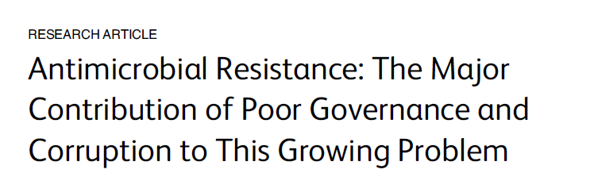
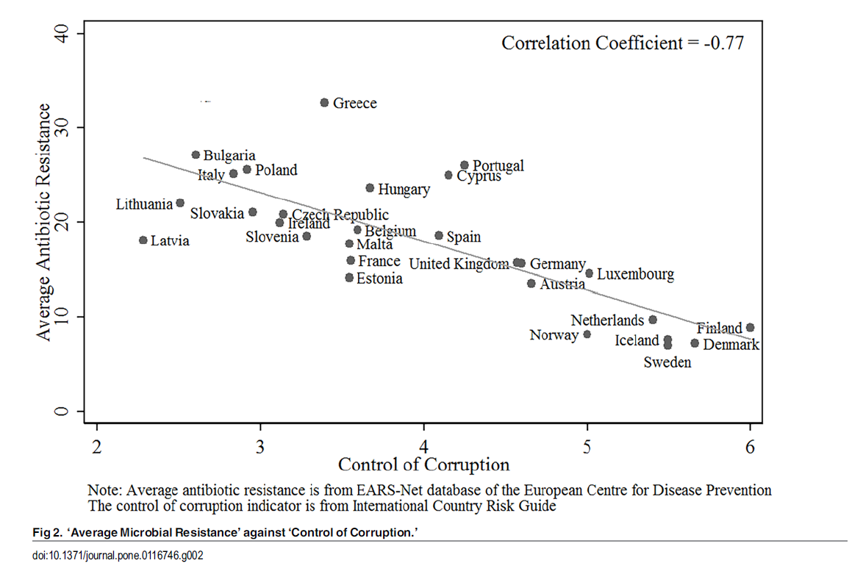
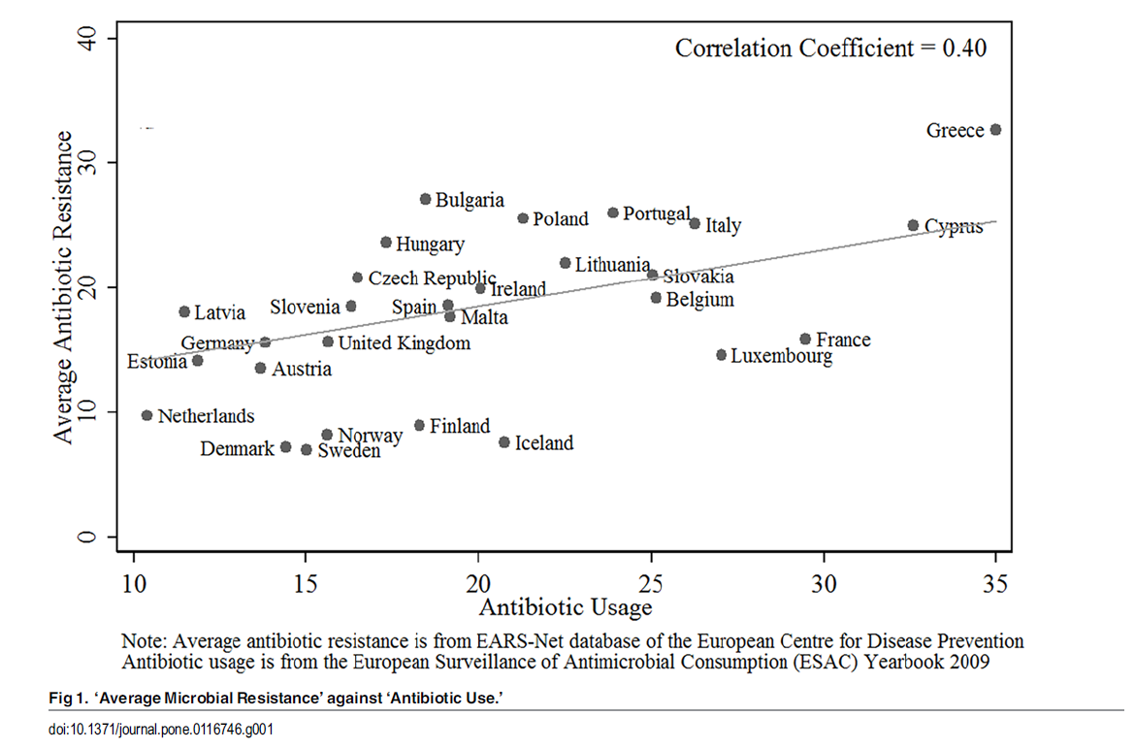
Non medical factors
Only 28% of the total variation in antibiotic resistance among countries is attributable to variation in antibiotic usage
Corruption is the main socioeconomic factor that explains antibiotic resistance
The income level of a country appeared to have no effect on resistance rates in the multivariate analysis
Collignon, PlosOne 2015

Slide 24

Priority Pathogens List
AMR Global R&D Priority Pathogens
Methodology
The WHO Department of Essential Medicines and Health Products launched a tender project to develop a list of global R&D priorities with respect to resistant pathogens
The project will contribute to the development of a Global R&D Priority Pathogens List which, in turn, will feed in to global R&D priorities for effective antibiotic treatments
Inclusive of countries, stakeholders, regulatory agencies, and expertise
Evidence-based
Not to be limited to human data
Flexible in order to easy integrate new important data and to be regularly updated
Notes:
Assessment on ATBS in isolation rather than as part of a bundle of interventions / phased introduction of individual measures over time
Trials with concurrent controls to avoid recognised biases
Studies in endemic areas and immunocompromsed
Studies in community and healthcare setting
Specific bundle for Pseudomonas and Klebsiella
Development of new indicators for outcome assessment

Slide 25
Keys actions
Antibiotic resistance is an adverse effect of antibiotic therapy.
Antibiotic prescription and stewardship must be pillars of the medical education.
Surveillance systems must be representative and connected among countries and with animal / food surveillance.
Significant improvements cannot be achieved without political and cultural changes.

Slide 26






Acknowledgments
Primrose Beryl
Deepthi Kattula
Andrea Cona
Pari Shamnsrizi
Giuseppe Marasca
Elena Carrara
Alessia Savoldi
Francesco Burkert
Yehuda Carmeli
Stephan Harbarth
Herman Goossens
Johan Mouton
Nicola Magrini
Evelina.Tacconelli@med.uni-tuebingen.de
@EveTacconelli

