Slide 1
Overview of PATENTSCOPE
Online
August
2020
Sandrine Ammann
Marketing & Communications Officer

Slide 2
Click this button if you can hear my voice and see my screen

Slide 5
Questions/concerns
patentscope@wipo.int

Slide 6
SEARCH
PATENTSCOPE
WIPO’s free patent database
TOOLS
BROWSE

Slide 7
Search

Slide 8
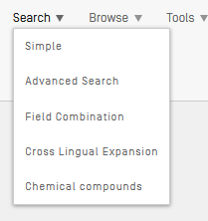
Search

Slide 9
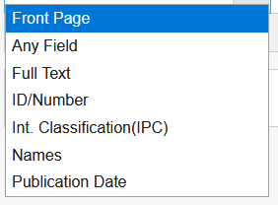
Search: Simple

Slide 10
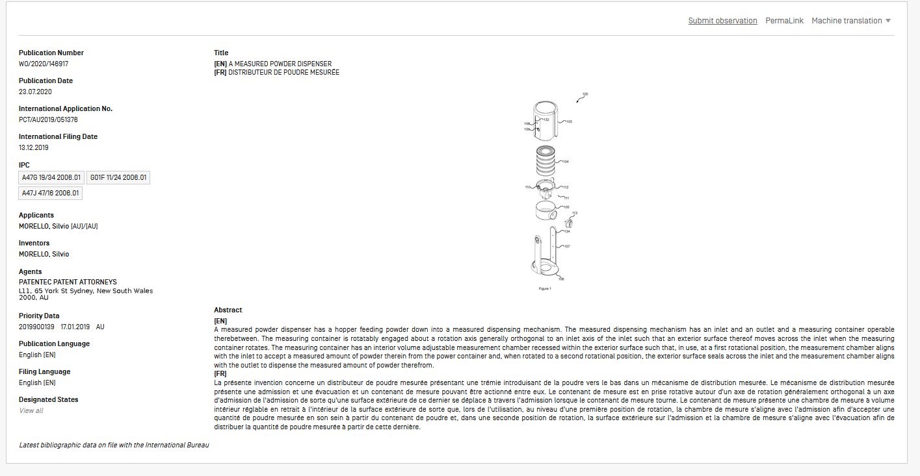
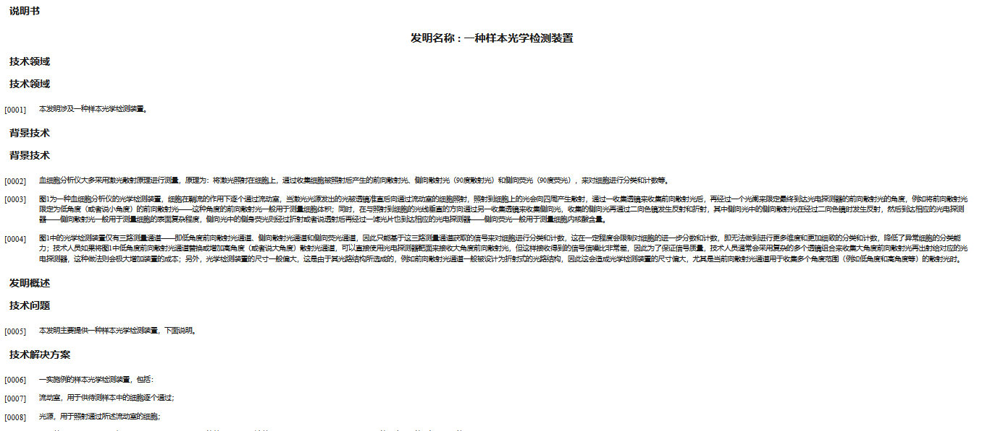

Slide 11
Search
bicycle – electric bicycle – «electric bicycle»
electric NEAR bicycle
electric NEAR bicycle AND campagnolo AND 2017

Slide 12
Search

Slide 13
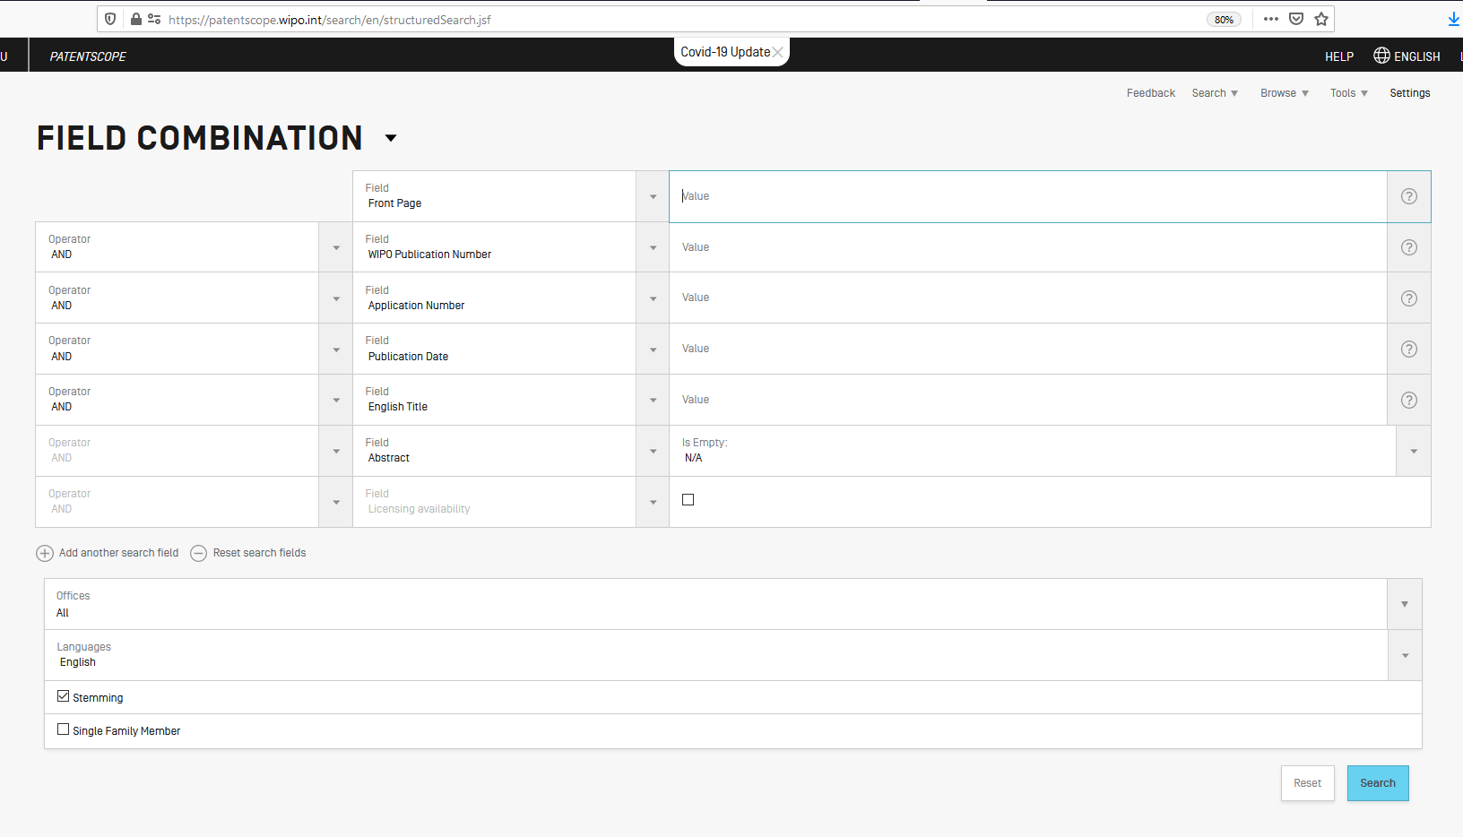
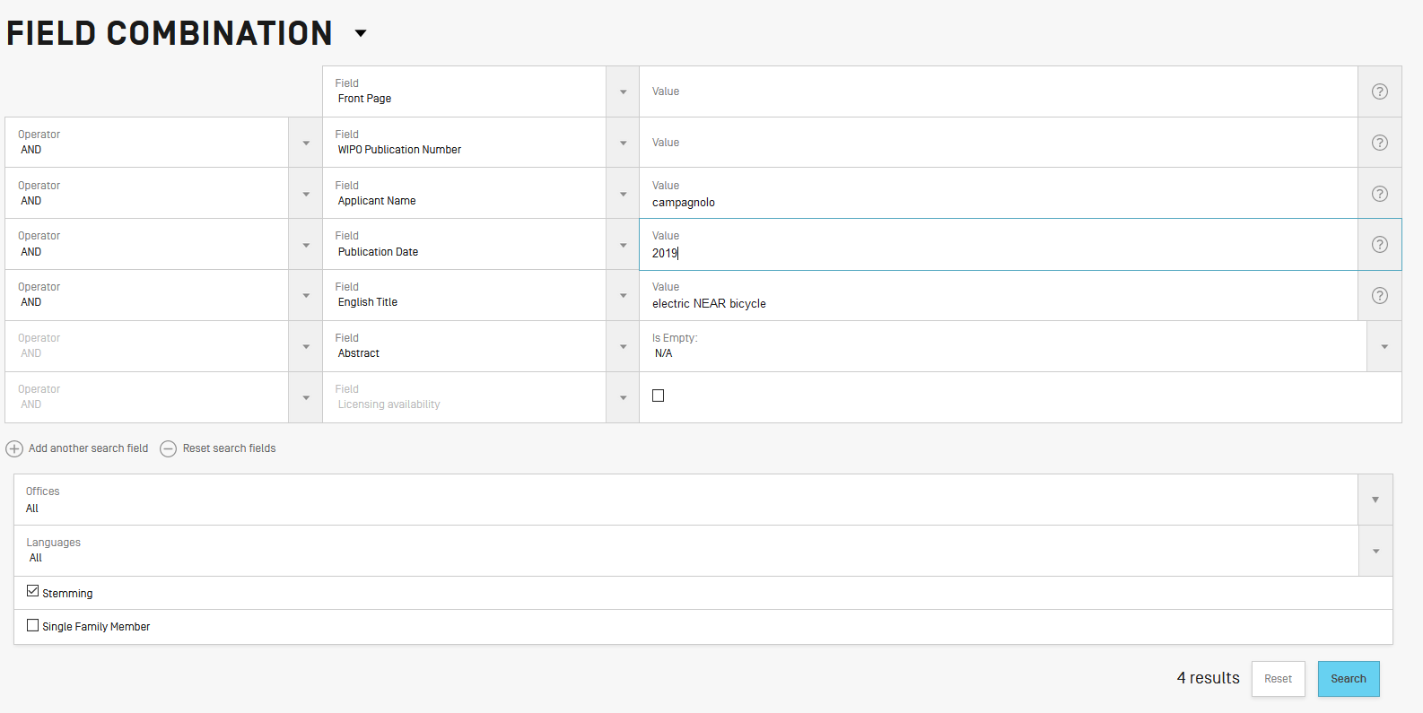
Search: Field Combination

Slide 14
Search

Slide 15
Search
Unlimited number of search terms
Boolean operators: AND, OR, NOT, ANDNOT
Proximity: NEAR, BEFORE
Range operators: […TO…], {…TO…}
Wildcards: ?, *
Weighting factor: ^

Slide 16
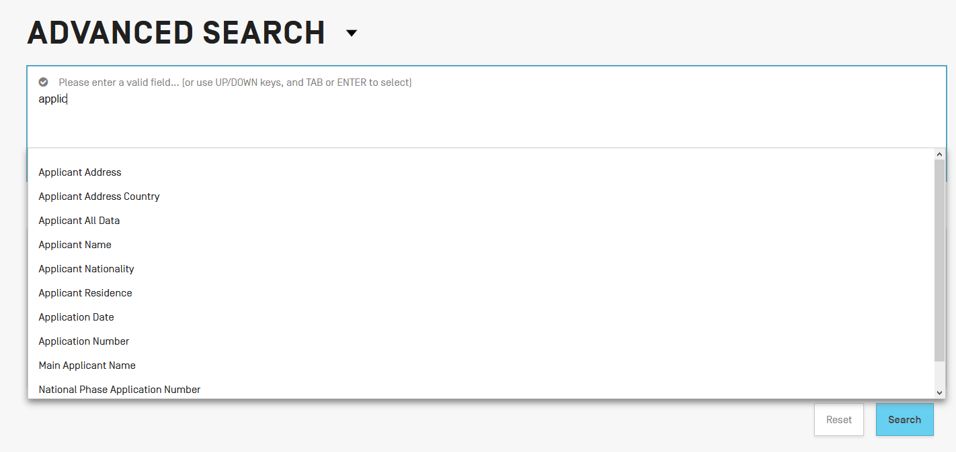

Slide 18
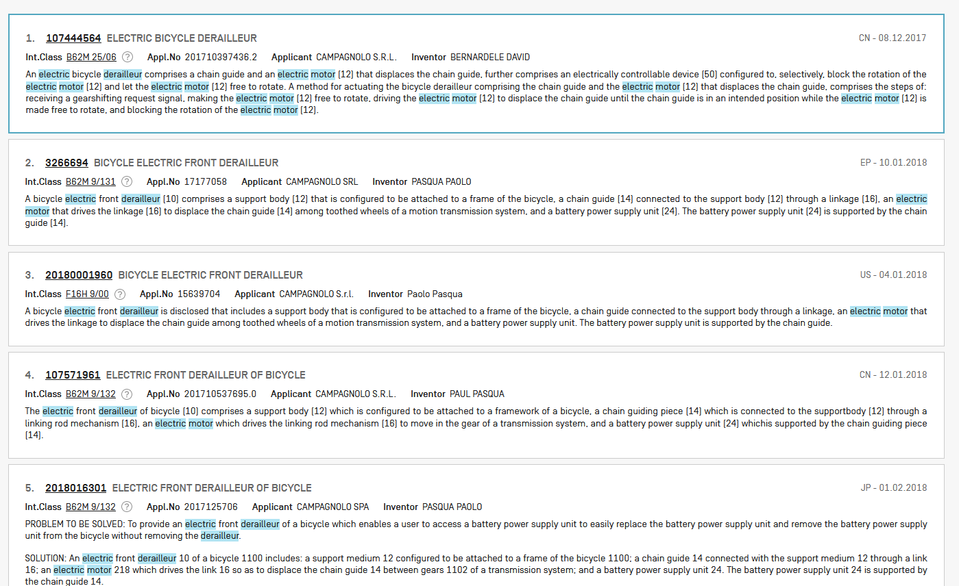

Slide 19
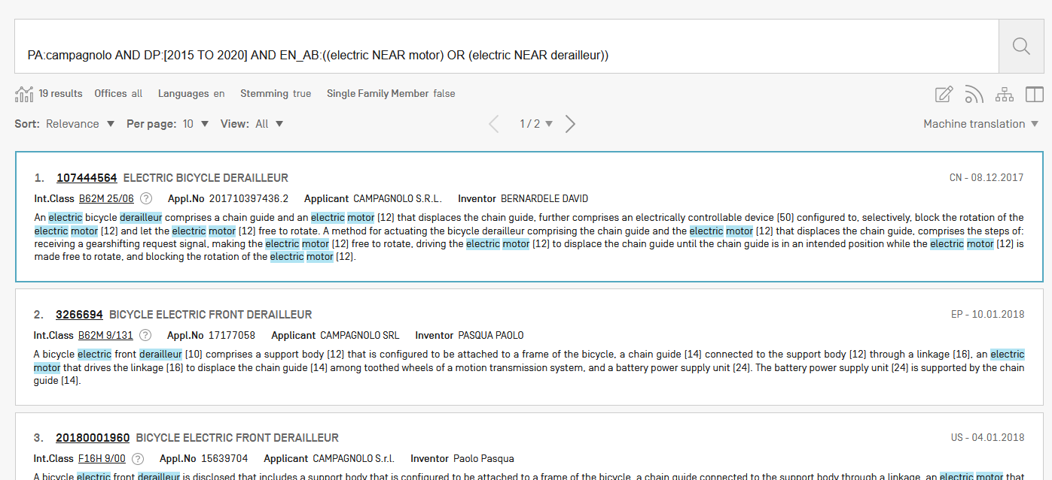
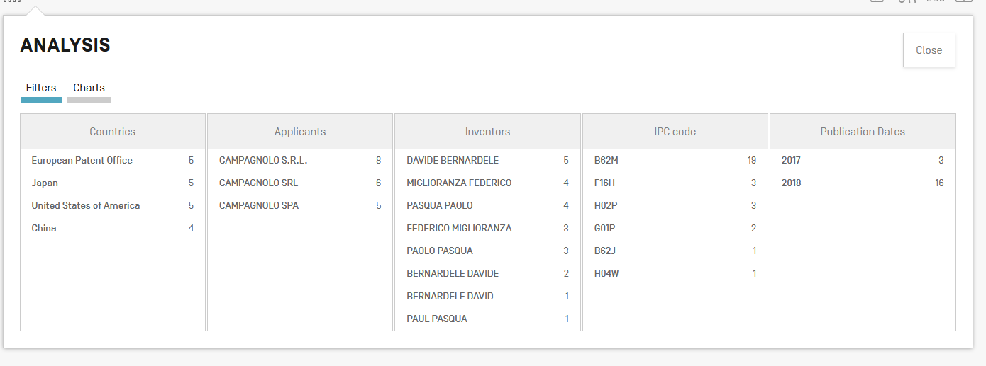

Slide 20
Search

Slide 21
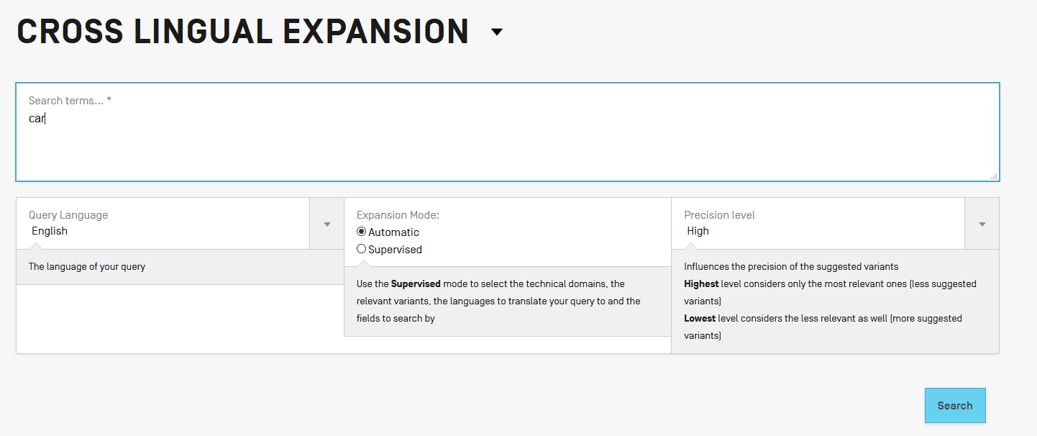
Search

Slide 22
Search

Slide 23
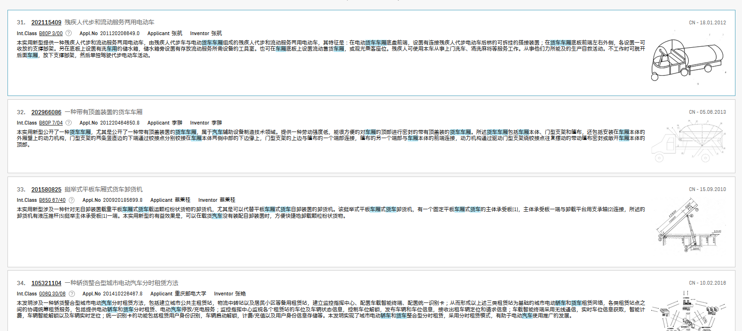
Search

Slide 24
Search

Slide 25
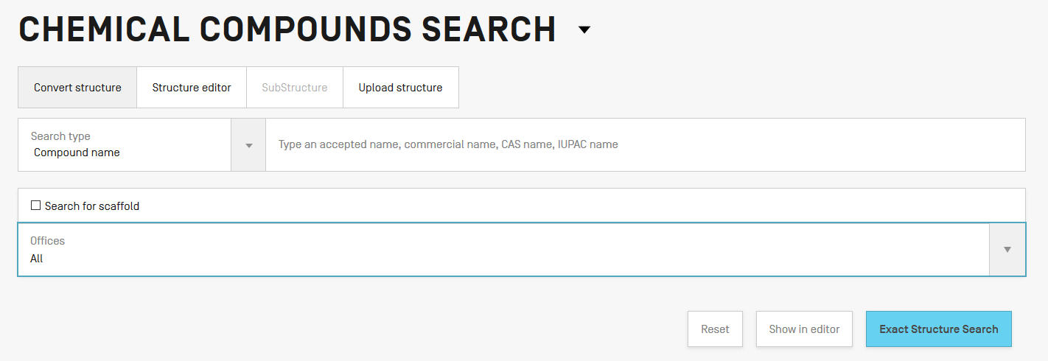
Search

Slide 26
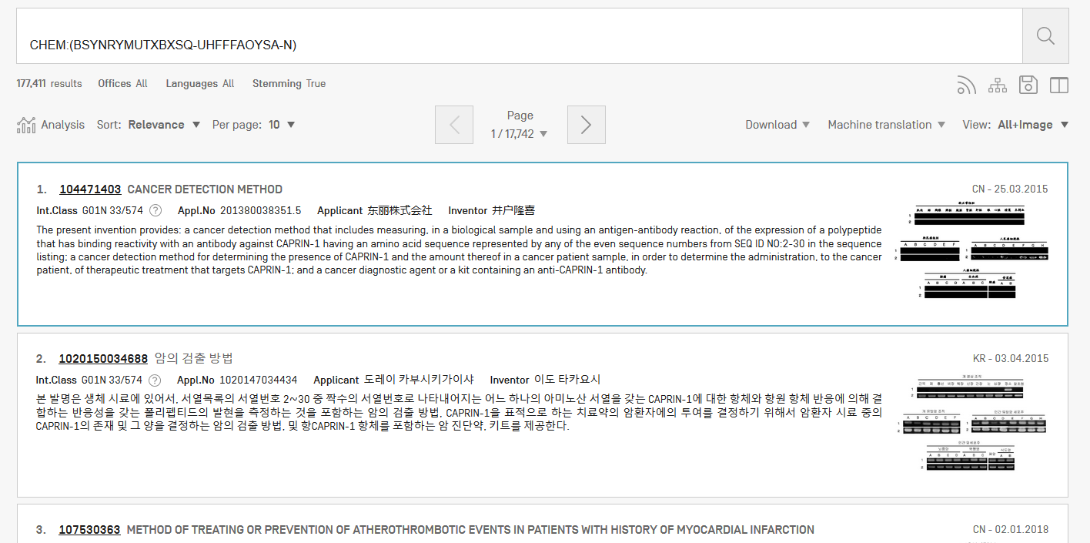
Results

Slide 27
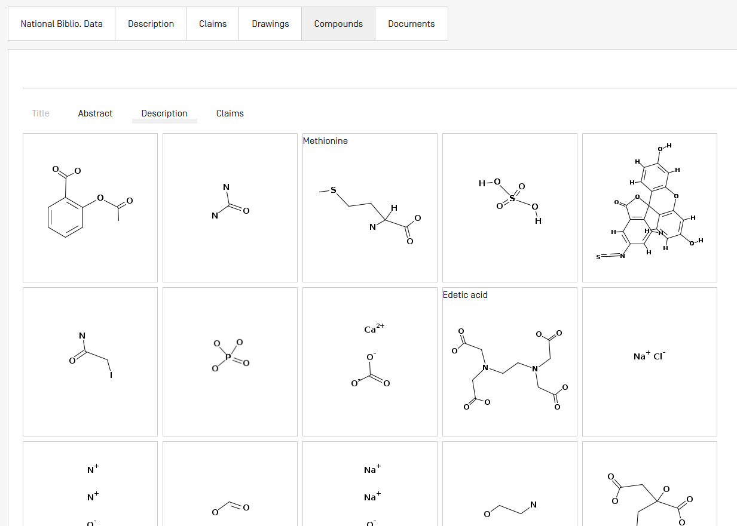

Slide 28
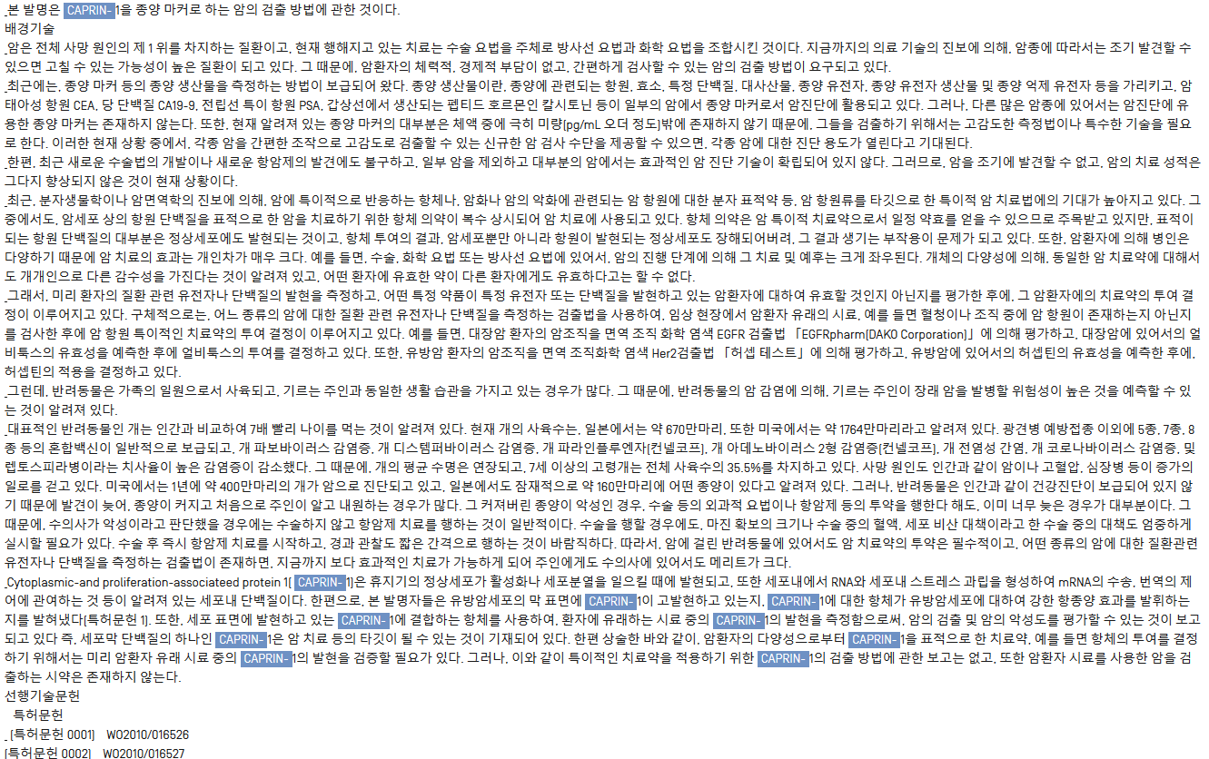

Slide 29
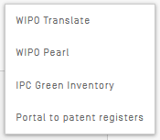
Tools

Slide 30
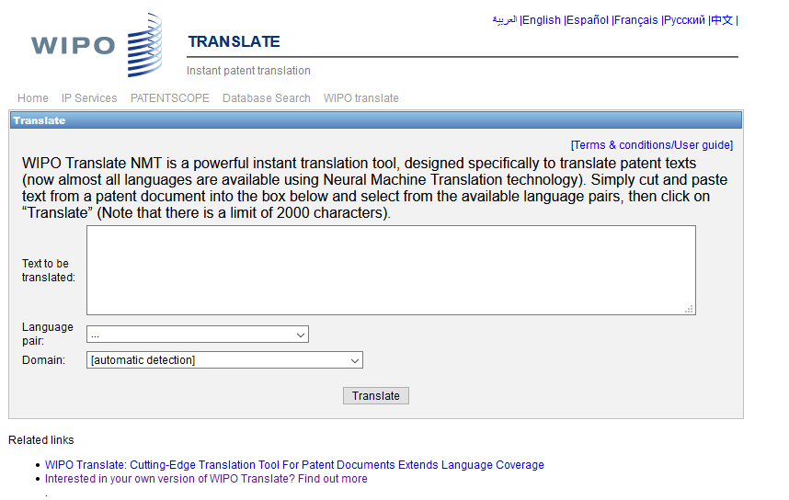
WIPO Translate

Slide 31
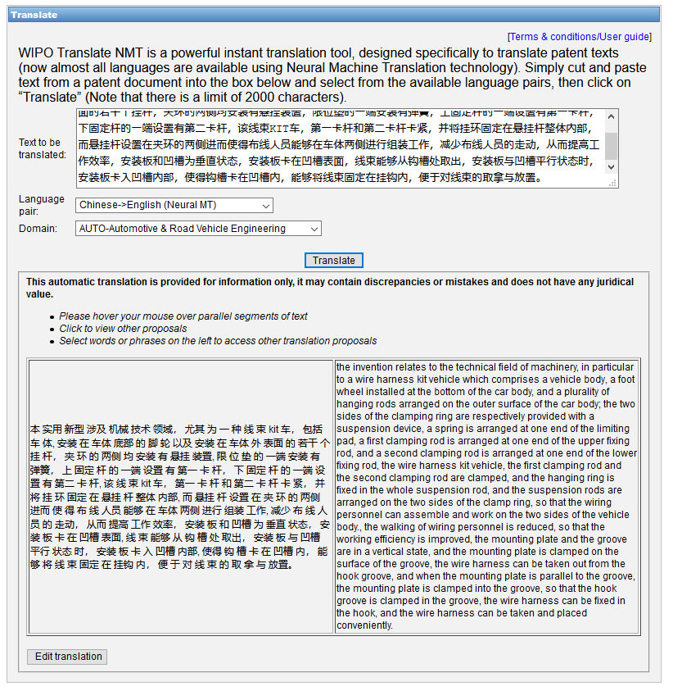

Slide 32
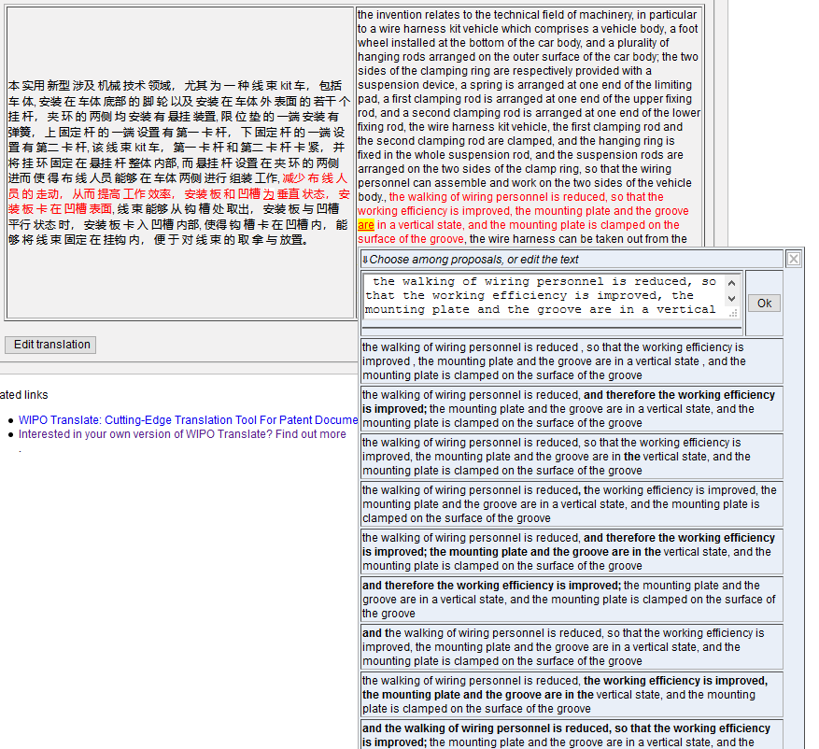

Slide 33
WIPO Pearl

Slide 34
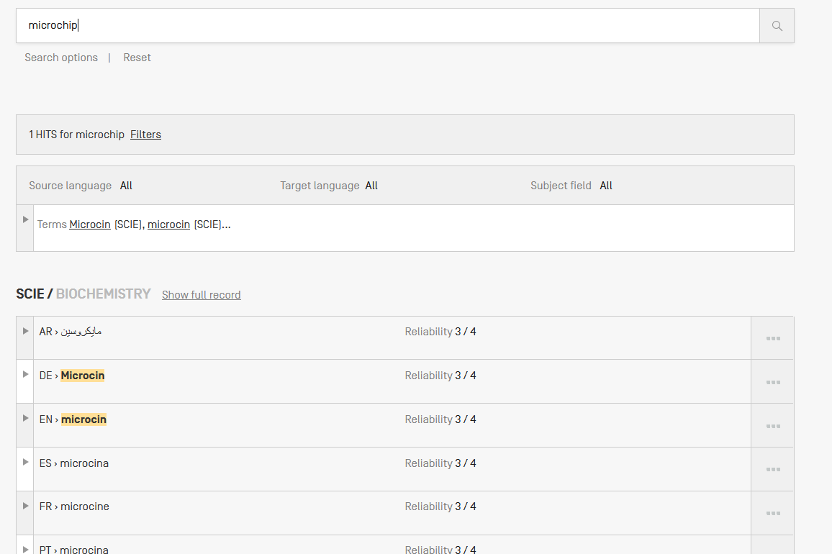

Slide 35
IPC Green Inventory

Slide 36
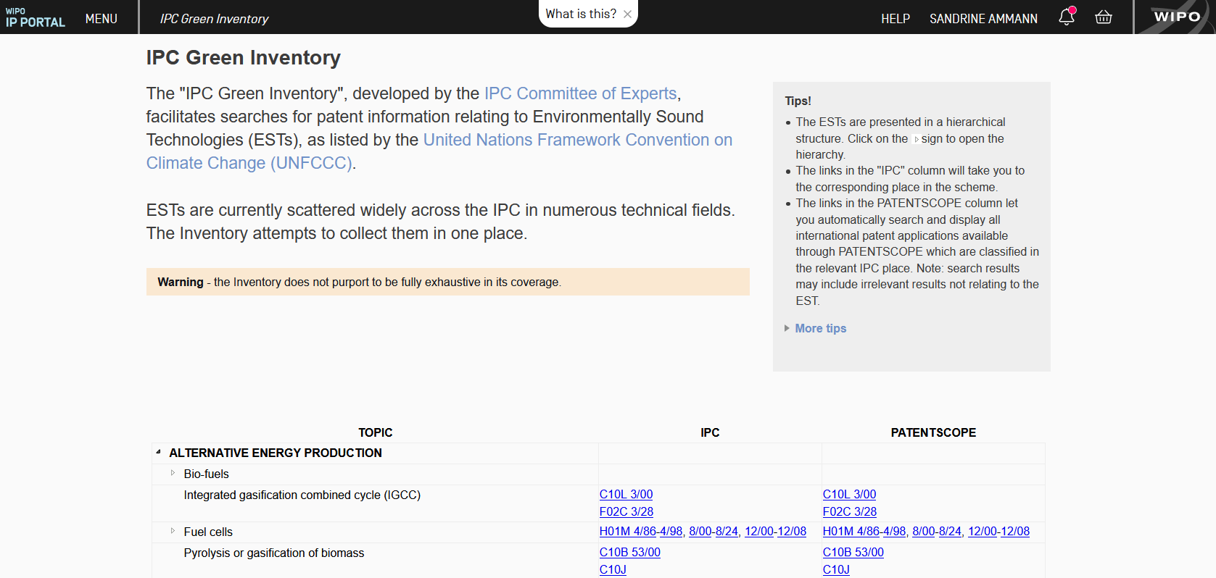

Slide 37
Patent Register Portal

Slide 38
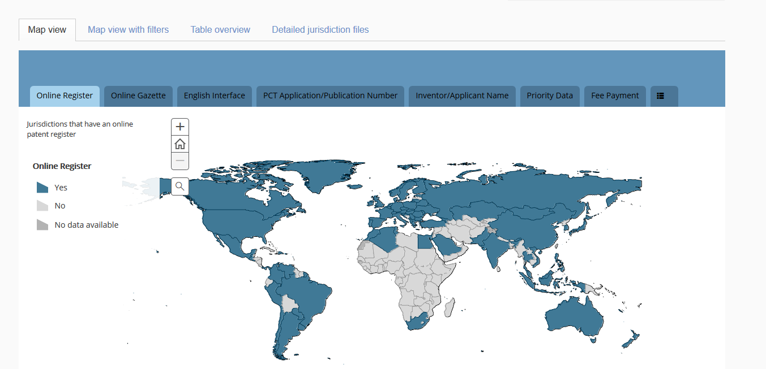

Slide 39
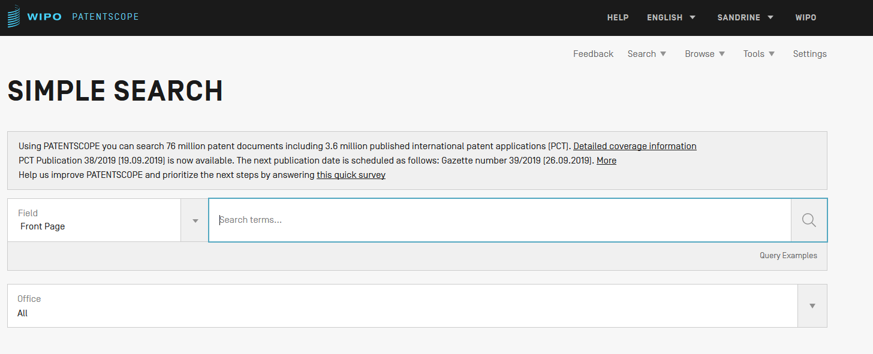
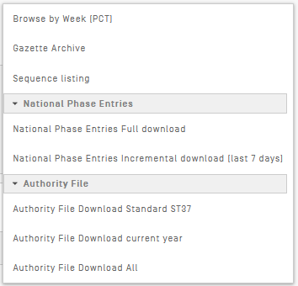
Browse

Slide 40
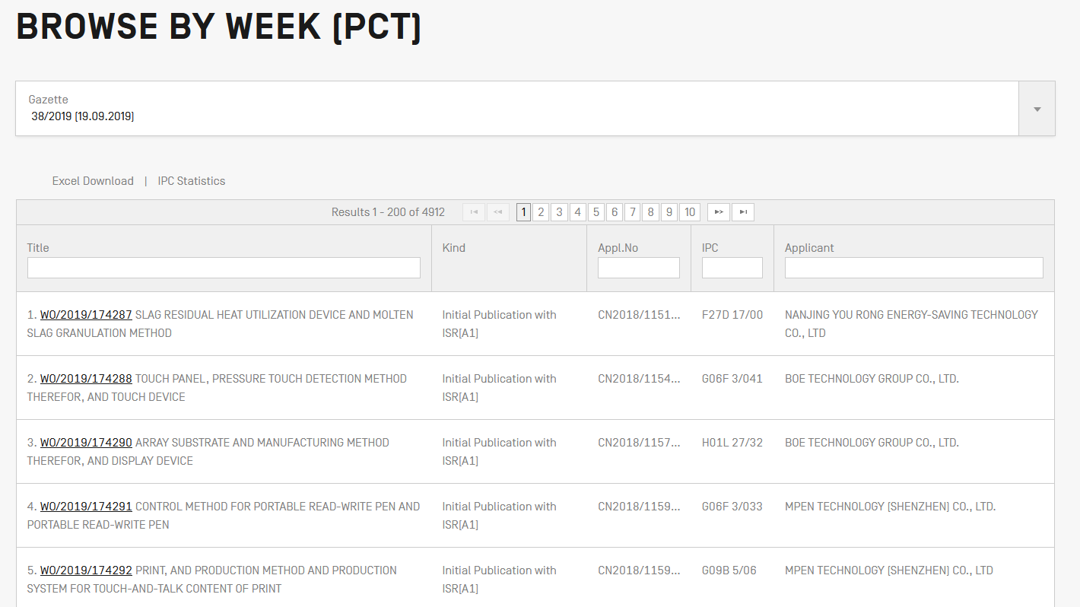
Browse

Slide 41
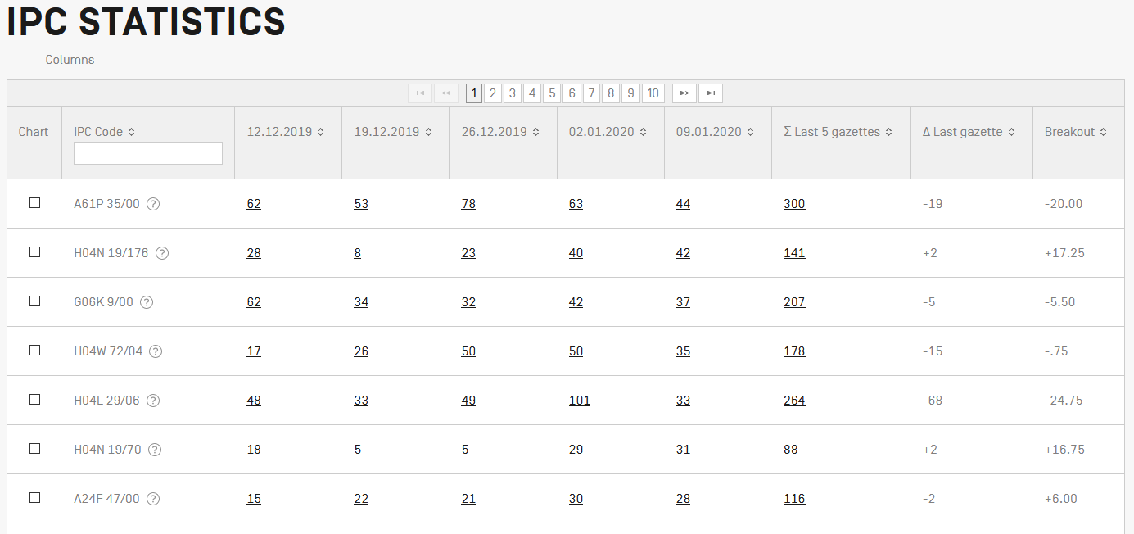
IPC Statistics
Browse

Slide 42
Browse

Slide 43
Browse

Slide 44
Browse

Slide 45
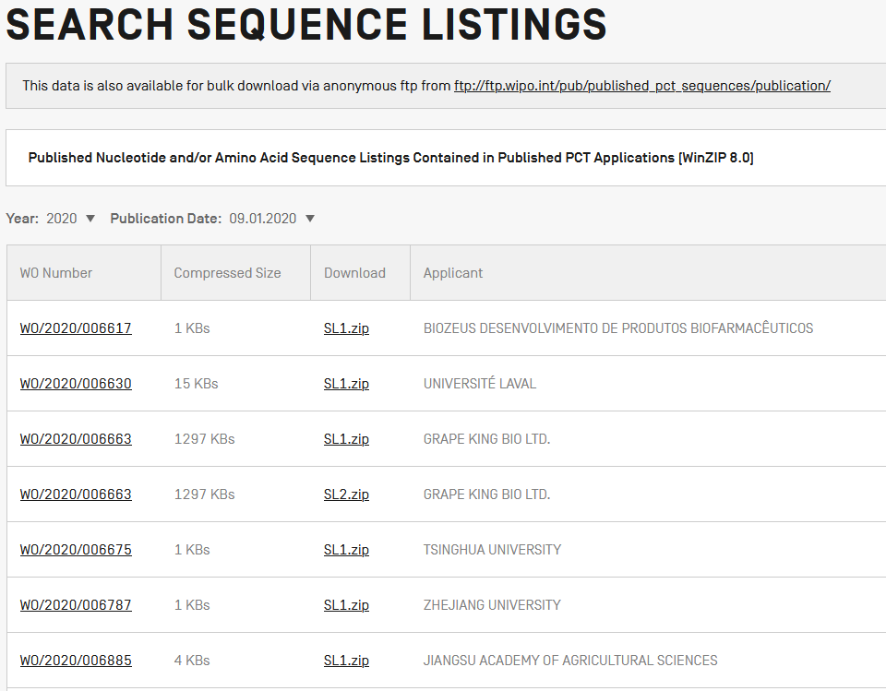

Slide 46
Browse

Slide 47
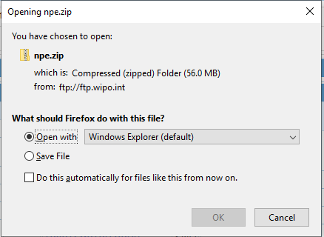

Slide 48
Browse

Slide 49
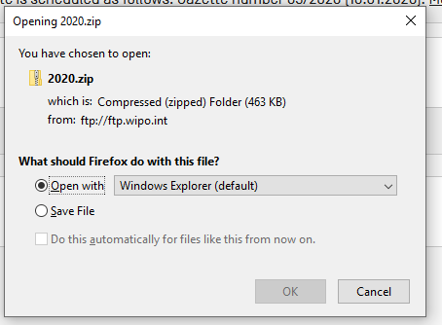

Slide 50
Content

Slide 51
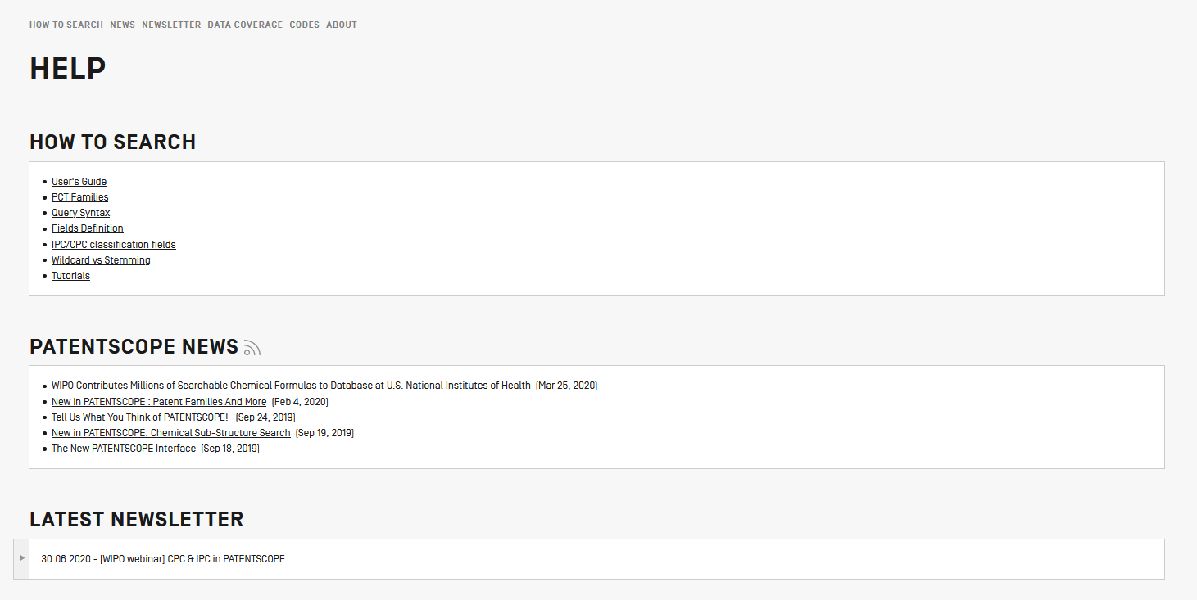

Slide 52
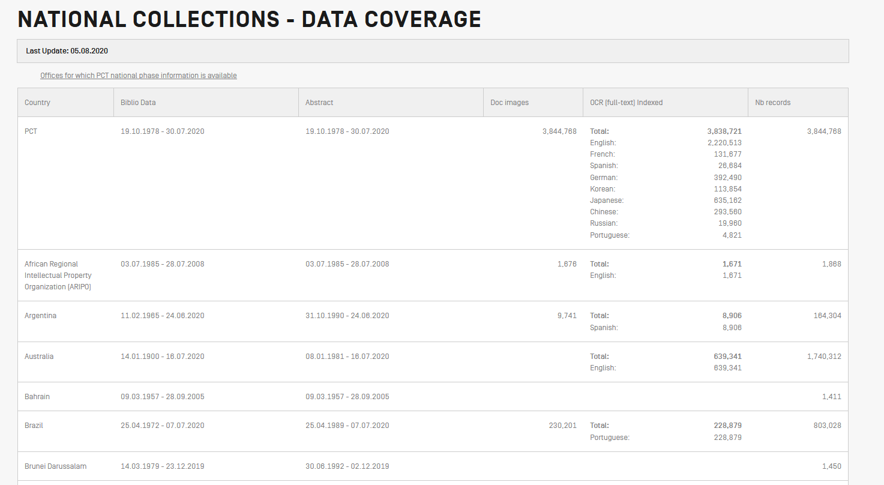
PCT: 3,844,768
Offices: 85,582,082
Overall: 89,426,850

Slide 53
Login-in/languages

Slide 54
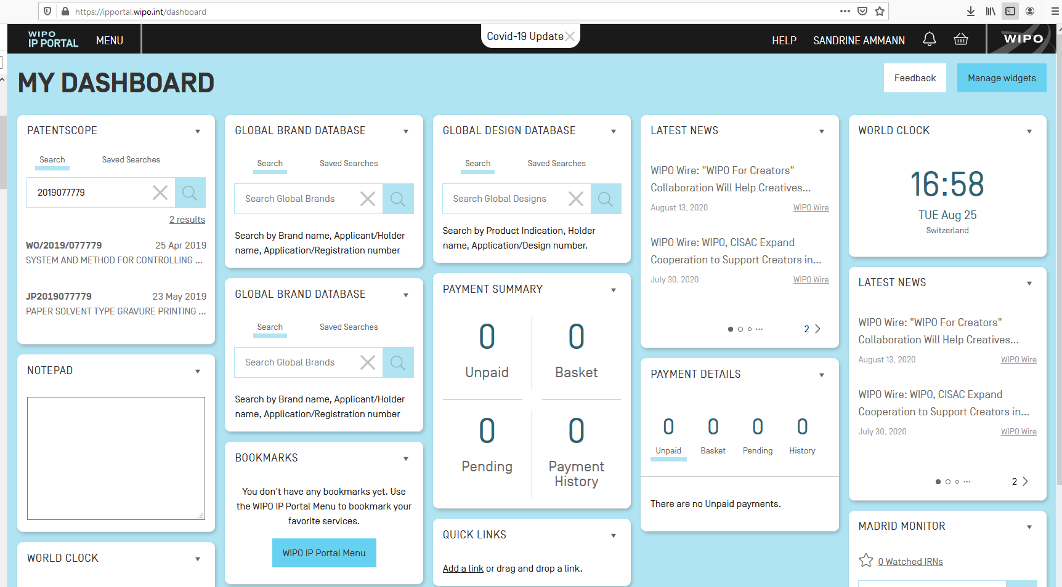
WIPO IP Portal
Notes:
The WIPO IP Portal is a new WIPO initiative aimed at harmonizing our services and simplifying your work. It is a one-stop shop for our full range of online intellectual property (IP) services. The underlying business processes will stay the same, so the way you conduct your interactions with WIPO will not change.
However, all services that are a part of the portal will now have a black navigation bar across the top like you saw in PATENTSCOPE This way, you always have access to the same options, no matter what service you are currently using. All services that are a part of the portal can now be accessed using the same WIPO Account. Log in to one service and you remain logged in to all services. You can navigate freely between them without the need to log in again.
The WIPO IP Portal offers a new widget-based dashboard for logged in users, providing an overview of and shortcuts to existing IP services as well as a summary of transactions, portfolios and outstanding actions. Widgets are not meant to replace the services but rather to present summary information from them and they allow you to perform simple actions.

Slide 55
Next webinar: September 8 or 10
Chemical searches in PATENTSCOPE
To register: https://www.wipo.int/patentscope/en/webinar/
September 24, 2020: paying expert chemical webinar

Slide 56
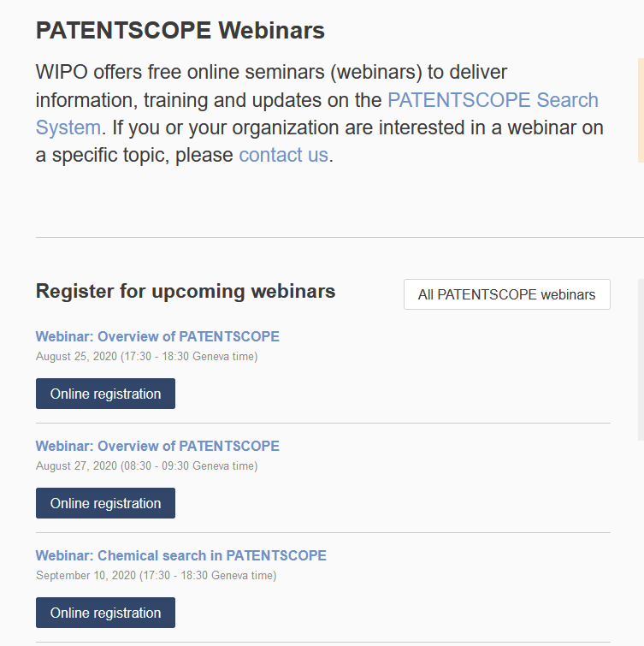
wipo.int/patentscope/en/webinar

Slide 57
Global Brand Database: webinar
An overview
September 22 at 5:30pm CEST
https://www.wipo.int/reference/en/branddb/webinar/index.html

Slide 58
Global Design Database: webinar
An introduction
September 30 at 5:30pm CEST
https://www.wipo.int/reference/en/branddb/webinar/index.html

Slide 59
patentscope@wipo.int

Slide 61
patentscope@wipo.int

