Slide 1
PATENTSCOPE
Translation tools
March
2018
Sandrine Ammann
Marketing & Communications Officer

Slide 2
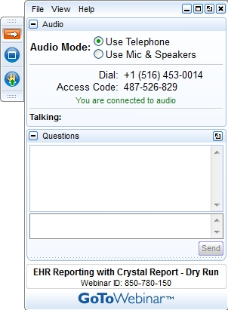

Slide 3


Slide 4
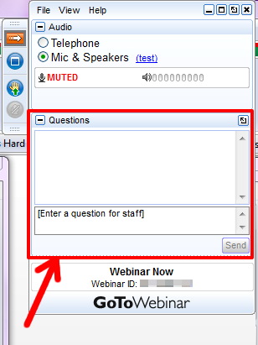

Slide 5
Questions/concerns
patentscope@wipo.int

Slide 6
Agenda
Latest addition
Translation tools
  WIPO Translate
Next webinar
Q&A session

Slide 7

Latest collection added

Slide 8
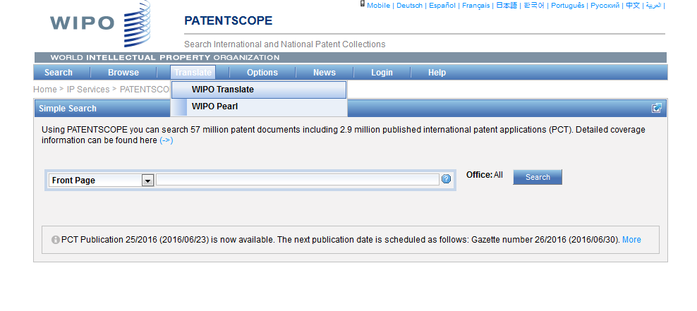
WIPO Translate

Slide 9
WIPO Translate before/after
发明公布了一种通过在不同位置摆放现实物体来演奏音乐的娱乐装置
invention discloses
one kind by this
of mean
different location
placing real object
by/for
play music
of
entertainment
device

Slide 10
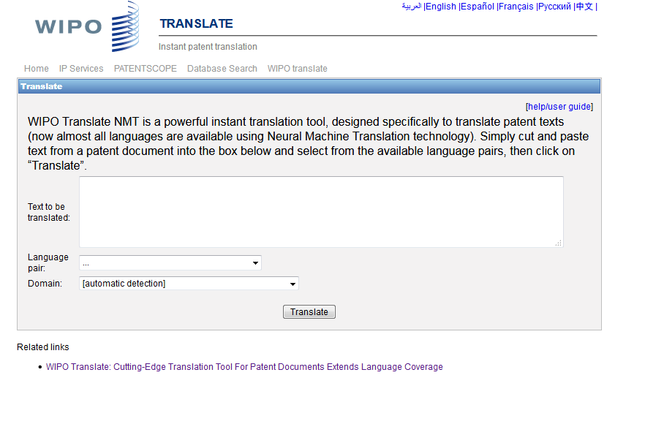

Slide 11
18 Language pairs
Arabic – English English-Arabic
Chinese – English English - Chinese
French – English English - French
German – English English - German
Japanese – English English - Japanese
Korean – English English - Korean
Portuguese – English English - Portuguese
Russian – English English - Russian
Spanish – English English - Spanish

Slide 12
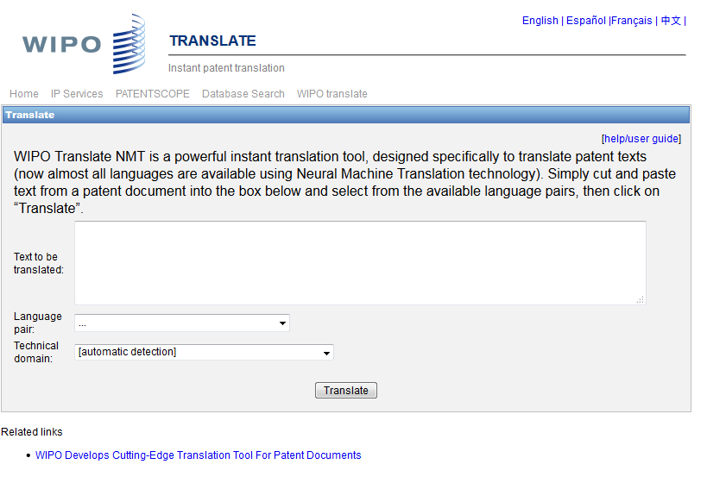
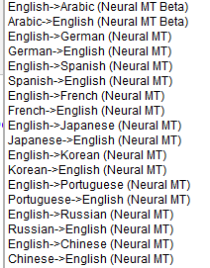

Slide 13

32 Technical domains from the IPC
[ADMN] Admin, Business, Management & Soc Sci
[AERO] Aeronautics & Aerospace Engineering
[AGRI] Agriculture, Fisheries & Forestry
[AUDV] Audio, Audiovisual, Image & Video Tech
[AUTO] Automotive & Road Vehicle Engineering
[BLDG] Civil Engineering & Building Construction
[CHEM] Chemical & Materials Technology
[DATA] Computer Sci, Telecom & Broadcasting
[ELEC] Electrical Engineering & Electronics
[ENGY] Energy, Fuels & Heat Transfer Eng
[ENVR] Environmental & Safety Engineering
[FOOD] Foods & Food Technology
[GENR] Generalities, Language, Media & Info Sci
[HOME] Home Contents & Household Maintenance
[HORO] Precision Mechanics, Jewelry & Horology
[MANU] Manufacturing & Materials Handling Tech
[MARI] Marine Engineering
[MEAS] Standards, Units, Metrology & Testing
[MECH] Mechanical Engineering
[MEDI] Medical Technology
[METL] Metallurgy
[MILI] Military Technology
[MINE] Mining, Oil & Gas Extraction & Minerals
[NANO] Nano Technology
[PACK] Packaging & Distribution of Goods
[PRNT] Printing & Paper
[RAIL] Railway Engineering
[SCIE] Optical Engineering
[SPRT] Sports, Leisure, Tourism & Hospitality
[TEXT] Textile & Clothing Industries
[TRAN] Transportation

Slide 14
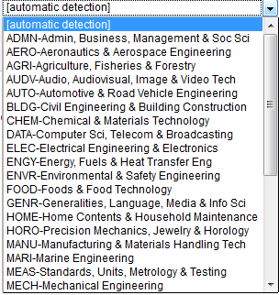

Slide 15
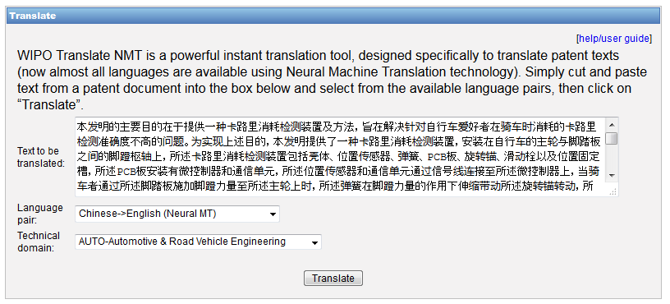
WIPO Translate: an example

Slide 16
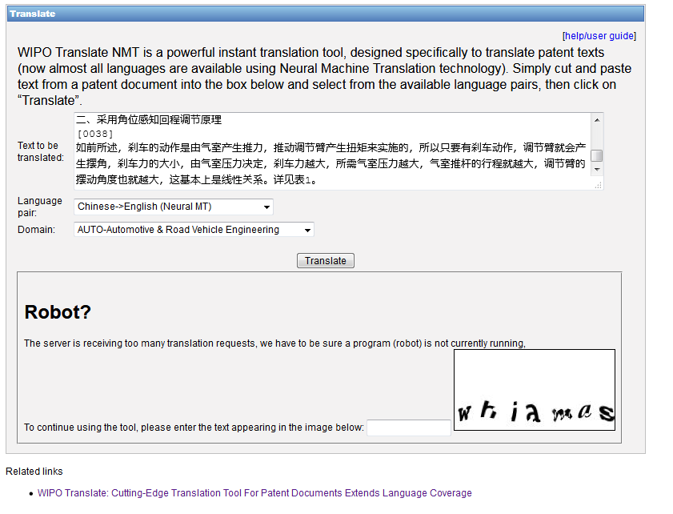

Slide 17
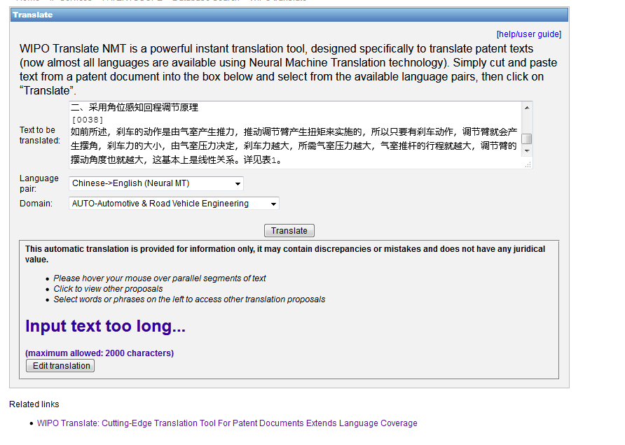

Slide 18
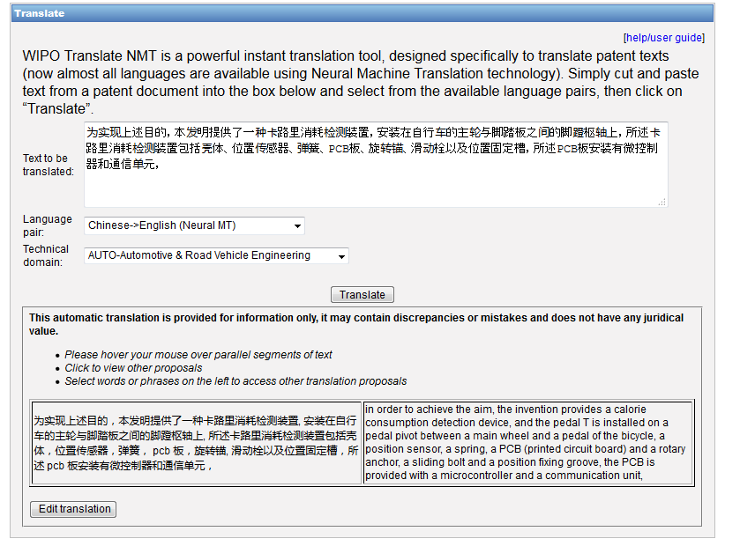

Slide 19
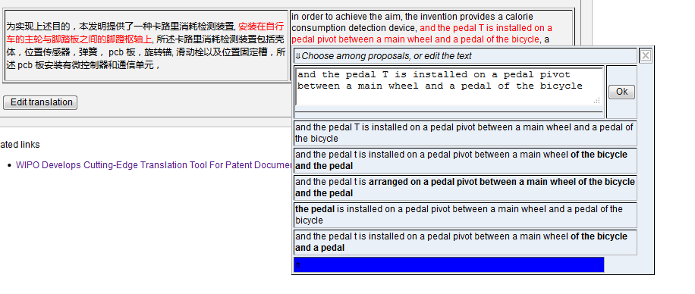

Slide 20
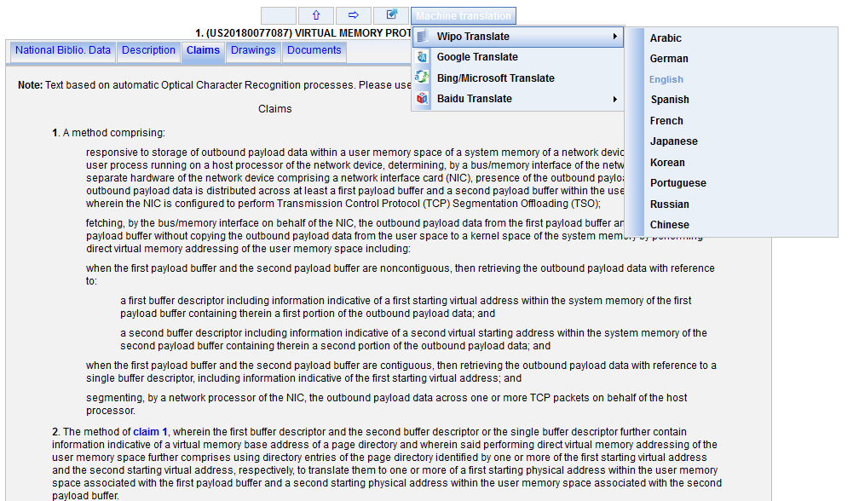
WIPO Translate: description/claims

Slide 21
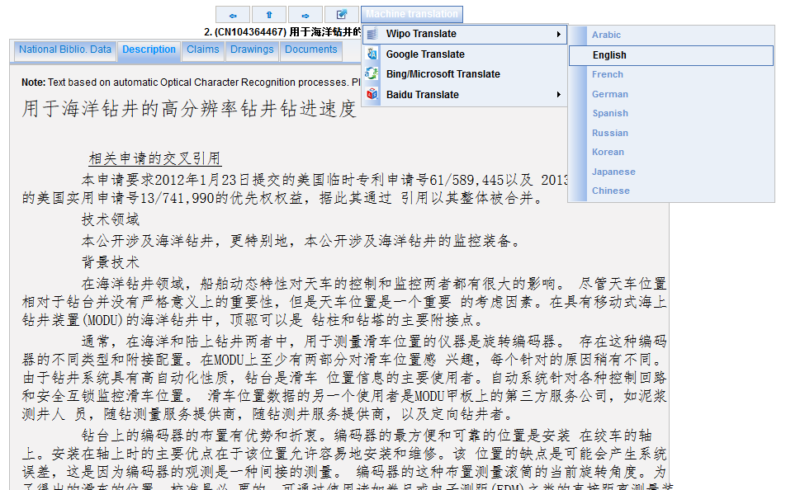

Slide 22
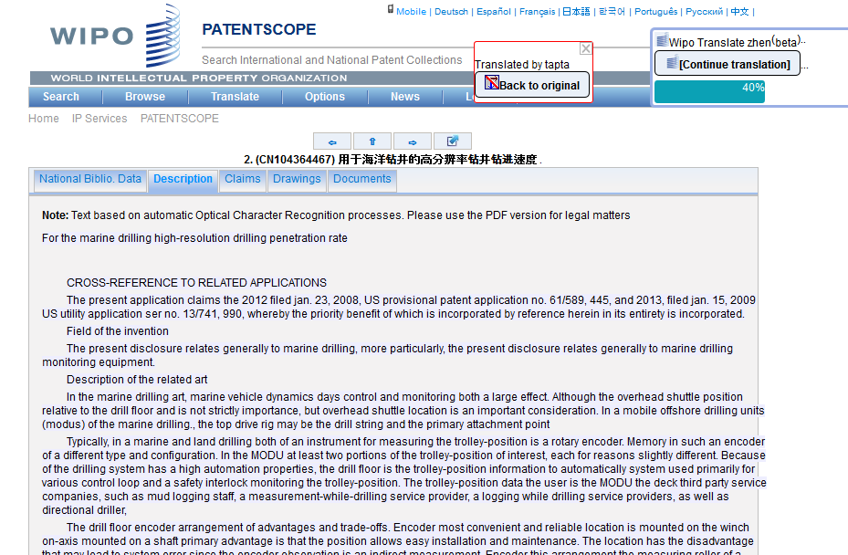

Slide 23
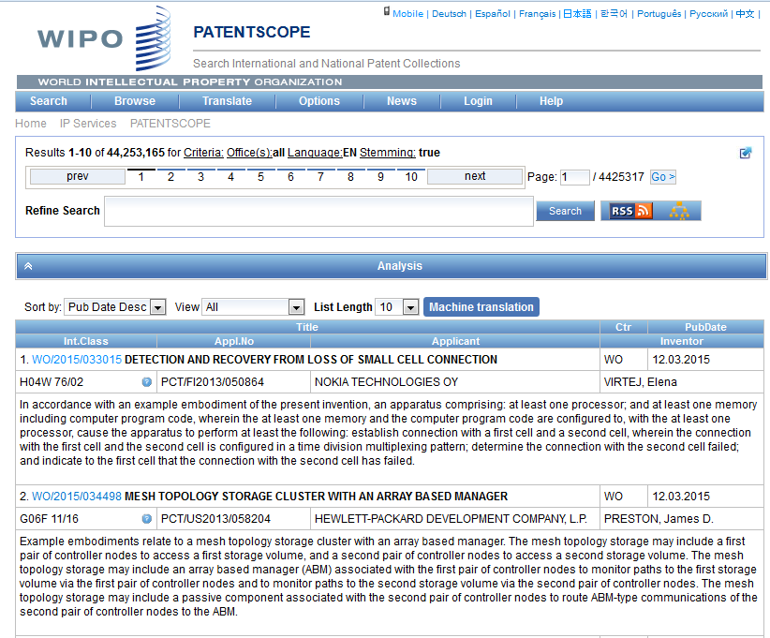
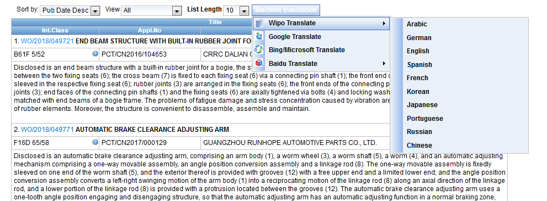
Result list

Slide 24
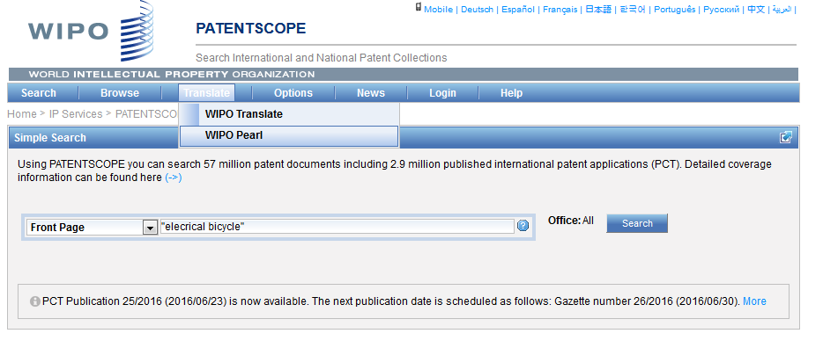
WIPO Pearl

Slide 25
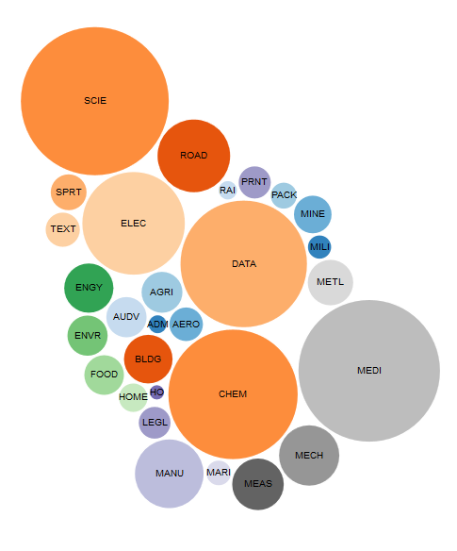
WIPO Pearl http://www.wipo.int/wipopearl/search/home.html

Slide 26

WIPO Pearl
WIPO’s online terminology database
17’000 concepts, 115’000 terms
10 languages
Contents validated by WIPO language experts and terminologists

Slide 27
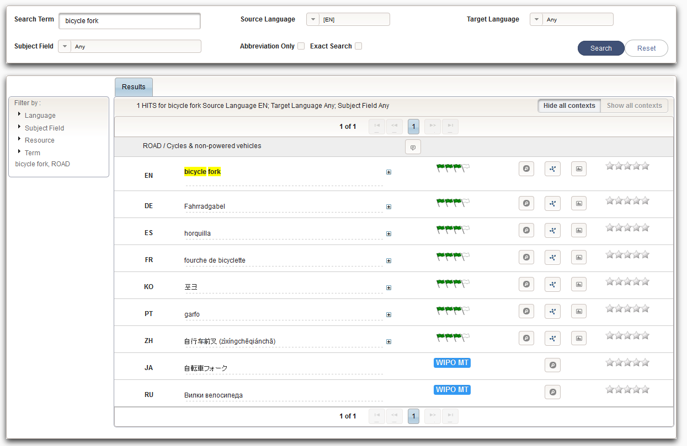
Example: bicycle fork

Slide 28
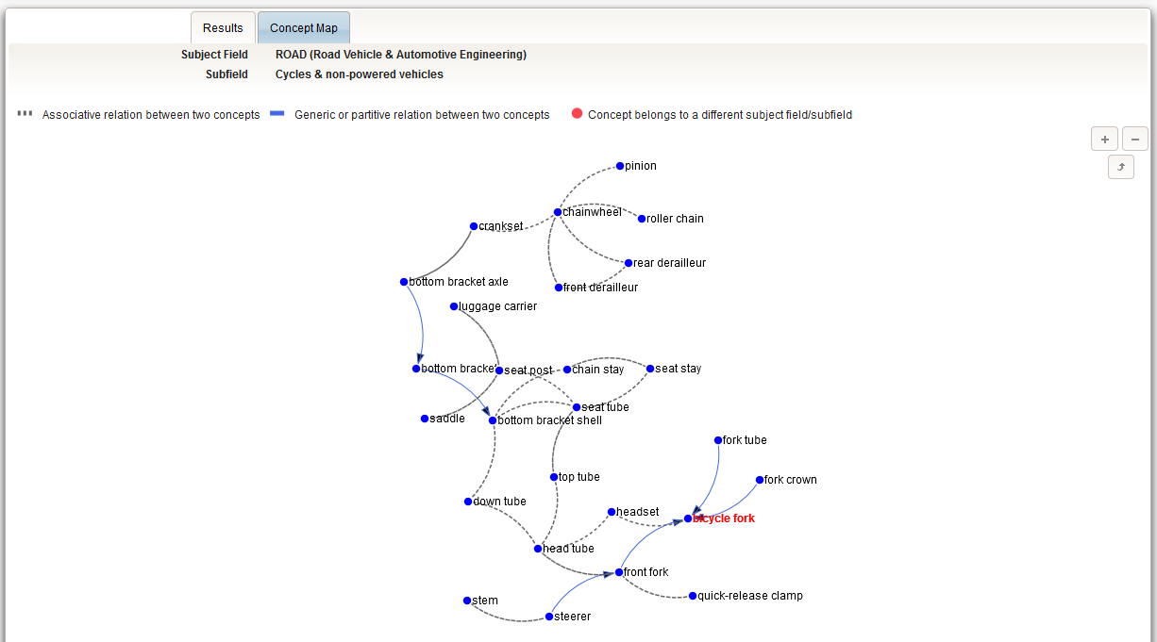

Slide 29
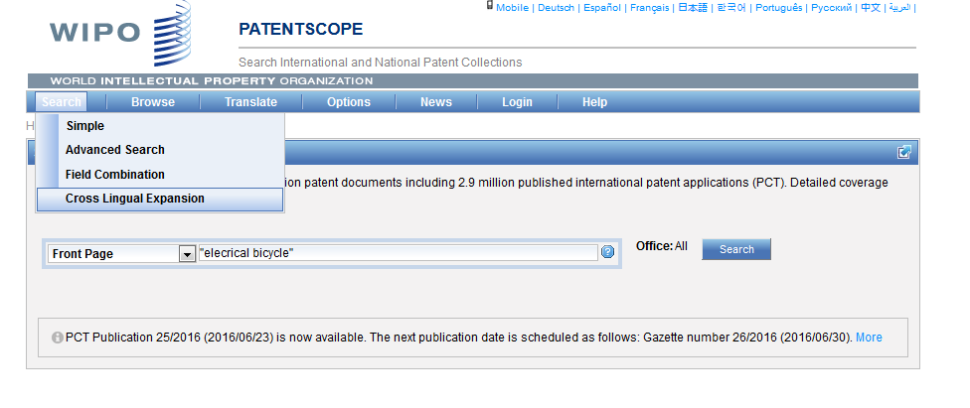
CLIR

Slide 30
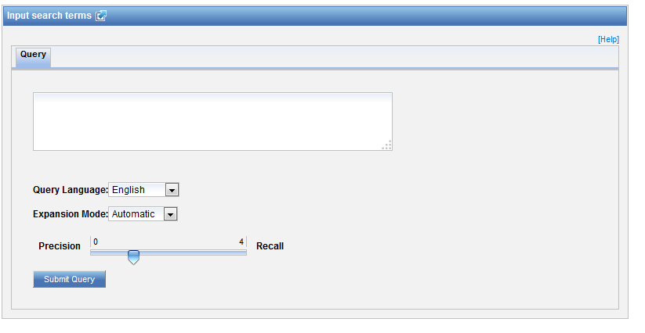
CLIR: interface

Slide 31
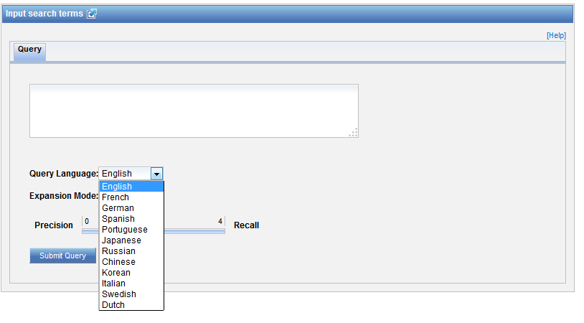
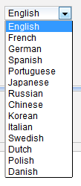
CLIR: query language

Slide 33
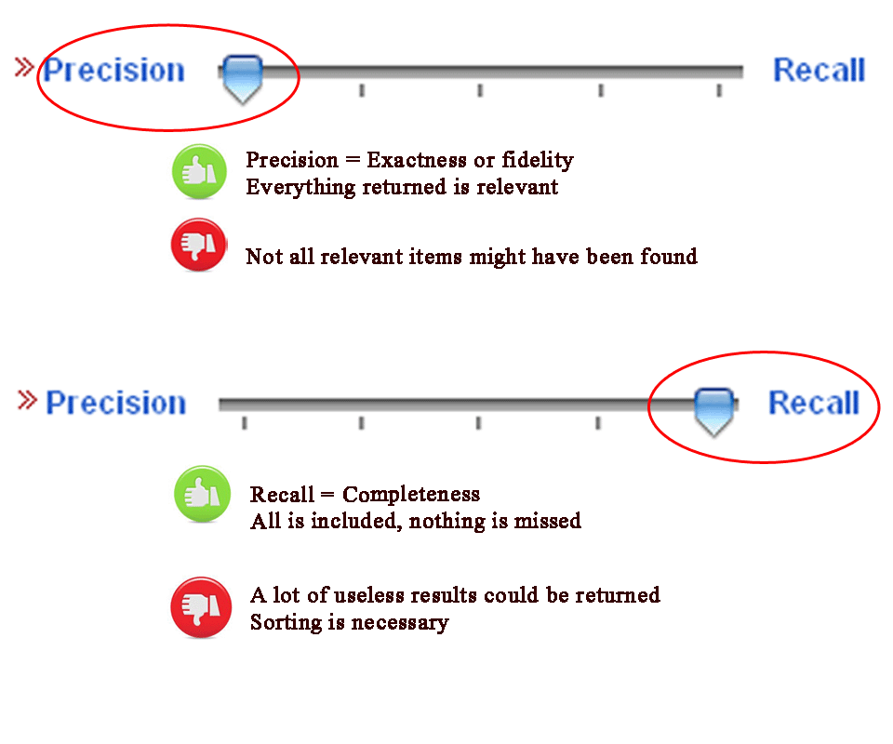
CLIR: precision vs recall

Slide 34
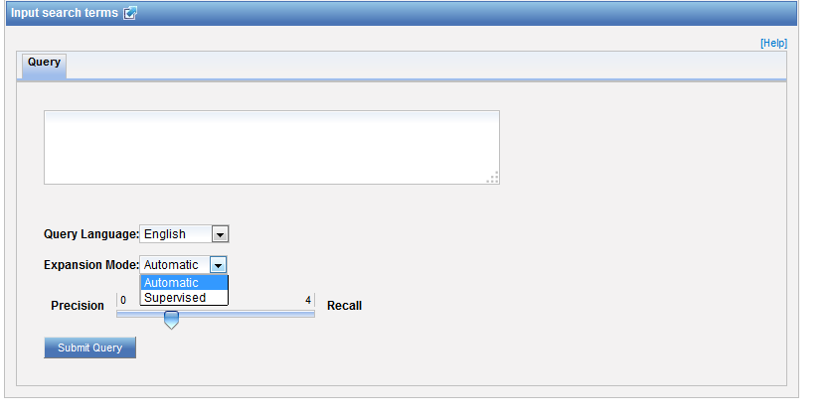
CLIR: expansion mode

Slide 35
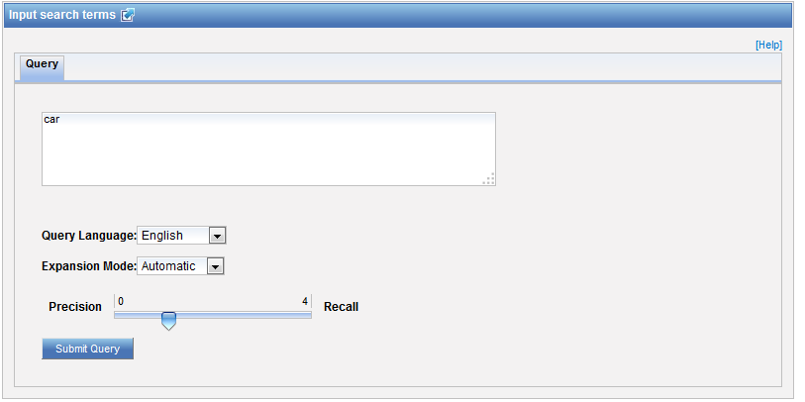
CLIR: an example

Slide 36
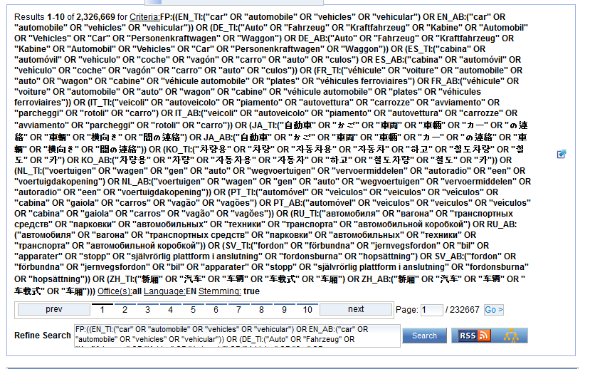
CLIR: an example

Slide 37
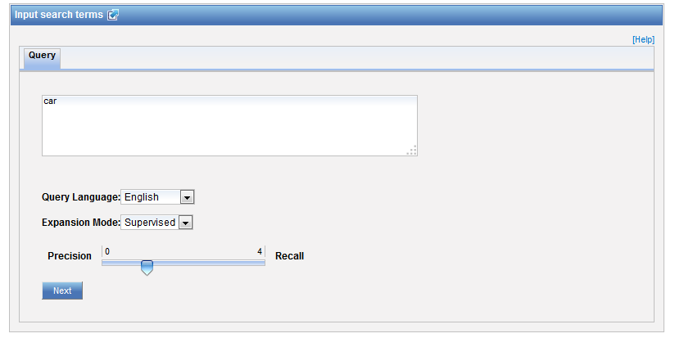
CLIR: supervised

Slide 38
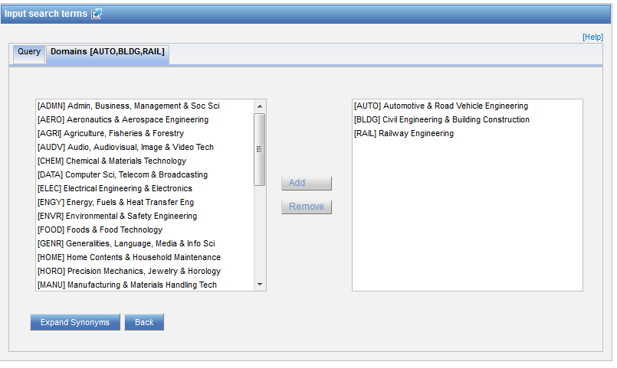
Domain selection

Slide 39
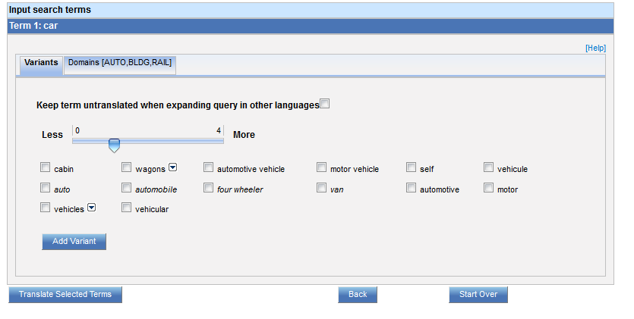
Variants selection

Slide 40
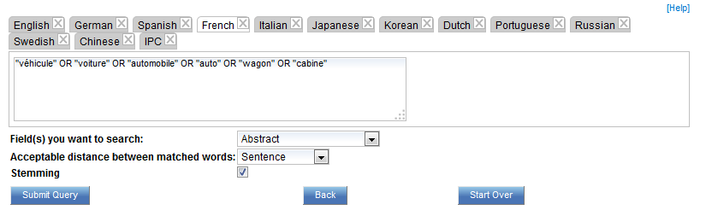
Summary of variants

Slide 41
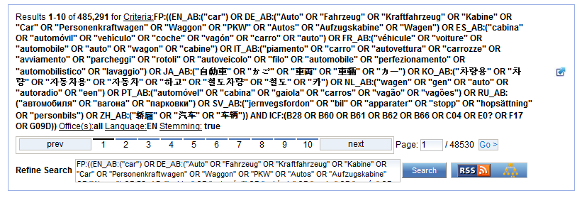
Results

Slide 42
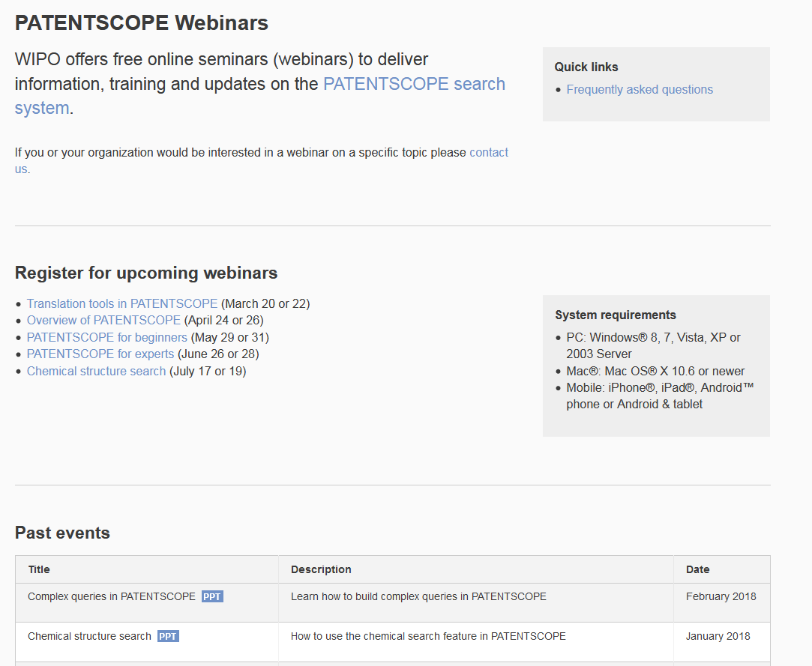
Future/past webinars:
wipo.int/patentscope/en/webinar

Slide 43
April webinar: Overview of PATENTSCOPE
Tue, April 24
8:30 AM - 9:30 AM CEST
Thu, April 26
5:30 PM - 6:30 PM CEST
To sign up:https://attendee.gotowebinar.com/rt/3755692414826051073

Slide 44
Global Brand Database: webinar
Performing effective searches in the Global Brand Database
  April 11 at 9:30 am CET
  https://attendee.gotowebinar.com/rt/8931489472329613057

Slide 45
Global Design Database: webinar
How to find a design using the Global Design Database
  May 23 at 9:30 am CET
  https://attendee.gotowebinar.com/rt/3487977827684331265

Slide 46


Slide 47

patentscope@wipo.int

