Slide 1
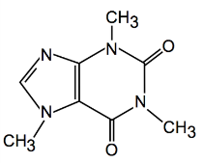
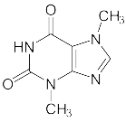
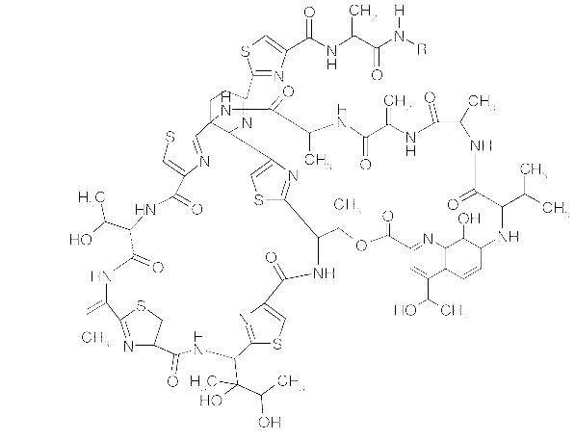
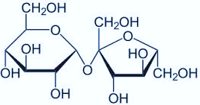
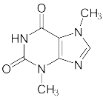
Chemical structure search in
PATENTSCOPE
September 2016
Sandrine Ammann
Marketing & Communications Officer

Slide 2
To this webinar:
Chemical structure search

Slide 3
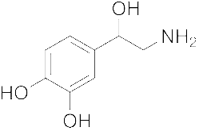
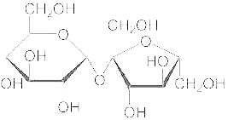
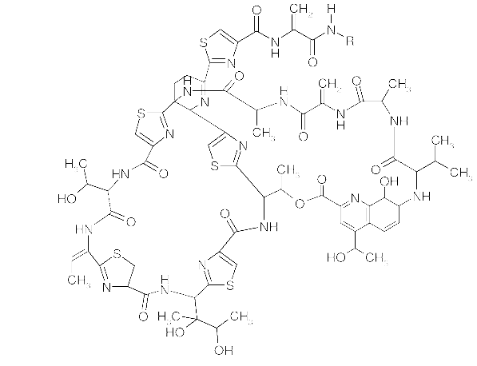
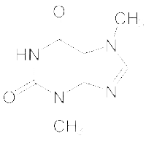
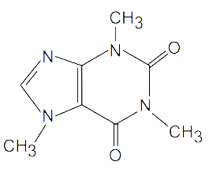
Agenda
Chemical structure search
Timeline
Access
How does it work?
Future plans
FAQs

Slide 4
Timeline
Official launch October 3rd, 2016

Slide 5
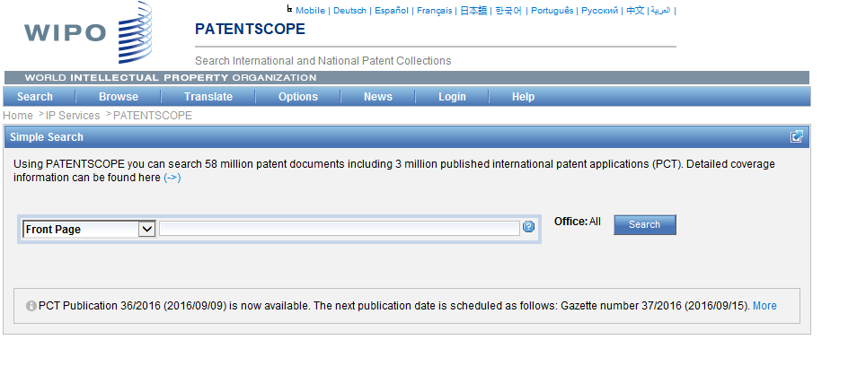
Access
Available at https://patentscope.wipo.int
Access only with a PATENTSCOPE account

Slide 6
The concept
Recognize the names of chemical compounds in patent texts and their structures from embedded drawings included in patent texts
Standardize all the different representations of chemical structures into InchIkeys
Implement search functions using InchIkeys that can be used by non chemists

Slide 7
InchIkeys
Definition: a short, fixed-length character signature based on a hash code of the InChI string.
InChIkeys provide a precise, robust, IUPAC* approved structure-derived tag for a chemical substance.
*International Union of Pure and Applied Chemistry

Slide 8
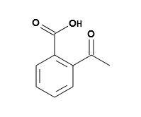
Example: InchI – InchIKey for aspirin

Slide 9
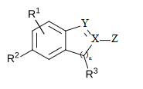
Scope
Works on developed exact formulas ≠ Markush structures (-R) that are chemical symbols used to indicate a collection of chemicals with similar structures.
PCT and US national (soon) collections
Languages: English and German

Slide 10
Limitations
Long automated procedures, no supervision
Will not recognize 100%! Same drawbacks as the OCR
Depend on OCR quality for PCT applications
Does not work with simple formulas such H2O
Notes:
Simple formulae like H2O are not captured to avoid information overload (and they can be searched by keywords).

Slide 11
Why is it useful?
Common names such as “aspirin”, “paracetamol” might not be used in patent documents
There are many ways of representing formulas

Slide 12
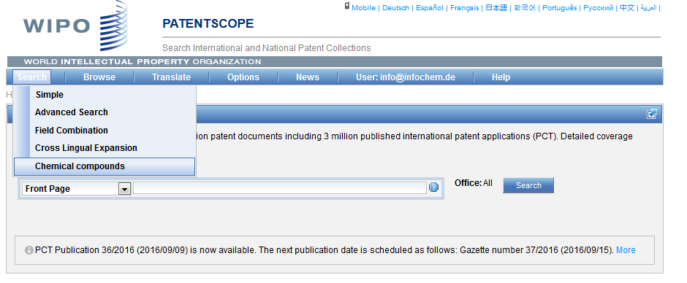
How does it work?

Slide 13
3 options

Slide 14
Scaffold
Basic skeleton of a molecule to which further groups and moieties are attached

Slide 15
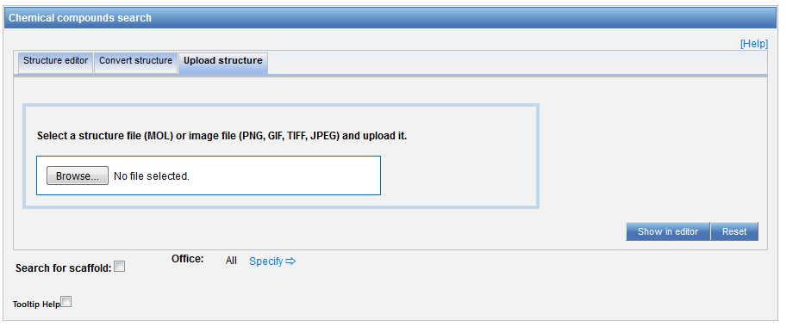
Upload a structure

Slide 16
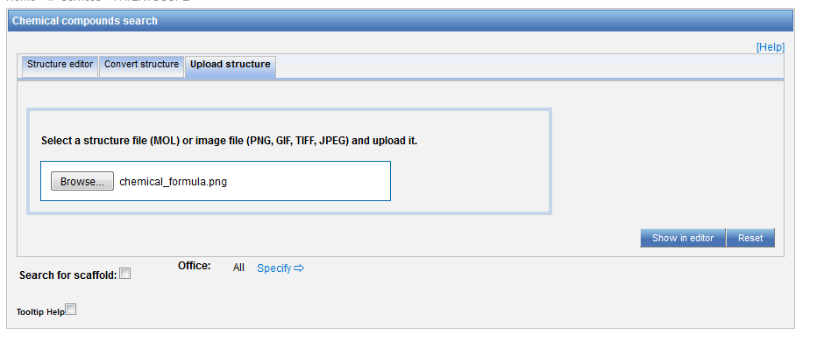
Example

Slide 17
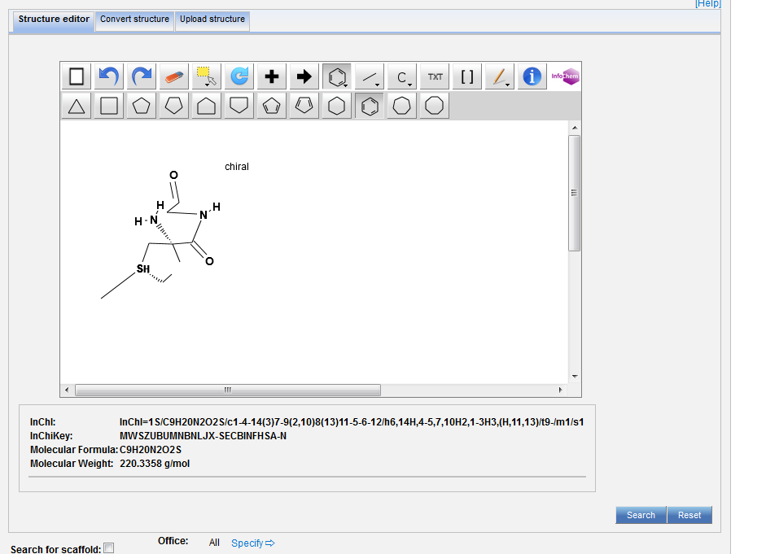

Slide 18
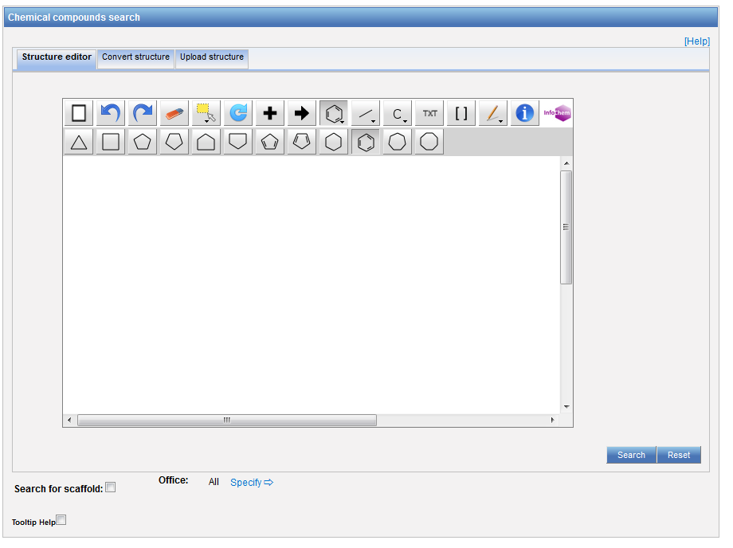
Structure editor

Slide 19
Example

Slide 20
Convert a structure

Slide 21
Convert structure: ex.: paracetamol

Slide 22
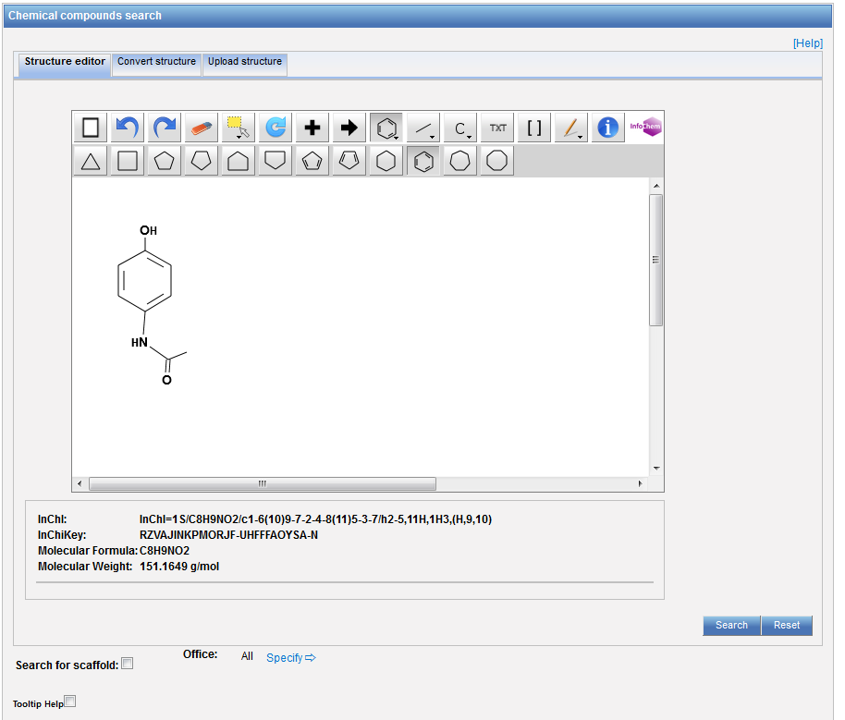

Slide 23
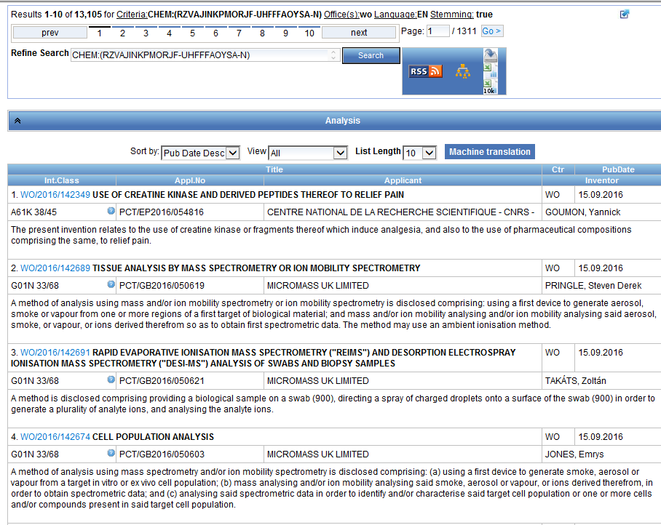
Results

Slide 24
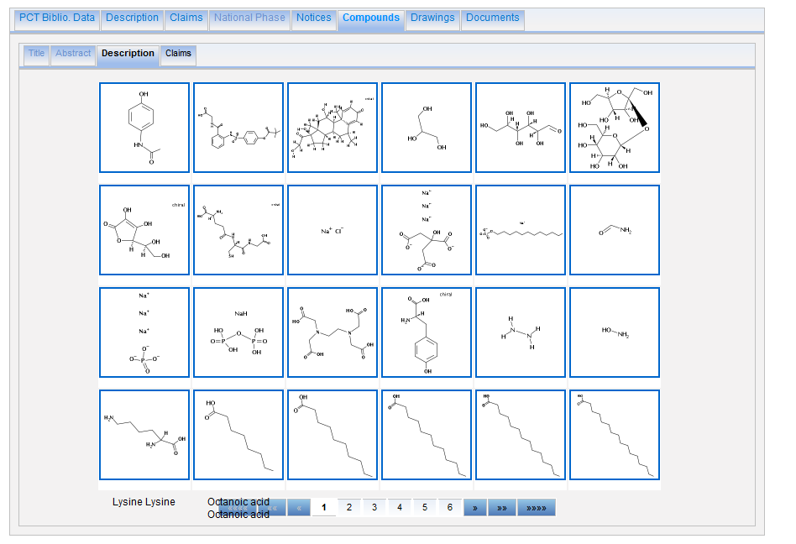

Slide 25
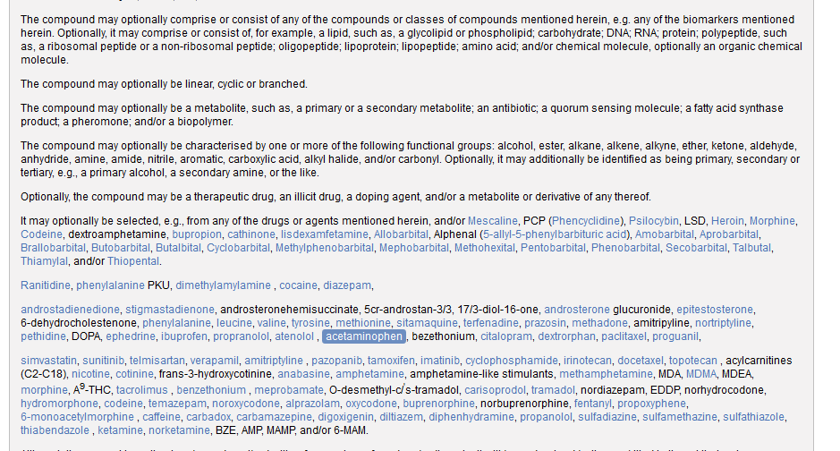

Slide 26
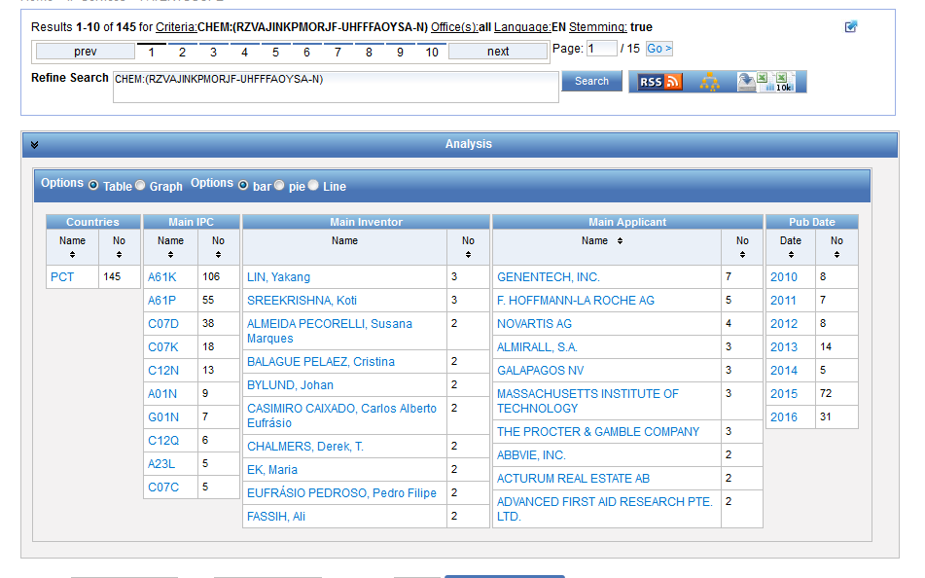
Analysis

Slide 27
Combine results with searches

Slide 28
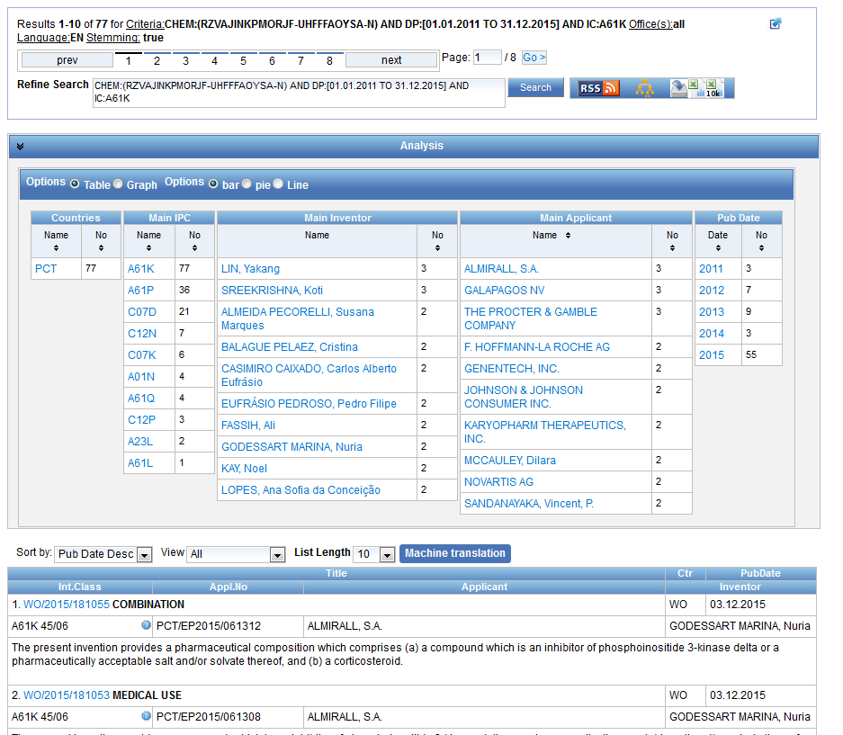

Slide 29
Example: fluoxetine hydrochloride
Its chemical formula is C₁₇H₁₉ClF₃NO
the first highly specific serotonin uptake inhibitor. It is used as an antidepressant and often has a more acceptable side-effects profile than traditional antidepressants.
Synonyms: Prozac, Sarafem

Slide 30
Chemical compound search

Slide 31
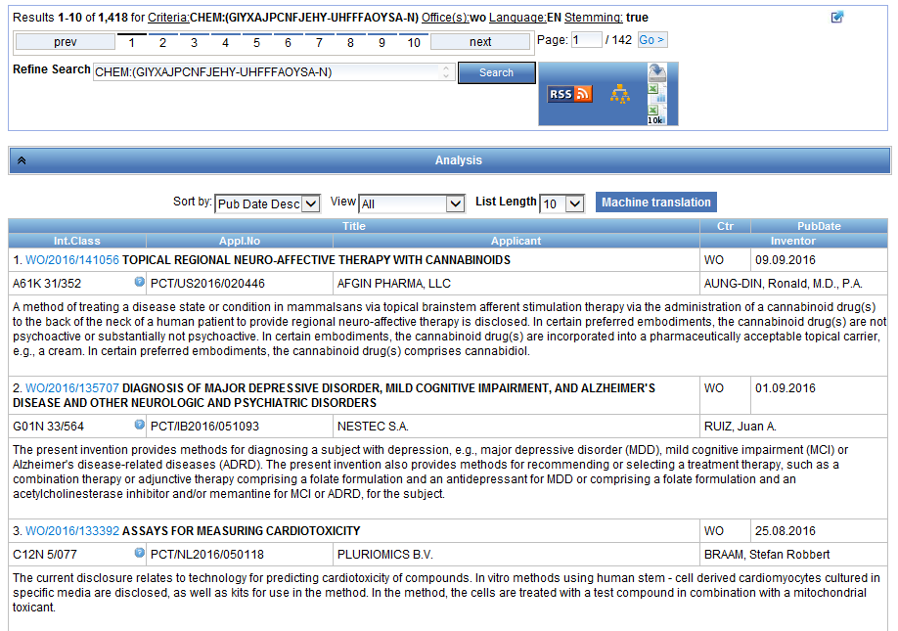

Slide 32
Advanced search

Slide 33
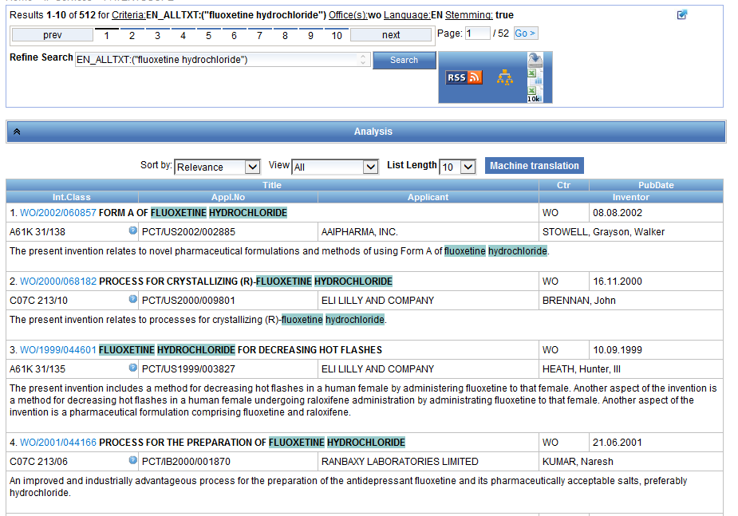

Slide 34
Example: Viagra
Chemical names: Sildenafil; 139755-83-2; Revatio; VIAGRA; Sildenafil [INN:BAN]; CHEMBL192
Molecular formula: C₂₂H₃₀N₆O₄S

Slide 35
Chemical compound search

Slide 36
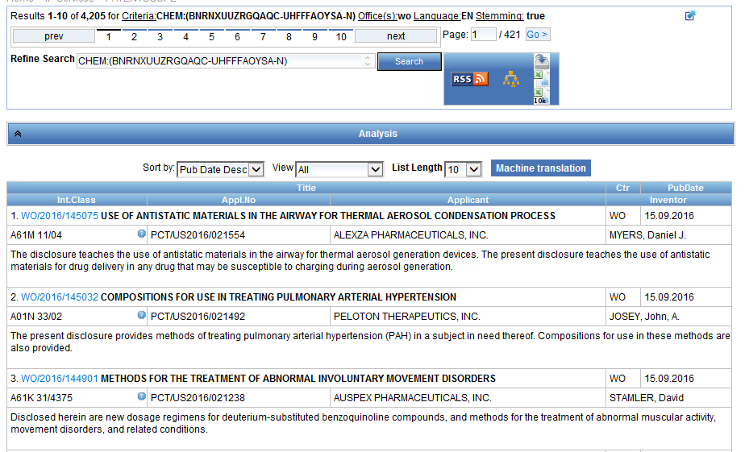

Slide 37
Advanced search

Slide 38
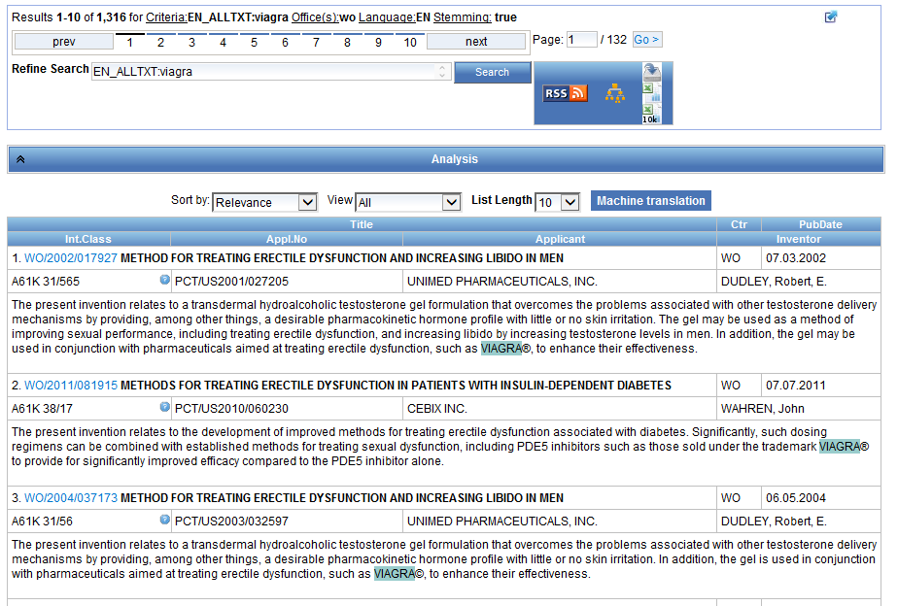

Slide 39
Example: Ritonavir

Slide 40
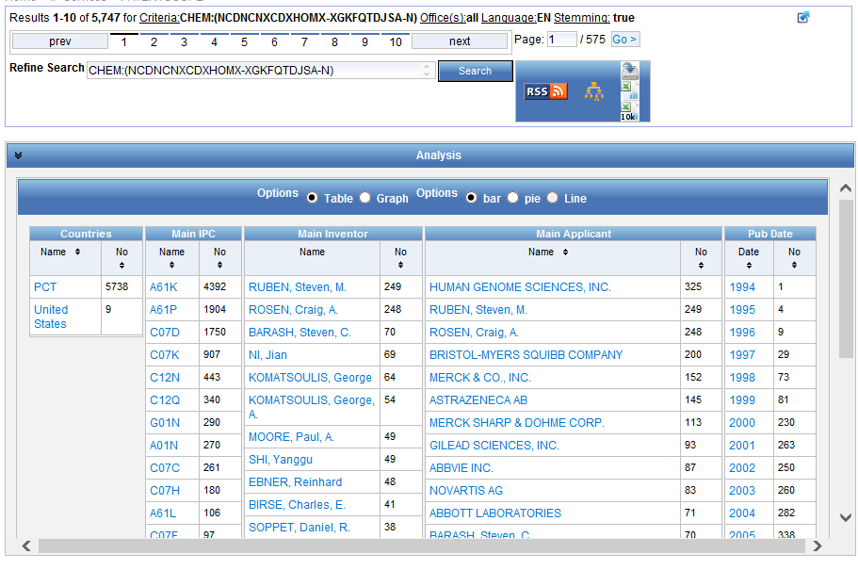

Slide 41
Patent landscape Report on Ritonavir- October 2011 http://www.wipo.int/edocs/pubdocs/en/patents/946/wipo_pub_946.pdf
Ritonavir is an antiretroviral drug from the protease inhibitor class used to treat HIV infection and AIDS. Ritonavir is included in the WHO Model List of Essential Medicines (EML)1.
The originator company is Abbott Laboratories, which markets Ritonavir under the brand name Norvir, or in combination with the protease inhibitor Lopinavir, as Kaletra or Aluvia. The U.S. Food and Drug Administration (FDA) approved the drug in March 1996 for oral solution and in June 1999 for capsules.

Slide 42
Future plans
Make the chemical search feature available for other collections and languages

Slide 44
Next webinar
Options and Help menus
October 25 at 5:30 pm
https://attendee.gotowebinar.com/rt/3847993105651763204
October 27 at 8:30 am
https://attendee.gotowebinar.com/rt/3847993105651763204

Slide 45
patentscope@wipo.int

Slide 46
mulțumesc
mulțumesc

