Slide 1
How to perform a search in the Global Design Database
Internet
October
2018
Sandrine Ammann
Marketing & Communications Officer

Slide 2
Agenda
Interface:
Coverage
Search features
Filter features
Results
Menus
Webinars
Q&A

Slide 3
Why is the GDD useful?
Find details about a specific design
Explore design landscape to find out if the design you have in mind already exists.
Notes:
A service on top of global industrial designs that aims to improve search quality and examination quality of designs data

Slide 4
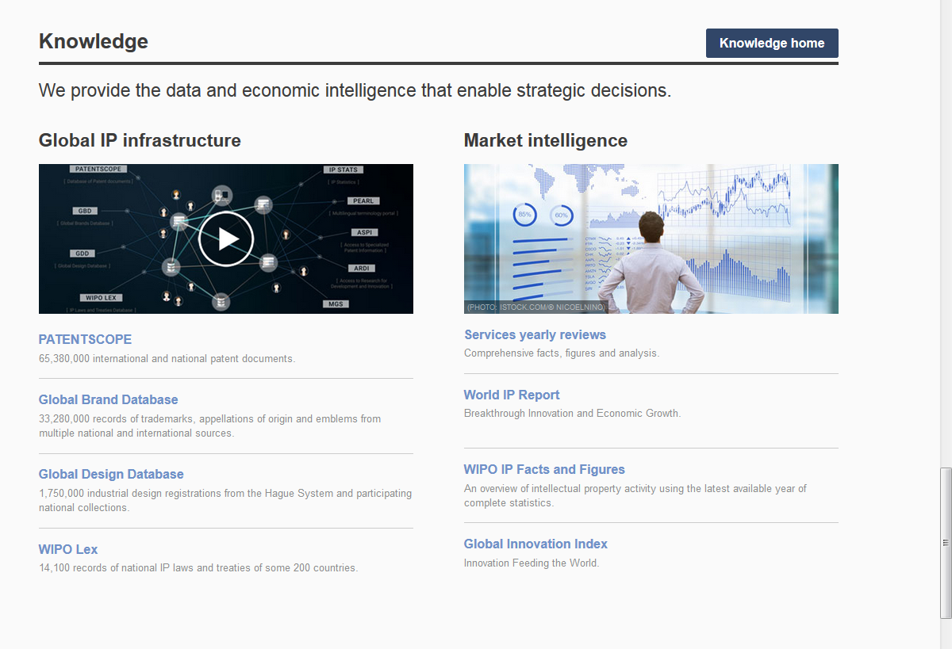
Access: www.wipo.int/designdb www.wipo.int

Slide 5
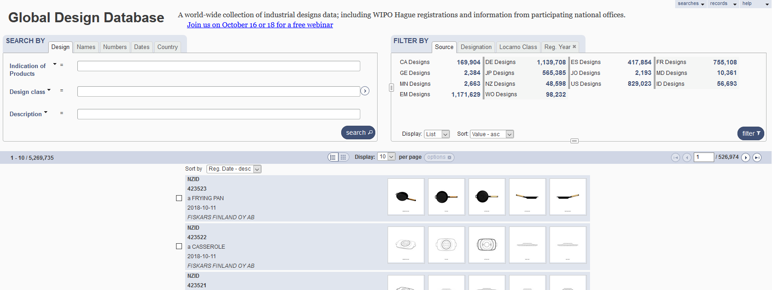
The Global Design Database

Slide 6
Combining many search criterias
Design Apple
2 Locarno classifications: 20 & 25
2 registration years: 2017 & 2016
No need to build complex queries

Slide 7
2 steps
1
2
- Design Apple
- 2 Locarno classifications: 20 & 25
-2 registration years: 2017 & 2016

Slide 8
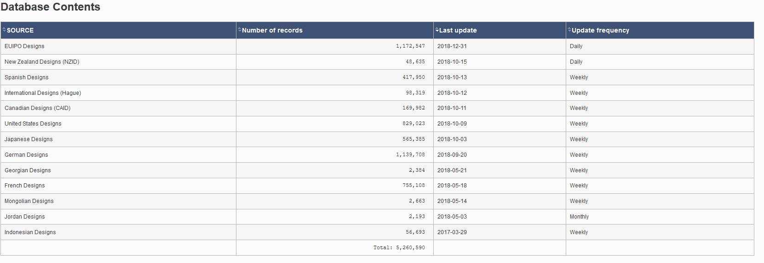
Coverage
http://www.wipo.int/designdb/en/designdb-help.jsp#db

Slide 9
Coverage

Slide 10
Coverage: new

Slide 11
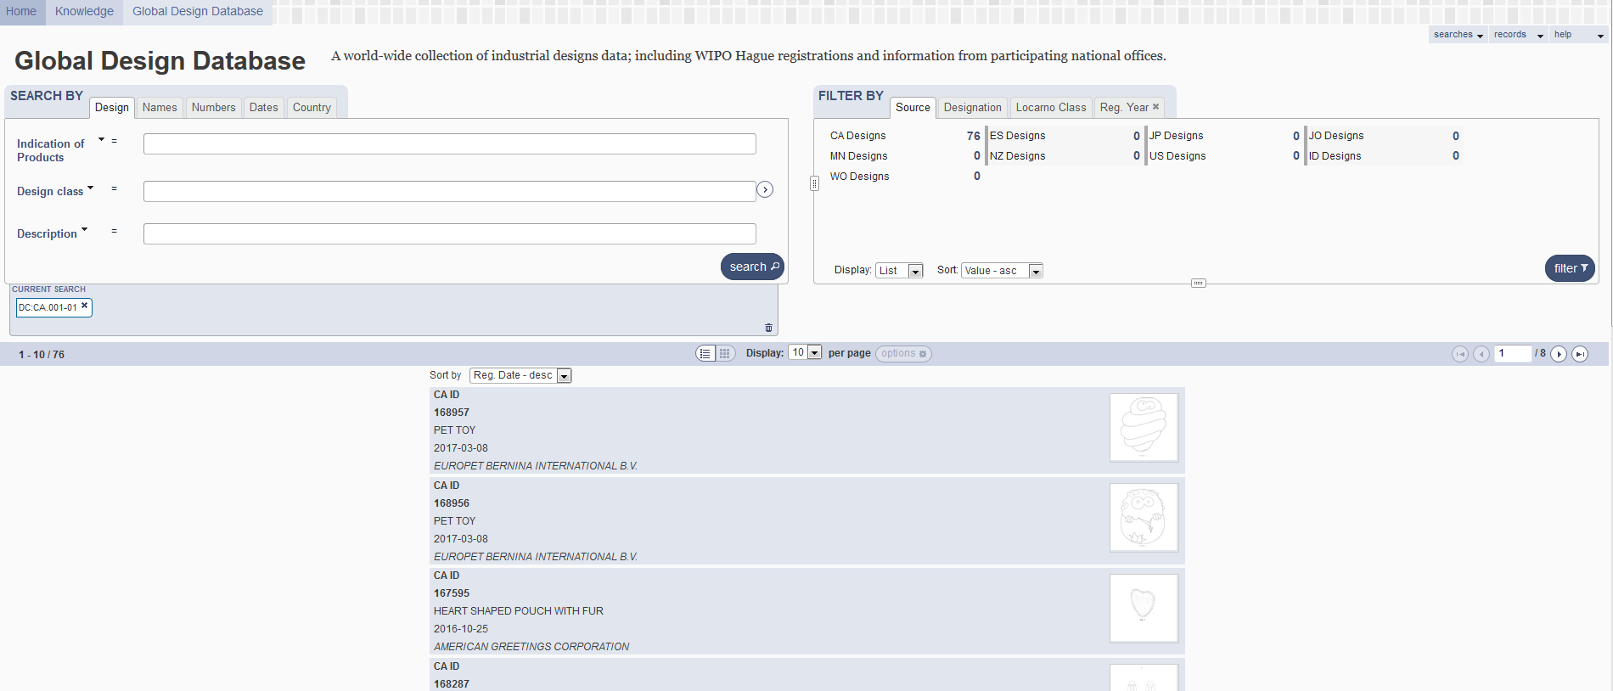
5
1
2
3
4

Slide 12
1

Slide 13
Boolean, proximity, operators, fuzzy

Slide 14
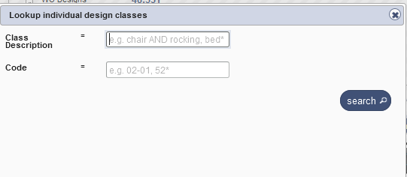
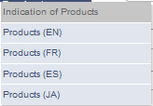
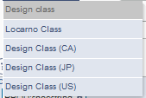
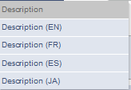
Search by design

Slide 15
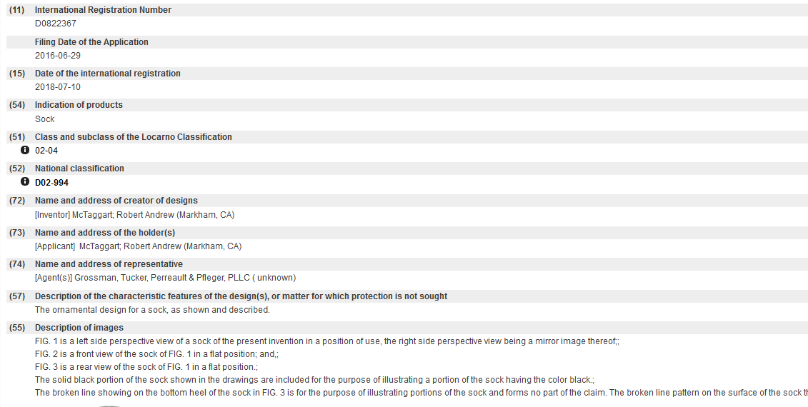
Indication of production/Description

Slide 16
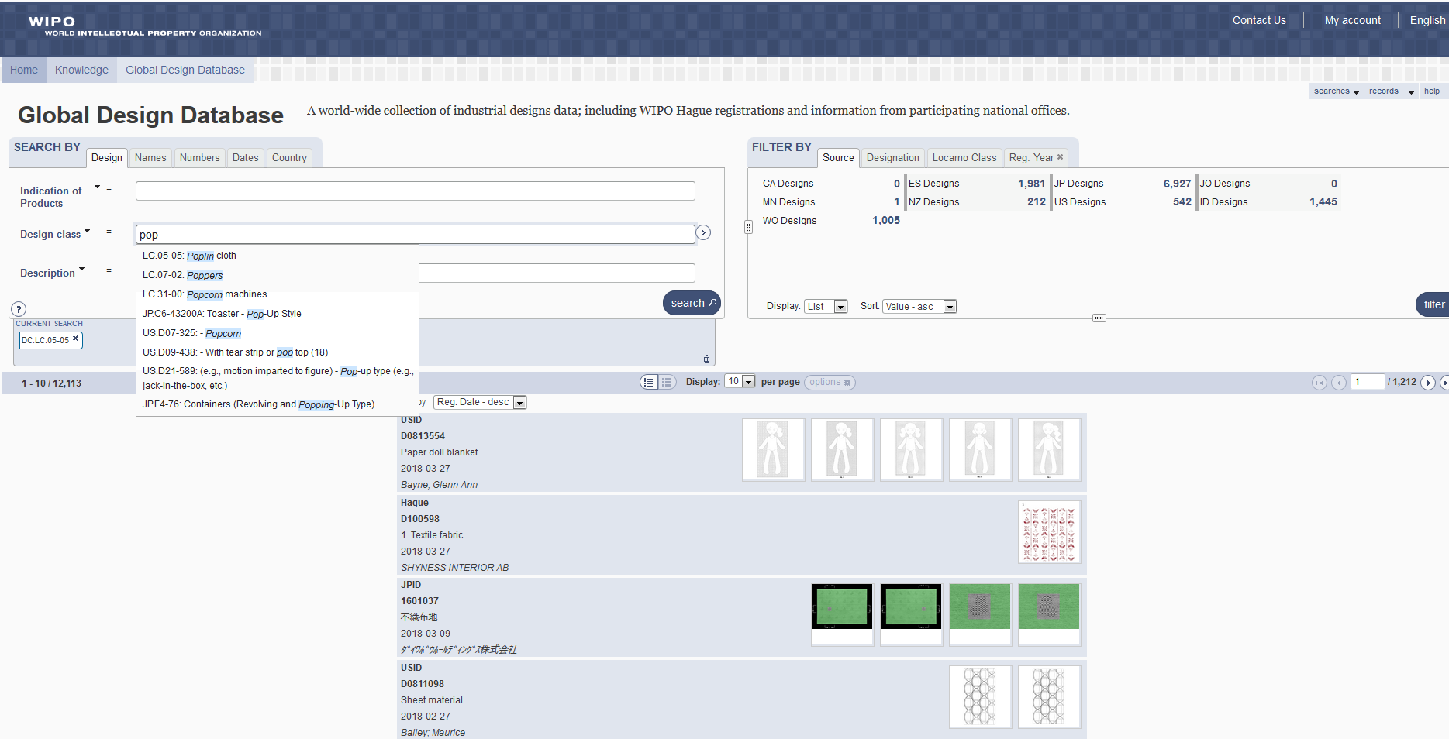

Slide 17
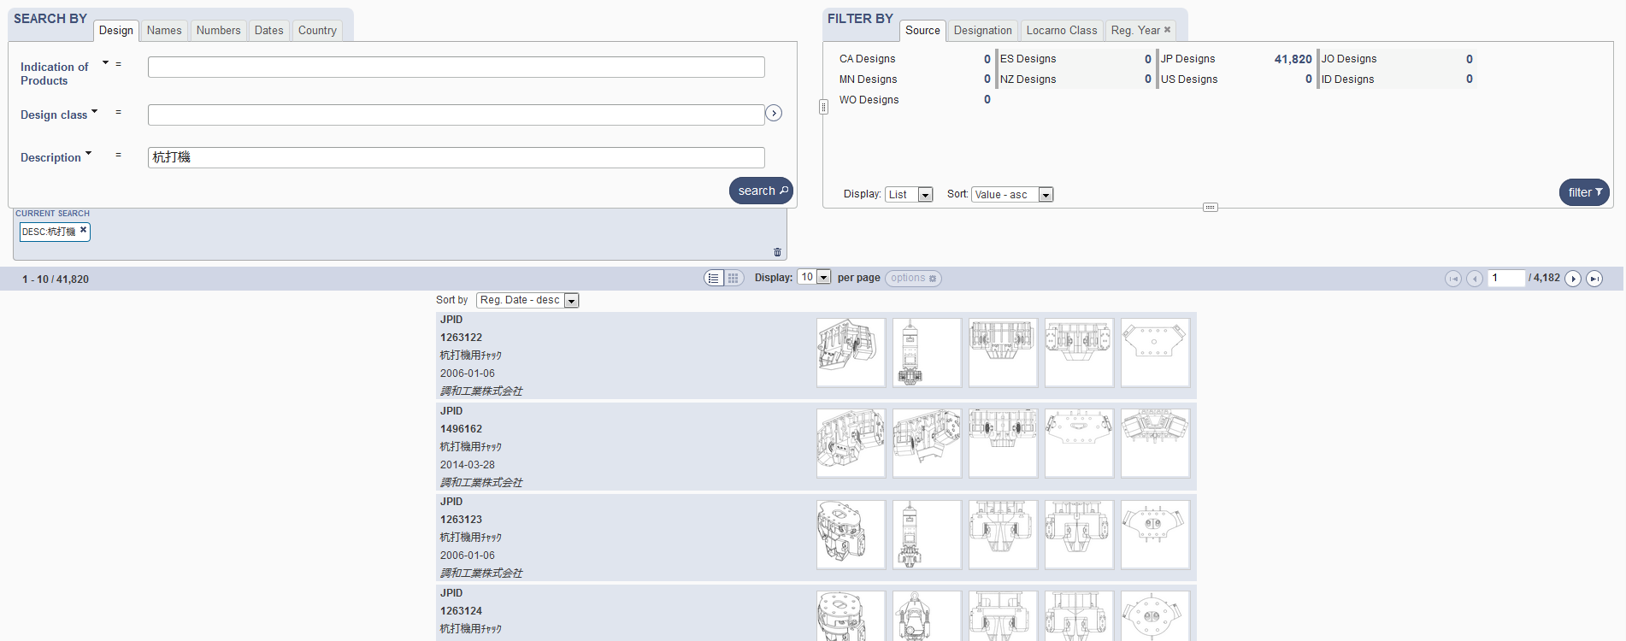
Search by Description JA

Slide 18
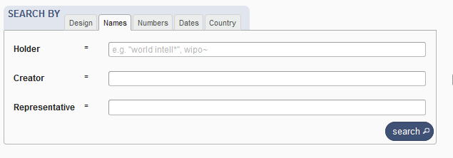
Search by name

Slide 19
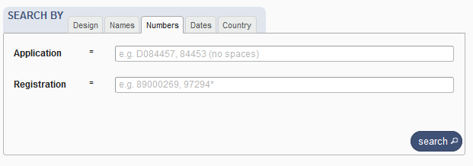
Search by numbers

Slide 20
Search by dates

Slide 21
Search by country

Slide 23
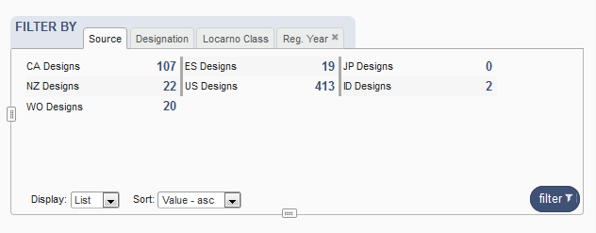
Filter by

Slide 24
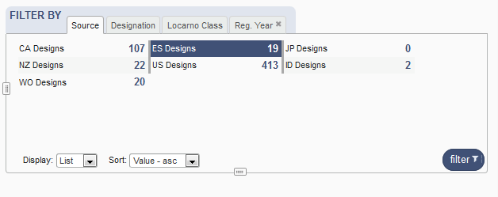
Filter by Source

Slide 25
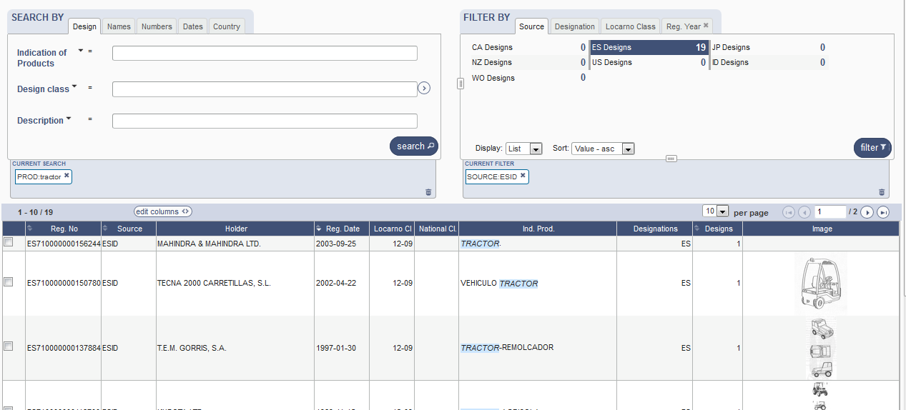

Slide 26
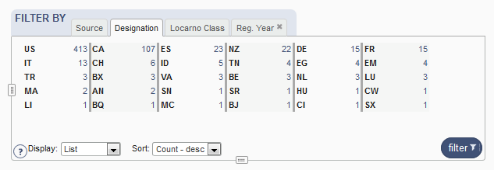
Filter by Designation

Slide 27
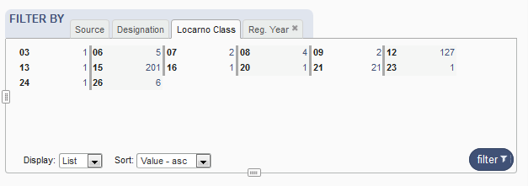
Filter by Locarno Class

Slide 28
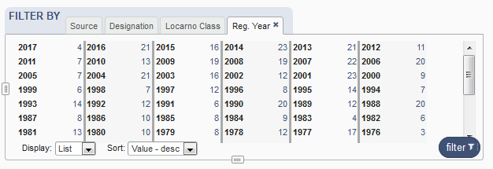
Filter by Registration Year

Slide 29
Options

Slide 30
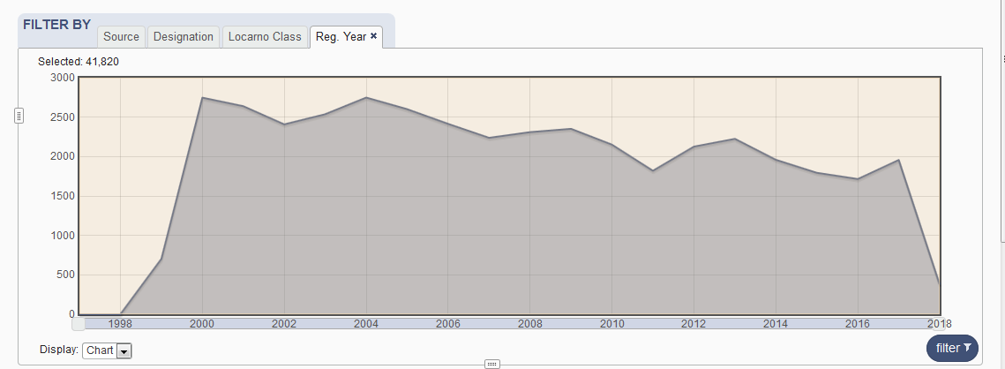

Slide 31
3

Slide 33
4

Slide 34
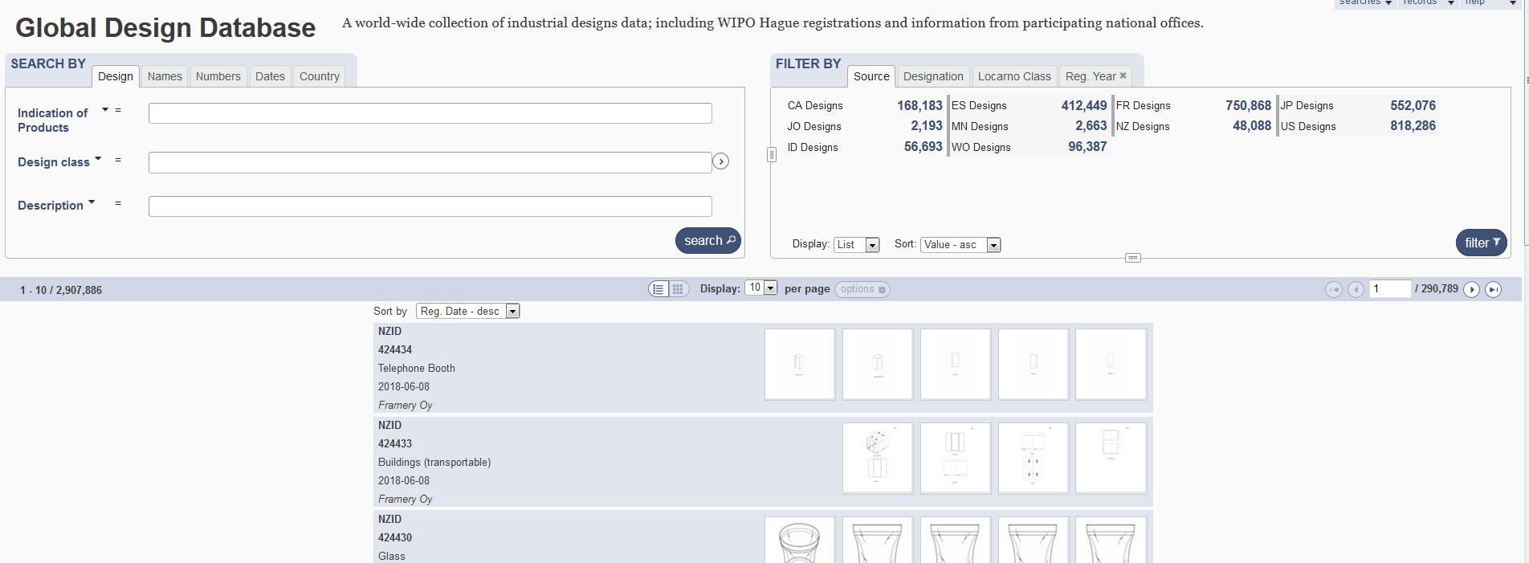
Result list

Slide 35
2 parts

Slide 36
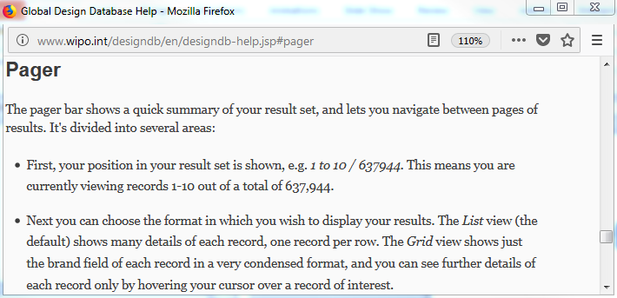
Pager bar

Slide 37
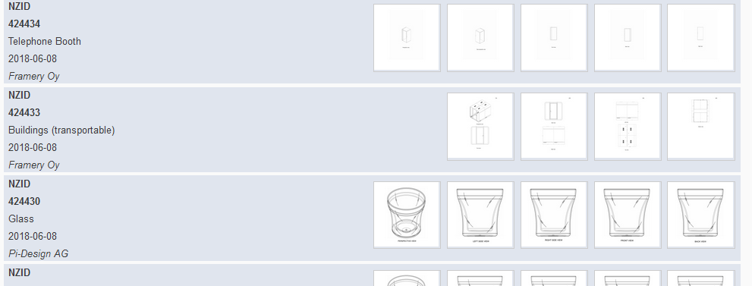
Display

Slide 38
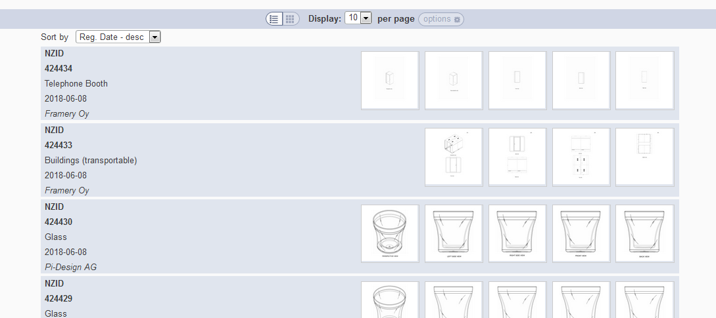
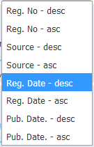
Grid view
Notes:
In case the design has multi models (hauge, new Zealand…), we show the images of every model
In case the design has one model (france, spain…), we should the first 5 images of the model

Slide 39
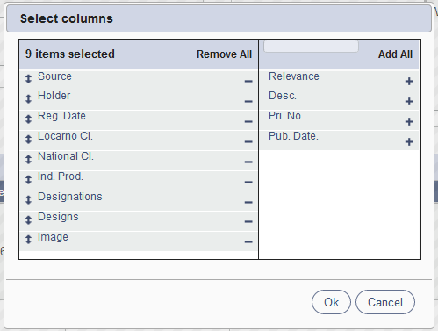
List view

Slide 40
Customized number of columns

Slide 41
2 parts

Slide 42
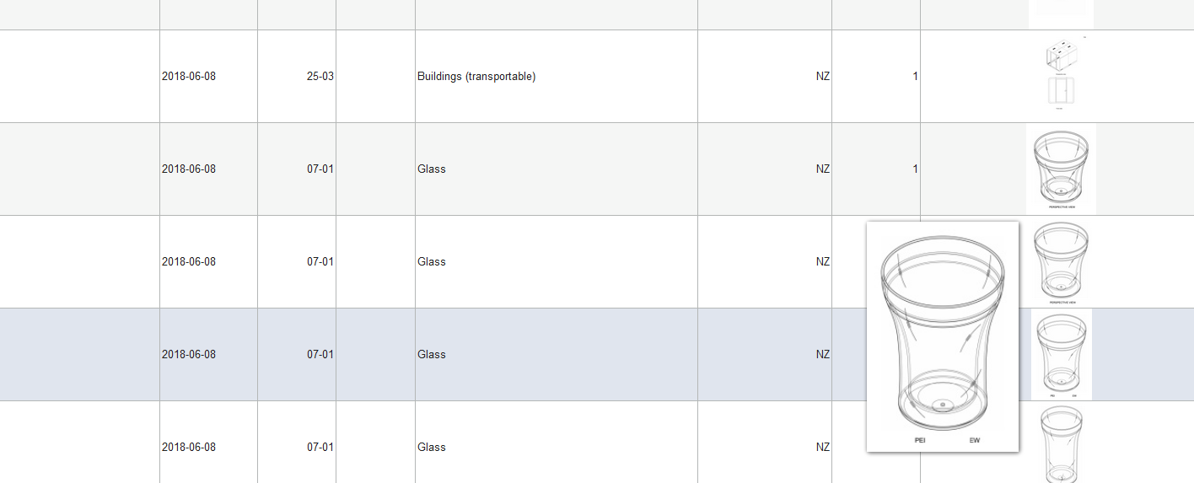

Slide 43
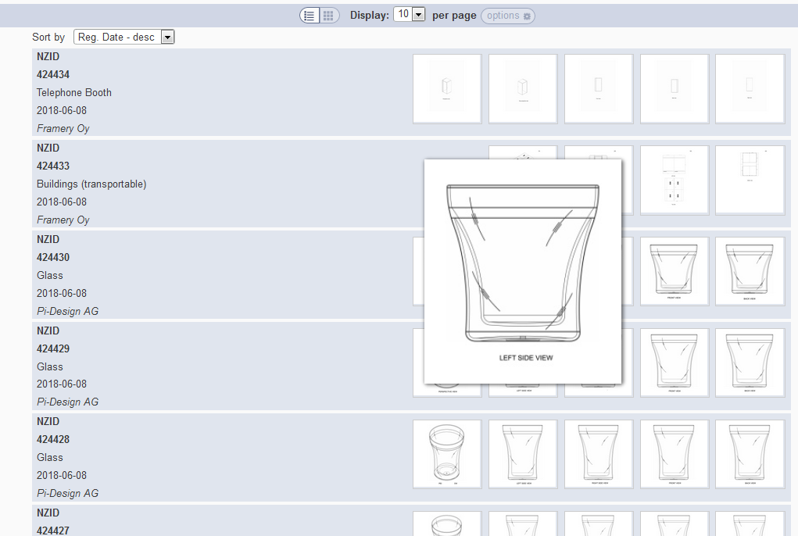

Slide 44
Back button/link

Slide 45
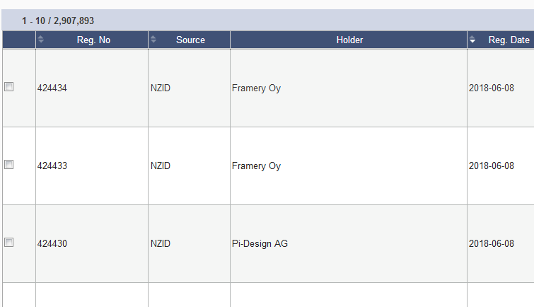
Options: checkbox

Slide 46
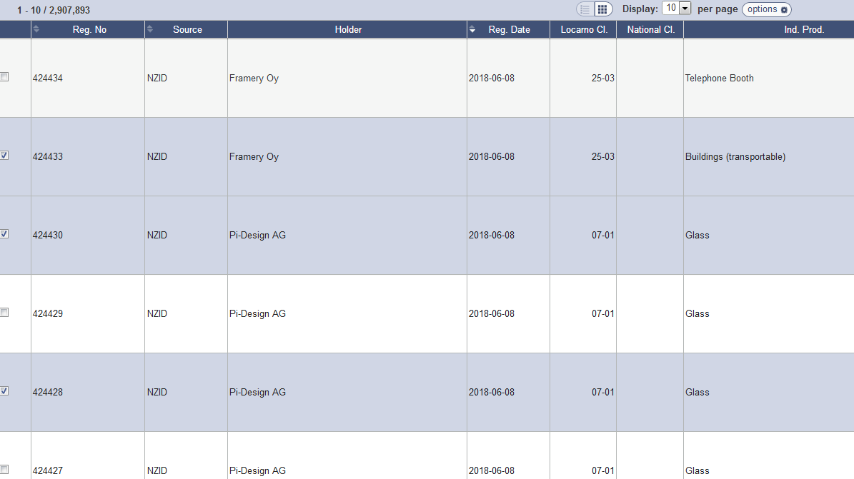

Slide 47
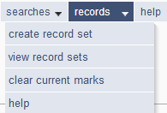

Slide 48
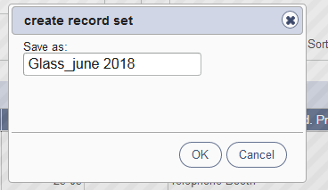
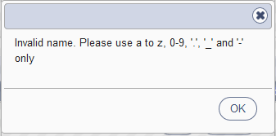
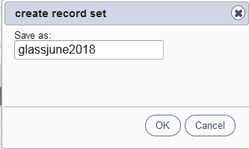
Save a record set

Slide 49
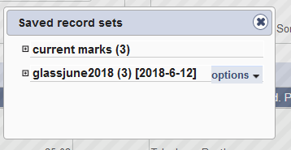
View record sets/Clear current marks

Slide 50
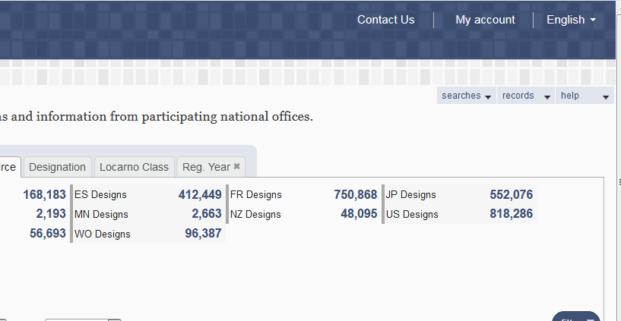
My account

Slide 51
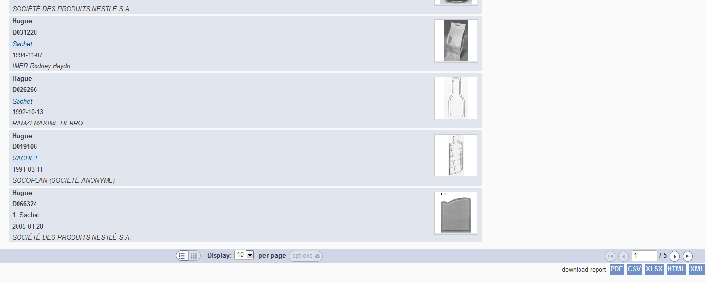
Download reports

Slide 52
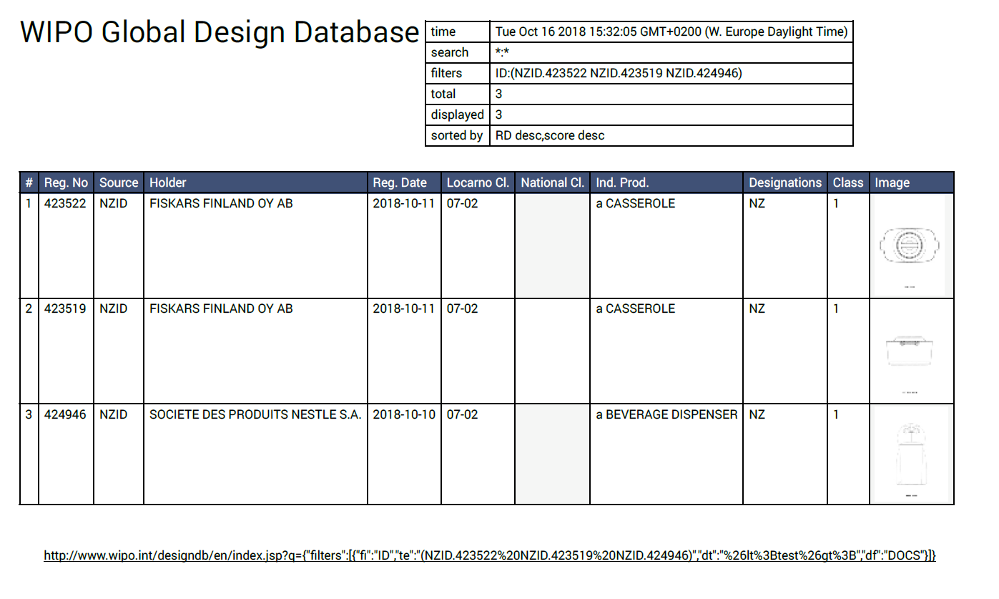

Slide 53
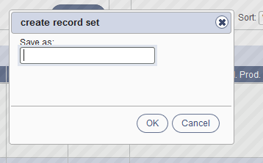
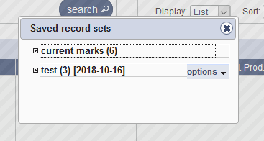

Slide 54
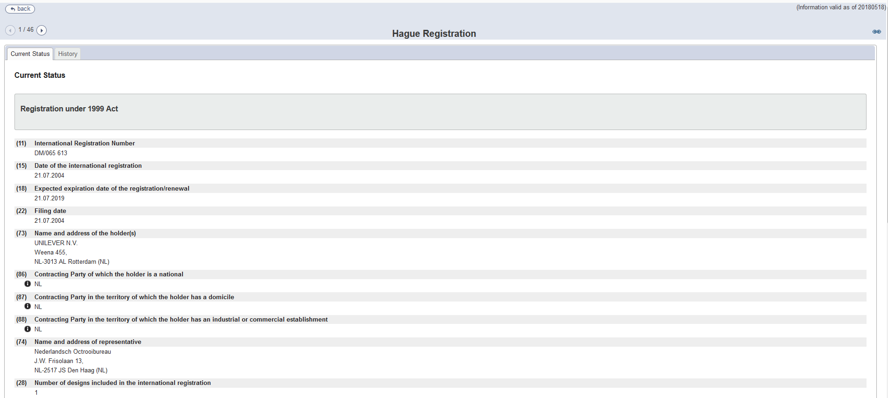
Individual record

Slide 55
5

Slide 57
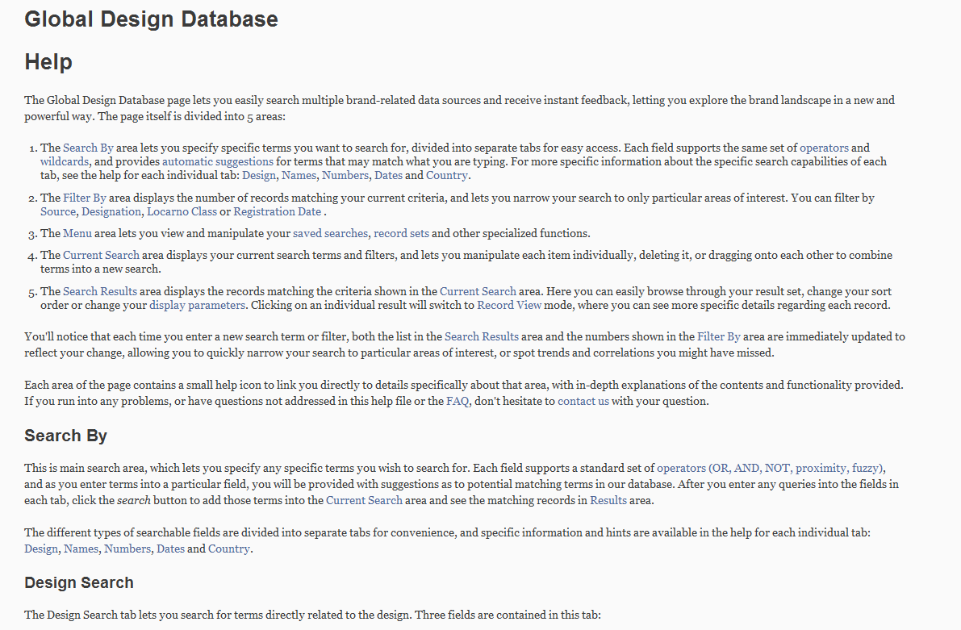
Help

Slide 58
Plans for the future
Add more collections

Slide 59
Webinars

Slide 60
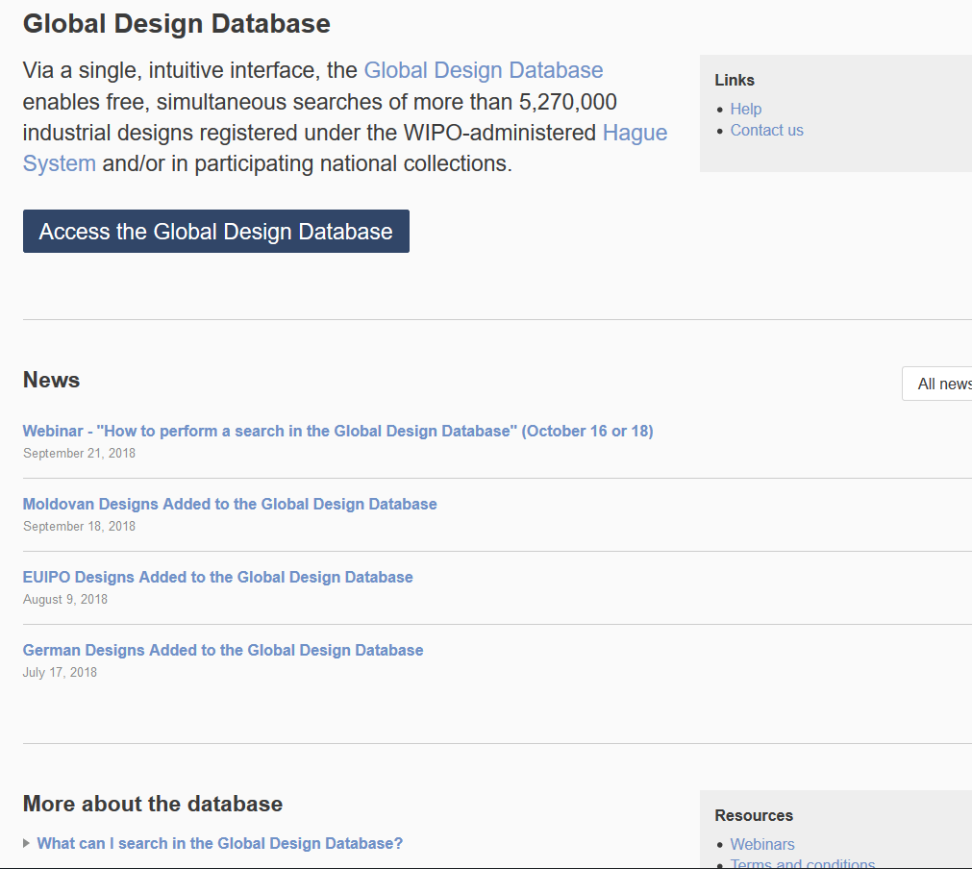

Slide 61
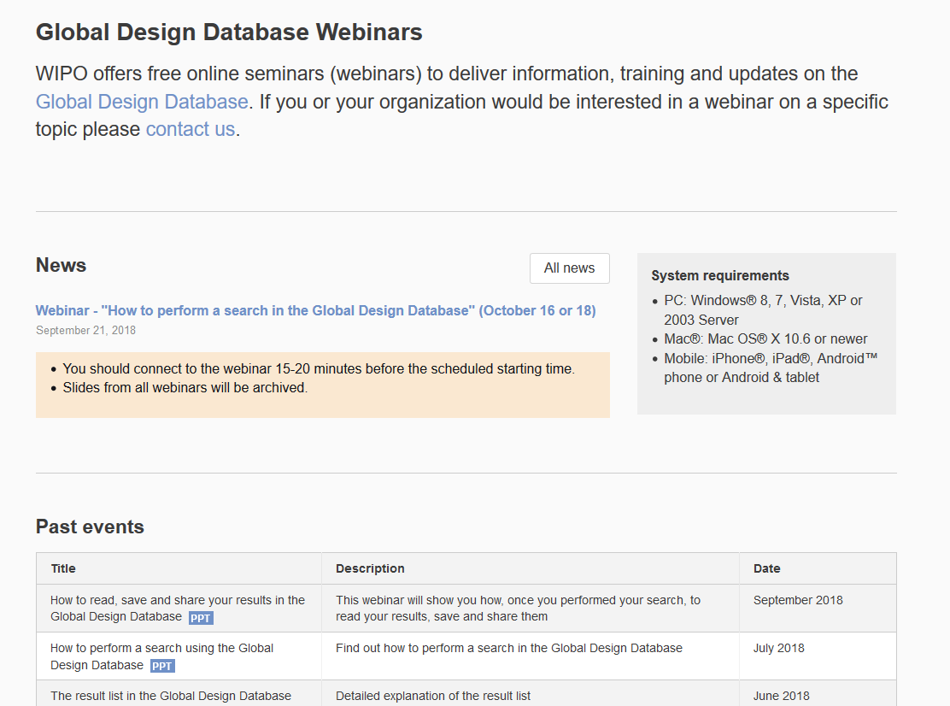

Slide 62
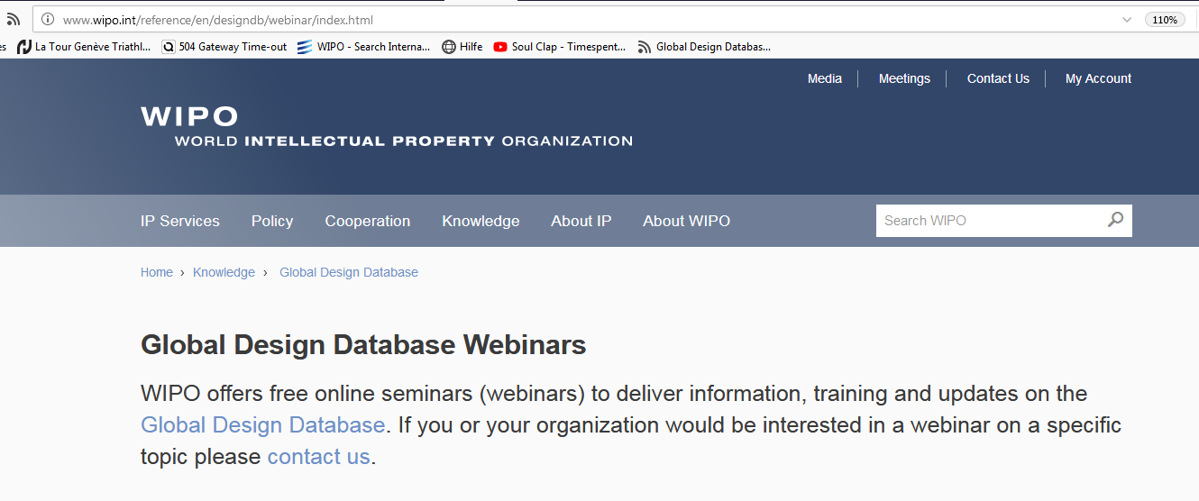
Updates
Click on open menu icon
Select ‘Customize’
Drag the ‘Subscribe’ icon to the navigation toolbar
Click on the icon in the navigation toolbar to view the page-specific feed

Slide 63
PATENTSCOPE webinar
Complex queries
October 23 or 25
https://attendee.gotowebinar.com/rt/3593756346531945475

Slide 64
Global Brand Database: webinar
How to read, save & share your results
October 23 at 3:00pm CET
https://attendee.gotowebinar.com/register/5172829866925090051

Slide 66
mulțumesc
mulțumesc
gbd@wipo.int

