Slide 1
Result list
Global Design Database
Cyberworld
19 June
2018
Sandrine Ammann
Marketing & Communications Officer

Slide 2
Agenda
What’s new?
Result list
Grid view
List view
Options
Quiz
Q&A

Slide 3
What’s new?
New collections: France, Jordan & Mongolia
Updated collection: Spain

Slide 4
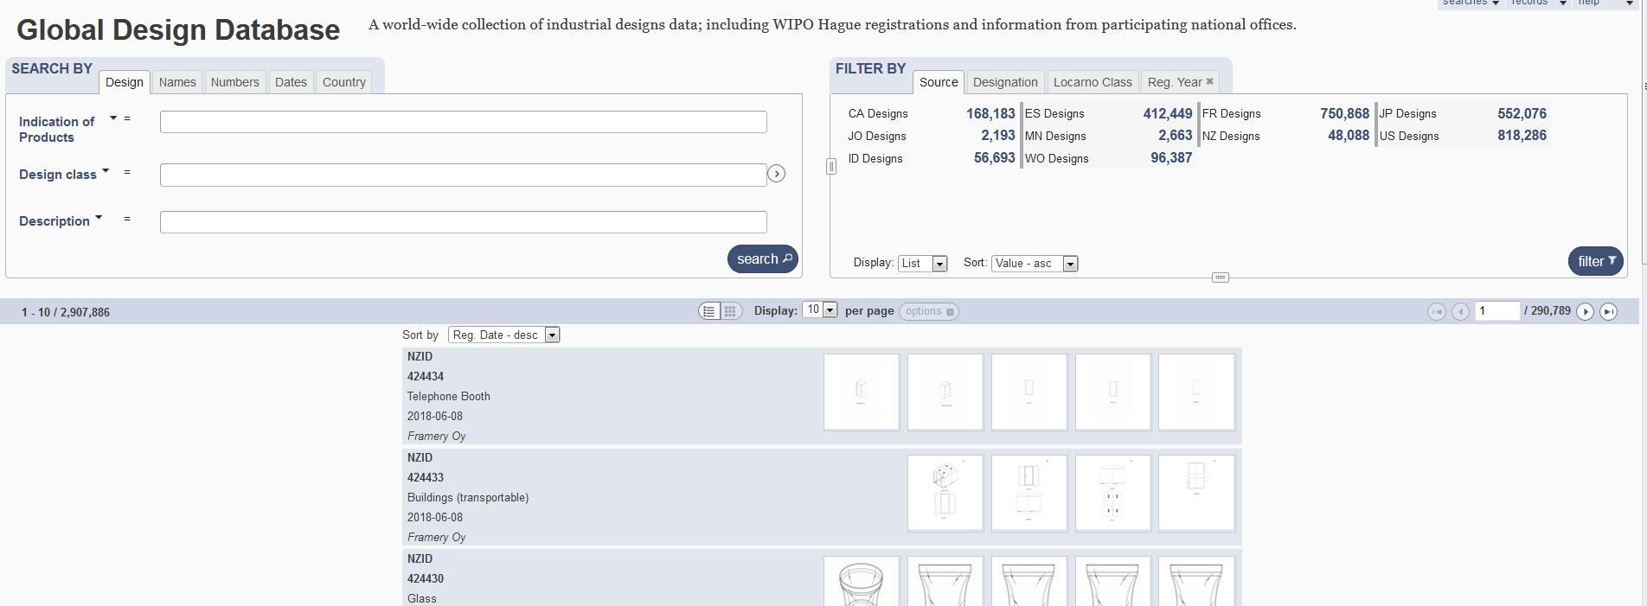
Result list

Slide 5
2 parts

Slide 6
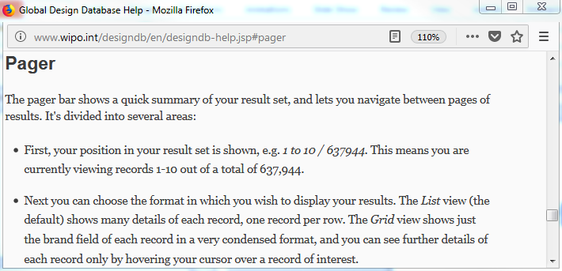
Pager bar

Slide 7
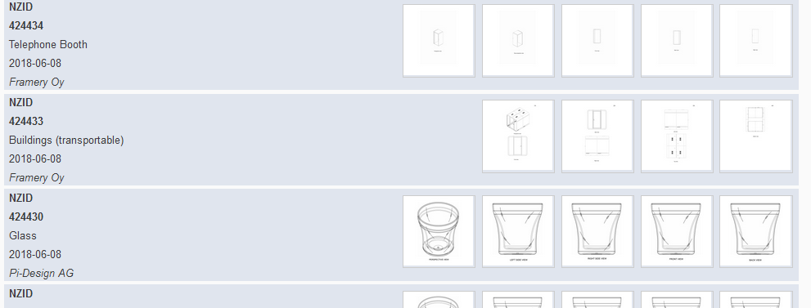
Display

Slide 8
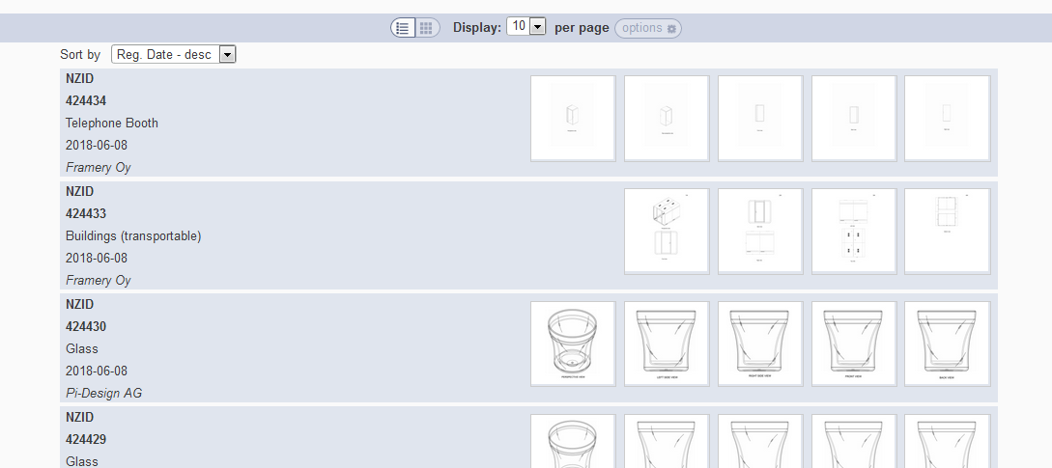
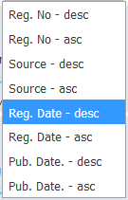
Grid view
Notes:
In case the design has multi models (hauge, new Zealand…), we show the images of every model
In case the design has one model (france, spain…), we should the first 5 images of the model

Slide 9
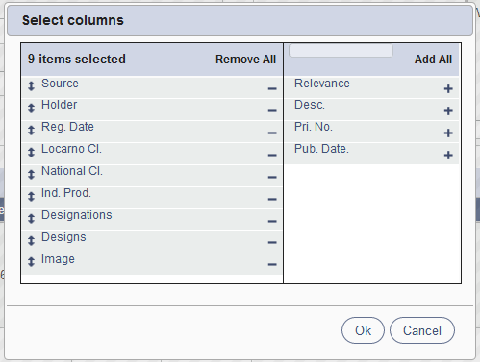
List view

Slide 10
Customized number of columns

Slide 11
2 parts

Slide 12
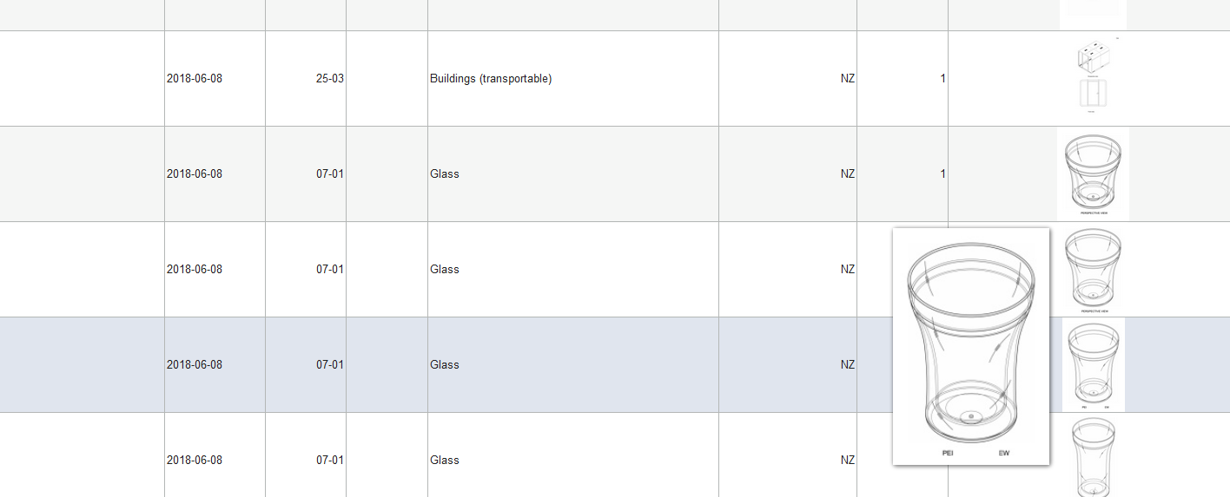

Slide 13
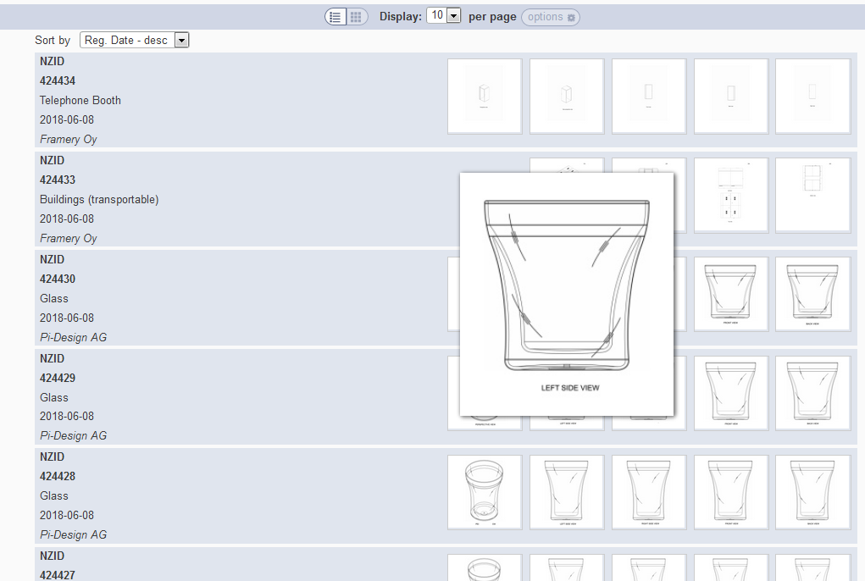

Slide 14
Back button/link

Slide 15
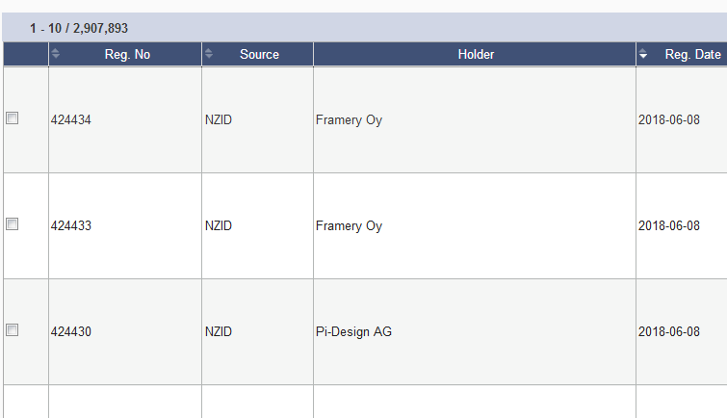
Options: checkbox

Slide 16
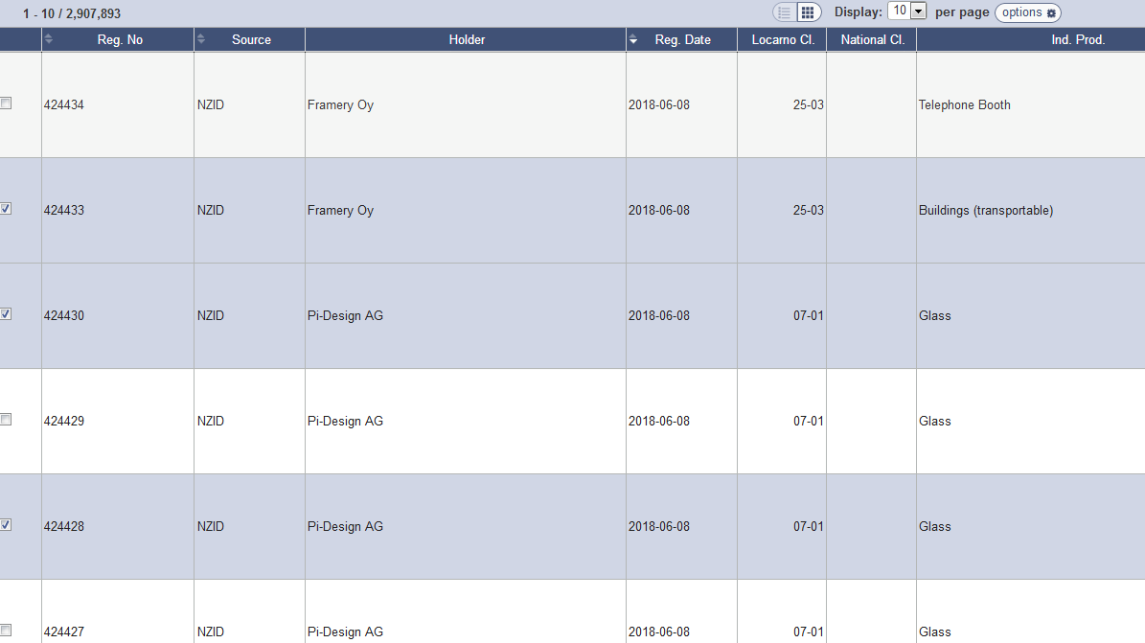

Slide 17
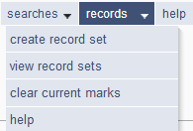

Slide 18
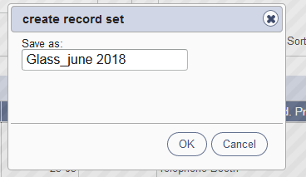
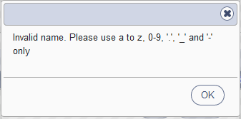
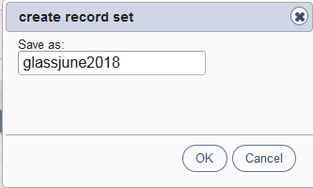
Save a record set

Slide 19
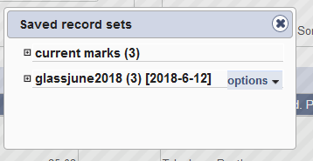
View record sets/Clear current marks

Slide 20
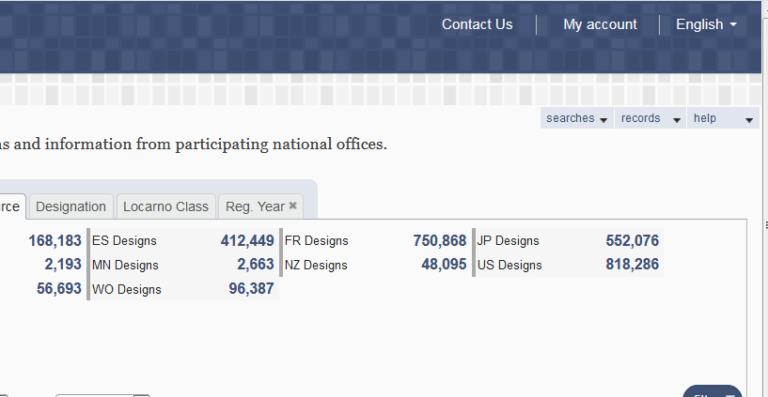
My account

Slide 22
Q.1: If you would like to access your saved records, what should you do?
A
Login
B
Nothing

Slide 23
Q.1: If you would like to access your saved records, what should you do?
A
Login
B
Nothing

Slide 24
Q.2: To customize the search result view, which view should you select?
A
Grid
B
List

Slide 25
Q 2: To customize the search result view, which view should you select?
A
Grid
B
List

Slide 26
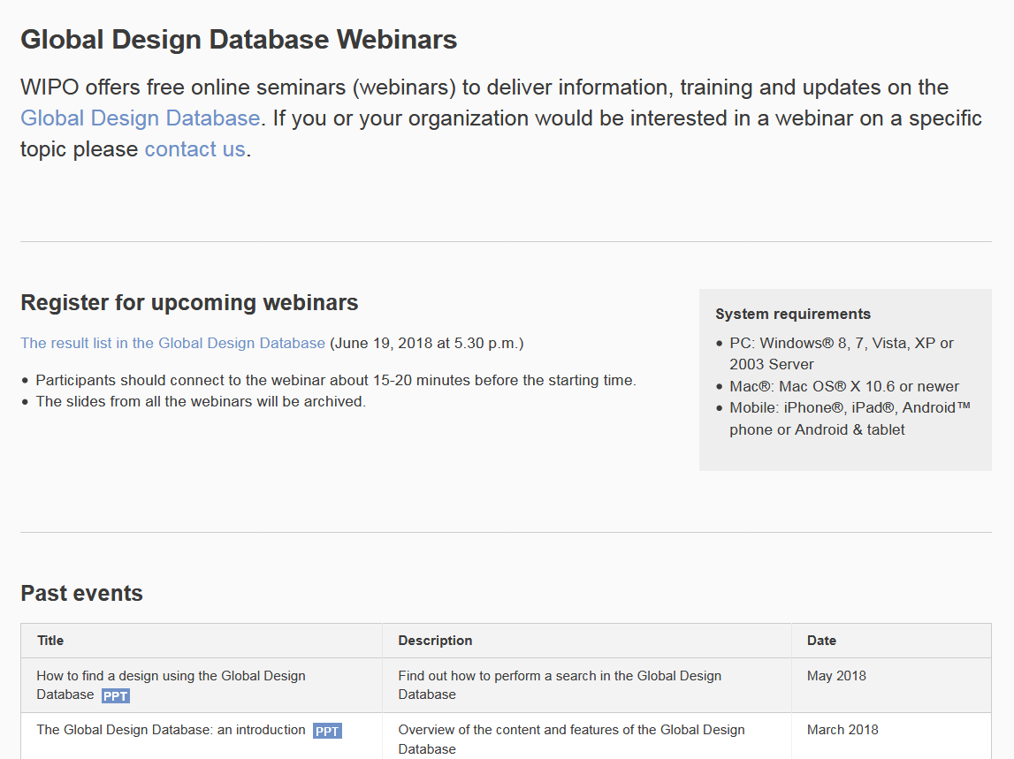
Future/past webinars:
http://www.wipo.int/reference/en/designdb/webinar/index.html

Slide 27
Global Design Database: webinar
How to perform a search in the Global Design Database
July 11 at 4:30pm CET
https://attendee.gotowebinar.com/register/2162408810209184771

Slide 28
Global Brand Database: webinar
Image searching in The Global Brand Database
June 20 at 4:30pm CET
https://global.gotowebinar.com/manageWebinar.tmpl?webinar=1953427932748107265

Slide 29
PATENTSCOPE webinar
PATENTSCOPE for experts
June 26 at 8:30 am
https://attendee.gotowebinar.com/rt/7639402775417310466
June 28 at 5:30 pm
https://attendee.gotowebinar.com/rt/7639402775417310466

Slide 31
gbd@wipo.int

