Slide 1
How to find designs using GDD
Intranet
January
2018
Sandrine Ammann
Marketing & Communications Officer

Slide 2
Agenda
Interface:
Coverage
Search features
Filter features
Results
Menus
Example
Q&A

Slide 3
Why is the GDD useful?
Find details about a specific design
Explore design landscape to find out if the design you have in mind already exists.
Notes:
A service on top of global industrial designs that aims to improve search quality and examination quality of designs data

Slide 4
Access: www.wipo.int/designdb www.wipo.int

Slide 5
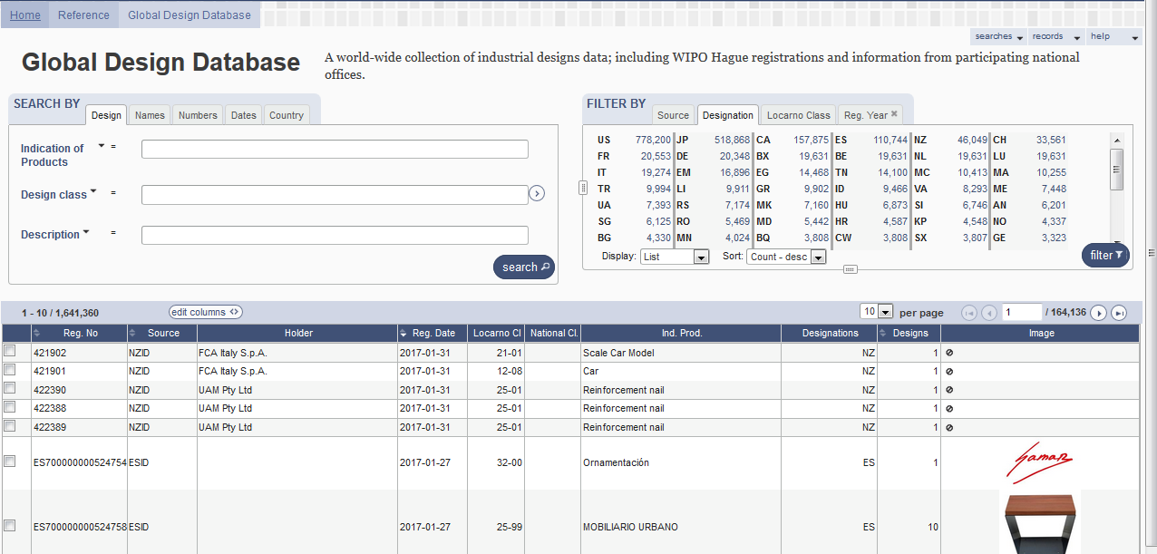

Slide 6
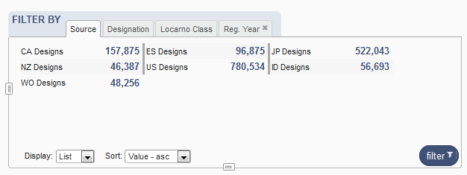
Coverage
Notes:
Industrial Designs data (1.7+ million records)
Hague System
National Collections – CA, ES, JP, NZ, US, ID
Pending Collections – DE, KR, EM … coming soon

Slide 7
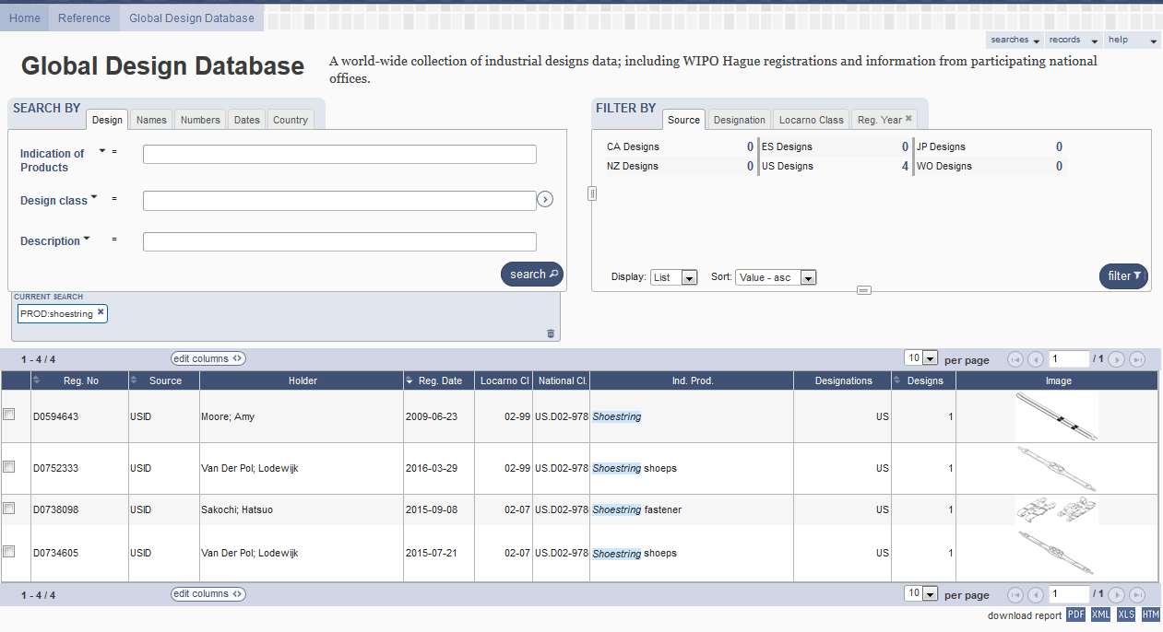
5
1
2
3
4

Slide 8
1

Slide 9
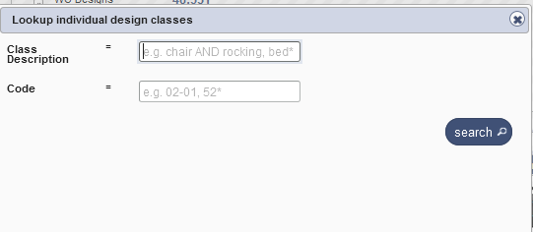
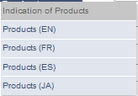
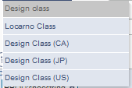
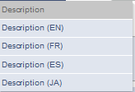
Search by design

Slide 10
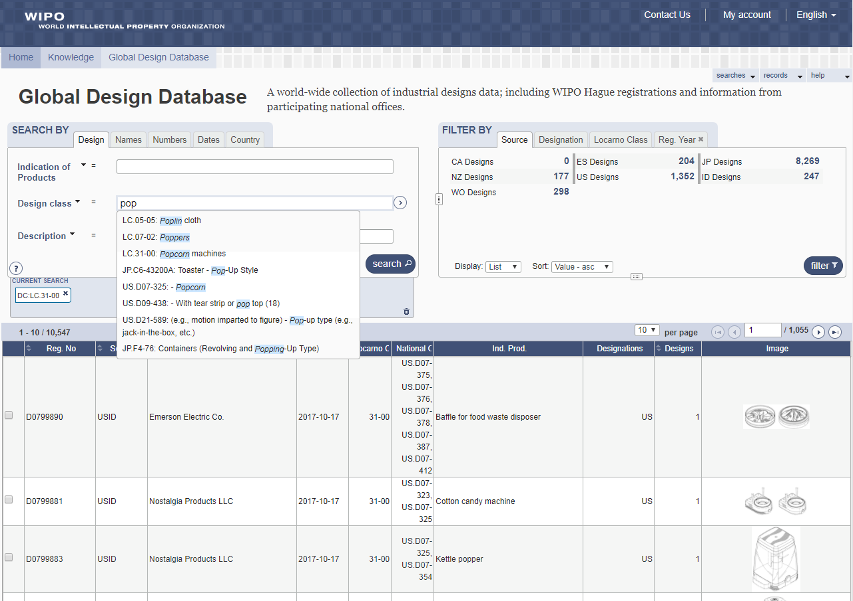

Slide 11
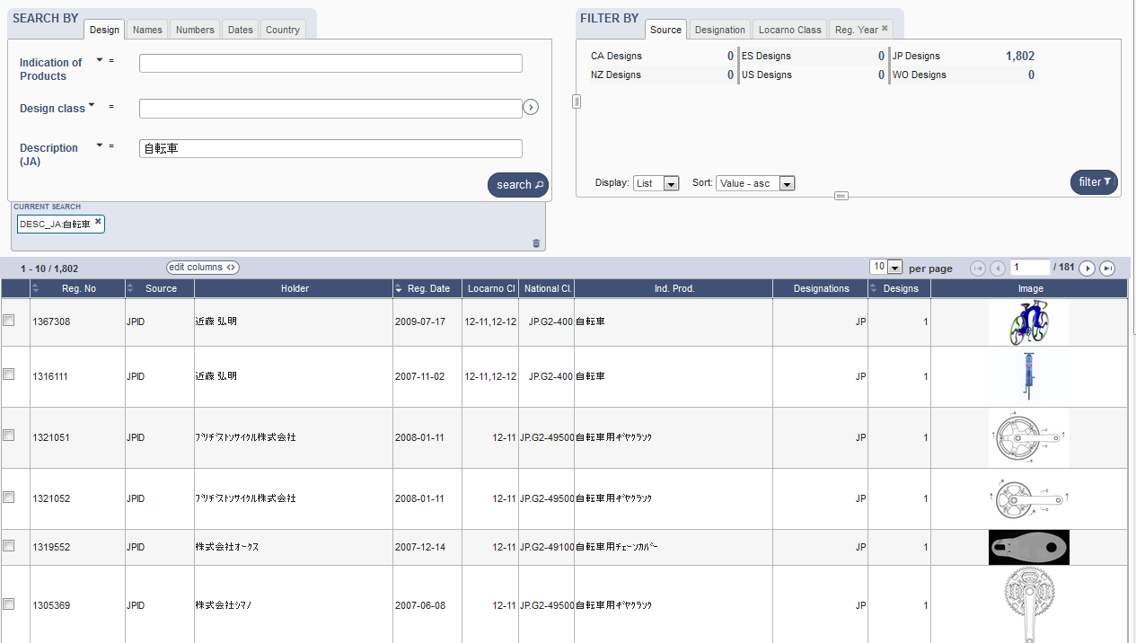
Search by Description JA

Slide 12
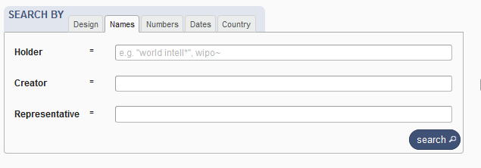
Search by name

Slide 13
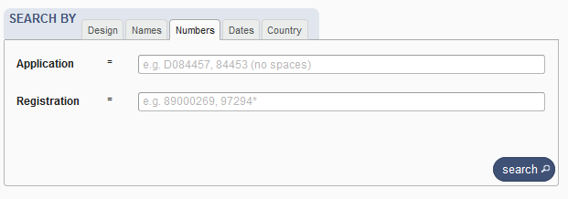
Search by numbers

Slide 14
Search by dates

Slide 15
Search by country

Slide 16
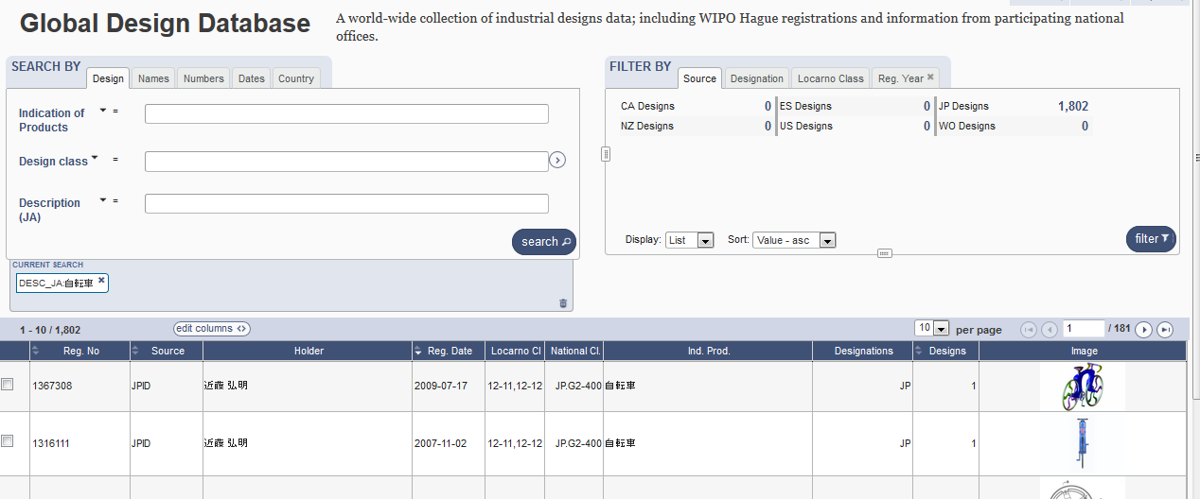

Slide 17
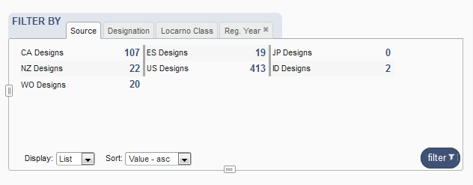
Filter by

Slide 18
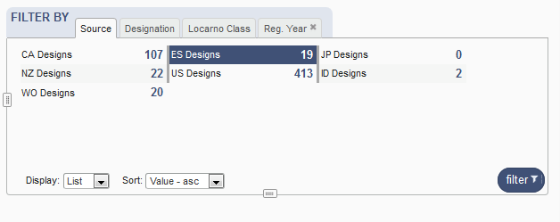
Filter by Source

Slide 19
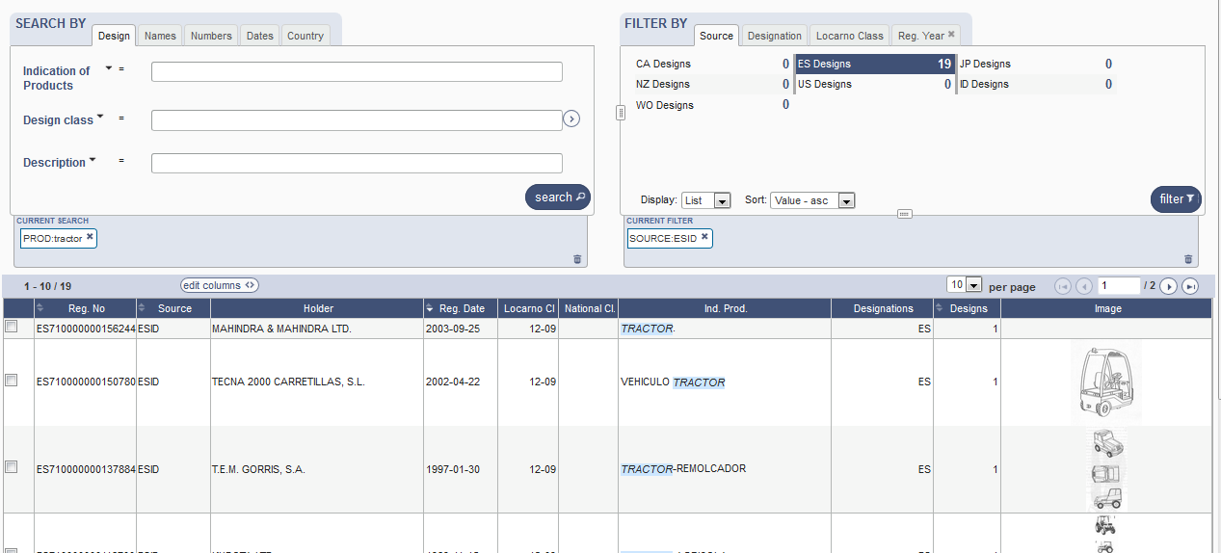

Slide 20
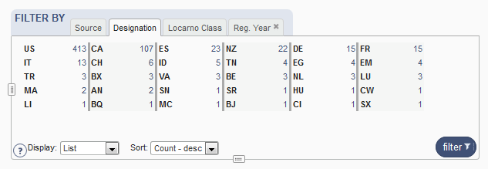
Filter by Designation

Slide 21
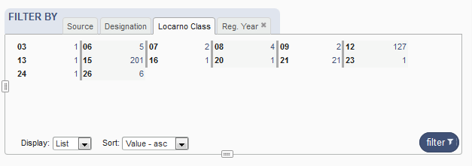
Filter by Locarno Class

Slide 22
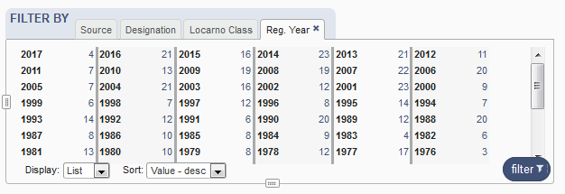
Filter by Registration Year

Slide 23
Options

Slide 24
3

Slide 25
4

Slide 26
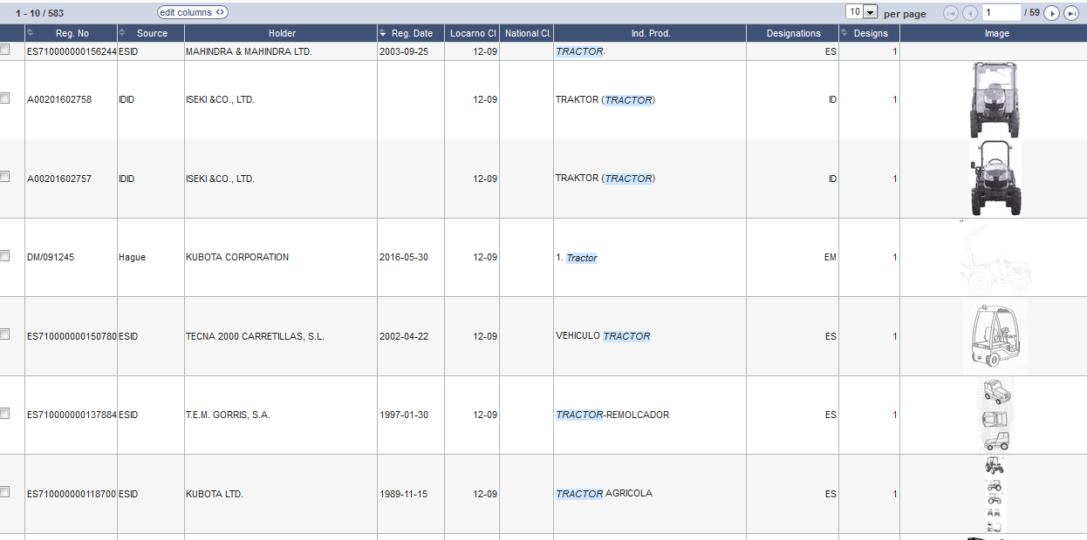
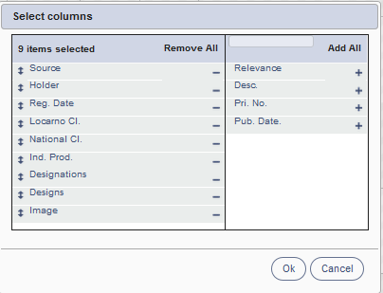
Results

Slide 27
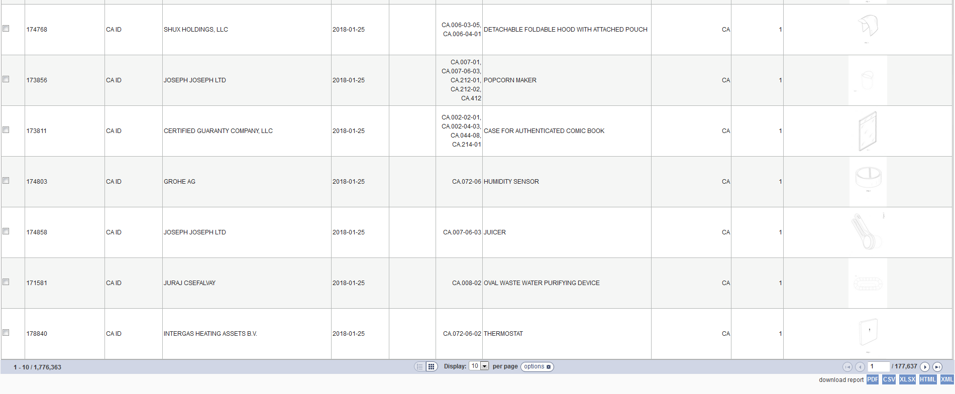
Download reports

Slide 28
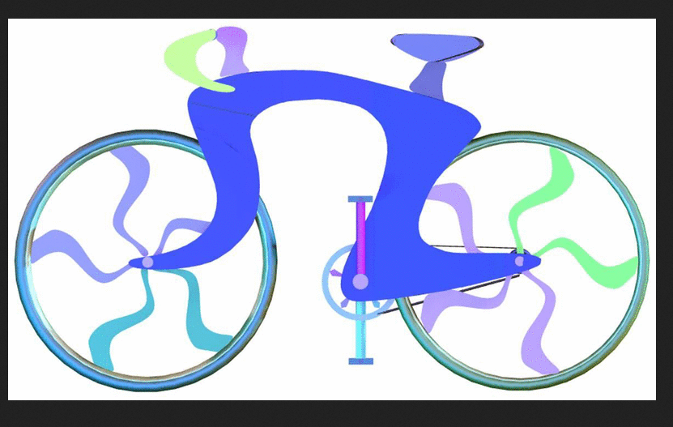
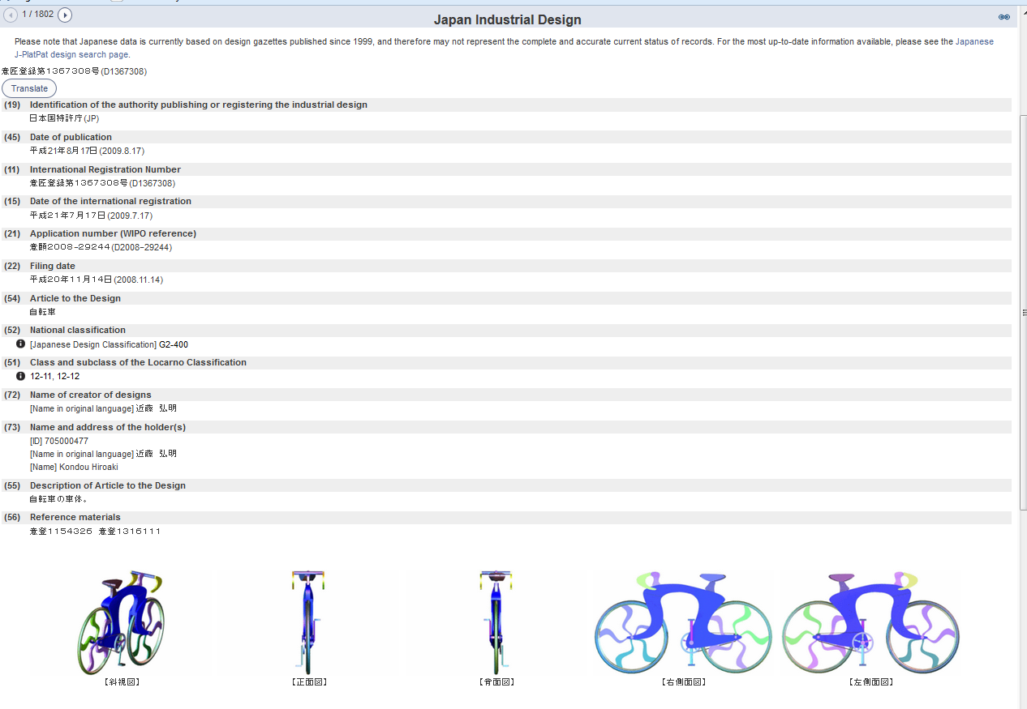
Individual record

Slide 29
5

Slide 31
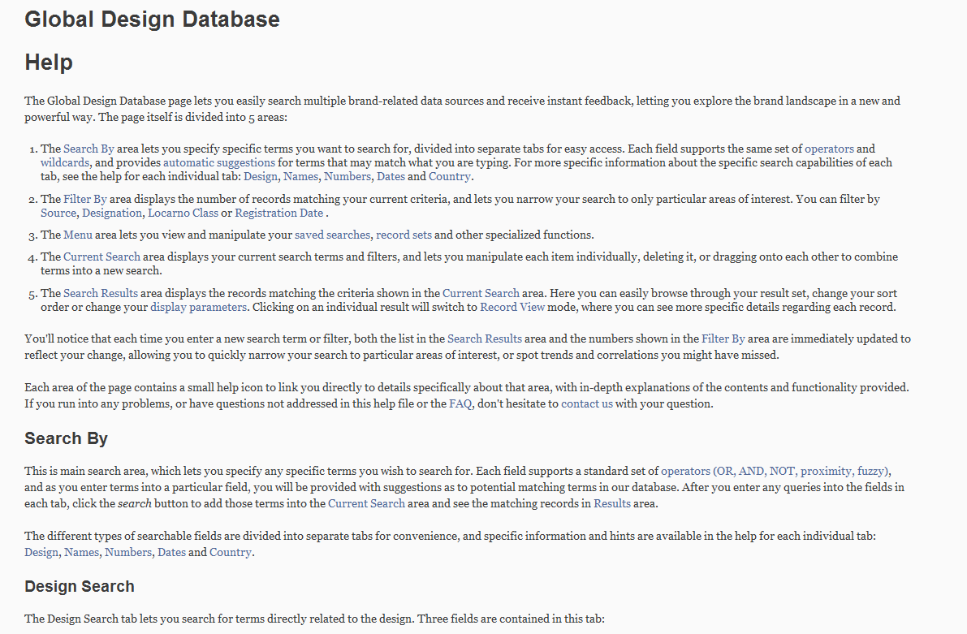
Help

Slide 32
Plans for the future
Hague designs before 1999
Add more collections: DE, KR, EM

Slide 34
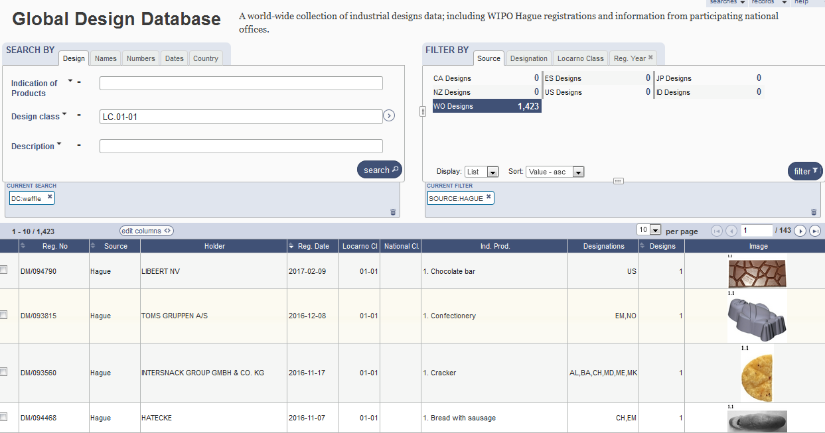
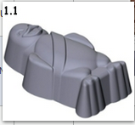

Slide 35
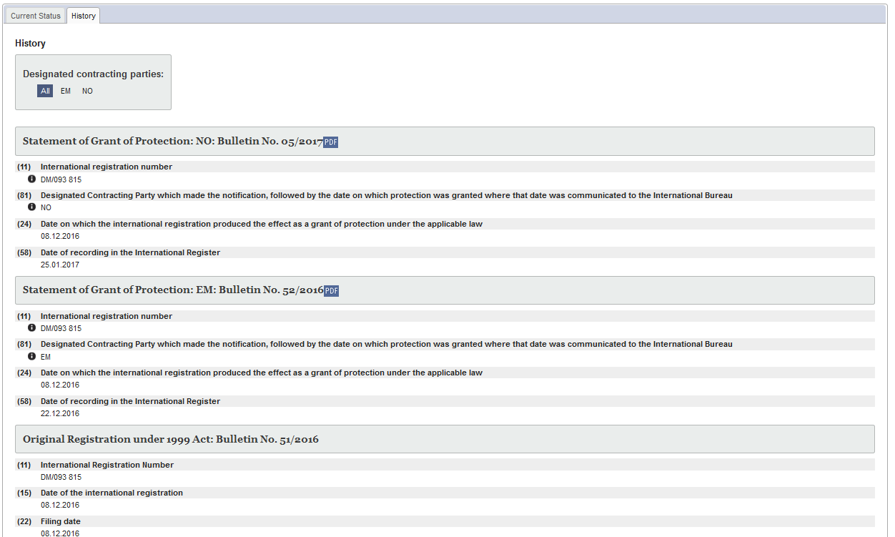
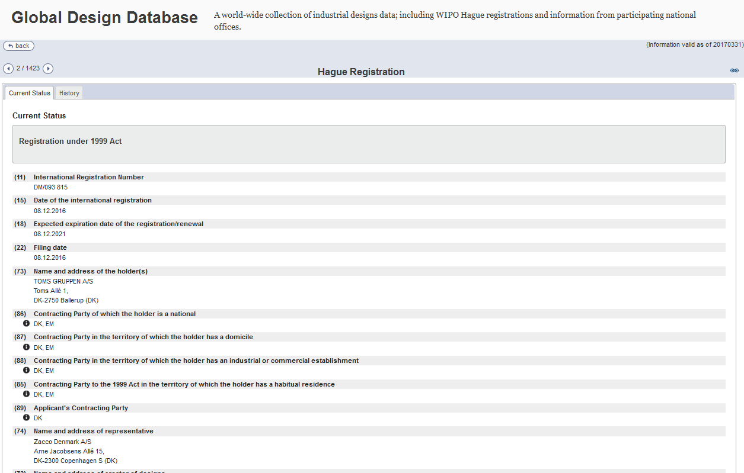

Slide 36
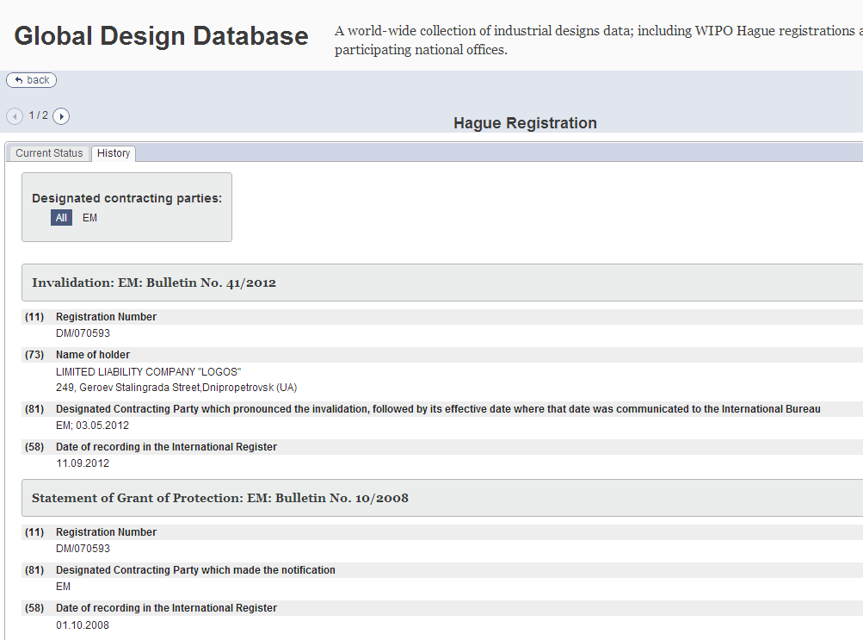

Slide 37
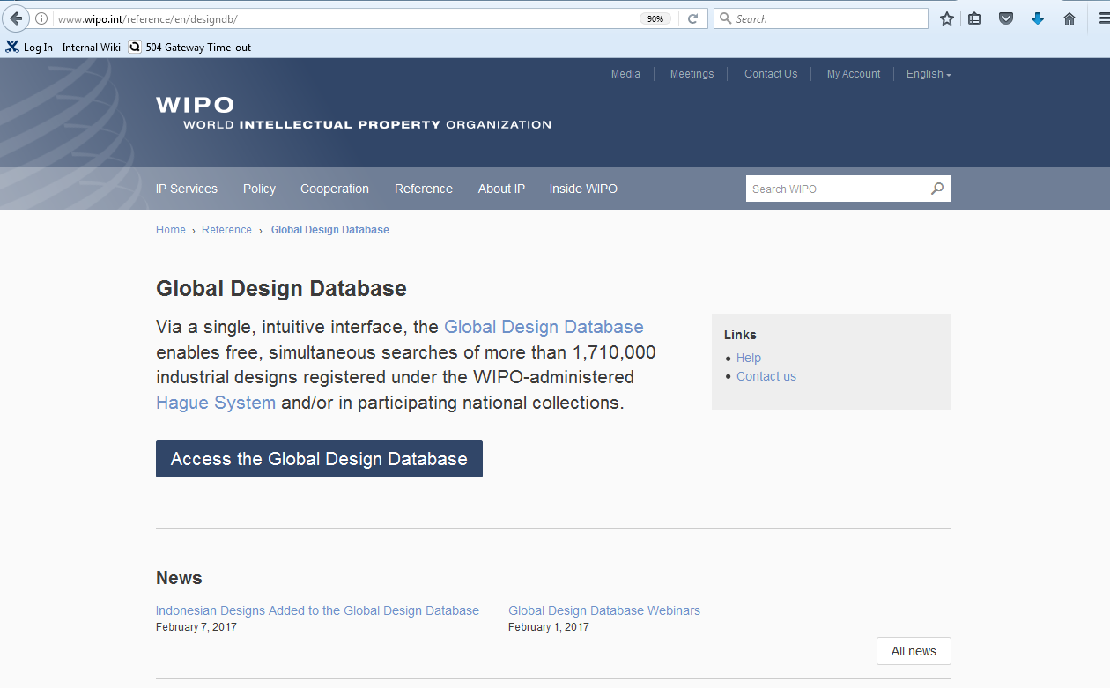

Slide 39
mulțumesc
mulțumesc
gbd@wipo.int

