Slide 1
South-South IP cooperation: Challenges & Opportunities
Session 4:
South-South and Triangular Cooperation Partnerships for Technology Transfer
Dr Sifeddine LABED
INTERREGIONAL EXPERT meeting – Lima, PERU 05, 06 May 2015
South-South and Triangular Cooperation for Access to Information and Knowledge, Innovation Support, and Technology Transfer

Slide 2
R
E
S
U
M
E
Dr Sifeddine LABED

Slide 3
organization of five regional technology transfer consultation meetings; 2. elaboration of six peer-reviewed analytic studies; 3. drafting of a concept paper on building solutions as the basis for discussion at the International Expert Forum, to be submitted to the CDIP for approval; 4. organization of an International Expert Forum in the form of an international conference; 5. preparation and provision of materials, modules, teaching tools and other instruments resulting from recommendations adopted at the High-Level International Expert Forum; 6. creation of a Web Forum; and 7.the incorporation of any outcome resulting from the above activities into the WIPO programs, after consideration by the CDIP and any possible recommendation by the Committee to the General Assembly.
The Project on Intellectual Property and Technology Transfer
“Common Challenges - Building Solutions”,
approved by the Committee on Development and Intellectual Property (CDIP) at its sixth session, held in November 2010, envisaged the following project deliverables:
FACTUAL REPORT
http://www.wipo.int/edocs/mdocs/mdocs/en/cdip_15/cdip_15_5.pdf

Slide 4
Session 2 & 3: Measures for Promoting International Technology Transfer: Challenges and Solutions
Moderator:
Ms. Alison Brimelow, Chairman,
Centre for Copyright and New Business Models in the Creative Economy (CREATe), Programme Advisory Council of the UK Research Councils, University of Glasgow, Glasgow, United Kingdom
Mr. Jaroslav Burčík, Director, Technology and Innovation Center, Czech Technical University, Prague, Czech Republic;
Mr. Francisco Rafael Cano Betancourt, Director, Planning, Evaluation and Development, National Council for Science and Technology, Guatemala City, Guatemala;
Ms. Sherry Knowles, Principal, Knowles Intellectual Property Strategies, LLC, Atlanta, Georgia, United States of America;
Mr. Sifeddine Labed, Director, Formation, Research, Innovation and Technology Transfer, Ministry of Information and Communication Technologies (ICTs), Algiers, Algeria;
Ms. Allison Mages, Senior Counsel, IP Procurement and Policy, General Electric Company, Representative from the Intellectual Property Owners Association, Washington, D.C., United States of America;
Mr. McLean Sibanda, Chief Executive Officer (CEO), Innovation Hub, Pretoria, South Africa;
Mr. Wenhuan Xia, Director, Business Development, Transpacific IP Group Limited, Beijing, China;
Ms. Audrey Yap, Founding Partner and Head, IP Department, Yusarn Audrey, Singapore

Slide 5
Debate Topics
1. Capacity Building
2. Global Cooperation
5. Innovation Infrastructure
6. Funding/Evaluation Mechanisms
4. Regulatory Framework
3. Institutional Framework

Slide 6
Outcome of the Forum
GENERAL REMARKS
(i) that the perception was that international technology transfer was effective but was yet at a low level; and
(ii) that, in terms of the human capital, there was a deficit, as people were at the center of ideas and were the enablers of international technology transfer.
(a) Design a technology transfer platform that would provide information on technologies that are available (“the gives”) and those that are needed (“the needs”). This could then evolve into a technology transfer matchmaking platform.
(b) Disseminate best practice illustrating effective cases of international technology transfer, using, inter alia, existing WIPO platforms and success stories from the Global Innovation Index, through periodic regional events.
(c) Set up a WIPO Technology Transfer Helpdesk, servicing the needs of Member States, to promote information exchange on technology transfer opportunities and failures, eventually evolving into a “clearing-house” for information and technologies.
(d) Conduct empirical work on science parks, incubators and accelerators and their effective use of intellectual property for technology transfer.
(e) Develop training materials that are case study-based to enable more effective technology transfer.
(f) Raise awareness on the importance of an IP framework, including the accession to PCT, Madrid and Hague systems, which is a necessary but not sufficient condition for effective technology transfer.
(g) Identify ways to use IPR from publicly-funded research for socio-economic development and implement them with local specific needs, given that ‘one size does not fit all’.
(h) Continue work on international technology transfer, which was useful and should be endorsed by the CDIP.

Slide 7
Final Comment
Finally, it was emphasized that WIPO should continue working on the theme of technology transfer through an appropriate instrument and that there should be broader, more holistic approach for promoting international technology transfer, including WIPO, governments, but also a wide array of other relevant stakeholders.
The factual report has been presented at the CDIP April 2015, and was approved by the member delegates

Slide 8
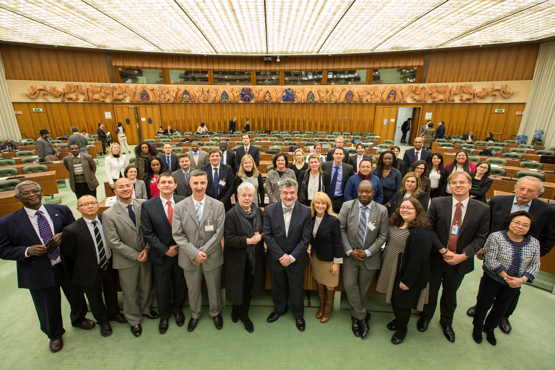
Photo of Mr Matus (WIPO), Expert’s Moderator, Experts, Mr Djazairy (WIPO), some member delegates and attendees of the Expert Forum for International Technology Transfer

Slide 9
Preamble
Developping and LDC’s countries share common problems:
Population Growth
Energy
Water
ICT
Health and Drugs
….etc.
Partnership is thus a necessity

Slide 10
South-South TT Initiatives
CASE 1 : BILATERA L PARTNERSHIP
Algeria-South Africa: Space Technology
CASE 2: TRIANGULAR PARTNERSHIP
AIEA – Algeria –African Countries: Agriculture & Biotechnology
CASE 3: REGIONAL PARTNERSHIP
EUROMED - Renewable Energies

Slide 11
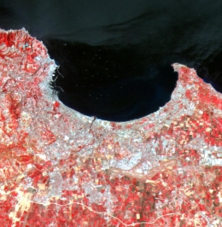
Case 1: South-South PARTNERSHIP Algeria-South Africa Space Programs
Overview Initiative/ Partnership:
Exchange expertise and technology transfer in designing satellites
Rationale:
Better use of satellite images in tackling socio economic problems (architechture planning, highways, soil degradation…etc)
Develop efficient tools for decision making process

Slide 12
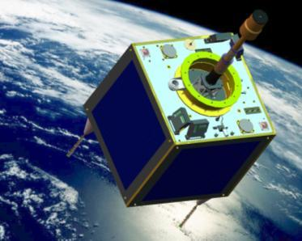
Satellite images for tackling socio economic problems
Main Partners:
ASAL (Algerian Space Agency)
SANSA (South African Space agency)
Target application domains:
Mapping, Management of ressources (agriculture, water, forests, mines and oil), locust fight, management of natural disasters, territory planning)

Slide 13
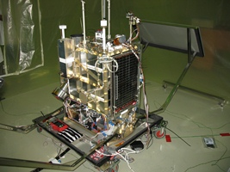
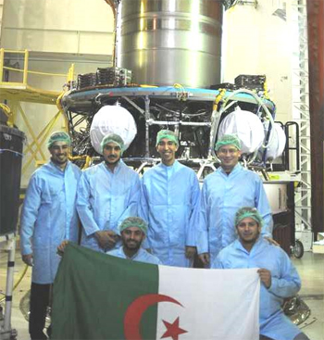
Moving forward in Science cooperation with Mixed R&D teams
state-of-the-art satellite assembly, integration and testing services
satellite systems and sub-systems coordination and development
human capital development and science advancement in space engineering
an environment conducive to industrial participation in satellite system development and sub-system development.

Slide 14
ALGERIA – SOUTH AFRICA COOPERATION R & D AND ACCESS TO KNOWLEDGE AND INFORMATION
FIELD | PROJECT | ALGERIA | SOUTH AFRICA
BIOCHEMISTRY | Bio guided isolation of biologically active compounds from recalcitrant South Africa seeds and endemic medecinal plants from Algerian sahara | Pr. CHERITI Abdelkrim Université de Bechar | Dr. Patrick GOVENDER University of KwaZulu-Natal
CHEMISTRY | Design, synthesis, characterization and biological evaluation of novel azaartemisinin derivatives | Pr. BENALI-CHERIF Noureddine Université Khenchela | Dr. David Dago N’DA North-West University
 | Biological & electrochemical activity of nanoscale transition metal dendrimers & novel polydentate Schiff base complexes | Dr. Achour Terbouche Centre de Recherche en Analyse Physico-chimique (CRAPC) | Dr. Gregory Smith University of Cape Town (UCT)
ENERGY | Determining the suitability of using wastwater as a substrate for algal propagation | Dr. ZEROUKIDjamel Université Kasdi Merbah De Ouargla | Pr. Faizal Bux Durban University Technology
 | Experimental and Numerical Investigation of Refrigerant Condensation in Inclined Tubes of the Cooling Towers of Concentrated Solar Systems | Pr. RAHAL Samir Université Hadj Lakhdar de Batna | Pr. Josua Petrus Meyer University of Pretoria
 | Integration and performance optimisation of hybrid renewable energy systems (hres) | Pr. ZAATRIAbdelouahab Université de Constantine1 | Pr. John Terhile AGEE Tshwane University of Technology
ICT | New machine learning techniques based on tree automata and rational kernels | Dr. CHERROUN Hadda Université Amar Telidji de Laghouat | Pr. Bruce WATSON Stellenbosch University
NANOSCIENCES | Preparation and Properties Characterization of Polyamide/Clay Bionanocomposites | Pr. Mustapha KACI Université Abderahmane Mira de Béjaia | Pr. Walter Wilhelm FOCKE University of Pretoria
 | Synthesis Of Metal-Oxide/Graphene foam (GF) - MO/CNTs Hybrid Nanostructured Materials and Their Applications in Energy Related Areas | Pr. GUERIOUNE Mohamed Université Badji Mokhtar d'Annaba | Pr. Ncholu Manyala University of Pretoria
WATER | Valorization & sustainable management of sludge residues from the waste water treatment plant of the city of Tiaret (Algeria) & Makana Municipality (South Africa) | Pr. DELLAL AbdelkaderUniversité de Tiaret | Dr. Roman Tandlich Rhodes University
ASTRONOMY/NUCLEAR PHYSICS | Laboratory measurements of nuclear date relevant to astrophysics and gamma astronomy | Pr. OUICHAOUI Saad Université des sciences et de la technologie Houari Boumediene (USTHB) | Dr. Elana LAWRIE Themba LABS

Slide 15
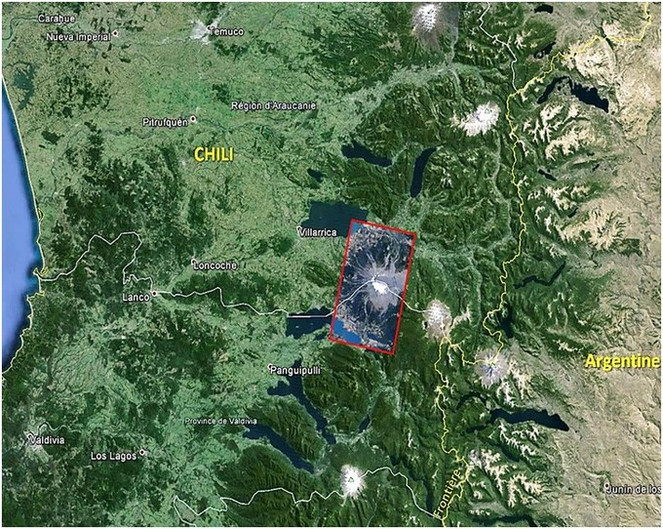
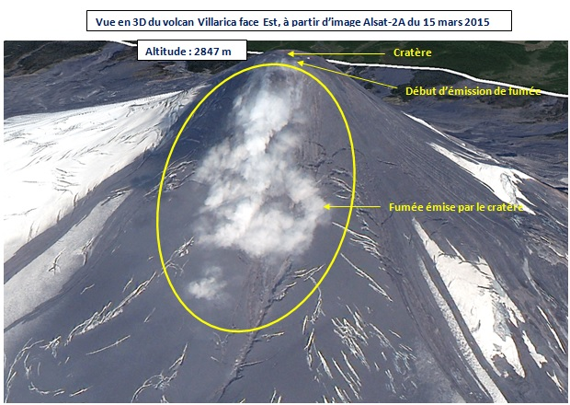
A good example of the usefulness of satellite images: The Villarrica Vulcano (Chile) eruption (march 2015)

Slide 16
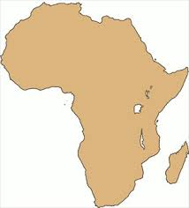
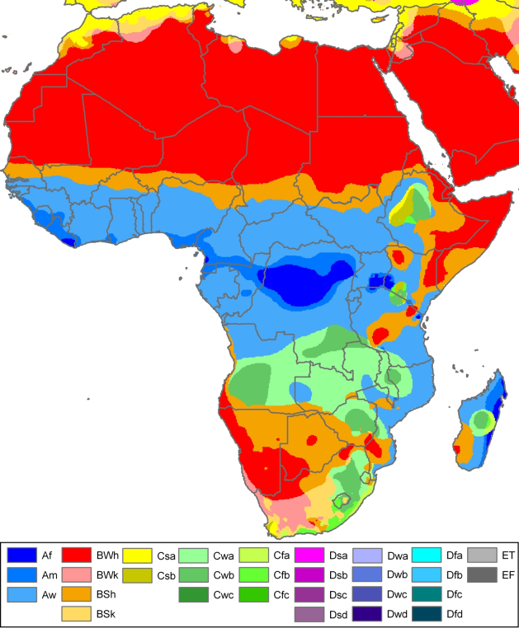
Case 2: Triangular PARTNERSHIP
AIEA – ALGERIA & AFRICAN COUNTRIES
Enhancing the Productivity of High Value Crops and Income Generation with Small-Scale Irrigation Technologies
RAF 5058
Overview Initiative/ Partnership:
To develop and pilot test appropriate irrigation systems (methods and related water/nutrient management practices) for small-scale farmers for increasing yield, quality of high value crops and farmers income to improved livelihood
Rationale:
smallholder farmers require appropriate irrigation technologies to enable production for the market
A better knowledge of soil characteristics especially in arid regions is a key issue
the access and availability of appropriate irrigation technology, accessibility to quality seeds
cost and knowledge on the effective use of inorganic and organic fertilizers, extension services and market information

Slide 17
Agriculture & Desertification in Africa: Water availability Vs Arid Zones
Main Partners:
IAEA (International Atomic Energy Agency)
INRAA (National Institute of Research in Agronomy-Algeria)- Focal Point
Some African Countries: Tanzania, Cameroon, Seychelles, Zimbabwe, Mali, Ivory Coast, Nigeria, Ghana, Kenya, Sudan, Egypt, Mauritius, Uganda, Botswana and Benin

Slide 18
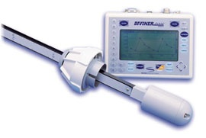
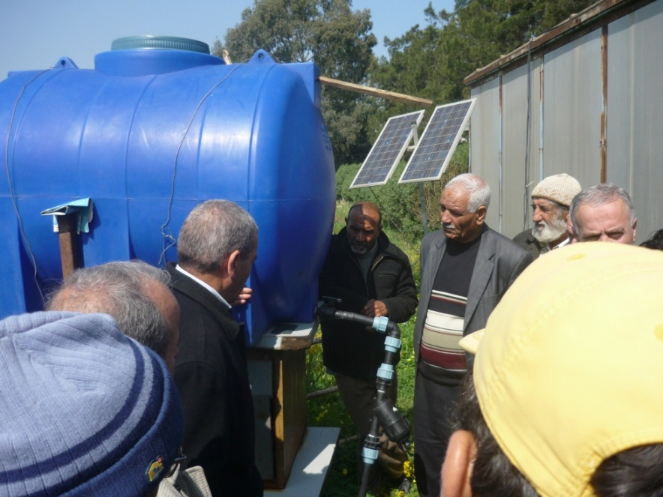
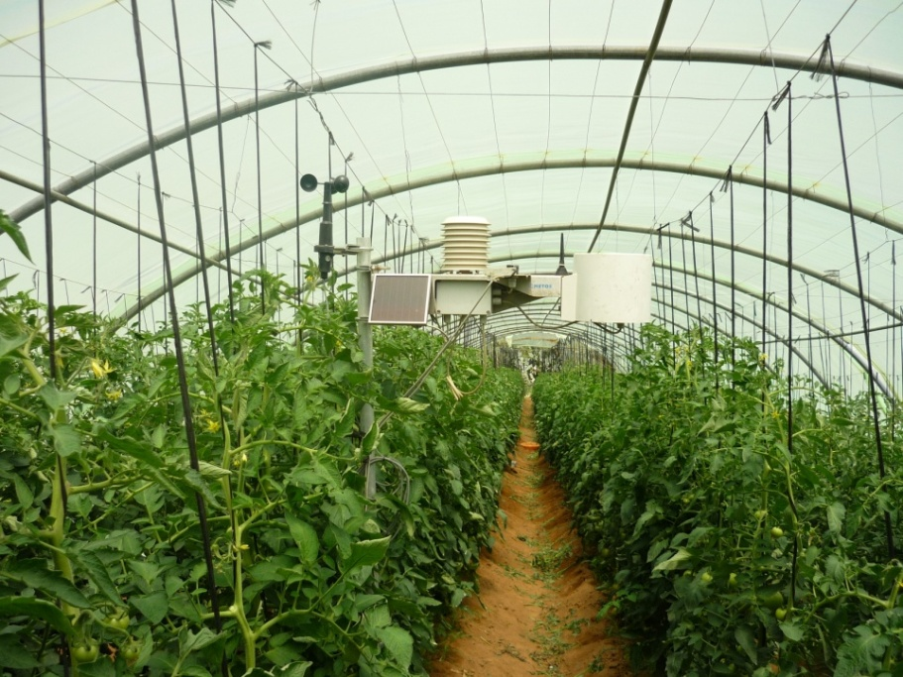
Pilot plant at INRAA-Algiers
Advantage of Nuclear Techniques:
Allow the changes in soil water content and crop water requirement to be determined accurately especially under saline conditions
Isotopes water (O, H2): indicator water lost (evaporation). Impact: Efficient evaluation of land and water management
Isotopes of Nitrogen (N): indicator of fertiliser. Impact: The quantity of Nitrogen that can be generated by the nitrogen-fixing plants.
Isotopes of Carbon (C): Indicator of water use efficiency of crops and its tolerance to drought and salt in the soil. Impact: How to conserve scarce rainfall by mulching, crop residue retention, crop rotation, crop varieties adapted to drought conditions

Slide 19
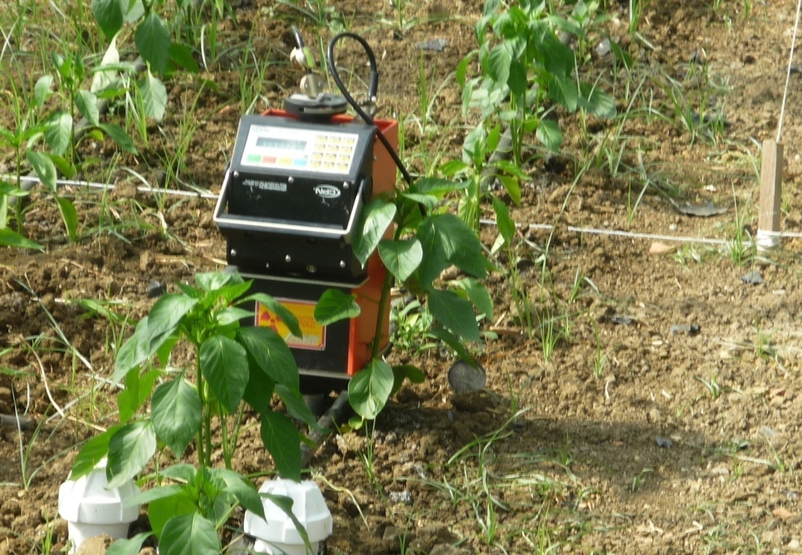
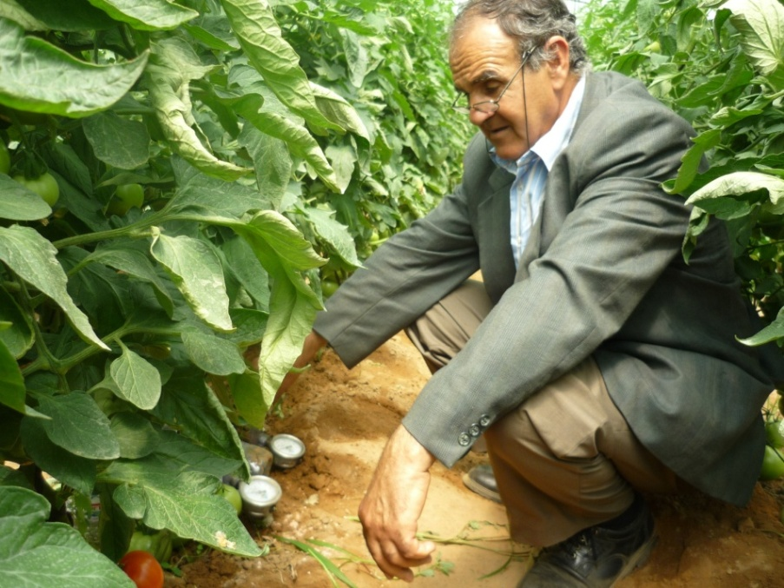
Scientific impact of Technology Transfer
On site measurements and monitoring

Slide 20
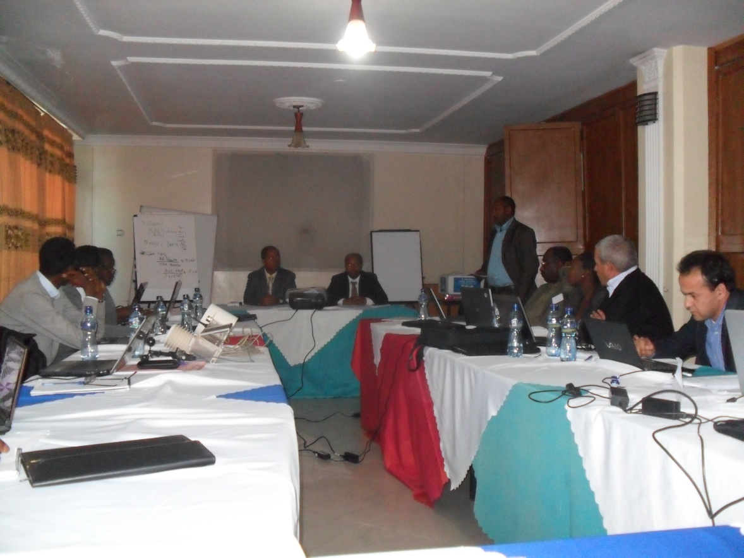
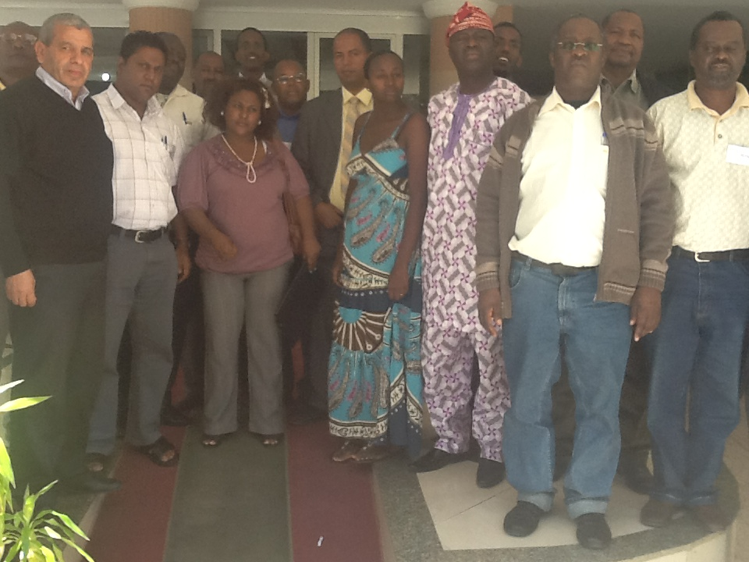
Capacity building :Trainings / Workshops
Sharing Knowledge and expertise

Slide 21
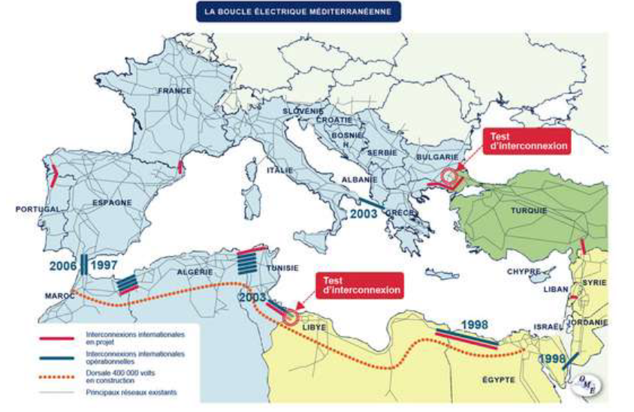
Case 3: The EUROMED
Renewable Energies Program

Slide 22
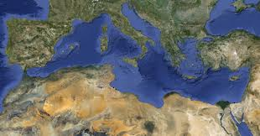
Euromed ECOSYSTEM -2030 (IPEMED)
Knowledge Transfer Competencies & Technologies
Human Capital/ Mobility
Project’s Selection/Job creation
Euromed Environment Fund + Solar Energy
Transport Networks/
Comerce South South
Euromed investment Bank
Euromed Policy Food Security
Product’s certification
Institutional Space

Slide 23
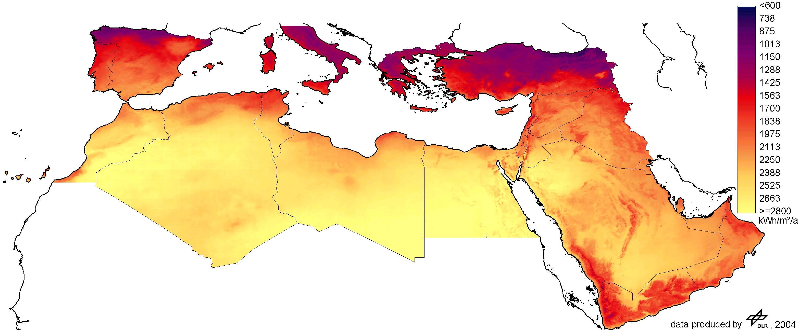
The solar potential in the Maghreb Region
The highest worldwide solar concentration

Slide 24
The UMA (Union the Arab Maghreb) Renewable Energies Initiative
Increase investments by accessing to funding sources and facilitating multi actors partnerships with international finance institutions, the private sector and the banking sector
Accelerate the emergence of an integrated regional market of green electricity with related reforms
Promote the development of a regional competitive industrial tissue
Valorize existing know-how and develop regional competences, innovation capacities and technology transfer
Reinforce dialogue and coordination at a regional level favoring policies convergence, reinforce synergies, increase the impact of national and regional initiatives and ensure the follow up of regional policies

Slide 25
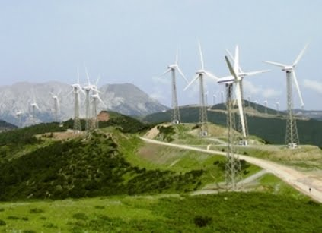
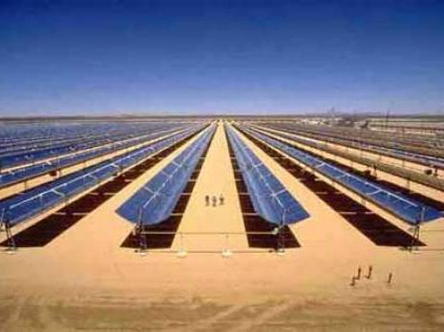
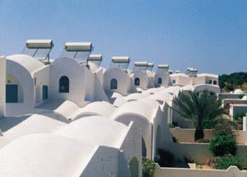
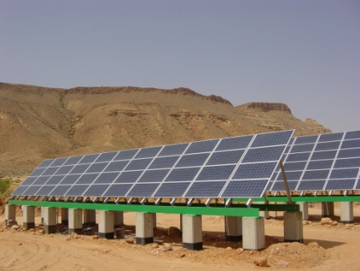
Renewable Energies in The Maghreb Region:
Challenging Goals
Country | Time frame | Objective (% National Energy Balance) | Capacity to Install (MW)
MORROCO | 2020 | 42% (14% solar, 14% Wind, 14% Hydro) | CSP/ PV 2000, Wind 2000, Hydro 2000
ALGERIA | 2030 | 40% (37% solar, 3% Wind) | CSP 7200, PV 2800, Wind 2000
TUNISIA | 2030 | 30% (15% Wind, 10% PV, 5% CSP) | Wind 1760, CSP 460, PV 1500, Biomass 300
LYBIA | 2020 | 10% (54% Wind, 30% CSP, 16% PV) | Wind 1500, CSP 800, PV 450
MAURETANIA | 2020 | 20% | NA

Slide 26
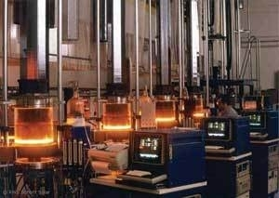
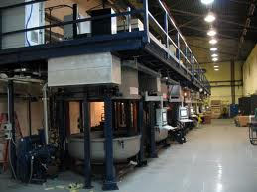
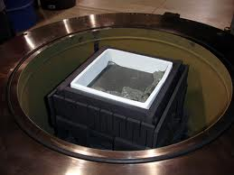
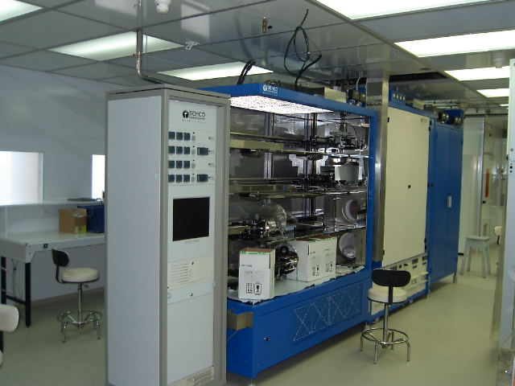
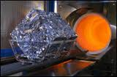
Alliance of companies & R-D Centres: A key success to technology transfer – CRSTE (Algeria) as an example
Carboreduction
2000°C
Crystal Growing
1580°C
Thermal Diffusion
Screen-printing
800 - 850°C
Mastering advanced technologies

Slide 27
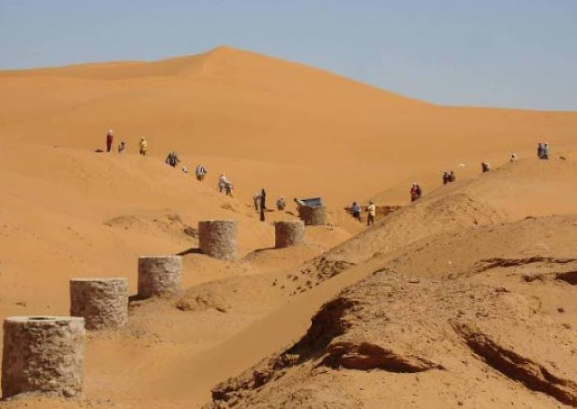
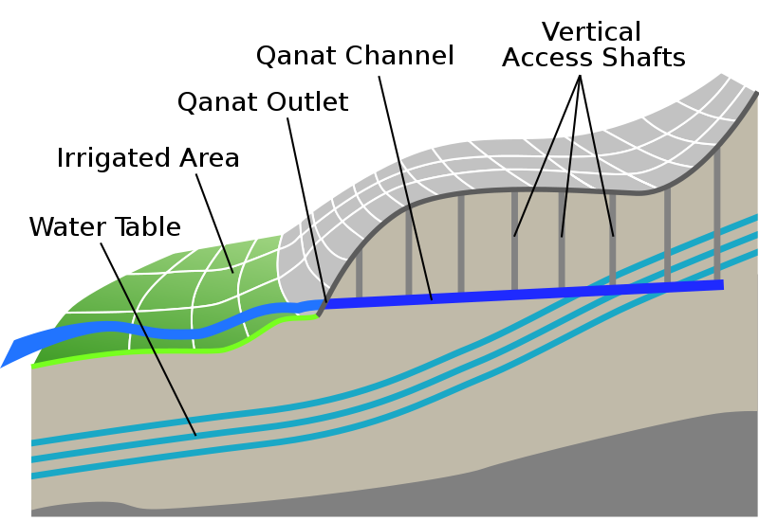
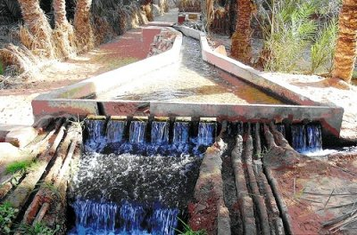
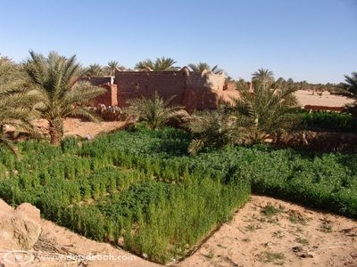
Citation: Wise people learn from their ancestors

Slide 28
Tracks for South-South partnership
National Systems of Intellectual Property
National System of Innovation
Twinning R&D activities
Sharing experiences and best practices
Exchanging expertise in science and technoparks
Drafting and setting national strategies in Technology Transfer

