Slide 1
Session 4:
South-South and Triangular Cooperation Partnerships for Technology Transfer
ETPL: A*STAR’s Commercialisation Technology
Ho Cheng Huat, Executive Vice-President,
IP Management Division, ETPL
Wednesday, 6th May 2015

Slide 2
Presentation Outline
Who we are
Technology Transfer Activities
Summary

Slide 3
What is ETPL?
Exploit Technologies Pte Ltd
The technology transfer arm of the Agency for Science, Technology and Research (A*STAR) in Singapore.
As an industry-research interface, ETPL provides a suite of services catered to the needs of our industry and research partners.
ETPL has teams of technology transfer professionals to harness new technologies, increase the value of intellectual property and incubate cutting-edge business ventures to create tangible commercial impact.

Slide 4
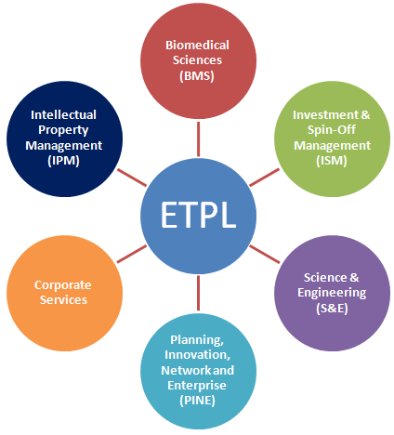
ETPL
Vision
To be the one-stop partner of choice to grow businesses through technology commercialisation in Singapore and beyond.

Slide 5
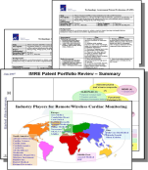


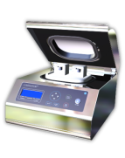




A Full Spectrum Technology Transfer Office
Commercialisation Value Chain
IP Management
Bridging the Gap
Licensing/
Spin-off
Protect Knowledge
Manage
A*STAR’s IP portfolio
Incubate Technology
Improve technology readiness levels for industry adoption
Transfer Knowledge
Commercialise technology

Slide 6
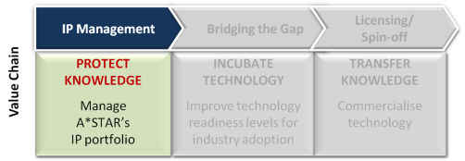
Protecting Knowledge
Portfolio Analysis and
Commercialisation Evaluation
(PACE) matrix to:
    Strategise the commercialisation plan;
    Prioritise the commercialisation effort; and
    Manage the IP portfolio by deciding the
    scope of patent required.
Technology Analysis
Filing and Prosecution
Maintenance
Priority filing (1st Filing)
50%
2nd Filing
75% of 1st Filing
Grants
50% of 1st filing
Analyze TDs
~600 TDs Annually
Patenting Trend

Slide 7
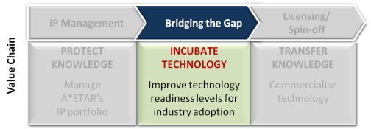
Incubating Technology
Gap Funding
Developing technology to a higher TRL Level
 | Conceptualization |  |  | Concept Refinement | Technology Development |  | System Development & Demonstration |  |  | Production & Deployment
TRL# | 1 | 2 | 3 | 4 | 5 | 6 | 7 | 8 |  | 9
Relative level of Technology Development | Basic Principles observed | Concept Formulated | Proof of Concept | Component/or system validated in lab. environment | Lab scale, similar system validated in relevant environment | System/sub system or Prototype demonstrated in relevant environment | Full scale/ Prototypical system demonstrated in operational environment | Actual Systems Qualified through test and demonstration |  | Mission proven
A*STAR’s Focus | Output from Research Institutes’ core fund*
 |  |  |  | Commercialisation efforts: Joint lab., RCA, Consortia, Gap Fund, TAP, Translation Centre **
Industries |  |  |  | Product development; customers’ validation and mass production

Slide 8


Incubating Technology
Gap Funding
Possible outcomes
Validation Studies
Scaling up
Production
Personal Genomics Solutions
Commercial Outcomes
PRL Monoclonal Antibodies
Driving Collaborations & Licensing
Developing Prototypes
Forging Collaborations
I2R’s 60GHz Chipset Development

Slide 9
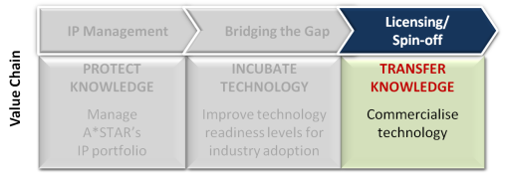

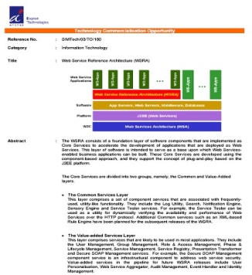

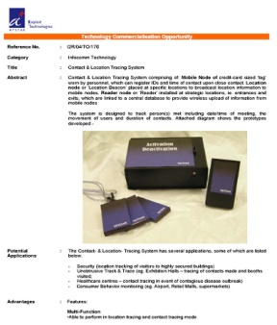
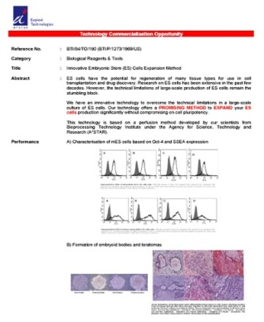
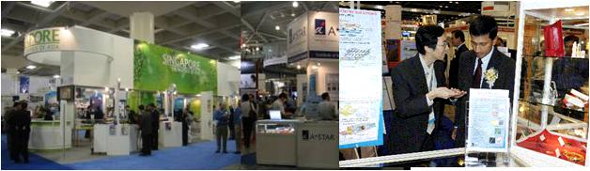

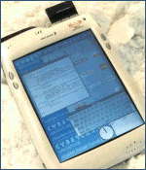
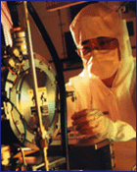
Transferring Knowledge
Licensing
Enabling our licensees to be competitiveness
Technology Offers
Trade Shows and Conferences

Slide 10
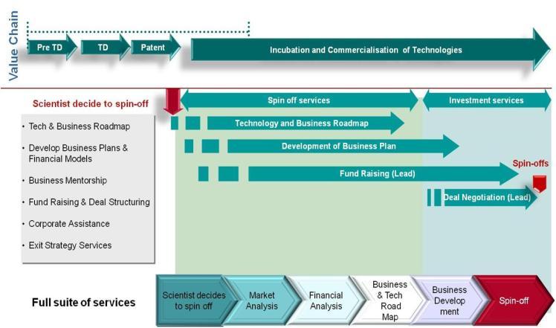
Transferring Knowledge
Investment and Spin-Off Management
Nurturing Scientific Entrepreneurs

Slide 11
Vision
A one-stop innovation partner of choice to grow business through technology commercialization in Singapore and beyond
Innovation Partner of Choice
Grow Businesses
Playmaker to shape a vibrant I&E ecosystem
Creating innovative solutions
Deepening engagements
IP management and strategies
Knowledge Protection

Slide 12
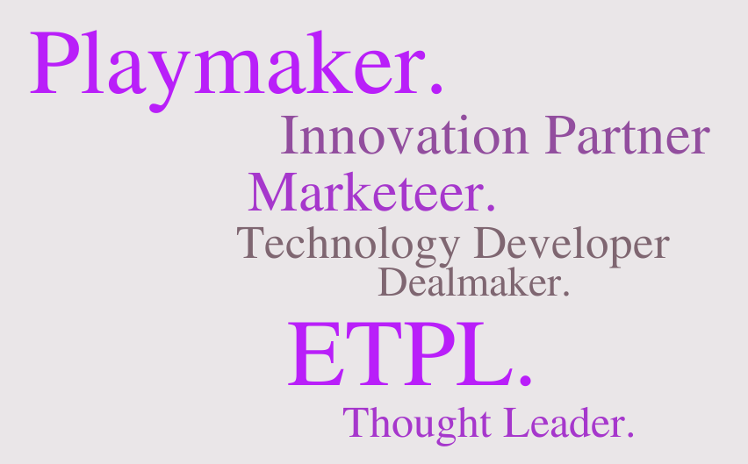
Innovation Partner of Choice
Government Agencies
NRF, EDB, SPRING, etc.
Research Community
Trade Associations
Distinguished Technopreneurship Speaker Forum
Ideation Bootcamp
A*STAR Scientific Conference
A*STAR-ASME Technology Day
Other TTOs
InnovFest
Presentation on I & E papers in international conferences
MNCs & Local Enterprises/SMES
Joint grant call
A*STAR SME Day
GET-UP/TAP
MediaExploits
Hackathon
i-Alert
Industry roundtable / forum
Start ups
Tech Venture
Start-up Asia
Action Community for Entrepreneurship (ACE)

Slide 13











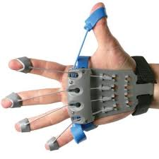

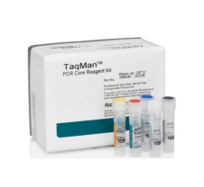


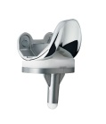

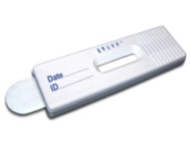
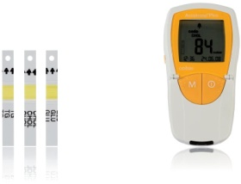


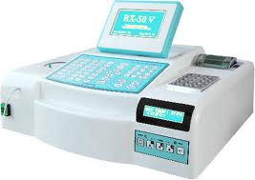


Diagnostics Development (DxD) Hub
2. Research Performers
DxD HUB
Regulatory Navigation
ISO Design and Development
Clinical Validation
Talent Management
Competency Creation
Market Strategy
Industry Standardisation
Productisation
Co-ordinate, manage and perform product focused regulatory and development activities to transform ideas into market ready products
1. Clinicians
4. Market
Design
Optimisation
Design
Verification
Clinical
Validation
Products
Reagents/
Diagnostics Assays
Rehabilitation
Imaging Tools
3. Local Co-development Partners
PoC /Lab Analysers

Slide 14



Gearing for 2020: Shaping for Success
Towards Co-Innovation
MARKET-NEED DISCOVERY
User & enterprise drive needs & solutions
Better inform science
OUTCOME-DRIVEN INNOVATION
Enterprise co-innovation
New products & services
New specifications/business models
INDUSTRY PULL
CLARITY OF APPLICATION
RESEARCH & VALUE CREATION
Research to enhance competitive advantage in key sectors
DEVELOPMENT & TRANSLATION
IP proliferation
and acceleration
COMMERCIALISATION & VALUE CAPTURE
Bringing products to market and supporting start-ups & spin-offs
TECHNOLOGY PUSH
TRL

Slide 15



Towards Co-Innovation
MARKET-NEED DISCOVERY
User & enterprise drive needs & solutions
Better inform science
OUTCOME-DRIVEN INNOVATION
Enterprise co-innovation
New products & services
New specifications/business models
Design Thinking
Specialised Platforms
Advisory Panels

Slide 16



Looking Forward
IP Proliferation
Acceleration
Shaping for Success
Driving outcome-driven innovation
Informing Research through market need discovery
Better growth in licensing revenue
Greater value capture through licensing
More impact with start-ups

Slide 17


Publications
https://www.etpl.sg/innovation-offerings/publications
This report aims to inform ETPL's stakeholders on our role and contributions to the national plan.
This Handbook is a starting point for A*STAR researchers to bring their inventions from Mind to Market through the technology transfer process.

Slide 18
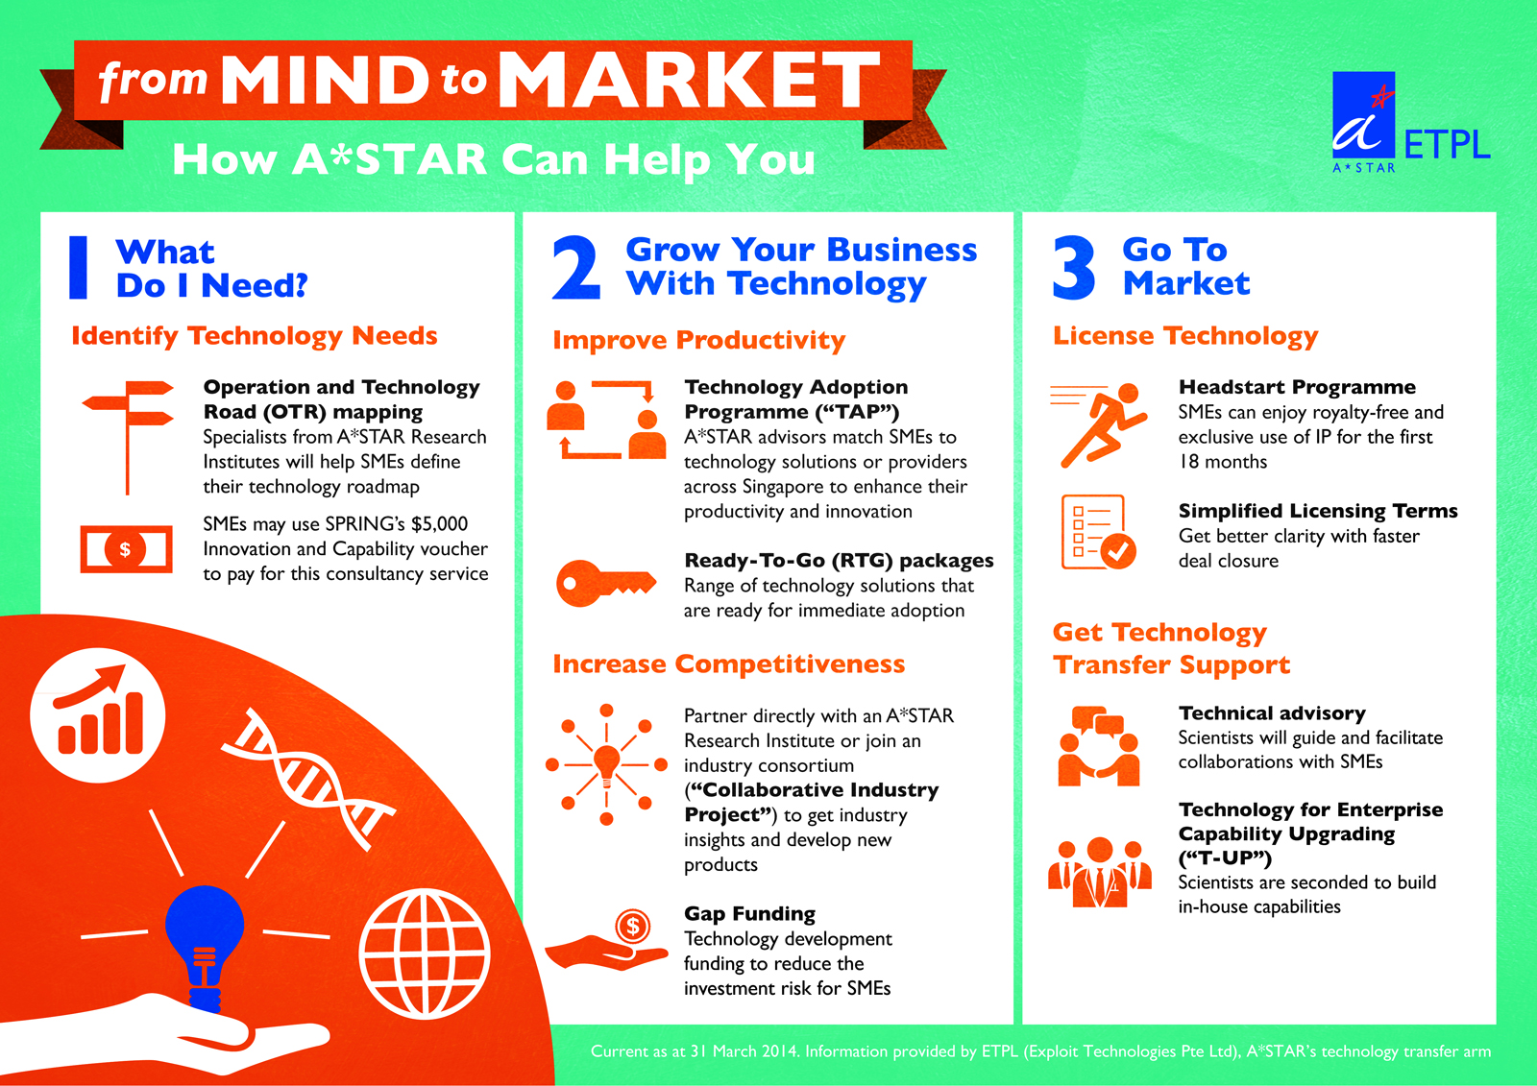
Summary of A*STAR’s Innovation and
Technology Transfer Programmes

Slide 19

End of Presentation
ETPL’s website: www.etpl.sg

