Slide 1
SECOND WIPO INTER-REGIONAL MEETING ON SOUTH-SOUTH COOPERATION ON PATENTS, TRADEMARKS, GEOGRAPHICAL INDICATIONS, INDUSTRIAL DESIGNS AND ENFORCEMENT
Cairo, Egypt
May 6 to 8, 2013
Supporting Innovation, Technology Transfer, Patent Information and Knowledge Dissemination – Regional Experience
Emmanuel Sackey
Chief Examiner. ARIPO

Slide 2

Geographical Distribution of Member States of ARIPO
The Gambia
Sudan
Somalia
Sierra Leone
Kenya
Ghana
East Africa
Uganda
Liberia
Rwanda
Tanzania
West Africa
Zambia
Malawi
Zimbabwe
Mozambique
Namibia
Botswana
Swaziland
Central & Southern
Africa
Lesotho

Slide 3
POTENTIAL MEMBER STATES OF ARIPO
Eritrea
Nigeria
Ethiopia
Burundi
Angola
Seychelles
Mauritius
South Africa

Slide 5
ORGANS OF ARIPO
TECHNICAL COMMITTEE
STAFF AFFAIRS
COMMITTEE
Ministers responsible for IP matters – IP High Level Forum for Decision Making on Policy Issues;
Administrative Council – Forum for IP Experts to determine development of IP;
Committees and Board of Appeal – for specialized functions ;
Secretariat – day to day operations of the Organization on IP matters.

Slide 6
ARIPO LEGAL INSTRUMENTS
LUSAKA AGREEMENT
Adopted 1976
HARARE PROTOCOL
Adopted 1982
BANJUL PROTOCOL
Adopted 1993
DEVELOPMENT AND HARMONIZATION OF IP LAWS
TO PROMOTE AND EVOLVE COMMON VIEWS AND APPROACH ON IP MATTERS
TO FOSTER CLOSE COOPERATION AMONG THE
MEMBER STATES
FACILITATE TECHNOLOGY TRANSFER AND DEVELOPMENT OF APPROPRIATE TECHNOLOGY
UNDERTAKE CAPACITY BUILDING, AWARENESS CREATION AND RESEARCH STUDIES
TO PROMOTE THE DEVELOPMENT OF COPYRIGHT , GENETIC RESOURCES, TK
AND FOLKLORE
TO REGISTER AND ADMINISTER THE FOLLOWING IP TITLES –;
PATENTS
UTILITY MODELS
INDUSTRIAL DESIGNS
TO REGISTER AND ADMINISTER TRADMARKS AND SERVICE MARKS

Slide 7
NEW LEGISLATIVE DEVELOPMENTS
SWAKOPMUND PROTOCOL
Adopted in 2010
PROPOSED REGIONAL FRAMEWORK ON ABS
PROPOSED REGIONAL PROTOCOL ON PLANT VARIETY PROTECTION
PROTECT NATIONAL AND TRANSBOUNDARY TK AND FOLKLORE
PREVENT MISAPPROPRIATION AND BIOPIRACY
PROMOTE THE DEVELOPMENT AND UTILIZATION OF THE RESOURCES FOR WEALTH CREATION
TO BE BASED ON THE NAGOYA PROTOCOL
PROTECT PLANT BREEDERS RIGHTS AND PROMOTE AGRICULTURAL DEVELOPMENT

Slide 8

The Main Objectives of The Harare Protocol
Promote, Harmonize & Develop Industrial Property in the Member States of ARIPO;
Facilitate the protection and administration of Patents, Industrial Designs and Utility Models in the Contracting States;
ARIPO Patents, Industrial Designs & Utility Models are equivalent to a bundle of national registrations and their administration is centralized and made easier;
Only one Grant, one publication, one agent is needed and
Centralized procedures like: renewal, amendments, representation, etc.

Slide 9
Advantages of the Harare Protocol to the National IP Offices
The Protocol ensures that IP offices handle more applications and therefore receive more revenue that would otherwise be the case
IP Offices save some of the costs of processing applications, particularly publication and grant/registration and renewals since this is done at the ARIPO Office on their behalf
The quality of examination, particularly with regards to patents ensures that the rights granted have a strong presumption of validity
IP Offices with weak infrastructure and limited human and financial resources still offer high standard of protection

Slide 10
SUPPORTING INNOVATION AND ENHANCING THE INDUSTRIAL PROPERTY SYSTEM AT ARIPO
Establishment of Masters in IP at the African University in Mutare, Zimbabwe (trained over 140 graduates). Planning to start MIP programmes in Tanzania (2014), Ghana (2015)
Possibility to establish certificate and diploma programmes for MSMEs
Enhancement of ICT infrastructure – KOICA, ARIPO, WIPO project
Strenghtening IP system through partnersphips and South-South cooperation

Slide 11
ARIPO PATENT INFORMATION AND DOCUMENTATION CENTRE
LIBRARY AND PUBLICATIONS (PRINTED MATTER)
VIRTUAL LIBRARY, INTERNET-BASED DATABASES AND INFORMATION STORAGE DEVICES
SEARCH SERVICES

Slide 12
LIBRARY AND PUBLICATIONS (PRINT MEDIA Collection dates back to 1982
OTHER RESOURCES
Policy and Project
Documents
Patent records
Council documents
SERIALS
Gazettes,
Annual Reports
Magazines
Monographs
BOOKS
IP Laws
Directories
Catalogues
MAINLY USED BY UNDERGRADUATE AND MIP STUDENTS AND STAFF

Slide 13
VIRTUAL LIBRARY, INTERNET-BASED DATABASES AND INFORMATION STORAGE DEVICES
PATENT LITERATURE
BIBLIOGRAPHIC DATA AND ABSTRACT
PAJ, POLite
FULL TEXT OF PJATENTS
Patentscope
Espacenet, USPTO, Japanese IPDL
NON-PATENT LITERATURE (NPL)
COMMERCIAL DATABASE HOSTS
Questel, STN Etc
NON-COMMERCIAL DATABASE HOSTS
aRDi, ASPI, Hinari, AGORA, OARI etc

Slide 14
Why should Patent Information be used
A tool for thinking outside the box
The inclusion of patent information at the beginning of research facilitates the identification of the trends in research and development and expedites the research for effective and readily applicable technical solutions to developmental problems
Guides Management of Research and reduces duplication of efforts
Significant input for licensing, mergers and acquisitions

Slide 15
Rule 4 of the Regulations under the Harare Protocol
ARIPO shall provide upon request patent information services to users of patent services in member and potential member states for the purpose of facilitating the adoption, transfer and acquisition of appropriate technology, the development of local research and the creation of indigenous technology……..

Slide 16
Types of Search Requests for Patent Information undertaken at ARIPO
State-of-the-art-searches;
Monographs (survey of information in a certain field);
Novelty Searches;
Infringement Searches;
Bibliographic data;
Copies of documents;
Selective Dissemination of Information Services (SDI).

Slide 17
USERS OF ARIPO PATENT INFORMATION SERVICES
Research and Development Institutions including Universities and other educational institutions
Government Authorities particularly departments involved in national development planning, industrial and agricultural developments
Industries (private sector) including MSMEs
Parastatals (state enterprises)
IP Administrators, Agents and Attorneys
Students, chambers of commerce, financial institutions

Slide 18
PROMOTING INNOVATION AND BRANDING IN ARIPO MEMBER STATES
Establishment of TTOs in the member states
Working with WIPO to establish TISCs
Working with member states to harness innovation –currently carrying out survey on best practices for strategic policy development
Working with WIPO to brand African products eg spices in Tanzania, Traditional Medicines in Ghana

Slide 19
ANALYSIS OF SEARCH SERVICES AT ARIPO

Slide 20
REASONS FOR SEARCH REQUEST

Slide 21
REQUESTED SEARCH SERVICES

Slide 22
STATISTICAL ANALYSIS OF PATENT INFORMATION SERVICES AT ARIPO

Slide 23
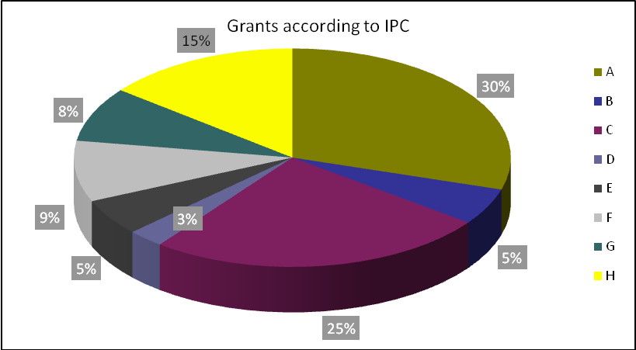
Classification of Applications Filed

Slide 24
CHALLENGES OF LOW UTILIZATION OF PATENT INFORMATION IN AFRICA
IP OFFICE BUREAUCRACY AND INERTIA
LACK OF INSTITUTIONAL LINKAGES AND COHESION
UNWILLINGNESS OF RESEARCHERS, PARTICULARLY EXPERIENCED RESEARCHERS TO ADOPT NEW INFORMATION TOOLS FOR RESEARCH AND DEVELOPMENT
INABILITY TO CREATE LOCAL DEMAND FOR PATENT INFORMATION AND RESEARCH DATABASES
LACK OF COMPREHENSIVE TISC WORK PROGRAM AND STRATEGY

Slide 25
CREATING A REGIONAL NETWORK FOR IP INFORMATION UTILIZATION TO PROMOTE INNOVATION IN AFRICA
WIPO
UNIVERSITIES
UNIVERSITIES
R & D INSTITUTIONS
MSMES
MEMBER STATES OF ARIPO
ARIPO
ASSOCIATION OF INDUSTRIES AND CHAMBERS OF COMMERCE
POLICY FRAMEWOK
IP OFFICES – PATENT MAPPING AND LANDSCAPING

Slide 26
IDENTIFICATION OF AREAS OF COMPETITIVE ADVANTAGE IN ARIPO MEMBER STATES –SUB-REGIONAL INITIATIVES
WEST AFRICA
EAST AFRICA
CENTRAL AFRICA
SOUTHERN AFRICA
NORTH AFRICA
REGIONAL STRATEGY FOR IP INFORMATION UTILIZATION MANAGED BY ARIPO AND OAPI

Slide 27
CONCLUSION
Inclusive and balanced approach towards the development of national IP policies and strategies
Need to continuously strengthen the IP cycle in the member states
Need to harmonize the ARIPO and OAPI systems
Need to demystify IP

Slide 28
THE HEADQUARTERS OF ARIPO
Based in Harare since February 1982;
Physical Address: 11 Natal Rd, Belgravia, Harare, Zimbabwe.
Postal Address: P O Box 4228 Harare, Zimbabwe.
Telephone: 00263 4 794065, 794066, 794070.
E-mail address: ; mail@aripo.org
Website: http://www.aripo.org .

Slide 29
Thank You For Listening!

