Slide 1


Slide 2

IP policy and Competition Policy
Tensions and complementarities
A New Multi-Layer Initiative
Innova-All (Mobtakeron)
Prof. Dr Maged Al-Sherbiny
President Academy Of Scientific
Research And Technology (ASRT)

Slide 3



National Strategy for Scientific Research & Technology in Egypt
A scientific society capable of presenting applied scientific solutions to society’s needs and supports knowledge –
based economy.
VISION
Reaching knowledge Economy through innovation in
A competitive atmosphere based on Excellence to
increase economic growth.
MISSION
Building Scientific and Technology Base .....Produce Knowledge ….. Innovation ……………Internationally- ranked …………….. Supporting Economic
development
STRATEGIC
OBJECTIVE

Slide 4


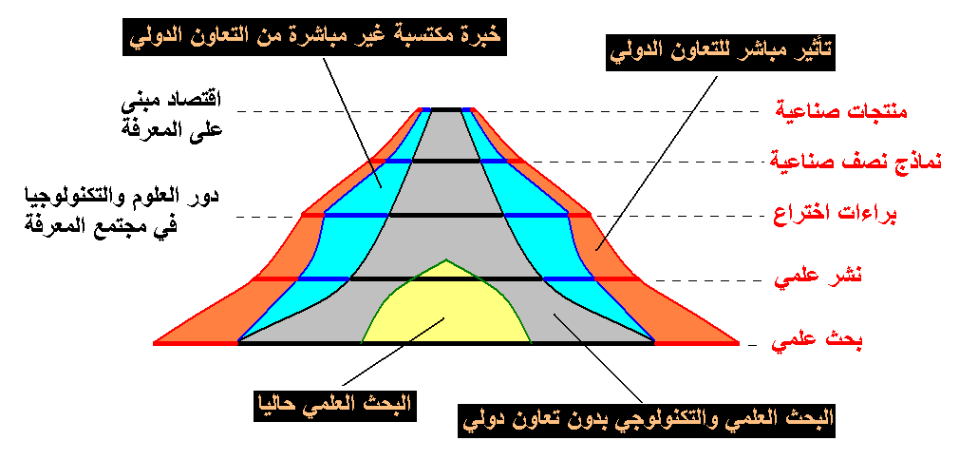
“4P’s” Concept
Indirect Experience Gained through International Cooperation
Direct Impact of International Cooperation
Knowledge Based Economy
Products
Prototypes
S&T Role in Knowledge Based Community
Patents
Publications
Scientific Research
Current Status of Scientific Research
S&T Research not Involving International Cooperation

Slide 5







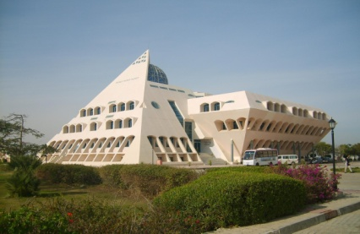





GERSS
E-JUST
GESP
GERLS
JST-STDF
GERF
JSPS-STDF
Egypt
Energy and Renewable Energy
Eg-It Univ.
Environment, including Water
CSP
Agriculture Sciences
Joint Research Prog.
Space Sciences
Africa
AMCOST
Archaeology
Life Sciences
Notes:
5

Slide 6
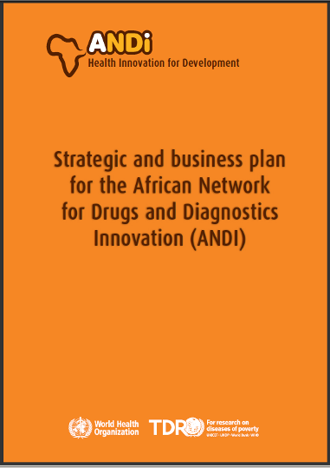
Strategic business plan adopted

Slide 7
Mapping of African research output reveals that several "hot spots" or “competency centers” exist today
Algiers
Tunisia
Rabat
Tunis
Monastir
Casablanca
Marrakech
Sousse
Alexandria
Morocco
Sfax
Tanta
Algeria
Cairo
Egypt
Libya
Assiat
  Cities with 30 or more articles published in the 2004 - 08 period
  Total of 90 cities in 27 countries
  16,647 biomedical articles led by African authors included in analysis
Mauritania
Senegal
Mali
Niger
Chad
Sudan
Eritrea
Gambia
Dakar
Khartoum
Djibouti
Cape Verde
Burkina
Addis
Ababa
Benin
Nigeria
Zaria
Ethiopia
Somalia
Abidjan
Ibadan
Lagos
Enuga
Cameroon
Uganda
Ivory
Coast
Ghana
Accra
Part Harcourt
Yaounde
Equatorial
Guinea
Kampala
Kenya
Gabon
Rwanda
Nairobi
Congo
Burundi
Tanzania
No of articles
Morogoro
Dar es salaam
Seychelles
<100
Angola
Zambia
100–249
250–499
Botswana
Zimbabwe
500–999
Namibia
Madagascar
Pretoria
>=1,000
Johannesburg
Swaziland
Potchefstroom
Pietermaritzburg
South Africa
Bloemfonteem
Durban
Cape Town
Note: Only top 40 cities by research output labeled
SOURCE: Thomson Web of Science

Slide 8
In addition, some African centers show patent activity in the biomedical areas
Canada
Belgium
Netherlands
UK
France
US
Japan
Morocco
Tunisia
Patent #
Guinea
Egypt
1 -2
Benin
3 - 4
Kenya
5 - 8
9 - 11
Madagascar
> 11
Uruguay
South Africa
Total: 164
Note: Patents published in the period 2004-2009 by WIPO or the US and European patent offices with at least one assignee from Africa (under under International Patent Codes A61K or A61P)
SOURCE: Delphion, VantagePoint, UCINET

Slide 9
Evolution of ANDI
2008
2009
2010
ANDI Concept Launch
(Abuja,
Nigeria)
ANDI Business Plan launch
(Cape Town,
South Africa)
ANDI operation launch
(in regions
across the Continent)

Slide 10













GERD (Gross Domestic Expenditure on R&D)
Government R&D Budget
0.4%
0.27%
4.7
4.7
0.26%
33,902(7th)
2.4
2.4
1.6
1.6
2006 2008 2010
2006 2008 2010
GERD (L.E. Bil.)
GERD as a % of GDP
R&D Budget (Billion L.E)
Number of Researchers
Researchers per million people
98,201
1197
1206
1183
96,500
92,320
2005-2006 2007-2008 2009/2010
2005-2006 2007-2008 2009/2010
Total Researchers (person)
Researchers per million people

Slide 11


R&D Expenditure in the Egyptian Landscape in 2011/2015
2.0%
1.5%
1.0%
89%
0.7%
85%
80%
70%
20%
30%
15%
11%
2011/2012
2012/2013
2013/2014
2014/2015
% Government Funding
% Industry , NGO & Fund Raising
GERD:GDP

Slide 12


S&T Paper
10,218
8,442
5,452
4,271
2004
2007
2010
2011
No. of International paper publications
Average citations per paper
5.02
4.64
2009
2010

Slide 13
No. of Application from (1970 To 2012 until 30-10)

Slide 16
EgPO ISA and IPEA
The International Patent cooperation union Assembly at it’s 17 session in October 2009 appointed the Egyptian patent Office as an International Searching and Preliminary Examination authority under the PCT.
The Egyptian Patent Office started on beginning of 2013 to work as ISA and IPEA.

Slide 17


Framework of Egypt New S&T Initiative
Input
2%
Investment
Reach 2% of GDP on GERD in Next 3 Years
6 Focused
Sciences
&
Initiatives
Sciences
Initiatives
① Basic Sciences (all disciplines
exp. Physics).
② Applied and Technological Sciences
(Energy, Water, Food, and Health)
③ New Frontier Sciences (NANO, MEMs)
④ Industrial Sciences (Textile, Oil and
Pharmaceutical Technologies).
⑤ State-led Sciences (Space, Ocean).
⑥ Services Sciences (Content, logistics
and communication Technologies)
① Improving Research Environment
② Competitive Human Resources.
③ Funding of S&T support programs
④ Innovation initiative.
⑤ Networking & globalization
⑥ Informal Science Education
initiative
Process
Performance
Major S&T User
Use S&T for Economic Growth

Slide 18

The Golden Triangle of Creativity
Innovation
Investment
Enterprise

Slide 19
Innovations
People, Culture, Diversity, Ecosystem & Opportunities drive Innovations.
Innovations are required to develop new Products, Services, Markets, reduce Costs, improve Efficiency, Productivity, Performance, Quality, etc
Innovations are the key to Growth, Prosperity and Problem solving world over

Slide 20
Innovation in Industry
36.9%
17.8%
12.2%
Product innovation
Process innovation
Organizational and Marketing
Innovation
Innovation Survey on 3,000 Egyptian Enterprises

Slide 21
Innovation types
Disruptive innovation – Takes a cheaper, low-end disruptive or a new- market disruptive innovation to the market
Application innovation – takes existing technologies into new markets to serve new purposes
Product innovation – takes established offers in established markets to the next level (a type of sustaining innovation)
Process innovation – makes processes for established offers in established markets more efficient or effective (also a type of sustaining innovation)
Experiential innovation – makes cosmetic/surface modifications of established products or processes that improve customers’ experience
Marketing innovation – improves customer touching processes e.g. by marketing communications or consumer transactions
Business Model innovation – reframes an established value proposition to the customer or a company’s established role in the value chain or both
Structural innovation – Capitalizes on disruption to restructure industry relationships

Slide 22
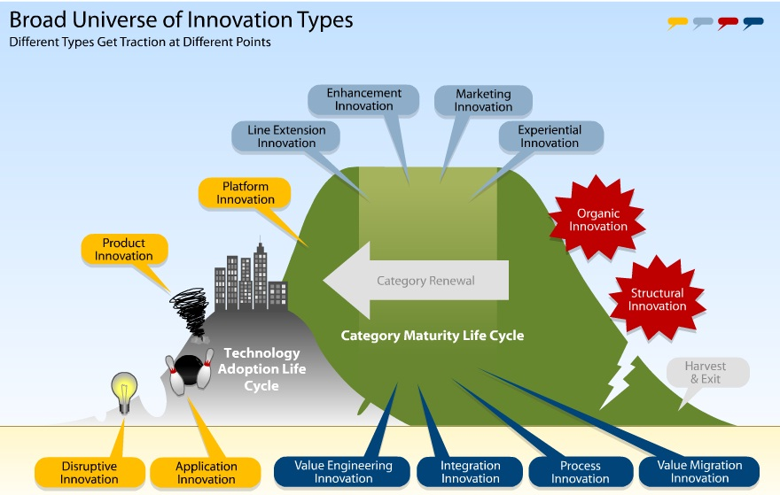

Slide 23
National System of Innovation

Slide 24
Components of Innovation
Strategies & Policies
Funding & Financing
Instruments & Programs
Monitoring & Evaluation
NSTP
NIS
NIPS
STDF
RDI
I.I.I
I.T.R
TISC
TICO
FEKRA
SENAA
HBO
ASRT R.C
Prototyping
IP Academy
Surveys
E-Science
Research Visualizer

Slide 25
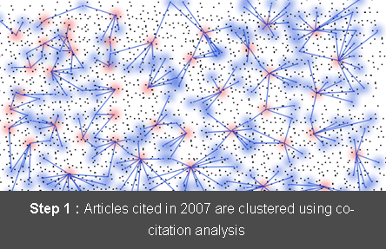
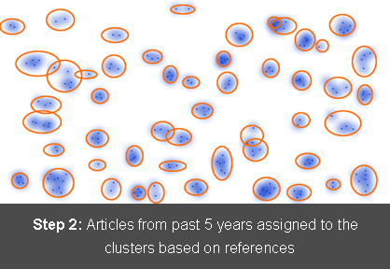
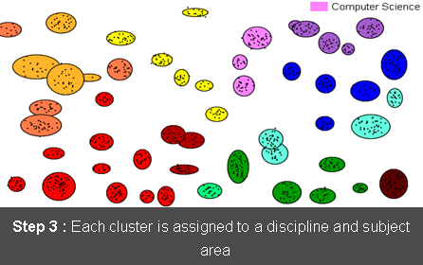
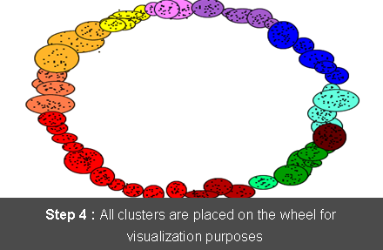
VISUALIZING EXISTING AND EMERGING RESEARCH CLUSTERS

Slide 26
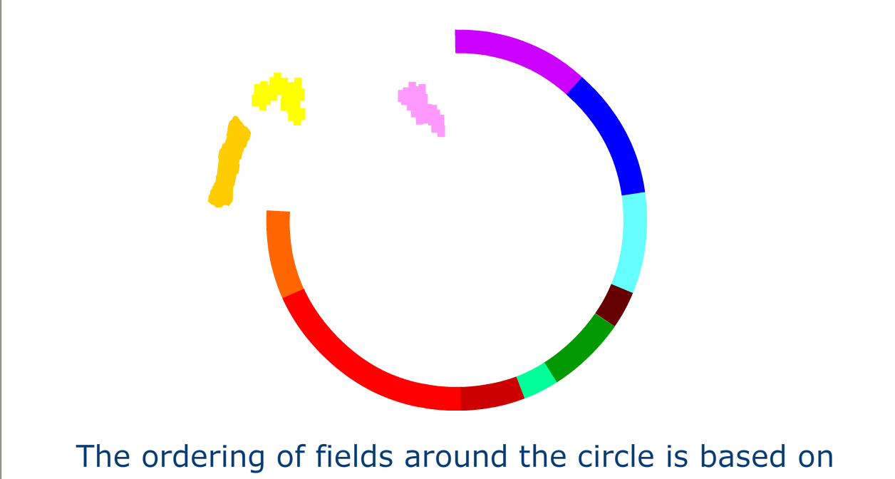
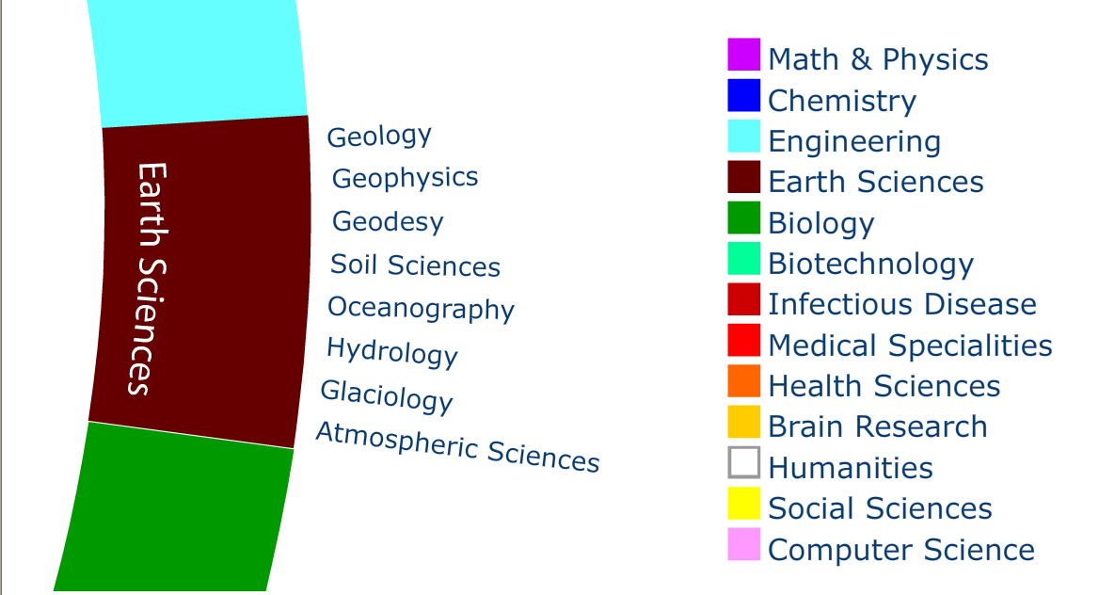
CREATING THE MAP
The ordering of disciplines around the circle is based upon 20 existing maps of science

Slide 27
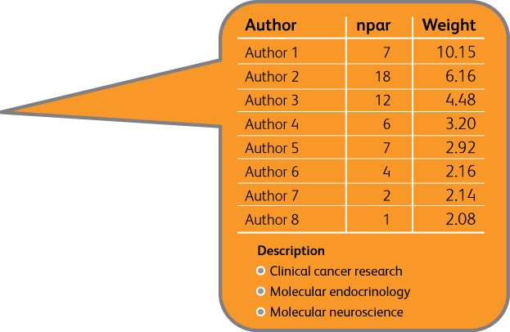
Research Performance Visualizer Development Partner
10
18
23
Medical Specialties (9053)
22
Chemistry (5161)
27
Math & Physics (3995)
Brain Research (3781)
12
Health Services (3034)
29
5
Biology (2912)
11
Infectious Disease (2773)
19
Social Sciences (2482)
13
Engineering (2273)
4
Computer Science (1911)
20
Biotechnology (1616)
Earth Sciences (1343)
Humanities (38)
28
24
6
8
7
2
17
14
3
1
25
21
26
15
16
9
Notes:
Here’s one way of addressing that problem. Instead of a journal-based classification for research output, we can do co-citation analysis on the individual articles that make up an institution’s profile and bring to light their distinctive competencies.
Click 1:
Once you have identified specific competencies to focus on, you drill down and extract information that helps you understand the key drivers. By doing so, you are able to spot emerging research areas ACROSS disciplines and ACT on the opportunities proactively.

Slide 28
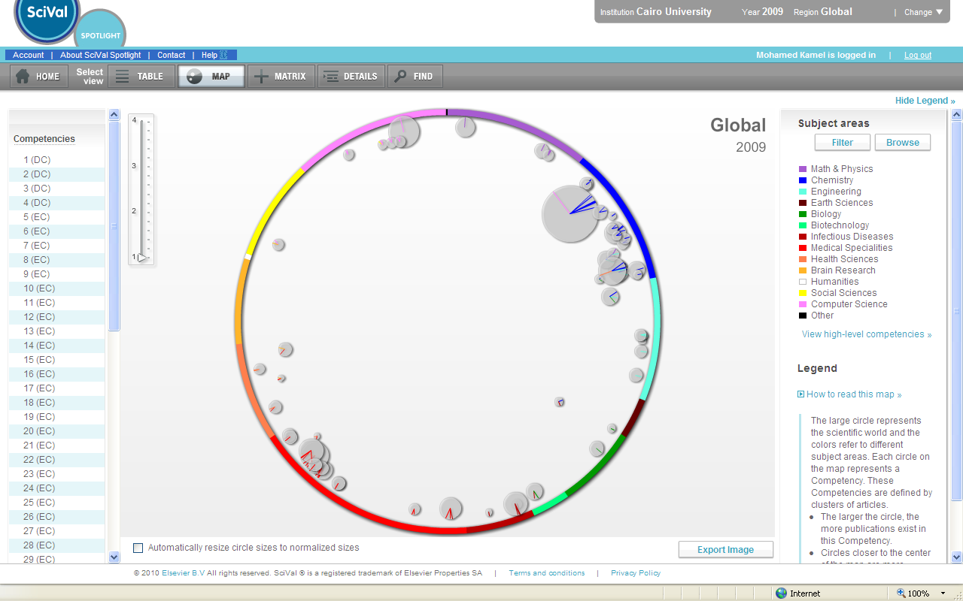
Cairo University has 58 competencies based on 2005-09 data
COMPUTER SCIENCE
PHYSICS
COMPUTER SCIENCE
PHYSICS
SOCIAL SCIENCE
SOCIAL SCIENCE
CHEMISTRY
MULTI-DISCIPLINARY
RESEARCH AREAS
CHEMISTRY
BRAIN RESEARCH
BRAIN RESEARCH
RESEARCH AREA
WITH GLOBAL STRENGTH
ENGINEERING
ENGINEERING
HEALTH SCIENCE
HEALTH SCIENCE
EARTH SCIENCE
EARTH SCIENCE
BIOLOGY
BIOLOGY
MEDICINE
MEDICINE
BIOTECHNOLOGY
INFECTIOUS DISEASE
BIOTECHNOLOGY
INFECTIOUS DISEASE
Source: SciVal Spotlight National Level map 2008

Slide 29
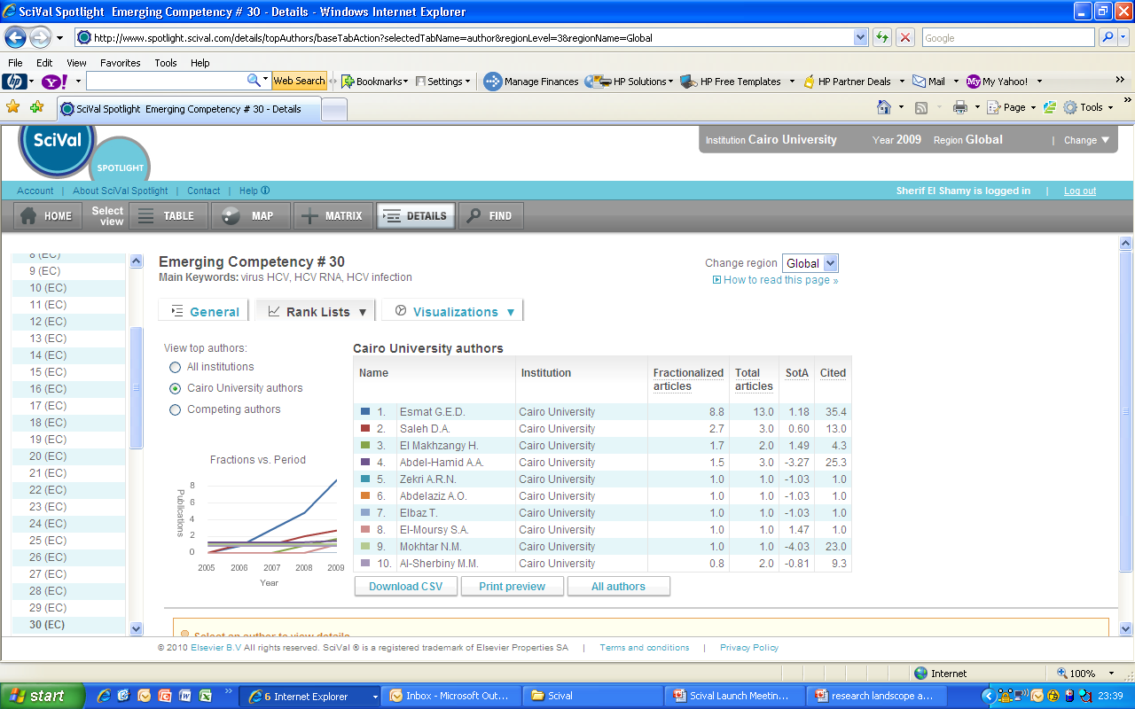
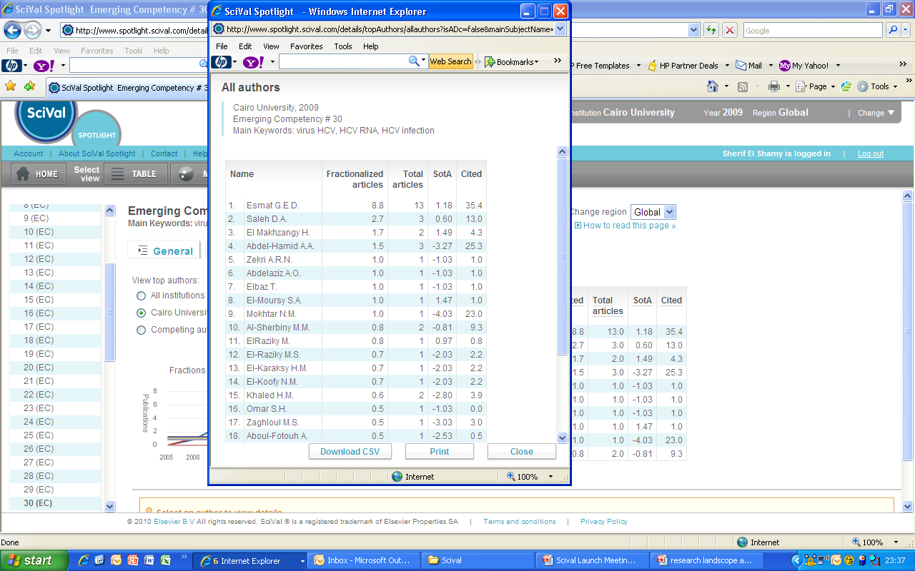
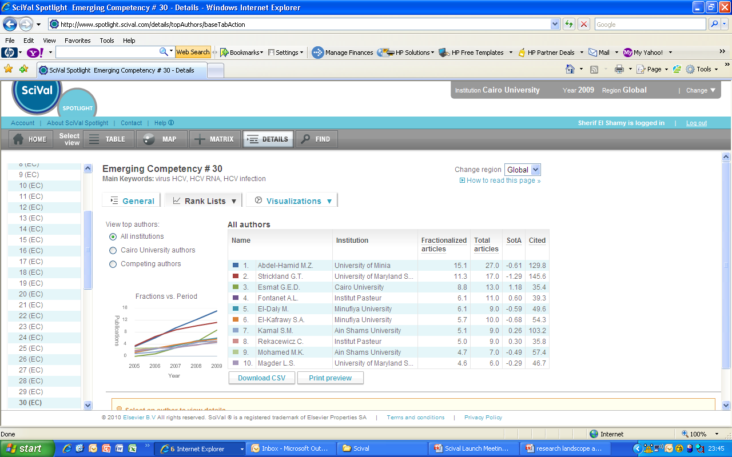
Get detailed information for each competency
2 - Top researchers
EXAMPLE
Top
Cairo University
Researchers
Global
Top
Researchers
Source: SciVal Spotlight National Level map 2009

Slide 30
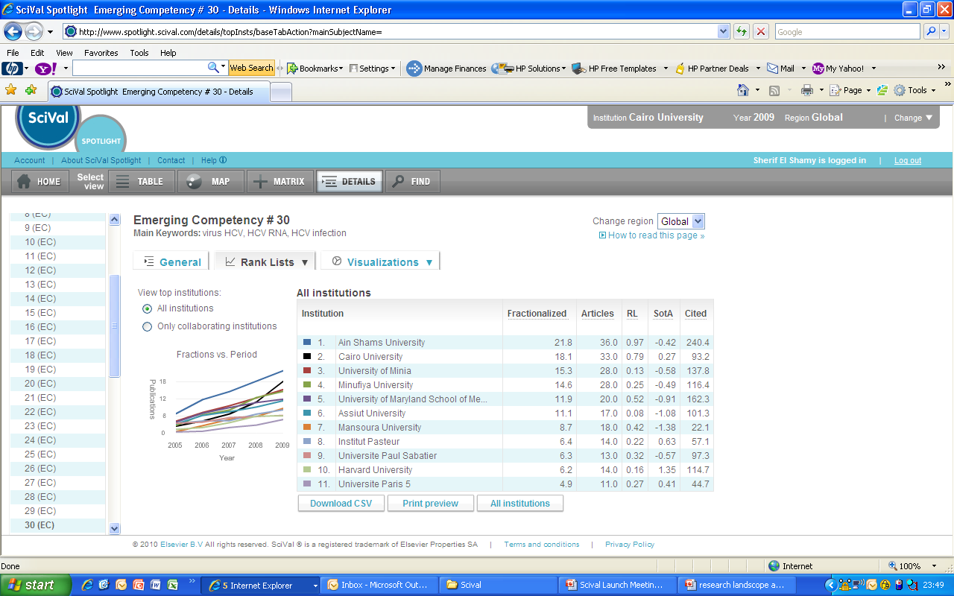

Get detailed information for each competency
3 - Top institutions
EXAMPLE
Global
Top
Institution
Top Collaborating
Universities
Source: SciVal Spotlight National Level map 2009

Slide 31
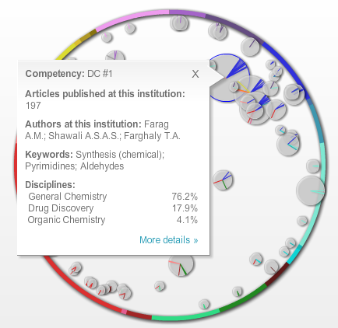
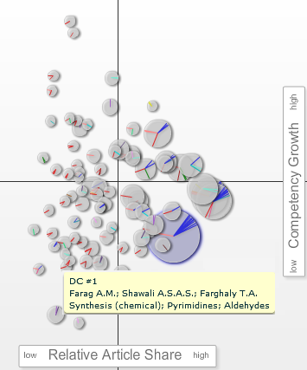

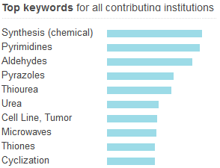
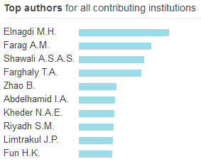
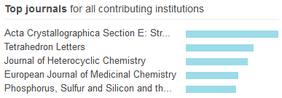
Research Strengths: DC #1
General Chemistry, Drug Discovery,
Organic Chemistry, Analytical Chemistry
World
Egypt
Cairo U.
Cairo U. is leader in all KPIs:
Published articles
Reference articles
State of the Art
Source: SciVal Spotlight
Notes:
The position of the competency in the matrix shows the leadership of Cairo University in terms of production. The fact that globally the growth is slightly negative tells that the leadership position of Cairo University is not in danger.
On the other hand, this could be a sign that this research area has reached a mature stage and a decision could be taken on whether to continue investing in this area or maybe explore other areas.

Slide 32
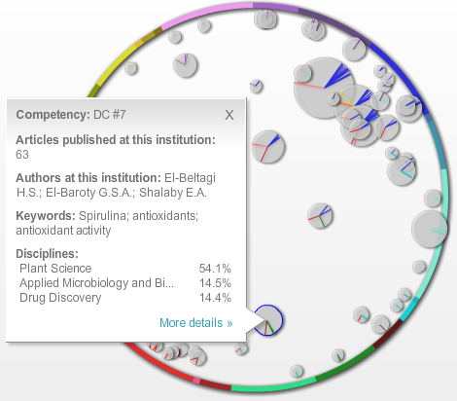
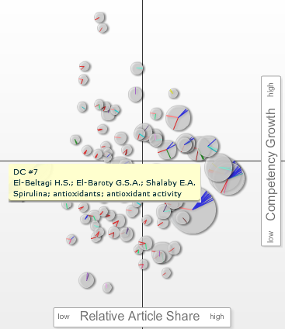

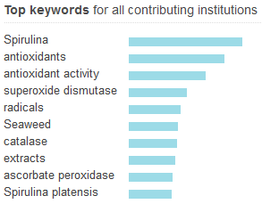
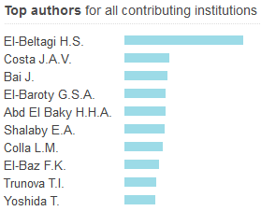
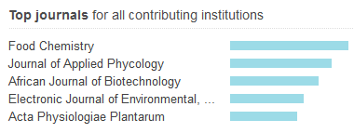
Research Strengths: DC #7
Plant Science, Applied Microbiology and Biotechnology,
Drug Discovery
World
Egypt
Cairo U.
Cairo U. is leader in all KPIs:
Published articles
Reference articles
State of the Art
Source: SciVal Spotlight
Notes:
This competency is an example of an interdisciplinary one. It lies towards the middle of the wheel of science, including different disciplines such as
Plant Science
Applied Microbiology and Biotechnology
Drug Discovery
Food Science
Pharmaceutical Science
This competency is growing on a global scale, and growing much faster in Egypt and even more at Cairo University. Almost 60% of Egyptian papers are authored by Cairo University researchers.

Slide 33
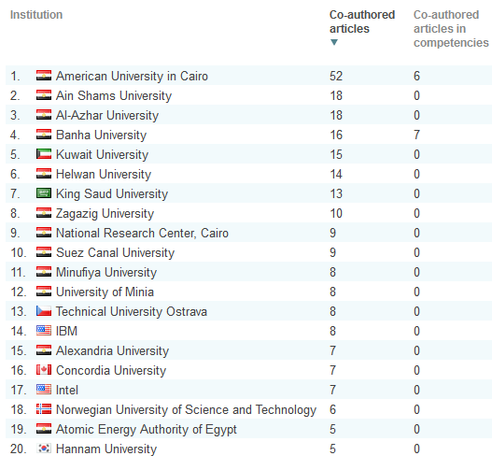
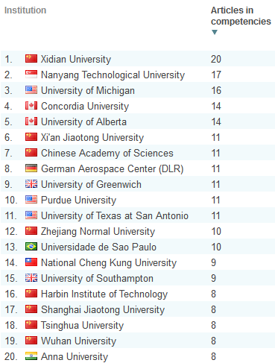
Collaboration: Computer Science
Existing collaborations
Potential collaborations
Notes:
By focusing on Computer Science, 8 foreign institutions have collaborated with Cairo University, including companies such as IBM and Intel.
The second list shows the institutions that appear in the computer science competencies but have not collaborated yet with Cairo University. These are all potential collaborating institutions.
The analysis can be further drilled down to the level of individual researchers from each of the institutions listed.

Slide 34
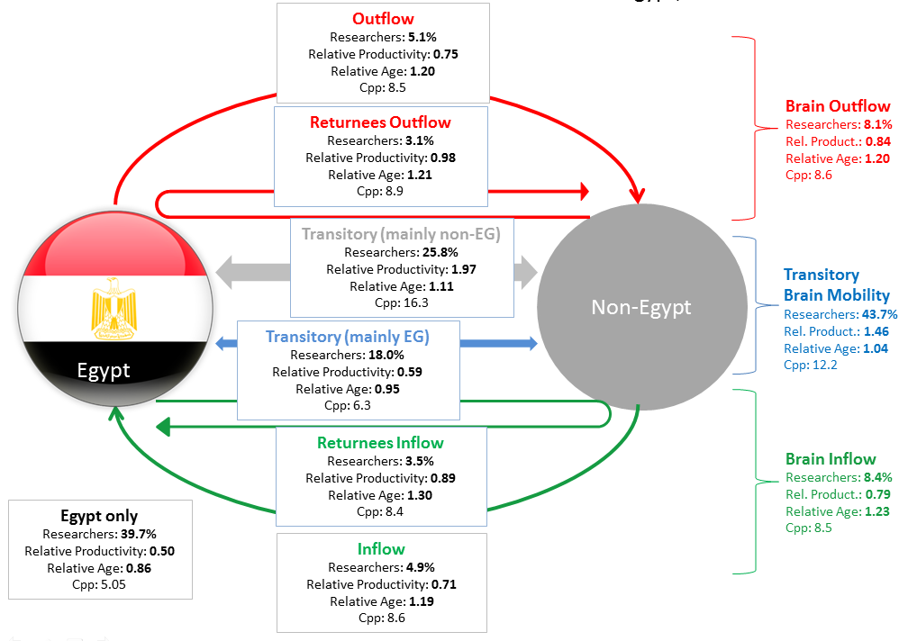
Figure 1 – International Mobility of Egypt’s researchers, 1996-2011.

Slide 35
Targets of Mobtakron Initiative
Grassroots Innovation of Communities “TOK-TOK”
STEM School Innovation “FAB-LAB”
University Student Innovation “AICE ” “GP” “ASMP”
University and R.C Research Innovation “TICO”
Enterprises Innovation “IRA’

Slide 36
INNOVA –ALL (MOBTAKERON)
INNOVATION PYRAMID
Enterprise
Innovation
“IRA”
Commercialization
Program
Researchers
Innovation
“TICO”
Incubators
Program
University Students Innovation
“AICE, G.P, ASMP”
HBO
EGP
Industry Prototyping Center
Prototype Design Center
STEM School Innovation
“FAB-LAB”
Grassroots Innovation of communities
“TOK TOK”
EgPO

Slide 37
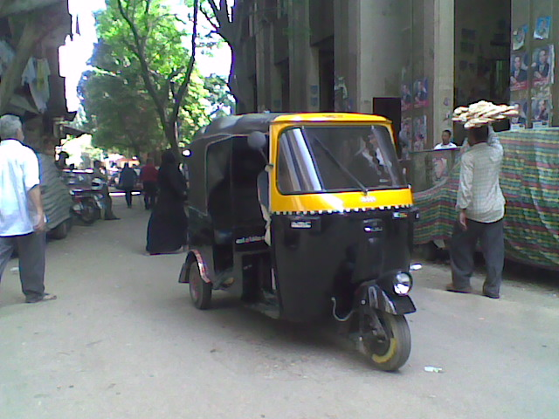
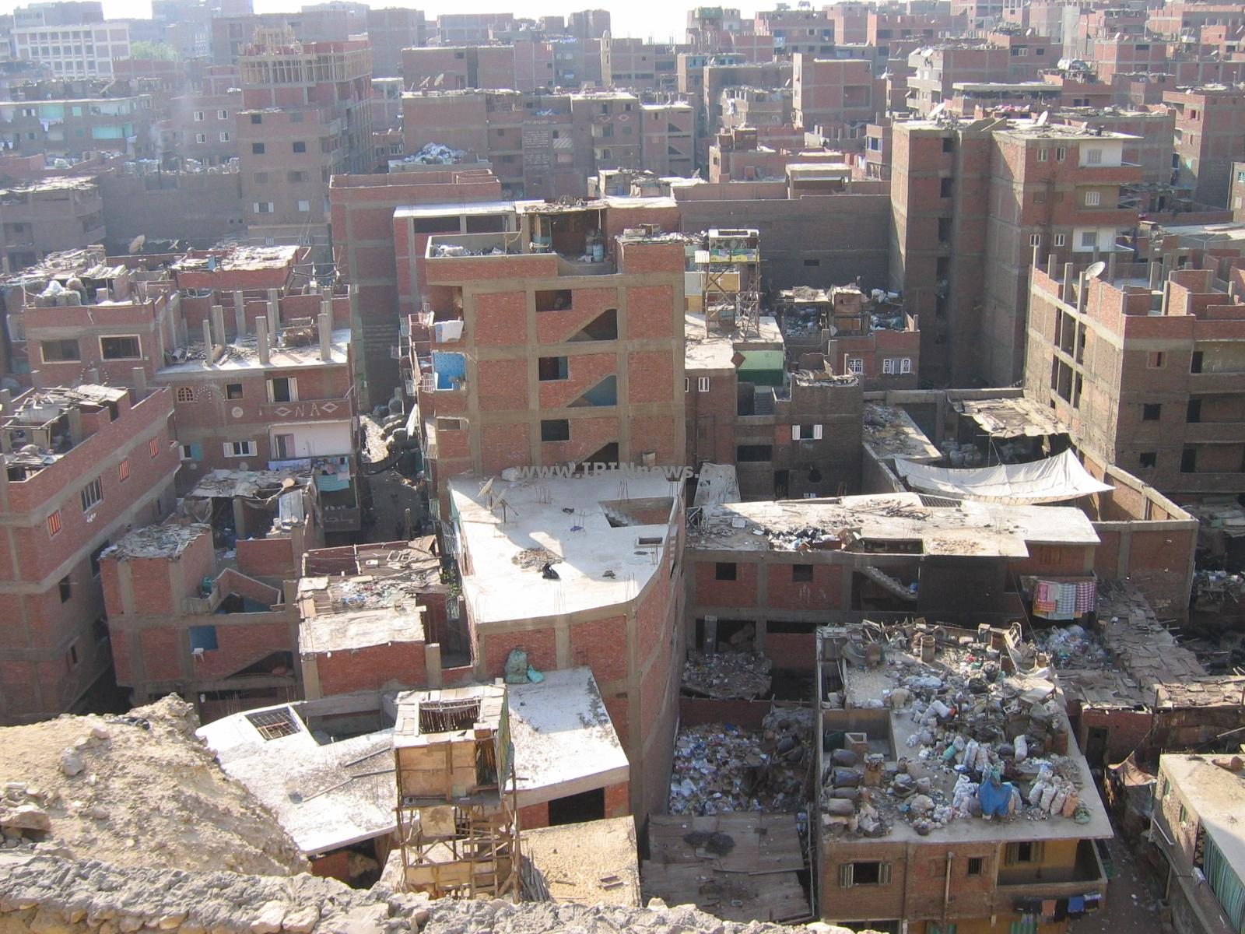
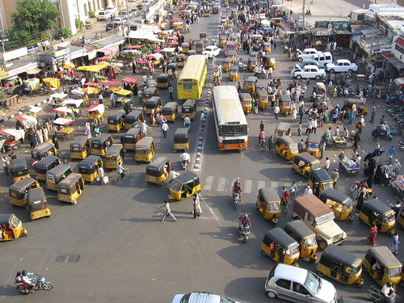


Grassroots Innovation
of Community
(TOK TOK)

Slide 38
Community “Grassroots” Innovation TOKTOK
To economically develop micro and small enterprises (MSEs) through scientific research and innovation.
To unleash the creativity and innovation of the Egyptian youth in order to improve the quality, productivity and competitiveness of Egyptian products.
To bridge the gaps between the challenges faced by the MSEs and the innovative ideas and skills of potential problem solvers through open-innovation tools.
To provide channels for MSEs solve the challenges they are facing with the support of the Egyptian universities and Research Centers.
To support innovators to bring their prototype or idea to the market and transform it to a concrete product through crowd-funding.

Slide 39
Provided Services
Open-innovation platform for MSEs or NGOs working with MSEs to post the challenges they face.
These challenges can vary from product development (innovative design or utilization of a handicraft product with a diminishing marketability), production process optimization (e.g. designing new machine that is compatible to the size of the local workshops), usage of alternative raw material, etc.
Provide creative solutions by the wisdom of the crowd through Crowd-funding for new innovative product.

Slide 40
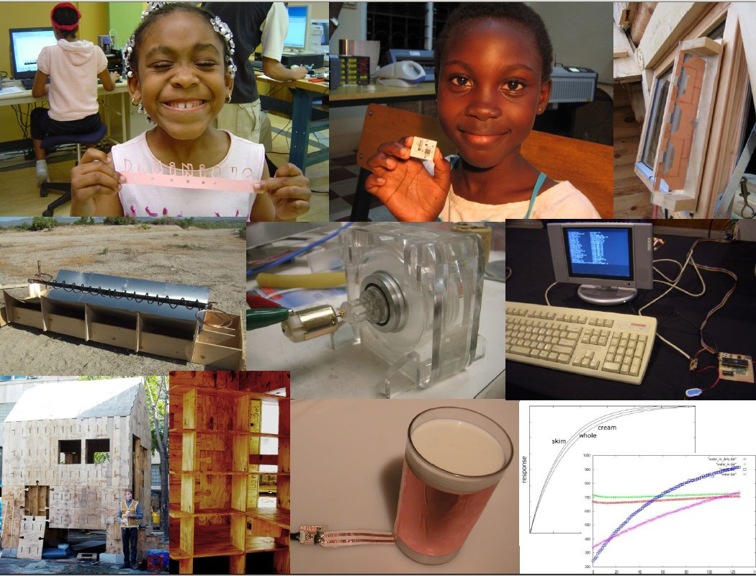
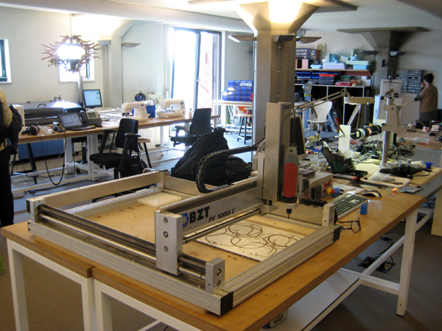

STEM School Innovation
“FAB-LAB”

Slide 41


Slide 42
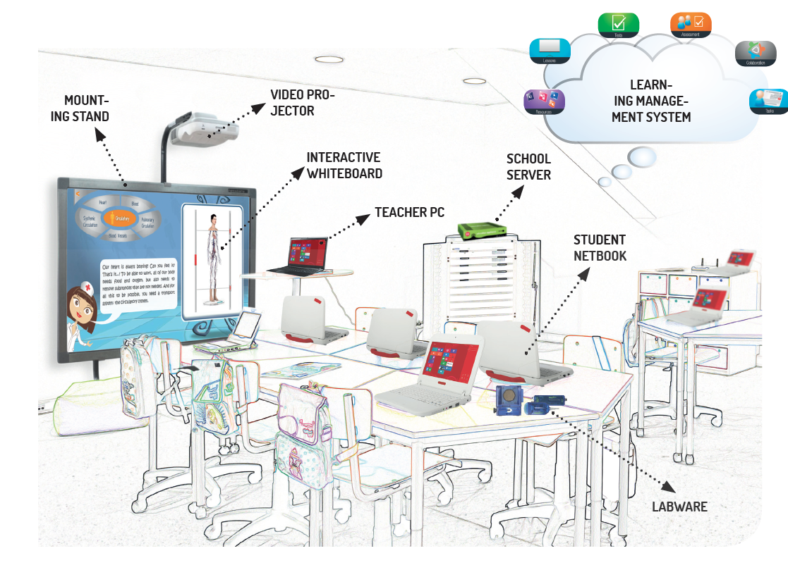

Slide 43
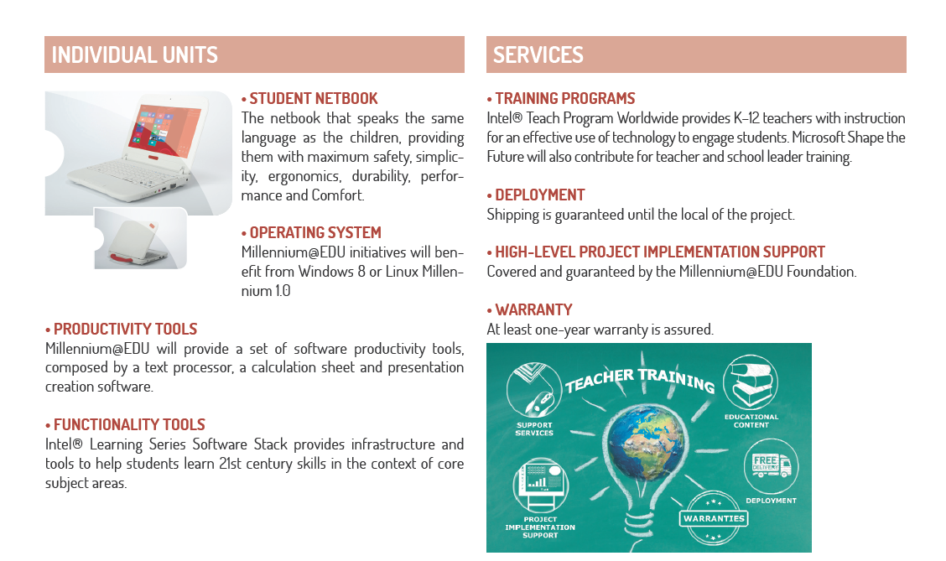

Slide 44
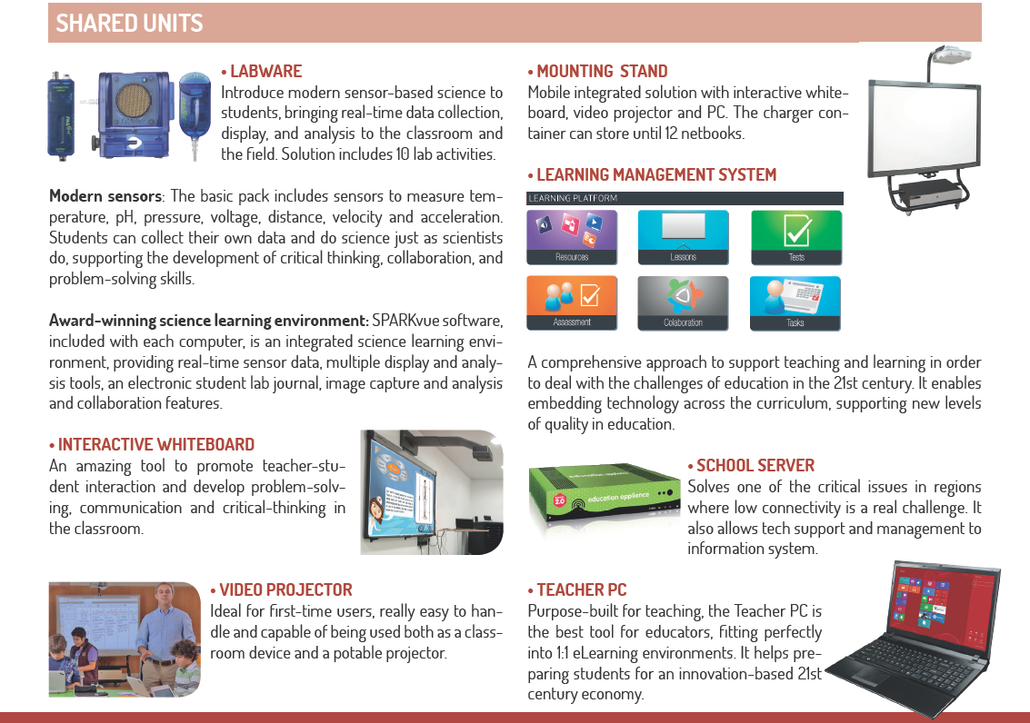

Slide 45
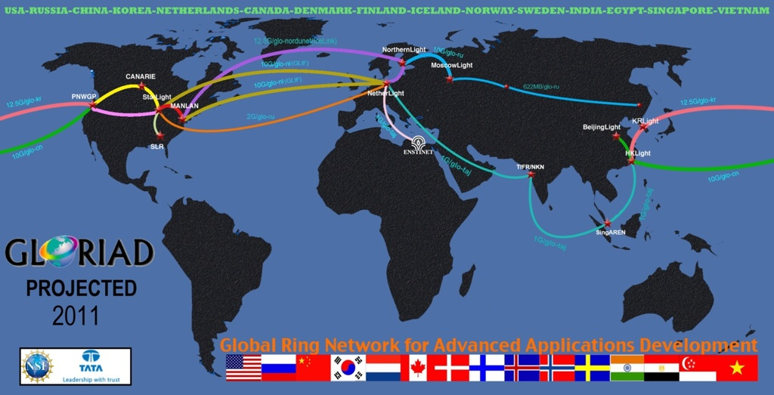
Egypt-GLORIAD Link

Slide 46
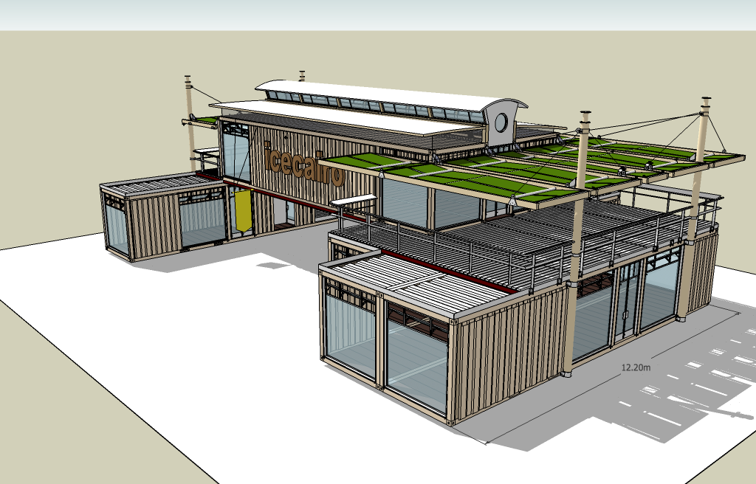
Academy Innovation Center for Entrepreneur “AICE”
AICE Centers in each University main campus to attract students innovation.
The centers will be run by senior students linked to scientists.
It will contain a small prototyping facility.
The major aim is to provide business opportunity after graduation projects.

Slide 47

وزارة البحث العلمي
أكاديمية البحث العلمي والتكنولوجيا
لائحــة دعـــم منــــح الماجستير والدكتوراة
ودعــم مشروعــات التخــرج ( كليات العلوم والهندسة )

Slide 48
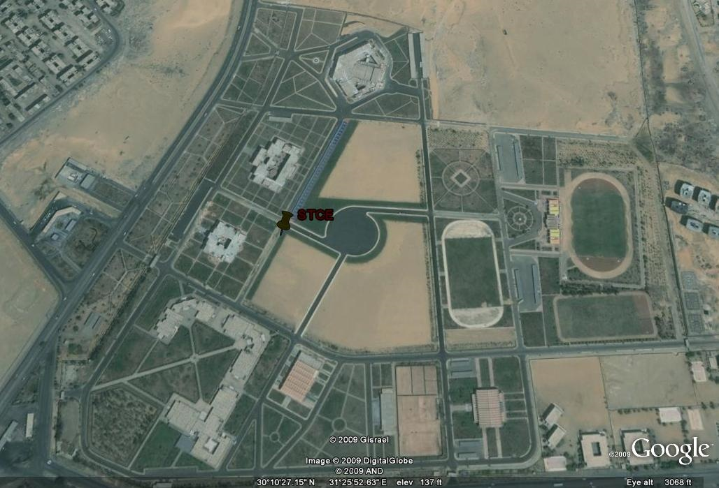
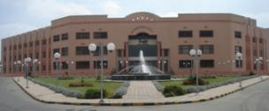
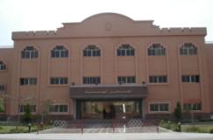
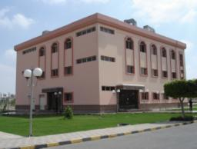
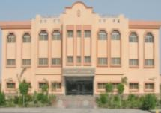
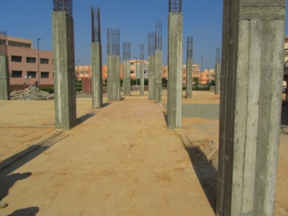
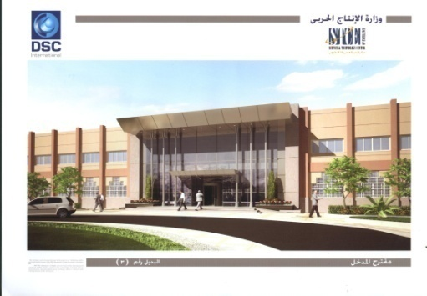
المعامل الهندسية
البحوث النصف صناعية
المعامل الكيمائية
المجمع التكنولوجى
مبنى المواد

Slide 49
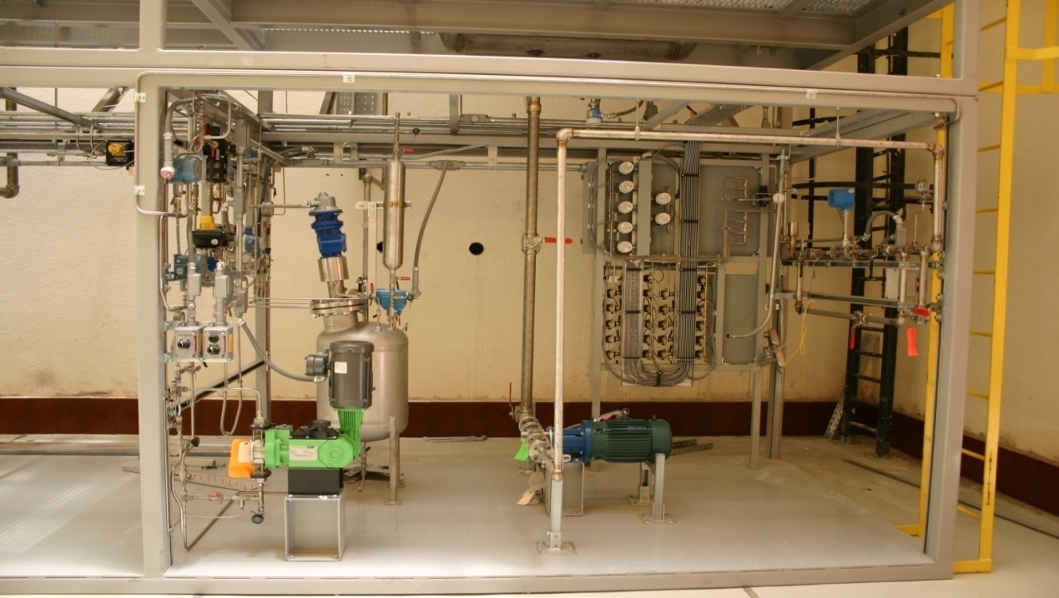
نظام الربط بين محطة التحكم ووحدة الانتاج مع وحدة خلط المواد

Slide 50
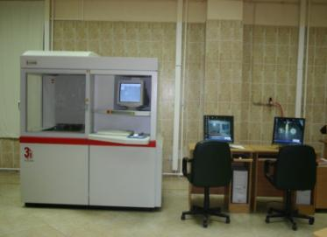
RAPID PROTOTYPING LABمعمل الإنتاج السريع للعينات

Slide 51
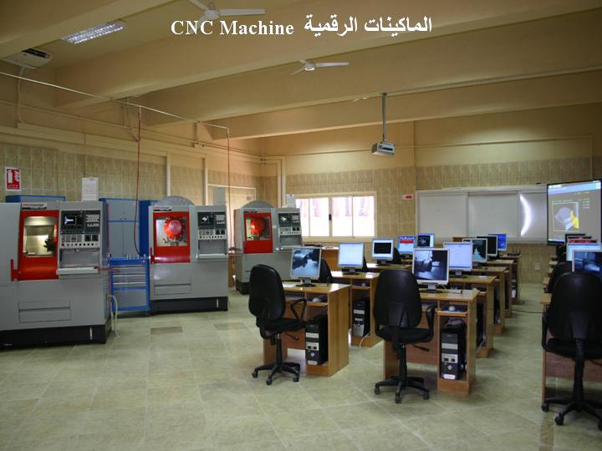
معمل الماكينات الرقمية

Slide 52
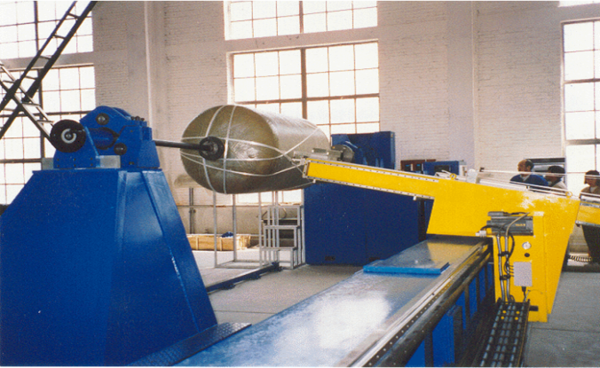
معمل رقم (10)
Filament Winder

Slide 53
TICO
GICO
TISC
TTO
- Funding Opportunities.
Grant Writing.
- Data-bases and Networking.
- IRB and ACUC approvals
- Patent drafting and application.
- WIPO Academy training curricula.
- Advice on IPR policy and Patent portfolio.
- IPR awareness campaigns.
- Industry Liaison.
- Technology Management and Incubation.
- Patent Commercialization.
- Licensing and Startups.

Slide 54

The EGNC Building
Hyper 1
EGNC
Building 4 in the Cairo University Extension in Sheikh Zayed City (adjacent to Hyper 1)
Floor space = 16,000 m²
Originally designed for classrooms and offices. Only basic construction complete.
Complete redesign needed to accommodate the functional and safety requirements of: Specialized Labs, Clean Room (600-2,000 m²), and Noise-Sensitive Labs
Hired a specialized design firm (CH2M Hill) to develop concept, schematic, and detailed designs. Now ready to issue turn-key construction tenders.

Slide 55
Research
Project Areas
  Thin Film PhotoVoltaic Cells
  Transparent Electrode (Graphene, CNT, Multicrystalline)
  Desalination using energy harvested in CPV systems
  Modeling & Simulation
  Biotechnology (biosensors)
46 Inventions:
  US Patent Applications filed = 22
  US Patent Applications being filed = 8
  Inventions being processed = 16
51 Research Papers:
  Refereed publications = 13
  Conference/Symposium presentations = 18
  Submitted = 13
  In preparation = 7

Slide 56
Industry Research Alliance (IRA)
Industrial Prototype Designs are carried out by ASRT established two Industrial fabrication Center in collaboration with the Ministry Of Industry.
IRA provide funding to researchers to develop demand-driven industrial protocols to be implemented by enterprises for new product fabrication.
IRA initiative is sector tailored according to its needs and potential expansion for market and job creation.

Slide 57
Thank You
The Academy Of Scientific Research And Technology (ASRT), Egypt
101 Kasr Al-Ainy Street
Email:maged123@link.net
Fax:+2-02-279-212-80

Slide 58


