Slide 1
Roundtable South-South Exchanges on Best Practices for the development of
IP and Branding Strategies in Developing Countries and LDCs
6 – 8 May 2013
Cairo, Egypt
Ms. Nisachol Sasanon
Head of Encouraging Utilization Group
Intellectual Property Management Office
Department of Intellectual Property
Thailand

Slide 2
WIPO Product Branding Project
Project on Intellectual Property and Product Branding for Business Development in Developing Countries and Least-Developed Countries
Duration : 2010 to 2013.
Pilot Countries: Thailand, Uganda and Panama
Budget: 885,000 Sfr.

Slide 3
Objective
The project aims primarily at supporting small and medium-sized enterprises (SMEs), especially those resulting from the association of local groups of farmers and producers in developing and least developed countries (LDCs), in the design and implementation of strategies for the appropriate use of IP in product branding.
In this way, the project will help to promote the development of local communities and strengthen capacities, both at the community and institutional levels, by focusing on the promotion and the strategic use of IP, particularly geographical indications, and trademarks.

Slide 4
Capacity Building Workshop in Thailand
Target group (those who are related to the selected product)
  Local community
  Producer
  SMEs
  Related Authorities
Topics
  Intellectual Property and Community Signs
  Marketing and Product Design
  Business Plan

Slide 5
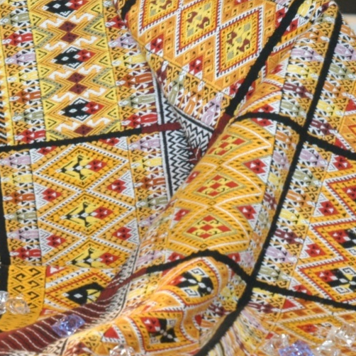
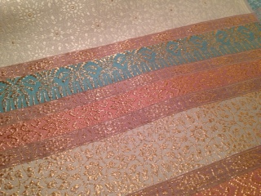
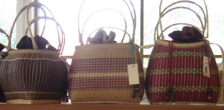
3 Selected Products
Mae Jaem Teen Jok Fabric (GI)
Lamphun Brocade Thai Silk (GI)
Bang Chao Cha Wicker (Collective Mark)

Slide 6

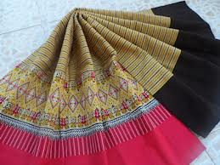
Mae Jaem Teen Jok Fabric
www.otopzone.com

Slide 7
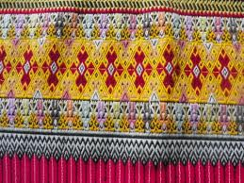
Mae Jaem Teen Jok Fabric
www.rongrean.com

Slide 8
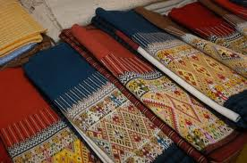
Mae Jaem Teen Jok Fabric
board.postjung.com

Slide 9

Lamphun Brocade Thai Silk
www.panoramio.com

Slide 10

Lamphun Brocade Thai Silk
www.oknation.net

Slide 11

Lamphun Brocade Thai Silk
www.panoramio.com

Slide 12
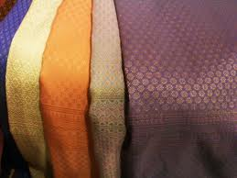
Lamphun Brocade Thai Silk
http://www.phayok-lamphun.org

Slide 13
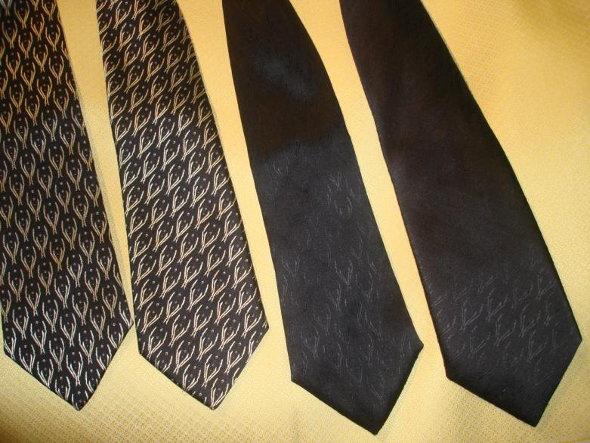

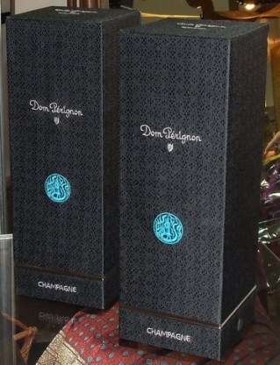


Twining product project
Lamphun Brocade Thai Silk + Champagne

Slide 14

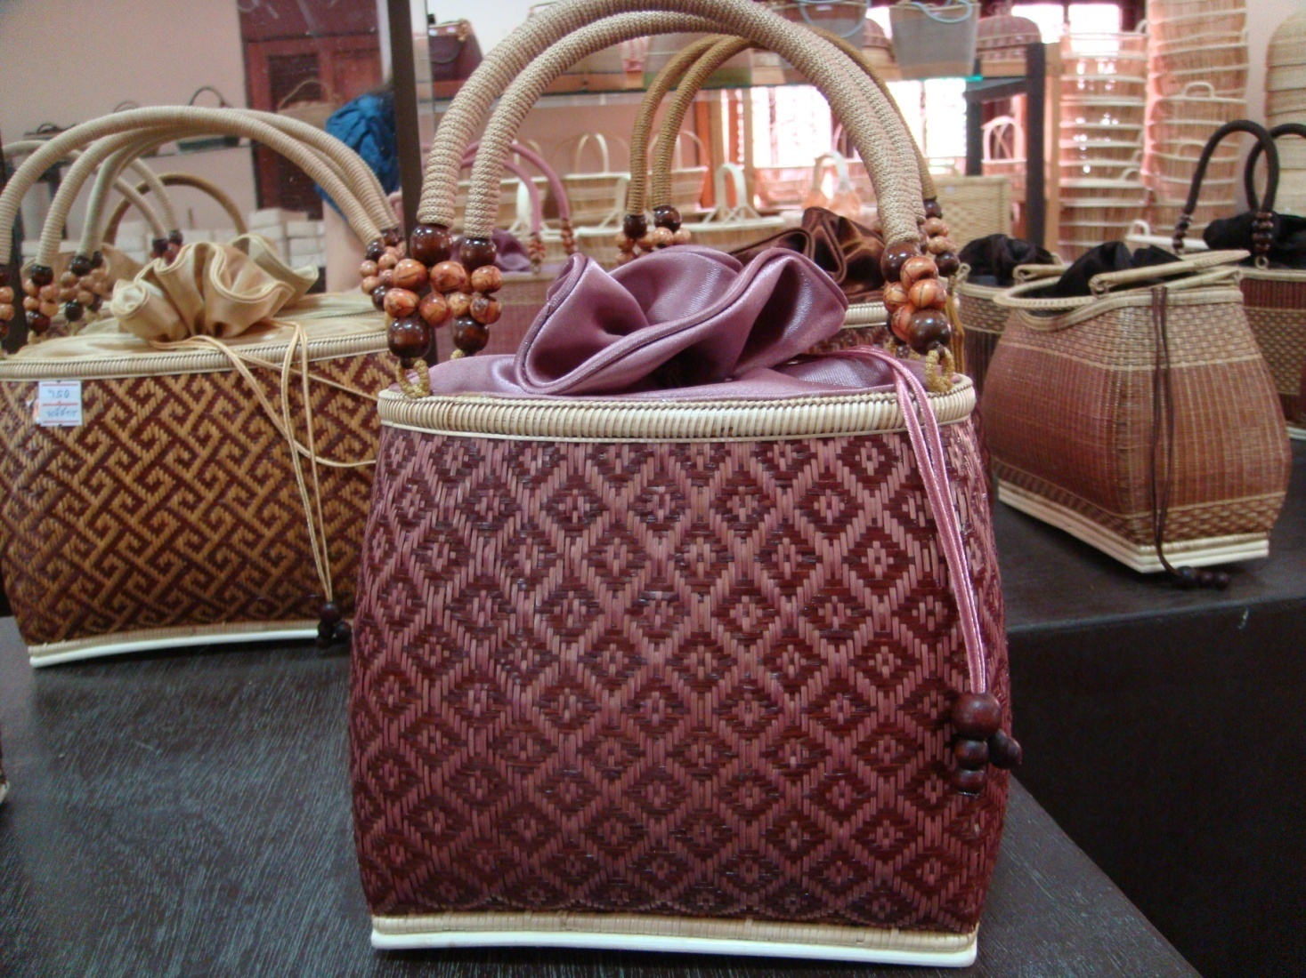
Bang Chao Cha Wicker

Slide 15


Thank you
Department of Intellectual Property
www.ipthailand.go.th
Tel. (66)2-5474700
Fax. (66)2-5474681
Notes:
15
Thank you for your kind attention.

