Slide 1
Opening Session
Mr. Antonios Farassopoulos, Director, International Classifications and Standards Division, Global Infrastructure Sector (GIS), WIPO

Slide 3
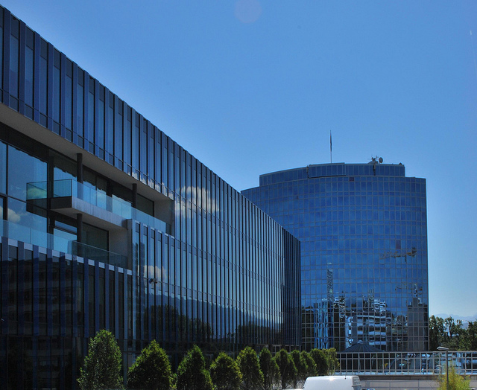
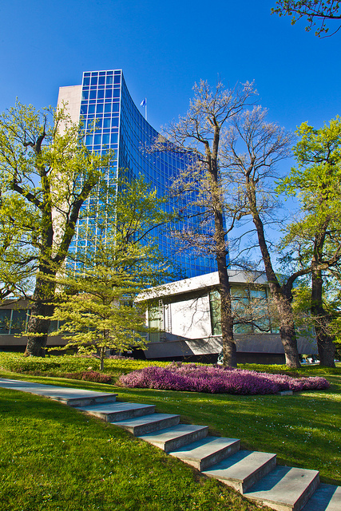
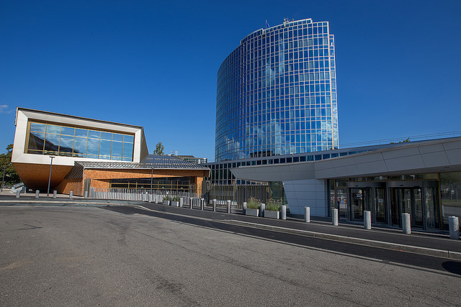
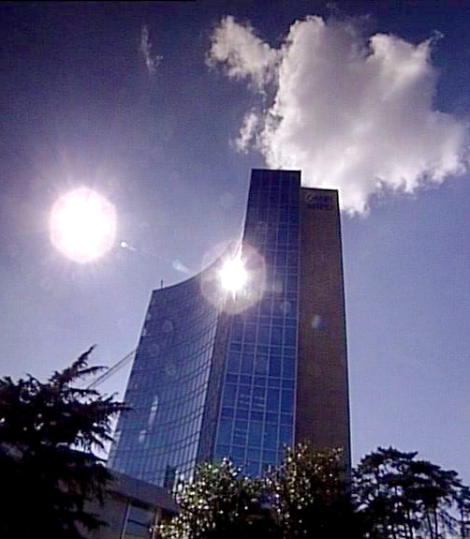

WIPO
A WIPO Dialogue with the Scientific Community and Innovators
Organized by the World Intellectual Property Organization (WIPO)
in cooperation with the Hellenic Industrial Property Organization (OBI)
and Euraxess – Researchers in Motion

Slide 4


Introduction to WIPO:
Major Intellectual Property Economic Studies
Speaker : Victor Vázquez López, Head
Section for Coordination of Developed Countries
E-mail: Victor.Vazquez-Lopez@wipo.int
Thessalonica, Greece
March 10, 2016

Slide 5
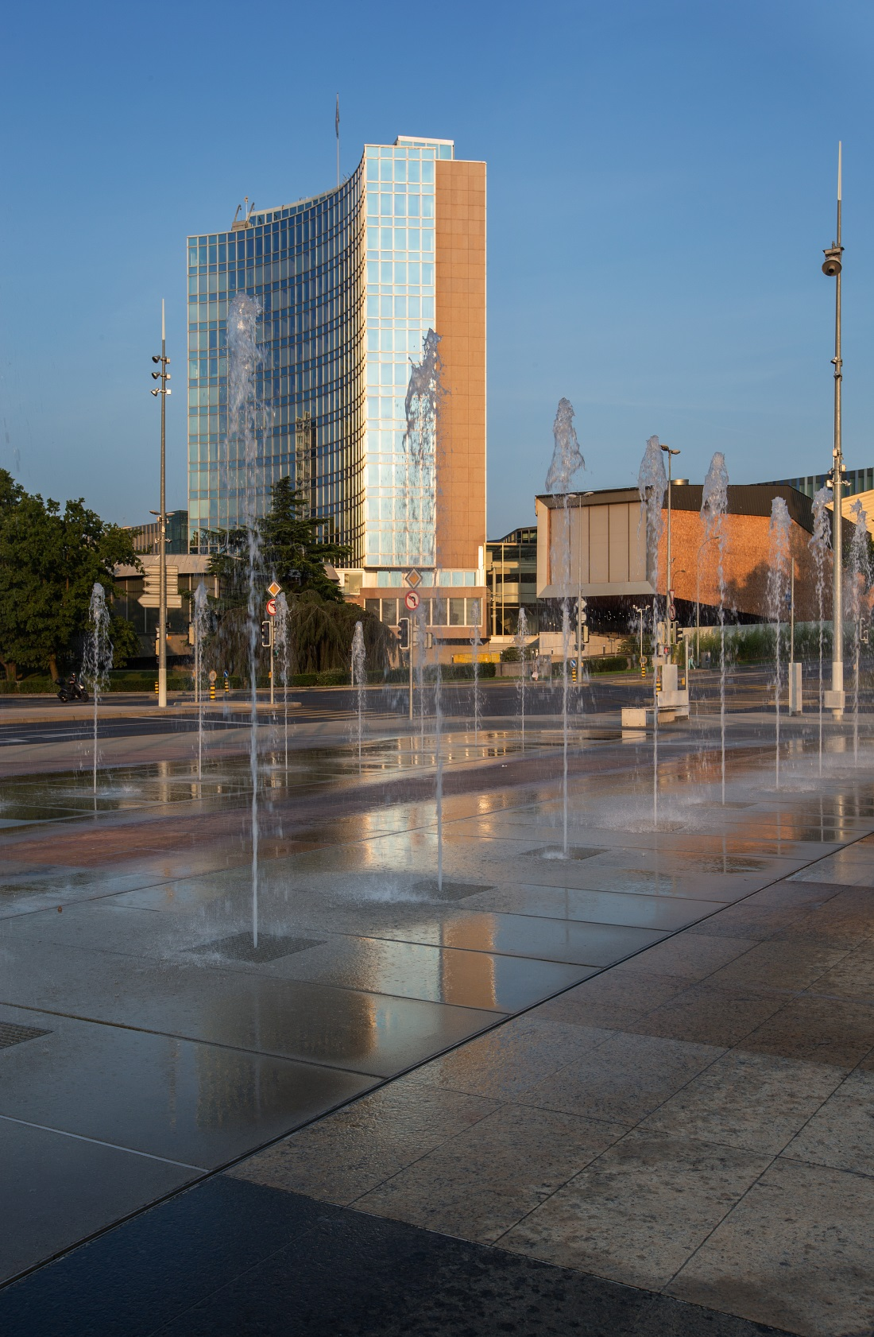
WIPO
MISSION: To lead the development of a balanced and effective international intellectual property (IP) system that enables innovation and creativity for the benefit of all.
MEMBER STATES: 188
OBSERVERS: more than 390 (NGOs, IGOs, industry groups, etc.)
STAFF: more than 1. 200
ADMINISTERED TREATIES: 26
MAIN BODIES: General Assembly, CC, WIPO CONFERENCE

Slide 6
WIPO is Service and Development oriented
Economic Development
Norm Setting
Services to Industry
Global Infrastructure

Slide 7
WIPO: Provider of Premier Global IP Services
WIPO Arbitration and Mediation Center
Hague System (Industrial Designs)
Madrid System (Trademarks)
Patent Cooperation Treaty (Patents)

Slide 8
WIPO’s Budget: 756,3 Million CHF for 2016 - 2017

Slide 9
Repositories of Information
International Classification Systems (Organize into indexed, manageable structures for easy retrieval)
Databases e.g. Patentscope and Global Brand Database
Platforms
Common platform for e-data exchange among IPOs: IPAS, DAS
Other platforms: WIPO GREEN and WIPO Re:Search
Treatment of Information
Standards for IP Offices (Help streamline data processing)
Global IP Infrastructure

Slide 10
Major Economic Studies on IP
WIPO Unit – THE ECONOMICS AND STATISTICS DIVISION – Reflects the Growing Consensus on the importance of the Economic Dimension of IP.
The Division applies statistic and Economic analysis to the use of WIPO services.
This structure also improves WIPO economic insight on IP Development.

Slide 11






The PCT Yearly Review provides an overview of the performance and development of the PCT system: http://www.wipo.int/ipstats/en/statistics/pct/
Madrid Yearly Review: http://www.wipo.int/ipstats/en
Hague Yearly Review: http://www.wipo.int/ipstats/en/
The WIPO IP Facts and Figures provides an overview of IP activity based on the latest available year of statistics. It serves as a quick reference guide for statistics: http://www.wipo.int/ipstats/en/
World Intellectual Property Indicators (WIPI) provides an overview of latest trends in IP filings and registrations covering more than 100 offices: http://www.wipo.int/ipstats/en/wipi/index.html
World Intellectual Property Report (2015): Breakthrough Innovation and Economic Growth
WIPO IP Statistics Data Center http://ipstatsdb.wipo.org/ipstatv2/ipstats/patentsSearch

Slide 12
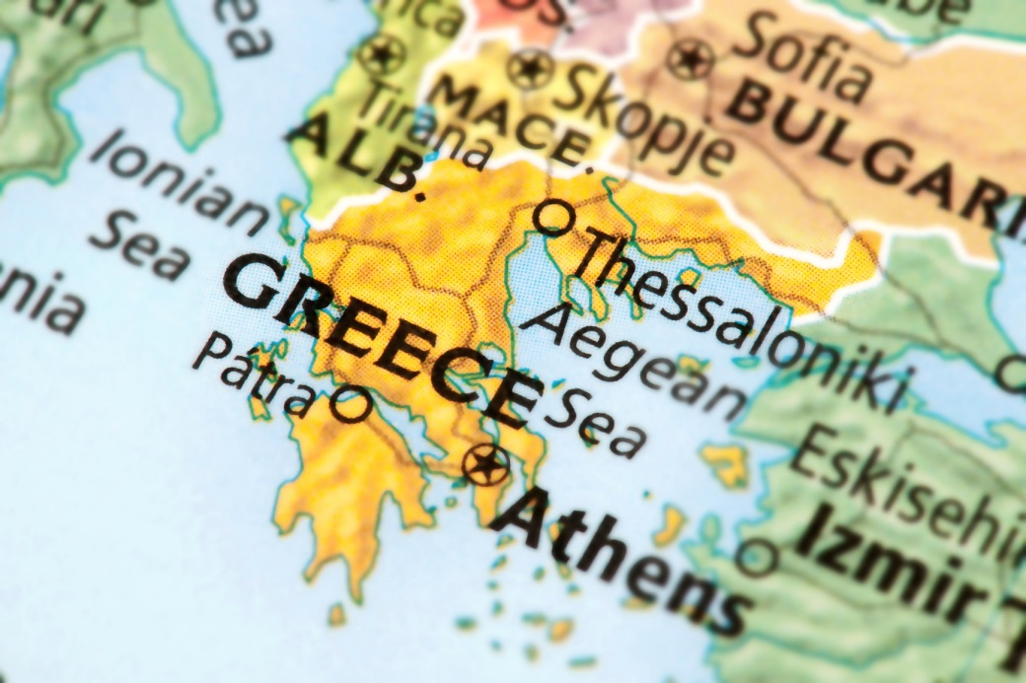
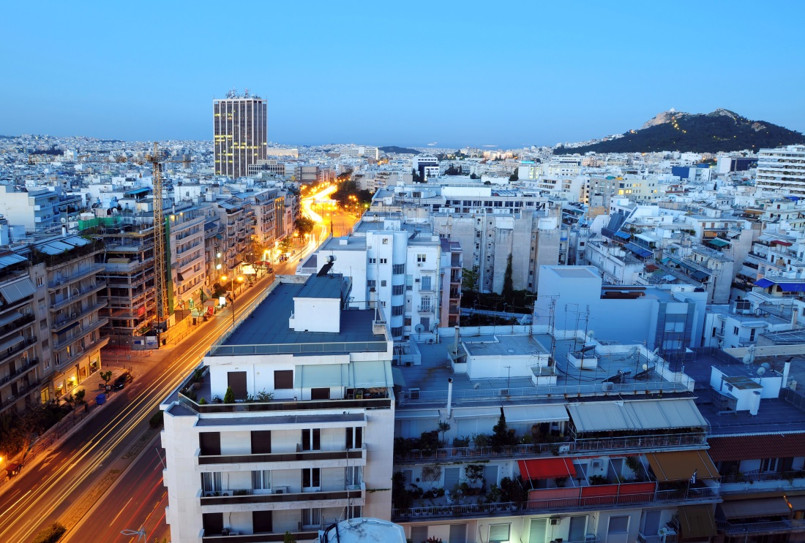
Country Profile

Slide 13
Greece in WIPO Systems
PCT applications in 2014: Greece made 133 patent applications, a 18.02 % increase from 2013
Madrid applications in 2014: Greece made 110 trademark applications, a 2.80% growth from 2013
Hague System: in 2014; 3 Industrial Design Applications were made in Greece, a decrease of 25% from 2013 (4)

Slide 14
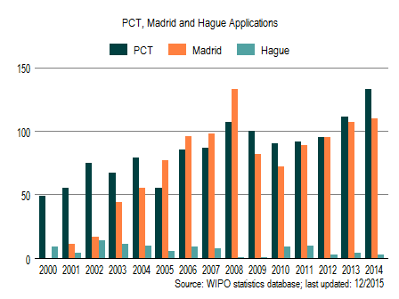
International Applications via WIPO Administered Treaties

Slide 15
Knowledge Transfer Outcomes of Greek Higher Education Institutes (1996-2011)
 | Spin-offs | Patent Applications | Active Patent Portfolio
Univ Thessaloniki (AUTh) | 5 | 69 | 29
Univ Patras (UPatras) | 4 | 42 | 17
Univ Athens (UoA) | 6 | 23 | 4
Natl Tech Univ Athens (NTUA) | 3 | 11 | 5
Univ Crete (UoC) | 2 | 8 | 4
Univ Thessaly (UTh) | 4 | 1 | 1
Athens Univ Econ Bus (AUEB) | 2 | 0 | 0
Agr Univ Athens (AUA) | 1 | 0 | 0
Univ Thrake (DUTh) | 0 | 9 | 0
Tech Univ Crete (TUC) | 0 | 3 | 1
Univ Ioannina (UoI) | 0 | 1 | 0
Univ Aegean (UAegean) | 0 | 1 | 0
Public Research Centres | 21 | 310 | 165
Source: Karraa, S. C., & Toliasa, Y. A. (2013). Greek Universities and Knowledge Transfer Performance: Assessment, Implications and Prospects.

Slide 16
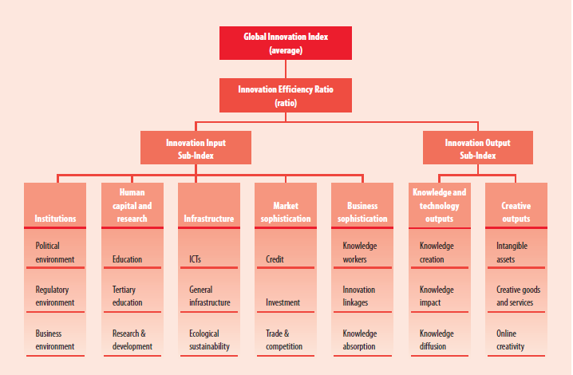
Framework of the Global Innovation Index (GII) 2015
Enables comparison among peers.
Enables to evaluate evolution in time.

Slide 17
The GII
RANKING 2014
RANKING 2015
1. SWITZERLAND
2. UNITED KINGDOM
3. SWEDEN
4. FINLAND
5. NETHERLANDS
50. GREECE
1. SWITZERLAND
2. UNITED KINGDOM
3. SWEDEN
4. NETHERLANDS
5. UNITED STATES OF AMERICA
45. GREECE
Improved GII ranking from 2014
Gross Domestic Expenditure on R&D: below crisis levels in 2013:
 | 2008 | 2009 | 2010 | 2011 | 2012 | 2013
GERD | 100 | 90 | 82 | 83 | 80 | 88

Slide 18
Greece in the GII
Strengths |  | Weaknesses
2.1.3 | School life expectancy | 3.2.3 | Gross capital formation
2.1.5 | Pupil-teacher ratio, secondary | 5.2.2 | University/Industry research collaboration
2.2 | Tertiary education | 5.3.4 | Foreign direct investment net inflows
2.2.1 | Tertiary enrolment | 6.1.3 | National office resident utility model application
2.2.2 | Graduates in science and engineering | 6.2.1 | Growth rate of GDP per person engaged
3.1.4 | E-participation | 6.3.4 | Foreign direct investment net outflows
3.3.2 | Environmental performance | 7.1 | Intangible assets
4.1.2 | Domestic credit to private sector | 7.1.3 | ICTs and business model creation
6.1.4 | Scientific and technical publications | 7.1.4 | ICTs and organizational model creation
6.2.4 | ISO 9001 quality certificates
7.2 | Creative goods and services
7.2.4 | Printing and publishing output

Slide 19
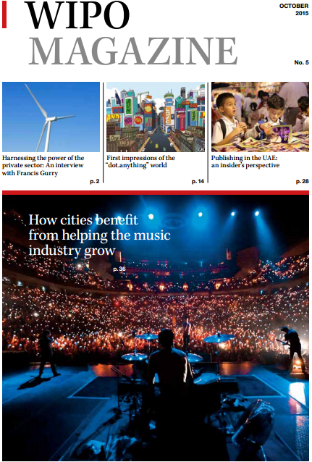
Follow us
Twitter: @wipo
WIPO Magazine
  www.wipo.int/wipo_magazine/en/
WIPO Wire:
  www.wipo.int/newsletters/en
Press releases
  www.wipo.int/pressroom/en/

Slide 20
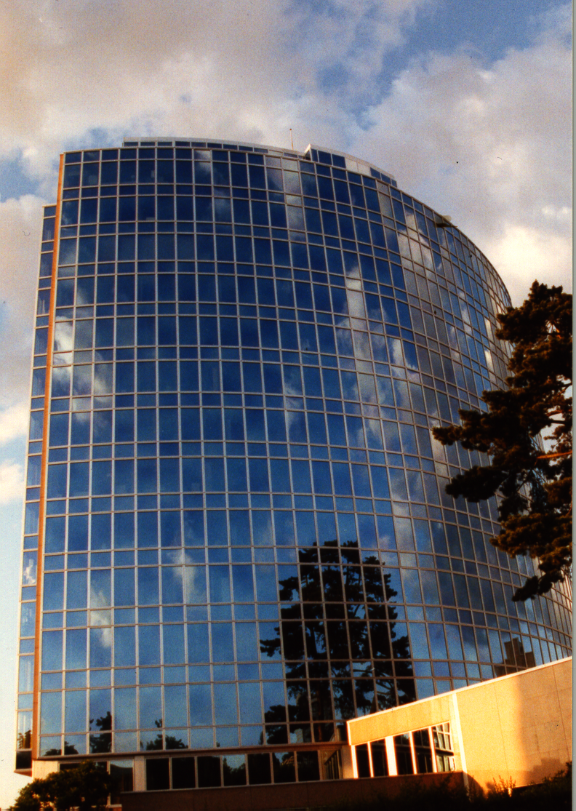
Thank you for your attention
E-mail: Victor.Vazquez-Lopez@wipo.int

Slide 22

The Patent System and the Scientific Community:
Success Stories and Challenges
Claus Matthes
Director, PCT Business Development Division
Thessalonica
March 8, 2016

Slide 23
What is Intellectual Property?
Intellectual property refers to creations of the mind: inventions; literary and artistic works; and symbols, names and images used in commerce
Intellectual property is divided into two categories:
  Industrial Property includes patents for inventions, trademarks, industrial designs and geographical indications.
  Copyright covers literary works (such as novels, poems and plays), films, music, artistic works (e.g., drawings, paintings, photographs and sculptures) and architectural design

Slide 24
What are Intellectual Property Rights?
Intellectual property rights are like any other property right
They allow creators, or owners, of patents, trademarks or copyrighted works to benefit from their own work or investment in a creation
These rights are outlined in Article 27 of the Universal Declaration of Human Rights:
  the right to benefit from the protection of moral and material interests resulting from authorship of scientific, literary or artistic productions

Slide 25
Why Promote and Protect
Intellectual Property?
Progress and well-being of humanity rest on its capacity to create and invent new works in the areas of technology and culture
Legal protection of new creations encourages the commitment of additional resources for further innovation
Promotion and protection of intellectual property spurs economic growth, creates new jobs and industries, and enhances the quality and enjoyment of life

Slide 26
Why Promote and Protect
Intellectual Property?
An efficient and equitable intellectual property system can help all countries to realize intellectual property’s potential as a catalyst for economic development and social and cultural well-being
The intellectual property system helps strike a balance between the interests of innovators and the public interest, providing an environment in which creativity and invention can flourish, for the benefit of all

Slide 27
Why Promote and Protect
Intellectual Property?
Intellectual property rights reward creativity and human endeavor, which fuel the progress of humankind
Examples:
  the multibillion dollar film, recording, publishing and software industries – which bring pleasure to millions of people worldwide – would not exist without copyright protection
  without the rewards provided by the patent system, researchers and inventors would have little incentive to continue producing better and more efficient products for consumers

Slide 28
What is a Patent?
A patent is an exclusive territorial right granted for an invention – a product or process that provides a new way of doing something, or that offers a new technical solution to a problem
A patent provides patent owners with protection for their inventions:
  right to prevent others from making, using, distributing, selling or importing the invention without the patent owner’s consent
  protection is granted for a limited period, generally
  20 years

Slide 29
Why are Patents Necessary?
Patents provide incentives to individuals by recognizing their creativity and offering the possibility of material reward for their marketable inventions
These incentives encourage innovation, which in turn enhances the quality of human life
In return for patent protection, all patent owners are obliged to publicly disclose information on their inventions in order to enrich the total body of technical knowledge in the world
This ever-increasing body of public knowledge promotes further creativity and innovation

Slide 30
So: Are Many Patent Applications Filed?

Slide 31
VIDEO

Slide 32
Why Should All of This Matter to Universities and PROs?
Universities and Public Research Organizations (PRO) are a fundamental source of knowledge for the business sector
On average, in 2009, the public sector performed more than three-quarters of all basic research in high-income economies

Slide 33
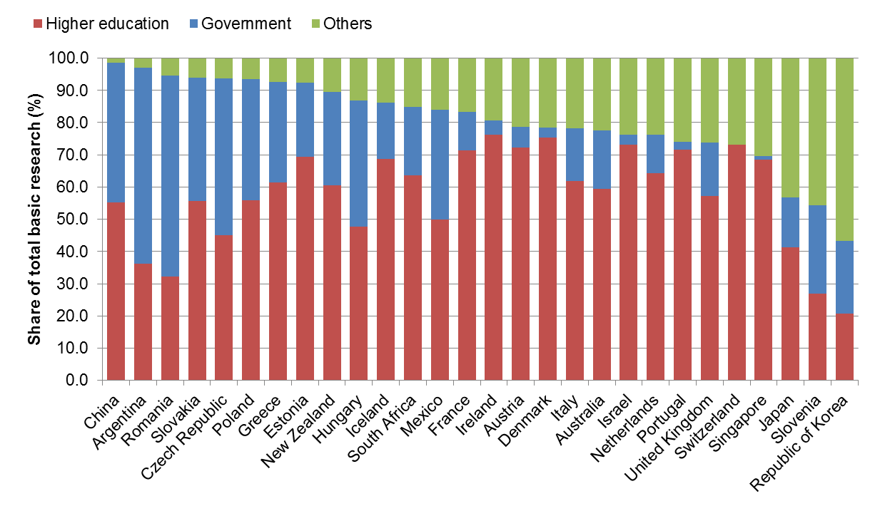
Why Should All of This Matter to Universities and PROs?
Source: WIPO Statistics Database

Slide 34
Why Should All of This Matter to Universities and PROs?
Firms and other innovators depend on the contributions of public research and of future scientists to produce innovation of commercial significance
Given the increasingly science-based nature of technological advances, interaction between firms and science is more and more key to innovation

Slide 35
Why Should All of This Matter to Universities?
So, how does interaction between firms and science work? How is knowledge transferred from Universities and PROs to Industry?
Since 1970, many countries have created support mechanisms to encourage interaction between Universities and firms, including through technology transfer
Placing the output of publicly funded research in the public domain is no longer seen as sufficient to generate the full benefits of the research for innovation

Slide 36
Why Should All of This Matter to Universities?
Policy approaches promoting increased commercialization of the results of public research have included:
  creating clusters, incubators and science parks
  promoting University – Industry collaboration
  instituting specific laws and institutions to regulate technology transfer
  encouraging public research institutions to protect their IPR and to commercialize their IP

Slide 37
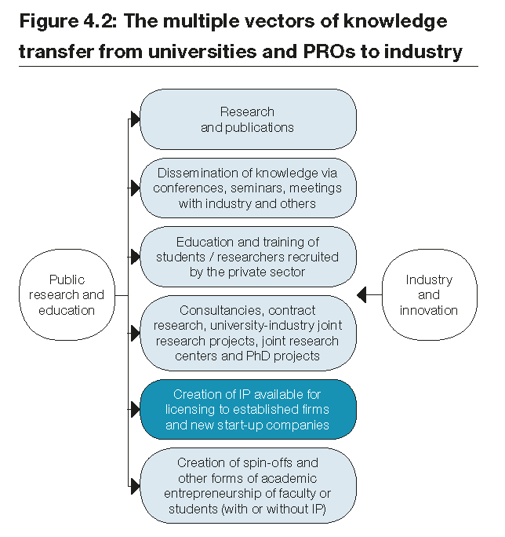
Why Should All of This Matter to Universities?
Source: Harnessing Public Research for Innovation – the Role of Intellectual Property; in World Intellectual Property Report 2011 - The Changing Face of Innovation, WIPO 2011

Slide 38
Why Should All of This Matter to Universities?
Patenting and licensing inventions based on public research are used as instruments for:
  accelerating knowledge transfer and
  fueling greater cross-fertilization between faculty and Industry
  which leads to entrepreneurship, innovation and growth
Research institutions are more and more transformed into entrepreneurial organizations!

Slide 39
Why Should All of This Matter to Universities?
Figures on patents and licences are used by researchers and policy makers to gain insights into University knowledge transfer and research performance:
Source: WIPO Statistics Database

Slide 40
Why Should All of This Matter to Universities?
Most widely used indicators for measuring University technology transfer: number of licenses and associated income (data available only from a few countries and often based on surveys only, plus largely confined to Universities and not PROs)
Data tend to support view:
  University and PRO licenses and related income are growing from low levels
  outside of the US, both relatively modest
  largely driven by a few institutions in a few sectors (pharma, biomedical, software)

Slide 41
Why Should All of This Matter to Universities?
Table 4.2: Canadian and US university technology transfer: 1991-2009
 | 1991 | 2001 | 2002 | 2005 | 2006 | 2007 | 2008 | 2009
Reporting institutions (Canada/US) | 9/841 | 27/169 | 31/181 | 33/180 | 39/182 | 37/187 | 35/184 | 36/175
Number of licenses and options executed
Canada |  |  |  | 570 | 462 | 675 | 620 | 690
US |  |  |  | 4,648 | 4,678 | 4,882 | 4,993 | 5,214
Licensing income (in million US dollars)
Canada | 3.3 | 42.1 | 32.8 | 43.7 | 56.6 | 58.6 | 53.9 | 52.1
US | 162 | 1,039 | 1,175 | 1,927 | 1,854 | 2,656 | 3,410 | 2,278
Source: Statistics Access for Tech Tranfer (STATT), database of the
US Association of University Technology Managers, (AUTM), May 2011

Slide 42
Why Should All of This Matter to Universities?
Approach of commercializing publicly funded research aims to enable firms to better identify and further develop inventions based on academic research, thus generating wider economic and social benefits
As a result, the number of national and international patent applications by research institutions has been increasing
Licensing income is still relatively modest and concentrated within a few institutions, but it is growing fast and is diversifying
In a nutshell: patenting does matter!

Slide 43
How To File a Patent Application?
Traditional system: Paris Convention
Alternative: Patent Cooperation Treaty (PCT)

Slide 44
Traditional system
Local patent application followed within 12 months by multiple foreign applications claiming priority under the Paris Convention:
  multiple formality requirements, searches, publications, examinations, prosecutions
  translations and national fees at 12 months
(months)
0
12
File
application
locally

Slide 45
What is the PCT?
An international treaty facilitating the process of seeking patents internationally
An efficient and advantageous procedure for users of the patent system and patent Offices
Signed in June 1970 and became operational in June 1978 with 18 Contracting States

Slide 46
General Remarks on the PCT
The PCT system is a patent “filing” system, not a patent “granting” system
The PCT system consists of an international and national phase
The decision on granting patents is taken exclusively by national or regional Offices in the national phase

Slide 47
The PCT ─ 1970
Basic idea: simplify the procedure for obtaining patent protection in many countries, making it more efficient and economical
  filing tool for applicants; and
  work sharing tool for Offices

Slide 48
PCT Basics
Filing Tool for applicants:
  One application, one language, one set of formality requirements, filed with one Office
  Containing, by default, the designation of all Member States, for every kind of protection available, and usual priority claim(s)
  Effect of a regular national filing (including establishment of a priority date) in each designated State
  Delays national processing until 30 months from priority date
  International search and examination reports improve basis for decision making

Slide 49
PCT Basics
Work sharing tool for Offices:
  central formality checking
  central international publication
  international search report (ISR)
  international Preliminary Reports on Patentability
    preliminary, non-binding opinion on novelty, inventive step (non-obviousness) and industrial applicability

Slide 50
Traditional Patent System
vs. PCT System
Filing of national applications
& processing by national Offices
Fees for translations, Offices, local agents
(months)
Traditional
0
12
File local
application
176 States
Entering of national phase before
& processing by national Offices
Fees for translations, Offices, local agents
delay of processing by national Offices
(months)
International
publication
PCT
0
12
16
18
22
28
30
File local
application
File PCT
application
International
search report & written opinion
(optional)
File
demand for
International
preliminary
examination
(optional)
International
preliminary report on patentability
148 States

Slide 51
The PCT System
Express intention and take steps to pursue to grant in various states
Typically filed in same national patent office--one set of fees, one language, one set of formality requirements--and legal effect in all PCT States
Disclosing to world content of application in standardized way
Enter
national
phase
International
publication
(months)
0
12
16
18
22
28
30
File local
application
File PCT
application
International
search report & written opinion
(optional)
File
demand for
International
preliminary
examination
(optional)
International
preliminary report on patentability
Typically a national patent application in the home country of the applicant
Report on state of the art (prior art documents and their relevance) + initial patentability opinion
Additional patentability analysis, designed to assist in national phase decision-making
Request an additional patentability analysis on
basis of amended application

Slide 52
International Searching Authorities
Australia
Austria
Brazil
Canada
Chile
China
Egypt
Finland
India
Israel
Japan
Republic of Korea
Russian Federation
Singapore
Spain
Sweden
Ukraine
United States of America
European Patent Office
Nordic Patent Institute (Denmark, Iceland, Norway)
Visegrad Patent Institute (not yet operating)
(Czech Republic, Hungary, Poland, Slovakia)

Slide 53
Prior Art for International Search
Prior art:
  everything which has been made available to the public,
  anywhere in the world,
  by means of written disclosure,
  which is capable of being of assistance in determining that the claimed invention is or is not new and that it does or does not involve an inventive step,
  provided the making available to the public occurred prior to the international filing date.

Slide 54
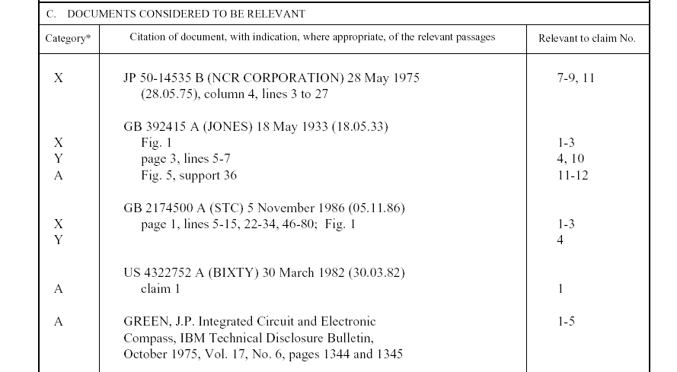
Example: PCT International Search Report
Symbols indicating
which aspect of patentability
the document cited is
relevant to (for example, novelty, inventive step, etc.)
The claim numbers
in your application to
which the document is
relevant
Documents relevant to whether or not your invention may be patentable

Slide 55
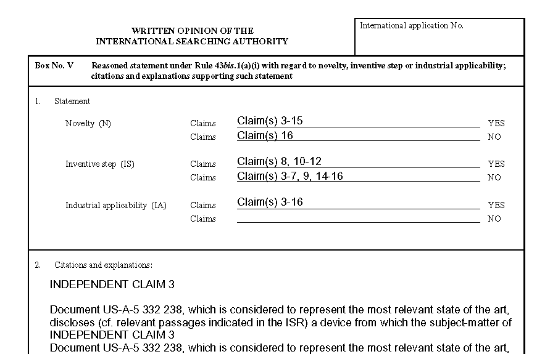
Example: PCT Written opinion of the International Searching Authority
Reasoning supporting the assessment
Patentability assessment
of claims

Slide 56
The PCT System
Express intention and take steps to pursue to grant in various states
Typically filed in same national patent office--one set of fees, one language, one set of formality requirements--and legal effect in all PCT States
Disclosing to world content of application in standardized way
Enter
national
phase
International
publication
(months)
0
12
16
18
22
28
30
File local
application
File PCT
application
International
search report & written opinion
(optional)
File
demand for
International
preliminary
examination
(optional)
International
preliminary report on patentability
Typically a national patent application in the home country of the applicant
Report on state of the art (prior art documents and their relevance) + initial patentability opinion
Additional patentability analysis, designed to assist in national phase decision-making
Request an additional patentability analysis on
basis of amended application

Slide 57
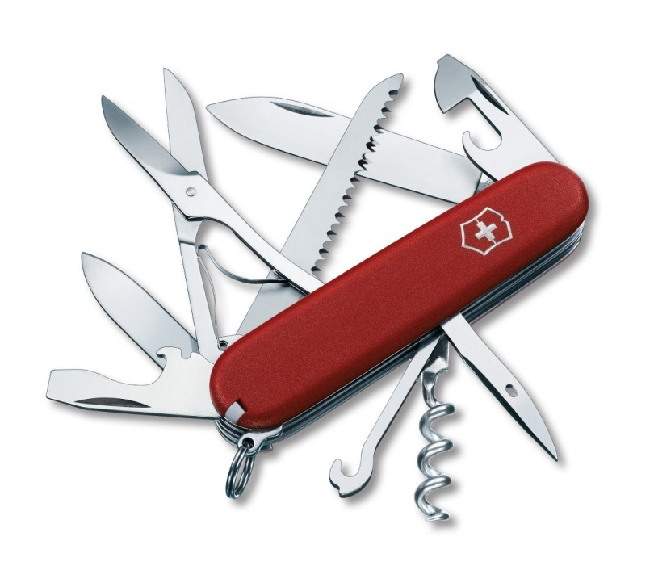
The PCT
filing tool for applicants with global reach
harmonized formalities
work-sharing tool for Offices
allows for
correction of errors
ePCT filing
and processing
buys time
patentability analysis
flexibility,
keeps options open

Slide 58
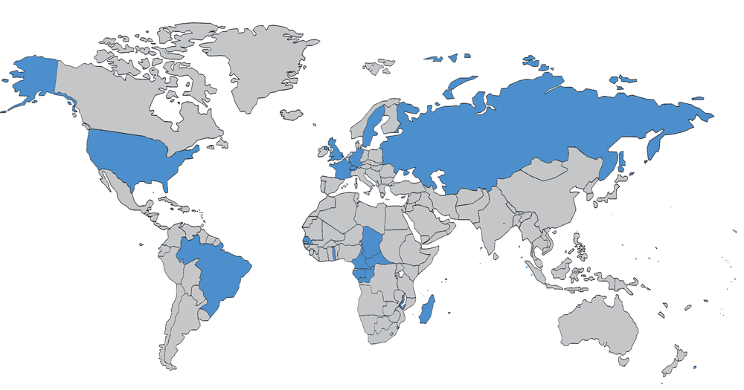
The PCT in 1978

Slide 59
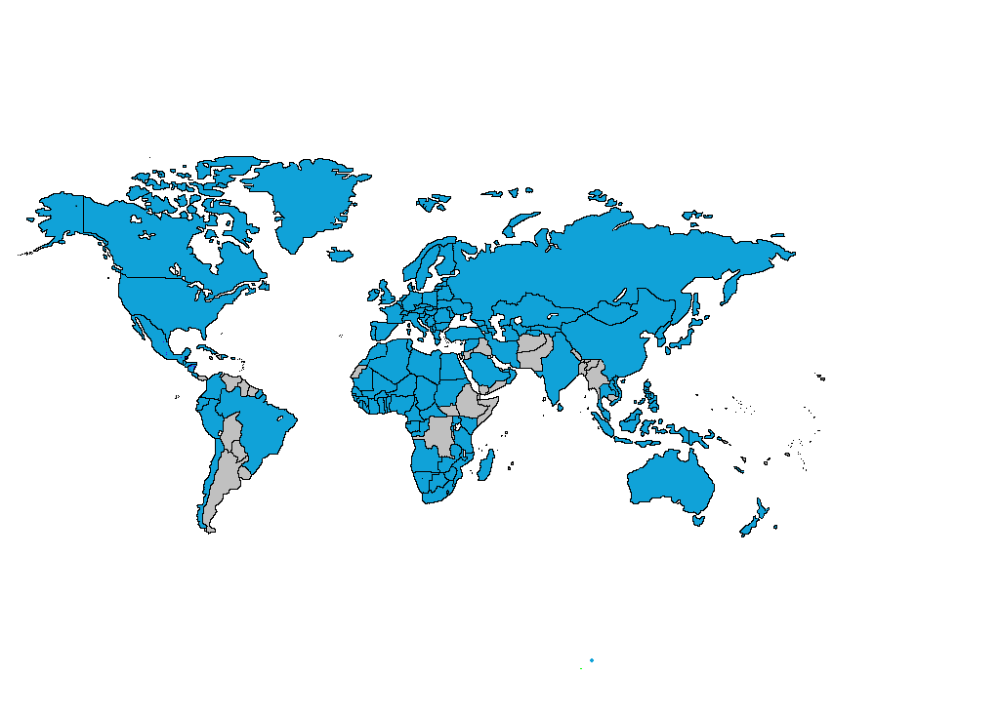
PCT Coverage Today

Slide 60

148 PCT States
=PCT
Albania
Algeria
Angola
Antigua and Barbuda
Armenia
Australia
Austria
Azerbaijan
Bahrain
Barbados
Belarus
Belgium
Belize
Benin
Bosnia and Herzegovina
Botswana
Brazil
Brunei Darussalam
Bulgaria
Burkina Faso
Cameroon
Canada
Central African Republic
Chad
Chile
China
Colombia
Comoros
Congo
Costa Rica
Côte d'Ivoire
Croatia
Cuba
Cyprus
Czech Republic
Democratic People's
Republic of Korea
Denmark
Dominica
Dominican Republic
Ecuador
Egypt
El Salvador
Equatorial Guinea
Estonia
Finland
France,
Gabon
Gambia
Georgia
Germany
Ghana
Greece
Grenada
Guatemala
Guinea
Malawi
Malaysia
Mali
Malta
Mauritania
Mexico
Monaco
Mongolia
Montenegro
Morocco
Mozambique
Namibia
Netherlands
New Zealand
Nicaragua
Niger
Nigeria
Norway
Oman
Panama
Papua New Guinea
Peru
Philippines
Poland
Portugal
Qatar
Republic of Korea
Republic of Moldova
Romania
Rwanda
Russian Federation
Saint Lucia
Saint Vincent and
the Grenadines
San Marino
Sao Tomé e Principe
Saudi Arabia
Senegal
Serbia
Seychelles
Sierra Leone
Singapore
Slovakia
Slovenia
South Africa
Spain
Sri Lanka
Sudan
Swaziland
Guinea-Bissau
Honduras
Hungary
Iceland
India
Indonesia
Iran
Ireland
Israel
Italy
Japan
Kazakhstan
Kenya
Kyrgyzstan
Lao People’s Dem Rep.
Latvia
Lesotho
Liberia
Libyan Arab Jamahiriya
Liechtenstein
Lithuania
Luxembourg
Madagascar
St. Kitts and Nevis
Sweden
Switzerland
Syrian Arab Republic
Tajikistan
Thailand
The former Yugoslav
Republic of Macedonia
Togo
Trinidad and Tobago
Tunisia
Turkey
Turkmenistan
Uganda
Ukraine
United Arab Emirates
United Kingdom
  United Republic of Tanzania
  United States of America
Uzbekistan
Viet Nam
Zambia
Zimbabwe
Notes:
60

Slide 61
Countries not yet in PCT
Afghanistan
Andorra
Argentina
Bahamas
Bangladesh
Bhutan
Bolivia
Burundi
Cambodia
Cape Verde
Democratic Republic of Congo
Djibouti
Eritrea
Ethiopia
Fiji
Guyana
Haiti
Iraq
Jamaica
Jordan
Kiribati
Kuwait
Lebanon
Maldives
Marshall Islands
Mauritius
Micronesia
Myanmar
Nauru
Nepal
Pakistan
Palau
Paraguay
Samoa
Solomon Islands
Somalia
South Sudan
Suriname
Timor-Leste
Tonga
Tuvalu
Uruguay
Vanuatu
Venezuela
Yemen
(45)

Slide 63
PCT Applications
+4.5% for 2014

Slide 64

International applications received in 2014 by country of origin
CN: +18.7%
GB: +9%
US: +7.8%
These 15 Offices received almost 92% of all applications filed in 2014
PCT fees=78% of WIPO’s revenue in 2014

Slide 65
Trend in PCT national phase entries

Slide 66
PCT national phase entries by office – 1-10

Slide 67
PCT national phase entries by office – 11-20

Slide 68
Top PCT Applicants 2014
Huawei Technologies—CN (3,442)
Qualcomm—US (2,409)
ZTE—CN (2,179)
Panasonic—JP (2,881)
Mitsubishi Electric—JP (1,593)
Intel—US (1,852)
Ericsson—SE (1,467)
Microsoft—US (1,460)
Siemens—DE (1,399)
Philips—NL (1,391)
Samsung—KR (1,381)
Toyota—JP(1,378)
Bosch—DE (1,371)
Sharp—JP (1,227)
NEC—JP (1,215)
LG Electronics—KR (1,138)
Tencent—CN (1,086)
Fujifilm—JP (1,072)
United Technologies—US (1,013)
Hitachi—JP (996)
() of published
PCT applications

Slide 69
Greek PCT Applications
Greece: Joined PCT in 1990
  international application received in 2014 (RO/GR): 68
  international application filed by Greek applicants in 2014: 166
  top Greek applicants (2014):
Applicant | Publication | Rank
PHARMATHEN S.A. | 11 | 1926
BIC-VIOLEX SA | 8 | 2491
ICR IOANNOU ABEE | 2 | 8263
INTRACOM S.A. TELECOM SOLUTIONS | 2 | 8263
ATLANTIC - P. PECHLIVANIDES, IKE | 1 | 13744
BIOMEDICAL RESEARCH FOUNDATION OF THE ACADEMY OF ATHENS | 1 | 13744
BOUTSINIS I - BAFALOUKAS I. G.P. - VIOMETALOUMIN | 1 | 13744
CHEMICAL & BIOPHARMACEUTICAL LABORATORIES OF PATRAS S.A. | 1 | 13744
CHIPITA INDUSTRIAL AND COMMERCIAL COMPANY S.A. | 1 | 13744
DIGITAL VERIFICATION SERVICES LTD | 1 | 13744

Slide 70
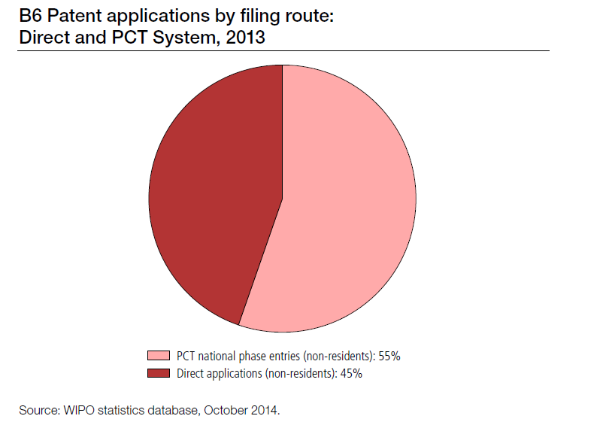
The PCT “Market Share”
*

Slide 71
Top University PCT Applicants 2014
University of California (US)
MIT (US)
University of Texas (US)
Harvard University (US)
Johns Hopkins (US)
Leland Stanford University (US)
Columbia University (US)
Cal Tech (US)
University of Pennsylvania (US)
Seoul National University (KR)
Cornell University (US)
Nanyang Technological University (SG)
University of Florida (US)
Kyoto University (JP)
Danemarks Tekniske Universitet (DK)
University of Tokyo (JP)
University of Michigan (US)
Korea University (KR)
Peking University (CN)
University of Washington (US)

Slide 72
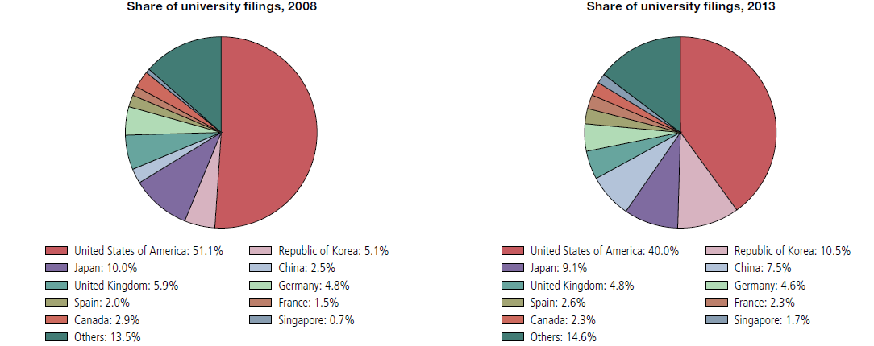
Share of University PCT Filings for the Top 10 Origins in 2008 and 2013
Source: WIPO Statistics Database

Slide 73
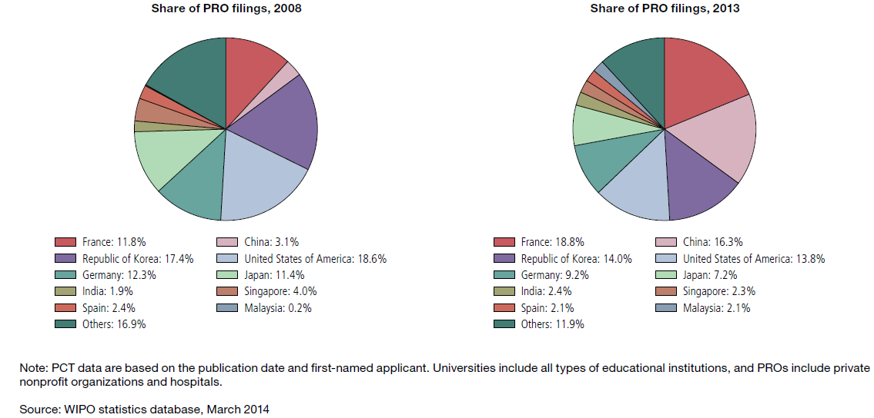
Share of PRO PCT Filings for the
Top 10 Origins in 2008 and 2013

Slide 74
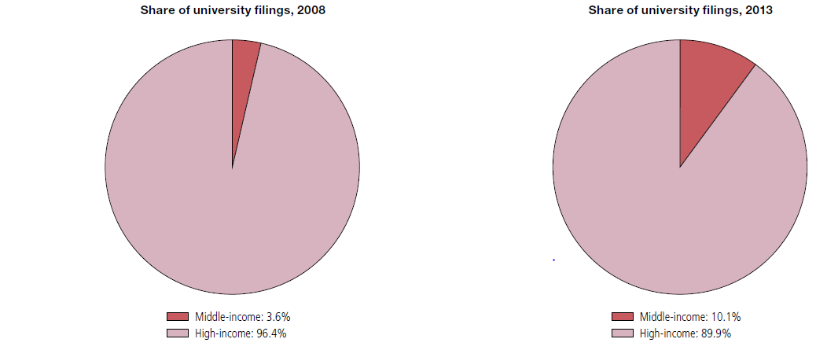
Share of University PCT Filings by Income Group in 2008 and 2013
Source: WIPO Statistics Database

Slide 75
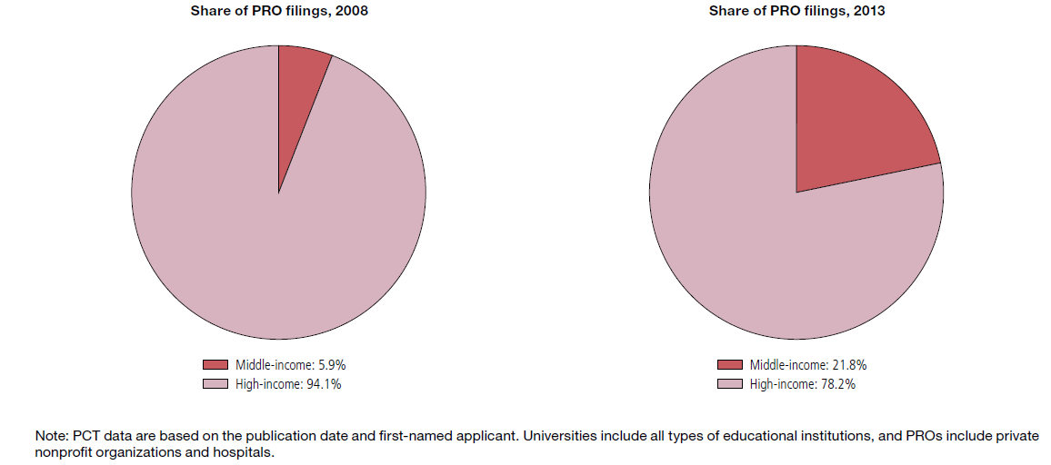
Share of PRO PCT Filings by
Income Group in 2008 and 2013
Source: WIPO Statistics Database

Slide 76
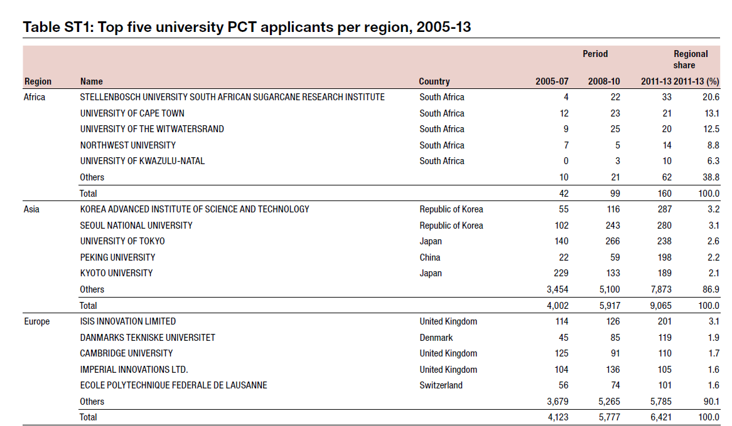
Source: WIPO Statistics Database

Slide 77
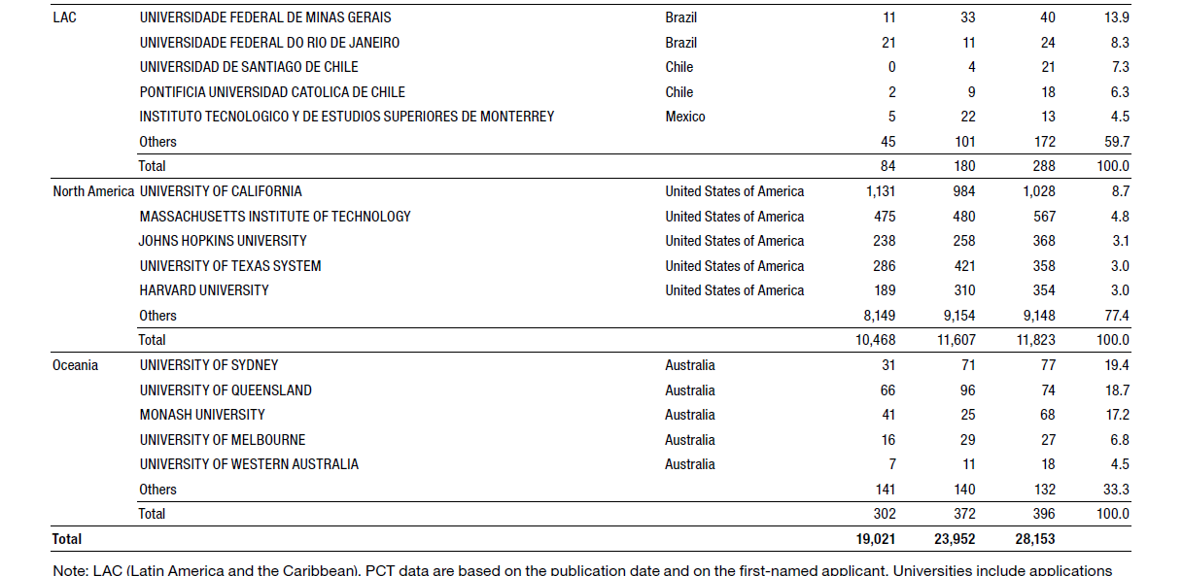
Top 5 PCT University Applicants by Region
Source: WIPO Statistics Database

Slide 78
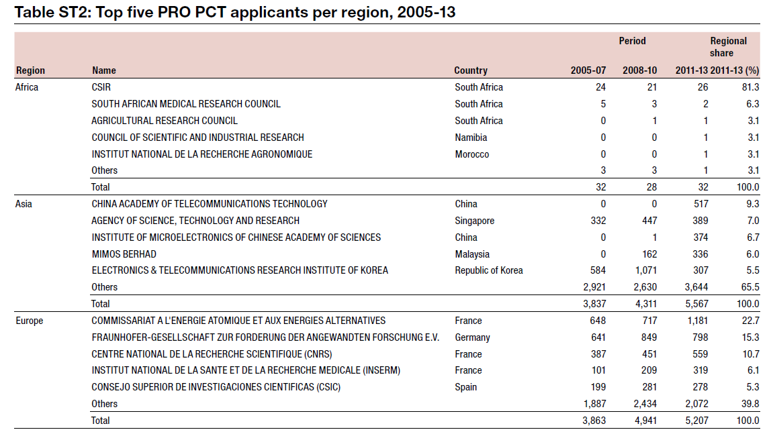
Source: WIPO Statistics Database

Slide 79
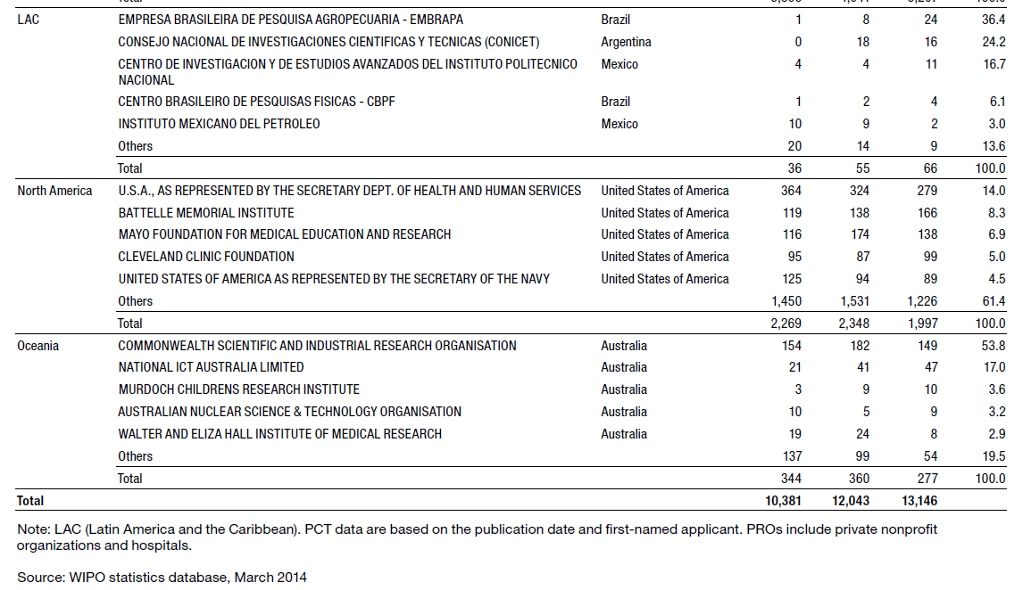

Slide 80
PCT Key Advantages
Postpones major costs of internationalizing a patent application
Provides a strong basis for patenting decisions
Harmonizes formal requirements
Helps applicants to correct errors
Evolves to meet user needs

Slide 81
PCT Key Advantages
Nokero stands for "No Kerosene". Its solar-powered lights replace kerosene lamps and candles. It is the only solar company to win the United States Patent and Trademark Office's Patents for Humanity Award. It has so far distributed over 1.4 million lights in 120 countries. The idea for the light came from a US patent agent.
  “When it comes to patenting, because we operate in so many different markets, we use WIPO’s Patent Cooperation Treaty (PCT). Every start-up has limited funds and the PCT is a great mechanism for delaying patent filing costs, allowing time to test the market and overcome any unforeseen technical problems. Without the PCT, protecting an invention in international markets would be a high-risk strategy with huge upfront costs.
  “In 2013, we even won the Patents for Humanity award from the United States Patent and Trademark Office (USPTO). We hold around 20 patents and have successfully sued a number of infringing companies. Our patent and trademark rights enable us to protect our inventions and our brand as well as the interests of our investors and the efforts of our distributors.”*
photo: Nokero Intl. Ltd.
Launched in October 2015, Nokero’s patented N233 lamp (above) can produce 700 lumen-hours per watt. The industry standard is 300 lumen-hours per watt. Intellectual property plays a critical role in Nokero’s business strategy enabling it to protect its inventions and its brand as well as the interests of investors and distributors.
Source: WIPO Magazine, February 2016

Slide 82
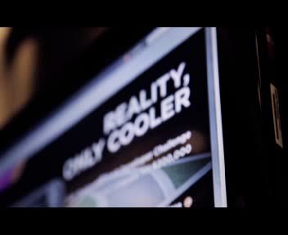
VIDEO QUALCOMM

Slide 83
PCT Training Options
29 video segments on WIPO’s Youtube channel and WIPO’s PCT page about individual PCT topics
PCT Distance learning course content available in the 10 PCT publication languages
PCT Webinars
  free updates on developments in PCT procedures and PCT strategies
  also for companies or law firms
In-person PCT Seminars and training sessions

Slide 84
PCT Resources/Information
For further information about the PCT, see
http://www.wipo.int/pct/en/
For general questions about the PCT, contact the PCT Information Service at:
      Telephone: (+41-22) 338 83 38
      Facsimile: (+41-22) 338 83 39
      E-mail: pct.infoline@wipo.int

Slide 85
Thank You!
Claus Matthes
Director, Patent Cooperation Treaty (PCT) Business Development Division
World Intellectual Property Organization (WIPO)
34 chemin des Colombettes, 1211 Geneva 20, Switzerland
T + 41 22 338 98 09; claus.matthes@wipo.int; www.wipo.int

Slide 87
Η σημασία των Πληροφοριών διπλωμάτων ευρεσιτεχνίας για τα δημόσια ερευνητικά ινστιτούτα και πανεπιστήμια
Και πως μπορούν να χρησιμοποιηθούν για την προώθηση συνεργασιών και καινοτομίας
Αντώνιος Φαρασόπουλος, Διευθυντής
Θεσσαλονίκη,
10 Μαρτίου 2016

Slide 88
Ο κύκλος καινοτομίας και λήψη αποφάσεων σχετιζόμενη με καινοτομία/διαχείριση ΒΙ
Απόκτηση δικαιωμάτων ΒΙ/ΠΙ/εμπορικά σήματα/ επιστημονική δημοσίευση
Προϊόντα/διεργασίες
Αξιοποίηση της ΙΡ/εμπορευματοποίηση/απόκτηση/μεταφορά τεχνολογίας/απόσβεση της επένδυσης/κέρδος
Επένδυση σε Ε&Α/έρευνα/καινοτομία (υπό τη στενή έννοια)

Slide 89
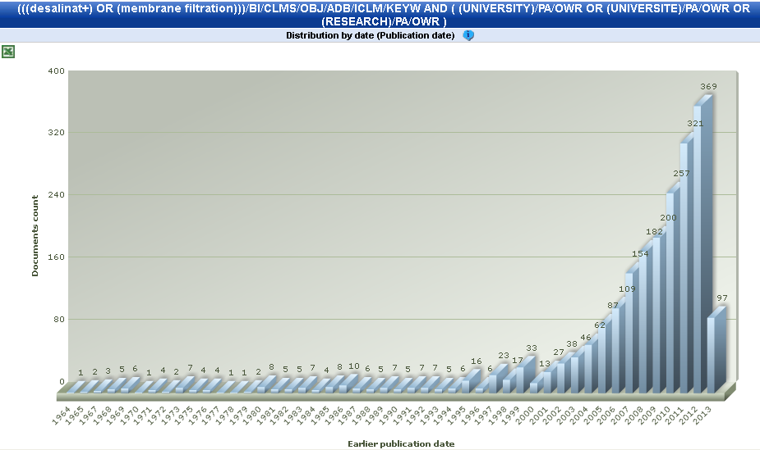
Οι ιδιαιτερότητες των πανεπιστημίων και των δημόσιων κέντρων έρευνας
Με τα ερευνητικά τους αποτελέσματα συμβάλλουν στην εξέλιξη των επιστημών, την προώθηση του δημοσίου συμφέροντος και της κοινωνίας
Δεν έχουν εμπορικό χαρακτήρα (αμερικανικά «επιχειρηματικά πανεπιστήμια»)
Οι δραστηριότητές τους σχετίζονται με την πολιτική καινοτομίας της χώρας και τη στρατηγική ΒΙ των ίδιων
Περισσότερο εστιασμένα στη βελτιστοποίηση του δυναμικού καινοτομίας, με αυξανόμενο αριθμό
Γραφείων Μεταφοράς Τεχνολογίας
(ΓΜΤ), Γραφείων Μεταφοράς/
Διαχείρισης Γνώσης
Δραστηριότητα ερευνητικών ινστιτούτων και πανεπιστημίων στον τομέα της αφαλάτωσης. Πηγή: WIPO Ανάλυση της καινοτόμου δραστηριότητας σχετικά με την αφαλάτωση

Slide 90
Τάσεις σε επιστημονικές δημοσιεύσεις και καταθέσεις διπλωμάτων ευρεσιτεχνίας
Ελλάδα
Κατάσταση παγκοσμίως
Πηγή: WIPO στατιστική βάση δεδομένων και Αμερικανικό Ίδρυμα Επιστήμης, Ιούλιος 2015

Slide 91
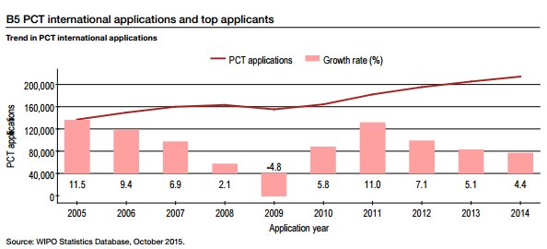
Η αυξανόμενη σημασία των πληροφοριών που περιλαμβάνονται στα διπλώματα ευρεσιτεχνίας
Source: WIPO Statistical Database – October 2015
Αύξηση του αριθμού αιτήσεων διπλωμάτων ευρεσιτεχνίας, καθώς και του όγκου πληροφοριών που περιλαμβάνονται στα σχετικά έγγραφα (τεχνικές, νομικές και επιχειρηματικές πληροφορίες)
Περιλαμβάνονται σε βάσεις δεδομένων (δωρεάν και εμπορικές)
Πρόκληση πρόσβασης στα δεδομένα και τις σχετικές πληροφορίες
PATENTSCOPE: 51 εκατομμύρια έγγραφα διπλωμάτων ευρεσιτεχνίας

Slide 92







Πρωτογενείς και δευτερογενείς πηγές πληροφοριών περί διπλωμάτων ευρεσιτεχνίας
Πρωτογενείς πηγές πληροφοριών διπλωμάτων ευρεσιτεχνίας:
  Εθνικές Επίσημες Δημοσιεύσεις (αιτήσεις διπλωμάτων ευρεσιτεχνίας/ απονεμημένα διπλώματα ευρεσιτεχνίας), Εθνικά Μητρώα Διπλωμάτων Ευρεσιτεχνίας
  Μητρώα διπλωμάτων ευρεσιτεχνίας σε κάποιες δικαιοδοσίες είναι προσβάσιμα/επιτρέπουν αναζήτηση online
Δευτερογενείς πηγές → Βάσεις δεδομένων διπλωμάτων ευρεσιτεχνίας
  Κάποιες δωρεάν, άλλες έναντι τελών
    Δωρεάν: WIPO , EPO ,
    Google Patents (US patents)
    SIPO Patent Search
    Με τέλη:
    TR , LexisNexis ,
    Orbit

Slide 93
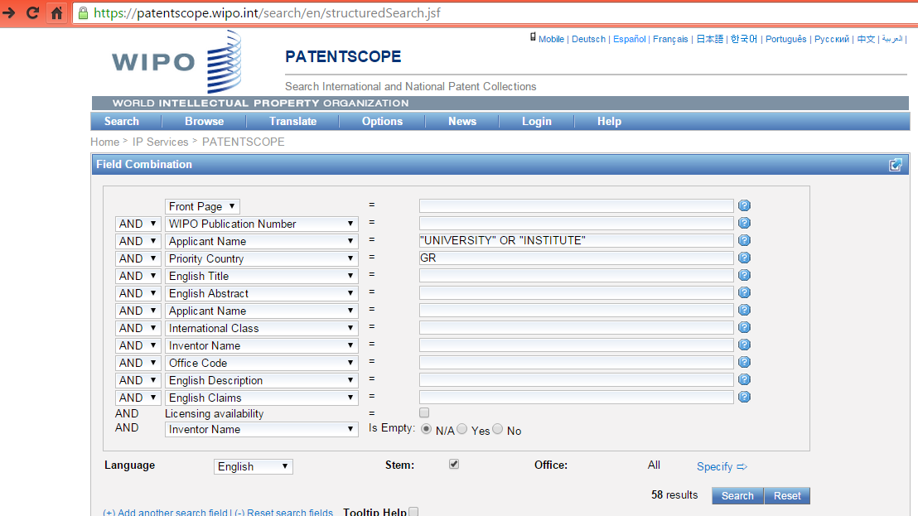
PATENTSCOPE: Αναζήτηση βάσει διαφόρων κριτηρίων
Ένδειξη αριθμού αποτελεσμάτων

Slide 94
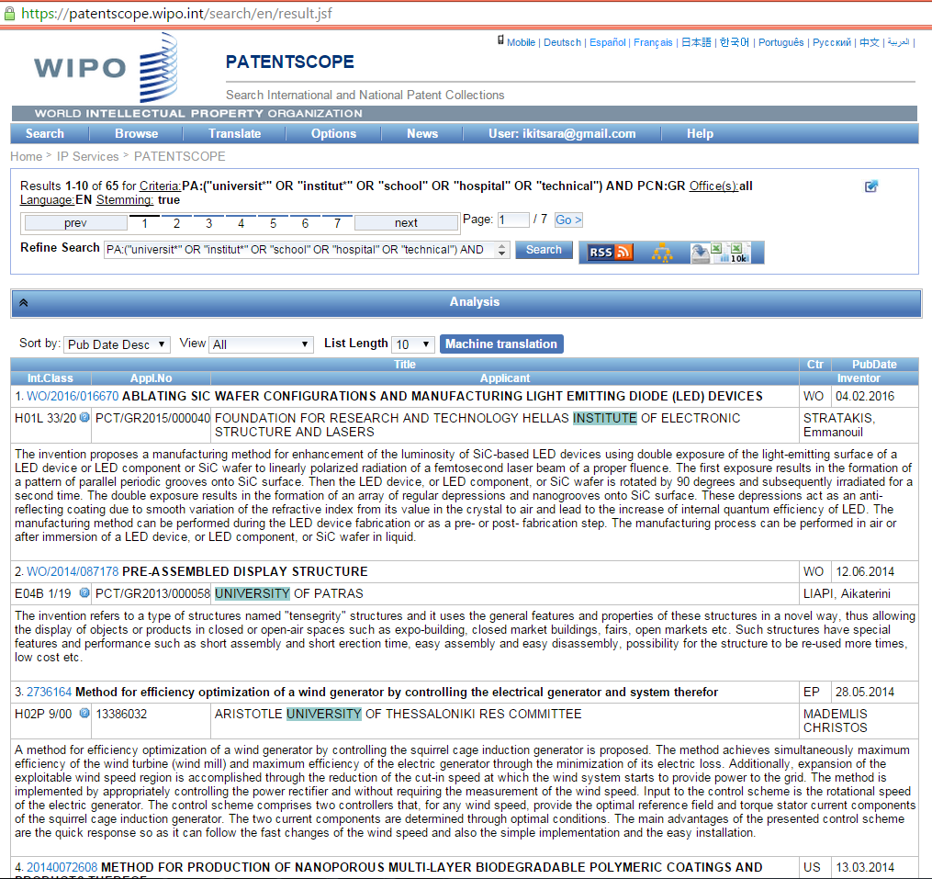
Λίστα με τα αποτελέσματα αναζήτησης
Εξαγωγή έως 10.000 αποτελεσμάτων. Μόνη προϋπόθεση: λογαριασμός WIPO

Slide 95
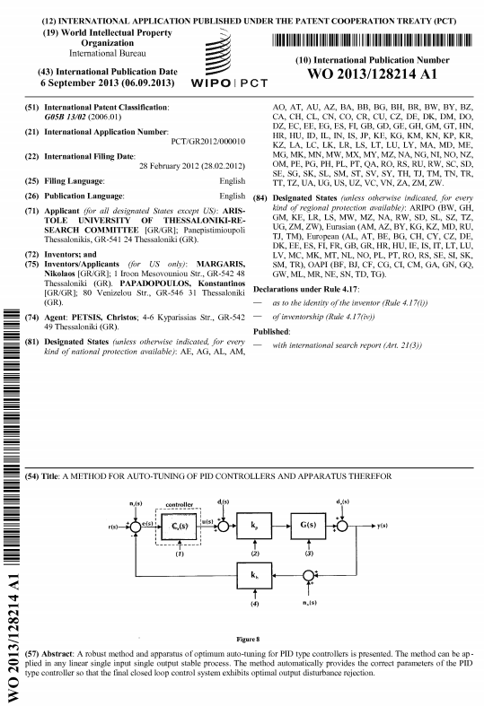
Η αίτηση διπλώματος ευρεσιτεχνίας: πλούσια πηγή πληροφοριών (τεχνικών, νομικών και εμπορικών)
Λεπτομερής περιγραφή εφεύρεσης με παραπομπές σε στάθμη της τεχνικής και λύση σε τεχνικό πρόβλημα
Πληροφορίες σχετικά με την έναρξη της προστασίας, τους καταθέτες και τους εφευρέτες, όπως και τη γεωγραφική κατανομή της προστασίας
Βιβλιογραφικά δεδομένα (1η σελίδα με τίτλο, περίληψη, αντιπροσωπευτική εικόνα)
Πλήρες έγγραφο (περιγραφή, αξιώσεις, εικόνες/σχέδια)

Slide 96
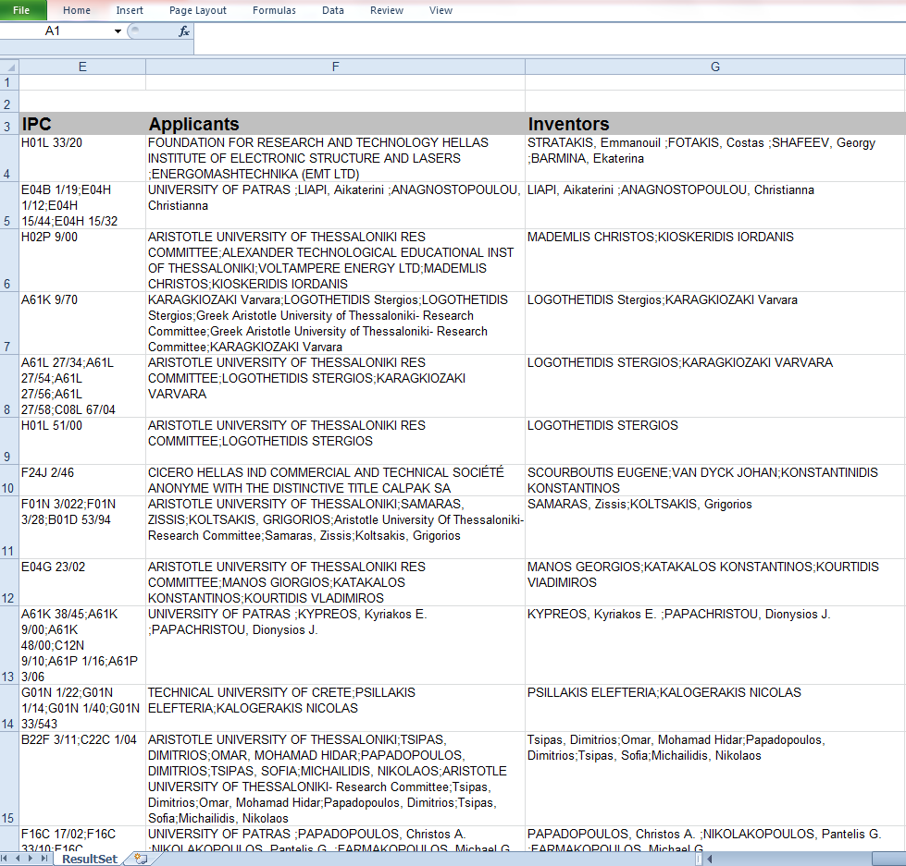
Εξαγωγή αποτελεσμάτων σε πίνακα Excel προς ανάλυση

Slide 97
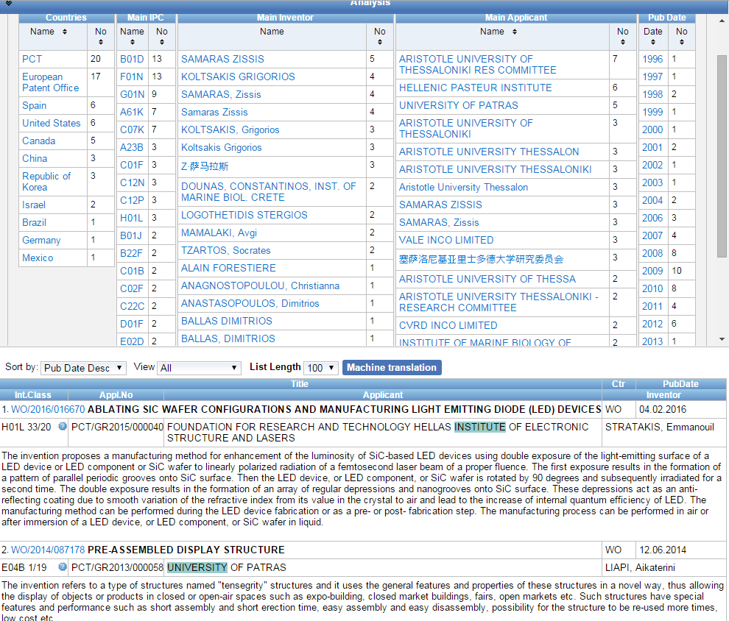
Ανάλυση αποτελεσμάτων στο Patentscope

Slide 98
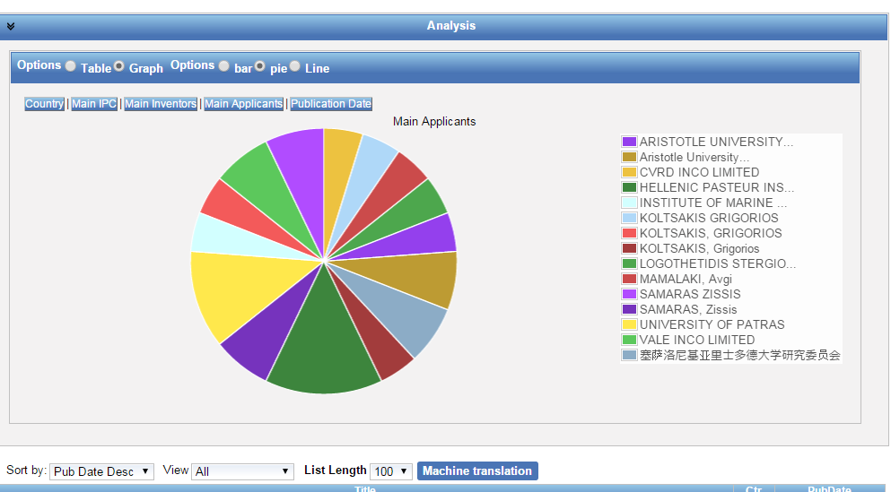
Ανάλυση αποτελεσμάτων στο Patentscope (2)

Slide 99
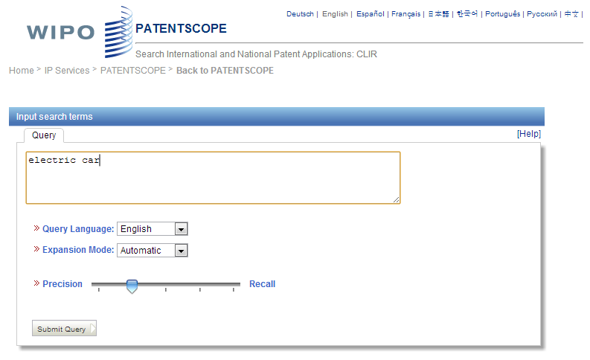

Εργαλείο CLIR: επέκταση όρων αναζήτησης σε συνώνυμα, επιλογή τεχνολογικών τομέων και ταυτόχρονη αναζήτηση σε 14 γλώσσες

Slide 100
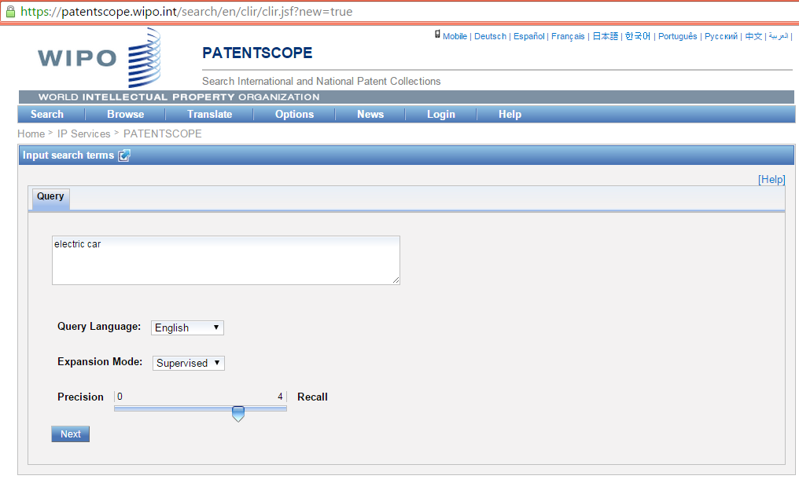
TIP: Use a key term in English. Why?
Αναζήτηση δυνατή σε 14 γλωσσες
Συμβουλή: λέξεις αναζήτησης – στα αγγλικά (καλύτερη για αύτόματη μετάφραση)

Slide 101
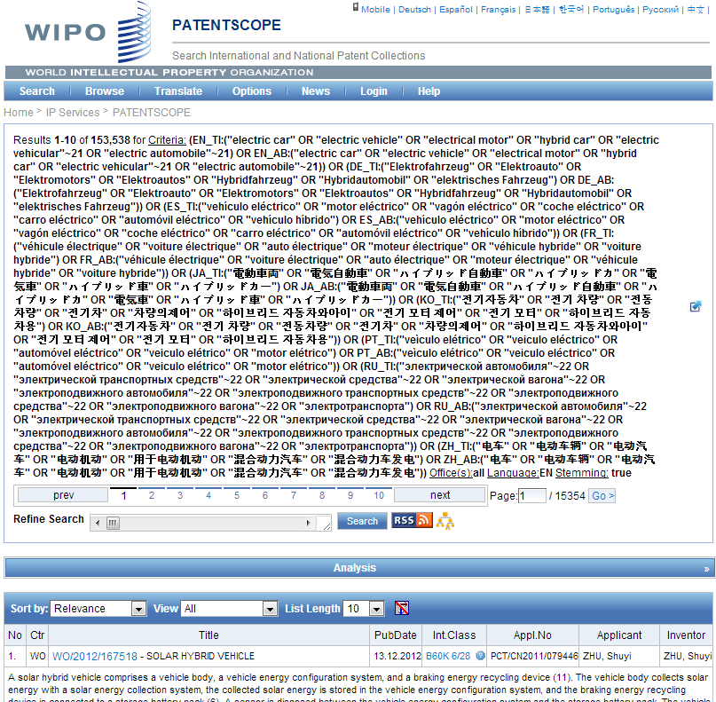

Όροι αναζήτησης:
Συνώνυμα και τεχνολογικά συναφείς όροι
Electric car - αποτελέσματα αναζήτησης μόνο στα Αγγλικά: 16,000 αποτελέσματα.
Αναζήτηση με τη βοήθεια του CLIR: πάνω από 153.000 αποτελέσματα

Slide 102
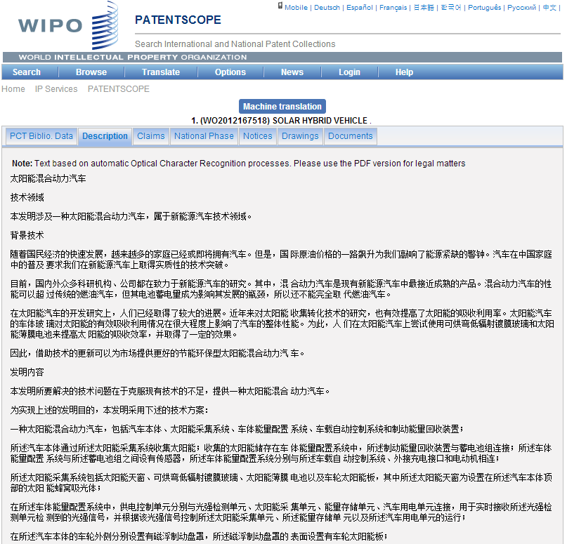
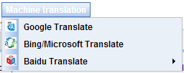
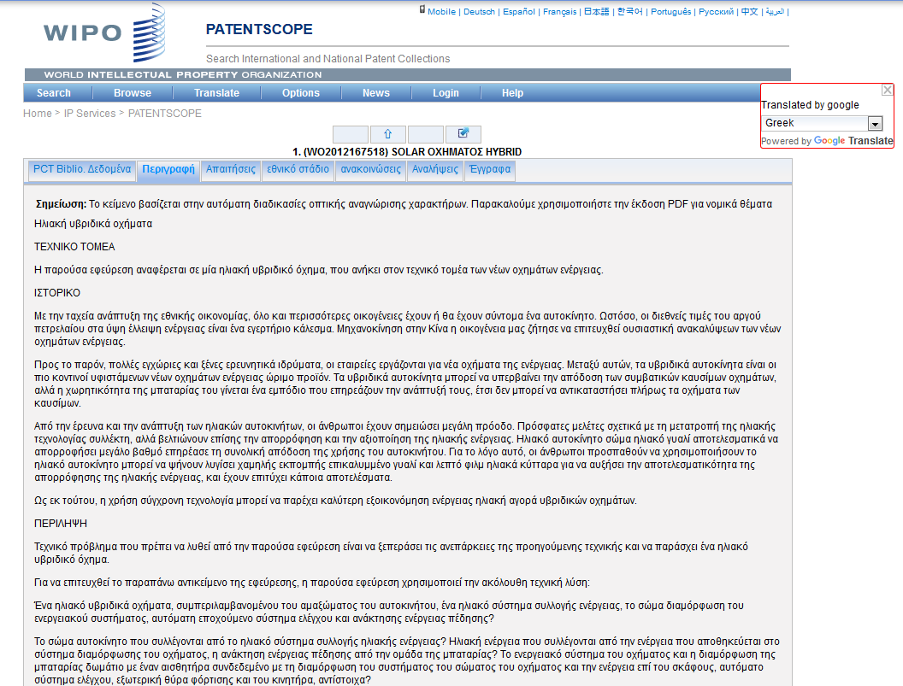
Εργαλεία μετάφρασης – πρόσβαση σε ξενόγλωσσες δημοσιεύσεις
???

Slide 103
Πώς και πότε είναι χρήσιμες οι πληροφορίες που περιέχονται στα διπλωμάτα ευρεσιτεχνίας και γιατί
Σε όλες τις φάσεις καινοτομίας, από την αρχή για διαφορετικούς λόγους:
  Έρευνα της στάθμης της τεχνικής, πριν την έναρξη της έρευνας για την αποφυγή επανάληψης των ερευνητικών προσπαθειών και για τον προσδιορισμό του πεδίου έρευνας και ταυτοποίηση εταίρων για συνδυασμένη έρευνα
    Συμπληρωματικές τεχνικές πληροφορίες ως προς τις επιστημονικές δημοσιεύσεις, και κάποιες φορές μοναδικές
  Κατά τη διάρκεια της έρευνας: ενημέρωση ως προς τις εξελίξεις στη στάθμη της τεχνικής, αξιολόγηση ως προς την πιθανότητα κατοχύρωσης διπλώματος ευρεσιτεχνίας για τα ερευνητικά αποτελέσματα και ορισμός της στρατηγικής ΒΙ
  Στη φάση μεταφοράς τεχνολογίας/εμπορευματοποίησης: ορισμός ελευθερίας δράσης/αναζήτηση εταίρων για συνεργασία, υφιστάμενες και δυνητικές αγορές

Slide 104
Η προστιθέμενη αξία της ανάλυσης των δεδομένων από τα διπλώματα ευρεσιτεχνίας
Η ανάλυση είναι ένα σχυρό εργαλείο που επιτρέπει:
  Δομημένη παρουσία των αποτελεσμάτων της αναζήτησης διπλωμάτων ευρεσιτεχνίας
  Παρουσίαση των πληροφοριών με τρόπο εύκολα κατανοητό σε μη ειδικούς, με τη βοήθεια στατιστικών, εργαλείων απεικόνισης και ερμηνεία των αποτελεσμάτων
  Διευκόλυνση του διατομεακού διαλόγου μεταξύ διαφόρων πλευρών
  Γνώση κρίσιμη για επιχειρηματικότητα/ανταγονιστικότητα – Επί τη βάσει πληροφρόρησης, λήψη στρατηγικών αποφάσεων σχετικών με επενδύσεις, προσανατολισμό της Ε&Α, δυνατότητα κατοχύρωσης με δίπλωμα ευρεσιτεχνίας, μεταφορά τεχνολογίας ή/και τεχνογνωσίας

Slide 105
ΤΙ ΕΙΔΟΥΣ ΠΛΗΡΟΦΟΡΙΕΣ ΚΑΙ ΠΩΣ ΜΠΟΡΟΥΝ ΝΑ ΧΡΗΣΙΜΟΠΟΙΗΘΟΥΝ ΓΙΑ ΤΗΝ ΠΡΟΑΓΩΓΗ ΤΗΣ ΚΑΙΝΟΤΟΜΙΑΣ ΚΑΙ ΤΩΝ ΣΥΝΕΡΓΑΣΙΩΝ;

Slide 106
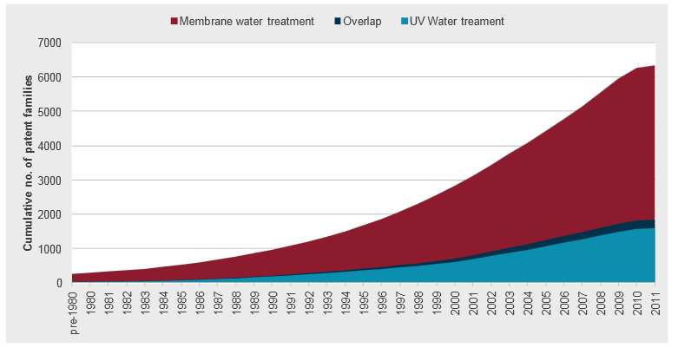
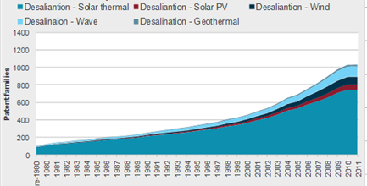
Γενικές τάσεις έναντι τάσεων σε υποτομείς
Κατάθεση διπλωμάτων ευρεσιτεχνίας για τη διήθηση με μεμβράνες και την επεξεργασία ύδατος με UV
Aφαλάτωση και ανανεώσιμες ενέργειες (RE): διαχωρισμός κατά τύπο RE
Source: WIPO PLR on Membrane Filtration and UV Water Treatment
Source: WIPO PLR on Water desalination and the use of renewable energies
* Εντοπισμός ώριμων ή υποσχόμενων τεχνολογιών

Slide 107
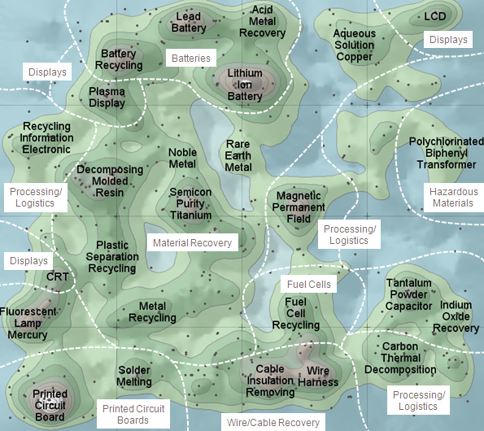
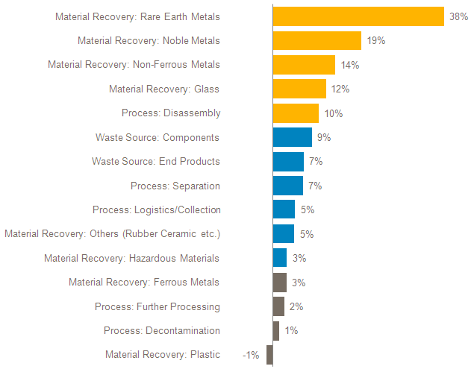
Περιοχές αυξημένου ενδιαφέροντος και υψηλού ρυθμού αύξησης
Τάσεις στη δραστηριότητα κατοχύρωσης στη διαχείριση ηλεκτρονικών απορριμμάτων: ετήσιος ρυθμός αύξησης 2006-2010
Themescape from E-waste PLR
Πεδία ιδιαίτερου ενδιαφέροντος
Υποσχόμενες τεχνολογίες

Slide 108
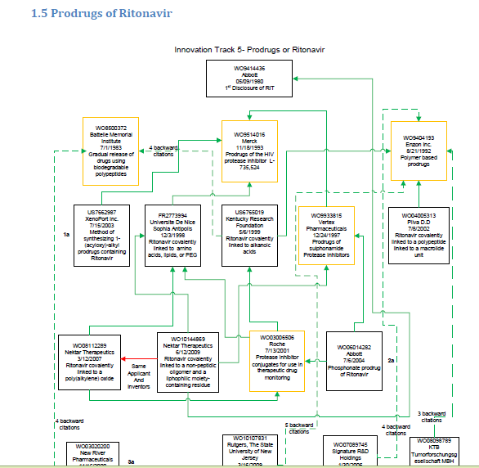
Ανάλυση παραπομπών και γενιές διπλωμάτων ευρεσιτεχνίας: καινοτομία βελτίωσης
Source: WIPO PLR on Ritonavir

Slide 109
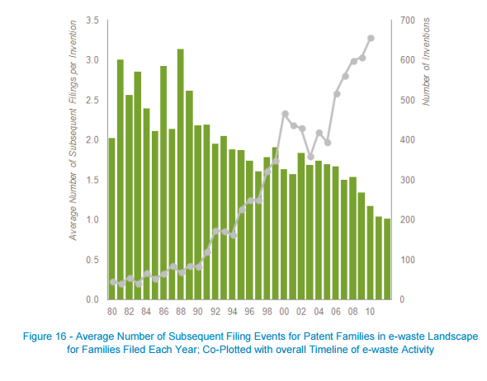
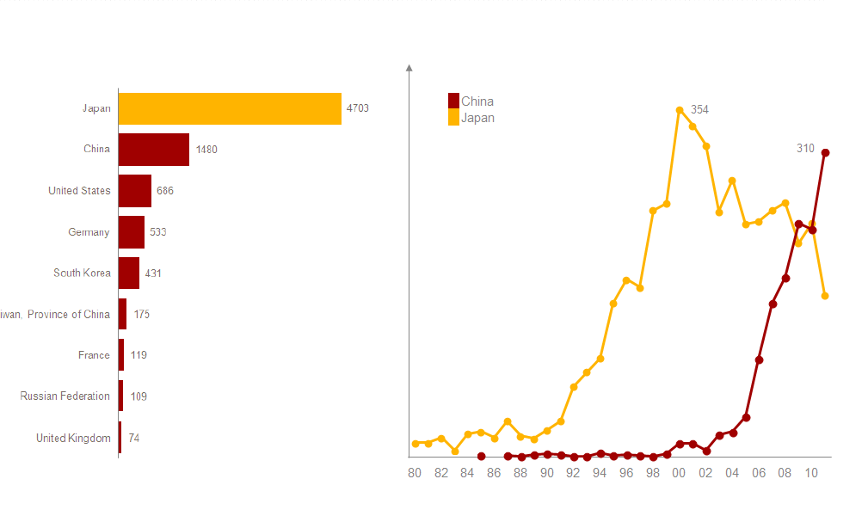
Γεωγραφική κατανομή της προστασίας με διπλώματα ευρεσιτεχνίας – συνδυασμός τύπων ανάλυσης
Τάσεις σε γραφείο πρώτης κατάθεσης και πρόσφατες τάσεις
Αριθμός επακόλουθων καταθέσεων και τάσεις στις καταθέσεις διπλωμάτων ευρεσιτεχνίας
Source: WIPO PLR on E-waste Recycling
Έμμεσος ορισμός και ανάλυση αγορών

Slide 110
α. Πληροφορίες που μπορούν να προάγουν την καινοτομία
  Εντοπισμός υπάρχουσας έρευνας και καινοτομίας (στάθμη της τεχνικής): περισσότερο στρατηγική και εστιασμένη καινοτομία, χωρίς επανάληψη προσπαθειών και μη-αποδοτική δαπάνη των επενδύσεων
Νέες προσεγγίσεις και τεχνικές λύσεις για υφιστάμενα προβλήματα, τάσεις σε δεδομένο πεδίο τεχνολογίας
Εντοπισμός τεχνολογικών τομέων με προοπτική
Μέσω εργαλείων ταξινόμησης και μετάφρασης → πρόσβαση σε μεγαλύτερο φάσμα πληροφοριών που μπορεί να προαγάγει τη δημιουργικότητα και να εμπνεύσει περαιτέρω καινοτομία
Αναγνώριση τεχνολογιών στη δημόσια σφαίρα, καινοτομία με βάση υφιστάμενη καινοτομία (βελτιώσεις, γενιές καινοτομίας)

Slide 111
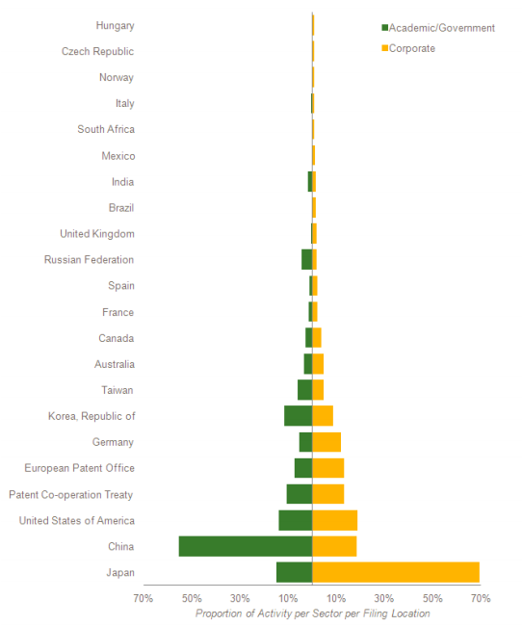
Βασικότεροι καταθέτες διπλωμάτων ευρεσιτεχνίας (ΔΕ), κατανομή της δραστηριότητας μεταξύ δημόσιου & ιδιωτικού τομέα
Source: WIPO Αναφορά σχετικά με τεχνολογίες επεξεργασίας νερού με μεμβράνες και υπεριώδη ακτινοβολία
Ανταγωνιστικότητα και προσδιορισμός της θέσης ενός ερευνητικού κέντρου έναντι άλλων /άλλων χωρών

Slide 112

Δίκτυα συνεκχώρησης διπλωμάτων ευρεσιτεχνίας (συνεργασία μεταξύ καταθετών ΔΕ)
Εργαλείο ανοιχτού κώδικα Gephi

Slide 113

Δίκτυα συνεργασιών μεταξύ καταθετών και εφευρετών
Πηγή: WIPO Αναφορά σχετικά με τεχνολογίες αφαλάτωσης
Συνεργασία δημοσίου-ιδιωτικού-δημοσίου

Slide 114
β. Πληροφορίες που μπορούν να προάγουν τις συμπράξεις
Αναγνώριση βασικών καταθετών και παικτών σε ένα τομέα, πιθανοί συνεργάτες:
    επενδυτές
    κοινή έρευνα
    Μεταφορά τεχνολογίας/τεχνογνωσία, κτήση τίτλων ΒΙ
    Συνεργάτες σε άλλες χώρες με υφιστάμενες ή δυνητικές αγορές
    Μελλοντικές επαγγελματικές προοπτικές για ερευνητές μετά το πανεπιστήμιο (assets για spin-offs)
Αλλαγή στρατηγικής και στατιστικά στοιχεία ορισμένων πρωτοπόρων και δυναμική νέων παικτών σε ένα τεχνολογικό τομέα

Slide 115

Αναλύσεις δεδομένων καινοτόμου δραστηριότητας (Patent Landscape Reports)
Ανάλυση βασισμένη σε δεδομένα από ΔΕ
Τα αποτελέσματα της αναζήτησης καθαρίζονται, ομαδοποιούνται και αναλύονται βάσει διαφόρων κριτηρίων
Το WIPO έχει ετοιμάσει τέτοιες αναλύσεις σε διάφορους τομείς (δημόσια υγεία, περιβάλλον και ενέργεια, γεωργία και διατροφή)
Επίσης έχει συλλέξει πάνω από 100 αναφορές άλλων φορέων
http://www.wipo.int/patentscope/en/programs/patent_landscapes

Slide 116





...Προσεχώς...
Ανάλυση σχετική με τεχνολογίες επιταχυντή, τις ιατρικές και βιομηχανικές χρήσεις τους, σε συνεργασία με το CERN
Ανάλυση σχετική με τεχνολογίες για Επιλεγμένες Παραμελημένες Ασθένειες
Ανάλυση σχετική με τεχνολογίες Παραγωγής Φοινικέλαιου και στην Αξιοποίηση των υπολοίπων των πρώτων υλών
(Συμβούλιο Φοινικέλαιου Μαλαισίας)
Ανάλυση τεχνολογιών σχετιζόμενων με μικροάλγες (Μαροκάνικο ερευνητικό κέντρο ΜΑSCIR)

Slide 117

WIPO Οδηγός προετοιμασίας αναλύσεων καινοτόμου δραστηριότας
Δημοσιεύθηκε το Σεπτέμβριο του 2015
Απευθύνεται σε χρήστες πληροφοριών
BI
Περιγράφει τα απαραίτητα στάδια και τις απαραίτητες σχετικές εργασίες
Χρησιμοποιείται και σε επιμορφώσεις
σχετικές με αναλύσεις δεδομένων ΒΙ
  http://www.wipo.int/edocs/pubdocs/en/wipo_pub_946.pdf

Slide 118

Εγχειρίδιο για εργαλεία ανοικτής πηγής για την ανάλυση δεδομένων καινοτόμου δραστηριότητας
  Εργαλεία ανοικτής πηγής για:
    λήψη
    καθαρισμό
    ανάλυση δεδομένων
    απεικόνιση
    κοινοποίηση
  Εγχειρίδιο διαθέσιμο στο GITHUB
  Αναμένεται να δημοσιευθεί τέλος Μαρτίου
https://github.com/poldham/opensource-patent-analytics

Slide 119
Συμπεράσματα
Τα δεδομένα που περιλαμβάνονται στα διπλώματα ευρεσιτεχνίας είναι μία πλούσια πηγή πληροφοριών
Η τέχνη της ανάλυσης διπλωμάτων ευρεσιτεχνίας:
  Αναγνώριση σχετικών πληροφοριών
  Ομαδοποίηση των αποτελέσματα βάσει σωστών κριτηρίων
  Συνδυασμός διαφόρων τύπων αναλύσεων για σωστά συμπεράσματα
  Επιλογή χρήσιμης απεικόνισης
  Εξαγωγή σημαντικών μηνυμάτων
Πλεονεκτήματα:
  Καλύτερη και ενημερωμένη λήψη αποφάσεων, περισσότερο συνειδητός προσανατολισμός της Ε&Α, αποφυγή επανάληψης προσπαθειών
  Αναγνώριση ευκαιριών για επένδυση και συνεργασία με άλλους ερευνητές

Slide 120
Ευχαριστώ!
Antonios.Farassopoulos@wipo.int

