Slide 1




Seminar on WIPO Services and Initiatives
Luxembourg
Oct. 27, 2014,

Slide 2



Slide 3
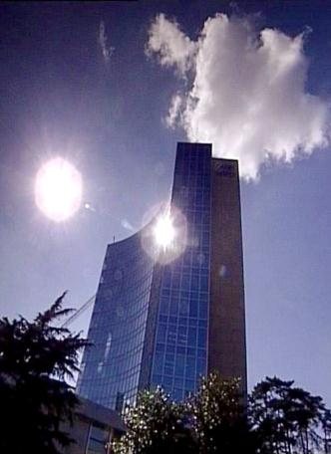
BASICS FACTS ABOUT WIPO
WIPO’s MISSION: To promote the protection of IP rights worldwide and extend the benefits of the international IP system to all member states.
MEMBER STATES: 186
OBSERVERS : + 390
STAFF : 950 FROM 101 COUNTRIES
ADMINISTERED TREATIES : 26
MAIN ORGANS/BODIES : GA, CC, WIPO CONFERENCE

Slide 4
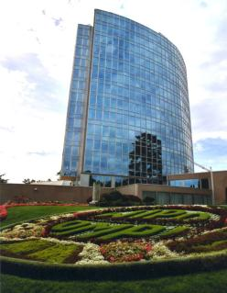
MILESTONES: 1883 - 2013
2013
MARRAKESH TREATY
2012
2006
BEIJING TREATY
2000
STLT
1996
PATENT LAW TREATY
INTERNET TREATIES
1989
MADRID PROTOCOL
1970
PCT ESTABLISHED
1967
1960
WIPO CONVENTION
1925
BIRPI MOVES TO GENEVA
1893
HAGUE AGREEMENT
1891
BIRPI
1886
1883
MADRID AGREEMENT
BERNE CONVENTION
PARIS CONVENTION

Slide 5

WIPO’s MAIN ACTIVITIES
Economic Development
Norm Setting
Global Infrastructure
Services to Industry

Slide 6
PROVIDER OF PREMIER GLOBAL IP SERVICES
Core income generating business areas:
  Patent Cooperation Treaty (Patents)
  Madrid System (Trademarks)
  Hague System (Industrial Designs)
  Lisbon System (Geographical Indications)
  WIPO Arbitration and Mediation Center
Notes:
Patent law differs from country to country. It can be a costly, complex and lengthy process to obtain patent protection in multiple countries. WIPO’s global protection services offer a swift, reliable cost-effective and user-friendly option. Principle objective of PCT is operational excellence and provision of high quality services to benefit users of patent system, patent administrations and general public by streamlining the filing and processing of patent applications in multiple countries (through reduced duplication of work of national filing and processing) to make the grant of patents more economical (ie less diversion of public resources for patent admin.)
Emphasis on ensuing PCT beneficiaries receive adequate knowledge of system and that the system responds satisfactorily to their needs.
TRADEMARKS: In constantly changing business environment, TMs, etc. are important tools for promotion of domestic commerce and int’l. trade which, in turn, contribute to sustainable national economic growth. Indispensable in designing marketing strategies to identify and promote goods in market place and distinguish these goods from those of competitors. To be effective, need adequate legal protection at national & int’l. levels. WIPO’s registration systems facilitate the acquisition and maintenance of these IPRs in different countries
A company in Morocco requesting TMP in 12 countries - application in 3 classes would pay over 6.5 times more if it didn't use MS but opted to apply to each national office separately -Madrid = 2,162 CHF; vs. 14,245 CHF using national route). Renewal of same app. = 5+ times cheaper and cost of registering a change in ownership is 20+ times cheaper, costing 177 Swiss francs as opposed to 3,697 Swiss francs under the national route.
Patent law differs from country to country. It can be a costly, complex and lengthy process to obtain patent protection in multiple countries. WIPO’s global protection services offer a swift, reliable cost-effective and user-friendly option. Principle objective of PCT is operational excellence and provision of high quality services to benefit users of patent system, patent administrations and general public by streamlining the filing and processing of patent applications in multiple countries (through reduced duplication of work of national filing and processing) to make the grant of patents more economical (i.e. less diversion of public resources for patent admin.)
Emphasis on ensuing PCT beneficiaries receive adequate knowledge of system and that the system responds satisfactorily to their needs.
TRADEMARKS: In constantly changing business environment, TMs, etc. are important tools for promotion of domestic commerce and int’l. trade which, in turn, contribute to sustainable national economic growth. Indispensable in designing marketing strategies to identify and promote goods in market place and distinguish these goods from those of competitors. To be effective, need adequate legal protection at national & int’l. levels. WIPO’s registration systems facilitate the acquisition and maintenance of these IPRs in different countries
A company in Morocco requesting TMP in 12 countries - application in 3 classes would pay over 6.5 times more if it didn't use MS but opted to apply to each national office separately -Madrid = 2,162 CHF; vs. 14,245 CHF using national route). Renewal of same app. = 5+ times cheaper and cost of registering a change in ownership is 20+ times cheaper, costing 177 Swiss francs as opposed to 3,697 Swiss francs under the national route.

Slide 7
WIPO’s MAIN SOURCES OF REVENUE

Slide 8


NORM SETTING
WIPO treaties are often closely connected to infrastructure and services:
  Treaties that provide legal support to international infrastructure and services: PCT, Madrid.
  Business simplification treaties, which simplify the operation of national infrastructure and services: Singapore Treaty on the Law of Marks (2006), Patent Law Treaty ( 2000)

Slide 9
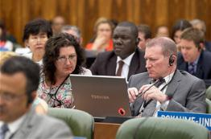

NORM SETTING
AIM → Progressive development of international IP law for an IP system that is:
  balanced/responsive to emerging needs
  effective in encouraging innovation/creativity
  sufficiently flexible to accommodate national policy objectives
Topical issues reviewed/discussed in Standing Committees

Slide 10
STANDING COMMITTEES
PATENTS (SCP)
COPYRIGHT & RELATED RIGHTS (SCCR)
TRADEMARKS, DESIGNS & GEOGRAPHICAL INDICATIONS (SCT)
AIM :
      Build consensus on topical issues
      Take into account interests of all stakeholders for a balanced, reliable, efficient, user-friendly, cost-effective system.
      N.B. Enforcement issues are discussed within the Advisory Committee on Enforcement (ACE)
Notes:
WIPO’s work in this area is designed to reduce complexity, cost and time involved in obtaining patent protection in multiple countries and to address workload crisis facing many office because of rising number of patent applications, changing nature of applications (biotech) and duplication of work. Various activities support this endeavor, namely:
- Substantive and procedural harmonization of patent law.
- Development and adoption of reforms of PCT System.
PCT Reform: began in Oct. 2000. General objectives to simplify the system, streamline procedures, reduce costs for applicants, maintains quality of services to facilitate greater use, ensure system works to advantage of all offices irrespective of size.

Slide 11
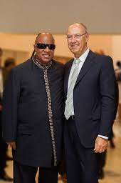
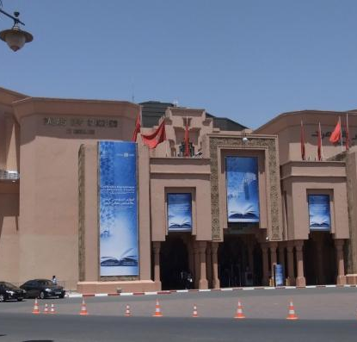
MARRAKESH TREATY TO FACILITATE ACCESS TO PUBLISHED WORKS FOR PERSONS WHO ARE BLIND,
VISUALLY IMPAIRED OR OTHERWISE PRINT DISABLED

Slide 12

MARRAKESH TREATY
The Diplomatic Conference took place in Marrakesh from June 18 to 28, 2013 (600 negotiators from WIPO’s 186 member states)
There are more than 285 million blind and VIP- 90 % living in developing countries.
Only 5 % of the books published are available in braille or other accessible formats.
Requires contracting parties to adopt limitations for the benefit the people who are blind, visually impaired, and print disabled.
It also provides for the exchange of accessible format works across borders.

Slide 13
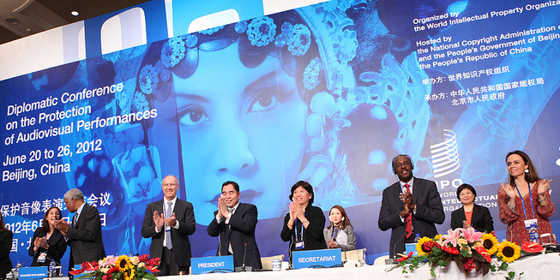
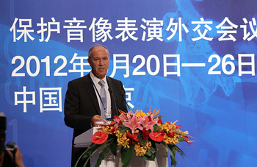
BEIJING TREATY ON AUDIOVISUAL PERFORMANCES JUNE, 26 2012

Slide 14


BEIJING TREATY
The treaty on audiovisual performances was adopted on June 2012. The treaty will enter into force with 30 ratifications.
This treaty will strengthen the position of performers, giving them moral and economic rights for the international use of their performances.
Countries becoming party will pay for the use of foreign audiovisual performances. Some or all of this money will be going to performers.
« The conclusion of the Beijing Treaty is an important milestone toward closing the gap in the international rights system for audiovisual performers » WIPO Director General, Francis Gurry

Slide 15
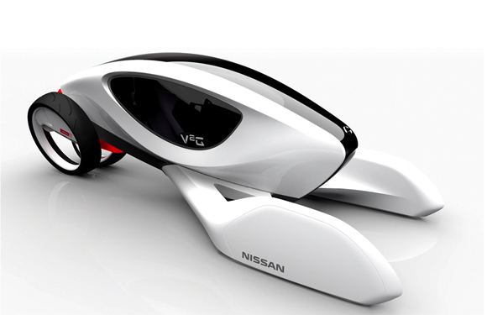
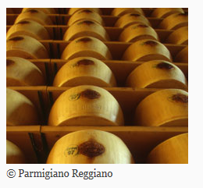
Current developments
Designs: The draft text for a Design Law Treaty has made progress (simplify and standardize national registration procedures). Pending areas of discussion relate to the inclusion of a technical assistance provision.
Appellations of Origins: GA September 2013 decided to convene a diplomatic conference for the adoption of a revised Lisbon Agreement on Appellations of Origins and Geographical Indications in 2015

Slide 16
WIPO STUDIES AND REPORTS
World Intellectual Property Indicators (WIPI): This is our flagship IP statistics publication. It provides an overview of latest trend in IP filings and registrations covering more than 100 offices : http://www.wipo.int/ipstats/en/wipi/index.html
The PCT Yearly Review provides an overview of the performance and development of the PCT system. It includes a comprehensive set of statistics for the latest available year See: http://www.wipo.int/ipstats/en/statistics/pct/
Madrid Yearly Review: http://www.wipo.int/ipstats/en/
Hague Yearly Review: http://www.wipo.int/ipstats/en/
The WIPO IP Facts and Figures provides an overview of intellectual property (IP) activity based on the latest available year of statistics. It serves as a quick reference guide for statistics: http://www.wipo.int/ipstats/en/
WIPO IP Statistics Data Center is an on-line service enabling access to WIPO’s statistical data. Users can select from a wide range of indicators and view or download data according to their needs: http://ipstatsdb.wipo.org/ipstatv2/ipstats/patentsSearch

Slide 17
DEMAND FOR IP RIGHTS HAS GROWN
Source: WIPO Statistics Database, October 2011

Slide 18

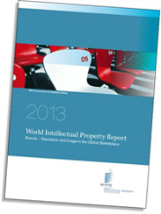
WIPO World IP Report
Published every two years; offers fresh insights into the role that the
IP system plays in market economies, aims to foster evidence-based
policy-making
2013: « Brands – Reputation and Image in the Global Marketplace» : The report looks at how branding behavior and trademark use have evolved in recent history, how they differ across countries, what is behind markets for brands, what lessons economic research holds for trademark policy and how branding strategies influence companies’ innovation activities
For further information and the full report :
http://www.wipo.int/econ_stat/en/economics/wipr

Slide 19
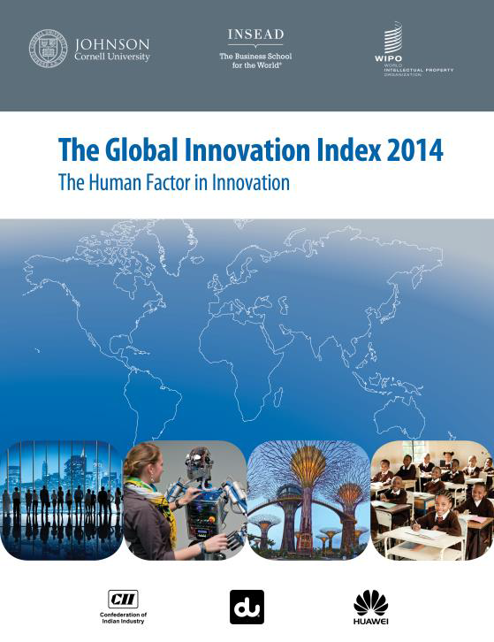
THE GLOBAL INNOVATION INDEX 2014
Annual publication that provides the latest trends in innovation activities across the world. It is co-published by INSEAD, Cornell University and WIPO http://www.wipo.int/econ_stat/en/economics/gii/index.html
Its results are useful:
  To benchmark countries against their peers
  To study countries profiles over time
  Identify countries strengths and weaknesses

Slide 20
GLOBAL INNOVATION INDEX FRAMEWORK
OUTPUT SUB INDEX
INPUT SUB INDEX
SCIENTIFIC OUTPUT
CREATIVE OUTPUT
HUMAN CAPITAL AND RESEARCH
INFRASTRUCTURE
MARKET SOPHISTICATION
BUSINESS SOPHISTICATION

Slide 21
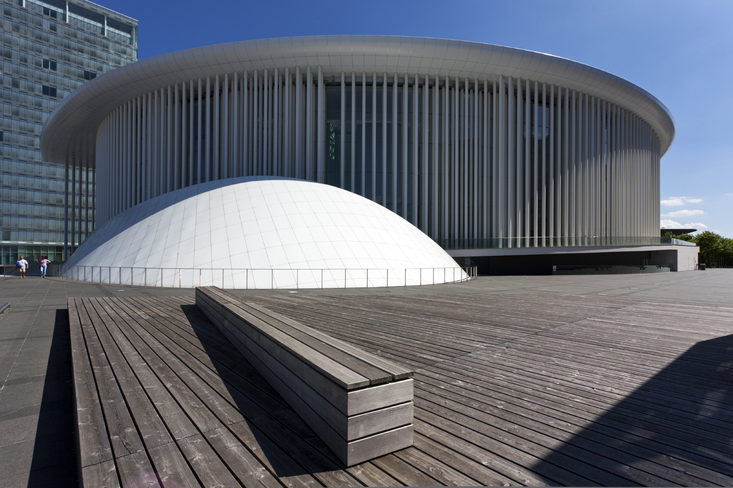
LUXEMBOURG PROFILE
istockphotos/Oliver Hoffmann
Philharmonic Hall at Luxembourg City

Slide 22

THE GLOBAL INNOVATION INDEX
RANKING 2013
RANKING 2014
1. SWITZERLAND
2. SWEDEN
3. UNITED KINGDOM
4. NETHERLANDS
5. UNITED STATES OF AMERICA
6. FINLAND
7. HONG KONG (CHINA)
8. SINGAPORE
9. DENMARK
10. IRELAND
11. CANADA
12. LUXEMBOURG
1. SWITZERLAND
2. UNITED KINGDOM
3. SWEDEN
4. FINLAND
5. NETHERLANDS
6. UNITED STATES OF AMERICA
7. SINGAPORE
8. DENMARK
9. LUXEMBOURG
10. HONG KONG (CHINA)
11. IRELAND
12. CANADA

Slide 23
LUXEMBOURG PROFILE
  Luxembourg is ranked 9th in the 2014 Global Innovation Index
  Luxembourg ranks higher on the output sub-index category (5th) than the input sub-index category (21st).
  Most of Luxembourg’s strengths at the variable level lie in the Creative outputs pillar, and include: Madrid trademark reg. holders/bn PPP$ GDP (1st), cultural and creative services exports (% of total trade) (1st), national feature films/mn pop. 15–69 (1st) and generic top-level domains (TLDs)/th pop. 15–69 (1st).
  On the Input side, Luxembourg exhibits particular strengths in the Business sophistication Input pillar (2nd), including: Knowledge-intensive employment, % (1st), Knowledge absorption (3rd), Comm., computer & info. services imports, % (4th), and FDI net inflows, % GDP (1st).
  The majority of Luxembourg’s GII weaknesses are encountered in Market sophistication (Input) pillar, including: ease of getting credit (134th), ease of protecting investors (105th), total value of stocks traded, % GDP (91st) and non-agricultural market access weighted tariff, % (97th).

Slide 24
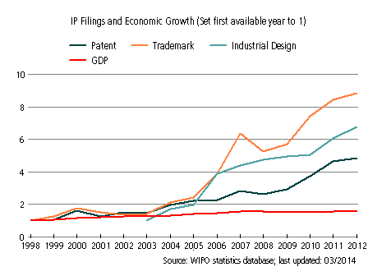
Luxembourg’s evolution with respect to IP filings and Economic Growth from 1998 to 2012
The period between 1998 and 2003 was one of relatively slow growth in IP filings.
Subsequently, however, IP filings have grown strongly despite a slow-down in the period between 2007 and 2009, which affected principally trademarks and to a lesser extent patents. Growth in this period has greatly outpaced corresponding growth in GDP.
In 2012 there were: 2,270 industrial designs filings; 30,821 trademark filings (including resident, abroad and regional filings); and, 2,463 patent filings (including resident, abroad and regional filings)
Notes:
GDP : GROSS DOMESTIC PRODUCT

Slide 25
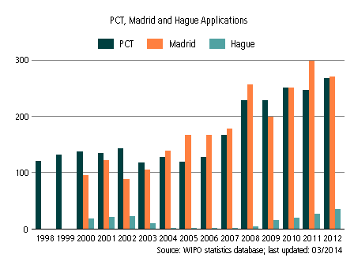
INTERNATIONAL APPLICATIONS
VIA WIPO ADMINISTERED TREATIES

Slide 26
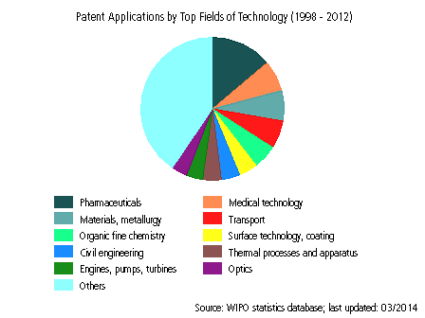
PATENT APPLICATIONS (1998-2012)

Slide 27
Patent Cooperation Treaty (PCT)
Introduction and Future Developments
October 2014
Claus Matthes
Director, PCT Business Development Division

Slide 28





Traditional Patent System
File national application first
Paris Convention gives 12 month “period of priority” from filing first application to file in other countries. Within that time (usually before outcome of procedures in Office of first filing is known):
  appoint local representatives in other countries
  prepare translations
  pay fees
  begin equivalent procedures, all carried out independently
GB grant
Prepare
National search and examination
Prep
National search and examination
Prep
National search and examination
Trans
Prep
National search and examination
AU grant
Trans
Prep
National search and examination
0 months
GB filing
12 months
rest of world filing
24 months
36 months

Slide 29
The PCT ─ 1970
Basic idea: simplify the procedure for obtaining patent protection in many countries, making it more efficient and economical
  filing tool for applicants; and
  work sharing tool for Offices

Slide 30
PCT Basics
Filing Tool for applicants:
  One application, one language, one set of formality requirements, filed with one Office
  Containing, by default, the designation of all Member States, for every kind of protection available, and usual priority claim(s)
  Effect of a regular national filing (including establishment of a priority date) in each designated State
  Delays national processing until 30 months from priority date
  International search and examination reports improve basis for decision making

Slide 31
PCT Basics
Work sharing tool for Offices:
  Central formality checking
  Central international publication
  International search report (ISR)
  International Preliminary Reports on Patentability
    preliminary, non-binding opinion on novelty, inventive step (non-obviousness) and industrial applicability

Slide 32
Traditional Patent System
vs. PCT System
Filing of national applications
& processing by national Offices
Fees for translations, Offices, local agents
(months)
Traditional
0
12
File local
application
Entering of national phase before
& processing by national Offices
Fees for translations, Offices, local agents
delay of processing by national Offices
(months)
International
publication
PCT
0
12
16
18
22
28
30
File local
application
File PCT
application
International
search report & written opinion
(optional)
File
demand for
International
preliminary
examination
(optional)
International
preliminary report on patentability

Slide 33
The PCT System
Express intention and take steps to pursue to grant in various states
Typically filed in same national patent office--one set of fees, one language, one set of formality requirements--and legal effect in all PCT States
Disclosing to world content of application in standardized way
Enter
national
phase
International
publication
(months)
0
12
16
18
22
28
30
File local
application
File PCT
application
International
search report & written opinion
(optional)
File
demand for
International
preliminary
examination
(optional)
International
preliminary report on patentability
Typically a national patent application in the home country of the applicant
Report on state of the art (prior art documents and their relevance) + initial patentability opinion
Additional patentability analysis, designed to assist in national phase decision-making
Request an additional patentability analysis on
basis of amended application

Slide 34
PCT International Searching Authorities
Australia Austria Brazil Canada China Chile (22.10.2014) Egypt Finland India Israel | Japan Republic of Korea Russian Federation Singapore (not yet operating) Spain Sweden Ukraine (not yet operating) United States of America European Patent Office Nordic Patent Institute

Slide 35
Prior Art for International Search
Prior art:
  everything which has been made available to the public,
  anywhere in the world,
  by means of written disclosure,
  which is capable of being of assistance in determining that the claimed invention is or is not new and that it does or does not involve an inventive step,
  provided the making available to the public occurred prior to the international filing date.

Slide 36
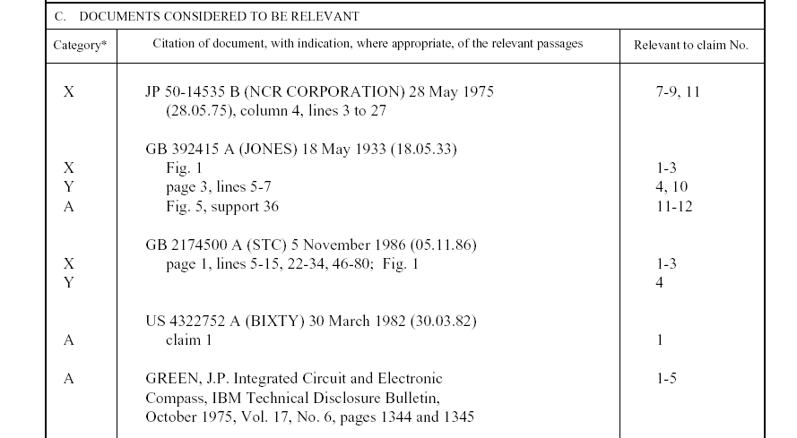
Example: PCT International Search Report
Symbols indicating
which aspect of patentability
the document cited is
relevant to (for example, novelty, inventive step, etc.)
The claim numbers
in your application to
which the document is
relevant
Documents relevant to whether or not your invention may be patentable

Slide 37
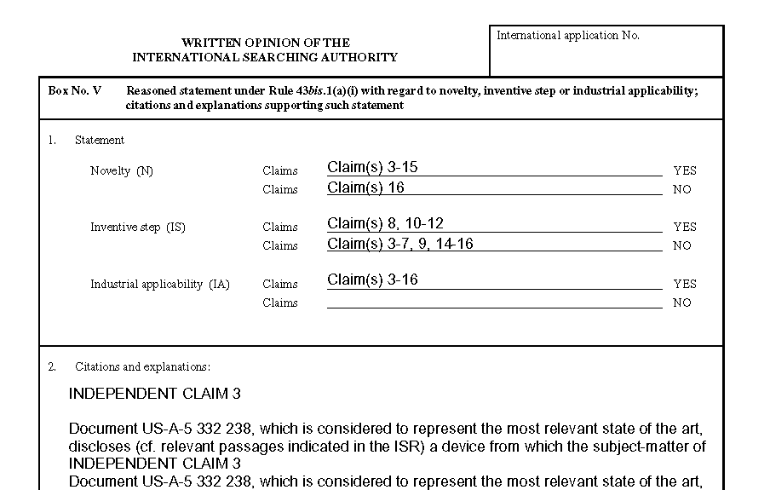
Example: PCT Written opinion of the International Searching Authority
Reasoning supporting the assessment
Patentability assessment
of claims

Slide 38
The PCT System
Express intention and take steps to pursue to grant in various states
Typically filed in same national patent office--one set of fees, one language, one set of formality requirements--and legal effect in all PCT States
Disclosing to world content of application in standardized way
Enter
national
phase
International
publication
(months)
0
12
16
18
22
28
30
File local
application
File PCT
application
International
search report & written opinion
(optional)
File
demand for
International
preliminary
examination
(optional)
International
preliminary report on patentability
Typically a national patent application in the home country of the applicant
Report on state of the art (prior art documents and their relevance) + initial patentability opinion
Additional patentability analysis, designed to assist in national phase decision-making
Request an additional patentability analysis on
basis of amended application

Slide 39
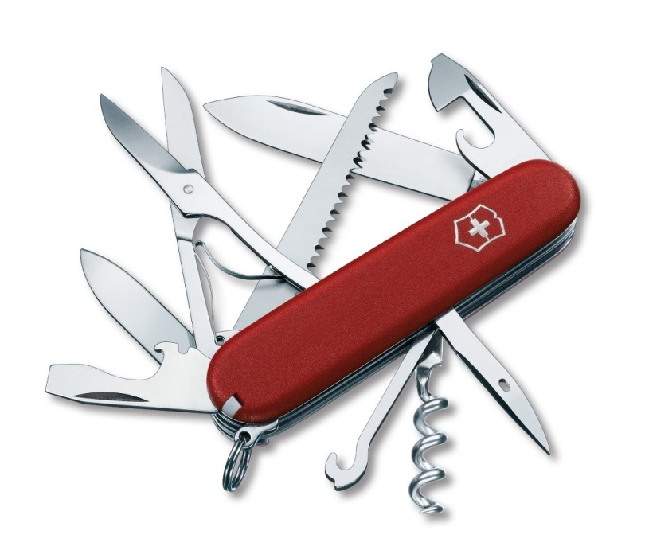
The PCT
filing tool for applicants with global reach
harmonized formalities
work-sharing tool for Offices
allows for
correction of errors
ePCT filing
and processing
buys time
patentability analysis
flexibility,
keeps options open

Slide 40
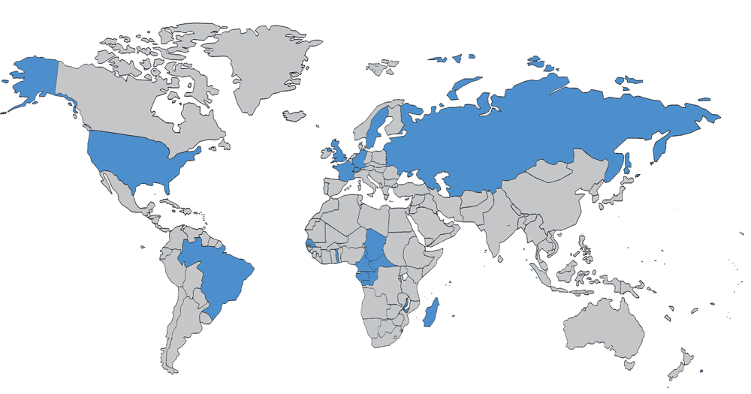
The PCT in 1978

Slide 41
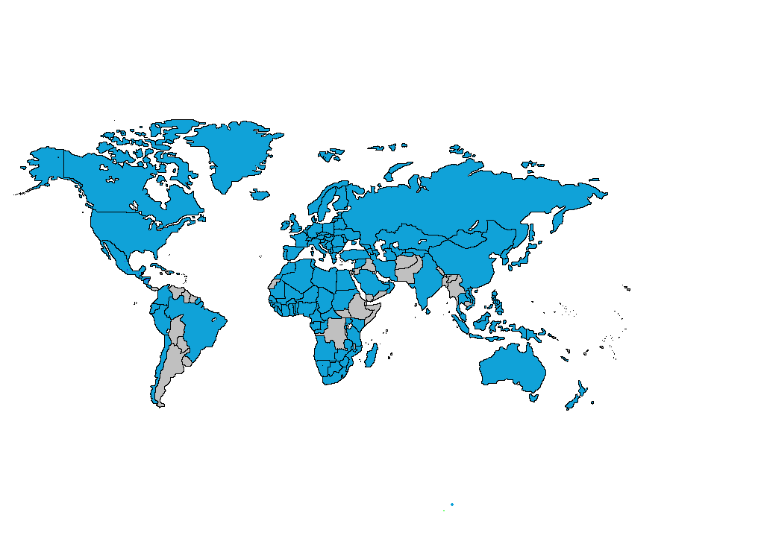
PCT Coverage Today

Slide 42

148 PCT States
=PCT
Albania
Algeria
Angola
Antigua and Barbuda
Armenia
Australia
Austria
Azerbaijan
Bahrain
Barbados
Belarus
Belgium
Belize
Benin
Bosnia and Herzegovina
Botswana
Brazil
Brunei Darussalam
Bulgaria
Burkina Faso
Cameroon
Canada
Central African Republic
Chad
Chile
China
Colombia
Comoros
Congo
Costa Rica
Côte d'Ivoire
Croatia
Cuba
Cyprus
Czech Republic
Democratic People's
Republic of Korea
Denmark
Dominica
Dominican Republic
Ecuador
Egypt
El Salvador
Equatorial Guinea
Estonia
Finland
France,
Gabon
Gambia
Georgia
Germany
Ghana
Greece
Grenada
Guatemala
Guinea
Malawi
Malaysia
Mali
Malta
Mauritania
Mexico
Monaco
Mongolia
Montenegro
Morocco
Mozambique
Namibia
Netherlands
New Zealand
Nicaragua
Niger
Nigeria
Norway
Oman
Panama
Papua New Guinea
Peru
Philippines
Poland
Portugal
Qatar
Republic of Korea
Republic of Moldova
Romania
Rwanda
Russian Federation
Saint Lucia
Saint Vincent and
the Grenadines
San Marino
Sao Tomé e Principe
Saudi Arabia
Senegal
Serbia
Seychelles
Sierra Leone
Singapore
Slovakia
Slovenia
South Africa
Spain
Sri Lanka
Sudan
Swaziland
Guinea-Bissau
Honduras
Hungary
Iceland
India
Indonesia
Iran
Ireland
Israel
Italy
Japan
Kazakhstan
Kenya
Kyrgyzstan
Lao People’s Dem Rep.
Latvia
Lesotho
Liberia
Libyan Arab Jamahiriya
Liechtenstein
Lithuania
Luxembourg
Madagascar
St. Kitts and Nevis
Sweden
Switzerland
Syrian Arab Republic
Tajikistan
Thailand
The former Yugoslav
Republic of Macedonia
Togo
Trinidad and Tobago
Tunisia
Turkey
Turkmenistan
Uganda
Ukraine
United Arab Emirates
United Kingdom
  United Republic of Tanzania
  United States of America
Uzbekistan
Viet Nam
Zambia
Zimbabwe
Notes:
42

Slide 43
Countries not yet in PCT
Afghanistan
Andorra
Argentina
Bahamas
Bangladesh
Bhutan
Bolivia
Burundi
Cambodia
Cape Verde
Democratic Republic of Congo
Djibouti
Eritrea
Ethiopia
Fiji
Guyana
Haiti
Iraq
Jamaica
Jordan
Kiribati
Kuwait
Lebanon
Maldives
Marshall Islands
Mauritius
Micronesia
Myanmar
Nauru
Nepal
Pakistan
Palau
Paraguay
Samoa
Solomon Islands
Somalia
South Sudan
Suriname
Timor-Leste
Tonga
Tuvalu
Uruguay
Vanuatu
Venezuela
Yemen
(45)

Slide 44
PCT Applications in 2013
2013: 205,300 PCT applications (+5.1%)

Slide 45
International Applications Received
in 2013 by Country of Origin
CN: +15.6%
US: +10.8%
SE: +10.4%

Slide 46
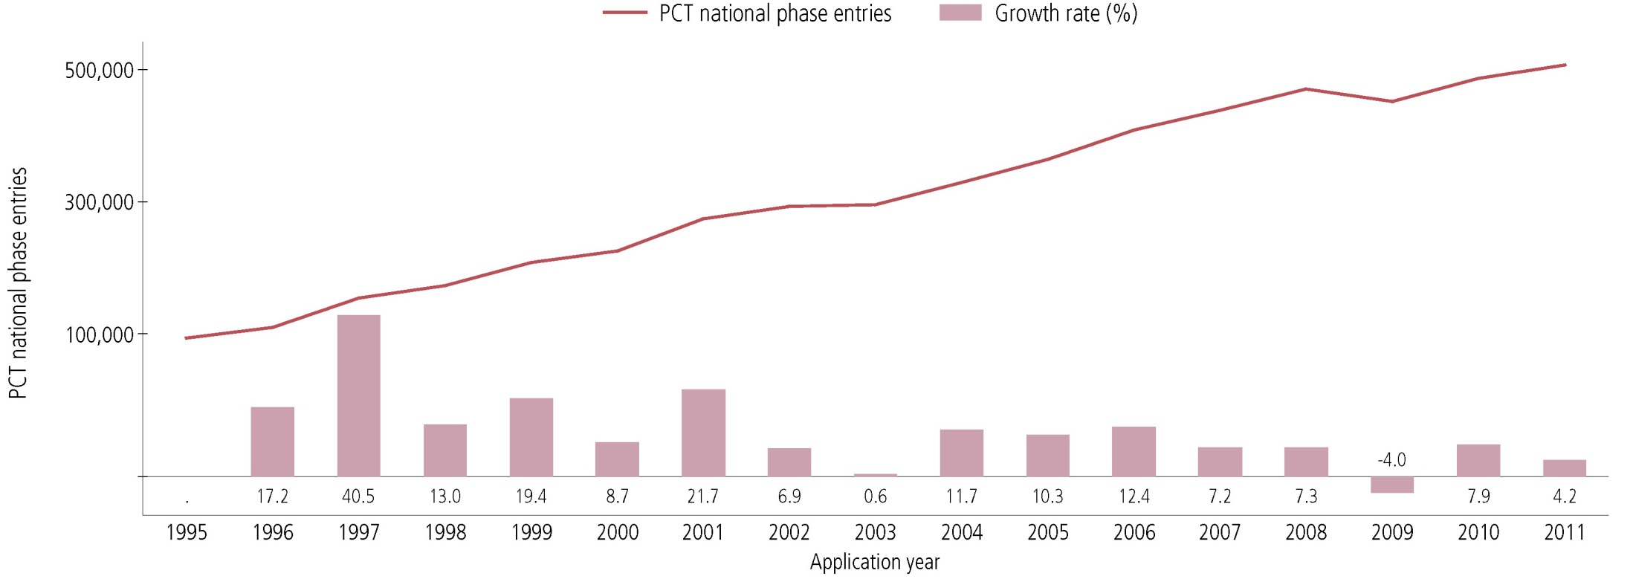
PCT National Phase Entries—Total
507,400 national phase entries estimated in 2011 (+ 4.2%)
431,800 (about 85%) of NPEs are from non-resident applicants, making PCT NPEs responsible for 54.9% of all non-resident patent applications filed worldwide in 2011

Slide 47
PCT National Phase Entries 2011—
by Target Office (1)
USPTO most preferred DO for National Phase Entries; had highest growth among the IP5 Offices (+7.3%)
Brazil (+12.6%) and India (+9.8%) had highest growth rates among top 10 Offices

Slide 48
PCT National Phase Entries 2011—
by Target Office (2)

Slide 49
Top PCT Applicants 2013
Panasonic—JP (2881)
ZTE—CN (2309)
Huawei—CN (2094)
Qualcomm—US (2036)
Intel—US (1852)
Sharp—JP (1840)
Bosch—DE (1786)
Toyota—JP (1696)
Ericsson—SE (1467)
Philips—NL (1423)
Top University Applicants 2013
University of California (US)
MIT (US)
Columbia University (US)
University of Texas (US)
Harvard University (US)
Johns Hopkins (US)
Korea Advanced Institute of Science and Technology (KR)
Leland Stanford University (US)
Cornell University (US)
Cal Tech (US)

Slide 50
The PCT “Market Share”
*

Slide 51
PCT Key Advantages
Postpones major costs of internationalizing a patent application
Provides a strong basis for patenting decisions
Harmonizes formal requirements
Helps applicants to correct errors
Evolves to meet user needs

Slide 52
The PCT ─ 1970 to Today
As filing tool: PCT extremely successful
  Preferred route for international patenting (> 200,000 applications in in 2013, > 54% “market share”)
  Harmonization of formal and procedural requirements, beyond PCT (national laws; Patent Law Treaty (PLT))

Slide 53
The PCT ─ 1970 to Today
However: as work sharing tool not as effective in practice for addressing national quality of examination and (for some Offices) backlogs
  Expectation was: “flying start” for offices; completing, checking
  and criticizing …
  Reality is: many Offices start “from scratch”, perhaps not in complete isolation, but …
What is needed: building trust between patent offices, so that duplicative international phase and national phase processing can
be reduced

Slide 54
PCT Areas of Work
Improve the quality and consistency of PCT international phase
work products
Develop quality metrics for measuring usefulness of work products and identifying areas of further work
Develop quality feedback system for offices
Help designated Offices to better understand reports
  Search strategies, standardized clauses, explanations of relevance of cited documents, …
Explore collaborative search and examination
Third party observations system

Slide 55
PCT Areas of Work
Improve timeliness of actions in international phase
Develop metrics for entire PCT system
Create incentives for applicants to use system efficiently
  Encourage high quality applications and early correction of defects and filing of amendments
  PCT/PPH
Improve access to national search and examination reports
  Patentscope, CASE, Global Dossier

Slide 56
PCT Areas of Work
Helping developing countries benefit from the PCT
  Top 10 countries responsible for 87% of IAs published in 2013;
  top 15 countries = 92%; top 20 countries = 96%
  Improve training for examiners, better coordinate training already offered
  Improve access to affordable online search systems
Making PCT accessible to applicants of all types from all Contracting States
  Fee reductions (SMEs, universities, research institutes, individual applicants)

Slide 57
PCT Areas of Work
ePCT: Seeks to provide electronic interface to entire PCT international phase process (RO, ISA, IPEA, IB)
  Real time access to IB files and bibliographic data
  Flexible applicant-controlled access rights system
  Increasing access to RO, ISA, IPEA documents not traditionally held by IB
  Increasing transmission of documents to RO, ISA, IPEA
  Where possible, replace letters with directly usable information
  Notifications of significant events and approaching deadlines

Slide 58
PCT Training Options
29 video segments on WIPO’s Youtube channel and WIPO’s PCT page about individual PCT topics
PCT Distance learning course content available in the 10 PCT publication languages
PCT Webinars
  free updates on developments in PCT procedures and PCT strategies
  also for companies or law firms
In-person PCT Seminars and training sessions

Slide 59
PCT Resources/Information
For further information about the PCT, see
http://www.wipo.int/pct/en/
For general questions about the PCT, contact the PCT Information Service at:
      Telephone: (+41-22) 338 83 38
      Facsimile: (+41-22) 338 83 39
      E-mail: pct.infoline@wipo.int

Slide 60
Thank You!
Claus Matthes
Director, Patent Cooperation Treaty (PCT) Business Development Division
World Intellectual Property Organization (WIPO)
34 chemin des Colombettes, 1211 Geneva 20, Switzerland
T + 41 22 338 98 09; claus.matthes@wipo.int; www.wipo.int

Slide 61

Global IP Systems:
The Madrid System
The Hague System
Debbie Roenning
Director, Legal Division
Madrid Registry
Luxembourg, October 27, 2014
Notes:
61

Slide 62



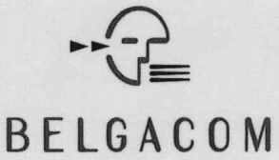
Trademarks

Slide 63

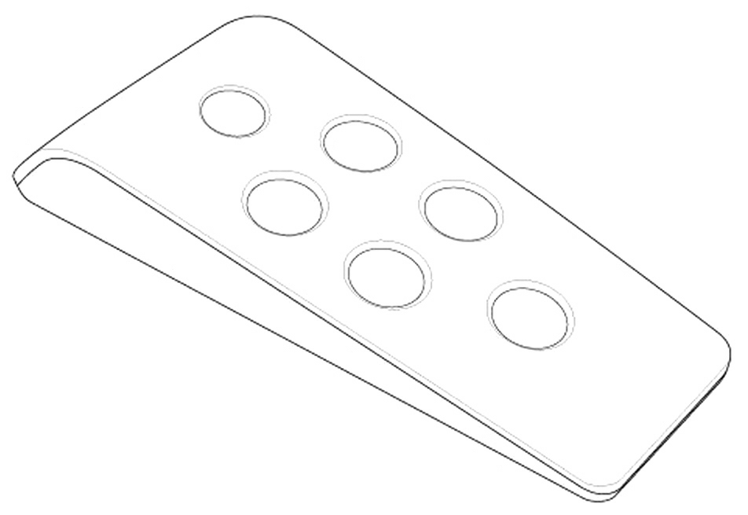
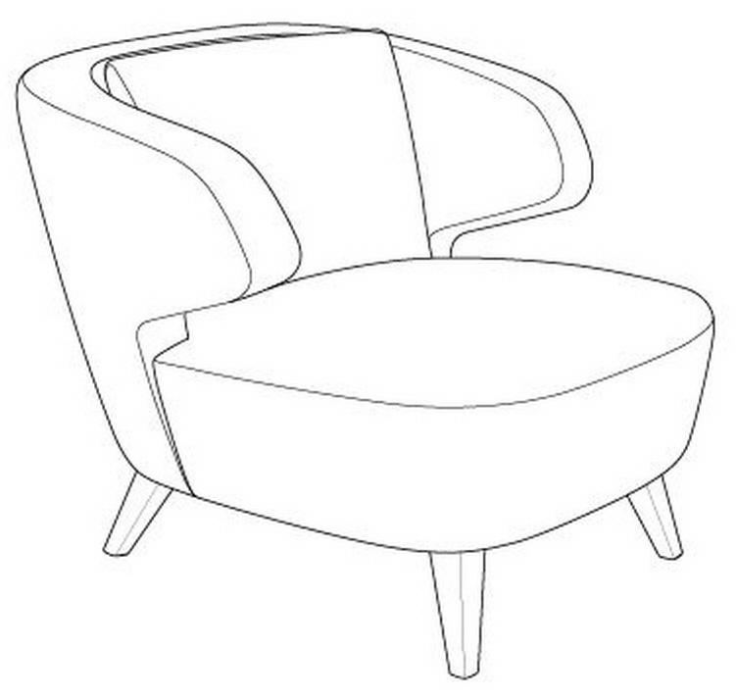
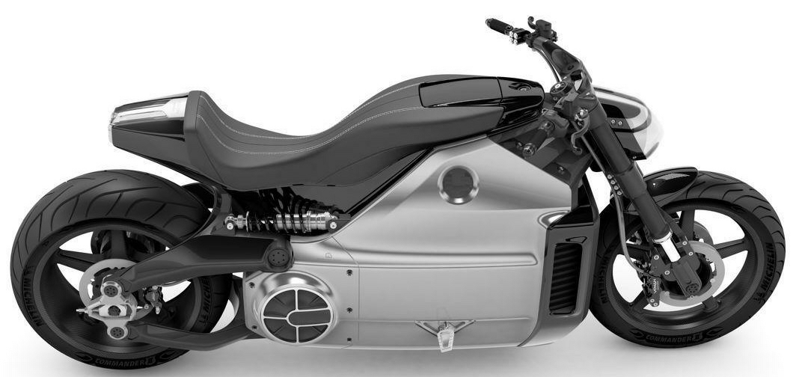
Industrial Designs

Slide 64



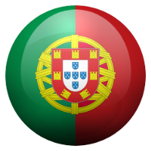
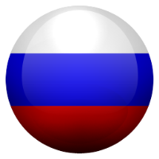







No international procedure
NATIONAL OFFICES
APPLICANT

Slide 65




















International procedure
INTERNATIONAL PROCEDURE
MADRID
NATIONAL OFFICE
WIPO
WIPO
MAINTENANCE
Basic
HAGUE
NATIONAL OFFICE
WIPO
WIPO
MAINTENANCE
USER

Slide 66
The Madrid System:
The International Trademark System

Slide 67

Trademarks
"A brand incarnates an enterprise's reputation and image and so is one of an enterprise's most valuable assets” (Director General, Francis Gurry)
Trademarks are the most widely used form of registered intellectual property (IP) throughout the world
Trademark demand quadrupled between 1985 and 2011, from just under 1 million applications per year in 1985 to 4.2 million by 2011

Slide 68
Routes for protecting a trademark
The national route: Filing trademark application with the Trademark Office of each country in which protection of the mark is sought
The regional route: Apply for protection in countries which are members of a regional trademarks registration system with effect in the territories of all Member States (ARIPO, Benelux Trademark Office, OHIM and OAPI)
The international route: The Madrid System

Slide 69
The Madrid System
A centralized filing and management procedure
A one-stop shop for trademark holders to obtain and maintain trademark protection in export markets
An alternative to the national or regional route
The domestic legislations of the designated Contracting Parties set the conditions for protecting a trademark and determine the rights which result from protection
Notes:
The Madrid system is a system for international registration of trademarks. A centralized filing mechanism. A one-stop shop for trademark holders to obtain as well as maintain and manage trademark protection in export markets by means of a single international application filed with WIPO. A registration system for 92 Contracting Parties. One application – one language – one set of fees. One registration covering multiple territories.
An option to the national and regional route - A simple, flexible, time and cost-effective and user-friendly option.
The Protocol does not contain any rules concerning procedures for obtaining rights in each of its Contracting Parties. A purely procedural treaty. The domestic legislations of the designated Contracting Parties set the conditions for protecting a trademark and determine the rights which result from protection.

Slide 70
Madrid System
1 Agreement only
91 Protocol (including EU)
92 Members

Slide 71
Accessions
2012: Colombia, Mexico, New Zealand and Philippines
2013: India, Rwanda and Tunisia
Future accessions?
  Algeria to the Protocol
  OAPI
  Canada
  Latin American countries
  ASEAN countries by 2015
  Caribbean countries
  African countries
Notes:
Significant geographical expansion of the Madrid system
In the last 2 years we have been a remarkable geographical expansion of the Madrid system, with 7 accessions.
What about future accessions? We know that there are a number of countries in the world, working towards a future accession to the Protocol. We know that there is important work being done in Latin America. Dominican Republic and Costa Rica.
ASEAN countries have an agreement that they will all be members by 2015, some of them will be members well before that, for example Malaysia and Cambodia.
Malta, being the only country in the EU not being an individual member of the Protocol is also preparing for the Protocol.
Barbados, Jamaica and Trinidad and Tobago are also preparing for accession to the Protocol.
Brazil – political oppositions from interest groups as well as internal processes needs to be cleared (backlogs).
Africa: South Africa, Nigeria, The Gambia, OAPI?

Slide 72
Key features – I
A registration system for 92 Contracting Parties
One application – one language – one set of fees
Entitlement and basic application or registration
Three main stages
  Basic mark > International application
  Formal examination by WIPO
  Substantive examination by the Offices of the designated Contracting Parties
Notes:
In order to use the Madrid system, you need a connection with a Contracting Party (CP), such as establishment, domicile or nationality, and a mark applied for or registered (basic mark) with that CP (Office of origin)
A CP will need to refuse protection within 12/18 months, otherwise the mark will be deemed protected

Slide 73
Key features – II
One registration covering multiple territories
Fixed time limit for refusal – 12 or 18 months
Manage a portfolio of trademarks via a single centralized procedure
Renew for all designated Contracting Parties with one request
Expand protection to new Contracting Parties

Slide 74
Fees under the Madrid System
Fees payable to WIPO in Swiss francs
Basic fee includes three classes of goods and services
  653 Swiss francs - b/w reproduction of mark
  903 Swiss francs - color reproduction of mark
Standard fees:
  Complementary: 100 Swiss francs per DCP
  Supplementary: 100 Swiss francs per class beyond three
  OR
Individual fees where this is declared

Slide 75
Fees under the Madrid System (2)
Fees can easily be paid by:
  Credit card using E-payment / E-subsequent designation / E-renewal
  WIPO current account
  Bank transfer
More information about the payment of fees is available at: http://www.wipo.int/about-wipo/en/finance/madrid.html
You can calculate the cost of an application, subsequent designation or a renewal at: http://www.wipo.int/madrid/en/fees/calculator.jsp

Slide 76
The international procedure
Office of Origin
Designated Contracting Party
Designated Contracting Party
Designated Contracting Party
WIPO
Applicant
Certifies the application and forwards it to WIPO
Conducts the formal examination; records the mark in the International Registry and publishes the international registration in the Gazette. Issues a certificate of registration and notifies the designated Contracting Parties
Entitlement
Basic Mark
Scope of protection of the international registration will be determined by the substantive examination under domestic law, within 12/18 months

Slide 77
The Madrid System – Facts and figures
Worldwide trademark filings + 9.3% from 2008 to 2011
2012 + 4.1% growth in applications
2013 + 6.4% growth in applications
Received 46,829 international applications
Over 578,320 international registrations in force
5.61 million designations in force
191,759 holders of international registrations

Slide 78
Top Offices of origin – 2013
Contracting Parties | Number of IA | Change from 2012
European Union | 7,444 | 15.3%
United States of America | 6,084 | 4.8%
Germany | 4,514 | 6.1%
France | 3,755 | 0.7%
Switzerland | 2,976 | 10.7%
China | 2,273 | 10.9%
Italy | 2,254 | -1.2%
Benelux | 1,916 | 0.1%
Japan | 1,845 | -9.3%
United Kingdom | 1,562 | 17.2%
Notes:
The Offices receiving the most international applications.
Luxembourg has been a member of the Madrid system since 1924 when it joined the Madrid Agreement and it joined the Protocol on April 1, 1998. Luxembourg is togehterwith Belgium and the Kingdom of the Netherlands deemed to be a single country – where all international applications from and designations of the Benelux is covered by the Benelux Office. It has made the declaraion of individual fee (211 for 3 classes + 21 for each additional class).
Benelux is number 8 concerning international applications. It is heavily used even though users can also file directly with the EU.
Number of IA:
EU: 7,444
USA: 6084
Germany: 4514
France: 3755
Switzerland: 2976
China: 2273
Italy: 2254
Benelux: 1916
Japan: 1845
UK: 1562

Slide 79
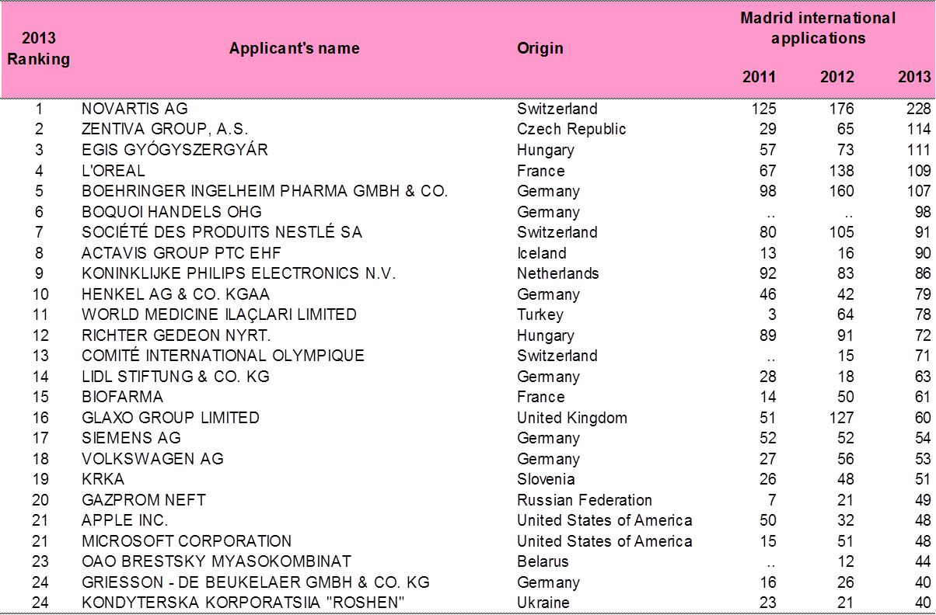
Top applicants
Notes:
Looking at the list of the top filers in the Madrid system, it is still quite heavily dominated by European companies.
Many german companies on this list.

Slide 80
Top designations – 2013
Contracting Parties | Number of designations | Change from 2012
China | 20,275 | 18.1%
Russian Federation | 18,239 | 24.4%
European Union | 17,598 | 23.7%
United States of America | 17,322 | 23.2%
Switzerland | 13,215 | 9.3%
Japan | 13,179 | 25.5%
Australia | 11,675 | 32.6%
Republic of Korea | 10,967 | 30.4%
Turkey | 9,838 | 10.9%
Ukraine | 9,589 | 11.6%
Notes:
Number of designations in international registrations and subsequent designations in 2013.
China: 20,275
Russian Federation: 18,239
European Union: 17,598
United States of America: 17,322
Switzerland: 13,215
Japan: 13,179
Australia: 11,675
Republic of Korea: 10,967
Turkey: 9,838
Ukraine: 9,589
We see here that Benelux is not on the list, in fact no EU member is on this list, which means that most foreigners wanting to have protection in Europe and Benelux, will designate EU as such, covering protection in all the 28 members, including Benelux.

Slide 81
General Profile 2013
44,414 International Registrations
Average Number of Designations | 6.9
Average Number of Classes | 2.5
Average Fee | CHF 2,926
All Fees | 70% < 3,000 CHF
Notes:
81

Slide 82
International Applications from Benelux and the EU

Slide 83
Designations in IRs and subsequently of Benelux and the EU

Slide 84
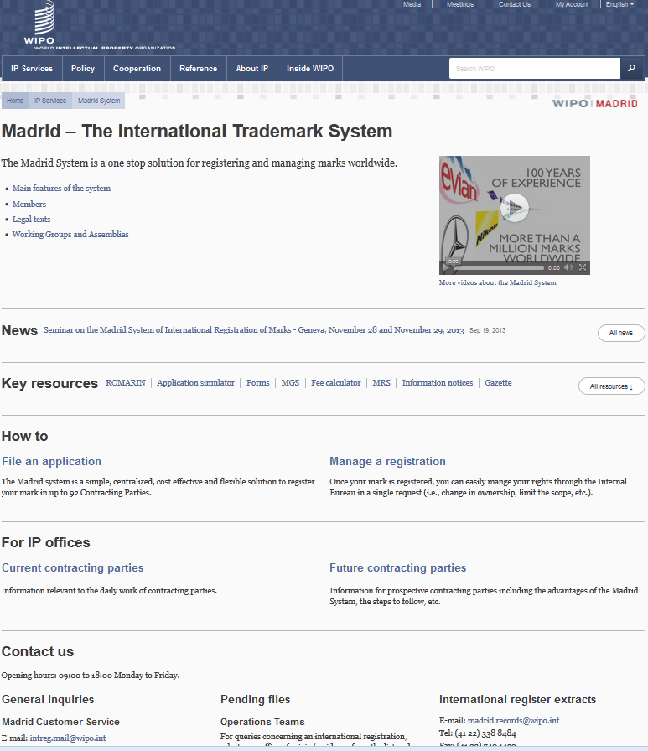

Slide 85
Online information services
Legal texts, Guide and Information Notices
WIPO Gazette of International Marks
New publication: Making the Most of the Madrid System
  Practical tips on how to use specific forms
Madrid Highlights at http://www.wipo.int/madrid/en/highlights/
E-Renewal Tool
Fee Calculator: Costing service
ROMARIN: On-line search database
Dynamic Madrid Statistics
free access at http://www.wipo.int/madrid/en/
Notes:
85

Slide 86
Online tools
Madrid Goods and Services Manager (MGS): To use correct specifications of goods and services
Madrid Real-Time Status (MRS): To inform of the status of an international application/registration
Madrid Portfolio Manager (MPM): To allow the holders and representatives to view and modify their portfolio
Madrid Electronic Alerts (MEA): To allow users to submit a list of IRs to monitor and to be informed by email when any of them change
Image-based search tool http://www.wipo.int/branddb/en/
E-subsequent designation is now available

Slide 87
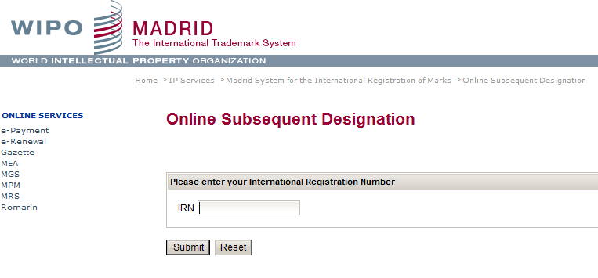
E - Subsequent Designation

Slide 88
Benefits for trademark owners
Simple and economical procedure
  A single set of simple formalities
  A single filing Office
  Low registration fees
  No need to pay foreign agents for filings
  No need to pay translation of the paperwork into several languages
Effective procedure
  A single international application produces the same legal effect in various countries
  A fixed deadline for the confirmation or refusal of the legal effects in each designated country
Notes:
88
88

Slide 89
Contact details
For general questions about the Madrid System
  Madrid Customer Service intreg.mail@wipo.int
  Telephone: + 41 22 338 8686
For questions regarding specific international applications or international registrations
  Madrid Team 2: madrid.team2@wipo.int
  Telephone: + 41 22 338 750 2

Slide 90
The Hague System:
The International Design System

Slide 91

In a nutshell
“The Hague Agreement provides creators and holders of designs with a simple, rapid and economical procedure to secure and maintain the protection of industrial designs, through a single international registration"

Slide 92
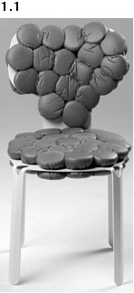
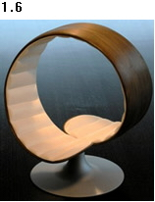
WIPO Director General Francis Gurry:
“Design is one of the principal means of differentiating a range of mass produced household and consumer items, such as chairs and tables, for which the technological possibilities for development have been exhausted.”
DM/075065 DM/076022
« Chair » « Chair »

Slide 93
The Hague System
A centralized filing mechanism
A closed system
A one-stop shop to obtain and maintain design protection in export markets
An option to the national route
A purely procedural treaty
The domestic legislations of the designated Contracting Parties set the conditions for protecting the design and determine the rights which result from protection
Notes:
93

Slide 94
Members of the Hague System
47 Geneva Act (1999) (including EU and OAPI)
15 Hague Act (1960)
62 Contracting Parties

Slide 95
Accessions
2012: Montenegro, Tajikistan, Tunisia
2013: Brunei Darussalam
2014: Republic of Korea
Future accessions?
  China, Japan and USA
  Russian Federation and Belarus
  ASEAN countries by 2015
  Barbados and Trinidad & Tobago
  Madagascar and Morocco
Notes:
95

Slide 96
Future expansion of the Hague System
Coming Soon!
Notes:
The Hague system will change in the future, expanding the geographical scope of where protection may be sought

Slide 97
Key principles of the Hague System (1)
Entitlement:
To use the Hague system, you need a connection with a Contracting Party (CP), like establishment, domicile, nationality or habitual residence
One to many relationship:
File a single international application for a single international registration (IR) in which one or more Contracting Parties (CP) are designated (“self-designation“ is possible)
Renewal:
Duration: 5 years renewable. 15 years for the 1999 Act or possibly longer if allowed by designated CP

Slide 98
Key principles of the Hague System (2)
Possible deferment of up to 12 months:
Counted from date of filing or priority date
Fixed time limit for refusal:
Any refusal must be notified to the International Bureau within 6 or 12 months from the publication of the international registration on the WIPO website, otherwise the design will be deemed protected
“Bundle of rights”:
If no refusal is issued, the resulting IR has the effect of a grant of protection in each designated CP

Slide 99
The use of the Hague System in 2013
2,990 international applications filed (13,172 designs)
2,734 international registrations recorded (12,806 designs)
Largest filers: Swatch AG, The Proctor and Gamble Company; Daimler AG, Volkswagen Aktiengesellschaft; Koninklijke Philips Electronics
Approximately 26,877 international registrations in force,
  Equivalent to over 134,385 designations in force
  Involving 8,204 holders
  80% SMEs?
Notes:
99

Slide 100
General profile 2013
2,734 International Registrations
Average Number of Designations | 3 to 5
Average Number of Designs | 4.68
Average Fee | Less than 1,000 CHF
All Fees | 79.2% < 2,000 CHF
Notes:
100

Slide 101
Top Filing Contracting Parties
Contracting Party of entitlement
1. European Union (5168 designs, 41.5%)
2. Switzerland (2855 designs, 22.9%)
3. Germany (1630 designs, 13.1%)
4. France (1265 designs, 10.2%)
5. Turkey (278 designs, 2.2%)
6. Norway (186 designs, 1.5%)
7. Spain (101 designs, 0.8%)
8. Poland (86 designs, 0.7%)
9. Croatia (76 designs, 0.6%)
10. Liechtenstein (73 designs, 0.6%)

Slide 102
Most Designated Contracting Parties
Number of designs recorded:
1. European Union (8961 designs, 74.9%)
2. Switzerland (8802 designs, 73.5%)
3. Turkey (5110 designs, 42.7%)
4. Ukraine (2853 designs, 23.8%)
5. Singapore (2531 designs, 21.1%)
6. Norway (2389 designs, 20%)
7. Croatia (2376 designs, 19.8%)
8. Morocco (1853 designs, 15.5%)
9. Liechtenstein (1499 designs, 12.5%)
10. Serbia (1494 designs, 12.5%)

Slide 103
The Registration Procedure
Only formal examination in the International Bureau
  Recording in the International Register
  Publication in the International Designs Bulletin
  Notification to designated CPs through the publication
Substantive examination by the designated Contracting Parties only
Refusal must be received by the International Bureau within a set time limit after publication: 6 or 12 months

Slide 104
Online services / tools
http://www.wipo.int/hague/en/
  E-Filing Portfolio Manager
  E-Renewal
  E-Payment
  Hague Express Database
  Fee calculator

Slide 105
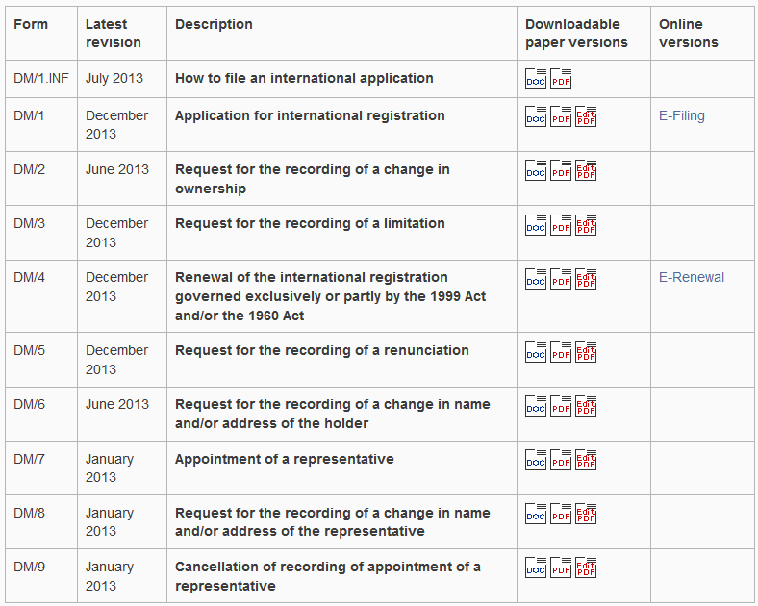
E-filing/Forms (http://www.wipo.int/hague/en/forms/)

Slide 106
Advantages
The Hague System is cost-effective and efficient, thereby creating opportunities that would not otherwise exist for any enterprise with a limited legal budget
It is flexible affording right holders great flexibility in targeting national, regional or global markets for particular goods
The centralized acquisition and maintenance of industrial design rights by filing a single international application for a single international registration with effect in one or more designated Contracting Parties

Slide 107
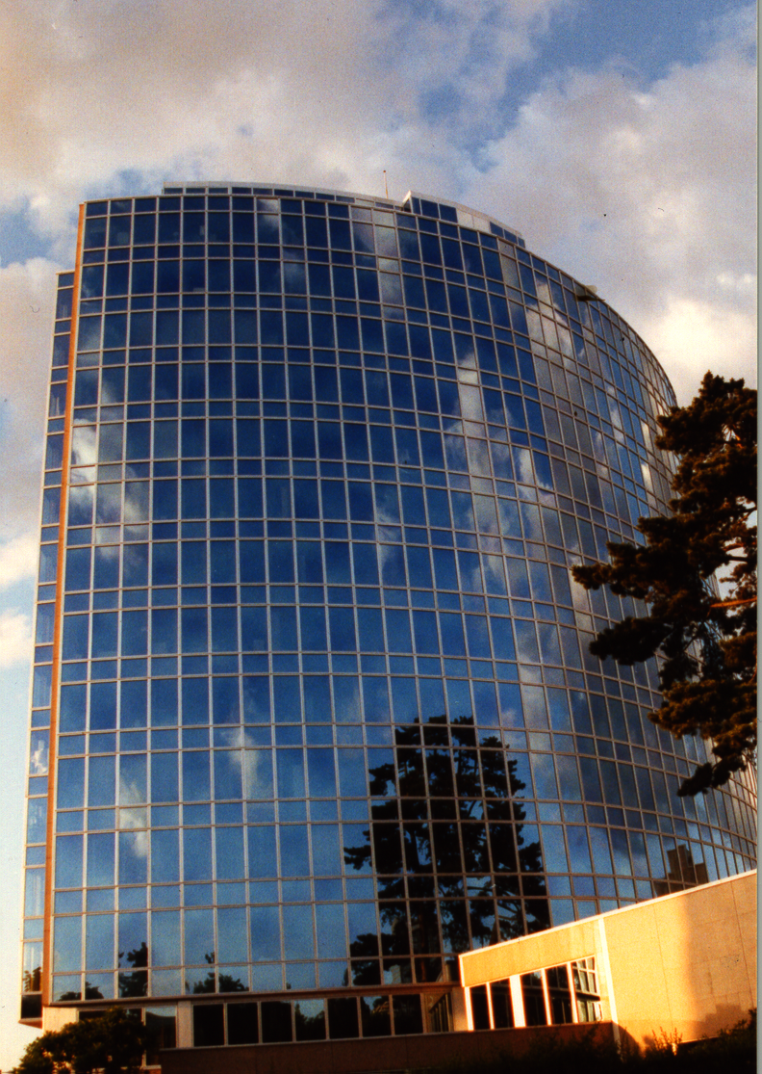
Thank you
for your attention
debbie.roenning@wipo.int

Slide 108
Global Databases for IP Platforms and
Tools for the Connected Knowledge Economy
Speaker: Christophe Mazenc, Head, Global Databases Service, Global Infrastructure Sector

Slide 109
Strategic Goals of Global Databases and Tools
2 related goals:
  “Coordination and Development of Global IP Infrastructure”
  “World Reference Source for IP Information and Analysis”

Slide 110
Benefits to Stakeholders
For Business/Research:
  Providing search facilities for IP collections (patents, trademarks, industrial designs)
  Simplifying application procedures to multiple IP authorities
  Providing IP related matchmaking services
For IP offices:
  Assisting automation, IP information dissemination to the public, and exchange of IP documents with other offices

Slide 111

GLOBAL DATABASES, TOOLS, AND PLATFORMS FOR IP BUSINESS (FREE)
PATENTSCOPE
Global Brand Database
WIPO Lex
WIPO Pearl
WIPO IPAS, WIPO DAS
WIPO CASE
WIPO RE:SEARCH
WIPO GREEN

Slide 112
PATENTSCOPE
2.5 million published PCT applications (first publish every week, high quality full text)
37 million patent applications from 38 countries or regions
Full text data from 18 countries or regions
15,000 pageviews per hour
Analyze results by graphs and charts
Search and read in your language

Slide 113
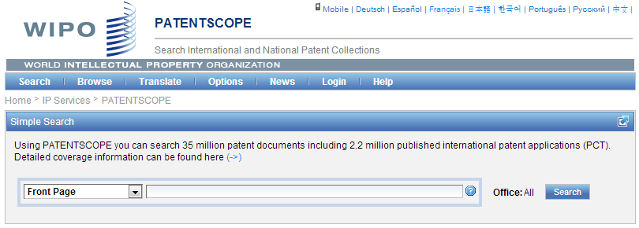
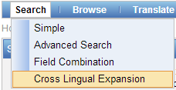

Slide 114
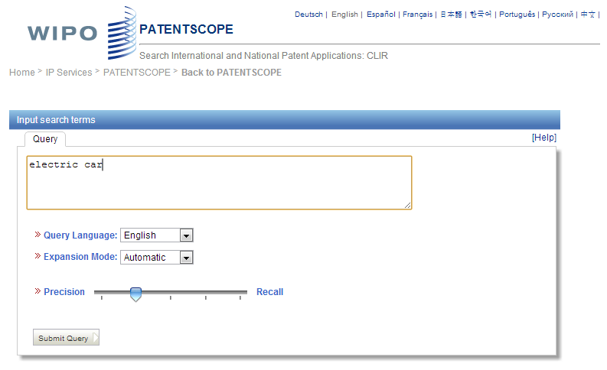


Slide 115
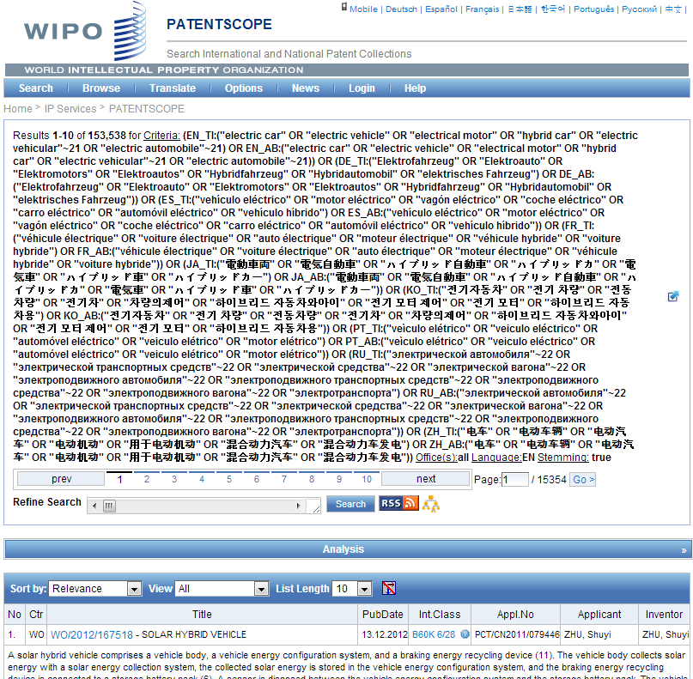

Electric car - only 16,000 hits
Search Query
(synonyms & technologically related terms)

Slide 116
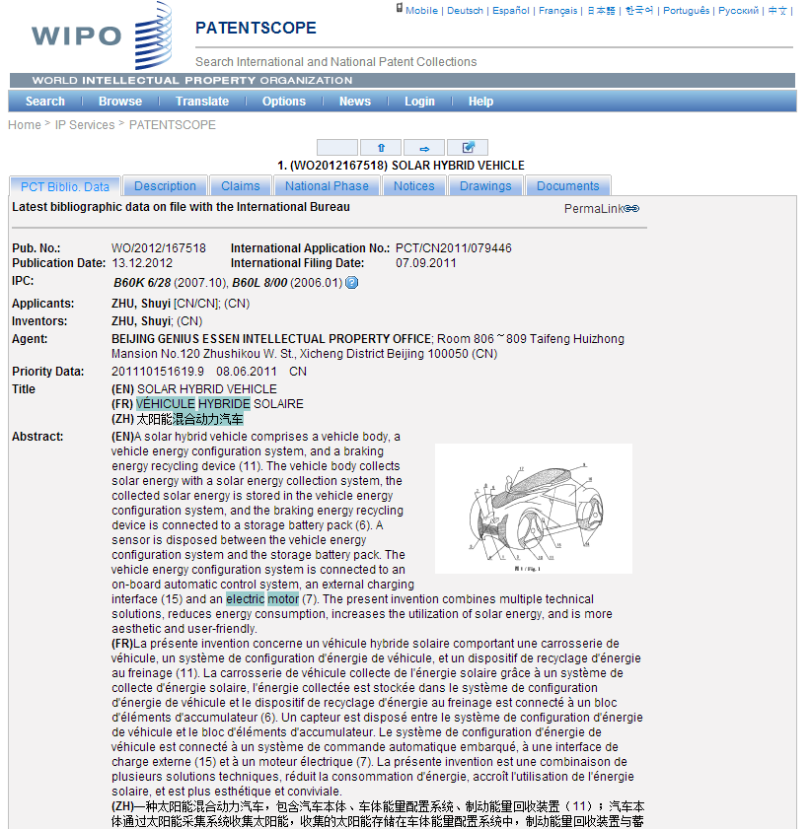

Slide 117
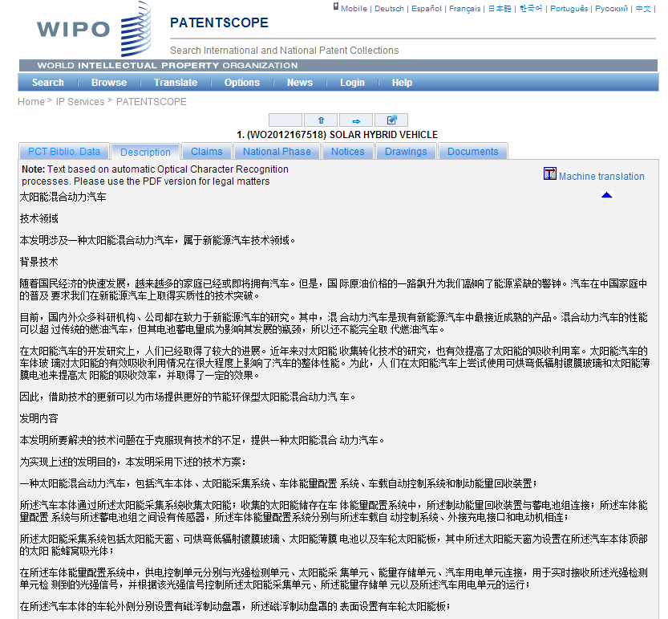
???

Slide 118
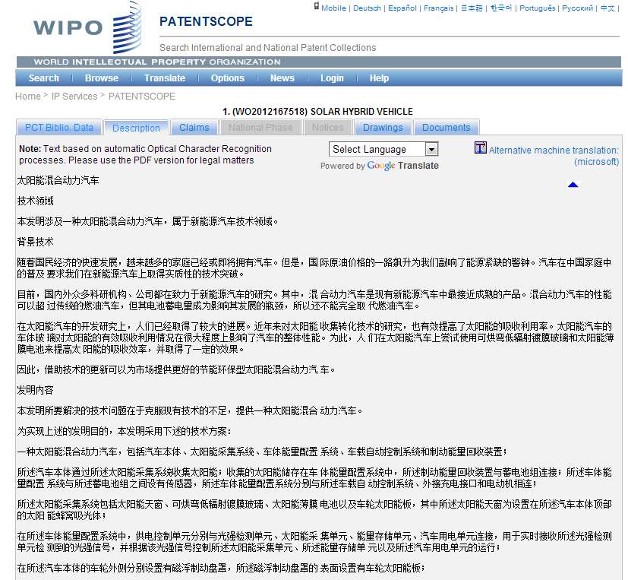

Slide 119
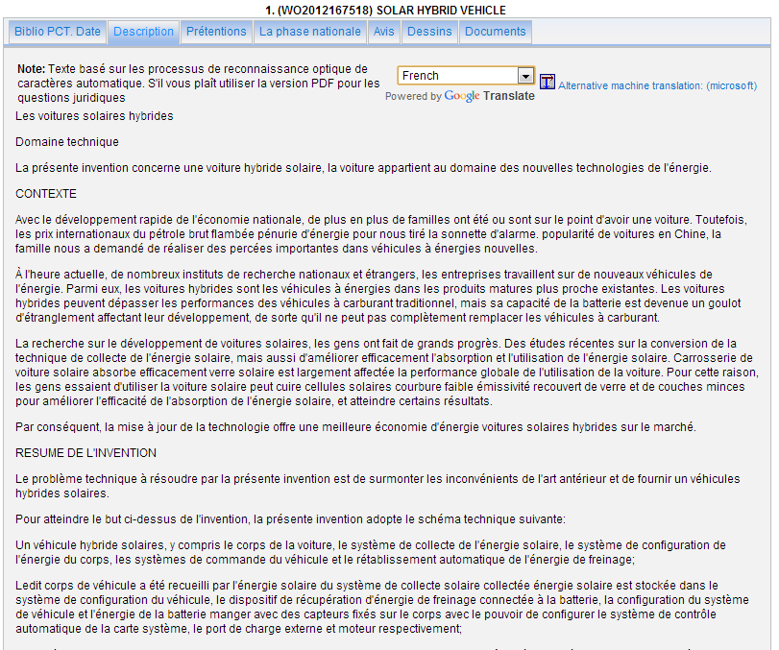

Slide 120
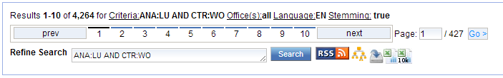

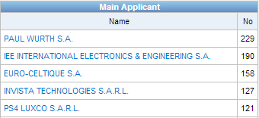


PATENTSCOPE what’s new?
Possibility to export the 10’000 first bibliographic data records of any search query in Excel format to build Patent Landscape reports
Expected for Q4 2014
  Inclusion in PATENTSCOPE of the complete full text of the national patent applications and grants from DPMA (more than 5'000'000 full text records)

Slide 121
Searching German Full text in PATENTSCOPE
Separate searchable fields for titles, abstracts, descriptions and claims
Stemming: very important for German as it is inflected language with different variations for ends of words
When Searching for “Robot” , documents containing the following words will also be returned:
Roboter, Roboters, Robotern
medizinisch => medizinisches, medizinischen, medizinischer, medizinische, medizinischem,
Gerät => Gerätes, Geräten, Geräte, Geräts, Geraet, Geraetes, Geraeten, Geraete, Geraets

Slide 122
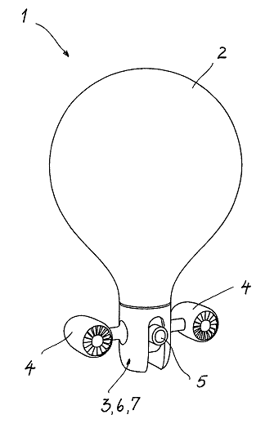
German decompounder
Special care has been taken to index efficiently compound words in German language
Example: WO2014/00729
Gasballongetragener Flugroboter
With decompounding, any of the following queries will match the WO2014/00729 document:
  “gasballon” AND “roboter”
  “gasballon” AND “flugroboter”
  “gasballongetragener “ AND “roboter”
  “getragener” AND “roboter”
Notes:
122

Slide 123
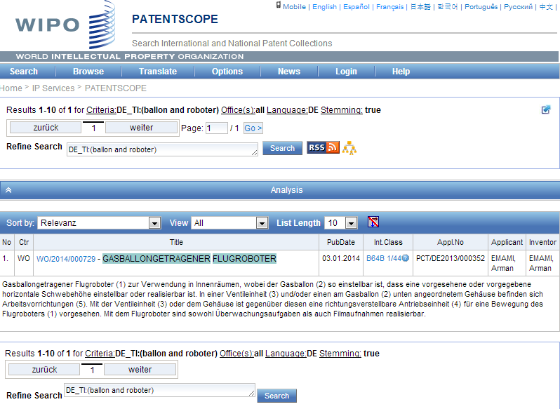
German decompounder

Slide 124
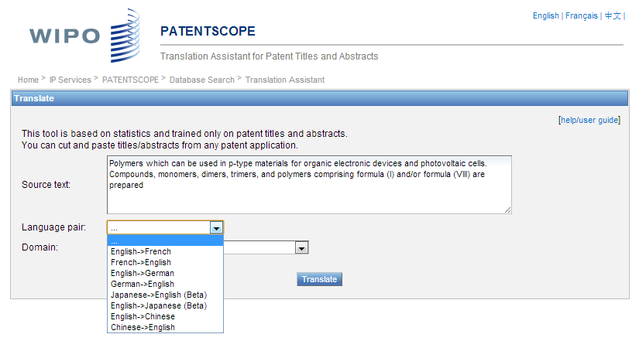
TAPTA

Slide 125
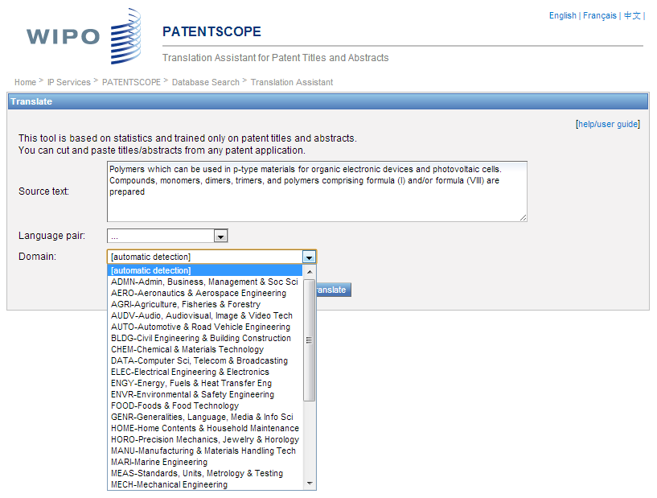

Slide 126
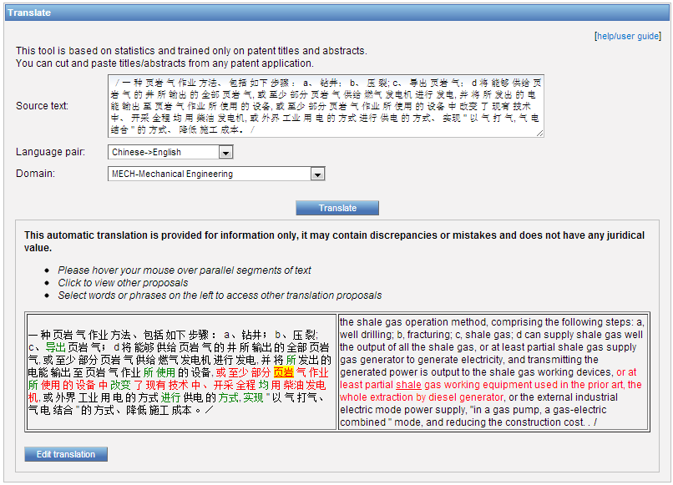
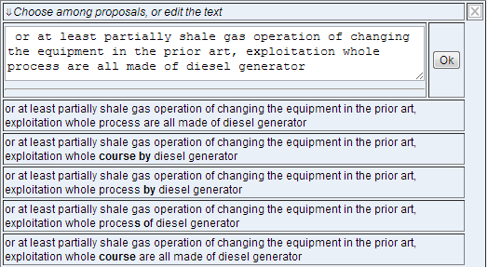

Slide 127

Monthly webinar

Slide 128
GLOBAL DATABASES, TOOLS, AND PLATFORMS FOR IP BUSINESS (FREE)
PATENTSCOPE
Global Brand Database
WIPO Lex
WIPO Pearl
WIPO IPAS, WIPO DAS
WIPO CASE
WIPO RE:SEARCH
WIPO GREEN

Slide 129
GLOBAL BRAND DATABASE
14 million records relating to internationally-protected trademarks, etc.
Free of charge simultaneous brand-related searches across multiple collections, including:
  Trademarks registered under Madrid System
  Appellations of Origin registered under Lisbon System
  Emblems protected under the Paris Convention 6ter
  UAE, Australia, Canada, Switzerland, Denmark, Algeria, Estonia, Egypt, Israel, Cambodia, Morocco, New Zealand, Oman, Philippines, Singapore and US

Slide 130
Global Brand Database
Video demo:
http://www.wipo.int/pressroom/en/articles/2014/article_0007.html

Slide 131




Global Brand Database – Features
Single intuitive interface to search 19 data collections
Image Search by example
Interactive & dynamic search with immediate feedback
Fuzzy, phonetic and word-stem matches
Automatic term suggestion
Easy search of US or Vienna image class
Full Boolean, proximity and range options
Unlimited, customizable results browsing
Saved searches and record sets
Instant, graphical data analysis

Slide 132



Slide 133


Slide 134





Slide 135


Slide 136




Slide 137


Slide 138





Slide 139
GLOBAL DATABASES, TOOLS, AND PLATFORMS FOR IP BUSINESS (FREE)
PATENTSCOPE
Global Brand Database
WIPO Lex
WIPO Pearl
WIPO IPAS, WIPO DAS
WIPO CASE
WIPO RE:SEARCH
WIPO GREEN

Slide 140


Slide 141


Slide 142


Slide 143


Slide 144
GLOBAL DATABASES, TOOLS, AND PLATFORMS FOR IP BUSINESS (FREE)
PATENTSCOPE
Global Brand Database
WIPO Lex
WIPO Pearl
WIPO IPAS, WIPO DAS
WIPO CASE
WIPO RE:SEARCH
WIPO GREEN

Slide 145

WIPO Pearl
WIPO’s online terminology database
15’000 concepts, 90’000 terms
10 languages
Contents validated by WIPO language experts and terminologists
http://www.wipo.int/wipopearl/search/home.html

Slide 146
GLOBAL DATABASES, TOOLS, AND PLATFORMS FOR IP BUSINESS (FREE)
PATENTSCOPE
Global Brand Database
WIPO Lex
WIPO Pearl
WIPO IPAS, WIPO DAS
WIPO CASE
WIPO RE:SEARCH
WIPO GREEN

Slide 147
IPAS AND DAS
IPAS (IP office Administration System) used by 60 IPOs
A WIPO software enabling small IPOs to electronically process patent, trademark, design applications
DAS (Digital Access System) used by 11 IPOs
A System that allows IPOs and applicants to securely exchange or submit a digital copy of priority documents to multiple IPOs
Notes:
Those are software systems developed and maintained by WIPO for IP offices of its member states.
The first one IPAS, which is an acronym for IP Office Administration System) is used by 60 small IP offices and enable them to electronically process patent, trademark and design applications.
The second one is named DAS, which stands for Digital Access System, is used by 11 IP offices and allows them and their applicants to securely exchange certified digital copies of priority documents among themselves.

Slide 148
GLOBAL DATABASES, TOOLS, AND PLATFORMS FOR IP BUSINESS (FREE)
PATENTSCOPE
Global Brand Database
WIPO Lex
WIPO Pearl
WIPO IPAS, WIPO DAS
WIPO CASE
WIPO RE:SEARCH
WIPO GREEN

Slide 149
WIPO CASE
“Centralized Access to Search and Examination Reports”
Started with an initiative of IP Australia and the Vancouver Group (AU, CA, UK)
Online patent work-sharing platform for patent examiners worldwide—secure sharing search and examination documentation
IPOs can enhance quality and efficiency of patent examination
CASE will be linked to Open Portal Dossier of IP5 to become the Global Portal Dossier

Slide 150


Slide 151




GLOBAL DOSSIER PLATFORM (WIPO-CASE, OPD AND PATENTSCOPE)
Public Users
(including IP office users)
Examiner of IP5 Office not participating in WPO/CASE
OPD
Feed dossier information that OPD/CASE Offices agree to publish
Public Domain
OPD
WIPO CASE
Not accessible to the public and for PTO official use only
IPAS+
CASE depositary
System
Examiner of CASE participating office
Examiner of IP5 Office participating in WPO/CASE
CASE depositary Office using IPAS
CASE depositary Office using own EDMS
E.g. Australia

Slide 152
GLOBAL DATABASES, TOOLS, AND PLATFORMS FOR IP BUSINESS (FREE)
PATENTSCOPE
Global Brand Database
WIPO Lex
WIPO Pearl
WIPO IPAS, WIPO DAS
WIPO CASE
WIPO RE:SEARCH
WIPO GREEN

Slide 153


Broad aims:
  Match-making for technology transfer and collaborations
  Reduce transaction costs
  Build on comparative advantages of multi-stakeholder approaches
  Demonstrate practical means for the global policy issues
Based on the recognition that:
    Users want access to technologies, not just patent rights
    Collaboration (e.g. training) is crucial to tech transfer

Slide 154
WIPO RE: SEARCH
A Global Database and Platform to bridge partners to use IP (including know-how and data) to facilitate R&D on neglected tropical diseases, tuberculosis, and malaria.
Royalty-free for R&D, manufacture and sale in LDCs
Over 60 partners (pharmaceutical industry, research institutes such as NIH, Universities)
As of January 2014, 44 collaborations

Slide 155

www.wipo.int/research

Slide 156













WIPO RE:SEARCH
Sharing Innovation in the Fight Against Neglected Tropical Diseases
Get involved:
As a user
As a provider
As a supporter
(Adhere to Guiding principles, contact email: re_search@wipo.int)
…

Slide 157
WIPO GREEN
A global database allowing users to make green technologies available for licensing or partnership, enter technology needs, search for technologies and needs
Started a pilot with Japan Intellectual Property Association in 2011
Launched in November 2013
as of January 2014, over 800 offers
Green tech providing companies in Germany, Japan, US etc.
Partners include companies, universities, UN agencies, governments, IPOs, NGOs, etc.

Slide 158































Partners of WIPO GREEN

Slide 159

www.wipo.int/green

Slide 160

Six Areas of Green Technology Markets

Slide 161

The Challenge
International Transfer of wind power technology, 1988-2007,
OECD 2010

Slide 162
Get Involved
Become a Partner and shape the further development of WIPO GREEN
Register to:
    communicate your green innovation and technology needs
    advertise your inventions, technologies, products and services
    connect with the innovation and business communities globally

Slide 163
Thank you for your attention

