Slide 1
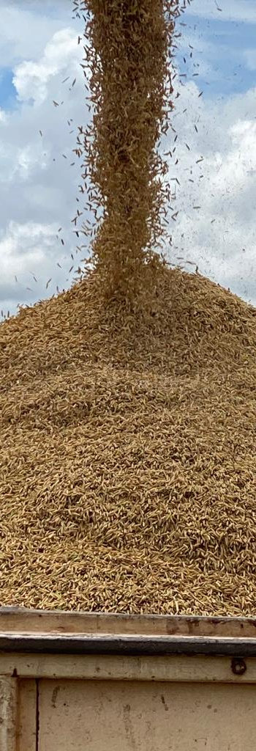

Plant Variety Protection Drives Innovation in Rice Breeding: Embrapa’s Successful Story
Elcio Perpetuo Guimaraes
DG Embrapa Rice and Beans
International Conference on Intellectual Property and Development
Geneva, April 24, 2023

Slide 2
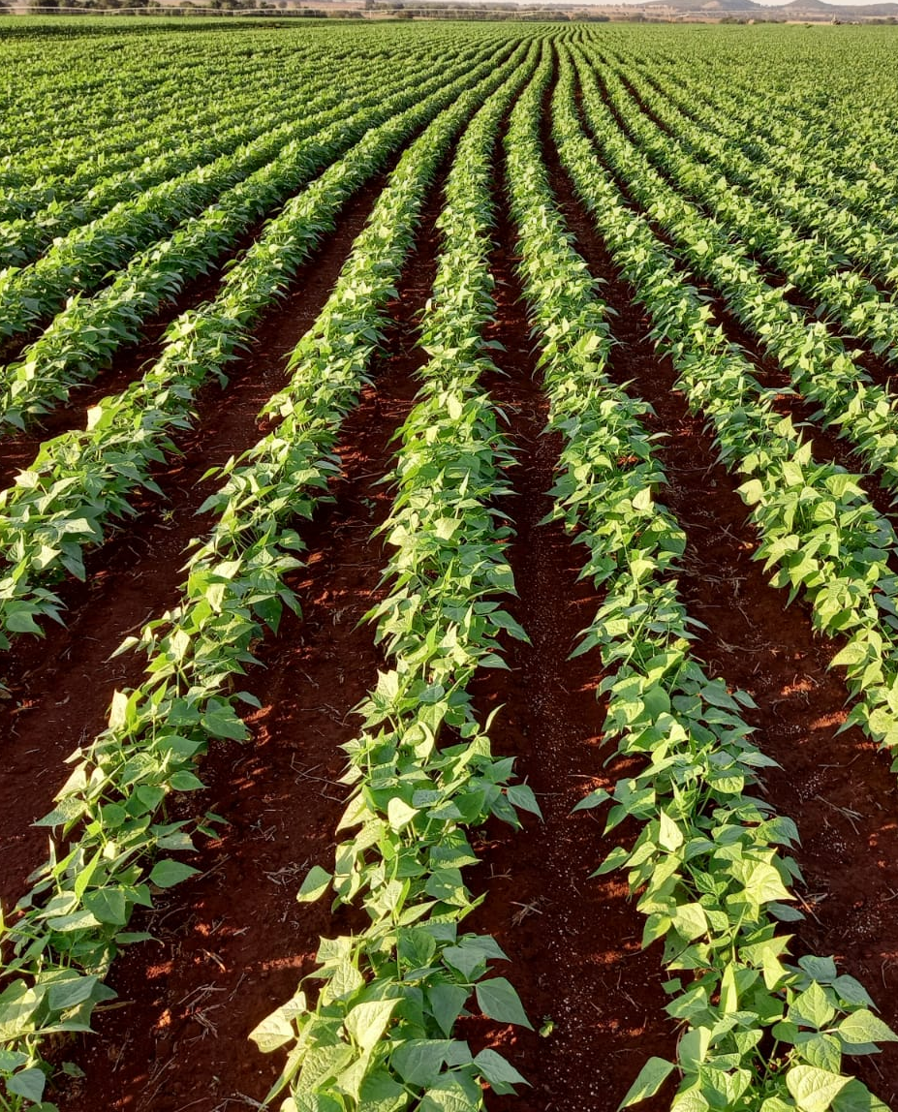
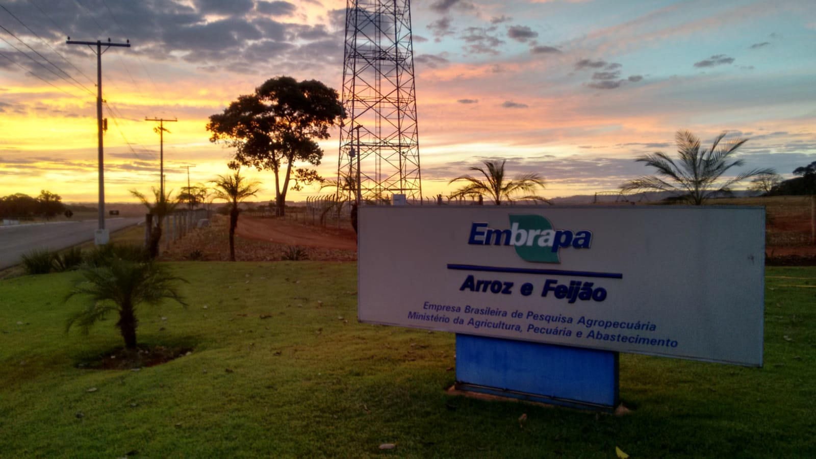
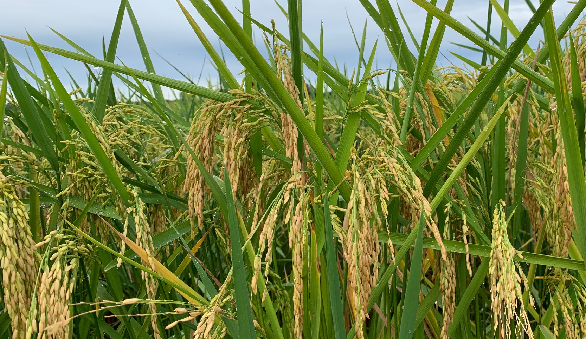

43
Research
Units

Slide 3
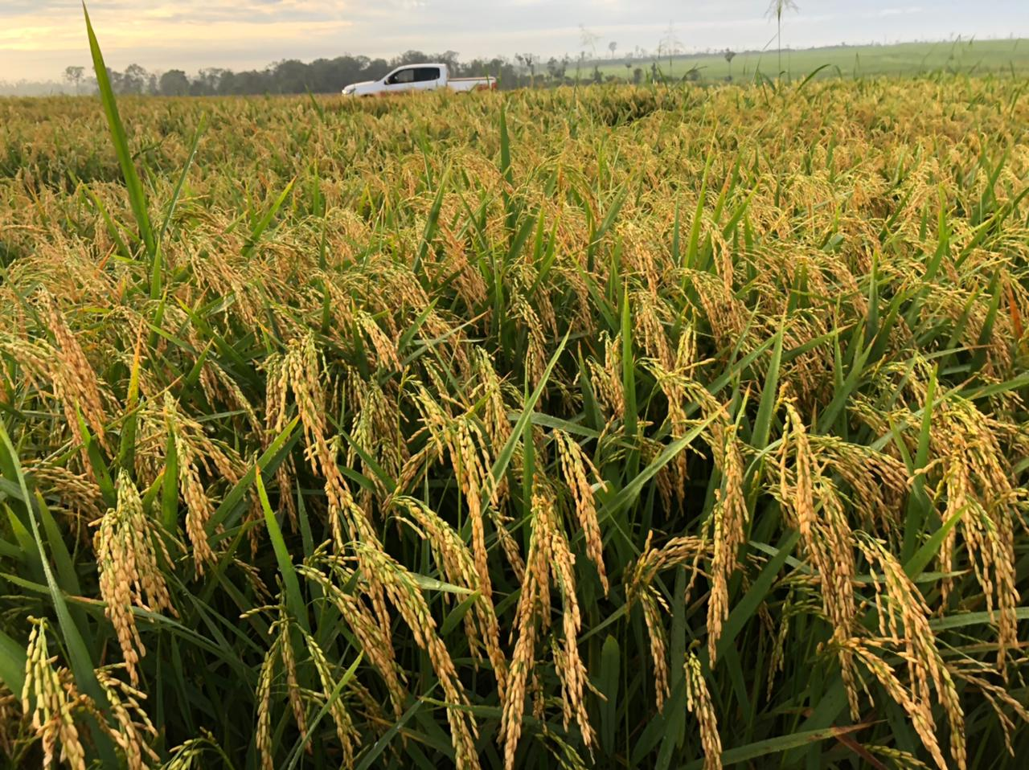
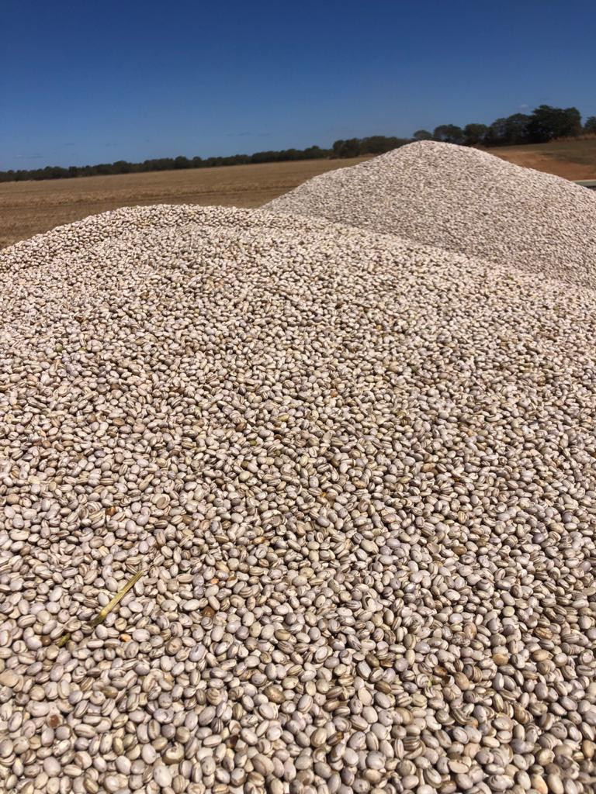

Technology Development - Research Groups
GHE
Carbon
Systems
Rice breeding
Bean breeding
Pathology
Bioinputs

Slide 4
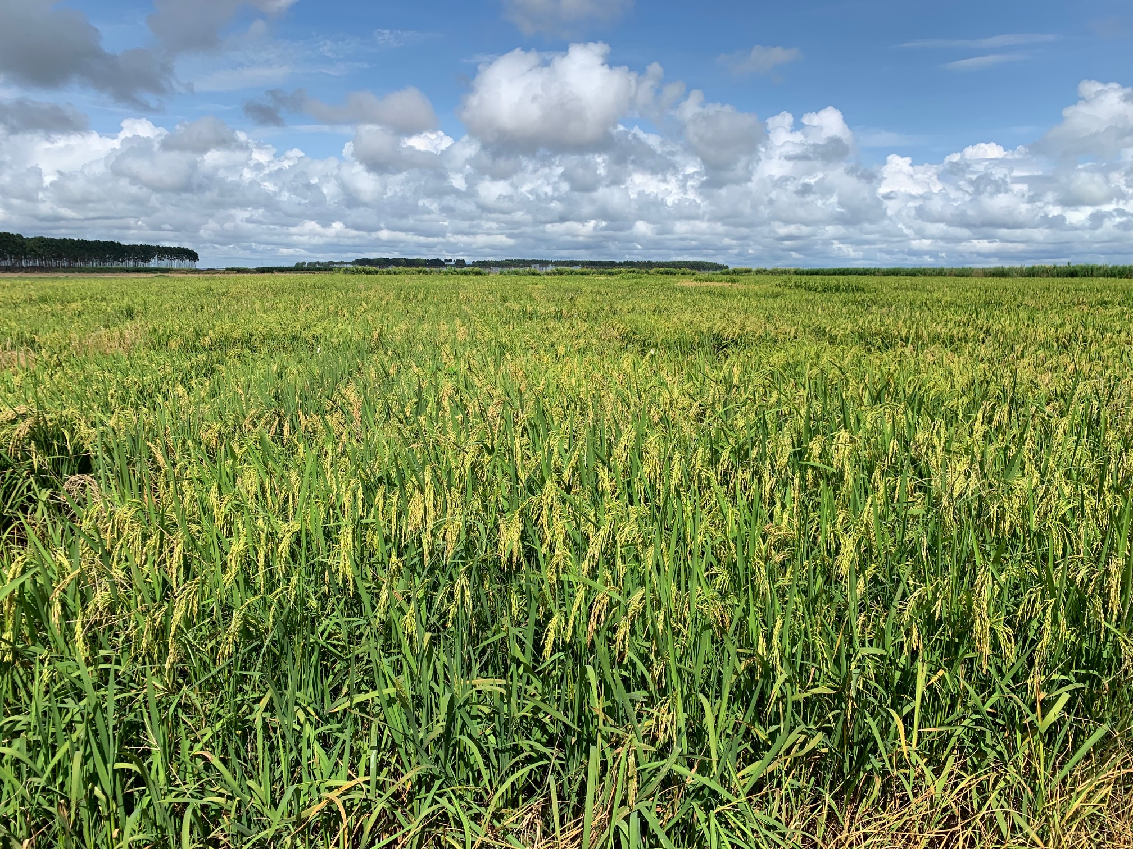
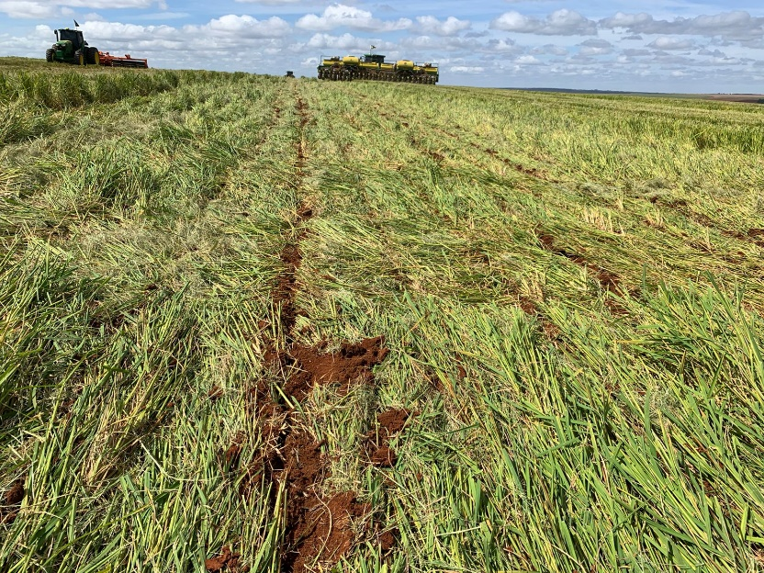
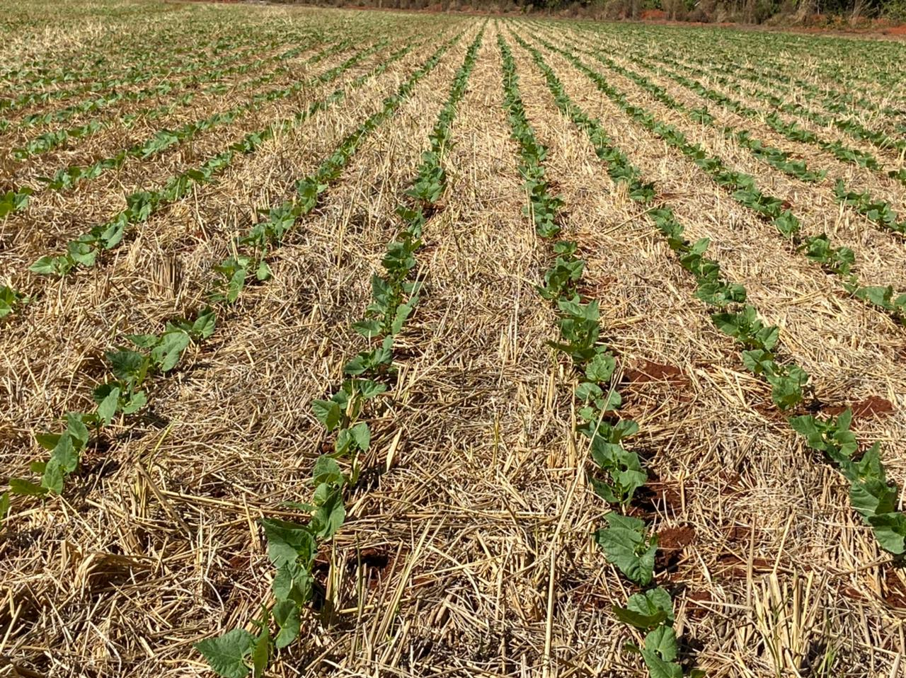
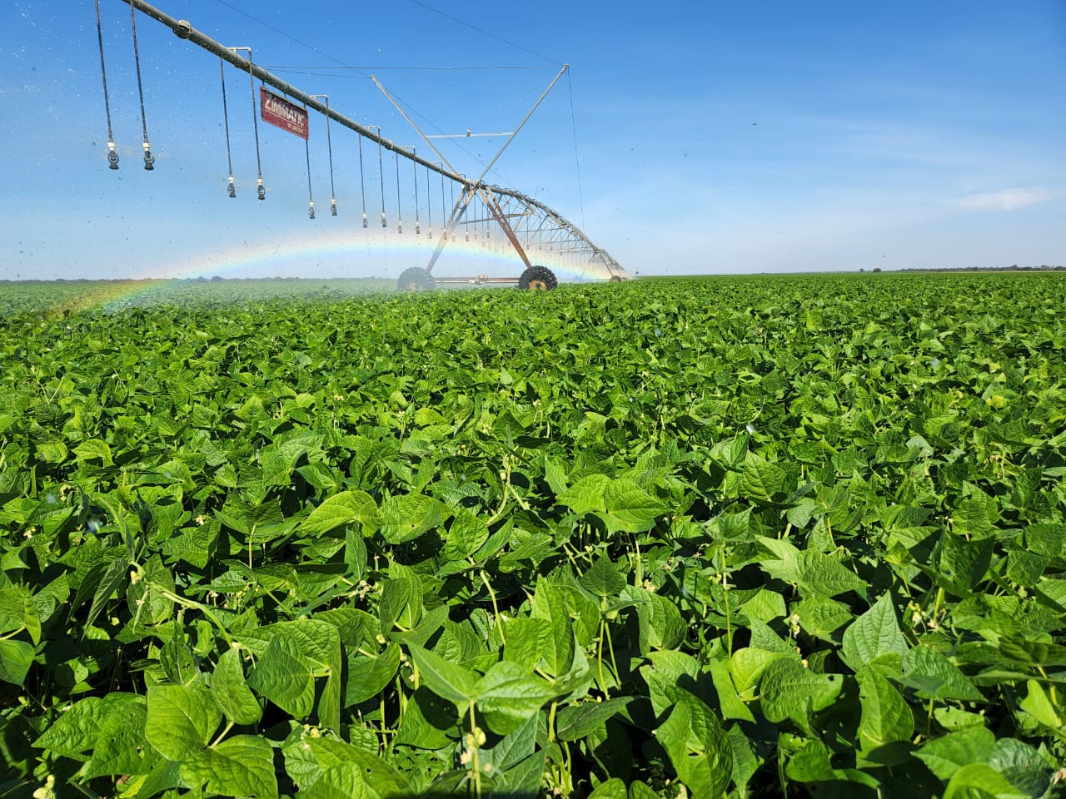
Sustainable Cropping Systems
1
2
3
4

Slide 5
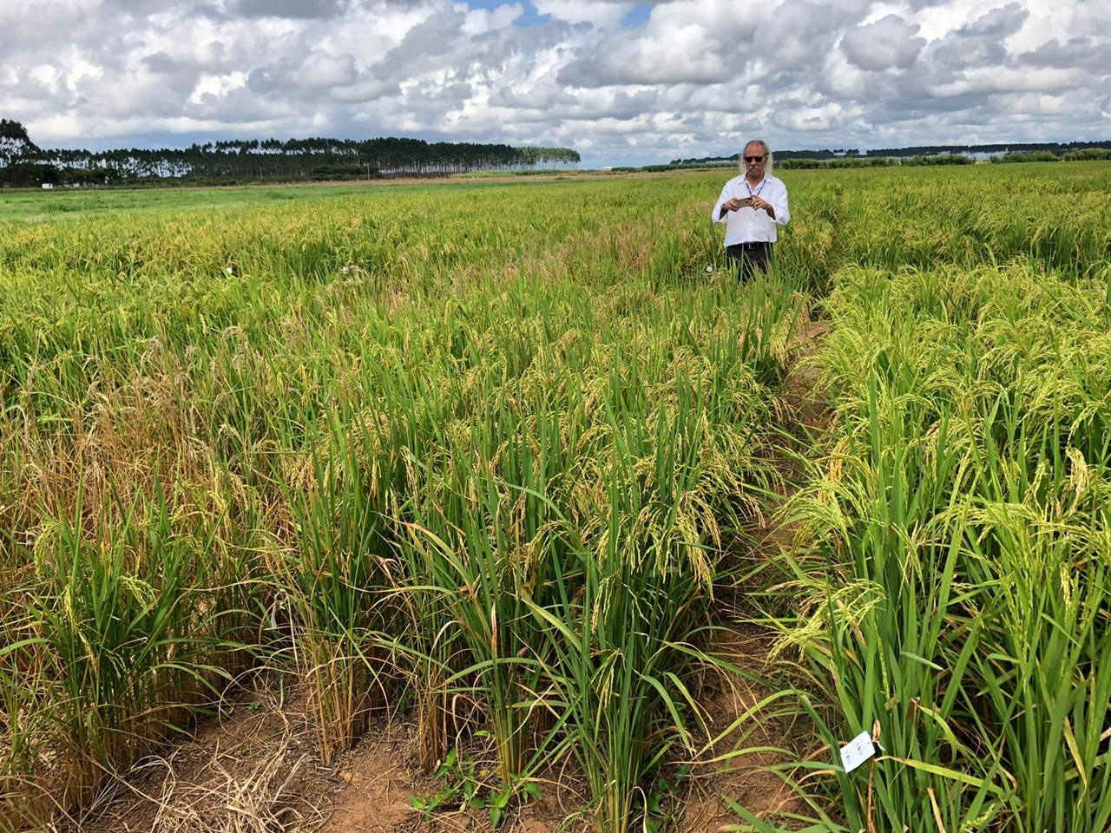
Rice Breeding Program
45 years breeding rice

Slide 6
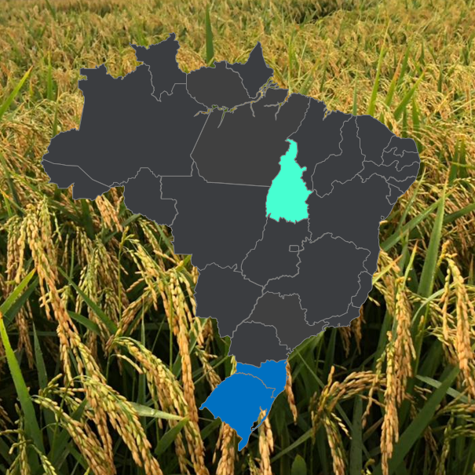
Tropical Rice
Subtropical Rice

Slide 7
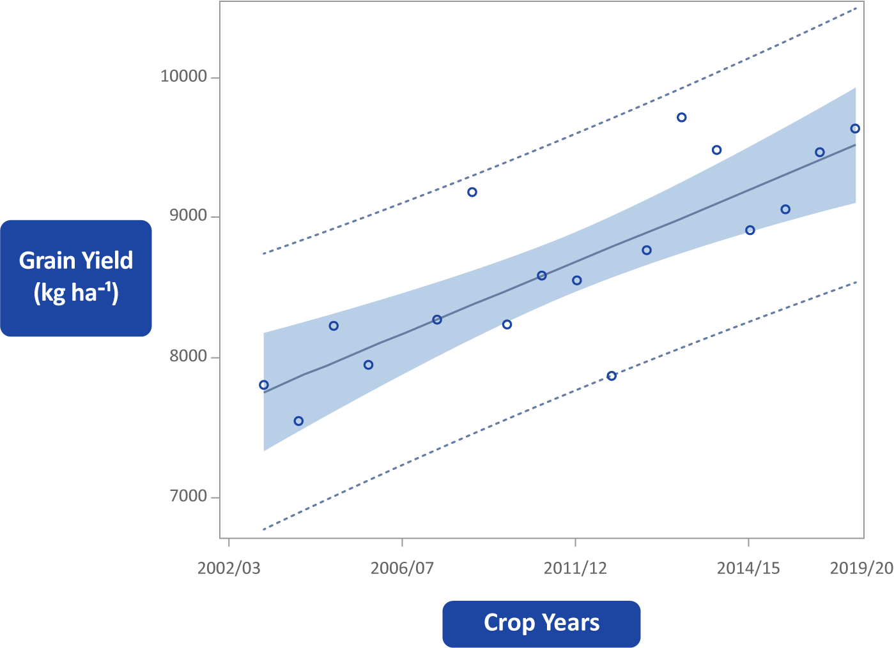


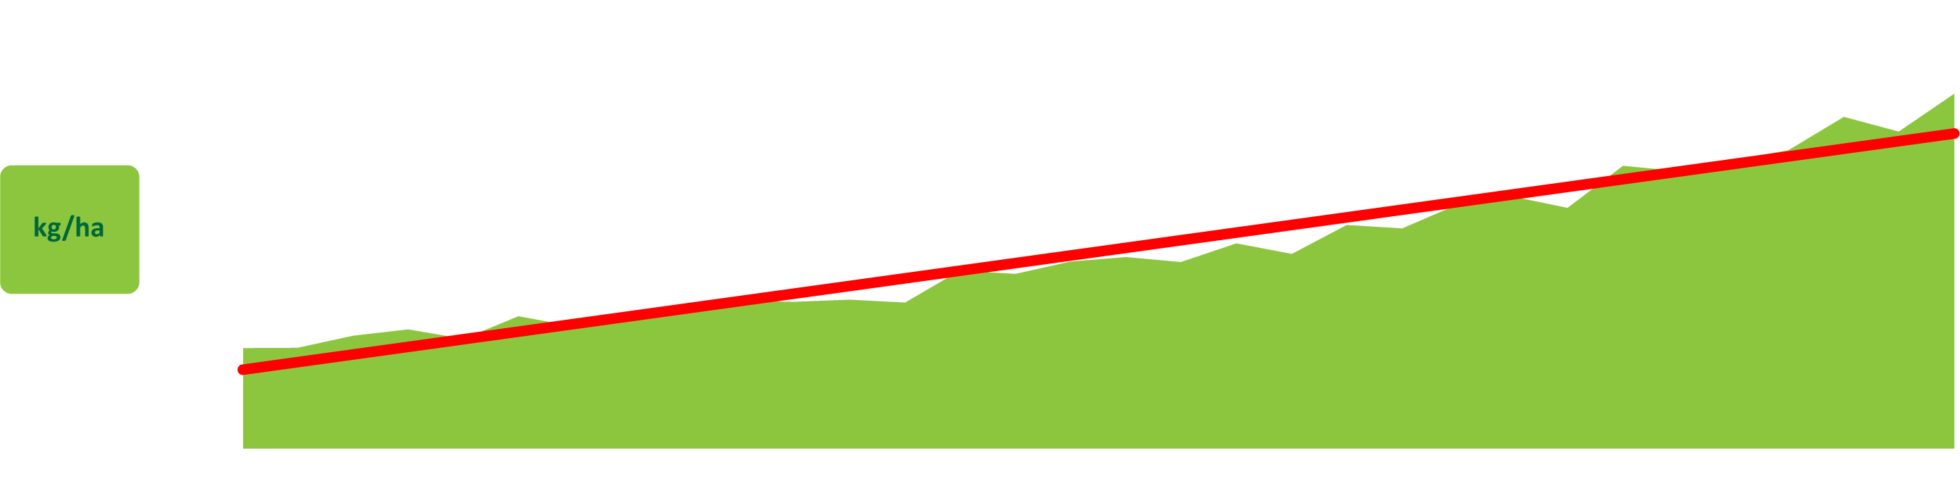
Genetic Progress
y = 7735,5 + 97,034x **
R² = 0,4152
F2:4 progeny groups per crop year
y = 131.71x + 1243.7
R² = 0.9524
Rice
grain yield trend in Brazil

Slide 8
Tropical Rice – Market Share

Slide 9



Policy Change
- 1997 -
Crop Protection Law

Slide 10
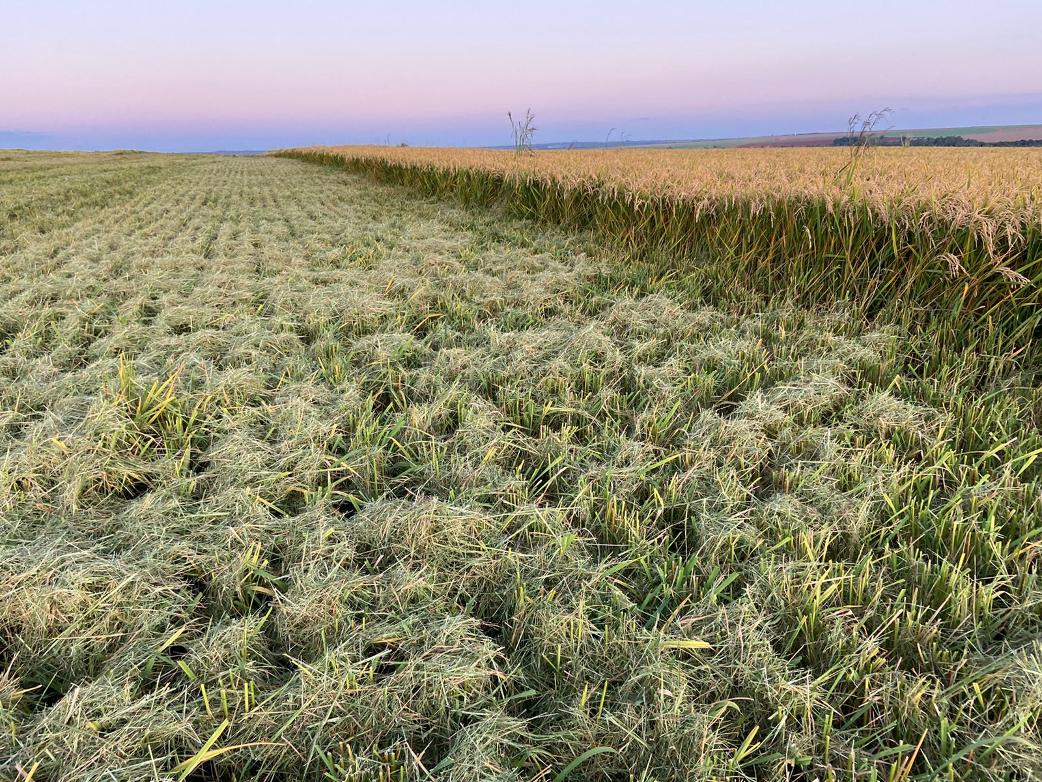




Slide 11
Tropical Rice – Market Share

Slide 12

Royalties

Slide 13
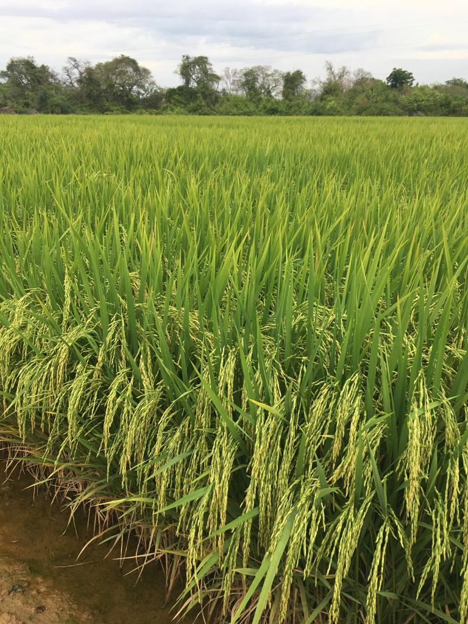
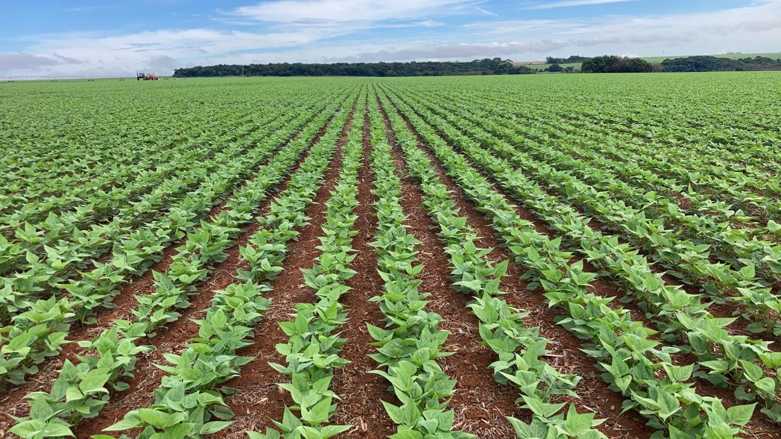
Looking forward
Irrigated Rice
Beans

Slide 14
Technology
Partnership
Innovation
Plant Variety Protection

Slide 15
Rice cultivars
Seed producers
Adoption – Market share
Plant Variety Protection

Slide 16
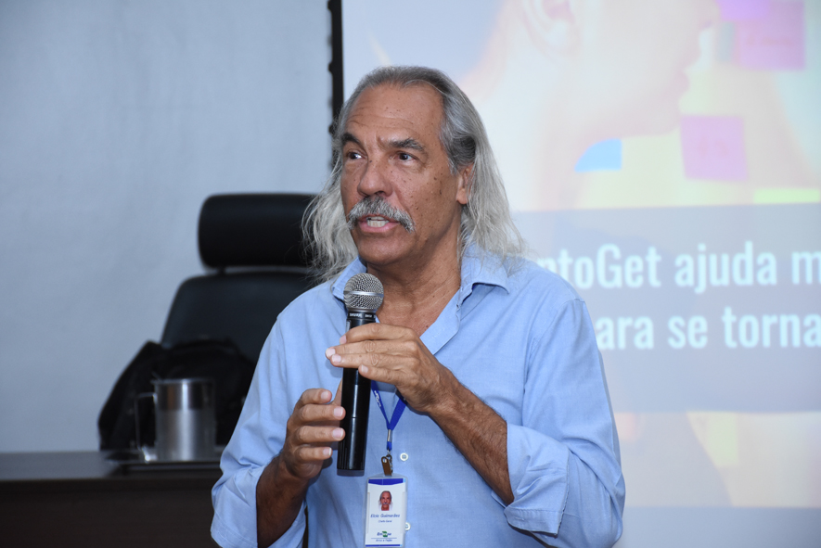

Elcio Perpétuo Guimarães
Director General
Embrapa Rice and Beans elcio.guimaraes@embrapa.br
+55.62.999300513

