Slide 1


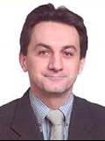

Seminar on WIPO Services and Initiatives
Stockholm, Sweden
March 12, 2014

Slide 2


Speaker: Víctor Vázquez, Head, Section for Coordination of Developed Countries, Department for Transition and developed Countries (TDC)

Slide 3
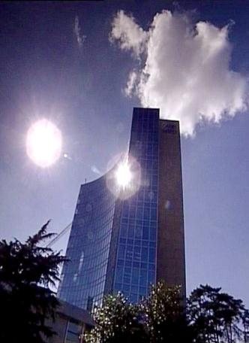
BASICS FACTS ABOUT WIPO
WIPO’s MISSION: To promote the protection of IP rights worldwide and extend the benefits of the international IP system to all member states.
MEMBER STATES: 186
OBSERVERS : + 390
STAFF : 950 FROM 101 COUNTRIES
ADMINISTERED TREATIES : 26
MAIN ORGANS/BODIES : GA, CC, WIPO CONFERENCE

Slide 4
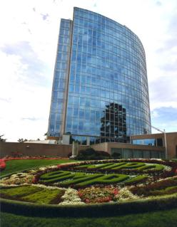
MILESTONES: 1883 - 2013
2013
MARRAKESH TREATY
2012
2006
BEIJING TREATY
2000
STLT
1996
PATENT LAW TREATY
INTERNET TREATIES
1989
MADRID PROTOCOL
1970
PCT ESTABLISHED
1967
1960
WIPO CONVENTION
1925
BIRPI MOVES TO GENEVA
1893
HAGUE AGREEMENT
1891
BIRPI
1886
1883
MADRID AGREEMENT
BERNE CONVENTION
PARIS CONVENTION

Slide 5
INTELLECTUAL PROPERTY : OUTREACH
PUBLIC SECTOR & POLICY MAKERS
BUILDING AWARENESS
INTELLECTUAL PROPERTY OFFICES
GENERAL PUBLIC & CIVIL SOCIETY

Slide 6

WIPO’s MAIN ACTIVITIES
Economic Development
Norm Setting
Global Infrastructure
Services to Industry

Slide 7
WIPO … PROVIDER OF PREMIER GLOBAL IP SERVICES
Core income generating business areas:
  Patent Cooperation Treaty (Patents)
  Madrid System (Trademarks)
  Hague System (Industrial Designs)
  Lisbon System (Geographical Indications)
  WIPO Arbitration and Mediation Center
AIM : to be the first choice for users by continuing to offer cost-effective and value-added services
Notes:
Patent law differs from country to country. It can be a costly, complex and lengthy process to obtain patent protection in multiple countries. WIPO’s global protection services offer a swift, reliable cost-effective and user-friendly option. Principle objective of PCT is operational excellence and provision of high quality services to benefit users of patent system, patent administrations and general public by streamlining the filing and processing of patent applications in multiple countries (through reduced duplication of work of national filing and processing) to make the grant of patents more economical (ie less diversion of public resources for patent admin.)
Emphasis on ensuing PCT beneficiaries receive adequate knowledge of system and that the system responds satisfactorily to their needs.
TRADEMARKS: In constantly changing business environment, TMs, etc. are important tools for promotion of domestic commerce and int’l. trade which, in turn, contribute to sustainable national economic growth. Indispensable in designing marketing strategies to identify and promote goods in market place and distinguish these goods from those of competitors. To be effective, need adequate legal protection at national & int’l. levels. WIPO’s registration systems facilitate the acquisition and maintenance of these IPRs in different countries
A company in Morocco requesting TMP in 12 countries - application in 3 classes would pay over 6.5 times more if it didn't use MS but opted to apply to each national office separately -Madrid = 2,162 CHF; vs. 14,245 CHF using national route). Renewal of same app. = 5+ times cheaper and cost of registering a change in ownership is 20+ times cheaper, costing 177 Swiss francs as opposed to 3,697 Swiss francs under the national route.
Patent law differs from country to country. It can be a costly, complex and lengthy process to obtain patent protection in multiple countries. WIPO’s global protection services offer a swift, reliable cost-effective and user-friendly option. Principle objective of PCT is operational excellence and provision of high quality services to benefit users of patent system, patent administrations and general public by streamlining the filing and processing of patent applications in multiple countries (through reduced duplication of work of national filing and processing) to make the grant of patents more economical (i.e. less diversion of public resources for patent admin.)
Emphasis on ensuing PCT beneficiaries receive adequate knowledge of system and that the system responds satisfactorily to their needs.
TRADEMARKS: In constantly changing business environment, TMs, etc. are important tools for promotion of domestic commerce and int’l. trade which, in turn, contribute to sustainable national economic growth. Indispensable in designing marketing strategies to identify and promote goods in market place and distinguish these goods from those of competitors. To be effective, need adequate legal protection at national & int’l. levels. WIPO’s registration systems facilitate the acquisition and maintenance of these IPRs in different countries
A company in Morocco requesting TMP in 12 countries - application in 3 classes would pay over 6.5 times more if it didn't use MS but opted to apply to each national office separately -Madrid = 2,162 CHF; vs. 14,245 CHF using national route). Renewal of same app. = 5+ times cheaper and cost of registering a change in ownership is 20+ times cheaper, costing 177 Swiss francs as opposed to 3,697 Swiss francs under the national route.

Slide 8
WIPO’s MAIN SOURCES OF REVENUE

Slide 9
GLOBAL IP INFRASTRUCTURE
WIPO is coordinating with stakeholders to develop tools, services, platforms, standards, etc. that enable IP institutions to work :
  EFFICIENTLY
  PROVIDE BETTER
  HIGH QUALITY SERVICES
Notes:
“Just as participation in the physical economy requires access to roads, bridges, and vehicles to transport goods, similar infrastructure is needed in the virtual and knowledge economy. However, here the highway is the Internet and other networks, bridges are interoperable data standards, and vehicles are computers and databases.”
WIPO DIRECTOR GENERAL, FRANCIS GURRY

Slide 10
GLOBAL IP INFRASTRUCTURE
INFRASTRUCTURE INCLUDES :
  Databases (PATENTSCOPE, Global Brand DB & access to aRDI and ASPI)
  Common platform for e-data exchange among IPOs (WIPO Case for Global Dossier, the Digital Access Service)
  Other platforms: WIPO Green; WIPO Research.
  Tools (international classifications in TMs/design; IPC, Green inventory, Nice classification)
  Standards & technical agreements
  Services (International Cooperation for Patent Examination (ICE), Patent Information Services, including Legal Status of Patents)

Slide 11
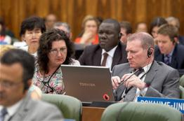

NORM SETTING
AIM → Progressive development of international IP law for an IP system that is:
  balanced/responsive to emerging needs
  effective in encouraging innovation/creativity
  sufficiently flexible to accommodate national policy objectives
Topical issues reviewed/discussed in Standing Committees

Slide 12


NORM SETTING
WIPO treaties are often closely connected to infrastructure and services:
  Treaties that provide legal support to international infrastructure and services: PCT, Madrid.
  Business simplification treaties, which simplify the operation of national infrastructure and services: Singapore Treaty on the Law of Marks (2006), Patent Law Treaty ( 2000)

Slide 13
STANDING COMMITTEES
PATENTS (SCP)
COPYRIGHT & RELATED RIGHTS (SCCR)
TRADEMARKS, DESIGNS & GEOGRAPHICAL INDICATIONS (SCT)
AIM :
      Build consensus on topical issues
      Take into account interests of all stakeholders for a balanced, reliable, efficient, user-friendly, cost-effective system.
      N.B. Enforcement issues are discussed within the Advisory Committee on Enforcement (ACE)
Notes:
WIPO’s work in this area is designed to reduce complexity, cost and time involved in obtaining patent protection in multiple countries and to address workload crisis facing many office because of rising number of patent applications, changing nature of applications (biotech) and duplication of work. Various activities support this endeavor, namely:
- Substantive and procedural harmonization of patent law.
- Development and adoption of reforms of PCT System.
PCT Reform: began in Oct. 2000. General objectives to simplify the system, streamline procedures, reduce costs for applicants, maintains quality of services to facilitate greater use, ensure system works to advantage of all offices irrespective of size.

Slide 14
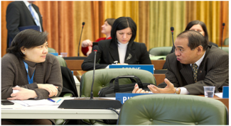
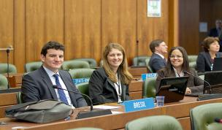
THE STANDING COMMITTEE ON LAW OF PATENTS
Member States’ Committee (IGOs and NGOs: observers)
Established in 1998
Forum to discuss issues, facilitate coordination and provide guidance concerning the progressive international development of patent law
Forum that deals with a cluster of issues rather than each issue in isolation
Since 2008, discussions on various issues identified by Member States

Slide 15
THE STANDING COMMITTEE ON LAW OF PATENTS
PART II
Twentieth Session of the SCP took place from January 27 to 31, 2014
Quality of patents: The Committee shared a general understanding that the proposal submitted with respect to the quality of patents did not lead to harmonization of substantive patent law and to automatic acceptance of work sharing products
    A study will be prepared on inventive step containing the definition of the person skilled in the art, methodologies employed for evaluating an inventive step and the level of the inventive step
    A study on sufficiency on of disclosure containing the enabling disclosure requirement, support requirement and written description requirement
Notes:
private and/or non-commercial use; experimental
use and/or scientific research; preparation of medicines; prior use; use of
articles on foreign vessels, aircrafts and land vehicles. The document should
also cover practical challenges encountered by Member States in
implementing them.

Slide 16
THE STANDING COMMITTEE ON LAW OF PATENTS
PART III
The Secretariat will prepare a document on how exceptions and limitations are implemented in Member States, without evaluating the effectiveness of those exceptions and limitations
The Secretariat will collect more practical examples and experiences on patent-related and impediments to transfer of technology from members and observers of the Committee
The Twenty-First session would be held from November 3 to 7, 2014

Slide 17
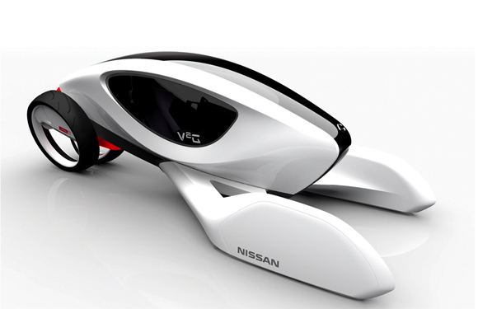
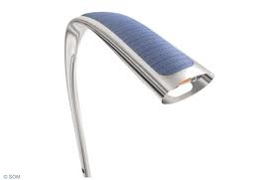
NORM SETTING :
INDUSTRIAL DESIGNS
THE STANDING COMMITTEE ON THE LAW OF TRADEMARKS, INDUSTRIAL DESIGNS AND GEOGRAPHICAL INDICATIONS (SCT)
  The SCT has substantially advanced work on the draft of a design law treaty
  The idea would be to have a design law treaty similar to the Patent Law Treaty and the Singapore Treaty
  A business simplification treaty will simplify and standardize the registration and ancillary procedures applied to industrial designs in different countries
  Final decision to convene a diplomatic conference for the adoption of the Design Law Treaty will be taken in June 2014

Slide 18
LATEST SCT SESSION (NOVEMBER 2013)
All the countries that took the floor in the latest SCT were in favor of convening a diplomatic conference for the adoption of the Design Law Treaty. Delegations however disagreed with respect to the conditions in order to do so:
  Technical assistance and capacity building to help implementing the new treaty:
    For a large number of delegations an agreement in the form of an article in the Treaty had to be reached prior to convening the DC.
    Other delegations considered that the SCT could already recommend to the GA the convening of a DC.
  A facilitator has been appointed for the next GA
Important SCT work is related to the protection of country names against registration or use of trademarks. This work is situated at the interface between private trademark rights and the interests of States to control the use and appropriation of their names..

Slide 19
BEYOND THE SCT
Beyond SCT: GA September 2013 decided on the convening of a Diplomatic Conference for the adoption of a Revised Lisbon Agreement on Appellations of Origin and Geographical Indications in 2015.

Slide 20
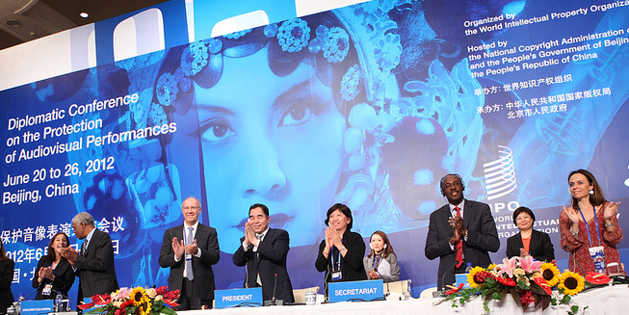
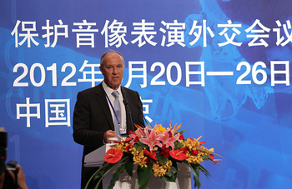
BEIJING TREATY ON AUDIOVISUAL
PERFORMANCES JUNE, 26 2012

Slide 21


BEIJING TREATY
The treaty on audiovisual performances was adopted on June 2012. The treaty will enter into force with 30 ratifications.
This treaty will strengthen the position of performers, giving them moral and economic rights for the international use of their performances.
Countries becoming party will pay for the use of foreign audiovisual performances. Some or all of this money will be going to performers.
« The conclusion of the Beijing Treaty is an important milestone toward closing the gap in the international rights system for audiovisual performers » WIPO Director General, Francis Gurry

Slide 22
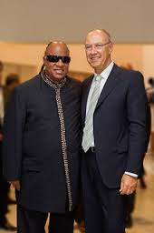
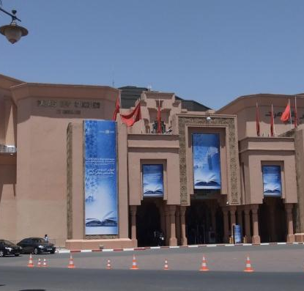
MARRAKESH TREATY TO FACILITATE ACCESS TO PUBLISHED WORKS FOR PERSONS WHO ARE BLIND, VISUALLY IMPAIRED OR OTHERWISE PRINT DISABLED

Slide 23

MARRAKESH TREATY
The Diplomatic Conference took place in Marrakesh from June 18 to 28, 2013 (600 negotiators from WIPO’s 186 member states)
There are more than 285 million blind and VIP- 90 % living in developing countries.
Only 5 % of the books published are available in braille or other accessible formats.
Requires contracting parties to adopt limitations for the benefit the people who are blind, visually impaired, and print disabled.
It also provides for the exchange of accessible format works across borders.

Slide 24
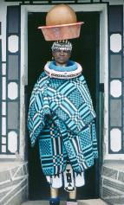
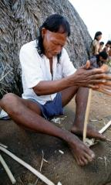
INTELLECTUAL PROPERTY AND
GENETIC RESOURCES, TRADITIONAL KNOWLEDGE
AND TRADITIONAL CULTURAL EXPRESSIONS
IGC: Created in 2000, the 26th session took place from February 3 to 7, 2014
Undertakes negotiations with the objective of reaching agreement on a text(s) of an international legal instrument(s) which will ensure the effective protection of traditional knowledge (TK), traditional cultural expressions (TCEs) and genetics resources (GRs)
Draft articles on TK and TCEs and a Consolidated Document Related to IP and GRs have been prepared

Slide 25

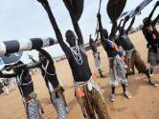
INTELLECTUAL PROPERTY AND
GENETIC RESOURCES, TRADITIONAL KNOWLEDGE
AND TRADITIONAL CULTURAL EXPRESSIONS
IGC’s MANDATE FOR 2014 – 2015:
  Continue to expedite work with open and full engagement on text-based negotiations
  Follow a clearly defined work program: three sessions of the IGC in 2014, including thematic and cross cutting/stocktaking sessions
  Build on existing work, in particular the existing draft texts
  Submit text(s) to the GA in 2014
2014 GENERAL ASSEMBLY
    Take stock
    Consider text(s) and progress made
    Decide on convening a Diplomatic Conference
    Consider need for additional meetings
Notes:
Toolkit for management for the management of IP interests in the documentation of TK
A guide for the Protection of Expressions of Traditional Culture
Survey of practical experience in legal protection of TK.
Information materials
Best practices reflecting international consensus on IP issues concerning TK, TCEs and genetic resources

Slide 26

MAJOR ECONOMIC STUDIES ON IP
A NEW WIPO UNIT – THE ECONOMICS AND STATISTICS DIVISION- REFLECTS THE GROWING CONSENSUS ON THE IMPORTANCE OF THE ECONOMIC DIMENSION OF IP.
THE DIVISION APPLIES STATISTIC AND ECONOMIC ANALYSIS TO THE USE OF WIPO SERVICES.
THIS NEW STRUCTURE ALSO IMPROVES WIPO ECONOMIC INSIGHT ON IP DEVELOPMENT.

Slide 27
STRATEGIC REALIGNMENT WITHIN WIPO
Economics and Statistics Division
WIPO Chief Economist
IP Statistics
Section
Data Development
Section
Economics
Section

Slide 28
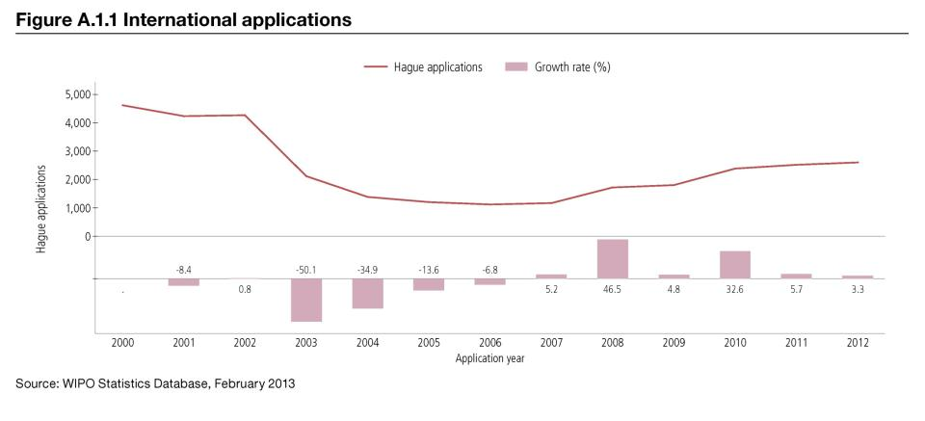
TREND IN HAGUE FILINGS (DESIGNS)

Slide 29
DEMAND FOR IP RIGHTS HAS GROWN
Source: WIPO Statistics Database, October 2011

Slide 30
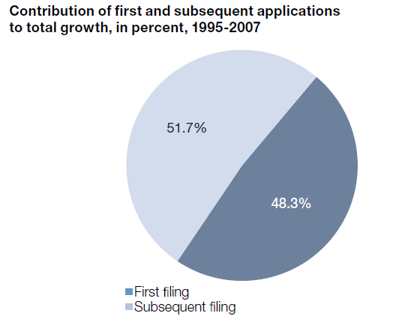
MORE INVENTIONS AND GREATER INTERNATIONALIZATION
Source: WIPO (2011)

Slide 31
STUDIES AND REPORTS
World Intellectual Property Indicators (WIPI): This is our flagship IP statistics publication. It provides an overview of latest trend in IP filings and registrations covering more than 100 offices : http://www.wipo.int/ipstats/en/wipi/index.html
The PCT Yearly Review provides an overview of the performance and development of the PCT system. It includes a comprehensive set of statistics for the latest available year See: http://www.wipo.int/ipstats/en/statistics/pct/
Madrid Yearly Review: http://www.wipo.int/ipstats/en/
Hague Yearly Review: http://www.wipo.int/ipstats/en/
The WIPO IP Facts and Figures provides an overview of intellectual property (IP) activity based on the latest available year of statistics. It serves as a quick reference guide for statistics: http://www.wipo.int/ipstats/en/
WIPO IP Statistics Data Center is an on-line service enabling access to WIPO’s statistical data. Users can select from a wide range of indicators and view or download data according to their needs: http://ipstatsdb.wipo.org/ipstatv2/ipstats/patentsSearch

Slide 32

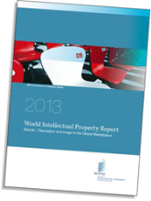
STUDIES AND REPORTS
II
New report « Brands – Reputation and Image in the Global Marketplace»
The report looks at how branding behavior and trademark use have evolved in recent history, how they differ across countries, what is behind markets for brands, what lessons economic research holds for trademark policy and how branding strategies influence companies’ innovation activities
For further information and the full report :
http://www.wipo.int/econ_stat/en/economics/wipr

Slide 33
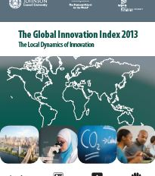
THE GLOBAL INNOVATION INDEX 2013
Annual publication that provides the latest trends in innovation activities across the world. It is co-published by INSEAD, Cornell Univ. and WIPO http://www.wipo.int/econ_stat/en/economics/gii/index.html
Its results are useful:
  To benchmark countries against their peers
  To study countries profiles over time
  Identify countries strengths and weaknesses

Slide 34
THE GLOBAL INNOVATION INDEX 2013
The framework is revised and adjusted every year in a transparent exercise
This year, out of 84 indicators, 64 are identical to GII 2012, and a total of 20 indicators were modified
10 indicators were deleted/replaced
10 indicators underwent changes such as the computation methodology at the source, change of scaling factor, change of classification etc.
The year per year comparison has to be carefully taken into consideration

Slide 35
GLOBAL INNOVATION INDEX FRAMEWORK
OUTPUT SUB INDEX
INPUT SUB INDEX
SCIENTIFIC OUTPUT
CREATIVE OUTPUT
HUMAN CAPITAL AND RESEARCH
INFRASTRUCTURE
MARKET SOPHISTICATION
BUSINESS SOPHISTICATION

Slide 36
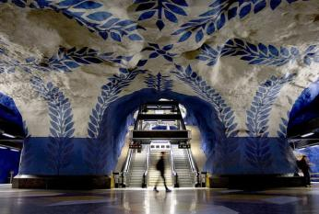
SWEDEN PROFILE
Very artistic subway in Stockholm, Sweden

Slide 37
THE GLOBAL INNOVATION INDEX
RANKING 2012
RANKING 2013
1. SWITZERLAND
2. SWEDEN
3. SINGAPORE
4. FINLAND
5. UNITED KINGDOM
6. NETHERLANDS
7. DENMARK
8. HONG KONG (CHINA)
9. IRELAND
10. UNITED STATES OF AMERICA
1. SWITZERLAND
2. SWEDEN
3. UNITED KINGDOM
4. NETHERLANDS
5. UNITED STATES OF AMERICA
6. FINLAND
7. HONG KONG (CHINA)
8. SINGAPORE
9. DENMARK
10. IRELAND

Slide 38
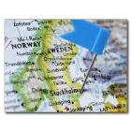

SWEDEN PROFILE
  Sweden is ranked 2nd in the Global Innovation Index
  Sweden is leading the rank within the Output sub-index category (3rd) due to the Knowledge & technology outputs where it has the 5th position. Sweden has also a leading position in the input sub-index (5th) due to proficiency in human capital and research (4th), infrastructure (2nd) and institutions (10th)
  Sweden stands high in the institution index. The political environment and its efficiency are its most valuable strength together with infrastructure
  Sweden’s strengths are also drawn from knowledge creation and intangible assets together with online creativity
  Sweden’s relative weaknesses are drawn from both Market and Business Sophistication with not a high score in the financial support from abroad in the research and development field

Slide 39
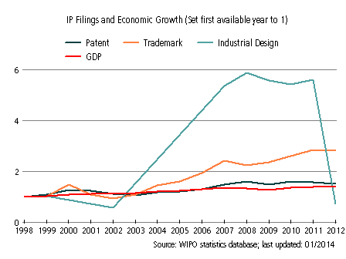
Sweden’s evolution with respect to IP filings and
Economic Growth from 1997 to 2012
The graphic shows a recent peak (2007) in industrial design’s filling, which is still growing strongly today. This is a sign of the strength of industrial designs in Sweden
The patent and trademark filings are also strong. This steady growth is a sign of Sweden’s reliance on IP for economic development.
Notes:
GDP : GROSS DOMESTIC PRODUCT

Slide 40
PATENT APPLICATION BY TOP FIELDS OF TECHNOLOGY (1997-2011)

Slide 41
INTERNATIONAL APPLICATIONS
VIA WIPO ADMINISTERED TREATIES
SWEDEN

Slide 42
THANK YOU!
Victor Vazquez
Head, Section for coordination of developed countries,
Department for Transition and Developed countries (TDC)
World Intellectual Property Organization (WIPO)
34 chemin des Colombettes, 1211 Geneva 20, Switzerland
T + 41 22 338 99 97; victor.vazquez-lopez@wipo.int ; www.wipo.int/dcea/en/roving_seminars.html
Notes:
Welcome ….
Today, we are going to explain to you, in very general terms,
what this Organization does and why?

Slide 43
THE PATENT COOPERATION TREATY
(PCT)
RECENT AND FUTURE DEVELOPMENTS
Speaker: Mr. Matthew Bryan, Director, PCT Legal Division, Innovation and Technology Sector (ITS)

Slide 44

THE PCT SYSTEM
(optional)
Supplementary international
search report
International
publication
(months)
0
12
16
18
19
22
28
30
File local
application
File PCT
application
International
search report & written opinion
(optional)
File
demand for
International
preliminary
examination
(optional)
International
preliminary report on patentability
(optional)
Request for supplementary international
search

Slide 45
CERTAIN PCT ADVANTAGES
The PCT, as the cornerstone of the international patent system, provides a worldwide system for simplified filing and processing of patent applications, which:
  1. postpones the major costs associated with internationalizing a patent application
  2. provides a strong basis for patenting decisions
  3. harmonizes formal requirements
  4. protects applicant from certain inadvertent errors
  5. evolves to meet user needs
  6. is used by the world’s major corporations, universities and research institutions when they seek international patent protection

Slide 46
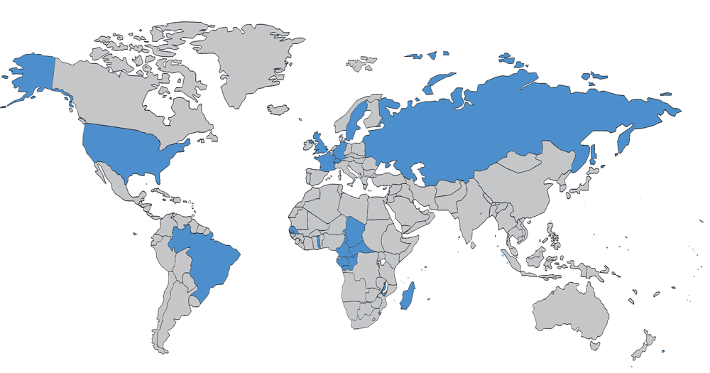
THE PCT IN 1978

Slide 47
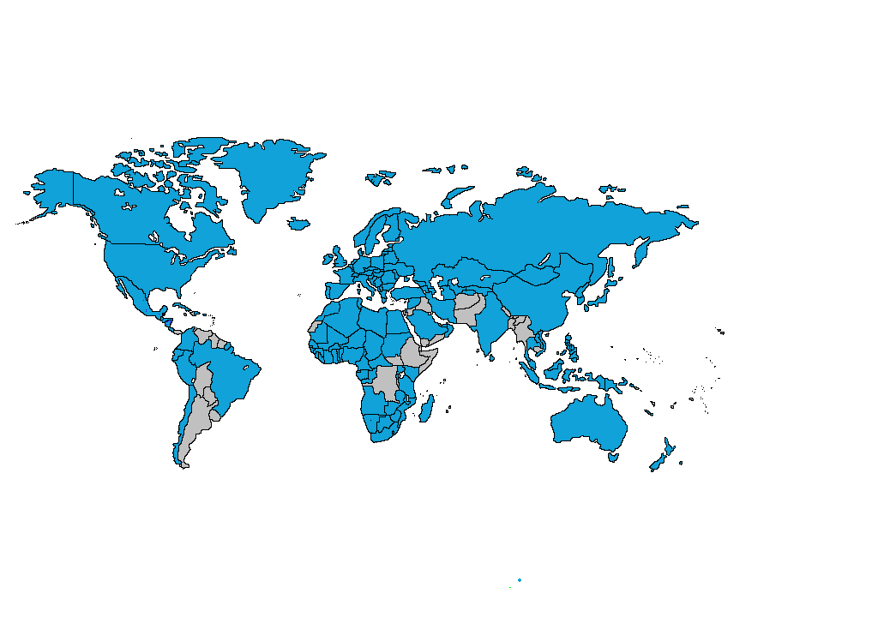
PCT COVERAGE TODAY

Slide 48

148 PCT STATES
=PCT
Albania
Algeria
Angola
Antigua and Barbuda
Armenia
Australia
Austria
Azerbaijan
Bahrain
Barbados
Belarus
Belgium
Belize
Benin
Bosnia and Herzegovina
Botswana
Brazil
Brunei Darussalam
Bulgaria
Burkina Faso
Cameroon
Canada
Central African Republic
Chad
Chile
China
Colombia
Comoros
Congo
Costa Rica
Côte d'Ivoire
Croatia
Cuba
Cyprus
Czech Republic
Democratic People's
Republic of Korea
Denmark
Dominica
Dominican Republic
Ecuador
Egypt
El Salvador
Equatorial Guinea
Estonia
Finland
France,
Gabon
Gambia
Georgia
Germany
Ghana
Greece
Grenada
Guatemala
Guinea
Malawi
Malaysia
Mali
Malta
Mauritania
Mexico
Monaco
Mongolia
Montenegro
Morocco
Mozambique
Namibia
Netherlands
New Zealand
Nicaragua
Niger
Nigeria
Norway
Oman
Panama
Papua New Guinea
Peru
Philippines
Guinea-Bissau
Honduras
Hungary
Iceland
India
Indonesia
Iran (Islamic Republic of)
Ireland
Israel
Italy
Japan
Kazakhstan
Kenya
Kyrgyzstan
Lao People’s Dem Rep.
Latvia
Lesotho
Liberia
Libyan Arab Jamahiriya
Liechtenstein
Lithuania
Luxembourg
Madagascar
Poland
Portugal
Qatar
Republic of Korea
Republic of Moldova
Romania
Rwanda
Russian Federation
Saint Lucia
Saint Vincent and
the Grenadines
San Marino
Sao Tomé e Principe
Saudi Arabia
Senegal
Serbia
Seychelles
Sierra Leone
Singapore
Slovakia
Slovenia
South Africa
Spain
Sri Lanka
Sudan
Swaziland
St. Kitts and Nevis
Sweden
Switzerland
Syrian Arab Republic
Tajikistan
Thailand
The former Yugoslav
Republic of Macedonia
Togo
Trinidad and Tobago
Tunisia
Turkey
Turkmenistan
Uganda
Ukraine
United Arab Emirates
United Kingdom
  United Republic of Tanzania
  United States of America
Uzbekistan
Viet Nam
Zambia
Zimbabwe
Notes:
48

Slide 49
COUNTRIES NOT YET IN PCT
Afghanistan
Andorra
Argentina
Bahamas
Bangladesh
Bhutan
Bolivia
Burundi
Cambodia
Cape Verde
Democratic Republic of Congo
Djibouti
Eritrea
Ethiopia
Fiji
Guyana
Haiti
Iraq
Jamaica
Jordan
Kiribati
Kuwait
Lebanon
Maldives
Marshall Islands
Mauritius
Micronesia
Myanmar
Nauru
Nepal
Pakistan
Palau
Paraguay
Samoa
Solomon Islands
Somalia
South Sudan
Suriname
Timor-Leste
Tonga
Tuvalu
Uruguay
Vanuatu
Venezuela
Yemen
(45)

Slide 50
PCT APPLICATIONS
2012: 194,400 PCT applications (+6.6%)
Forecasting +4% in 2013 (more than 200,000—all-time high)

Slide 51
TRENDS IN PCT FILING

Slide 52
INTERNATIONAL APPLICATIONS RECEIVED IN 2012 BY COUNTRY OF ORIGIN
Top 15 countries responsible for 92.7% of IAs filed in 2012

Slide 53
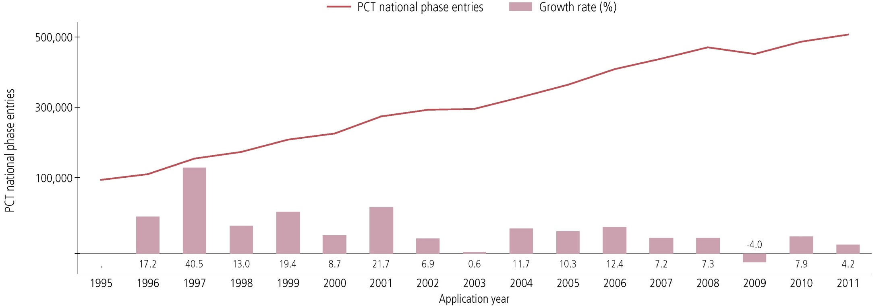
PCT NATIONAL PHASE ENTRIES—TOTAL
507,400 national phase entries estimated in 2011 (+ 4.2%)
431,800 (about 85%) of NPEs are from non-resident applicants

Slide 54
PARIS ROUTE VS. PCT NATIONAL PHASE
*

Slide 55
TOP PCT APPLICANTS 2012
ZTE Corporation—CN (3906)*
Panasonic—JP (2951)
Sharp—JP (2001)
Huawei—CN (1801)
Bosch—DE (1775)
Toyota—JP (1652)
Qualcomm—US (1305)
Siemens—DE (1272)
Philips—NL (1230)
Ericsson—SE (1197)
LG Electronics—KR (1094)
Mitsubishi Electric—JP (1042)
NEC—JP (999)
Fujifilm Corporation (891)
Hitachi—JP (745)
Samsung Electronics—KR (683)
Fujitsu—JP (671)
Nokia—FI (670)
BASF—DE (644)
Intel—US (640)
*Almost 18 IAs/working day
() of published
PCT applications

Slide 56
TOP UNIVERSITY PCT APPLICANTS 2012
University of California (US)
MIT (US)
Harvard University (US)
Johns Hopkins (US)
Columbia University (US)
University of Texas (US)
Seoul National University (KR)
Leland Stanford University (US)
Peking University (CN)
University of Florida (US)
Cal Tech (US)
Korea Advanced Institute of Science and Technology (KR)
Cornell University (US)
University of Tokyo (JP)
Yonsei University (KR)
Isis Innovation Limited (GB)
Tsinghua University (CN)
Kyoto University (JP)
University of Michigan (US)
Purdue University (US)

Slide 57
TOP GOVERNMENT/RESEARCH INSTITUTION PCT APPLICANTS 2012
Commissariat a l’Energie Atomique et aux Energies Alternatives (France)
Fraunhofer-Gesellschaft zur Forderung Der Angewandten Forschung e.v. (Germany)
Centre National de la Recherche Scientifique (CNRS) (France)
China Academy of Telecommunications Technology
Institute of Microelectronics of Chinese Academy of Sciences (China)
Mimos Berhad (Malaysia)
Institut National de la Sante et de la Recherche Medicale (INSERM) (France)
Electronics & Telecommunications Research Institute of Korea
Agency of Science, Technology and Research (Singapore)
Consejo Superior de Investigaciones Cientificas (CSIC) (Spain)
United States of America, represented by the Secretary, Department of Health and Human Services
National Institute of Advanced Industrial Science and Technology (Japan)
Council of Scientific and Industrial Research (India)
Korea Research Institute of BioScience and Biotechnology
Nederlandse Organisatie voor Toegepast-Natuurwetenschappelijk Onderzoek Tno (Netherlands)
Max Plank Institute (Germany)

Slide 58
SOME SWEDISH PCT APPLICANTS
ERICSSON
ASTRAZENECA
SCANIA
HUSQVARNA
AKTIEBOLAGET
VOLVO

Slide 59
PCT INTERNATIONAL SEARCHING AUTHORITIES
The ISAs are the following 19 offices:
  Australia
  Austria
  Brazil
  Canada
  Chile (not yet operating)
  China
  Egypt
  Finland
  India
  Israel
  Japan
  Republic of Korea
  Russian Federation
  Spain
  Sweden
  Ukraine (not yet operating)
  United States of America
  European Patent Office
  Nordic Patent Institute

Slide 60
RECENT PCT DEVELOPMENTS
America Invents Act (AIA) Simplification for PCT
3rd Party Observation system
Indication of availability for license
ePCT
PCT-PPH
WIPO AMC fee reduction for PCT users
Misleading invitations
PCT Working Group 2013

Slide 61
AIA SIMPLIFICATION FOR PCT
US national law changes which entered into force on 16 September 2012 had the effect of simplifying use of the PCT
  Related PCT Rule changes were adopted by the PCT Assembly in October 2012 and entered into force on 1 January 2013
PCT applications can be filed in the name of a corporate applicant for all designated States, including the US
  Only declarations of inventorship (PCT Rule 4.17(iv)) complying with new standardized wording (Section 214 PCT/AIs) will be accepted by DO/US
  The request form (PCT/RO/101) and PCT-SAFE software were modified accordingly

Slide 62
3RD PARTY OBSERVATION SYSTEM
Allows third parties to submit prior art observations relevant to novelty and inventive step as to published PCT applications
  Goal: Improve patent quality--give national offices (and PCT Authorities) better/more complete information on which to base their decisions
Web-based system using in PATENTSCOPE or via ePCT public services
Free-of-charge
Submissions possible until the expiration of 28 months from the priority date
Applicants may submit comments in response to submitted observations until the expiration of 30 months from the priority date
Anonymous submission of third party observations possible

Slide 63
INDICATION OF AVAILABILITY FOR LICENSE
PCT applicants can indicate in relation to their published applications that the invention is available for license
  How? Applicants may submit a “licensing request” (see PCT Form PCT/IB/382) directly to the IB
  When? At the time of filing or within 30 months from the priority date
  Free of charge
  Applicants can file multiple licensing requests or update previously submitted ones (within 30 months from the priority date) and such requests may be revoked by the applicant at any time, that is, also after 30 months from the priority date
Submitted licensing indications made publicly available after international publication of the application on PATENTSCOPE under “Bibliographic data” tab with a link to the submitted licensing request itself
International applications containing such licensing indication requests can be searched in PATENTSCOPE
Most use thus far from universities/research institutions

Slide 64
ePCT
WIPO online service that provides secure electronic access to/interaction with IB’s PCT application files by applicants/agents
8500 users in over 100 countries, 30+ offices
Positive feedback from users
  applicant features generally reckoned best in class
  unique notifications feature already saved applicants
  Office features found easy to use
More information: https://pct.wipo.int/ePCT
ePCT-Filing: web-based electronic filing of new PCT applications
  Currently available live for filings with RO/IB, RO/AT & RO/SE; awaiting other ROs
  We believe if has even better validations than PCT-SAFE, including up-to-date validation direct from IB database, and validations and feedback not possible with PCT-SAFE (such as automatically detecting and converting color drawings to B/W)

Slide 65
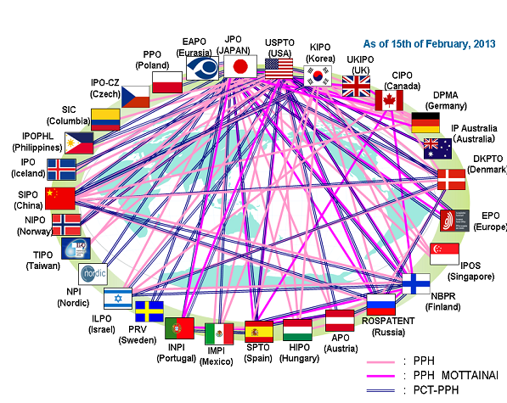
PCT-PPH (1)
Accelerated national phase examination based on positive work product of PCT International Authority (written opinion of the ISA or the IPEA, IPRP (Ch I or II)
MANY individual PCT-PPH pathways
    Information on the PCT Website: http://www.wipo.int/pct/en/filing/pct_pph.html
    PCT-PPH user experience/strategy: http://www.youtube.com/watch?v=XnSShsUHXss (Carl Oppedahl video)

Slide 66
PCT-PPH (2)
 | JP | US | KR | CA
Grant rate | 93 (69) | 88 (53) | 85.9 (65.6) | 100 (65)
1st action allowance rate | 65 (15) | 19.3 (15.2) | 16.8 (10.7) | 61 (5.1)
Average Pendency from PPH Request to First Office Action {months} | 2.3 (16) | 5.6 (18.8) | 3.4 (14.8) | 2.25 (17.8)
Average Pendency from PPH Request to Final Decision {months} | 4.0 (25) | 9.9 (30.7) | 6.3 (21.6) | 3.7 (35.6)
Average Number of Office Actions | 0.43 (1.1) | TBD (2.5) | 0.8 (1.5) | 0.5 (1.5)
See http://www.jpo.go.jp/ppph-portal/statistics.htm
() = all applications (PPH and non-PPH)

Slide 67
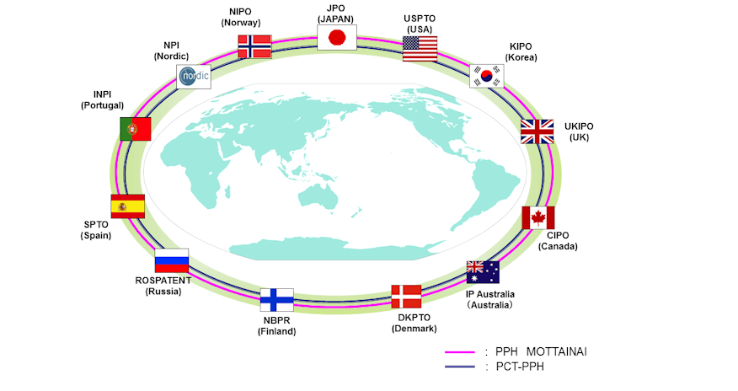
PCT-PPH (3)
Global Patent Prosecution Highway (GPPH) pilot began 6 January 2014, using single set of qualifying requirements, and includes PCT reports
Framework provisions: http://www.jpo.go.jp/ppph-portal/globalpph.htm

Slide 68
WIPO AMC fee reduction for PCT users
AMC=WIPO Arbitration and Mediation Center
  AMC offers a 25% reduction in the Center’s registration and administration fees where at least one party to the dispute has been named as an applicant or inventor in a published PCT application
Type of fee | Amount in dispute | Expedited Arbitration | Arbitration
Registration fee | Any amount | USD 1,000 | USD 2,000
Administration fee | Up to 2.5M | USD 1,000 | USD 2,000
 | Over 2.5M and up to 10M | USD 5,000 | USD 10,000
 | Over 10M | USD 5,000 +0.05% of amount over $10M up to a maximum fee of $15,000 | USD 10,000 +0.05% of amount over $10M up to a maximum fee of $25,000
Type of fee | Mediation
Administration fee | 0.10% of the value of the mediation, subject to a maximum of USD 10,000

Slide 70
WIPO warnings
http://www.wipo.int/pct/en/warning/pct_warning.html
WIPO continues various efforts concerning such notifications, including:
  keeping the warning page up to date with newly submitted examples
  WIPO letters to offices requesting assistance and cooperation
  WIPO letters to IP associations requesting that all clients be warned
  WIPO letters to banks doing business with the entities behind these notifications
  working with government agencies in countries where these entities are based
Help us by making complaints to appropriate consumer protection authorities in your country and/or state/locality

Slide 72
PCT WORKING GROUP MAY 21-24, 2013
Mandatory response to negative comments in the national phase (PCT/WG/6/16)
Formal integration of PPH into PCT (PCT/WG/6/17)
Mandatory recordation of search strategies (PCT/WG/6/?)
Requirements and procedures of appointment of International Authorities (PCT/WG/6/4)
PCT Fee Reductions (PCT/WG/6/10)
PCT Minimum Documentation (PCT/WG/6/9)
PCT Sequence Listing Standard (PCT/WG/6/7)
Other USPTO/UK “20/20” proposals:
  Self-service 92bis changes and priority claim corrections
  Limited Chapter I corrections to claims
  Simplified withdrawal without signatures within limited period
  Formally integrate collaborative search into PCT
  Incorporate Global Dossier into PCT

Slide 73
FUTURE PCT DEVELOPMENTS
New Rules—July 2014
ePCT further improvements
PCT/WG 2014
Collaborative search

Slide 74
NEW RULES—JULY 2014
2 sets of amendments approved by PCT Assembly 2013
  Amend PCT Rules 66 and 70 to require IPEAs to conduct top-up searches during IPE
  Delete PCT Rule 44ter and amend PCT Rule 94 to make WO/ISA available to the public via PATENTSCOPE at international publication
  These amendments to the PCT Regulations will enter into force July 1, 2014, for demands for IPE filed on or after that date, and for applications filed on or after that date, respectively

Slide 75
EPCT: FURTHER IMPROVEMENTS
Aiming for fully hosted RO service by end 2014
Multilingual interface (eventually 10 languages)
Extension of ePCT to interested Offices in their various capacities (RO, ISA, SISA, IPEA, DO, EO)
Goal to offer centralized real-time credit card transactions for all fee types and all authorities
National phase entry function could be added to ePCT
  Opt-in for DOs
  Applicant would select from among participating DOs, upload any necessary documents and add any bibliographic data not already available to IB
  Local counsel could be fully involved, as needed
  Positive reaction during an initial discussion at Feb. 2013 IP5 meeting

Slide 76
PCT/WG 2014
Review of revised US/UK “20/20” proposals
  Limited Ch. I amendments
  Self-service changes
  Simplifying withdrawal
  Mandatory response to negative written opinion
  Formal PCT integration of PPH
  International/national phase linkage
  National phase fee reductions
Collaborative international search
Colour drawings
Notes:
76

Slide 77
COLLABORATIVE PCT SEARCH
PCT past discussions
  PCT Collaborative Search (and Examination) were important elements of initial “PCT Roadmap” proposal presented at the 2009 PCT WG
  Most recent status reports at 2013 PCT MIA (PCT/MIA/20/4) and 2013 PCT WG (PCT/WG/6/22 Rev.)
2nd IP5 pilot
  In very large % of pilot cases (from 40% to almost 90%), collaboration between examiners resulted in new citations in ISR
  In vast majority of pilot cases, examiners perceived significant improvement in quality as a result of collaboration, and would trust search and examination results produced via collaboration in national/regional phases
Notes:
77

Slide 78
PCT TRAINING OPTIONS
New: 29 video segments on WIPO’s YouTube channel and WIPO’s PCT page about individual PCT topics
PCT Distance learning course content available in the 10 PCT publication languages
PCT Webinars
  providing free updates on developments in PCT procedures, and PCT strategies—previous webinars are archived and freely available
  upon request also for companies or law firms, for example, for focused training on how to use ePCT
In-person PCT Seminars and training sessions

Slide 79
PCT RESOURCES/INFORMATION
For further information about the PCT, see
http://www.wipo.int/pct/en/
For general questions about the PCT, contact the PCT Information Service at:
Telephone: (+41-22) 338 83 38
Facsimile: (+41-22) 338 83 39
E-mail: pct.infoline@wipo.int
matthew.bryan@wipo.int

Slide 80
GLOBAL IP SYSTEMS: THE MADRID SYSTEM &
THE HAGUE SYSTEM
Speaker: Mrs. Debbie Roenning, Legal Division, Madrid Registry, Brands and Designs Sector

Slide 81
The Madrid System:
The International Trademark System

Slide 82
ROUTES FOR PROTECTING A TRADEMARK
The national route: Filing trademark application with the Trademark Office of each country in which protection of the mark is sought
The regional route: Apply for protection in countries which are members of a regional trademarks registration system with effect in the territories of all Member States (ARIPO, Benelux Trademark Office, OHIM and OAPI)
The international route: The Madrid System

Slide 83
THE MADRID SYSTEM
A centralized filing mechanism
A one-stop shop for trademark holders to obtain and maintain trademark protection in export markets
An option to the national route
A purely procedural treaty
The domestic legislations of the designated Contracting Parties set the conditions for protecting a trademark and determine the rights which result from protection

Slide 84
THE MEMBERS OF THE MADRID SYSTEM
1 Agreement only
37 Protocol only (including EU)
54 Agreement and Protocol
92 Members

Slide 85
ACCESSIONS
Significant geographical expansion of the Madrid system
2012: The Philippines, Colombia, New Zealand and Mexico
2013: India, Rwanda and Tunisia (October 16, 2013)
Future accessions?
  Latin American countries
  ASEAN countries by 2015
  Caribbean countries
  African countries

Slide 86
KEY PRINCIPLES OF THE MADRID SYSTEM (1)
Entitlement and Basic Mark:
To use the Madrid system, you need a connection with a Contracting Party (CP), like establishment, domicile or nationality, and a mark applied for or registered (basic mark) with that CP (Office of origin)
One to many relationship:
File a single international application through the Office of origin for a single international registration (IR) in which one or more Contracting Parties (CP) are designated
Renewal:
Every 10 years

Slide 87
KEY PRINCIPLES OF THE MADRID SYSTEM (2)
Fixed time limit for refusal:
A CP will need to refuse protection within 12/18 months, otherwise the mark will be deemed protected
“Bundle of rights”:
If no refusal is issued, the resulting IR has the effect of a grant of protection in each designated CP
Extending the geographical protection:
Additional countries may later be included in the IR by subsequent designation

Slide 88
THE INTERNATIONAL PROCEDURE
Office of Origin
Designated Contracting Party
Designated Contracting Party
Designated Contracting Party
WIPO
Applicant
Certifies the application and forwards it to WIPO
Conducts the formal examination; records the mark in the International Registry and publishes the international registration in the Gazette. Issues a certificate of registration and notifies the designated Contracting Parties
Entitlement
Basic Mark
Scope of protection of the international registration will be determined by the substantive examination under domestic law, within 12/18 months

Slide 89
THE MADRID SYSTEM – FACTS AND FIGURES
Worldwide trademark filings + 9.3% from 2008 to 2011
2012 + 4.1% growth in applications
2013 + 6.4% growth in applications
Received 46,829 international applications
Over 578,320 international registrations in force
5.61 million designations in force
191,759 holders of international registrations

Slide 90
GENERAL PROFILE 2013
44,414 International Registrations
Average Number of Designations | 6.89
Average Number of Classes | 2.46
Average Fee | CHF 3,038
All Fees | 68% < 3,000 CHF
Notes:
90

Slide 91
TOP 5 CONTRACTING PARTIES: DESIGNATIONS IN IRS (COUNTRY OF THE HOLDER)

Slide 92
IRS BY OFFICE OF ORIGIN – NORDIC COUNTRIES

Slide 93
DESIGNATIONS IN IRS: SWEDEN AS COUNTRY OF THE HOLDER
Total: 1.830

Slide 94
TOP 5 DESIGNATED CONTRACTING PARTIES

Slide 95
DESIGNATIONS OF NORDIC COUNTRIES

Slide 96
DESIGNATIONS IN IRS: SWEDEN AS DCP

Slide 97
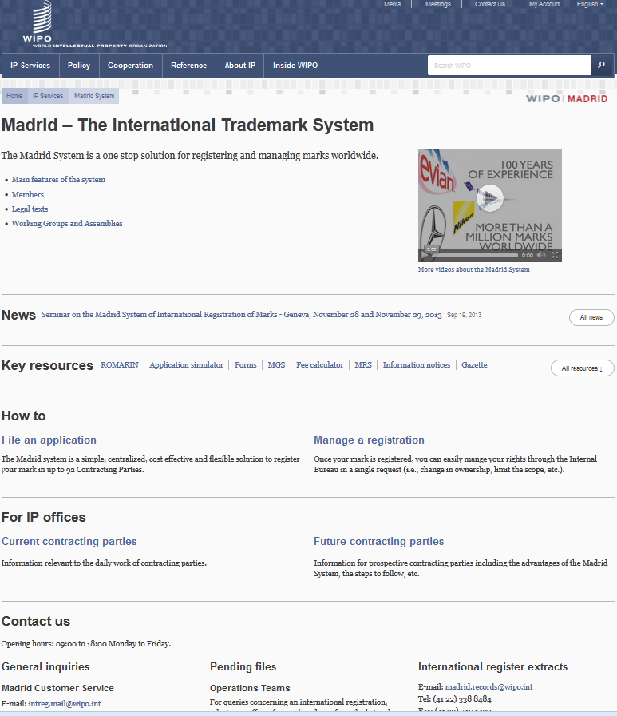

Slide 98
ONLINE INFORMATION SERVICES
Legal texts, Guide and Information Notices
WIPO Gazette of International Marks
E-Renewal Tool
Fee Calculator: Costing service
ROMARIN: On-line search database
Dynamic Madrid Statistics
free access at http://www.wipo.int/madrid/en/
Notes:
98

Slide 99
ONLINE TOOLS
Madrid Goods and Services Manager (MGS): To use correct specifications of goods and services
Madrid Real-Time Status (MRS): To inform of the status of an international application/registration
Madrid Portfolio Manager (MPM): To allow the holders and representatives to view and modify their portfolio
Madrid Electronic Alerts (MEA): To allow users to submit a list of IRs to monitor and to be informed by email when any of them change
Accessible from http://www.wipo.int/madrid/en/services/

Slide 100
RECENT DEVELOPMENTS
Webform: Online filing of subsequent designations
Moving towards a one treaty system
Revision of official forms and new publication

Slide 101
BENEFITS FOR TRADEMARK OWNERS
Simple and economical procedure
  A single set of simple formalities
  A single filing Office
  Low registration fees
  No need to pay foreign agents for filings
  No need to pay translation of the paperwork into several languages
Effective procedure
  A single international application produces the same legal effect in various countries
  A fixed deadline for the confirmation or refusal of the legal effects in each designated country
Notes:
101
101

Slide 102
THE HAGUE SYSTEM:
THE INTERNATIONAL DESIGN SYSTEM

Slide 103

IN A NUTSHELL
“The Hague Agreement provides creators and holders of designs with a simple, rapid and economical procedure to secure and maintain the protection of industrial designs, through a single international registration"

Slide 104
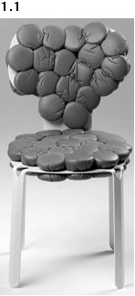
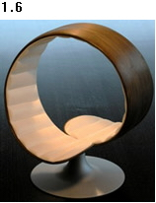
WIPO DIRECTOR GENERAL FRANCIS GURRY:
“Design is one of the principal means of differentiating a range of mass produced household and consumer items, such as chairs and tables, for which the technological possibilities for development have been exhausted.”
DM/075065 DM/076022
« Chair » « Chair »

Slide 105
THE HAGUE SYSTEM
A centralized filing mechanism
A closed system
A one-stop shop to obtain and maintain design protection in export markets
An option to the national route
A purely procedural treaty
The domestic legislations of the designated Contracting Parties set the conditions for protecting the design and determine the rights which result from protection
Notes:
105

Slide 106
MEMBERS OF THE HAGUE SYSTEM
46 Geneva Act (1999) (including EU and OAPI)
15 Hague Act (1960)
61 Contracting Parties

Slide 107
ACCESSIONS
2011: Finland, Monaco, Rwanda
2012: Montenegro, Tajikistan, Tunisia
2013: Brunei Darussalam (December 24, 2014)
Future accessions?
  China, Japan, Republic of Korea and USA
  Russian Federation and Belarus
  ASEAN countries by 2015
  Barbados and Trinidad & Tobago
  Madagascar and Morocco
Notes:
107

Slide 108
KEY PRINCIPLES OF THE HAGUE SYSTEM (1)
Entitlement:
To use the Hague system, you need a connection with a Contracting Party (CP), like establishment, domicile, nationality or habitual residence
One to many relationship:
File a single international application for a single international registration (IR) in which one or more Contracting Parties (CP) are designated (“self-designation“ is possible)
Renewal:
Duration: 5 years renewable. 15 years for the 1999 Act or possibly longer if allowed by designated CP

Slide 109
KEY PRINCIPLES OF THE HAGUE SYSTEM (2)
Possible deferment of up to 12 months:
Counted from date of filing or priority date
Fixed time limit for refusal:
Any refusal must be notified to the International Bureau within 6 or 12 months from the publication of the international registration on the WIPO website, otherwise the design will be deemed protected
“Bundle of rights”:
If no refusal is issued, the resulting IR has the effect of a grant of protection in each designated CP

Slide 110

FILING OPTIONS
Applicant
Applicant
Country A
Country B
Country C
Country A
Country B
Country C
Notes:
110

Slide 111
THE REGISTRATION PROCEDURE
Only formal examination in the International Bureau
  Recording in the International Register
  Publication in the International Designs Bulletin
  Notification to designated CPs through the publication
Substantive examination by the designated Contracting Parties only
  Refusal must be received in the International Bureau within a set time limit publication, 6 or 12 months

Slide 112
THE USE OF THE HAGUE SYSTEM IN 2013
2,990 international applications filed (13,172 designs)
2,734 international registrations recorded (12,806 designs)
Largest filers: Swatch AG, The Proctor and Gamble Company; Daimler AG, Volkswagen Aktiengesellschaft; Koninklijke Philips Electronics
Approximately 26,877 international registrations in force
    Equivalent to over 134,385 designations in force
    Involving 8,204 holders
    80% SMEs?
Notes:
112

Slide 113
GENERAL PROFILE 2013
2,734 International Registrations
Average Number of Designations | 3 to 5
Average Number of Designs | 4.68
Average Fee | Less than 1,000 CHF
All Fees | 79.2% < 2,000 CHF
Notes:
113

Slide 114
2013: TOP FILING CONTRACTING PARTIES
Contracting Party of entitlement:
1. European Union (5084 designs, 39.7%)
2. Switzerland (3529 designs, 27.6%)
3. Germany (1681 designs, 13.1%)
4. France (1284 designs, 10.0%)
5. Turkey (303 designs, 2.4%)
6. Liechtenstein (166 designs, 1.3%)
7. Norway (149 designs, 1.2%)
8. Spain (103 designs, 0.8%)
9. Singapore (76 designs, 0.6%)
10. Bulgaria (76 designs, 0.6%)

Slide 115
DESIGNS IN IR: TOP ORIGINS 2013

Slide 116
2013: MOST DESIGNATED CONTRACTING PARTIES
Number of designs recorded:
1. European Union (10178 designs, 79.5%)
2. Switzerland (9287 designs, 72.5%)
3. Turkey (5993 designs, 46.8%)
4. Norway (3152 designs, 24.6%)
5. Ukraine (2911 designs, 22.7%)
6. Singapore (2639 designs, 20.6%)
7. Morocco (1932 designs, 15.0%)
8. Croatia (1884 designs, 14.7%)
9. Monaco (1724 designs, 13.5%)
10. Liechtenstein (1706 designs, 13.3%)

Slide 117
LATEST DEVELOPMENTS
Weekly publication cycle since January 2012
Enhancement of the E-filing interface as from June, 2013
  A WIPO User account
  Facilitated downloading of reproductions
  Automatic check and transformation of images
  Integrated fee calculator
  Payment of fees by credit card

Slide 118
ADVANTAGES
The Hague System is cost-effective and efficient, thereby creating opportunities that would not otherwise exist for any enterprise with a limited legal budget
It is flexible affording right holders great flexibility in targeting national, regional or global markets for particular goods
The centralized acquisition and maintenance of industrial design rights by filing a single international application for a single international registration with effect in one or more designated Contracting Parties

Slide 119
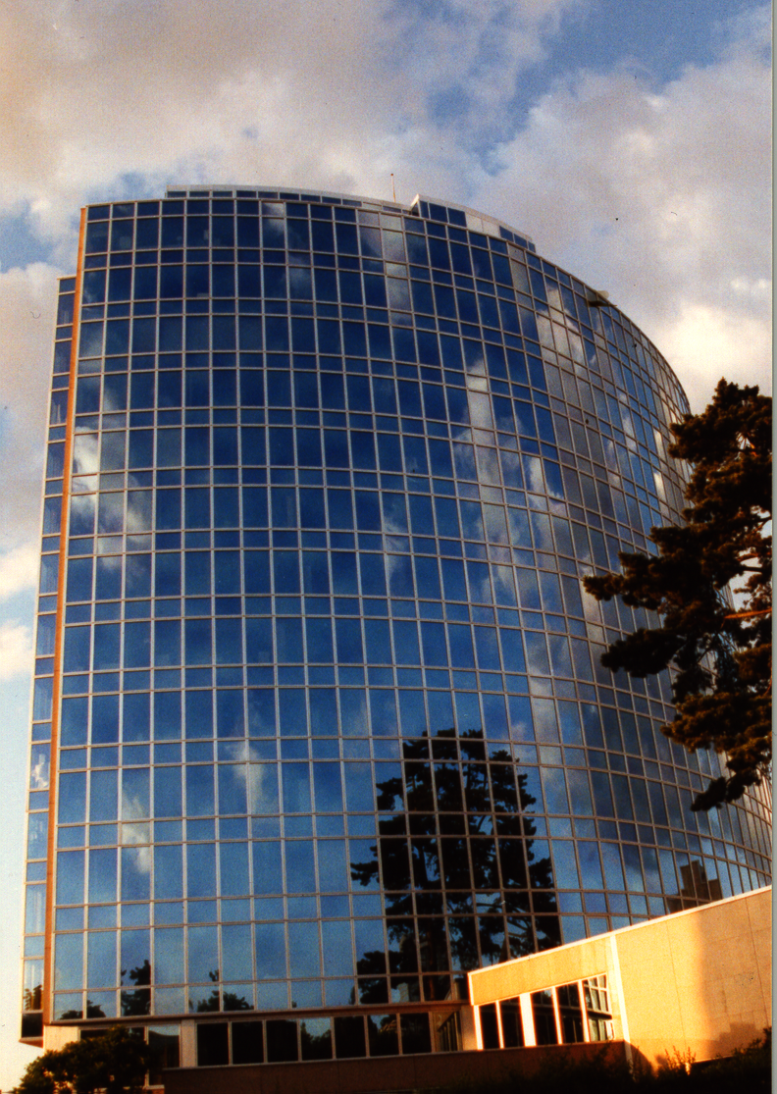
Thank you
for your attention
debbie.roenning@wipo.int

Slide 120
GLOBAL DATABASES FOR IP PLATFORMS AND
TOOLS FOR THE CONNECTED KNOWLEDGE ECONOMY
Speaker: Christophe Mazenc, Head, Global Databases Service, Global Infrastructure Sector

Slide 121
STRATEGIC GOALS OF GLOBAL DATABASES AND TOOLS
2 related goals:
  “Coordination and Development of Global IP Infrastructure”
  “World Reference Source for IP Information and Analysis”

Slide 122
BENEFITS TO STAKEHOLDERS
For Business/Research:
  Providing search facilities for IP collections (patents, trademarks, industrial designs)
  Simplifying application procedures to multiple IP authorities
  Providing IP related matchmaking services
For IP offices:
  Assisting automation, IP information dissemination to the public, and exchange of IP documents with other offices

Slide 123
GLOBAL DATABASES, TOOLS, AND PLATFORMS FOR IP BUSINESS (FREE)
PATENTSCOPE
Global Brand Database
WIPO Lex
WIPO IPAS, WIPO DAS
WIPO CASE
WIPO RE:SEARCH
WIPO GREEN

Slide 124
PATENTSCOPE
2.4 million PCT data (first publish every week, high quality full text)
35 million records from 36 countries or regions
Full text data from 18 countries or regions
15,000 pageviews per hour
Analyze results by graphs and charts
Search and read in your language
How to use it?

Slide 125
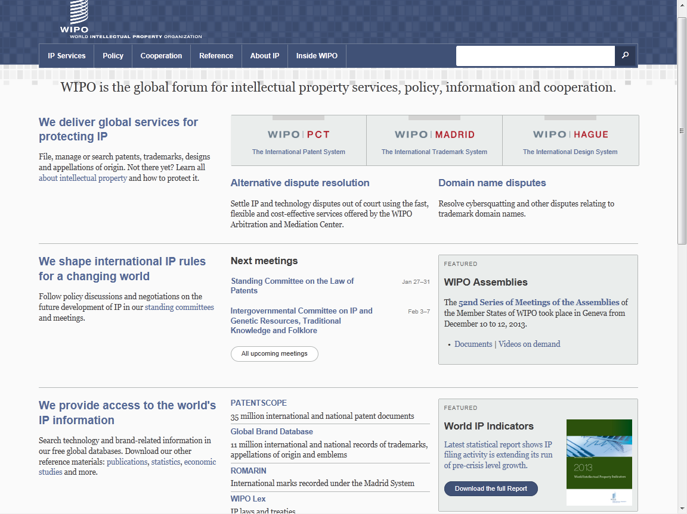
www.wipo.int

Slide 126
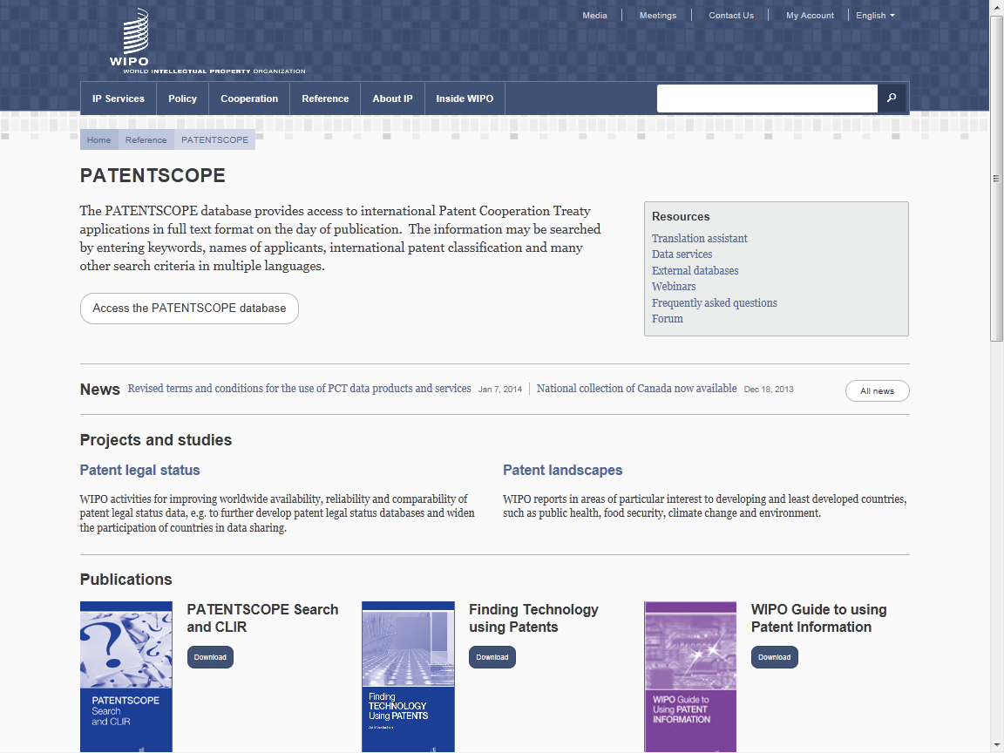

Slide 127
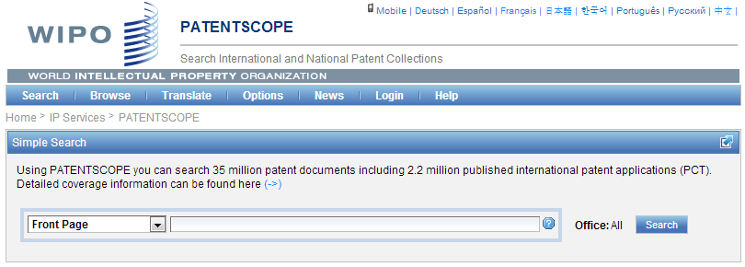
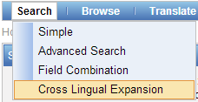

Slide 128
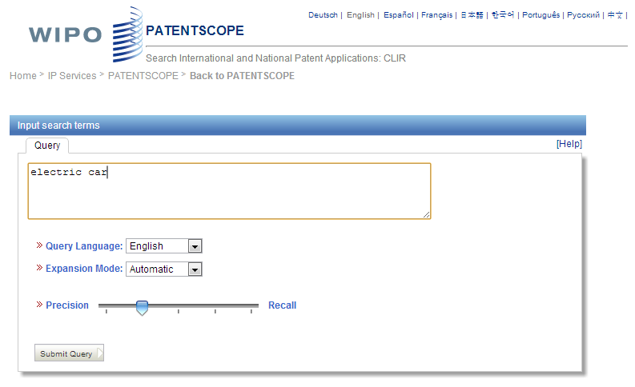

Slide 129
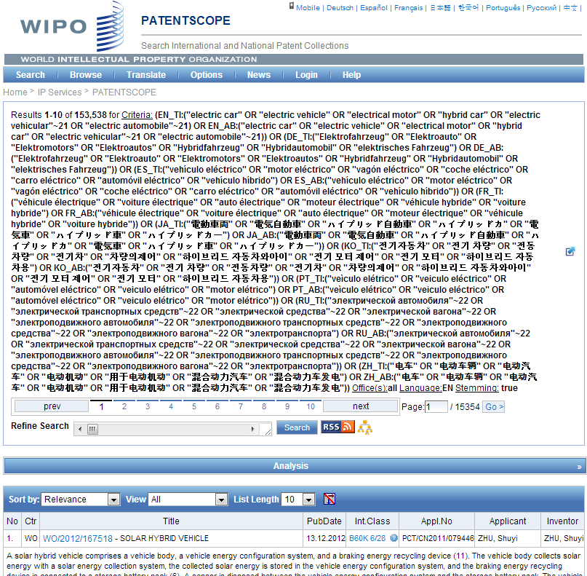

Electric car - only 16,000 hits
Search Query
(synonyms & technologically related terms)

Slide 130
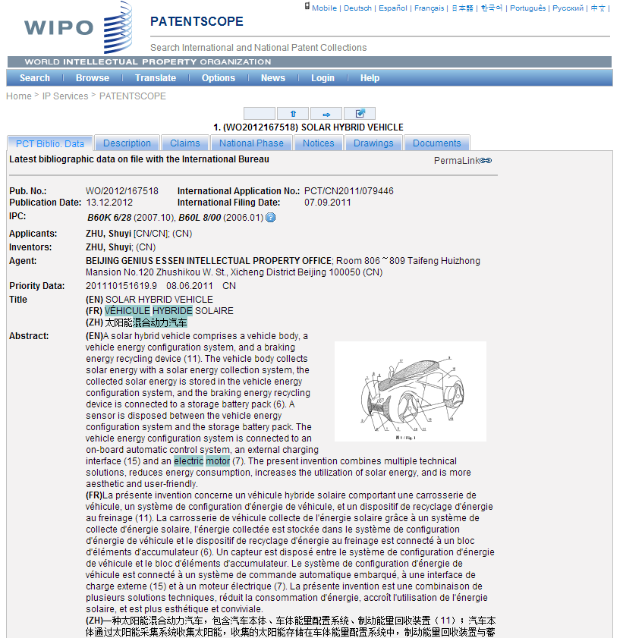

Slide 131
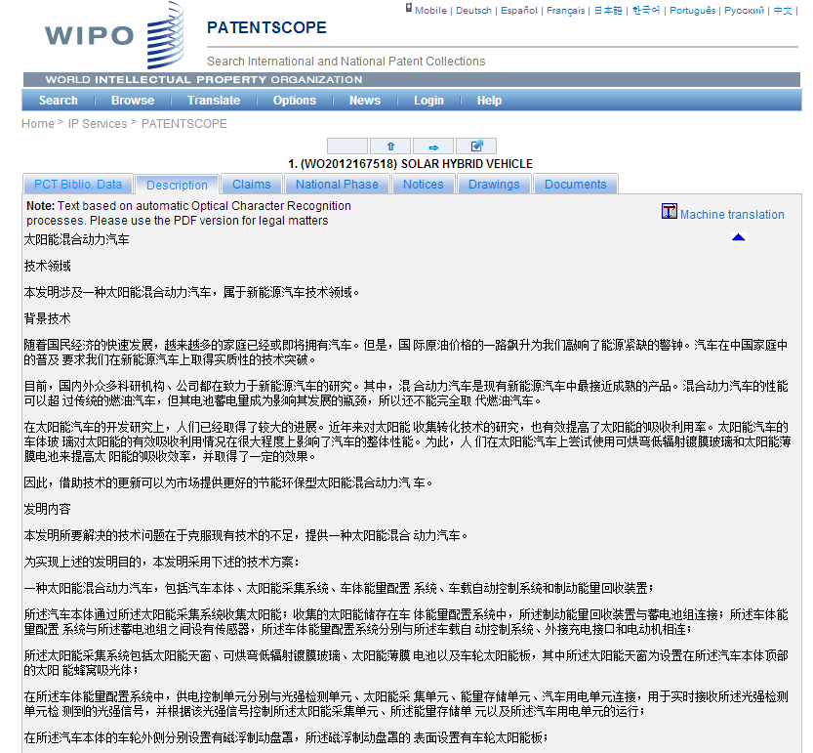
???

Slide 132
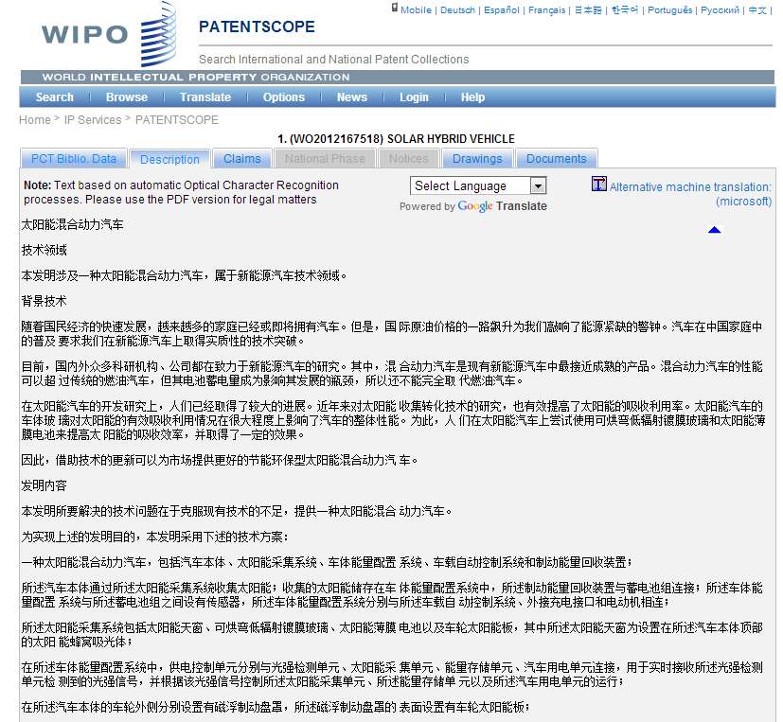

Slide 133
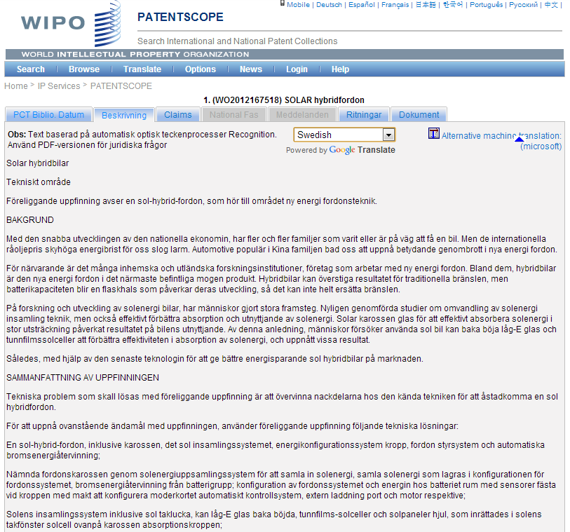

Slide 134
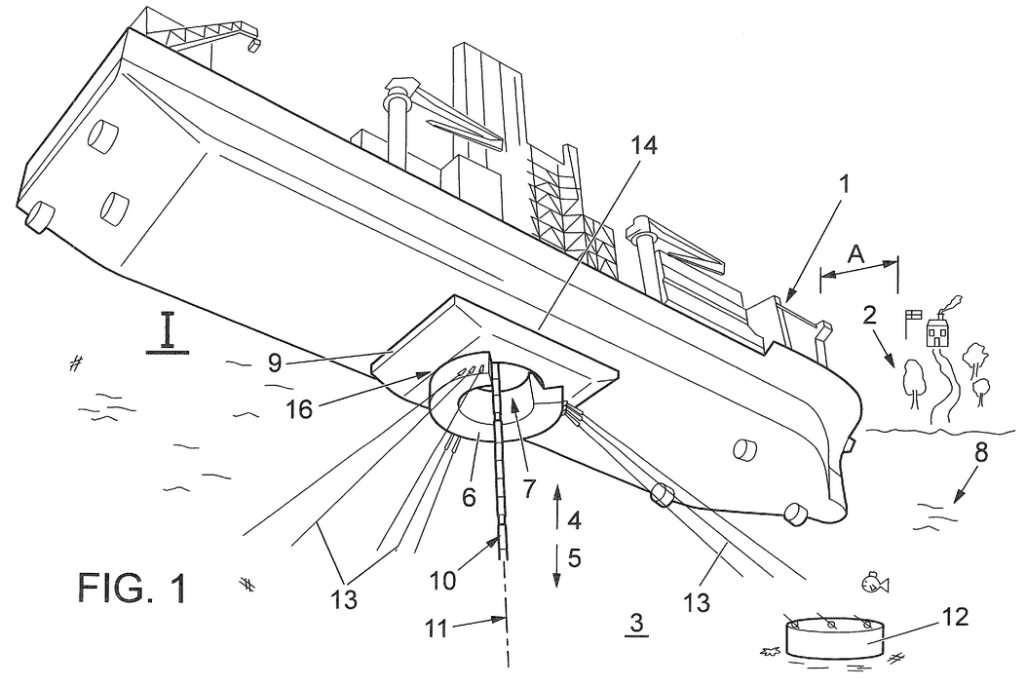
What if you do not know a term in English?

Slide 135
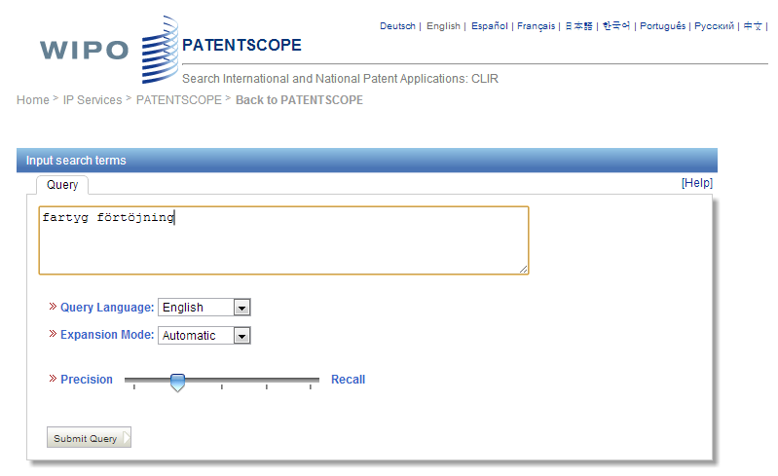
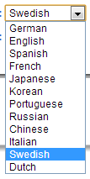

Slide 136
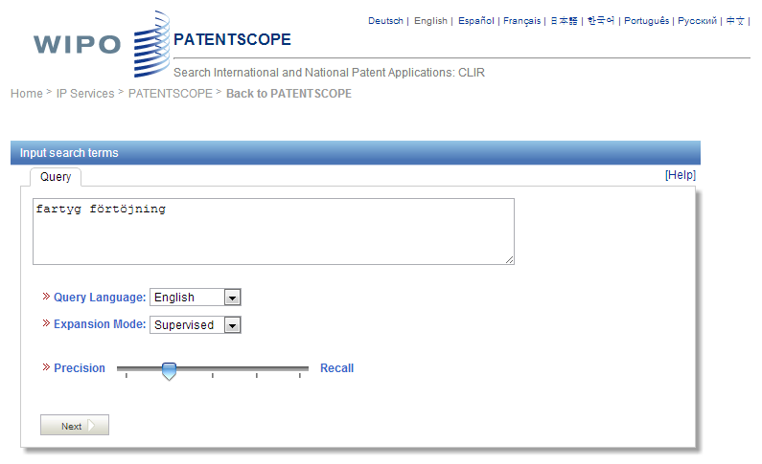


Slide 137
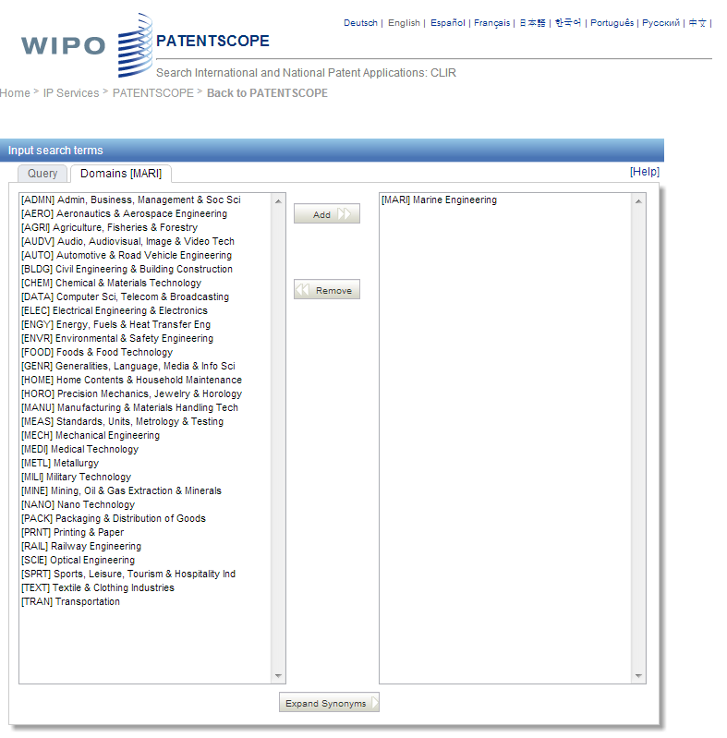

Slide 138
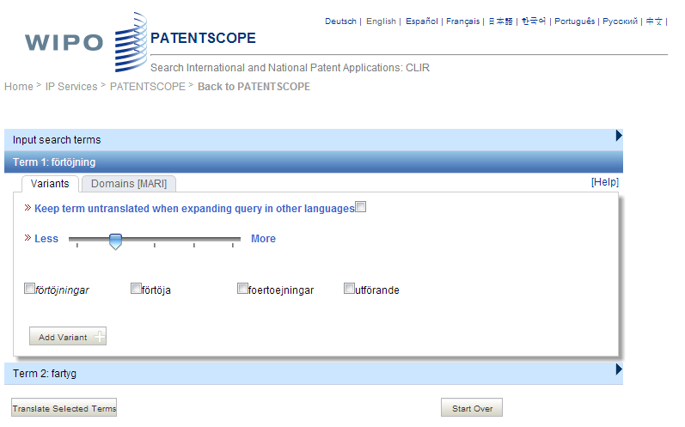

Slide 139
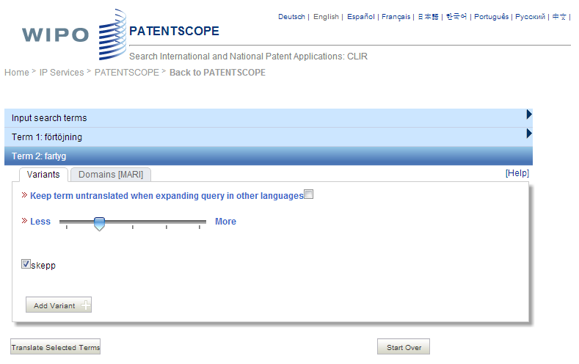

Slide 140
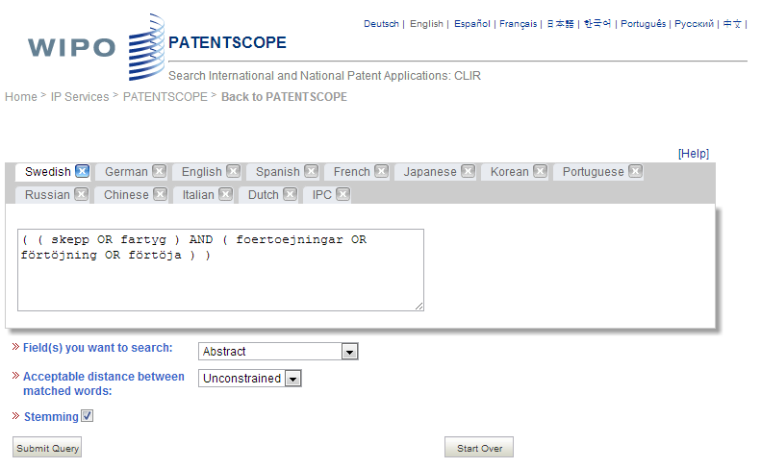
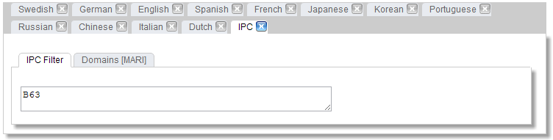












Slide 141


Slide 142


Slide 143

TAPTA

Slide 144


Slide 145


Slide 146

Survey in 2013

Slide 147


Who are using PATENTSCOPE ?

Slide 148

71% : interface is good

Slide 149

Monthly webinar

Slide 150
GLOBAL DATABASES, TOOLS, AND PLATFORMS FOR IP BUSINESS (FREE)
PATENTSCOPE
Global Brand Database
WIPO Lex
WIPO IPAS, WIPO DAS
WIPO CASE
WIPO RE:SEARCH
WIPO GREEN

Slide 151
GLOBAL BRANDS DATABASE
Over 12 million records relating to internationally-protected trademarks, etc.
Free of charge simultaneous brand-related searches across multiple collections, including:
  Trademarks registered under Madrid System
  Appellations of Origin registered under Lisbon System
  Emblems protected under the Paris Convention 6ter
  Algeria, Australia, Canada, Egypt, Estonia, Israel, Morocco, Singapore, Switzerland, UAE, US

Slide 152
www.wipo.int

Slide 153




Slide 154




Slide 155


Slide 156











Slide 157





Slide 158


Slide 159


Slide 160


Slide 161
GLOBAL DATABSES, TOOLS, AND PLATFORM FOR IP BUSINESS (FREE)
PATENTSCOPE
Global Brand Database
WIPO Lex
WIPO IPAS, WIPO DAS
WIPO CASE
WIPO RE:SEARCH
WIPO GREEN

Slide 162
www.wipo.int

Slide 163


Slide 164


Slide 165


Slide 166


Slide 167


Slide 168


Slide 169
GLOBAL DATABASES, TOOLS AND PLATFORMS FOR IP BUSINESS (FREE)
PATENTSCOPE
Global Brand Database
WIPO Lex
WIPO IPAS, WIPO DAS
WIPO CASE
WIPO RE:SEARCH
WIPO GREEN

Slide 170
IPAS AND DAS
IPAS (IP Office Administration System) used by 60 IPOs
  A WIPO software enabling small IPOs to electronically process patent, trademark, design applications
DAS (Digital Access System) used by 11 IPOs
  A System that allows IPOs and applicants to securely exchange or submit a digital copy of priority documents to multiple IPOs

Slide 171
GLOBAL DATABASES, TOOLS, AND PLATFORM FOR IP BUSINESS (FREE)
PATENTSCOPE
Global Brand Database
WIPO Lex
WIPO IPAS, WIPO DAS
WIPO CASE
WIPO RE:SEARCH
WIPO GREEN

Slide 172
WIPO CASE
“Centralized Access to Search and Examination Reports”
Started with an initiative of IP Australia and the Vancouver Group (AU, CA, UK)
Online patent work-sharing platform for patent examiners worldwide—secure sharing search and examination documentation
IPOs can enhance quality and efficiency of patent examination
CASE will be linked to Open Portal Dossier of IP5 to become the Global Portal Dossier
How will it work?

Slide 173
WIPO CASE (CONTINUED)
The System functions to:
  search by patent number and retrieve simple results or a list of patent family members.
  view bibliographic data, citation data (if available) and lists of documents available for each patent record.
  view and/or download the available documents.
  subscribe to notifications of updates to a given patent record.
  Will be linked to OPD of IP5 -> “Global Dossier”

Slide 174


Slide 175




GLOBAL DOSSIER PLATFORM (WIPO-CASE, OPD AND PATENTSCOPE)
Public Users
(including IP office users)
Examiner of IP5 Office not participating in WPO/CASE
OPD
Feed dossier information that OPD/CASE Offices agree to publish
Public Domain
OPD
WIPO CASE
Not accessible to the public and for PTO official use only
IPAS+
CASE depositary
System
Examiner of CASE participating office
Examiner of IP5 Office participating in WPO/CASE
CASE depositary Office using IPAS
CASE depositary Office using own EDMS
E.g. Australia

Slide 176

GLOBAL DATABASES, TOOLS, AND PLATFORMS FOR IP BUSINESS (FREE)
PATENTSCOPE
Global Brand Database
WIPO Lex
WIPO IPAS, WIPO DAS
WIPO CASE
WIPO RE:SEARCH
WIPO GREEN

Slide 177


Broad aims:
  Match-making for technology transfer and collaborations
  Reduce transaction costs
  Build on comparative advantages of multi-stakeholder approaches
  Demonstrate practical means for the global policy issues
Based on the recognition that:
    Users want access to technologies, not just patent rights
    Collaboration (e.g. training) is crucial to tech transfer

Slide 178
WIPO RE: SEARCH
A Global Database and Platform to bridge partners to use IP (including know-how and data) to facilitate R&D on neglected tropical diseases, tuberculosis, and malaria.
Royalty-free for R&D, manufacture and sale in LDCs
Over 60 partners (pharmaceutical industry, research institutes such as NIH, Universities)
As of January 2014, 44 collaborations

Slide 179

www.wipo.int/research

Slide 180


Slide 181













WIPO RE:SEARCH
Sharing Innovation in the Fight Against Neglected Tropical Diseases
Get involved:
As a user
As a provider
As a supporter
(Adhere to Guiding principles, contact email: re_search@wipo.int)
…

Slide 182
WIPO GREEN
A global database allowing users to make green technologies available for licensing or partnership, enter technology needs, search for technologies and needs
Started a pilot with Japan Intellectual Property Association in 2011
Launched in November 2013
as of January 2014, over 800 offers
Green tech providing companies in Germany, Japan, US etc.
Partners include companies, universities, UN agencies, governments, IPOs, NGOs, etc.

Slide 183
































Partners of WIPO GREEN

Slide 184

www.wipo.int/green

Slide 185

Six Areas of Green Technology Markets

Slide 186

THE CHALLENGE
International Transfer of wind power technology, 1988-2007,
OECD 2010

Slide 187



EXAMPLE: PRODUCT TO LICENSE OR SELL
TEIJIN Limited (Japan)

Slide 188
GET INVOLVED
Become a Partner and shape the further development of WIPO GREEN
Register to:
    communicate your green innovation and technology needs
    advertise your inventions, technologies, products and services
    connect with the innovation and business communities globally

Slide 189
CONCLUSION
WIPO Global Databases and Platforms will promote global partnerships among multiple stakeholders
DB, Tools, Platforms need to be easy to search, most updated, interactive/dynamic, multilingual, and robust

Slide 190
ALTERNATIVE DISPUTE RESOLUTION @ WIPO’S ARBITRATION AND MEDIATION CENTER
Speaker: Mr. Matthew Bryan, Director, PCT Legal Division, Innovation and Technology Sector

Slide 191
COMMON TYPES OF IP DISPUTES
Contractual: patent licenses, software and other information technology (IT), research and development agreements, trademark coexistence agreements, patent pools, distribution agreements, joint ventures, copyright collecting societies, IP settlement agreements
Infringement of IP rights
Domestic as well as international disputes

Slide 192
PATENT LITIGATION IN COURTS
Country | Characteristic of Legal System | Average Length | Average Costs
France | - Civil Law - Unified Litigation - No specialized courts | First Instance: 12-24months Appeal: 18-24 months | € 80,000-150,000 (1st Inst.)
Germany | - Civil Law - Bifurcated Litigation - Specialized courts | First Instance: 12 months Appeal: 15-18 months | € 50,000 (1st Inst.) € 70,000 (App.)
Italy | - Civil Law - Unified Litigation - Specialized courts | First Instance: Few months – 24 months Appeal: 18-24 months | € 50,000-150,000 (1st Inst.) € 30,000-70,000 (App.)
Spain | Civil Law - Unified Litigation - Commercial courts | First Instance: 12 months Appeal: 12-24 months | € 100,000 (1st Inst.) € 50,000 (App.)
UK | Common Law - Unified Litigation - Specialized courts - Mediation promoted | First Instance: 12 months Court of Appeal: 12 months Supreme Court: 24 months | € 550,000-1,500,000 (1st Inst.) € 150,000-1,500,000 (App.) € 150,000-1,500,000 (Supreme Court)
China | - Civil Law - Bifurcated Litigation - Specialized courts | First Instance: 6 months Appeal: 3 months | USD 150,000 (1st Inst.) USD 50,000 (App.)
Japan | - Civil Law - Bifurcated Litigation - Specialized courts | First Instance: 14 months Appeal: 9 months | USD 300,000 (1st Inst.) USD 100,000 (App.)
USA | - Common Law - Unified Litigation Specialized court of appeals (CAFC) Jury trial available Mediation promoted | First Instance: up to 24 months Appeal: 12+ months | USD 650,000-5,000,000* (1st Inst.) USD 150,000-250,000 (App.)
This chart is based on figures provided in Patent Litigation - Jurisdictional Comparisons, Thierry Calame, Massimo Sterpi (ed.), The European Lawyer Ltd, London 2006.
* Report of the Economic Survey, Prepared Under the Direction of Law Practice Management Committee, AIPLA, Arlington 2011.

Slide 193
WIPO Arbitration and Mediation Center
Facilitates the resolution of commercial disputes between private parties involving IP and IT, through procedures other than court litigation
ADR of IP disputes benefits from a specialized ADR provider
  WIPO panel members experienced in IP and technology - able to deliver informed results efficiently
  Competitive WIPO fee structure (including reduced fees for PCT applicants)
  International neutrality
  Offices in Geneva and Singapore

Slide 194
MEDIATION, ARBITRATION, EXPERT DETERMINATION
Mediation: an informal consensual procedure in which a neutral intermediary, the mediator, assists the parties in reaching a settlement of their dispute, based on the parties’ respective interests. The mediator cannot impose a decision. The settlement agreement has the force of a contract. Mediation leaves open all other dispute resolution options.
Arbitration: a consensual procedure in which the parties submit their dispute to one or more chosen arbitrators, for a binding and final decision (award) based on the parties’ respective rights and obligations and enforceable as an award under arbitral law. Arbitration constitutes a private alternative to court litigation.
Expert Determination: a consensual procedure in which the parties submit a specific matter (e.g. technical question) to one or more experts who make a determination on the matter, which can be binding unless the parties have agreed otherwise.

Slide 195
WHY ADR FOR IP DISPUTES?
Internationalization of creation/use of IP: cross-border solutions
Technical and specialized nature of IP: specific expertise of the neutral
Short product and market cycles: time-efficient procedures
Confidential nature of IP: confidential procedures
Collaborative nature of IP creation and commercialization: procedures that preserve relations

Slide 196
WIPO ADR OPTIONS
WIPO Contract Clause/ Submission Agreement
Party Agreement
(Negotiation)
First Step
Mediation
Expert Determination
Expedited Arbitration
Arbitration
Procedure
Determination
Settlement
Award
Outcome

Slide 197
WIPO MODEL CLAUSE EXAMPLE: MEDIATION
FOLLOWED BY EXPEDITED ARBITRATION
"Any dispute, controversy or claim arising under, out of or relating to this contract and any subsequent amendments of this contract, including, without limitation, its formation, validity, binding effect, interpretation, performance, breach or termination, as well as non-contractual claims, shall be submitted to mediation in accordance with the WIPO Mediation Rules. The place of mediation shall be [specify place]. The language to be used in the mediation shall be [specify language]”
If, and to the extent that, any such dispute, controversy or claim has not been settled pursuant to the mediation within [60][90] days of the commencement of the mediation, it shall, upon the filing of a Request for Arbitration by either party, be referred to and finally determined by arbitration in accordance with the WIPO Expedited Arbitration Rules. Alternatively, if, before the expiration of the said period of [60][90] days, either party fails to participate or to continue to participate in the mediation, the dispute, controversy or claim shall, upon the filing of a Request for Arbitration by the other party, be referred to and finally determined by arbitration in accordance with the WIPO Expedited Arbitration Rules. The place of arbitration shall be [specify place]. The language to be used in the arbitral proceedings shall be [specify language]. The dispute, controversy or claim referred to arbitration shall be decided in accordance with [specify jurisdiction] law."
http://www.wipo.int/amc/en/clauses/index.html
Notes:
197

Slide 198
198
WIPO Arbitration
WIPO Expedited Arbitration
Request for Arbitration
Request for Arbitration
and Statement of Claim
Answer to Request for Arbitration
Answer to Request for Arbitration and Statement of Defense
Appointment of Arbitrator(s)
Appointment of Arbitrator(s)
Statement of Claim
Hearing
Statement of Defense
Closure of Proceedings
Further Written Statements and Witness Statements
Final Award
Hearings
One exchange of pleadings
Shorter time limits
Sole arbitrator
Shorter hearings
Fixed fees
Closure of Proceedings
Final Award
Notes:
198

Slide 199
ACTIVE WIPO CASE MANAGEMENT
General procedural information, training programs
Initiation of procedure and subsequent case communication (option of WIPO Electronic Case Facility)
Neutral appointment process
  Over 1,500 specialized neutrals
  Mediators, arbitrators, technical experts
  All areas of IP/IT
  New neutrals added in function of specific case needs
Setting fees, financial management
Availability of procedural guidance to neutral
At request, hearing/meeting logistical assistance

Slide 200

WIPO ELECTRONIC CASE FACILITY (ECAF)
Easy; instant; centralized; location-independent; secure; available at parties’ option

Slide 201


WIPO CASES
Subject Matter
Business Areas
WIPO AMC has administered over 350 cases, with parties from Austria, China, Cyprus, Denmark, Finland, France, Germany, India, Ireland, Israel, Italy, Japan, Netherlands, Norway, Panama, Romania, Russian Federation, Singapore, Spain, Switzerland, Turkey, United Kingdom and United States of America

Slide 202
WIPO MEDIATION EXAMPLE 1 (I)
US company/Swiss company
Patent infringement dispute related to US patents owned by US company in automotive sector
Settlement agreement 2007
Dispute resolution clause: WIPO Mediation followed if necessary by WIPO Arbitration
Request for mediation in 2009
WIPO proposed a shortlist of candidates
Parties chose from such list a patent practitioner, fluent in English, with knowledge of US patent law and experience in patent infringement mediation

Slide 203
WIPO MEDIATION EXAMPLE 1 (II)
Two-day session in Geneva at WIPO
Mediator explained ground rules of the session (e.g. confidentiality, caucus) and his role
Early agreement on framework for royalty payments
Final Settlement:
  ‘Term sheet’: down payment, annual installments, net sales-based royalty
  Re-drafted original licensing agreement, final agreement by September 2009
End of two-year dispute within 5 months, parties avoided (US) arbitration, option of further collaboration

Slide 204
WIPO MEDIATION EXAMPLE 2 (I)
Patent infringement dispute
  R&D company holding patents disclosed patented invention to manufacturer during consultancy
  No transfer or license of patent rights
  Manufacturer started selling products which R&D company alleged included patented invention
  Negotiation patent license failed
  Parallel infringement proceedings in several jurisdictions?
Parties submitted to WIPO Mediation

Slide 205
WIPO MEDIATION EXAMPLE 2 (II)
WIPO appointed an experienced mediator with expertise in the subject matter of the dispute
Parties and mediator met during one week
Settlement agreement reached, including grant of license for royalties, and a new consultancy agreement
Process duration: 4 months
Mediator fees: USD 24,000

Slide 206
WIPO MEDIATION EXAMPLE 3
2006 European airline agreement with a US software company re. development of worldwide platform for the management of ticket sales
2007 professional services agreement: detailed description of the project as well as the support services to be delivered by the software company
WIPO mediation followed by WIPO expedited arbitration clause
Airline paid several million USD for the application
2009 airline terminated the agreement
Software company requested that the software be returned
Airline initiated mediation
Result: new license

Slide 207
WIPO ARBITRATION EXAMPLE 1 (I)
Asian inventor granted exclusive license over a European patent and five US patents to US manufacturer
Clause provided that disputes whether royalties had to be paid in respect of products manufactured by US party be resolved through WIPO Expedited Arbitration
US party rejected claim that its products embodies technologies covered by the licensed patents and refused to pay royalties

Slide 208
WIPO ARBITRATION EXAMPLE 1 (II)
Inventor initiated WIPO case
Center appointed sole arbitrator under WIPO Expedited Arbitration Rules
Arbitrator had to consider whether products infringed the ‘claims’ asserted for each of the patents and whether patents had been anticipated by prior art
    Highly complex legal and technical issues
    Business secrets, models, site visits
    Eight days hearing
    Final award

Slide 209
EXAMPLES OF TAILORED WIPO ADR FOR SPECIFIC SECTORS
Domain Names (40,000+ cases since 1999)
Intellectual Property Offices (e.g., ADR options for parties in administrative procedures before the IPO of Singapore and INPI Brazil)
Research and Development/Technology Transfer
Patents in Standards
http://www.wipo.int/amc/en/center/specific-sectors/

Slide 210
WIPO INTERNATIONAL SURVEY ON DISPUTE RESOLUTION IN TECHNOLOGY TRANSACTIONS
Place of Survey Respondent
Business Operations
Type of Survey Respondent
Notes:
Question 7

Slide 211
SCOPE OF AGREEMENTS: PARTIES/TECHNOLOGY
91% of respondents conclude agreements with parties from other jurisdictions.
+80% of respondents conclude agreements relating to technology patented in multiple jurisdictions.

Slide 212
TOP TEN CONSIDERATIONS IN CHOICE OF DISPUTE RESOLUTION CLAUSE
Domestic Contracts | International Contracts
Costs – 71% | Costs – 71%
Time – 59% | Time – 57%
Quality Outcome – 44% | Enforceability – 53%
Confidentiality – 33% | Quality Outcome – 44%
Enforceability – 33% | Neutral Forum – 36%
Business Solution – 30% | Confidentiality – 32%
Neutral Forum – 18% | Business Solution – 29%
None in Particular – 9% | Support Provided by Institution – 9%
Setting Precedent – 6% | None in Particular – 6%
Support Provided by Institution – 6% | Setting Precedent – 5%

Slide 213
HOW ARE TECHNOLOGY DISPUTES RESOLVED?

Slide 214
RELATIVE TIME AND COST OF TECHNOLOGY DISPUTE RESOLUTION

Slide 215


SETTLEMENT IN WIPO-ADMINISTERED CASES

Slide 216


ADDITIONAL INFORMATION
Download more model clauses : http://www.wipo.int/amc/en/clauses/
Information on WIPO Rules, procedures, cases examples:
    http://www.wipo.int/amc/en/
Contact information:
  WIPO Center Office in Geneva
  WIPO Headquarters
+41 22 338 8247
  WIPO Center Office in Singapore Maxwell Chambers
+65 6225 2129
    arbiter.mail@wipo.int

Slide 217
SESSION II
RECENT DEVELOPMENTS IN WIPO INFRASTRUCTURE

Slide 218
RECENT DEVELOPMENTS IN WIPO INFRASTRUCTURE
Speaker: Christophe Mazenc, Head, Global Databases Service, Global Infrastructure Sector

Slide 219
RECENT DEVELOPMENTS
PATENTSCOPE
Global Brand Database
WIPO CASE
WIPO GREEN

Slide 220
PATENTSCOPE
2.4 million PCT data (first publish every week, high quality full text)
35 million records from 36 countries or regions
Full text data from 18 countries or regions
15,000 pageviews per hour
Analyze results by graphs and charts
Search and read in your language

Slide 221
www.wipo.int

Slide 224
PATENTSCOPE: DEVELOPMENTS IN 2013
US collection added in April 2013:
  10 million bibliographic data records
  6.4 million searchable full text (since 1976)
CN collection added in September 2013
  3.3 million bibliographic data records
  3.3 million searchable full text
Small collections: Bahrain, Egypt, UAE, Estonia
Monthly webinars

Slide 225
PATENTSCOPE: DEVELOPMENTS IN 2014
CA collection added in January 2014
  1.8 million bibliographic data records
  1 million searchable full text
EA collection added in February 2014
  33000 bibliographic data records
  23000 searchable full text

Slide 226
PATENTSCOPE: WHAT NEXT?
Addition of the DE, NZ, and UK collections
Addition of recent ES full texts
Addition of JP records prior to 1993
Probably after 2014: AU, SK
Work on improving the timeliness of the updates

Slide 227
PATENTSCOPE LANGUAGE TOOLS:
WHAT NEXT?
CLIR: retraining of the system with last 18 months updates and addition of one language (may be Danish or Polish)
TAPTA: addition of the EN <=> KR language pair, development of a prototype to translate descriptions and claims (EN<=>ZH)

Slide 228
SURVEY IN 2013

Slide 229
WHO ARE USING PATENTSCOPE ?

Slide 230
71% : interface is good

Slide 231
RECENT DEVELOPMENTS
PATENTSCOPE
Global Brand Database
WIPO CASE
WIPO GREEN

Slide 232
GLOBAL BRAND DATABASE
Over 12 million records relating to internationally-protected trademarks, etc.
Free of charge simultaneous brand-related searches across multiple collections, including:
  Trademarks registered under Madrid System
  Appellations of Origin registered under Lisbon System
  Emblems protected under the Paris Convention 6ter
  Algeria, Australia, Canada, Egypt, Estonia, Israel, Morocco, Singapore, Switzerland, UAE, US

Slide 233
www.wipo.int

Slide 235
GLOBAL BRAND DATABASE:
DEVELOPMENTS IN 2013
US collection added in February 2013 with full support of the USPTO design search codes
Collections of Algeria, Egypt, Singapore, Morocco, Switzerland, Philippines, Estonia, UAE and Israel
Implementation of bi directional links between OHIM's TMView and the Global Brand Database

Slide 236
GLOBAL BRAND DATABASE:WHAT NEXT?
New collections: NZ, MX, RU?, SK
Prototype on trademark images similarity searching

Slide 237
RECENT DEVELOPMENTS
PATENTSCOPE
Global Brand Database
WIPO CASE
WIPO GREEN

Slide 238
WIPO CASE
“Centralized Access to Search and Examination Reports”
Started with an initiative of IP Australia and the Vancouver Group (AU, CA, UK)
Online patent work-sharing platform for patent examiners worldwide—secure sharing search and examination documentation
IPOs can enhance quality and efficiency of patent examination
CASE will be linked to Open Portal Dossier of IP5 to become the Global Portal Dossier
How will it work?

Slide 239
WIPO CASE (CONTINUED)
The System functions to:
  search by patent number and retrieve simple results or a list of patent family members.
  view bibliographic data, citation data (if available) and lists of documents available for each patent record.
  view and/or download the available documents.
  subscribe to notifications of updates to a given patent record.
Will be linked to OPD of IP5 -> “Global Dossier”

Slide 241
GLOBAL DOSSIER PLATFORM (WIPO-CASE, OPD AND PATENTSCOPE)
Public Users
(including IP office users)
Examiner of IP5 Office not participating in WPO/CASE
OPD
Feed dossier information that OPD/CASE Offices agree to publish
Public Domain
OPD
WIPO CASE
Not accessible to the public and for PTO official use only
IPAS+
CASE depositary
System
Examiner of CASE participating office
Examiner of IP5 Office participating in WPO/CASE
CASE depositary Office using IPAS
CASE depositary Office using own EDMS
E.g. Australia

Slide 242
RECENT DEVELOPMENTS
PATENTSCOPE
Global Brand Database
WIPO CASE
WIPO GREEN

Slide 243
WIPO GREEN
A global database allowing users to make green technologies available for licensing or partnership, enter technology needs, search for technologies and needs
Started a pilot with Japan Intellectual Property Association in 2011
Launched in November 2013
as of January 2014, over 800 offers
Green tech providing companies in Germany, Japan, US etc.
Partners include companies, universities, UN agencies, governments, IPOs, NGOs, etc.

Slide 244
PARTNERS OF WIPO GREEN

Slide 245
www.wipo.int/green

Slide 246
SIX AREAS OF GREEN TECHNOLOGY MARKETS

Slide 247
THE CHALLENGE
International Transfer of wind power technology, 1988-2007,
OECD 2010

Slide 248

EXAMPLE: PRODUCT TO LICENSE OR SELL
TEIJIN Limited (Japan)

Slide 249
GET INVOLVED
Become a Partner and shape the further development of WIPO GREEN
Register to:
    communicate your green innovation and technology needs
    advertise your inventions, technologies, products and services
    connect with the innovation and business communities globally

Slide 250
CONCLUSION
WIPO Global Databases and Platforms will promote global partnerships among multiple stakeholders
DB, Tools, Platforms need to be easy to search, most updated, interactive/dynamic, multilingual, with a large coverage and robust

Slide 251
SESSION II
THE MADRID SYSTEM: RECENT DEVELOPMENTS

Slide 252
THE MADRID SYSTEM
A centralized filing mechanism
A one-stop shop for trademark holders to obtain and maintain trademark protection in export markets
An option to the national route
A purely procedural treaty
The domestic legislations of the designated Contracting Parties set the conditions for protecting a trademark and determine the rights which result from protection

Slide 253
THE MEMBERS OF THE MADRID SYSTEM
1 Agreement only
37 Protocol only (including EU)
54 Agreement and Protocol
92 Members

Slide 254
ACCESSIONS
Significant geographical expansion of the Madrid system
2012: The Philippines, Colombia, New Zealand and Mexico
2013: India, Rwanda and Tunisia (October 16, 2013)
Future accessions?
  Latin American countries
  ASEAN countries by 2015
  Caribbean countries
  African countries

Slide 255
KEY PRINCIPLES OF THE MADRID SYSTEM (1)
Entitlement and Basic Mark:
To use the Madrid system, you need a connection with a Contracting Party (CP), like establishment, domicile or nationality, and a mark applied for or registered (basic mark) with that CP (Office of origin)
One to many relationship:
File a single international application through the Office of origin for a single international registration (IR) in which one or more Contracting Parties (CP) are designated
Renewal:
Every 10 years

Slide 256
KEY PRINCIPLES OF THE MADRID SYSTEM (2)
Fixed time limit for refusal:
A CP will need to refuse protection within 12/18 months, otherwise the mark will be deemed protected
“Bundle of rights”:
If no refusal is issued, the resulting IR has the effect of a grant of protection in each designated CP
Extending the geographical protection:
Additional countries may later be included in the IR by subsequent designation

Slide 257
THE INTERNATIONAL PROCEDURE
Office of Origin
Designated Contracting Party
Designated Contracting Party
Designated Contracting Party
WIPO
Applicant
Certifies the application and forwards it to WIPO
Conducts the formal examination; records the mark in the International Registry and publishes the international registration in the Gazette. Issues a certificate of registration and notifies the designated Contracting Parties
Entitlement
Basic Mark
Scope of protection of the international registration will be determined by the substantive examination under domestic law, within 12/18 months

Slide 258
THE MADRID SYSTEM – FACTS AND FIGURES
Worldwide trademark filings + 9.3% from 2008 to 2011
2012 + 4.1% growth in applications
2013 + 6.4% growth in applications
Received 46,829 international applications
Over 578,320 international registrations in force
5.61 million designations in force
191,759 holders of international registrations

Slide 259
GENERAL PROFILE 2013
44,414 International Registrations
Average Number of Designations | 6.89
Average Number of Classes | 2.46
Average Fee | CHF 3,038
All Fees | 68% < 3,000 CHF
Notes:
259

Slide 260
TOP 5 CONTRACTING PARTIES – DESIGNATIONS BY CP OF THE HOLDER

Slide 261
IRS BY OFFICE OF ORIGIN – NORDIC COUNTRIES

Slide 262
DESIGNATIONS IN IRS: SWEDEN AS COUNTRY OF THE HOLDER
Total: 1.830

Slide 263
TOP 5 DESIGNATED CONTRACTING PARTIES

Slide 264
DESIGNATIONS OF NORDIC COUNTRIES

Slide 265
DESIGNATIONS IN IRS: SWEDEN AS DCP

Slide 266
ONLINE INFORMATION SERVICES
Legal texts, Guide and Information Notices
WIPO Gazette of International Marks
E-Renewal Tool
Fee Calculator: Costing service
ROMARIN: On-line search database
Dynamic Madrid Statistics
free access at http://www.wipo.int/madrid/en/
Notes:
266

Slide 268
ONLINE TOOLS
Madrid Goods and Services Manager (MGS): To use correct specifications of goods and services
Madrid Real-Time Status (MRS): To inform of the status of an international application/registration
Madrid Portfolio Manager (MPM): To allow the holders and representatives to view and modify their portfolio
Madrid Electronic Alerts (MEA): To allow users to submit a list of IRs to monitor and to be informed by email when any of them change
Accessible from http://www.wipo.int/madrid/en/services/

Slide 269
RECENT DEVELOPMENTS
Webform: Online filing of subsequent designations
Moving towards a one treaty system
Revision of official forms and new publication

Slide 270
Thank you
for your attention
debbie.roenning@wipo.int

