Slide 1



Seminar on WIPO Services and Initiatives
Reykjavík
November 22, 2013
Mrs. Asta Valdimarsdottir, Director, Operations Service, Madrid Registry, Brands and Designs Sector (BDS), WIPO, Geneva
Mr. Matthew Bryan, Director, PCT Legal Division, Innovation and Technology Sector, WIPO
Víctor Vázquez, Head, Section for Coordination of Developed Countries, Department for Transition and Developed Countries (TDC), WIPO

Slide 2


Speaker: Víctor Vázquez, Head, Section for Coordination of Developed Countries, Department for Transition and developed Countries (TDC)

Slide 3
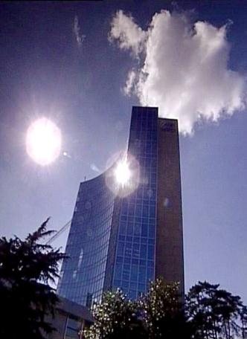
BASICS FACTS ABOUT WIPO
WIPO’s MISSION: To promote the protection of IP rights worldwide and extend the benefits of the international IP system to all member states.
MEMBER STATES: 186
OBSERVERS : + 350
STAFF : 950 FROM 101 COUNTRIES
ADMINISTERED TREATIES : 26
MAIN ORGANS/BODIES : GA, CC, WIPO CONFERENCE

Slide 4
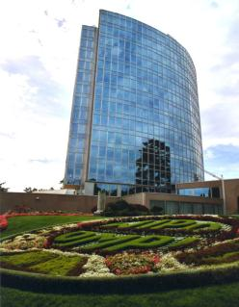
MILESTONES: 1883 - 2013
2013
MARRAKESH TREATY
2012
2006
BEIJING TREATY
2000
STLT
1996
PATENT LAW TREATY
INTERNET TREATIES
1989
MADRID PROTOCOL
1970
PCT ESTABLISHED
1967
1960
WIPO CONVENTION
1925
BIRPI MOVES TO GENEVA
1893
HAGUE AGREEMENT
1891
BIRPI
1886
1883
MADRID AGREEMENT
BERNE CONVENTION
PARIS CONVENTION

Slide 5
INTELLECTUAL PROPERTY : OUTREACH
PUBLIC SECTOR & POLICY MAKERS
BUILDING AWARENESS
INTELLECTUAL PROPERTY OFFICES
GENERAL PUBLIC & CIVIL SOCIETY

Slide 6

WIPO’s MAIN ACTIVITIES
Economic Development
Norm Setting
Services to Industry
Global Infrastructure

Slide 7
GLOBAL IP INFRASTRUCTURE
“Just as participation in the physical economy requires access to roads, bridges, and vehicles to transport goods, similar infrastructure is needed in the virtual and knowledge economy. However, here the highway is the Internet and other networks, bridges are interoperable data standards, and vehicles are computers and databases.”
WIPO DIRECTOR GENERAL, FRANCIS GURRY
WIPO is coordinating with stakeholders to develop tools, services, platforms, standards, etc. that enable IP institutions to work more efficiently and provide better and high quality services.

Slide 8
GLOBAL IP INFRASTRUCTURE
DYNAMIC DIMENSION OF IP
INFRASTRUCTURE INCLUDES :
  Databases (PATENTSCOPE, Global Brand DB & access to aRDI and ASPI)
  Common platform for e-data exchange among IPOs (WIPO Case for Global Dossier, the Digital Access Service)
  Other platforms: WIPO Green; WIPO Research.
  Tools (international classifications in TMs/design; IPC, Green inventory, Nice classification)
  Standards & technical agreements
  Services (International Cooperation for Patent Examination (ICE), Patent Information Services, including Legal Status of Patents)
  Capacity building & networking by Technology Innovation Support Centers (TISCs)

Slide 9
WIPO … PROVIDER OF PREMIER GLOBAL IP SERVICES
Core income generating business areas:
  Patent Cooperation Treaty (Patents)
  Madrid System (Trademarks)
  Hague System (Industrial Designs)
  Lisbon System (Geographical Indications)
  WIPO Arbitration and Mediation Center
AIM : to be the first choice for users by continuing to offer cost-effective and value-added services
Notes:
Patent law differs from country to country. It can be a costly, complex and lengthy process to obtain patent protection in multiple countries. WIPO’s global protection services offer a swift, reliable cost-effective and user-friendly option. Principle objective of PCT is operational excellence and provision of high quality services to benefit users of patent system, patent administrations and general public by streamlining the filing and processing of patent applications in multiple countries (through reduced duplication of work of national filing and processing) to make the grant of patents more economical (ie less diversion of public resources for patent admin.)
Emphasis on ensuing PCT beneficiaries receive adequate knowledge of system and that the system responds satisfactorily to their needs.
TRADEMARKS: In constantly changing business environment, TMs, etc. are important tools for promotion of domestic commerce and int’l. trade which, in turn, contribute to sustainable national economic growth. Indispensable in designing marketing strategies to identify and promote goods in market place and distinguish these goods from those of competitors. To be effective, need adequate legal protection at national & int’l. levels. WIPO’s registration systems facilitate the acquisition and maintenance of these IPRs in different countries
A company in Morocco requesting TMP in 12 countries - application in 3 classes would pay over 6.5 times more if it didn't use MS but opted to apply to each national office separately -Madrid = 2,162 CHF; vs. 14,245 CHF using national route). Renewal of same app. = 5+ times cheaper and cost of registering a change in ownership is 20+ times cheaper, costing 177 Swiss francs as opposed to 3,697 Swiss francs under the national route.
Patent law differs from country to country. It can be a costly, complex and lengthy process to obtain patent protection in multiple countries. WIPO’s global protection services offer a swift, reliable cost-effective and user-friendly option. Principle objective of PCT is operational excellence and provision of high quality services to benefit users of patent system, patent administrations and general public by streamlining the filing and processing of patent applications in multiple countries (through reduced duplication of work of national filing and processing) to make the grant of patents more economical (i.e. less diversion of public resources for patent admin.)
Emphasis on ensuing PCT beneficiaries receive adequate knowledge of system and that the system responds satisfactorily to their needs.
TRADEMARKS: In constantly changing business environment, TMs, etc. are important tools for promotion of domestic commerce and int’l. trade which, in turn, contribute to sustainable national economic growth. Indispensable in designing marketing strategies to identify and promote goods in market place and distinguish these goods from those of competitors. To be effective, need adequate legal protection at national & int’l. levels. WIPO’s registration systems facilitate the acquisition and maintenance of these IPRs in different countries
A company in Morocco requesting TMP in 12 countries - application in 3 classes would pay over 6.5 times more if it didn't use MS but opted to apply to each national office separately -Madrid = 2,162 CHF; vs. 14,245 CHF using national route). Renewal of same app. = 5+ times cheaper and cost of registering a change in ownership is 20+ times cheaper, costing 177 Swiss francs as opposed to 3,697 Swiss francs under the national route.

Slide 10
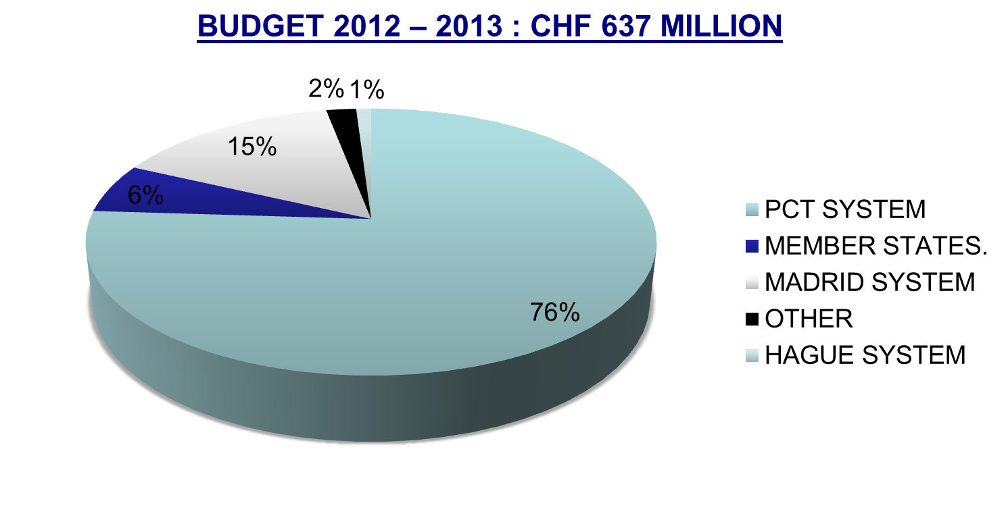
WIPO’s MAIN SOURCES OF REVENUE

Slide 11
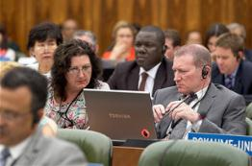

NORM SETTING
AIM → Progressive development of international IP law for an IP system that is:
  balanced/responsive to emerging needs
  effective in encouraging innovation/creativity
  sufficiently flexible to accommodate national policy objectives
Topical issues reviewed/discussed in Standing Committees

Slide 12


NORM SETTING
WIPO treaties are often closely connected to infrastructure and services:
  Treaties that provide legal support to international infrastructure and services: PCT, Madrid.
  Business simplification treaties, which simplify the operation of national infrastructure and services: Singapore Treaty on the Law of Marks (2006), Patent Law Treaty ( 2000)

Slide 13
STANDING COMMITTEES
PATENTS (SCP) (patent quality, E&Ls, patents & health, client-patent adviser privilege, tech transfer)
COPYRIGHT & RELATED RIGHTS (SCCR) (AV performances- E&Ls VIPs/libraries/archives, broadcasting)
TRADEMARKS, DESIGNS & GEOGRAPHICAL INDICATIONS (SCT) (Design Law Treaty/protection of country names against registration and use as TMs)
  AIM :
      Build consensus on topical issues
      Take into account interests of all stakeholders for a balanced, reliable, efficient, user-friendly, cost-effective system.
      N.B. Enforcement issues are discussed within the Advisory Committee on Enforcement (ACE)
Notes:
WIPO’s work in this area is designed to reduce complexity, cost and time involved in obtaining patent protection in multiple countries and to address workload crisis facing many office because of rising number of patent applications, changing nature of applications (biotech) and duplication of work. Various activities support this endeavor, namely:
- Substantive and procedural harmonization of patent law.
- Development and adoption of reforms of PCT System.
PCT Reform: began in Oct. 2000. General objectives to simplify the system, streamline procedures, reduce costs for applicants, maintains quality of services to facilitate greater use, ensure system works to advantage of all offices irrespective of size.

Slide 14
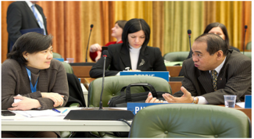
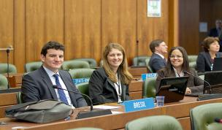
THE STANDING COMMITTEE ON LAW OF PATENTS
Member States’ Committee (IGOs and NGOs: observers)
Established in 1998
Forum to discuss issues, facilitate coordination and provide guidance concerning the progressive international development of patent law
Forum that deals with a cluster of issues rather than each issue in isolation
Since 2008, discussions on various issues identified by Member States

Slide 15
THE STANDING COMMITTEE ON LAW OF PATENTS
PART II
For the next session of the SCP (from the 27th to the 31st of January 2014):
Quality of patents: the secretariat will prepare a compilation of work-sharing programs among patent offices and use of external information for search and examination.
A document compiling laws and practices on confidentiality of communications between clients and their patent advisors
The Secretariat will prepare a document on how 5 different exceptions/limitations are implemented by member states and a half day seminar will also be organized on the above. A sharing session on countries’ use of health-related patent flexibilities will also be organized.
The Secretariat will revise the existing document on transfer of technology by adding practical examples and experiences regarding patent-related incentives and impediments
Notes:
private and/or non-commercial use; experimental
use and/or scientific research; preparation of medicines; prior use; use of
articles on foreign vessels, aircrafts and land vehicles. The document should
also cover practical challenges encountered by Member States in
implementing them.

Slide 16
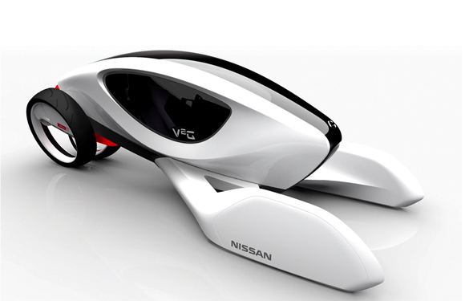
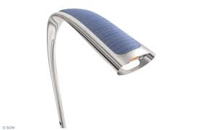
NORM SETTING :
INDUSTRIAL DESIGNS
THE STANDING COMMITTEE ON THE LAW OF TRADEMARKS, INDUSTRIAL DESIGNS AND GEOGRAPHICAL INDICATIONS (SCT)
  The SCT has substantially advanced work on the draft of a design law treaty
  The idea would be to have a design law treaty similar to the Patent Law Treaty and the Singapore Treaty
  A business simplification treaty will simplify and standardize the registration and ancillary procedures applied to industrial designs in different countries
  GA in December 2013 will decide on whether to convene a diplomatic conference for the adoption of a design law treaty.

Slide 17
LATEST SCT SESSION (NOVEMBER 2013)
All the countries that took the floor in the latest SCT were in favor of convening a diplomatic conference for the adoption of the Design Law Treaty. Delegations however disagreed with respect to the conditions in order to do so:
  Technical assistance and capacity building to help implementing the new treaty:
    For a large number of delegations an agreement in the form of an article in the Treaty had to be reached prior to convening the DC.
    Other delegations considered that the SCT could already recommend to the GA the convening of a DC.
  A facilitator has been appointed for the next GA
Important SCT work is related to the protection of country names against registration or use of trademarks. This work is situated at the interface between private trademark rights and the interests of States to control the use and appropriation of their names. The Secretariat will prepare a working document based on submissions from Member States for consideration of the SCT at its next session.
Beyond SCT: GA September 2013 decided on the convening of a Diplomatic Conference for the adoption of a Revised Lisbon Agreement on Appellations of Origin and Geographical Indications in 2015.

Slide 18
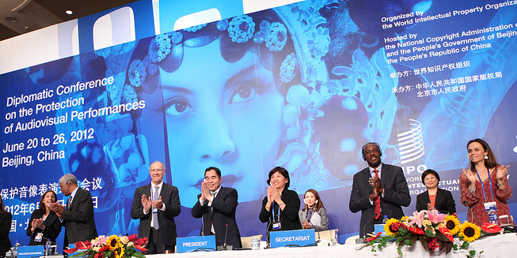
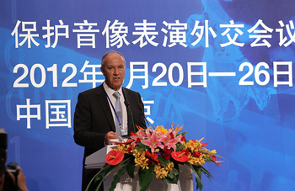
BEIJING TREATY ON AUDIOVISUAL
PERFORMANCES JUNE, 26 2012

Slide 19


BEIJING TREATY
The treaty on audiovisual performances was adopted on June 2012. The treaty will enter into force with 30 ratifications.
This treaty will strengthen the position of performers, giving them moral and economic rights for the international use of their performances.
Countries becoming party will pay for the use of foreign audiovisual performances. Some or all of this money will be going to performers.
« The conclusion of the Beijing Treaty is an important milestone toward closing the gap in the international rights system for audiovisual performers » WIPO Director General, Francis Gurry

Slide 20
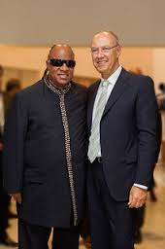
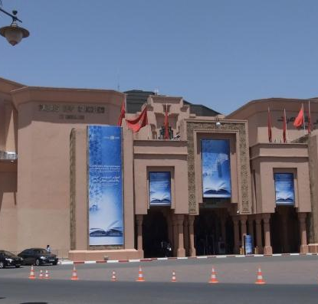
MARRAKESH TREATY TO FACILITATE ACCESS TO PUBLISHED WORKS FOR PERSONS WHO ARE BLIND, VISUALLY IMPAIRED OR OTHERWISE PRINT DISABLED

Slide 21

MARRAKESH TREATY
The Diplomatic Conference took place in Marrakesh from June 18 to 28, 2013 (600 negotiators from WIPO’s 186 member states)
There are more than 314 million blind and VIP- 90 % living in developing countries.
Only 5 % of the books published are available in braille or other accessible formats.
Requires contracting parties to adopt limitations for the benefit the people who are blind, visually impaired, and print disabled.
It also provides for the exchange of accessible format works across borders.

Slide 22
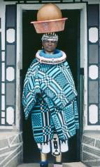
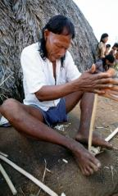
INTELLECTUAL PROPERTY AND TRADITIONAL KNOWLEDGE, ACCESS TO GENETIC RESOURCES AND FOLKORE
Created in 2000, the 26th session would take place from February 3 to 7, 2014
Undertakes negociations with the objective of reaching agreement on a text(s) of an international legal instrument(s) which will ensure the effective protection of traditional knowledge (TK), traditional cultural expressions (TCEs) and genetics resources (GRs)
Draft articles on TK and TCEs and a Consolidated Document Related to IP and GRs have been prepared
  KEY ISSUES NEGOCIATED BY THE ICG :
  Why protect? Aims and objectives
  What to protect? Definitions of TK/TCEs
  How to protect? Options
  What acts should be forbidden? Scope
  Who should benefit? Beneficiaries
  For how long? Duration

Slide 23

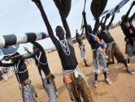
INTELLECTUAL PROPERTY AND TRADITIONAL KNOWLEDGE, ACCESS TO GENETIC RESOURCES AND FOLKORE
IGC’s MANDATE FOR THE 2014 – 2015:
  Continue to expedite work with open and full engagement on text-based negociations
  Follow a clearly defined work program: Three sessions of the IGC in 2014, including thematic and cross cutting/stocktaking sessions
  Build on existing work, in particular the existing draft texts
  Submit text(s) to the GA in 2014 which will ensure effective protection of GRs, TK and TCEs
2014 GENERAL ASSEMBLY
    Take stock
    Consider text(s) and progress made
    Decide on convening a Diplomatic Conference
    Consider need for additional meetings
Notes:
Toolkit for management for the management of IP interests in the documentation of TK
A guide for the Protection of Expressions of Traditional Culture
Survey of practical experience in legal protection of TK.
Information materials
Best practices reflecting international consensus on IP issues concerning TK, TCEs and genetic resources

Slide 24

MAJOR ECONOMIC STUDIES ON IP
A NEW WIPO UNIT – THE ECONOMICS AND STATISTICS DIVISION- REFLECTS THE GROWING CONSENSUS ON THE IMPORTANCE OF THE ECONOMIC DIMENSION OF IP.
THE DIVISION APPLIES STATISTIC AND ECONOMIC ANALYSIS TO THE USE OF WIPO SERVICES.
THIS NEW STRUCTURE ALSO IMPROVES WIPO ECONOMIC INSIGHT ON IP DEVELOPMENT.

Slide 25
STRATEGIC REALIGNMENT WITHIN WIPO
Economics and Statistics Division
WIPO Chief Economist
IP Statistics
Section
Data Development
Section
Economics
Section

Slide 26
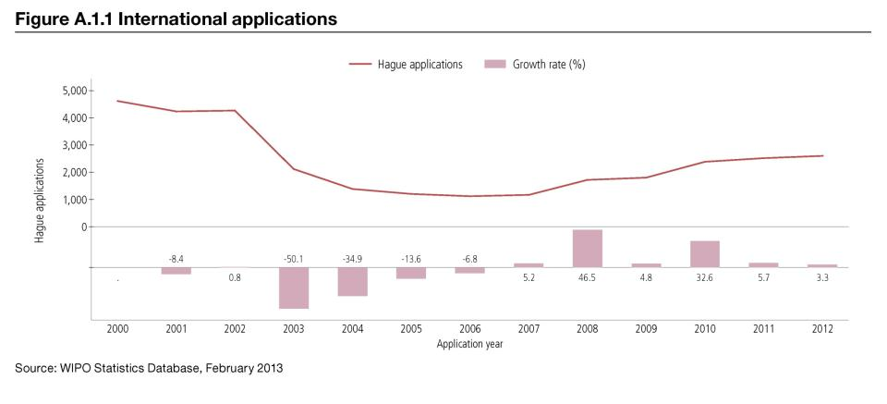
TREND IN HAGUE FILINGS (DESIGNS)

Slide 27
DEMAND FOR IP RIGHTS HAS GROWN
Source: WIPO Statistics Database, October 2011

Slide 28
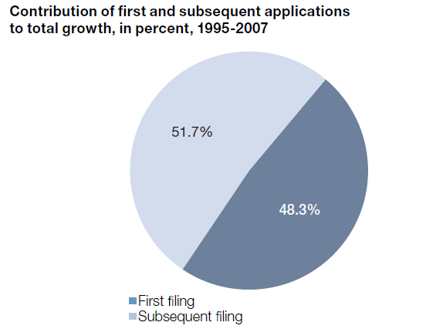
MORE INVENTIONS AND GREATER INTERNATIONALIZATION
Source: WIPO (2011)

Slide 29
STUDIES AND REPORTS
World Intellectual Property Indicators (WIPI): This is our flagship IP statistics publication. It provides an overview of latest trend in IP filings and registrations covering more than 100 offices : http://www.wipo.int/ipstats/en/wipi/index.html
The PCT Yearly Review provides an overview of the performance and development of the PCT system. It includes a comprehensive set of statistics for the latest available year See: http://www.wipo.int/ipstats/en/statistics/pct/
Madrid Yearly Review: http://www.wipo.int/ipstats/en/
Hague Yearly Review: http://www.wipo.int/ipstats/en/
The WIPO IP Facts and Figures provides an overview of intellectual property (IP) activity based on the latest available year of statistics. It serves as a quick reference guide for statistics: http://www.wipo.int/ipstats/en/
WIPO IP Statistics Data Center is an on-line service enabling access to WIPO’s statistical data. Users can select from a wide range of indicators and view or download data according to their needs: http://ipstatsdb.wipo.org/ipstatv2/ipstats/patentsSearch

Slide 30

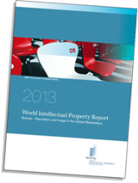
STUDIES AND REPORTS
II
New report « Brands – Reputation and Image in the Global Marketplace»
The report looks at how branding behavior and trademark use have evolved in recent history, how they differ across countries, what is behind markets for brands, what lessons economic research holds for trademark policy and how branding strategies influence companies’ innovation activities
For further information and the full report :
http://www.wipo.int/econ_stat/en/economics/wipr

Slide 31
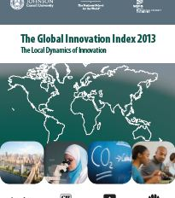
THE GLOBAL INNOVATION INDEX 2013
Annual publication that provides the latest trends in innovation activities across the world. It is co-published by INSEAD, Cornell Univ. and WIPO http://www.wipo.int/econ_stat/en/economics/gii/index.html
Its results are useful:
  To benchmark countries against their peers
  To study countries profiles over time
  Identify countries strengths and weaknesses

Slide 32
THE GLOBAL INNOVATION INDEX 2013
The framework is revised and adjusted every year in a transparent exercise
This year, out of 84 indicators, 64 are identical to GII 2012, and a total of 20 indicators were modified
10 indicators were deleted/replaced
10 indicators underwent changes such as the computation methodology at the source, change of scaling factor, change of classification etc.
The year per year comparison has to be carefully taken into consideration

Slide 33
GLOBAL INNOVATION INDEX FRAMEWORK
OUTPUT SUB INDEX
INPUT SUB INDEX
SCIENTIFIC OUTPUT
CREATIVE OUTPUT
HUMAN CAPITAL AND RESEARCH
INFRASTRUCTURE
MARKET SOPHISTICATION
BUSINESS SOPHISTICATION

Slide 34
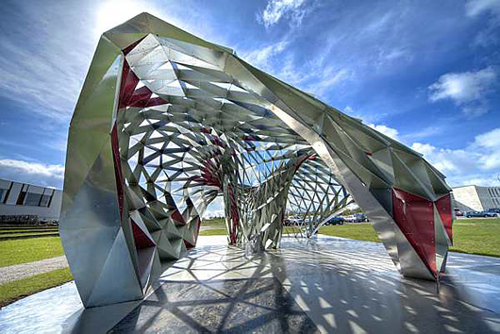
ICELAND PROFILE
DO IT YOURSELF REYKJAVIK , is a modern pavilion located in front of the Nordic House

Slide 35
THE GLOBAL INNOVATION INDEX
RANKING 2012
RANKING 2013
1. SWITZERLAND
2. SWEDEN
3. SINGAPORE
4. FINLAND
5. UNITED KINGDOM
6. NETHERLANDS
7. DENMARK
8. HONG KONG (CHINA)
9. IRELAND
10. UNITED STATES OF AMERICA
11. LUXEMBOURG
12. CANADA
13. NEW ZEALAND
14. NORWAY
15. GERMANY
18. ICELAND
Iceland is ranked within the top 20 in both 2012 and 2013
1. SWITZERLAND
2. SWEDEN
3. UNITED KINGDOM
4. NETHERLANDS
5. UNITED STATES OF AMERICA
6. FINLAND
7. HONG KONG (CHINA)
8. SINGAPORE
9. DENMARK
10. IRELAND
11. CANADA
12. LUXEMBOURG
13. ICELAND
14. ISRAEL
15. GERMANY
16. NORWAY

Slide 36
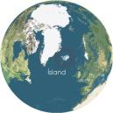
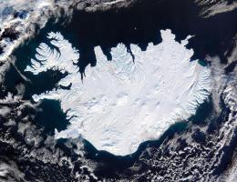
ICELAND PROFILE
  Iceland is ranked 13th in the Global Innovation Index
  Iceland has a leading position in the output sub-index (7th) due to proficiency in human capital and research (5th), creative outputs (3th) and institutions (12th)
  Iceland stands high in the institution index. The education level as well as the amount of the scientific & technical publications are its most valuable strength
  Iceland’s strengths are also drawn from general infrastructure within the electricity output and its consumption. Iceland is also ranked first with regard to the video uploads on YouTube and Wikipedia monthly publications which underline the strong approach to collaborative creativity.
  Iceland’s relative weaknesses are drawn from both market sophistication (with an issue regarding investment and market capitalization) and the knowledge & technology outputs.

Slide 37
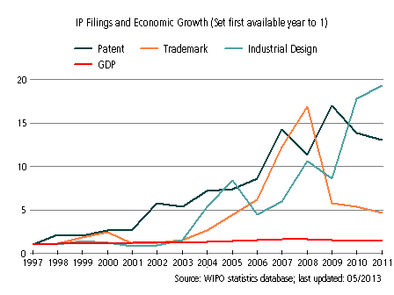
ICELAND’S EVOLUTION WITH RESPECT TO IP FILINGS AND
ECONOMIC GROWTH FROM 1997 TO 2011
The graphic shows a recent peak in industrial design’s filling, which is still growing strongly today. This is a sign of the strength of industrial designs in Iceland
The patent and trademark filings are also strong. This steady growth is a sign of Iceland’s reliance on IP for economic development.
Notes:
GDP : GROSS DOMESTIC PRODUCT

Slide 38
PATENT APPLICATION BY TOP FIELDS OF TECHNOLOGY (1997-2011)

Slide 39
INTERNATIONAL APPLICATIONS
VIA WIPO ADMINISTERED TREATIES
ICELAND

Slide 40
THANK YOU!
Victor Vazquez
Head, Section for coordination of developed countries,
Department for Transition and Developed countries (TDC)
World Intellectual Property Organization (WIPO)
34 chemin des Colombettes, 1211 Geneva 20, Switzerland
T + 41 22 338 99 97; victor.vazquez-lopez@wipo.int ; www.wipo.int/dcea/en/roving_seminars.html
Notes:
Welcome ….
Today, we are going to explain to you, in very general terms,
what this Organization does and why?

Slide 41

GLOBAL IP SYSTEMS:
RECENT AND FUTURE DEVELOPMENTS IN THE PATENT COOPERATION TREATY (PCT)
Speaker: Matthew Bryan, Director, PCT Legal Division, Innovation and Technology Sector, WIPO

Slide 42
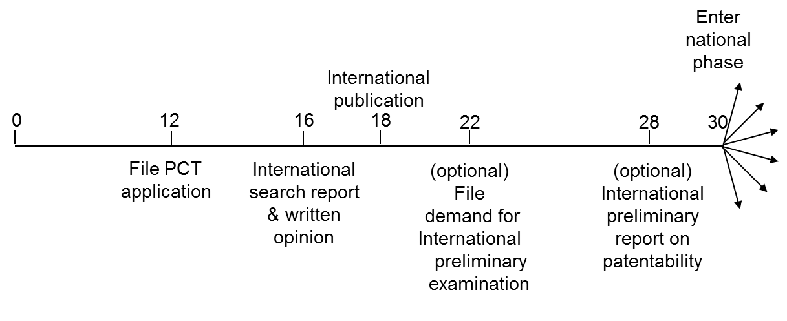
THE PATENT COOPERATION TREATY (PCT) SYSTEM

Slide 43

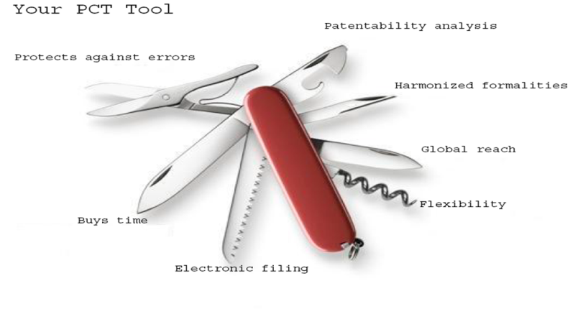
THE PCT

Slide 44
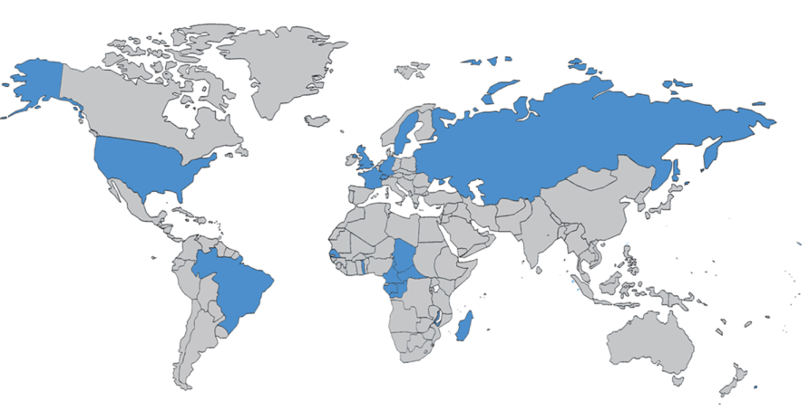
THE PCT IN 1978

Slide 45
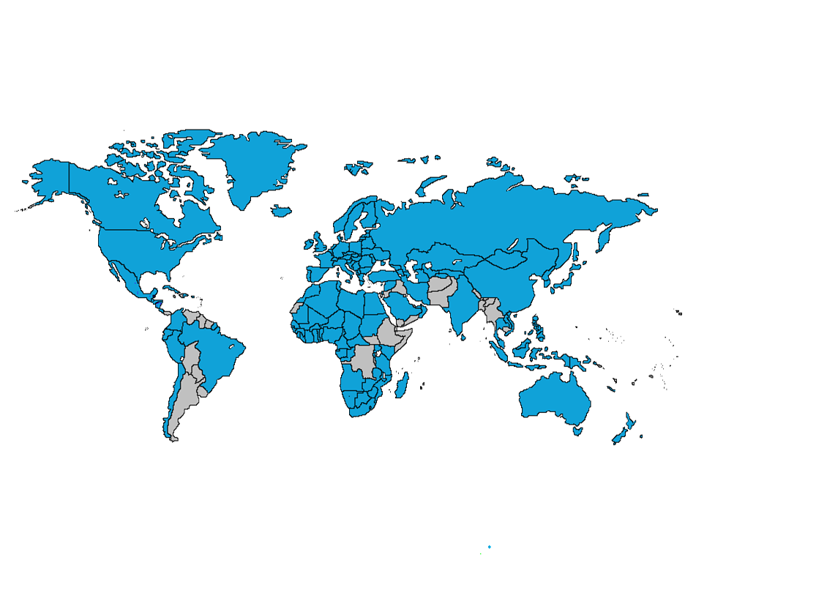
PCT COVERAGE TODAY

Slide 46
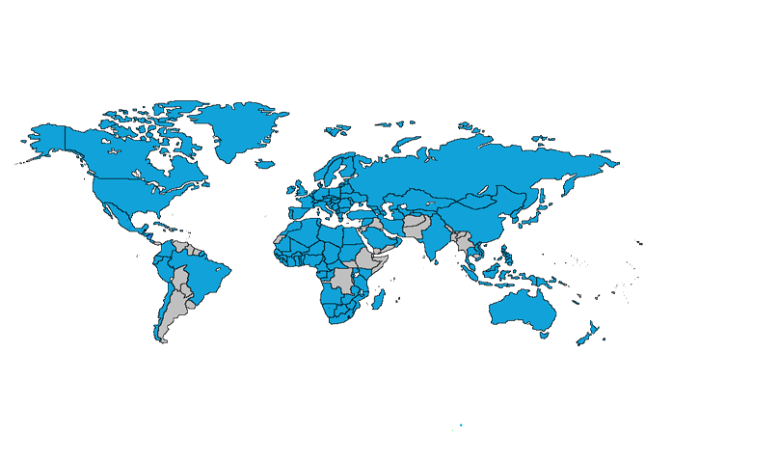

148 PCT STATES
Albania
Algeria
Angola
Antigua and Barbuda
Armenia
Australia
Austria
Azerbaijan
Bahrain
Barbados
Belarus
Belgium
Belize
Benin
Bosnia and Herzegovina
Botswana
Brazil
Brunei Darussalam
Bulgaria
Burkina Faso
Cameroon
Canada
Central African Republic
Chad
Chile
China
Colombia
Comoros
Congo
Costa Rica
Côte d'Ivoire
Croatia
Cuba
Cyprus
Czech Republic
Democratic People's
Republic of Korea
Denmark
Dominica
Dominican Republic
Ecuador
Egypt
El Salvador
Equatorial Guinea
Estonia
Finland
France,
Gabon
Gambia
Georgia
Germany
Ghana
Greece
Grenada
Guatemala
Guinea
Malawi
Malaysia
Mali
Malta
Mauritania
Mexico
Monaco
Mongolia
Montenegro
Morocco
Mozambique
Namibia
Netherlands
New Zealand
Nicaragua
Niger
Nigeria
Norway
Oman
Panama
Papua New Guinea
Peru
Philippines
St. Kitts and Nevis
Sweden
Switzerland
Syrian Arab Republic
Tajikistan
Thailand
The former Yugoslav
Republic of Macedonia
Togo
Trinidad and Tobago
Tunisia
Turkey
Turkmenistan
Uganda
Ukraine
United Arab Emirates
United Kingdom
  United Republic of Tanzania
  United States of America
Uzbekistan
Viet Nam
Zambia
Zimbabwe
Poland
Portugal
Qatar
Republic of Korea
Republic of Moldova
Romania
Rwanda
Russian Federation
Saint Lucia
Saint Vincent and
the Grenadines
San Marino
Sao Tomé e Principe
Saudi Arabia (3 Aug. 2013)
Senegal
Serbia
Seychelles
Sierra Leone
Singapore
Slovakia
Slovenia
South Africa
Spain
Sri Lanka
Sudan
Swaziland
Guinea-Bissau
Honduras
Hungary
Iceland
India
Indonesia
Iran (Islamic Republic of)
(4 Oct. 2013)
Ireland
Israel
Italy
Japan
Kazakhstan
Kenya
Kyrgyzstan
Lao People’s Dem Rep.
Latvia
Lesotho
Liberia
Libyan Arab Jamahiriya
Liechtenstein
Lithuania
Luxembourg
Madagascar

Slide 47
COUNTRIES NOT YET IN PCT
Somalia
South Sudan
Suriname
Timor-Leste
Tonga
Tuvalu
Uruguay
Vanuatu
Venezuela
Yemen
(45)
Afghanistan
Andorra
Argentina
Bahamas
Bangladesh
Bhutan
Bolivia
Burundi
Cambodia
Cape Verde
Democratic Republic of Congo
Djibouti
Eritrea
Ethiopia
Fiji
Guyana
Haiti
Iraq
Jamaica
Jordan
Kiribati
Kuwait
Lebanon
Maldives
Marshall Islands
Mauritius
Micronesia
Myanmar
Nauru
Nepal
Pakistan
Palau
Paraguay
Samoa
Solomon Islands

Slide 48
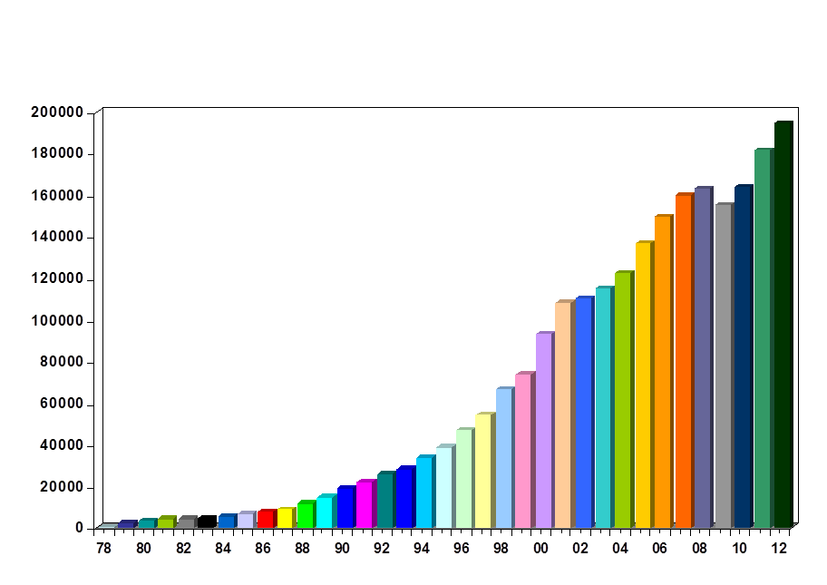


PCT APPLICATIONS 2012

Slide 49
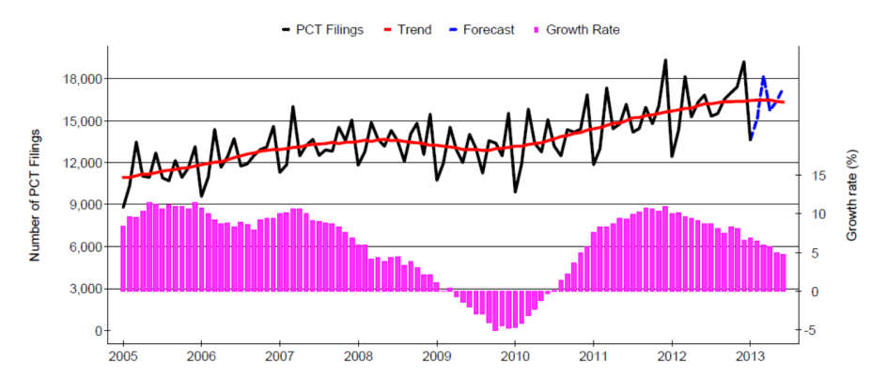
TRENDS IN PCT FILING

Slide 50
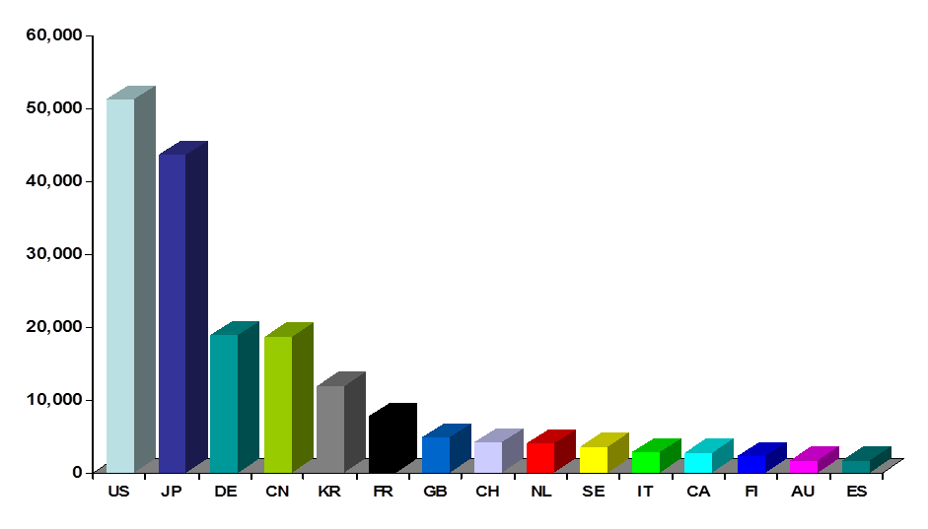
INTERNATIONAL APPLICATIONS RECEIVED IN 2012 BY COUNTRY OF ORIGIN
Top 15 countries responsible for 92.7% of IAs filed in 2012

Slide 51
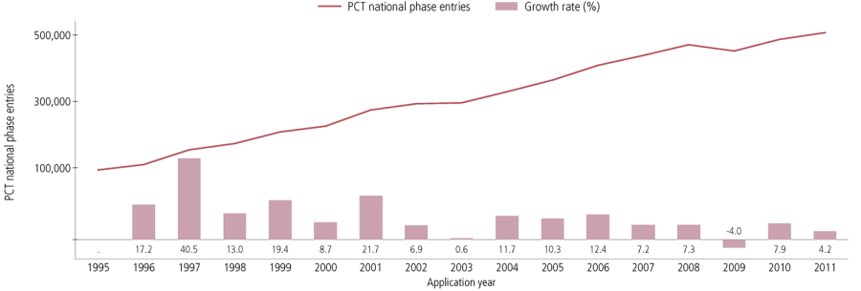
PCT NATIONAL PHASE ENTRIES – TOTAL
507,400 national phase entries estimated in 2011 (+ 4.2%)
431,800 (about 85%) of NPEs are from non-resident applicants

Slide 52
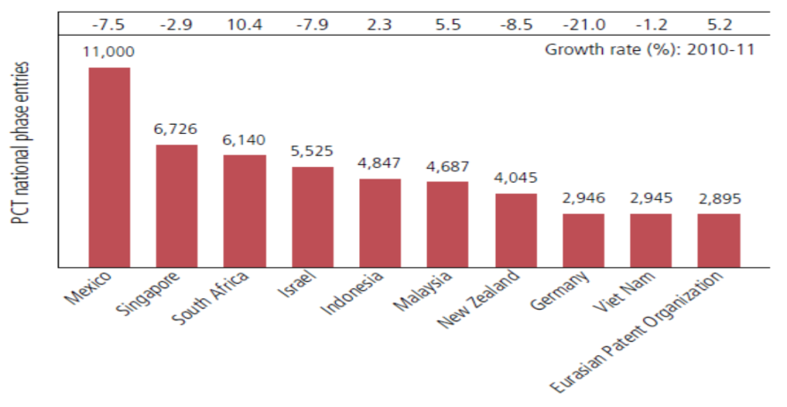
PCT NATIONAL PHASE ENTRIES 2011 BY TARGET DO (2)

Slide 53
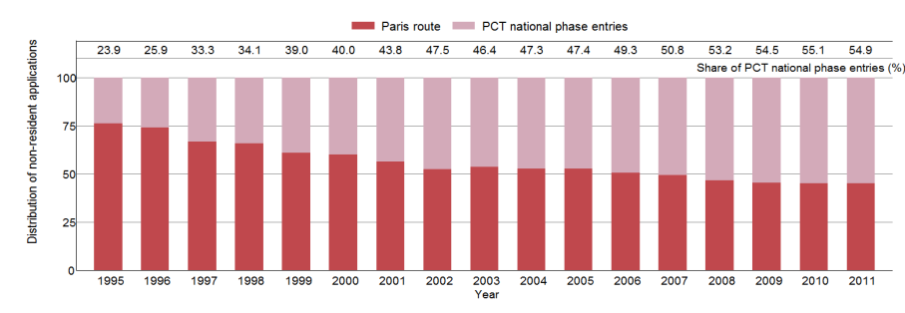
PARIS ROUTE VS. PCT NATIONAL PHASE

Slide 54
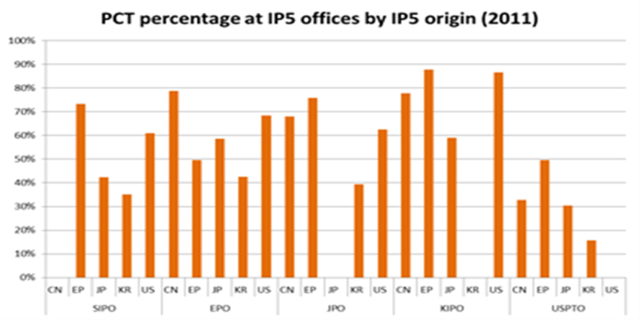
USE OF PCT WHEN SEEKING IP5 PROTECTION

Slide 55
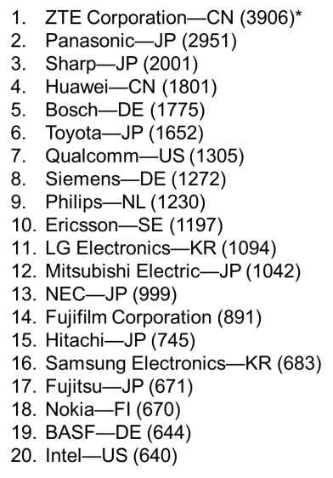
TOP PCT APPLICANTS 2012
*Almost 18 IAs/working day
() of published PCT applications

Slide 56
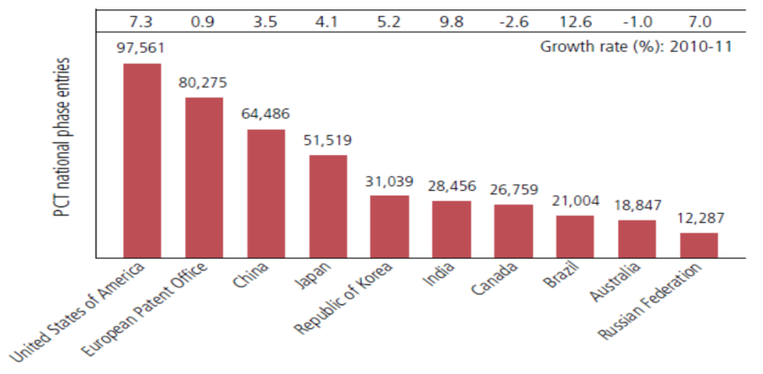
PCT NATIONAL PHASE ENTRIES 2011 BY TARGET DO (1)
USPTO most preferred DO for National Phase Entries; had highest growth among the IP5 Offices (+7.3%)
Brazil (+12.6%) and India (+9.8%) had highest growth rates among top 10 Offices

Slide 57
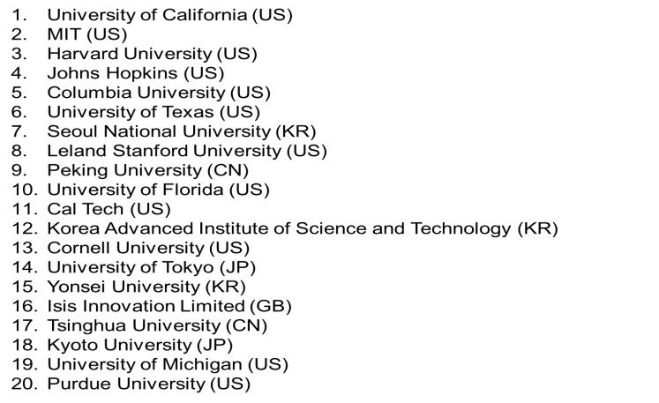
TOP UNIVERSITY PCT APPLICANTS 2012

Slide 58
TOP GOVERNMENT/RESEARCH INSTITUTION
PCT APPLICANTS 2012
Commissariat a l’Energie Atomique et aux Energies Alternatives (France)
Fraunhofer-Gesellschaft zur Forderung Der Angewandten Forschung e.v. (Germany)
Centre National de la Recherche Scientifique (CNRS) (France)
China Academy of Telecommunications Technology
Institute of Microelectronics of Chinese Academy of Sciences (China)
Mimos Berhad (Malaysia)
Institut National de la Sante et de la Recherche Medicale (INSERM) (France)
Electronics & Telecommunications Research Institute of Korea
Agency of Science, Technology and Research (Singapore)
Consejo Superior de Investigaciones Cientificas (CSIC) (Spain)
United States of America, represented by the Secretary, Department of Health and Human Services
National Institute of Advanced Industrial Science and Technology (Japan)
Council of Scientific and Industrial Research (India)
Korea Research Institute of BioScience and Biotechnology
Nederlandse Organisatie voor Toegepast-Natuurwetenschappelijk Onderzoek Tno (Netherlands)
Max Plank Institute (Germany)

Slide 59
SOME ICELAND PCT APPLICANTS
Decode Genetics EHF
Össur HF
Actavis Group PTC EHF
Marel HF
Skaginn HF
Prokaria EHF

Slide 60
PCT INTERNATIONAL SEARCHING AUTHORITIES
The ISAs are the following 19 offices:
  Australia
  Austria
  Brazil
  Canada
  Chile (not yet operating)
  China
  Egypt
  Finland
  India
  Israel
  Japan
  Republic of Korea
  Russian Federation
  Spain
  Sweden
  Ukraine (not yet operating)
  United States of America
  European Patent Office
  Nordic Patent Institute

Slide 61
RECENT PCT DEVELOPMENT
America Invents Act (AIA) Simplification for PCT
3rd Party Observation system
Indication of availability for license
ePCT
PCT-PPH
WIPO AMC fee reduction for PCT users
Misleading invitations
PCT Working Group 2013

Slide 62
AIA SIMPLIFICATION FOR PCT (1)
US national law changes which entered into force on 16 September 2012 have direct impact on the PCT system
  Related PCT Rule changes were adopted by the PCT Assembly in October 2012 and entered into force on 1 January 2013
Simplification for PCT system since 16 September 2012:
  PCT applications can be filed in the name of a corporate applicant for all States, including the US
  Only declarations of inventorship (PCT Rule 4.17(iv)) complying with new standardized wording (Section 214 PCT/AIs) will be accepted by DO/US
  The request form (PCT/RO/101) and PCT-SAFE software were modified accordingly

Slide 63
AIA SIMPLIFICATION FOR PCT (2)
Transitional period:
  Applicants who, on or after 16 September 2012, continue to indicate inventors as applicants for the US only in the request form will receive a notice from the RO (PCT/RO/132) or the IB (PCT/IB/345) informing them about the possibility to submit a request for the recording of a change under Rule 92bis
  Applicants who use the old standardized wording for the declaration of inventorship for international applications filed on or after 16 September 2012 will receive an invitation to correct from the IB (Form PCT/IB/370)

Slide 64
3rd PARTY OBSERVATION SYSTEM (1)
Allows third parties to submit prior art observations relevant to novelty and inventive step as to published PCT applications
  Goal: Improve patent quality--give national offices (and PCT Authorities) better/more complete information on which to base their decisions
Web-based system using in PATENTSCOPE or via ePCT public services
Free-of-charge
Submissions possible until the expiration of 28 months from the priority date
Applicants may submit comments in response to submitted observations until the expiration of 30 months from the priority date
Anonymous submission of third party observations possible

Slide 65
3rd PARTY OBSERVATION SYSTEM (2)
Third-party supplied documents will not be available via PATENTSCOPE, but will be made available to International Authorities and national Offices
WIPO:
  checks for spam/abuse
  notifies applicant of submission of observations
  makes observations available in PATENTSCOPE
  sends to IAs/DOs observations, cited documents, and any applicant responses
Thus far:
  no attempts at abusive submissions nor campaigns against particular technologies
  everything received so far has been very professional, most in English, almost all anonymous, and have included copies of citations
  user feedback so far has been “easy to use if you already have a WIPO account” but 500 character limit presents some difficulties

Slide 66
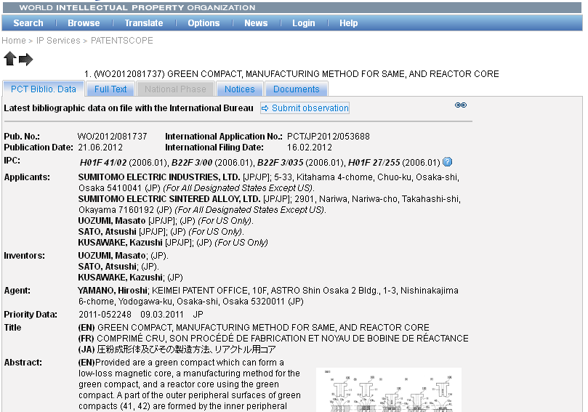

Slide 67
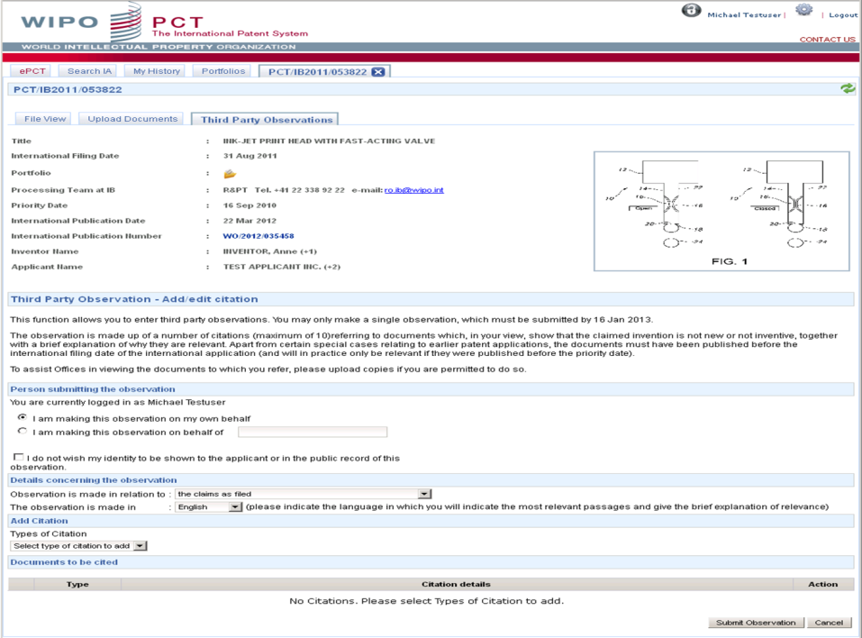

Slide 68
INDICATIONS OF AVAILABILITY FOR LICENCE
Most use thus far from universities/research institutions
PCT applicants can indicate in relation to their published applications that the invention is available for license
  How? Applicants should submit a “licensing request” (see Form PCT/IB/382) directly to the IB
  When? At the time of filing or within 30 months from the priority date
  Free of charge
  Applicants can file multiple licensing requests or update previously submitted ones (within 30 months from the priority date) and such requests may be revoked by the applicant at any time, that is, also after 30 months from the priority date
Submitted licensing indications made publicly available after international publication of the application on PATENTSCOPE under “Bibliographic data” tab with a link to the submitted licensing request itself
International applications containing such licensing indication requests can be searched in PATENTSCOPE

Slide 69
ePCT
WIPO online service that provides secure electronic access to/interaction with IB’s PCT application files
  Secure access via ePCT private services requires a WIPO user account and valid digital certificate (available for PCT applications filed as from 1 January 2009)
  Access via ePCT public services for online document upload requires only a basic WIPO user account (no additional authentication is required) (available for all PCT applications)
8500 users in over 100 countries, 30+ offices
Positive feedback from users
  applicant features generally reckoned best in class
  unique notifications feature already saved applicants
  Office features found easy to use
More information: https://pct.wipo.int/ePCT

Slide 70
ePCT: FUTURE IMPROVEMENTS (1)
Web-based electronic filing of new PCT applications
  Currently in pilot with RO/IB
  Aiming at Q3/2013 for opening up for RO/IB filing
  Aiming to have even better validations than PCT-SAFE, including up-to-date validation direct from IB database, and validations and feedback not possible with PCT-SAFE (such as automatically detecting and converting color drawings to B/W)
Aiming for fully hosted RO service by end 2014
Multilingual interface (eventually 10 languages)
Extension of ePCT to interested Offices in their various capacities (RO, ISA, SISA, IPEA, DO, EO) has started, including hosting on behalf of offices, and 2-way communication

Slide 71
ePCT: FUTURE IMPROVEMENTS (2)
Goal to offer centralized real-time credit card transactions for all fee types and all authorities
National phase entry function could be added to Epct
  Opt-in for DOs
  Applicant would select from among participating DOs, upload any necessary documents and add any bibliographic data not already available to IB
  Local counsel could be fully involved, as needed
  Would not initially include fee payment facility, but this could be added in the future
  Positive reaction during an initial discussion at Feb. 2013 IP5 meeting

Slide 72
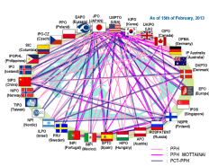
PCT – PPH (1)
Accelerated national phase examination based on positive work product of PCT International Authority (written opinion of the ISA or the IPEA, IPRP (Ch I or II)
MANY individual PCT-PPH pathways
    Information on the PCT Website: http://www.wipo.int/pct/en/filing/pct_pph.html
PCT-PPH user experience/strategy: http://www.youtube.com/watch?v=XnSShsUHXss (Carl Oppedahl video)

Slide 73
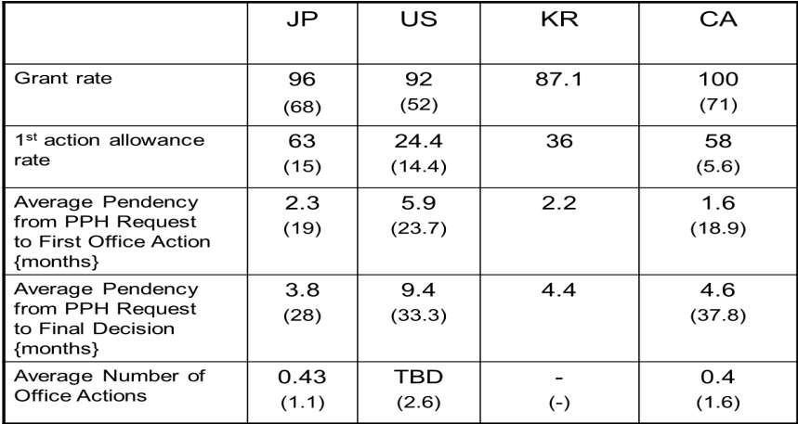
PCT – PPH (2)

Slide 74
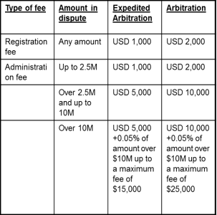
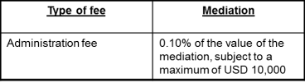
WIPO AMC FEE REDUCTION FOR PCT USERS
AMC = WIPO Arbitration and Mediation Center
  AMC offers a 25% reduction in the Center’s registration and administration fees where at least one party to the dispute has been named as an applicant or inventor in a published PCT application

Slide 75
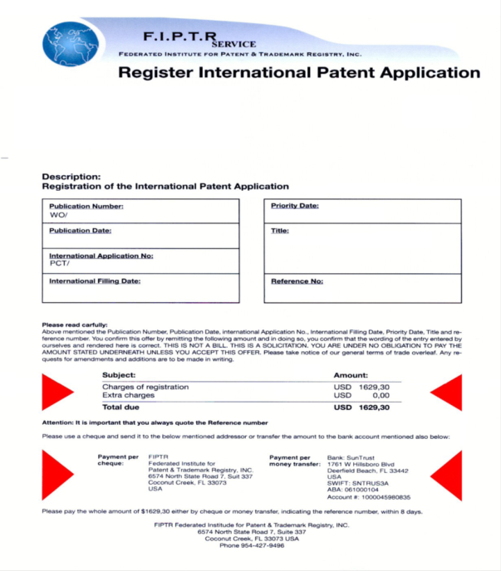

Slide 76
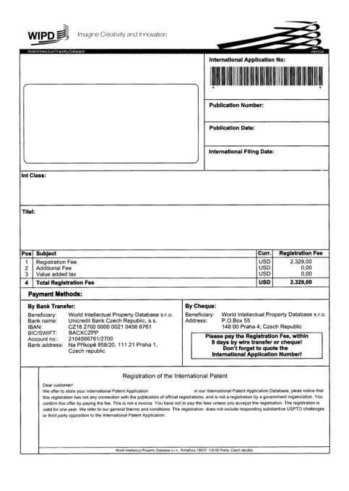

Slide 77
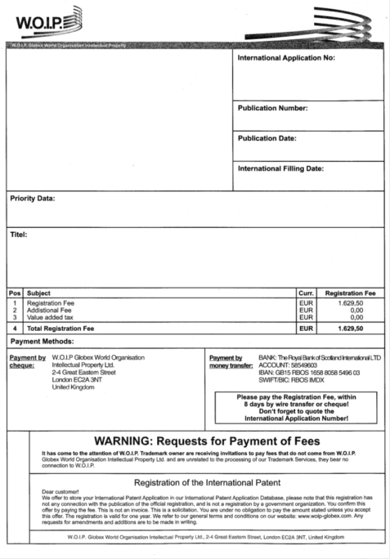

Slide 78
WIPO WARNINGS
http://www.wipo.int/pct/en/warning/pct_warning.html
WIPO continues various efforts concerning such notifications, including:
  keeping the warning page up to date with newly submitted examples
  WIPO letters to offices requesting assistance and cooperation
  WIPO letters to IP associations requesting that all clients be warned
  WIPO letters to banks doing business with the entities behind these notifications
  working with government agencies in countries where these entities are based
Help us by making complaints to appropriate consumer protection authorities in your country and/or state/locality

Slide 79
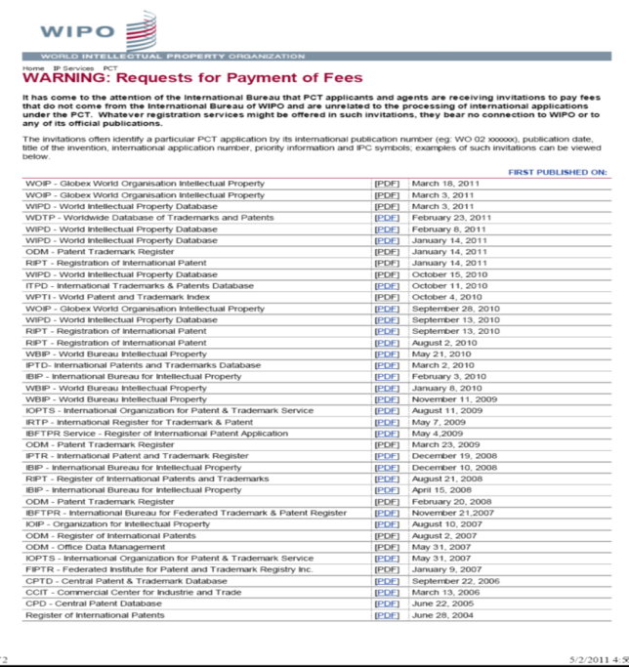

Slide 80
PCT WORKING GROUP MAY 21-24 (1)
USPTO/UK--Mandatory response to negative comments in the national phase (PCT/WG/6/16)
USPTO/UK-- Formal integration of PPH into PCT (PCT/WG/6/17)
USPTO/UK-- Mandatory top-up search in Ch. II (PCT/WG/6/18)
USPTO/UK-- Mandatory recordation of search strategies (PCT/WG/6/?)
Other USPTO/UK “20/20” proposals:
  Self-service 92bis changes and priority claim corrections
  Limited Chapter I corrections to claims
  Simplified withdrawal without signatures within limited period
  Formally integrate collaborative search into PCT
  Incorporate Global Dossier into PCT
Availability of Written Opinion of ISA as of publication date (PCT/WG/6/13)
Requirements and procedures of appointment of International Authorities (PCT/WG/6/4)
PCT Fee Reductions (PCT/WG/6/10)
Restoration of the Right of Priority (PCT/WG/6/12)
Evaluation Report of 2nd Collaborative Search/Exam pilot (PCT/WG/6/22)

Slide 81
PCT WORKING GROUP MAY 21-24 (2)
PCT Minimum Documentation (PCT/WG/6/9)
PCT Sequence Listing Standard (PCT/WG/6/7)
Revision of WIPO Standard ST.14 (PCT/WG/6/8)
Updates for the WG:
  Supplementary International Search
  3rd party observations
  ePCT
Quality (PCT/MIA/20/3)
  Report from the Quality Subgroup
  Matters Arising from Report from the Quality Subgroup
  Future Quality-Related Work

Slide 82
PCT WORKING GROUP MAY 21-24 :
OUTCOMES
2 sets of amendments forwarded to PCT Assembly
  Amend PCT Rules 66 and 70 to require IPEAs to conduct top-up searches during IPE
  Delete PCT Rule 44ter and amend PCT Rule 94 to make WO/ISA available to the public via PATENTSCOPE at international publication
  If approved by PCT Assembly in October, these amendments to the PCT Regulations will enter into force July 1, 2014, for demands for IPE filed on or after that date, and for applications filed on or after that date, respectively
Many of the proposals discussed will be revised for further discussion next year

Slide 83
FUTURE PCT DEVELOPMENTS
Further work on all remaining WG proposals:
  Fee reductions
  Appointment of ISAs/IPEAs
  US/UK “20/20” revised proposals
  Etc.
Collaborative search

Slide 84
COLLABORATIVE PCT SEARCH (1)
WIPO’s position: collaborative search should be part of the future of the PCT
PCT past discussions
  PCT Collaborative Search (and Examination) were important elements of initial “PCT Roadmap” proposal presented at the 2009 PCT WG
  Most recent status reports at 2012 PCT MIA (PCT/MIA/19/4) and 2012 PCT WG (PCT/WG/5/9)
2nd IP5 pilot
  preliminary views of EPO (as example)
    In 87% of cases, feedback from USPTO and KIPO examiners resulted in addition of citations to ISR, and in 27% resulted in amendments to WO-ISA
    In 92% of cases, lead examiner (EPO) perceived the final products (ISR and WO-ISA) improved as a result of collaboration; in more than 1/3 of cases, significant improvement
    In 70% of cases, EPO examiners (as peer examiners) would trust both search and exam results produced collaboratively
    In 30% of cases, complementary examination would be required at EPO due to differences in patent law (e.g., medical use, method of treatment, etc.)

Slide 85
COLLABORATIVE PCT SEARCH (2)
KIPO’s experience (2nd pilot)
  92% of cases: result improved through collaboration
  New citations resulted from collaboration in 71% of cases
  84% of cases: KIPO would trust the collaborative result in the national phase
USPTO experience (2nd pilot)
  Additional citations on novelty in ISR in 41% of cases resulting from collaboration
  23% of draft ISRs presented to peers remained unchanged
  USPTO examiners perceived great improvement in quality in 67% of cases
  USPTO stated (2013 PCT WG) if such a system were eventually adopted, the cost should not be significantly greater than that for the main international search

Slide 86
PCT TRAINING OPTIONS
PCT Distance learning course content available in the 10 PCT publication languages
New: 29 video segments on WIPO’s Youtube channel about individual PCT topics from our Basic Seminar series
PCT Webinars
  providing free updates on developments in PCT procedures, and PCT strategies—previous webinars are archived and freely available
  upon request also for companies or law firms, for example, for focused training on how to use ePCT
In-person PCT Seminars and training sessions

Slide 87
PCT RESOURCES/INFORMATION
For further information about PCT, see :
  http://wipo.int/pct/en/
For general questions about the PCT, please contact the PCT information Service at :
  Telephone : (+41-22) 338 83 38
  Fascimile : (+41-22) 338 83 39
  E-mail: pct.infoline@wipo.int
  Matthew.bryan@wipo.int

Slide 88


Slide 89
THE MADRID SYSTEM & THE HAGUE SYSTEM
Speaker: Mrs. Asta Valdimarsdottir, Director, Operations Service, Madrid Registry, Brands and Designs Sector (BDS), WIPO, Geneva

Slide 90
THE MADRID SYSTEM

Slide 91
TRADEMARKS
A brand incarnates an enterprise's reputation and image and so is one of an enterprise's most valuable assets” (Director General, Francis Gurry)
Trademarks are the most widely used form of registered intellectual property (IP) throughout the world
Trademark demand quadrupled between 1985 and 2011, from just under 1 million applications per year in 1985 to 4.2 million by 2011
Notes:
WIPOs report “Brands, reputation and Image in the Global market

Slide 92
ROUTES FOR PROTECTING A TRADEMARK
The national route: File a trademark application with the Trademark Office of each country in which protection of the mark is sought
The regional route: Apply for protection in countries which are members of a regional trademark registration system with effect in the territories of all Member States (ARIPO, Benelux Trademark Office, OHIM and OAPI)
The international route: The Madrid system

Slide 93



FILING OPTIONS
Applicant
Applicant
Office of Origin
Country B
Country C
Country A
Country B

Slide 94

THE NATIONAL ROUTE VS. THE MADRID ROUTE
Filing in one Office
One application form
One language (E/F/S)
One currency (CHF)
One international registration
One renewal
One modification
Foreign attorney first needed in case of refusal
Filing in several Offices
Many application forms
Several languages
Several currencies
Several registrations
Several renewals
Several modifications
Foreign attorney needed from filing

Slide 95
MADRID UNION
1 Agreement only
37 Protocol only (including EU)
54 Agreement and Protocol
92 Members

Slide 96
ACCESSIONS
2012: Colombia, Mexico, New Zealand and Philippines
2013: India, Rwanda and Tunisia (October 16, 2013)
Future accessions?
  Latin American countries
  ASEAN countries by 2015
  Caribbean countries
  African countries
Notes:
Significant geographical expansion of the Madrid system

Slide 97
MADRID SYSTEM I
A registration system for 92 Contracting Parties
One application – one language – one set of fees
Three main stages
  Basic application/basic registration > International application
  Formal examination by WIPO
  Substantive examination by the Offices of the designated Contracting Parties
Notes:
In order to use the Madrid system, you need a connection with a Contracting Party (CP), such as establishment, domicile or nationality, and a mark applied for or registered (basic mark) with that CP (Office of origin)
A CP will need to refuse protection within 12/18 months, otherwise the mark will be deemed protected

Slide 98
MADRID SYSTEM II
One registration covering multiple territories
Manage a portfolio of trademarks via a single centralized system
Renew in all designated Contracting Parties with one request
Expand protection to new Contracting Parties
Notes:
Expand your protection to states that have already been members for some time

Slide 99
THE INTERNATIONAL PROCEDURE I
Office of Origin
Designated Contracting Party
Designated Contracting Party
Designated Contracting Party
WIPO
Applicant
Certifies the application and forwards it to WIPO
Conducts the formal examination; records the mark in the International Registry and publishes the international registration in the Gazette. Issues a certificate of registration and notifies the designated Contracting Parties
Entitlement
Basic Mark
Scope of protection of the international registration will be determined by the substantive examination under domestic law, within 12/18 months

Slide 100
THE INTERNATIONAL PROCEDURE II
Designated Contracting Parties
National Procedure
Regional Procedure
National Procedure
WIPO
Holder
Substantive examination under domestic law within 12/18 months
Provisional refusals and/or statements of grant of protection are sent to WIPO. WIPO notifies the holder/representative

Slide 101
THE INTERNATIONAL PROCEDURE III
Notification Provisional Refusal
National / Regional Procedure
WIPO
Holder
Holder
WIPO
Each Office gives the deadline to respond to provisional refusal (between 15 days and 3 months)
Limitation to overcome the Provisional Refusal
This procedure is governed by domestic law and the holder has to defend his rights directly before the Office of the designated Contracting Party
Offices send WIPO their final decision (Statement of Grant of Protection Following a Provisional Refusal (Total or Partial) or Confirmation of a Total Provisional Refusal). WIPO notifies the holder/representative

Slide 102
THE MADRID SYSTEM – FACTS AND FIGURES
Worldwide trademark filings + 9.3% from 2008 to 2011
2012 + 4.1% growth in applications
2013 (July) + 5.9% growth in applications
Over 560,000 international registrations in force
5.57 million designations in force
185,503 holders of international registrations
Notes:
Some figures

Slide 103
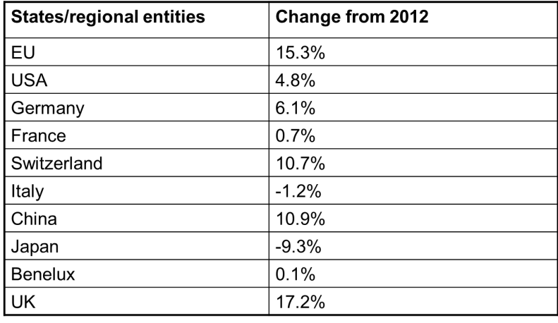
TOP FILING STATES – 2013

Slide 104
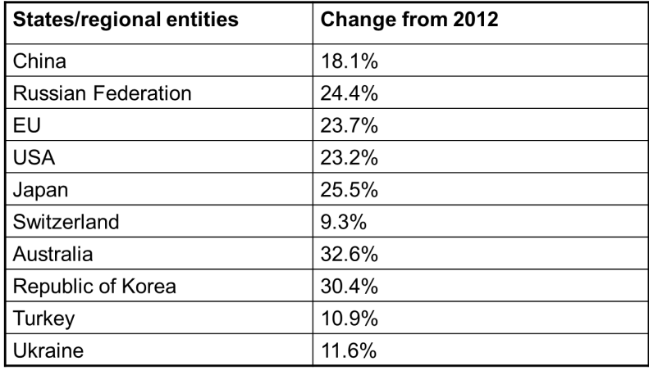
TOP DESIGNATIONS – 2013

Slide 105

GENERAL PROFILE 2012
Notes:
Over 80% of our users have rather small portfolios

Slide 106

IR FILED BY NORDIC COUNTRIES

Slide 107

DESIGNATIONS OF NORDIC COUNTRIES

Slide 108

INTERNATIONAL APPLICATIONS REGISTRATIONS FROM ICELAND

Slide 109

DESIGNATIONS IN INTERNATIONAL REGISTRATIONS AND SUBSEQUENT DESIGNATIONS – DCP : IS
Notes:
Designations to Iceland – so people abroad seeking protection in Iceland has always been rather high, compared to the national filings.
Dropped in 2008.

Slide 110

DESIGNATIONS IN INTERNATIONAL REGISTRATIONS AND SUBSEQUENT DESIGNATIONS. DCP: IS 2012
Total number of designations: 2,372
Notes:
13% of teh registration to Iceland are form EU
Swiss 12%
11 from the US

Slide 111
ONLINE INFORMATION SERVICES
Legal texts, Guide and Information Notices
WIPO Gazette of International Marks
E-Renewal Tool
Fee Calculator: Costing service
ROMARIN: Online search database
Dynamic Madrid Statistics free access at http://www.wipo.int/madrid/en/

Slide 112
ONLINE TOOLS
Madrid Goods and Services Manager (MGS): To use correct specifications of goods and services
Madrid Real-Time Status (MRS): To check the status of an international application/registration
Madrid Portfolio Manager (MPM): To enable holders and representatives to view and modify their portfolio
Madrid Electronic Alerts (MEA): To enable users to submit a list of IRs to monitor and to be informed by email when any of them change
Accessible from http://www.wipo.int/madrid/en/services/
Notes:
Protection for design – the line between trademark protection and designs.
For a bottle – only the design but as trademark the product

Slide 113


Slide 114
BENEFITS FOR TRADEMARKS OWNERS
Simple and economical procedure
  A single set of simple formalities
  A single filing Office
  Low registration fees
  No need for representatives for filings
  No need to pay for translation into several languages
Effective procedure
  A single international application has the same legal effect in various countries
  A fixed deadline for the confirmation or refusal of the legal effects in each designated country
Notes:
To sum up

Slide 115
THE HAGUE SYSTEM
Notes:
Protection for design – the line between trademark protection and designs.
For a bottle – only the design but as trademark the product

Slide 116

IN A NUTSHELL
«The Hague Agreement provides creators and holders of designs with a simple, rapid and economical procedure to secure and maintain the protection of industrial designs, through a single international registration»

Slide 117
THE HAGUE SYSTEM
A centralized filing mechanism
A one-stop shop to obtain and maintain design protection in export markets
An option to the national route
A purely procedural treaty
The domestic legislation of the designated Contracting Parties sets the conditions for protecting designs and determines the rights which result from protection
Notes:
Provides a simple, rapid and economical procedure to obtian protection

Slide 118

THE HAGUE UNION
46 Geneva Act (1999) (including EU and OAPI)
15 Hague Act (1960)
61 Contracting Parties

Slide 119
ACCESSIONS
2010: Germany, Norway, Azerbaijan
2011: Finland, Monaco, Rwanda
2012: Montenegro, Tajikistan, Tunisia
Future accessions?
  China, Japan, Republic of Korea and USA
  Russian Federation and Belarus
  ASEAN countries by 2015
  Barbados and Trinidad & Tobago
  Madagascar and Morocco

Slide 120


FORESEEN EXPANSION OF THE HAGUE SYSTEM
Coming Soon!

Slide 121
KEY PRINCIPLES OF THE HAGUE SYSTEM (I)
Entitlement:
In order to use the Hague system, you need a connection with a Contracting Party (CP), such as establishment, domicile, nationality or habitual residence
One file > many territories:
File a single international application for a single international registration (IR) in which one or more Contracting Parties (CP) are designated (“self-designation“ is possible)
Renewal:
Duration: 5 years renewable. 15 years for the 1999 Act or possibly longer if allowed by a designated CP

Slide 122
KEY PRINCIPLES OF THE HAGUE SYSTEM (II)
Possible deferment of up to 30 months:
Counted from date of filing or priority date
Fixed Time Limit for Refusal:
Any refusal must be notified to the International Bureau within 6 or 12 months from the publication of the international registration on the WIPO website, otherwise the design will be deemed protected
“Bundle of Rights”:
If no refusal is issued, the resulting IR has the effect of a grant of protection in each designated CP
Notes:
In some states it is possible to defer the publication of the design. This can be up to 30 months.
Iceland does not allow any deferment of publication

Slide 123
FILING OPTIONS
Applicant
Applicant
Country A
Country B
Country C
Country A
Country B
Country C

Slide 124
THE NATIONAL ROUTE VS. THE HAGUE ROUTE
Several Offices for filing
Several application forms
Several languages
Several currencies
Several registrations
Several renewals
Several modifications
Foreign attorney needed from filing
One Office for filing
One application form
One language (E/F/S)
One currency (CHF)
One international registration
One renewal
One modification
Foreign attorney first needed in case of refusal

Slide 125
THE REGISTRATION PROCEDURE
Only formal examination in the International Bureau
  Recording in the International Register
  Publication in the International Designs Bulletin
  Notification to designated CPs through the publication
Substantive examination by the designated Contracting Parties only
Refusal must be received by the International Bureau within a set time limit after publication: 6 or 12 months

Slide 126
THE USE OF THE HAGUE SYSTEM IN 2012
2,604 international applications filed (12,454 designs)
2,440 international registrations recorded (11,971 designs)
Largest filers: Swatch AG, Daimler AG, Koninklijke Philips Electronics
Approximately 26,284 international registrations in force, containing 110,158 designs
  Equivalent to over 131,420 designations in force
  Involving 8,029 holders

Slide 127
International Registration | 799 | 419 | 619 | 355 | 160 | 62 | 26
% | 32.7% | 17.2% | 25.4% | 14.5% | 6.6% | 2.5% | 1.1%
Notes:
Most applications – contain only one design

Slide 128
International Registration | 1162 | 775 | 270 | 153 | 80
% | 47.6% | 31.8% | 11.1% | 6.3% | 3.3%
Notes:
Most of the applicatant pay less than 1000 chf

Slide 129

International Registration | 371 | 663 | 715 | 380 | 241 | 57 | 13
% | 15.2% | 27.2% | 29.3% | 15.6% | 9.9% | 2.3% | 0.5%

Slide 130
TOP FILING CONTRACTING PARTIES
Contracting Party of entitlement
1. European Union (5168 designs, 41.5%)
2. Switzerland (2855 designs, 22.9%)
3. Germany (1630 designs, 13.1%)
4. France (1265 designs, 10.2%)
5. Turkey (278 designs, 2.2%)
6. Norway (186 designs, 1.5%)
7. Spain (101 designs, 0.8%)
8. Poland (86 designs, 0.7%)
9. Croatia (76 designs, 0.6%)
10. Liechtenstein (73 designs, 0.6%)

Slide 131
MOST DESIGNATED CONTRACTING PARTIES
Number of designs recorded:
1. European Union (8961 designs, 74.9%)
2. Switzerland (8802 designs, 73.5%)
3. Turkey (5110 designs, 42.7%)
4. Ukraine (2853 designs, 23.8%)
5. Singapore (2531 designs, 21.1%)
6. Norway (2389 designs, 20%)
7. Croatia (2376 designs, 19.8%)
8. Morocco (1853 designs, 15.5%)
9. Liechtenstein (1499 designs, 12.5%)
10. Serbia (1494 designs, 12.5%)

Slide 132

DESIGNATIONS IN IRs, ICELAND AS COUNTRY OF THE HOLDER (2012)
Notes:
Majority from the EU

Slide 133

DESIGNATIONS IN Irs, ICELAND AS DCP (2012)
Total: 90
Notes:
The total number of designs via Hague in Icleand are 90.
Majority from the EU

Slide 134
LATEST DEVELOPMENTS
Weekly publication cycle since January 2012
Enhancement of the E-filing interface as from June, 2013
  A WIPO User account
  Facilitated downloading of reproductions
  Automatic check and transformation of images
  Integrated fee calculator
  Payment of fees by credit card

Slide 135
ADVANTAGES
Cost-effective and efficient
Flexible in targeting national, regional or global markets
Centralized acquisition and maintenance of rights
Notes:
1 cost-effective and efficient, thereby creating opportunities that would not otherwise exist for any enterprise with a limited legal budget
3 by filing a single international application for a single international registration with effect in one or more designated Contracting Parties

Slide 136

Thank you
for your attention
Asta.valdimarsdottir@wipo.in

Slide 137
ALTERNATIVE DISPUTE RESOLUTION- WIPO ARBITRATION AND MEDIATION CENTER
Speaker : Víctor Vázquez, Head, Section for Coordination of Developed Countries, Department for Transition and Developed Countries (TDC), WIPO

Slide 138
COMMON TYPES OF INTELLECTUAL PROPERTY DISPUTES
Contractual:
patent licenses,
software and other information technology (IT),
research and development agreements,
trademark coexistence agreements,
patent pools,
distribution agreements,
joint ventures,
copyright collecting societies,
IP settlement agreements
Infringement of IP rights
Domestic as well as international disputes

Slide 139
WIPO INTERNATIONAL SURVEY ON DISPUTE RESOLUTION IN TECHNOLOGY TRANSACTION
Place of Survey Respondent
Business Operations
Type of Survey Respondent

Slide 140
HOW ARE TECHNOLOGY DISPUTES RESOLVED ?

Slide 141
RELATIVE TIME & COST OF TECHNOLOGY DISPUTE RESOLUTION

Slide 142

PATENT LITIGATION IN COURT
This chart is based on figures provided in Patent Litigation - Jurisdictional Comparisons, Thierry Calame, Massimo Sterpi (ed.), The European Lawyer Ltd, London 2006.
* Report of the Economic Survey, Prepared Under the Direction of Law Practice Management Committee, AIPLA, Arlington 2011.

Slide 143
ALTERNATIVE DISPUTE RESOLUTION
Procedure for settling disputes by means other than litigation (e.g. Arbitration, mediation or expert determination)
The WIPO Arbitration and Mediation center was established in 1994
Headquarters in Geneva with an office at Maxwell Chambers Singapore

Slide 144
MEDIATION, ARBITRATION, EXPERT DETERMINATION
Mediation: an informal consensual procedure in which a neutral intermediary the mediator, assists the parties in reaching a settlement of their dispute, based on the parties’ respective interests. The mediator cannot impose a decision. The settlement agreement has the force of a contract. Mediation leaves open all other dispute resolution options.
Arbitration: A consensual procedure in which the parties submit their dispute to one or more chosen arbitrators, for a binding and final decision (award) based on the parties’ respective rights and obligations and enforceable as an award under arbitral law. Arbitration constitutes a private alternative to court litigation.
Expert Determination: A consensual procedure in which the parties submit a specific matter (e.g. technical question) to one or more experts who make a determination on the matter, which can be binding unless the parties have agreed otherwise

Slide 145


WIPO CASES
Subject Matter
Business Areas
WIPO AMC has administered over 350 cases, with parties from Austria, China, Cyprus, Denmark, Finland, France, Germany, India, Ireland, Israel, Italy, Japan, Netherlands, Norway, Panama, Romania, Russian Federation, Singapore, Spain, Switzerland, Turkey, United Kingdom and United States of America

Slide 146


SETTLEMENT IN WIPO ADMINISTERED CASES

Slide 147
SCOPE OF AGREEMENTS : PARTIES/TECHNOLOGIES
91% of respondents conclude agreements with parties from other jurisdictions.
+80% of respondents conclude agreements relating to technology patented in multiple jurisdictions.

Slide 148

TOP 10 CONSIDERATIONS IN CHOICE OF DISPUTE RESOLUTION CLAUSE

Slide 149

WIPO ADR OPTIONS
Party Agreement
WIPO Contract Clause/ Submission Agreement
First Step
(Negotiation)
Mediation
Procedure
Expert Determination
Expedited Arbitration
Arbitration
Outcome
Determination
Settlement
Award

Slide 150
WIPO ARBITRATION AND MEDIATION CENTER
ALTERNATIVE DISPUTE RESOLUTION WITH WIPO:
THE NEUTRAL :
  Person in charge of settling the dispute
  Optimal procedural skills with respect to the decision-maker
  Specialized knowledge within areas of patent, trademark, copyright, designs and other intellectual property disputes
  Over 1’500 independent WIPO arbitrators, mediators and experts from over 70 countries
  Impartial & Independent

Slide 151
EXAMPLES OF TAILORED WIPO ADR FOR SPECIFIFC SECTORS
Domain Names (40,000+ cases since 1999)
Intellectual Property Offices (e.g., ADR options for parties in administrative procedures before the IPO of Singapore and INPI Brazil)
Research and Development/Technology Transfer
Patents in Standards
http://www.wipo.int/amc/en/center/specific-sectors/

Slide 152
WHAT DOES MEDIATION MEAN ?
Informal consensual procedure
Neutral third party : Mediator
Assisting the parties in order to reach a settlement
Taking into account the parties’ benefits
The mediator cannot impose a decision
The settlement agreement has the force of a contract.
Mediation leaves open all other dispute resolution options
  Arbitration
  Expert determination

Slide 153
WHY MEDIATION RATHER THAN LITIGATION ? (PART I)
Mediator’s fees are about 300 $ and 600 $ per hour and between 1.500 $ and 3.500 $ per day
Within the US legal system, the cost varies from 650.000 $ to 5.000.000 $ depending on the matter
The amount of the administration fee shall be 0.10% of the value of the mediation with a maximum up to 10’000
The cost of court litigation may usually include fees and expenses of the lawyers engaged to represent parties, court fees, expert witnesses’ fees, postal services with additional cost in a foreign jurisdiction
The cost of mediation amounts on average to 21,000 $

Slide 154
WHAT DOES ARBITRATION MEAN?
consensual procedure
Neutral third party : Arbitrator(s)
binding and final decision (award)
enforceable as an award under arbitral law
Arbitration constitutes a private alternative to court litigation
Expedited Arbitration is a short procedure where the costs are reduced
Arbitration can be preceded by mediation or expert determination

Slide 155
WHY ARBITRATION RATHER THAN LITIGATION?
The cost for the registration is 2000 $
The cost of the administration fee depends on the amount asked for in the dispute :
  Up to 2.500.000 $ = 2.000 $
  Over 2.500.000 $ = 10.000 $
  Over 10.000.000 $ = 10.000 $ & 0.05 % of an amount over 10.000.000 $
The cost of arbitrator fees is an indicative rate between 300 $ and 600 $ per hour. The cost of arbitration is nearly 165’000 $ and 48,000 $ for expedited arbitration.
WIPO Expedited Arbitration takes on average 7 months whereas the WIPO Arbitration Rules take on average 23 months.

Slide 156
WIPO Arbitration
WIPO Expedited Arbitration
Request for Arbitration
Request for Arbitration
and Statement of Claim
Answer to Request for Arbitration
Answer to Request for Arbitration and Statement of Defense
Appointment of Arbitrator(s)
Appointment of Arbitrator(s)
Statement of Claim
Hearing
Statement of Defense
Closure of Proceedings
Further Written Statements and Witness Statements
Final Award
Hearings
One exchange of pleadings
Shorter time limits
Sole arbitrator
Shorter hearings
Fixed fees
Closure of Proceedings
Final Award

Slide 157
WHAT DOES EXPERT DETERMINATION MEAN?
Consensual procedure
Specific matter (e.g. technical matter)
one or more experts who make a determination on the matter
Binding decision unless the parties decided otherwise

Slide 158
ACTIVE WIPO CASE MANAGEMENT
General procedural information, training programs
Initiation of procedure and subsequent case communication (option of WIPO Electronic Case Facility)
Neutral appointment process
  Over 1,500 specialized neutrals
  100 nationalities
  Mediators, arbitrators, technical experts
  All areas of IP/IT
  New neutrals added in function of specific case needs
Setting fees, financial management
Availability of procedural guidance to neutral/ At request, hearing/meeting logistical assistance

Slide 159

WIPO ELECTRONIC CASE FACILITY (ECAF)
Easy; instant; centralized; location-independent; secure; available at parties’ option

Slide 160


MORE INFORMATION
Download more model clauses : http://www.wipo.int/amc/en/clauses/
Published information:
    wipo.int/amc
Contact information:
  WIPO Center Office in Geneva
  WIPO Headquarters
+41 22 338 8247
  WIPO Center Office in Singapore Maxwell Chambers
+65 6225 2129
    arbiter.mail@wipo.int

Slide 161

GLOBAL DATABASES FOR INTELLECTUAL PROPERTY PLATFORMS AND TOOLS FOR CONNECTED KNOWLEDGE ECONOMY
Speaker: Mr. Matthew Bryan, Director, PCT Legal Division, Innovation and Technology Sector, WIPO

Slide 162
WIPO STRATEGIC GOALS
2 related goals:
  “Coordination and Development of Global IP Infrastructure”
  “World Reference Source for IP Information and Analysis”

Slide 163
GLOBAL DATABASES, TOOLS, AND PLATFORMS
For IP Businesses:
  Providing search facilities for IP collections
  Simplifying application procedures to multiple IP authorities
  Providing IP related matchmaking services
For IP offices:
Assisting automation, IP information dissemination and exchange of IP documents with other offices

Slide 164
GLOBAL DATABASES, TOOLS, AND PLATFORMS FOR IP BUSINESS (FREE)
PATENTSCOPE
Global Brand Database
WIPO Lex
WIPO IPAS, WIPO DAS
WIPO CASE
WIPO RE:SEARCH
WIPO GREEN

Slide 165


Slide 166


Slide 167
PATENTSCOPE
2.3 million PCT applications (high quality full text) including national phase data from 48 designated offices
Over 30 million national records (from 36 countries/regions)
Full text search
Cross Lingual Information Retrieval (CLIR)
Machine translation tools (Google, Microsoft, WIPO’s TAPTA)
Analysis and graphical presentation
Over 6,000 Vistors per day

Slide 168


Slide 169


Slide 170


Slide 171

Search Query

Slide 172


Slide 173

??

Slide 174


Slide 175


Slide 176


Slide 177

TAPTA

Slide 178


Slide 179


Slide 180
GLOBAL DATABASES, TOOLS, AND PLATFORMS FOR IP BUSINESS (FREE)
PATENTSCOPE
Global Brand Database
WIPO Lex
WIPO IPAS, WIPO DAS
WIPO CASE
WIPO RE:SEARCH
WIPO GREEN

Slide 181
GLOBAL BRANDS DATABASE
Over 12 million records relating to internationally-protected trademarks, etc.
Free of charge simultaneous brand-related searches across multiple collections, including:
  US, Canada, Switzerland, Australia, Singapore, Morocco, Egypt, UAE, Algeria, Israel, Estonia

Slide 182


Slide 183


Slide 184
GLOBAL DATABSES, TOOLS, AND PLATFORM FOR IP BUSINESS (FREE)
PATENTSCOPE
Global Brand Database
WIPO Lex
WIPO IPAS, WIPO DAS
WIPO CASE
WIPO RE:SEARCH
WIPO GREEN

Slide 185


Slide 186


Slide 187


Slide 188
GLOBAL DATABASES, TOOLS AND PLATFORMS FOR IP BUSINESS (FREE)
PATENTSCOPE
Global Brand Database
WIPO Lex
WIPO IPAS, WIPO DAS
WIPO CASE
WIPO RE:SEARCH
WIPO GREEN

Slide 189
IPAS AND DAS
IPAS (IP Office Administration System) used by 55 IPOs
A WIPO software enabling small IPOs to electronically process patent, trademark, design applications
DAS (Digital Access System) used by 11 IPOs
A System that allows IPOs and applicants to securely exchange or submit a digital copy of priority documents to multiple IPOs

Slide 190
GLOBAL DATABASES, TOOLS, AND PLATFORM FOR IP BUSINESS (FREE)
PATENTSCOPE
Global Brand Database
WIPO Lex
WIPO IPAS, WIPO DAS
WIPO CASE
WIPO RE:SEARCH
WIPO GREEN

Slide 191
WIPO CASE
“Centralized Access to Search and Examination Reports”
Started with an initiative of IP Australia and the Vancouver Group (AU, CA, UK)
Online patent work-sharing platform for patent examiners worldwide—secure sharing search and examination documentation
IPOs can enhance quality and efficiency of patent examination
CASE will be linked to Open Portal Dossier of IP5 to become the Global Portal Dossier
How will it work?

Slide 192
WIPO CASE (CONTINUED)
The System functions to:
  search by patent number and retrieve simple results or a list of patent family members.
  view bibliographic data, citation data (if available) and lists of documents available for each patent record.
  view and/or download the available documents.
  subscribe to notifications of updates to a given patent record.
  Will be linked to OPD of IP5 -> “Global Dossier”

Slide 193




«WORLD PATENT OFFICE» ON GLOBAL DOSSIER PLATFORM (WIPO-CASE, OPD AND PATENTSCOPE)
Public Users
(including IP office users)
Examiner of IP5 Office not participating in WPO/CASE
OPD
Feed dossier information that OPD/CASE Offices agree to publish
Public Domain
OPD
WIPO CASE
Not accessible to the public and for PTO official use only
IPAS+
CASE depositary
System
Examiner of CASE participating office
Examiner of IP5 Office participating in WPO/CASE
CASE depositary Office using IPAS
CASE depositary Office using own EDMS
E.g. Australia

Slide 194

GLOBAL DATABASES, TOOLS, AND PLATFORMS FOR IP BUSINESS (FREE)
PATENTSCOPE
Global Brand Database
WIPO Lex
WIPO IPAS, WIPO DAS
WIPO CASE
WIPO RE:SEARCH
WIPO GREEN

Slide 195
WIPO RE: SEARCH
A Global Database and Platform to bridge partners to use IP (including know-how and data) to facilitate R&D on neglected tropical diseases, tuberculosis, and malaria.
Over 60 partners (pharmaceutical industry, research institutes such as NIH, Universities)
As of July 2013, 25 license agreements concluded

Slide 196


Slide 197
GLOBAL DATABASES, TOOLS, AND PLATFORM FOR IP BUSINESS (FREE)
PATENTSCOPE
Global Brand Database
WIPO Lex
WIPO IPAS, WIPO DAS
WIPO CASE
WIPO RE:SEARCH
WIPO GREEN

Slide 198
WIPO GREEN
A Global Database to bridge providers of green tech and commercial partners
Essentially a matchmaking platform designed to accelerate development and dissemination of environmentally sound technologies to combat environmental changes
Users can make green technologies available for licensing or partnership, enter technology needs, search for technologies and needs
Partners include: ADB, JIPA, Siemens, INPI Brazil, UN Global Compact
Tech providers include: CERN, Fujitsu, GE, Hitachi, Honda, MIT, Stanford University, University of Geneva
To be launched in November 28, 2013

Slide 199


Slide 200
VISION
WIPO Global Databases and Platforms will promote global partnerships among multiple stakeholders
DB, Tools, Platforms need to be easy to search, most updated, interactive/dynamic, multilingual, and robust

Slide 201
THANK YOUR FOR YOUR ATTENTION !
Mrs. Asta Valdimarsdottir, Director,
Operations Service, Madrid Registry,
Brands and Designs Sector (BDS),
Mr. Matthew Bryan, Director,
PCT Legal Division,
Innovation and Technology Sector,
Mr. Víctor Vázquez, Head,
Section for Coordination of Developed Countries,
Department for Transition and Developed Countries (TDC),

